Slide 1
AI VOICE ASSISTANT
Project NAME : GENESIS
WORKS ON PYHTON
Presentation by : Rahul singh
And
mayank dubey(cs-ai)

Slide 2
WHAT IS A VOICE ASSISTANT
Voice assistants are devices/apps that use voice recognition technology, natural language processing, and AI to respond to humans.
Voice assistants use Artificial Intelligence and Voice recognition to accurately and efficiently deliver the result that the user is looking for.
Voice recognition works by taking an analog signal from a users voice and turning it into a digital signal.
Artificial intelligence is using machines to simulate and replicate human intelligence.

Slide 3
BENEFITS OF VOICE ASSISTANT
Efficiency and Safety : Using your voice will always be quicker, much more natural and much efficient than typing with a keyboard.
Quick learning curve : Instead of having to learn how to use devices like mice and touch screens and get used to using specific physical devices, you can just use your natural conversation tendencies and use your voice.
Wider Device Integration : Since a screen or keyboard isn’t necessary, it’s easy to place voice integration into a much wider array of devices. In the future, smart glasses, furniture, appliances, will all come with voice assistants already integrated into the device.

Slide 4
GROWTH OF VOICE ASSISTANT DURING (2016-2022)

Slide 5
Basic Working Of Voice Assistant
Voice Recognition
Natural Language Processing
Desired Business Logic Via Hooks
Text To Speech
DESIRED RESULTS

Slide 6
Famous Voice Assistants
Alexa ( by Amazon)
Google assistant ( by google)
Siri ( by Apple)

Slide 7
ABOUT GENESIS TILL NOW
PRESENT :
FUTURE :
It is a basic Voice Assistant designed for most basic use like calculations , playing music , search something on web , open something on browser.
It only have a limited access till date .
It can answer some specific questions.
It will become advance Voice Assistant which will work purely on Artificial Intelligence.
It will perform any task which user want.
It will have have full access to networks.
It will be able to answer any question user ask.

Slide 8
Applications of voice assistant
.

Slide 9
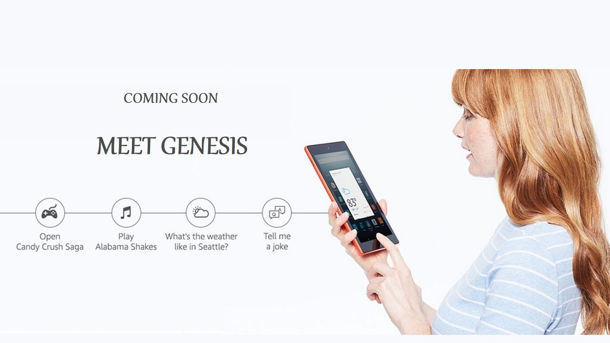
Helps streamline operations

Slide 10
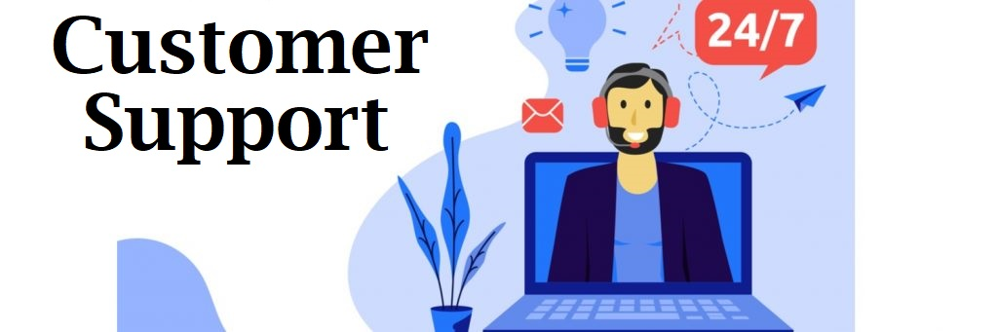
PROVIDES 24/7 CUSTOMER SUPPORT
.

Slide 11

ERADICATES LANGUAGE BARRIER.

