Slide 1
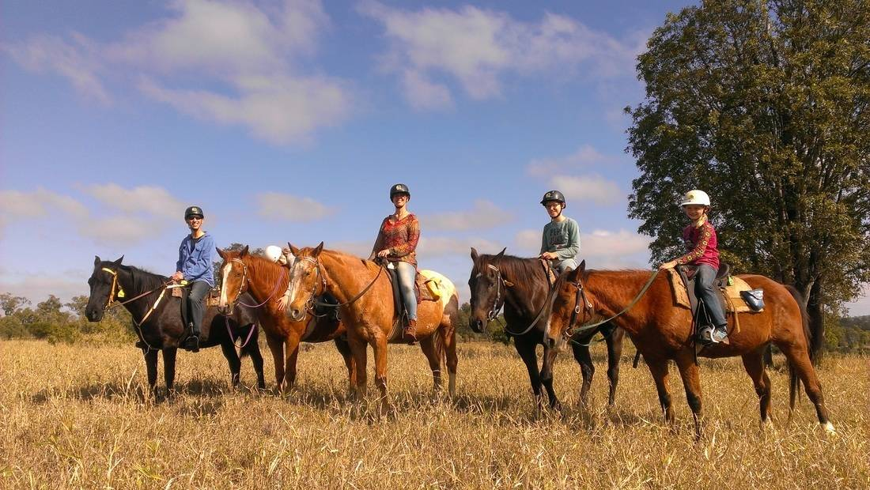
Horse Colic
Predict whether or not a horse can survive based upon past medical conditions.

Slide 2
Problem Statement.
What is Horse colic?
Equine colic is a relatively common disorder of the digestive system. Although
the term colic, in the true definition of the word, simply means “abdominal pain,”
the term in horses refers to a condition of severe abdominal discomfort characterized by
pawing, rolling, and sometimes the inability to defecate.
A Ranch owner who owns many horses wanted to know how long will his horses last depending on the medical conditions that particular horse has been through.
He plans on predicting whether they will die soon or live. With the help of such a prediction he would be able to provide better treatment and care for his horses.
He has given us the data of his previously owned horses with various parameters.
His data has many missing values as he could not keep a track on all the parameters.
Our main motive is to predict if the horse will survive or not.

Slide 3
About Dataset and its features
Data Set Characteristics: | Multivariate | Number of Instances: | 368 | Area: | Life
Attribute Characteristics: | Categorical, Integer, Real | Number of Attributes: | 27 | Date Donated | 1989-08-06
Associated Tasks: | Classification | Missing Values? | Yes | Number of Web Hits: | 131396
300 instances with 28 attributes (continuous, discrete, and nominal); 30% missing values

Slide 4
Features and its brief Details
surgery | age | hospital_number | rectal_temp | pulse | respiratory_rate
1 = Yes, it had surgery 2 = It was treated without surgery | 1 = Adult horse 2 = Young (< 6 months) | numeric id, the case number assigned to the horse | in degrees celsius. An elevated temp may occur due to infection. | the heart rate in beats per minute | normal rate is 8 to 10 - usefulness is doubtful due to the great fluctuations
temp_of_extremities | peripheral_pulse | mucous_membrane | capillary_refill_time | pain | peristalsis
1 = Normal 2 = Warm 3 = Cool 4 = Cold | 1 = normal 2 = increased 3 = reduced 4 = absent | a subjective measurement of colour | The longer the refill, the poorer the circulation - possible values 1 = < 3 seconds 2 = >= 3 seconds | a subjective judgement of the horse's pain level | an indication of the activity in the horse's gut
abdominal_distention | nasogastric_tube | nasogastric_reflux | nasogastric_reflux_ph | rectal_exam_feces | abdomen
- possible values 1 = none 2 = slight 3 = moderate 4 = severe | this refers to any gas coming out of the tube | possible values 1 = none 2 = > 1 liter 3 = < 1 liter | scale is from 0 to 14 with 7 being neutral | possible values 1 = normal 2 = increased 3 = decreased 4 = absent | possible values 1 = normal 2 = other 3 = firm feces in the large intestine 4 = distended small intestine 5 = distended large intestine

Slide 5
packed_cell_volume | total_protein | abdomo_appearance | abdomo_protein | outcome | surgical_lesion
the # of red cells by volume in the blood - normal range is 30 to 5 | normal values lie in the 6-7.5 (gms/dL) range - the higher the value the greater the dehydration | possible values: 1 = clear 2 = cloudy 3 = serosanguinous | the higher the level of protein the more likely it is to have a compromised gut | possible values: 1 = lived 2 = died 3 = was euthanized | retrospectively, was the problem (lesion) surgical? - possible values: 1 = Yes 2 = No

Slide 6
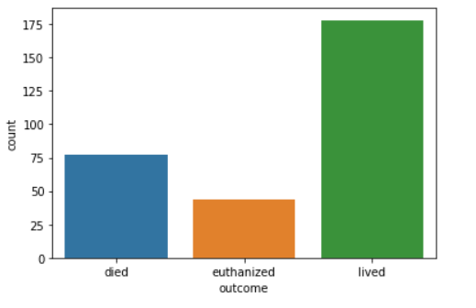
Exploratory Data Analysis

Slide 7
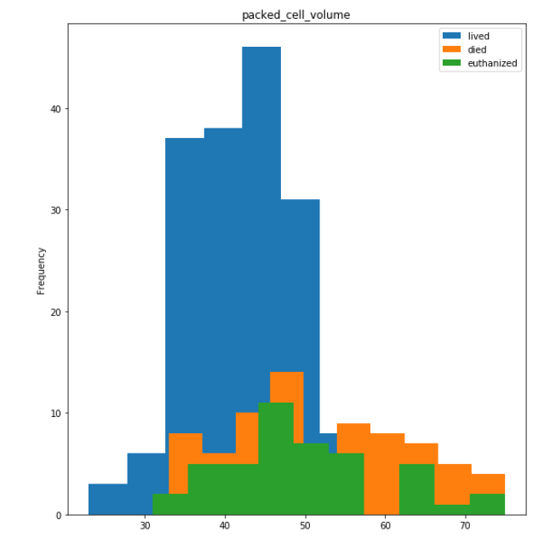
Packed cell volume vs Frequency
The plots show that packed cell volume after approx 50, outcome is most likely to be euthanized, and after 60, it is likely to be dead.

Slide 8
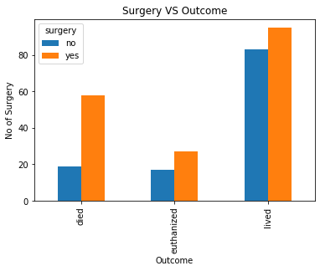
Surgery vs Frequency
High number of Horses without any surgery have lived.
Whereas almost equal number of horses have either died, euthanized or are alive after a surgery.
This shows that horses after getting a surgery need extra attention and care.

Slide 9
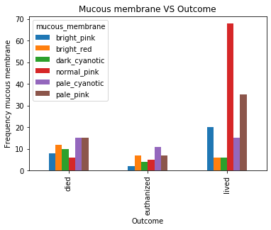
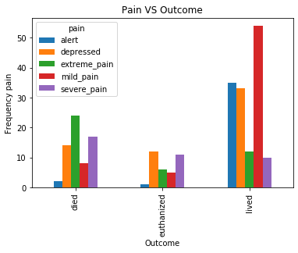

Slide 10
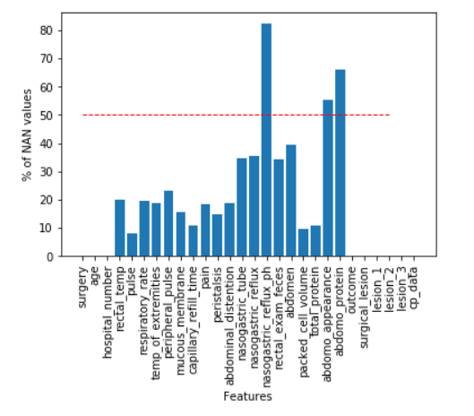
Data Imputation and feature selection
Missing Values
surgery 0.000000
age 0.000000
hospital_number 0.000000
rectal_temp 20.066890
pulse 8.026756
respiratory_rate 19.397993 temp_of_extremities 18.729097 peripheral_pulse 23.076923 mucous_membrane 15.719064 capillary_refill_time 10.702341
pain 18.394649
peristalsis 14.715719 abdominal_distention 18.729097 nasogastric_tube 34.782609 nasogastric_reflux 35.451505 nasogastric_reflux_ph 82.274247 rectal_exam_feces 34.113712
abdomen 39.464883
packed_cell_volume 9.698997 total_protein 11.036789 abdomo_appearance 55.183946 abdomo_protein 66.220736 o
utcome 0.000000
surgical_lesion 0.000000
lesion_1 0.000000
lesion_2 0.000000
lesion_3 0.000000
cp_data 0.000000

Slide 11
Null Values after Imputation
surgery 0.0
age 0.0
rectal_temp 0.0
pulse 0.0
respiratory_rate 0.0 temp_of_extremities 0.0 peripheral_pulse 0.0 mucous_membrane 0.0 capillary_refill_time 0.0
pain 0.0
peristalsis 0.0 abdominal_distention 0.0 nasogastric_tube 0.0 nasogastric_reflux 0.0 rectal_exam_feces 0.0
abdomen 0.0
packed_cell_volume 0.0 total_protein 0.0
outcome 0.0
surgical_lesion 0.0
lesion_1 0.0
lesion_2 0.0
lesion_3 0.0
cp_data 0.0
We have removed features with less than 0.1 correlation rate.

Slide 12
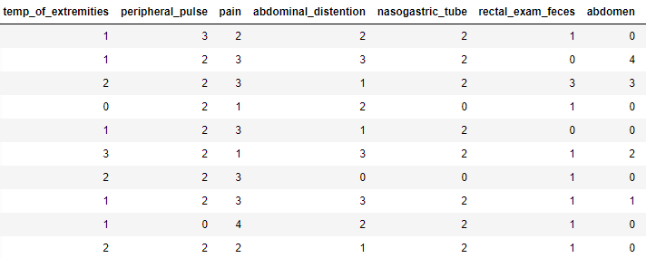
Data Wrangling
temp_of_extremities
peripheral_pulse
pain
abdominal_distention
nasogastric_tube
rectal_exam_feces
abdomen
outcome
surgical_lesion
cp_data

Slide 13
Supervised Learning of Datasets
Algorithms Used | Train Score | Test Score | Overfit/Underfit/Normal
Logistic Regression | 72.25 | 73.33 | Normal
Decision Tree | 100 | 63.33 | Overfit
Random Forest | 100 | 75.56 | Overfit
KNN Model | 77 | 63.33 | Overfit
Naive Baye's Model | 63.64 | 72.22 | Normal
Bagging Model | 97.61 | 71.11 | Overfit
Adaboost Classifier | 78.95 | 64.44 | Normal
XG Boost classifier | 99.04 | 73.33 | Overfit
Gradient Boost | 86.60 | 72.22 | Normal

Slide 14
Inference
Random Forest gave the highest accuracy of around 75% but it was an overfit.
Hence we choose Logistic Regression which gave accuracy of 73.33%.Being neither overfit or underfit.
Gradient Boost also gave a pretty good model with decent scores.

Slide 15
Unsupervised Learning of Dataset
Unsupervised Algorithm | Accuracy score comparing with original Y
KMEANS Clustering | 18.39
Hierarchical clustering | 24.04
Hierarchical value of y is used for below algorithms, as accuracy score is high for Hierarchial
Algorithms Used | Accuracy score
Logistic Regression | 90
Decision Tree | 78
Random Forest | 87
KNN Model | 82
Naive Baye's Model | 84

Slide 16
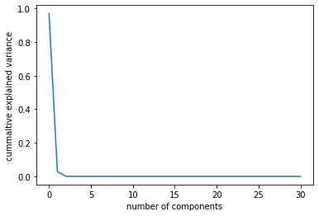
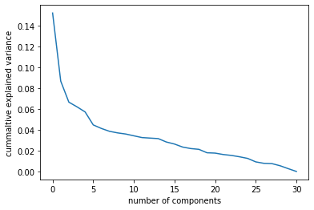
Principal component analysis (PCA)
Apply PCA with scaling and not scaling | Accuracy Score
PCA with Scaling, Random Forest algorithm used | 71.11
PCA without Scaling, Random Forest algorithm used | 65.56

Slide 17
Conclusion
As there were many missing values the accuracy has been effected.
Yet Gradient Decent Booster gave a good accuracy of 74.5%.
We could have got better scores if we had used feature selection and engineering techniques.
PCA with scaling gave a good accuracy using very few features.

