Slide 1
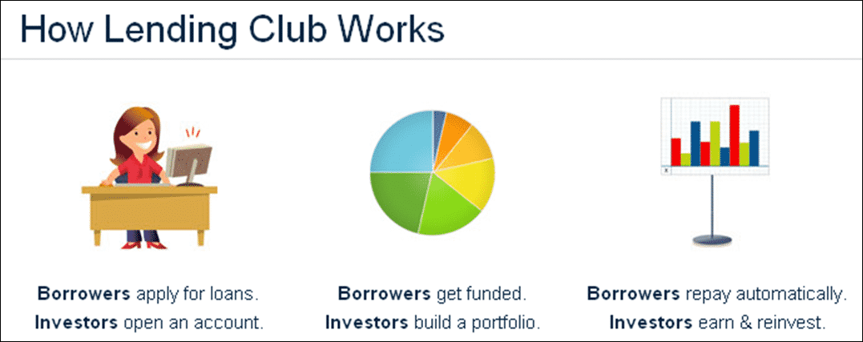
Introduction
Lending Club is online financial institution bringing borrowers and investors together, transforming the way people access credit. Over the last 10 years, they have helped millions of people take control of their debt, grow their small businesses, and invest for the future.
Now they are in need to reduce charged off borrowers, by predicting them before investing on them. So they can assure investors by having good number of borrowers, those who have a good credit history.
For this, we as an analytics team in LendingClub, given a project to develop a machine learning model to predict the defaulters using past data of borrowers.

Slide 2

How Lending Club make money?
Lending Club makes money through origination and service fees. Borrowers pay a one-time origination fee of 1.11% to 5% of the total loan amount, depending on the loan grade and term. Meanwhile, investors pay a service fee of 1% of each payment received from a borrower.

Slide 3
Problem Statement
Lending Club wants to predict borrower’s loan status, whether they will refund the loan back or gets charged off.
(Charged off are the borrowers who fails to pay back the loan at given time, which is normally 120 days or more.)
So, they approach us to help with it, by building prediction model to identify mainly charged off borrowers.
As this can result to take proactive measures to deal with those charged off borrowers, before they get charged off. And also they can proactively inform investor to invest money on borrower who have good credit history.
Also they can reduce the costs on the third party like, LendingClub has a robust internal servicing team and works with several external collection agencies(which is a third party service provider) on a regular basis.
So less the number of defaulters, the cost would be less.

Slide 4
Dataset Information
Dataset has 252971 instances (rows) and 52 attributes (columns).
Number of Attributes:
52 (33 continuous; 19 Categorical)
Attribute Information: Important attributes:
Column Names | Description
Annual_inc | The self-reported annual income provided by the borrower during registration.
Delinq_2yrs | The number of 30+ days past-due incidences of delinquency in the borrower's credit file for the past 2 years
DTI | Total Debt/ Annual Income
Emp_length | Employment length in years.
Funded_amnt | The total amount committed to that loan at that point in time.
home_ownership | The home ownership status provided by the borrower during registration.
loan_status | Current status of the loan
revol_bal | Total credit revolving balance
Grade | Lending Club assigned loan grade
Purpose | A category provided by the borrower for the loan request.

Slide 5
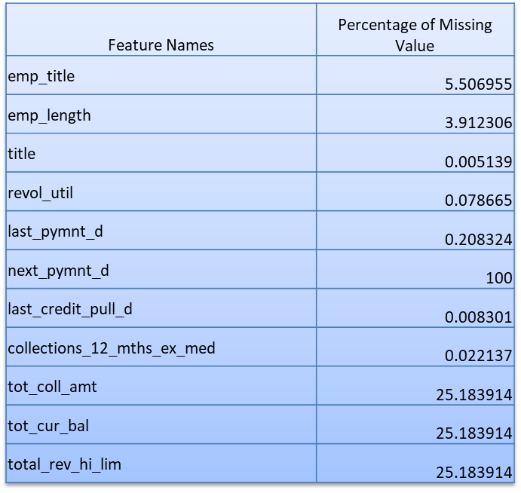
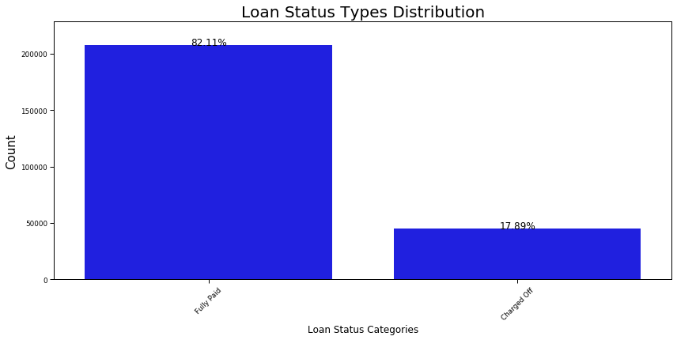
Dataset Information
Missing Values:
Class Distribution:
Fully Paid : 82.11%
Charged Off : 17.89%

Slide 6
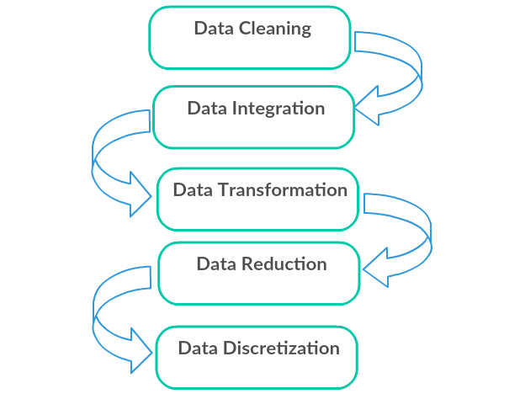
Pre – Processing Steps
Missing Value Imputation.
Data Wrangling of categorical features.
Balancing dataset using Under-sampling method.
Outliers Treatment and data normalization using SQRT transformation.

Slide 7
Dropped Columns
Imputation
'id',
member_id'
url'
'policy_code'
next_pymnt_d
addr_state -> converted to regions(north, south..)
Column Names | Method of Imputation
emp_title | replace missing values with (Manager)
emp_length | replace missing values with <1 year
title | replace missing value with debt consolidation
revol_util | replace with mean
last_pymnt_d | replace with mode
last_credit_pull_d | replace with mode
collections_12_mths_ex_med | replace with median
tot_cur_bal | replace with mean
tot_coll_amt | replace with 0 (majority had 0 )
total_rev_hi_lim | replace with mean
home_ownership | replace other, none , any values as mortage

Slide 8
Exploratory Data Analysis

Slide 9
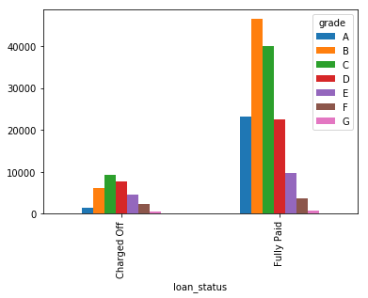
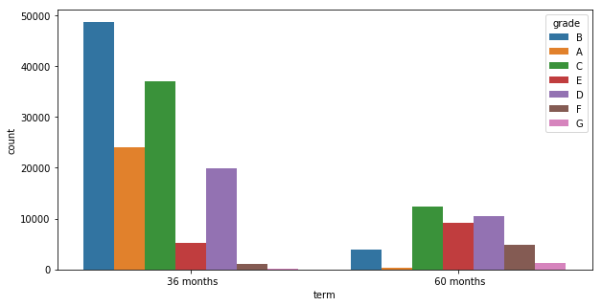
Grade and Term Analysis

Slide 10
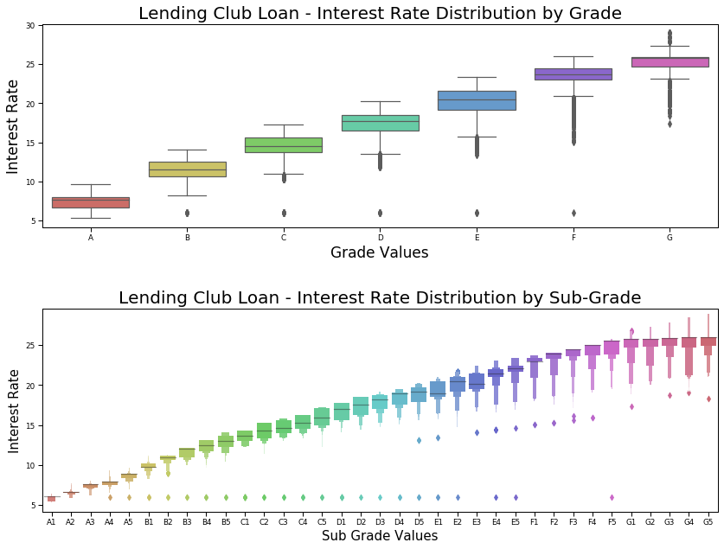

Slide 11
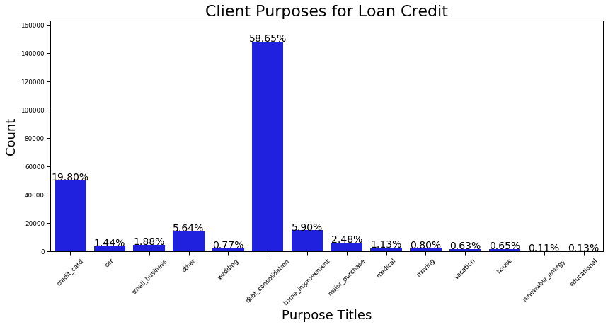
The top 3 purposes are:
58.65% of the Loans are for Debt Consolidation
19.80% are to pay Credit Card
5.90% towards Home Improvement

Slide 12
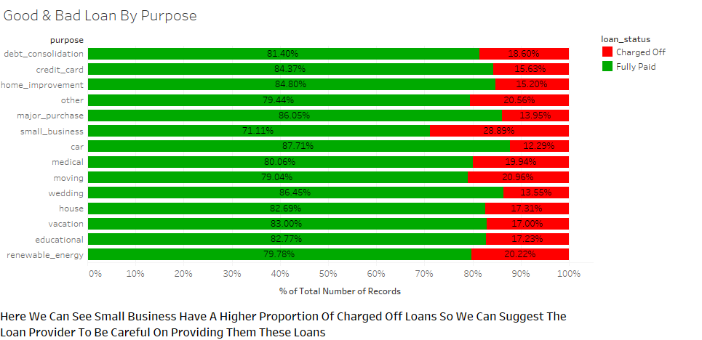
Good & Bad Loan By Purpose

Slide 13
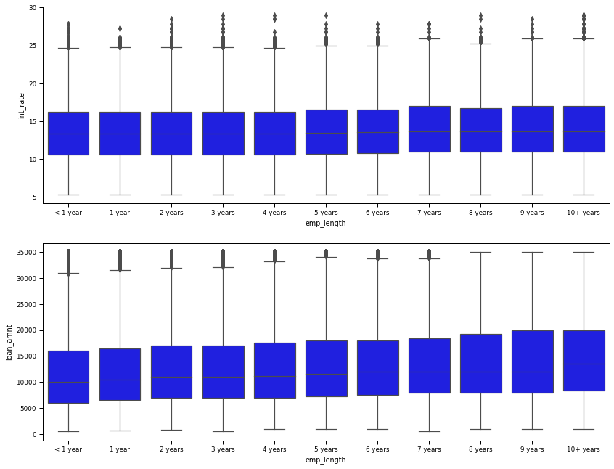
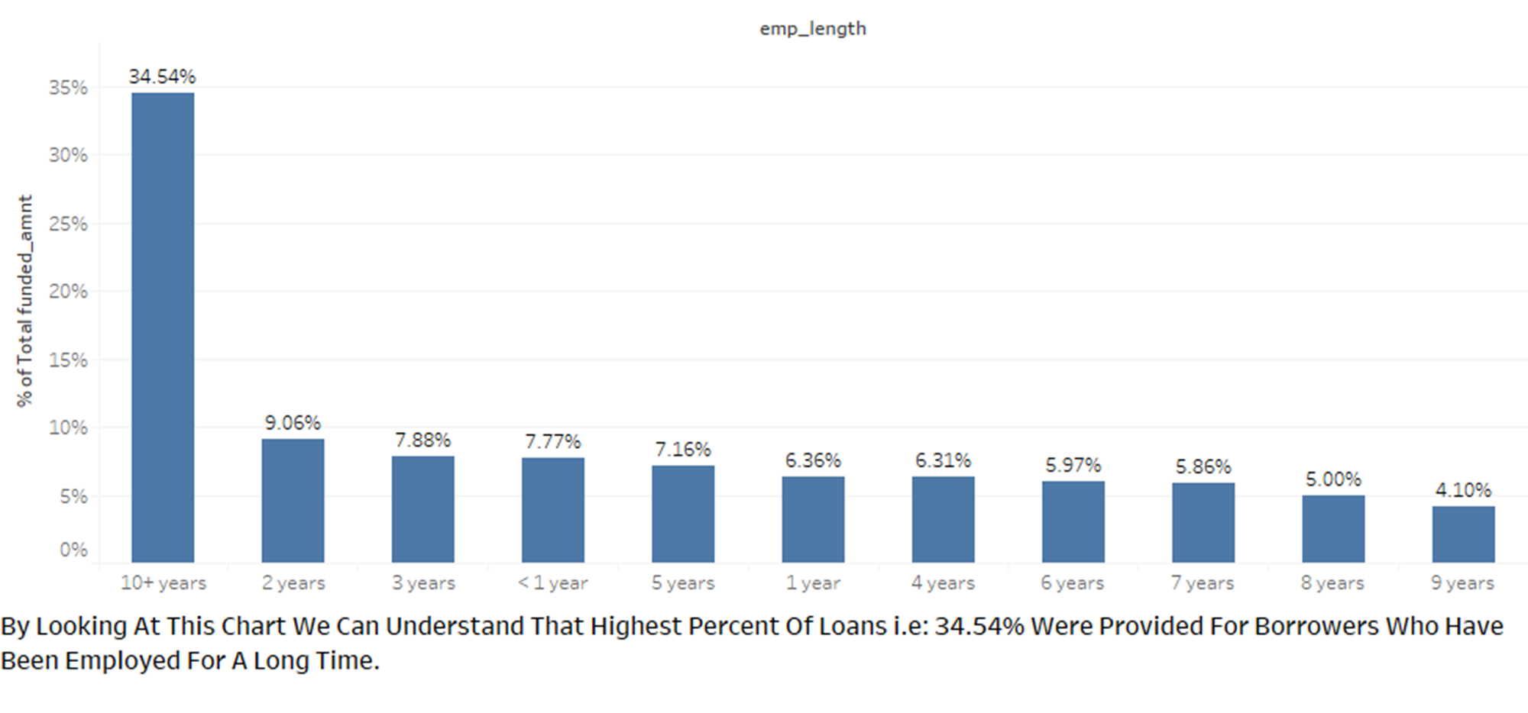
Employment Length Vs Funded Amount

Slide 14
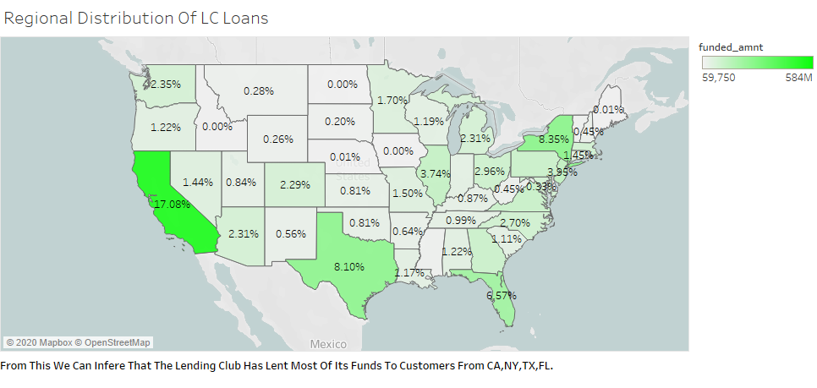
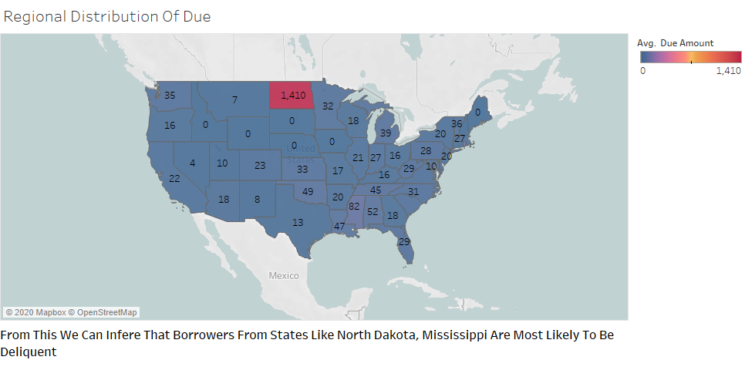
Total Funded Amount Vs Total Due Amount (state Wise Analysis)

Slide 15
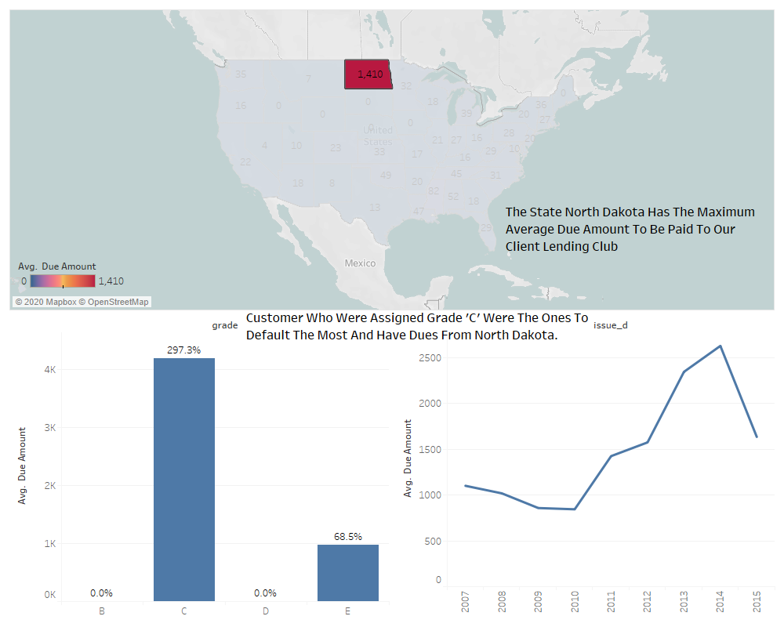
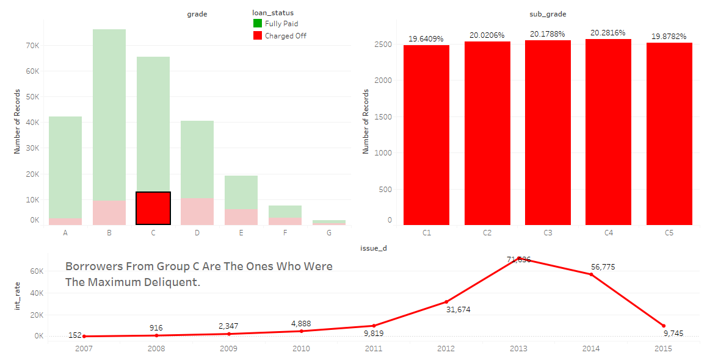
Grade Vs Loan Status

Slide 16
Statistical Testing to find Significant features

Slide 17
Using one sample TTest for continuous features
loan_amnt | 3.41E-181
funded_amnt | 2.16E-180
funded_amnt_inv | 6.81E-170
int_rate | 0
installment | 8.23E-105
annual_inc | 8.34E-195
dti | 0
delinq_2yrs | 1.16E-16
inq_last_6mths | 2.26E-183
open_acc | 1.90E-06
pub_rec | 0.387719727
revol_bal | 0.01470687
revol_util | 0
total_acc | 9.69E-63
total_pymnt | 0
total_pymnt_inv | 0
total_rec_prncp | 0
total_rec_int | 3.22E-118
total_rec_late_fee | 0
recoveries | 0
collection_recovery_fee | 0
last_pymnt_amnt | 0
collections_12_mths_ex_med | 0.000398133
acc_now_delinq | 0.002008776
tot_coll_amt | 0.534777652
tot_cur_bal | 1.04E-240
total_rev_hi_lim | 1.62E-126

Slide 18
Using CHI square test for categorical features
sub_grade | 0
emp_title | 1.36E-23
home_ownership | 5.22E-150
verification_status | 8.80E-295
loan_status | 0
pymnt_plan | 0.792940068
purpose | 4.17E-175
title | 0.646502531
zip_code | 9.51E-109
earliest_cr_line | 1
initial_list_status | 2.52E-05
application_type | 0.402061694

Slide 19

Baseline Model
Algorithm
RandomForestClassifier
Properties
It runs efficiently on large data bases.
It can handle thousands of input variables without variable deletion
It gives estimates of what variables are important in the classification.
It has methods for balancing error in class population unbalanced data sets

Slide 20
Accuracy and AUC (as per initial base model)
Accuracy and AUC(as per initial baseline model)
Experiment setting
Total samples
Fully Paid: 207723
Charged off: 45248
10-fold cross-validation
Training set: 70% examples
Test set: 30% examples
Train Accuracy Score: 100%
Test Average accuracy: 99%
Roc_Auc_score: 99.34%
Confusion Matrix
Actual/Predicted | 0 | 1
0 | 1339 | 178
1 | 2 | 6231

Slide 21
Drawbacks of Baseline Model
Used all columns, without any statistical test. So this makes the model more complex.
It is not robust model as many feature are biased to predict the outcome easily.
So we have improved the model robustness by doing feature selection and using ensemble techniques.

Slide 22
Model using significant features

Slide 23
Model after removing insignificant features. (22 features are implemented)
Algorithms Used | Train Score | Test Score | F1 score | Roc-Auc score | Precision Score(of 0) | Recall score(of 0) | Overfit/Underfit/Normal
Logistic Regression | 92 | 92 | 95 | 82 | 85 | 68 | Normal
Random Forest | 99 | 95 | 97 | 90 | 91 | 84 | Underfit
KNN Model | 90 | 86 | 91 | 73 | 65 | 53 | Underfit
Naive Baye's Model | 91.2 | 91.3 | 94 | 76 | 98 | 53 | Normal
Bagging Model | 99.2 | 95.7 | 97 | 90 | 92 | 82 | Underfit
XG Boost classifier | 96.7 | 96.3 | 97.8 | 92.8 | 92 | 88 | Normal
Gradient Boost | 96.6 | 96.4 | 97.8 | 93 | 92 | 88 | Normal
From above models, we infer that XG Boost and Gradient Boost perform very well in terms of Accuracy and
F1-Score. They are normal fitted. These algorithms are able to classify very well.
Advantages of this Model:
It has the best prediction power. And include all statistically significant features.
Disadvantages of this model:
This model is quite complex.

Slide 24
Model after using 10 important features using RFE (feature selection method)
Algorithms Used | Train Score | Test Score | Roc-Auc score | Precision Score(of 0) | Recall score(of 0) | Overfit/Underfit/Normal
Logistic Regression | 91.7 | 91.8 | 81 | 86 | 64 | Normal
Random Forest | 99 | 95 | 91 | 91 | 85 | Underfit
KNN Model | 90 | 86 | 73 | 65 | 53 | Underfit
Naive Baye's Model | 91.2 | 91.3 | 75.7 | 100 | 51 | Normal
Bagging Model | 99.2 | 95.7 | 91 | 91 | 85 | Underfit
XG Boost classifier | 96.7 | 96.3 | 92.8 | 92 | 87 | Normal
Gradient Boost | 96.6 | 96.4 | 92 | 92 | 87 | Normal
From above models, we infer that XG Boost and Gradient Boost perform very well in terms of Accuracy and F1-Score. They are normal fitted. These algorithms are able to classify very well.
Advantages of this Model:
Since we choose only 10 features, the model is not complex.
The features are statistically significant.
Disadvantages of this model:
We could miss a feature that would improve the overall model performance.

Slide 25
Principle Component Analysis(PCA)

Slide 26
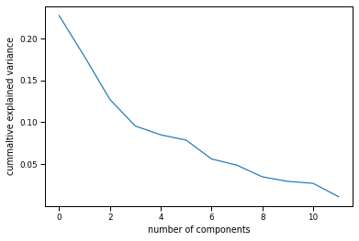
Application of PCA on continuous features in 22 significant features.
There were 12 continuous features.
Outlier treatment is done using SQRT transformation
Then we scaled those features using Standard Scaler function.
PCA is applied on those scaled features, and we got below graph.
So from below graph we found the n-components as 3 to be apply in PCA. As threshold for Cumulative explained variance set by us to be below 0.10.

Slide 27
Model after doing PCA
Algorithms Used | Train Score | Test Score | F1 score | Roc-Auc score | Precision Score(of 0) | Recall score(of 0) | Overfit/Underfit/Normal
Logistic Regression | 91 | 91 | 95 | 79 | 89 | 62 | Normal
Random Forest | 99 | 92 | 95 | 83 | 84 | 70 | Underfit
Bagging Model | 98 | 92 | 95 | 83 | 85 | 69 | Underfit
XG Boost classifier | 92 | 92 | 95 | 84 | 83 | 73 | Normal
Gradient Boost | 92 | 92 | 95 | 84 | 83 | 72 | Normal
PCA helps in dimensionality reduction. Here we were able to reduce 12 continuous features into 3 features. We can see that the overall F1-Score for predicting Charged-off borrowers has reduced. Yet the best performing algorithm is XGBoost and Gradient Boost which has a pretty good F1-score and Roc-auc score compared to other algorithms.
Advantages of this model:
Reduces model complexity.
Reduces noise.
Disadvantages of this model:
Unable to properly predict charged off borrowers. Misclassification takes place.

Slide 28
Balancing the Data using Under-Sampling

Slide 29
Model after doing Under-sampling
Algorithms Used | Train Score | Test Score | F1 score | Roc-Auc score | Precision Score(of 0) | Recall score(of 0) | Overfit/Underfit/Normal
Logistic Regression | 89 | 89 | 89 | 89 | 85 | 97 | Normal
Random Forest | 100 | 93 | 93 | 93 | 93 | 95 | Underfit
Bagging Model | 99 | 93 | 93 | 93 | 93 | 95 | Underfit
XG Boost classifier | 95 | 94 | 94 | 94 | 94 | 95 | Normal
Gradient Boost | 95 | 94 | 94 | 94 | 94 | 95 | Normal
We tried to Balance the dataset by using Under sampling technique. In the previous models the algorithms could predict the Fully paid borrowers with ease and hence sometimes used to even predict charged off borrowers into the fully paid category. To even it out we used Under-sampling.
Here we can again see that the Ensemble techniques are performing really well. F1- Score and roc-auc scores are very good. Yet the model misclassifies a little.
Advantages of this model:
Both categories are equally balanced.
Disadvantages of this model
Loss of Potentially good data.

Slide 30
Business Benefits

Slide 31
How the prediction model will benefit the LendingClub?
Loss of $8500
For every 1000 borrowers there are 17% defaulters
So on average if each borrower as loan of $5000. And LendingClub charge 1% on refund payments of loan back with interest.
Loss of $17,000
So $8,500 + extra cost like using third party debt collection agencies help to get back to borrowers.
Profit of $15,600
Using our prediction model we can predict 92% precisely the defaulters.
Then $8500 is on risk to be lost.
Charges could be max $50 per borrower.
Which would be $8500, so loss would be $17000
So from previous number it would be 156 out of 170.
So profit of $7800+$7800, which would be $15600, with loss of $1400

Slide 32
Summarize
XG Boost Model with 22 features, with accuracy of 96% and predicting defaulters with 92% precision and 88% recall is one of the final model.
XG Boost Model with 10 features, with accuracy of 96.8% and predicting defaulters with 92% precision and 87% recall is one of the final models with lesser complexity.
Future Scope:
With the good computational speed, we could have used grid search and stacking for tuning the model furtherer.
Working on data leakage problem.
Predicting interest rate as a sub goal.

Slide 33
Thank You

