Slide 1
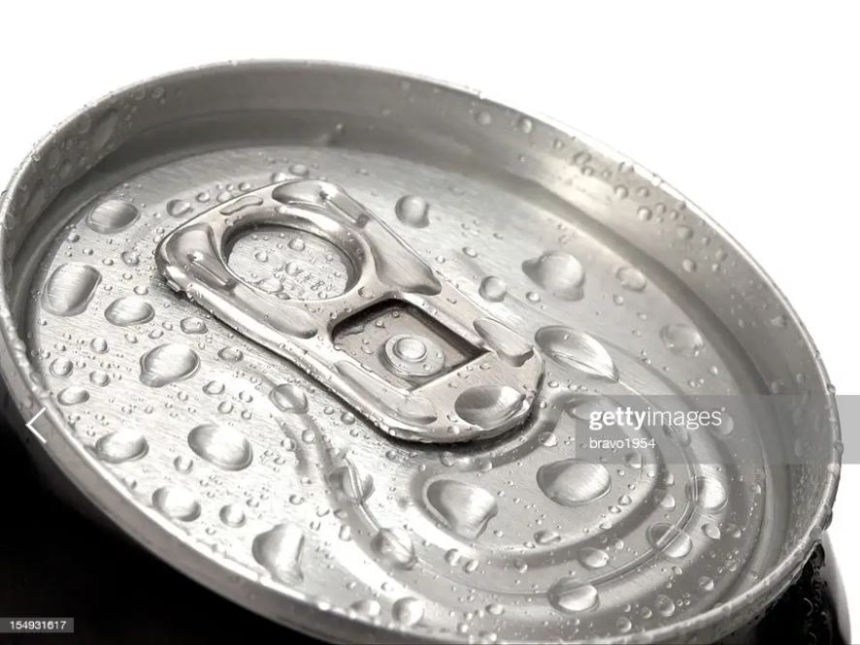
Provides Insights to the Marketing Team in food and Beverage Industry
Code basics Resume Challenge #6
Marketing Insights by: Rahul Wakalkar

Slide 2
Why Beverage Industry?
This Industry is experiencing significant growth and offers ample opportunity for businesses. People are
Increasingly Interested in diverse and Innovative beverage options.
Beverages are essential to peoples daily lives, and consumer demand for new and unique beverages
Experiences is on the rise.
The beverage Industry is highly versatile, offering a wide range of products categories such as carbonated
drinks, juice, energy drinks, tea, coffee and more.
Beverage have a universal appeal allowing businesses to explore global markets. Expanding internationally
Can lead to new customers, partnerships and Increased business opportunities.

Slide 3
Dataset
There are 3 CSV files:
1. dim_respondents
2. dim_cities
3. fact_survey_responses
1.Column Description for dim_respondents:
Respondent_ID: This column represents the unique identifier assigned to each respondent in the survey.
Name: This column represents the name of the respondent who participated in the survey.
Age_Group: This column represents the categorized age group of the respondent. Age groups (15-18, 19-30, 31-45,46-65,65+)
Gender: This column represents the gender of the respondent. (Male, Female, Non-binary)
City_ID: This column represents the ID of the city where the respondent is located.

Slide 4
2. Column Description for dim_cities:
City_ID: This column represents the ID of the city.
City: This column represents name of the city where the respondent is located. ("Delhi","Mumbai", "Bangalore","Chennai", "Kolkata","Hyderabad", "Ahmedabad","Pune","Jaipur", "Lucknow")
Tier: This column represents the tier category of the city
3.Column Description for fact_survey_responses:
Response_ID: This column represents the unique identifier assigned to each response in the survey.
Respondent_ID: This column represents the unique identifier assigned to each respondent who provided the survey response.
Consume_frequency

Slide 5
Consume_time
Consume_reason
Heard_before
Brand_perception
General_perception
Tried_before
Taste_experience
Reasons_preventing_trying
Current_brands
Reasons_for_choosing_brands
Improvements_desired
Ingredients_expected
Health_concerns
Interest_in_natural_or_organic
Marketing_channels
Packaging_preference
Limited_edition_packaging
Price_range
Purchase_location
Typical_consumption_situations

Slide 6
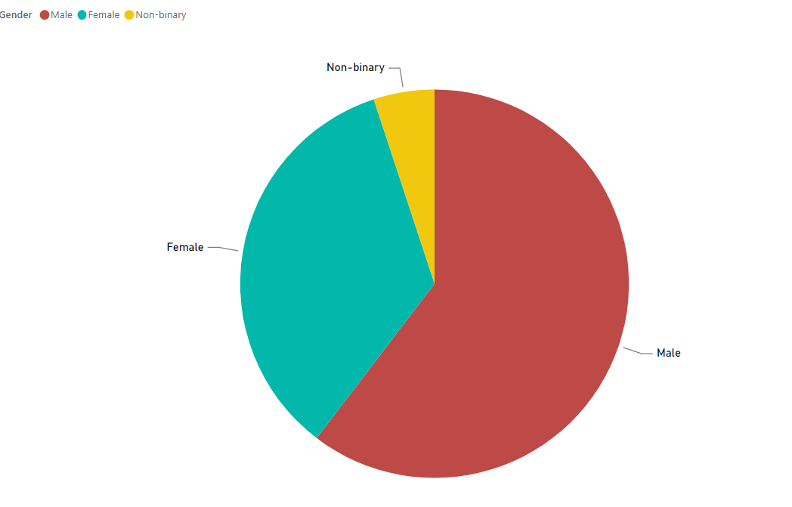
Who prefers energy drink more? (male/female/non-binary?)
Males are preferred energy drink more compare to Female and non-binary. There are 60.38% Male, 34.55% are
Female and 5% are Non-Binary.
For Codex, there are only 980 customers those who have purchased CodeX energy drinks and 980 out of 590 male customers are purchased.
Male customers are responded more.

Slide 7
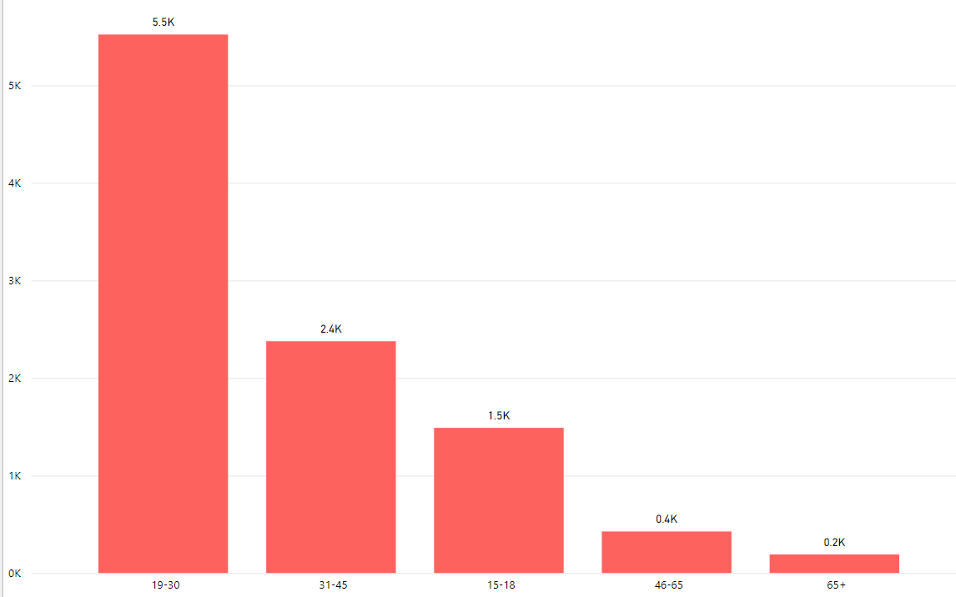
Which age group prefers energy drinks more?
Age group 19-30 are prefers
More energy drinks. There are
5.5k peoples in this group. After
that age group 31-45k peoples
are prefers more energy drinks.

Slide 8
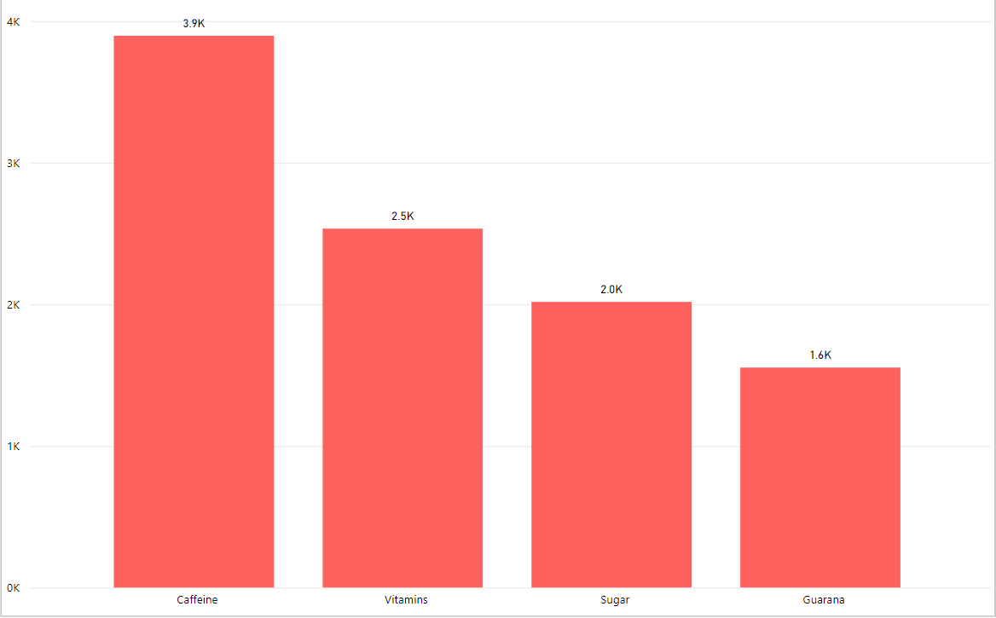
What are the preferred ingredients of energy drinks among respondents?
Respondent most likely prefers Ingredients in the
energy drinks are Caffeine.
For CodeX there are 363 respondent prefers Caffeine.

Slide 9
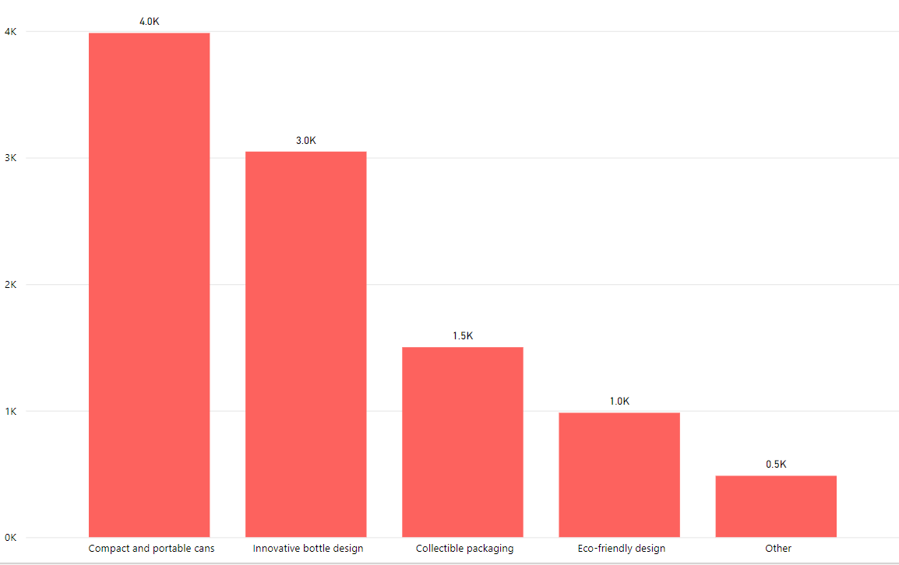
What packaging preferences do respondents have for energy drinks?
Packaging preferences for energy drinks are
Compact and Portable cans.
For CodeX 412 respondent Prefers Compact
and Portable cans.

Slide 10
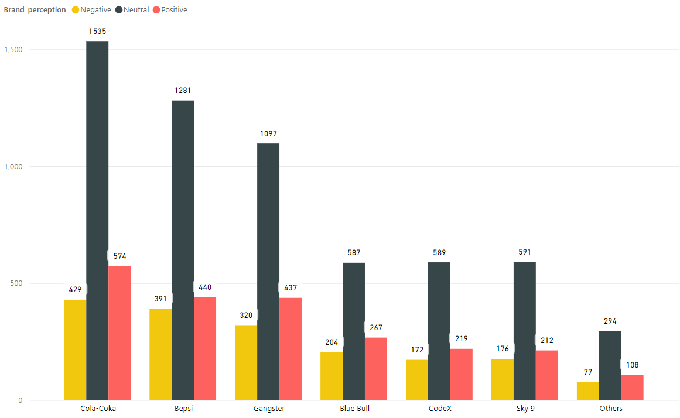
Who are the current market leaders?
Cola-Coka is the current market leader
And Cola-Coka captures 25% market.
Bepsi captures 20% market.
CodeX captures 9% Market.

Slide 11
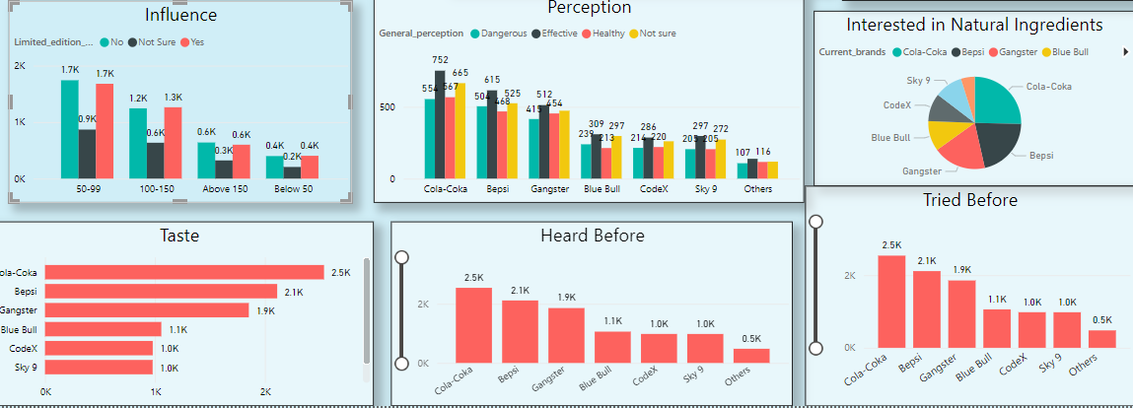
What are the primary reasons consumers prefer those brands over ours?

Slide 12
Reason for choosing brand are:
More number of consumer likes General perception is effective and healthy sales of that product is more.
For CodeX 286 customers perception is effective and 220 customers perception is healthy.
Customers are also Interested in Natural Ingredients and CodeX uses 9.8% Natural Ingredients.
2.5k peoples are likes the taste of Cola-Coka and 1k peoples likes taste of CodeX.
Customers heard before or not and tried before or not that effects on sales of the product

Slide 13
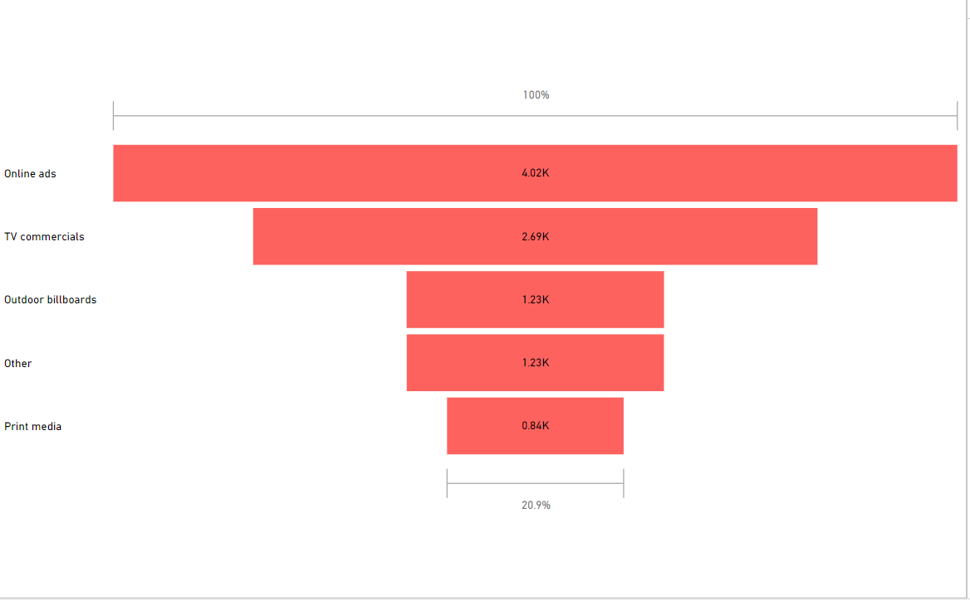
Which marketing channel can be used to reach more customers?
Online ads are to reach more customers.
Online ads reach 4.02k customers and TV Commercials reach 2.69k customers.

Slide 14
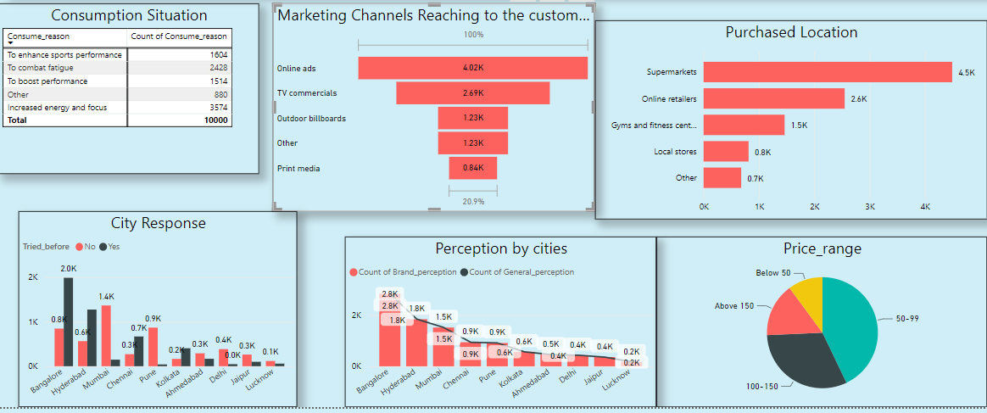
How effective are different marketing strategies and channels in reaching our customers?

Slide 15
Marketing strategies:
Marketing Strategies are making for attract the customers towards the products. More number of
Energy drinks customers are in age 19-30.
On the basis of product consumption 3574 customers takes the drinks for Increased energy and focused.
Using Online ads companies are directly reach to the customer.
Every time product is available in Super market and Online retailers.
In South Indian region maintain brand perception and general perception
Price is 50-99 rupees.

Slide 16
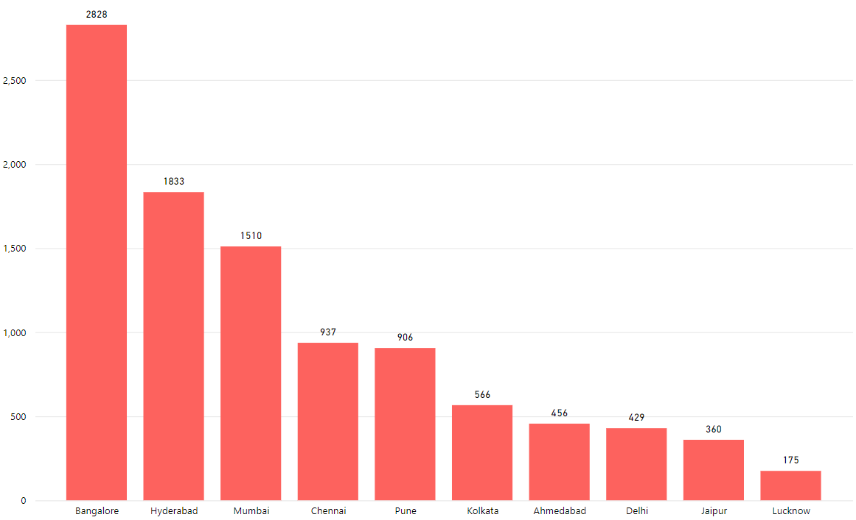
Which cities do we need to focus more on?
For CodeX 292 customers are in
Bangalore and 182 in Hyderabad.
Company needs to more focus
On Bangalore, Hyderabad and
Mumbai.

Slide 17
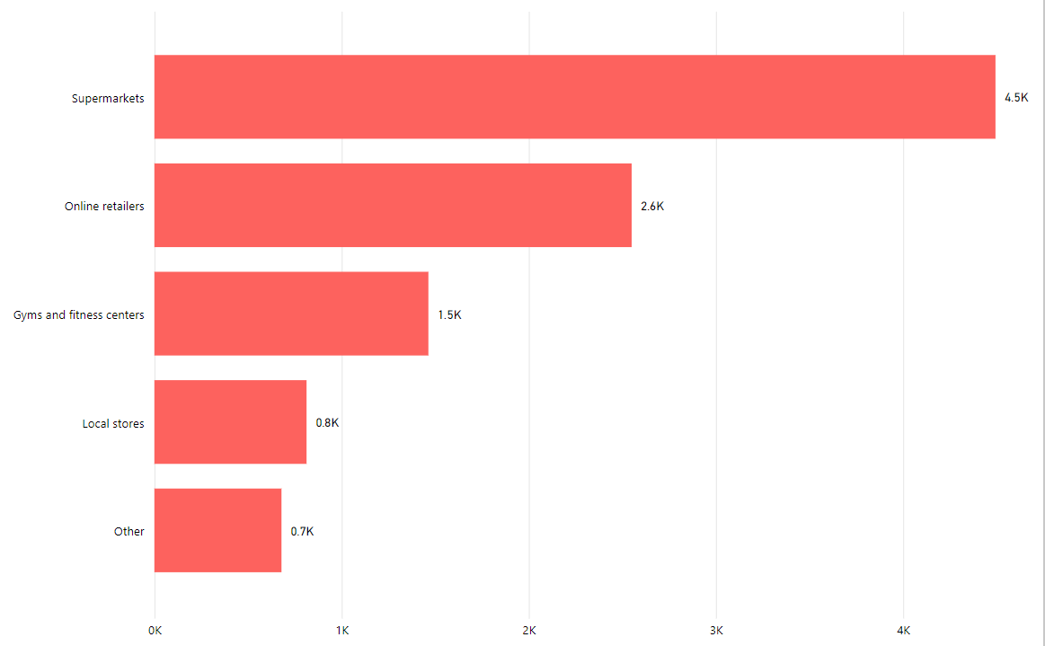
Where do respondents prefer to purchase energy drinks?
Respondent purchases more energy drinks
from Supermarkets and online retailers.
For CodeX 436 respondent purchases energy drink from supermarket and 248 respondent purchases energy drink from online retailers.

Slide 18
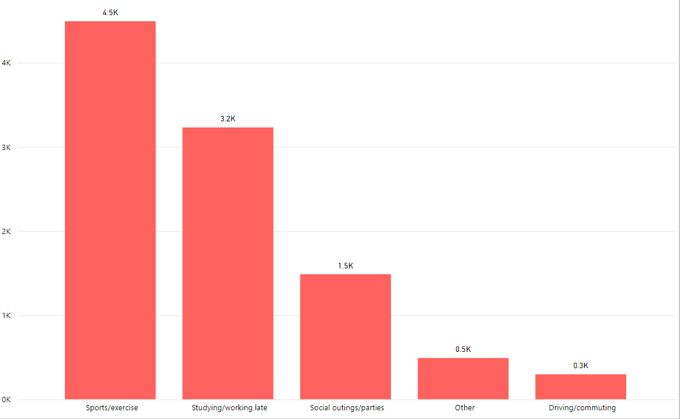
What are the typical consumption situations for energy drinks among respondents?
Typical consumption situation for
Respondents are sports/exercise and
Studying/ working late.
Number of respondent for sports/exercise
are 450 and Studying/ working late are 320.

Slide 19
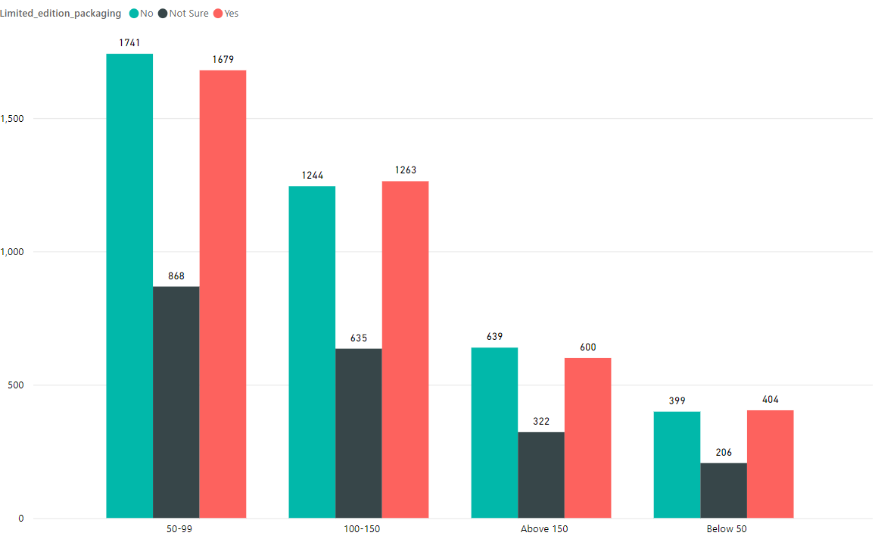
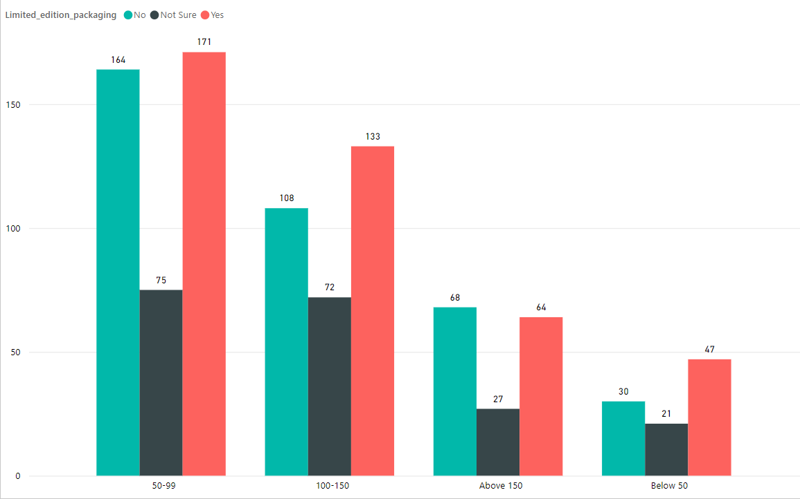
What factors influence respondents' purchase decisions, such as price range and limited edition packaging?
Price range is more influencer to purchase product as compare to limited edition packaging.
For CodeX limited edition packaging is more influencer to
purchase product as compare to price range.

Slide 20
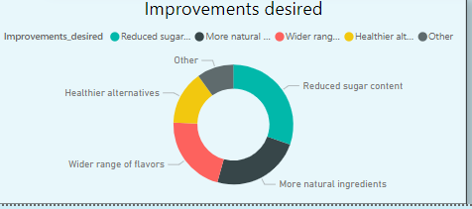
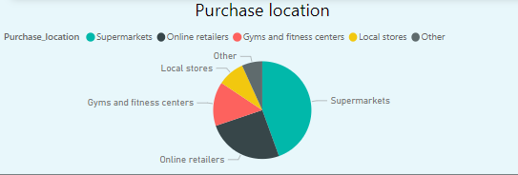
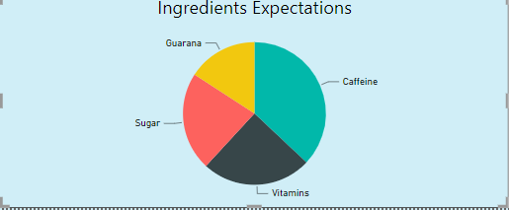
Which area of business should we focus more on our product development?
For our product CodeX reduced sugar content and increases Natural Ingredients
At any time In supermarket and online retailers product is available means supply more number of energy drinks to supermarket and online retailers
Try to add required number of Ingredients In the product like Caffeine and Vitamins

