Slide 1


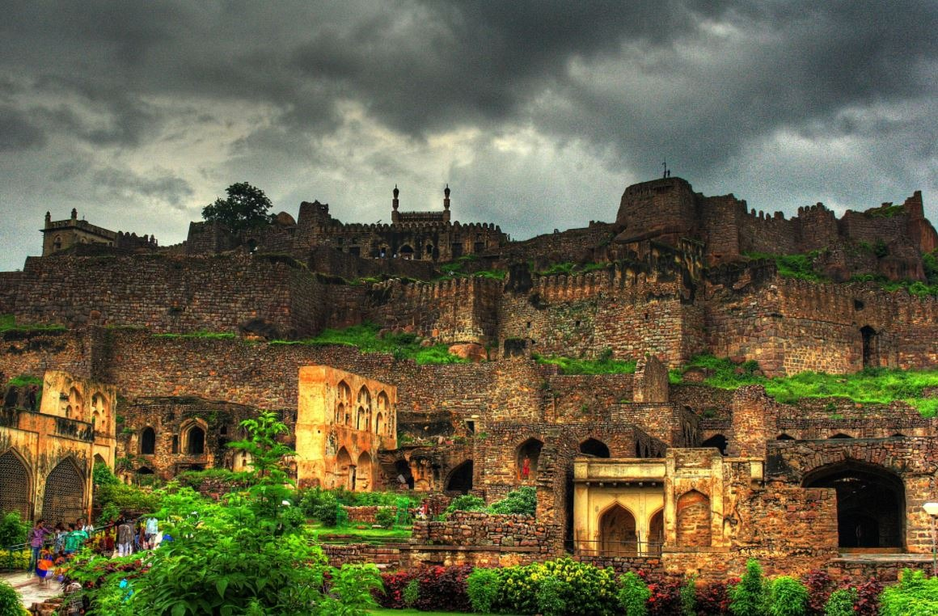
Telangana Tourism Analysis

Slide 2

Problem Statement
Telangana is one of the leading state in India in various sectors, has published its tourism data
Under its open data policy. As a data analyst, my task is to analyze the given visitor data that is
Domestic and Foreign visitors for 2016-2019.

Slide 3
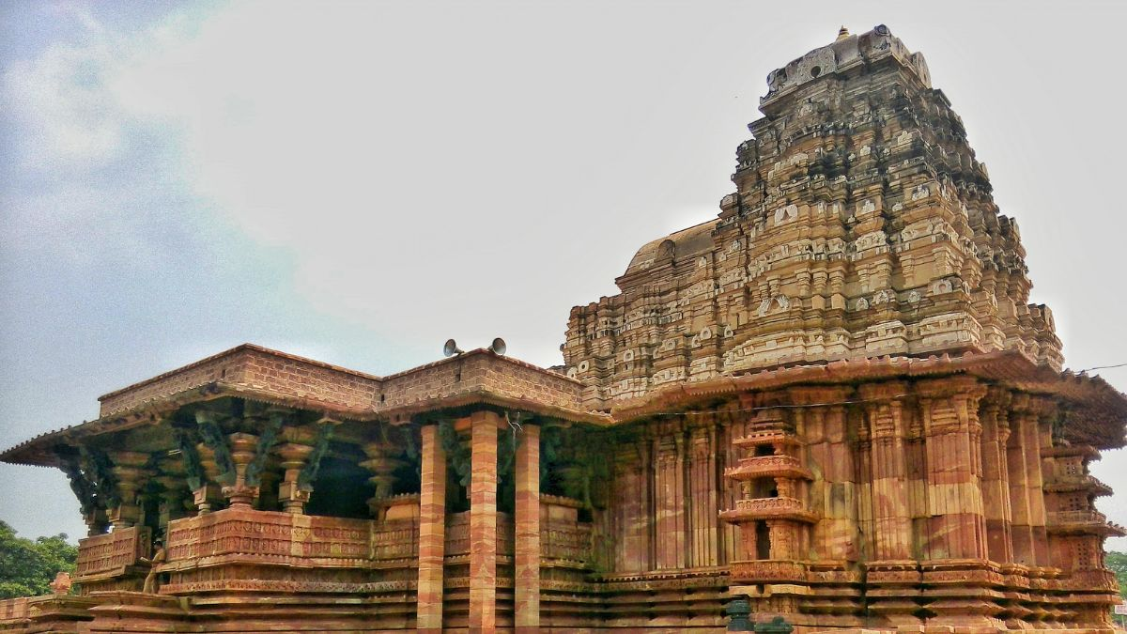
Hyderabad is the capital city of Telangana and is also known as the "City of Pearls".
The state is home to many historic monuments, including the Charminar, Golconda Fort,
temples, and the Qutb Shahi Tombs. The economy of Telangana is driven by a mix of traditional
and modern industries, including agriculture, manufacturing, and technology.

Slide 4
About Dataset
We were provided with two folders which contained domestic and foreign visitor data for year
2016-2019.
Column description is as follows:
District: The name of the district in Telangana state.
Date: The starting date of the month when the tourist data was collected for the specified district.
Month: The month for which tourist data is being reported.
Year :The year is YYYY format.
Visitors: The number of visitors who visited the given district in Telangana during the specified
month. And we have two categories of visitors that is domestic and foreign visitors.

Slide 5
Data cleaning and processing
Steps in Pandas:
Concatenated all files using pandas and created separate file that have foreign visitors and
domestic visitors.
Change data type of visitors column.
Removed leading and trailing whitespace from visitor and district column.
Removed empty string and null values from visitors column and replaced it with 0.
Steps in power BI:
Join two csv files domestic visitors and foreign visitors on district column.

Slide 6
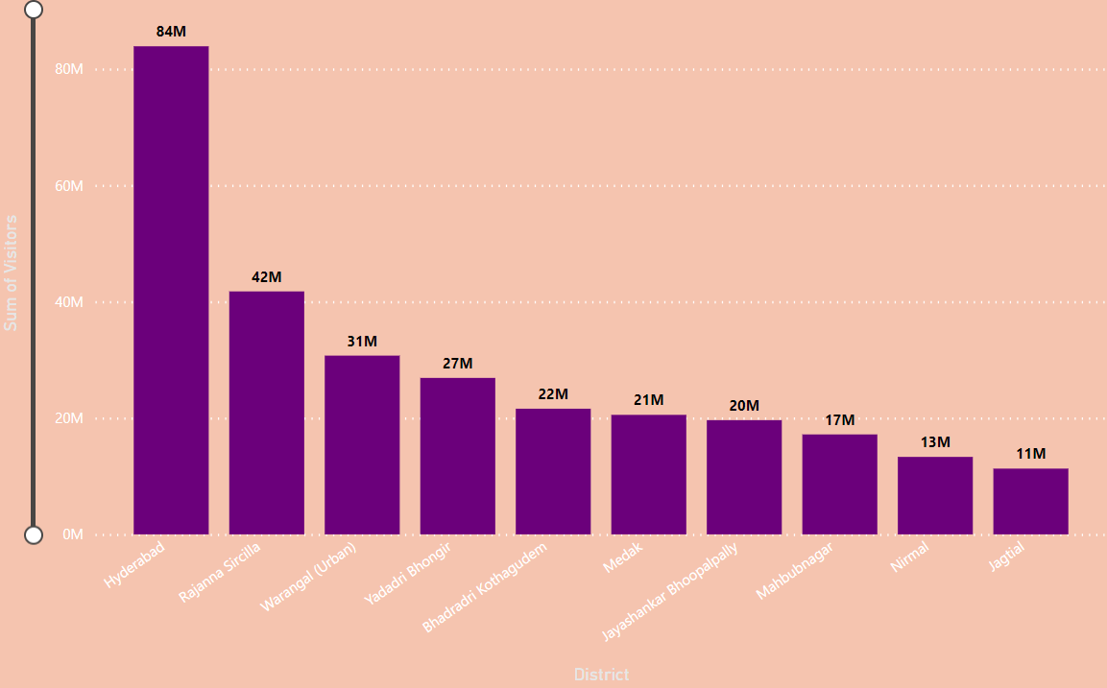
Top 10 District based on Domestic Visitors
Insight
Top 10 District that have highest number of Domestic visitors are Hyderabad, Rajana Sircilla, Warangal(urban), Yadadri Bhongir, Bhadradi Kothagudem, Medak, jayshankar Bhoopalpally, Mahbubnagr, Nirmal, Jagtial.

Slide 7
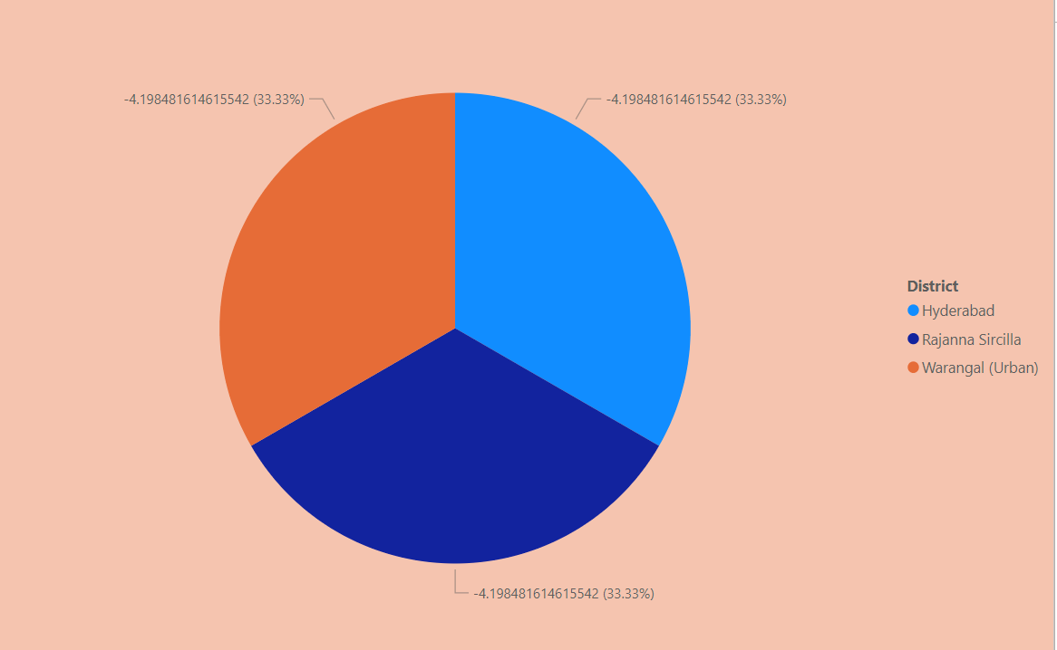
Top 3 district based on CAGR
Top 3 districts based on Compounded Annual growth rate from 2016 – 2019 are Hyderabad, Rajanna Sircilla, Warangal(Uraban)

Slide 8
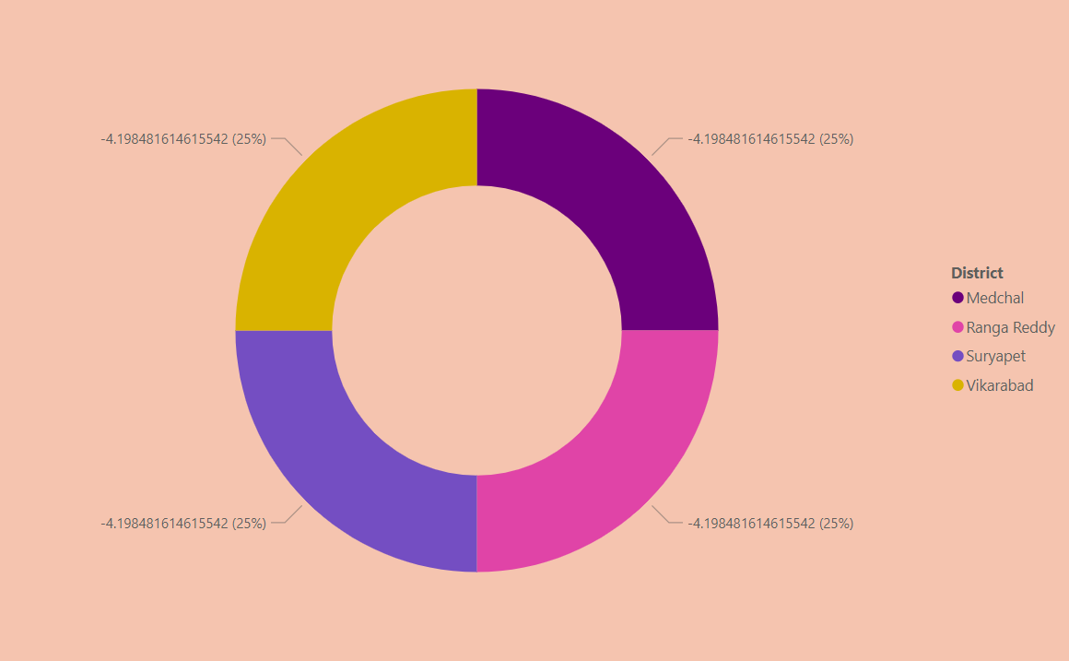
Bottom 3 district based on CAGR
Bottom 3 districts based on Compounded Annual growth rate from 2016 – 2019 are Medchal, Ranga Reddy, suryapet

Slide 9
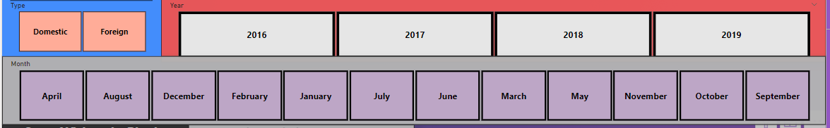
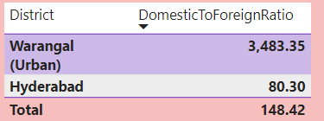
Domestic to Foreign tourist ratio
Domestic to Foreign tourist ratio high for two
Districts are Warangal(Urban) and Hyderabad

Slide 10
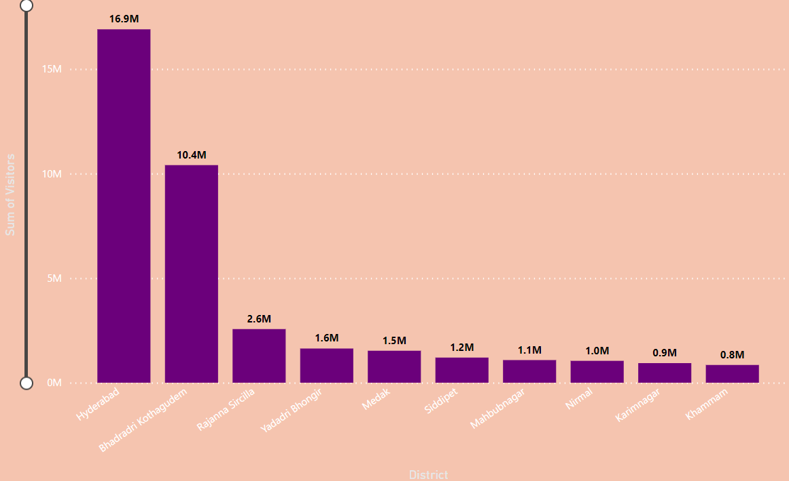
What are the Peak season months for Hyderabad?
Peak season months for Hyderabad is June(16.9M),December(9.5M)

Slide 11
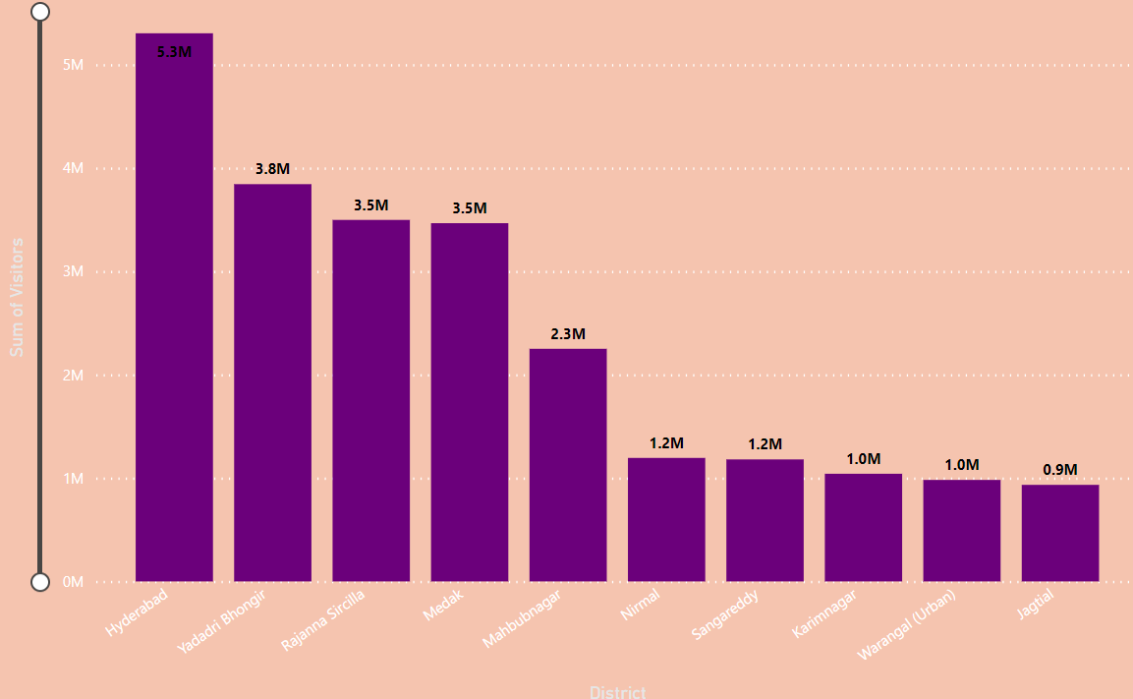
What are the low season months for Hyderabad?
Low season months for Hyderabad are March(5.2M), August(5.8M), July(5.6M), May(6.1M), November(5.7M),October(6.7M), September(5.3M) and April(6.2M), February(5M),

Slide 12
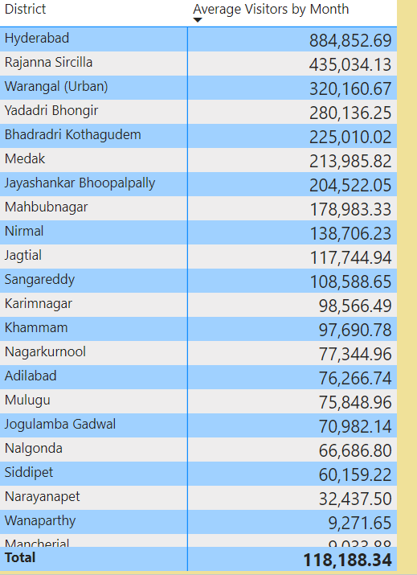
What are the Average Number of visitors by month for each district?
Average Number of visitors by month is high for Hyderabad.

Slide 13
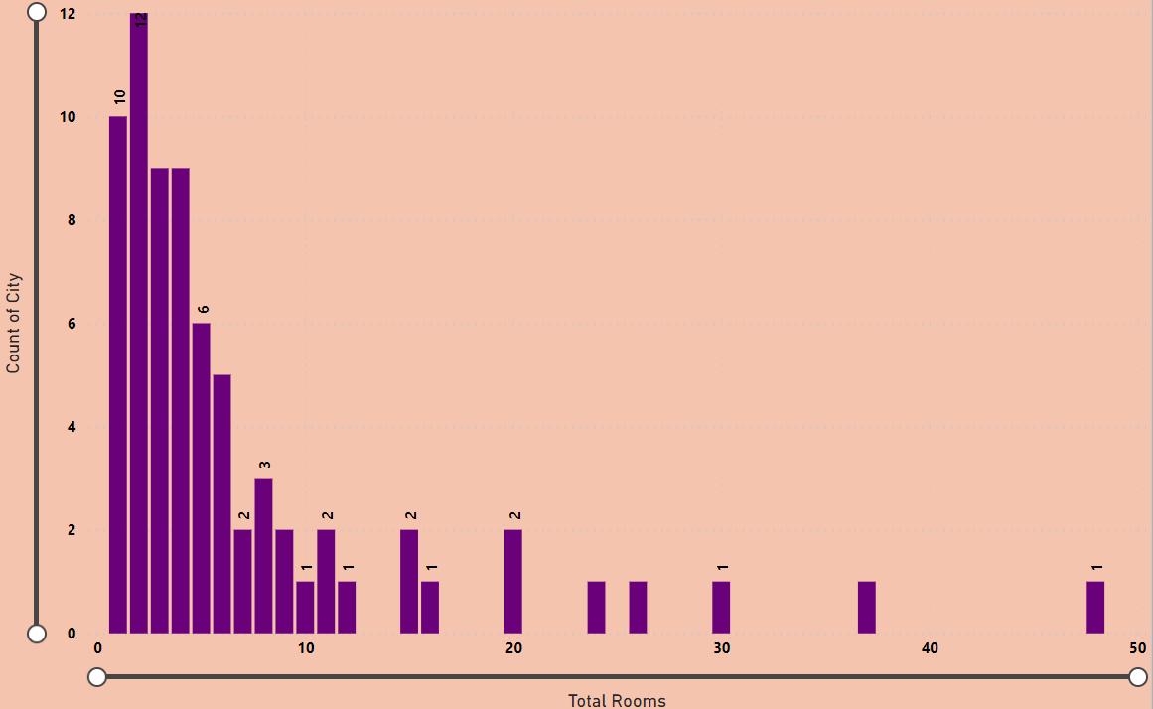
Accommodation plan for each city
The cities has less than 10 rooms Alisagar, Gadwal , Kadem , Kondagattu , Kothakonda, Mannanur, Medak, Medaram, Pakal, Pochampally, Singoor, Singotam.

Slide 14
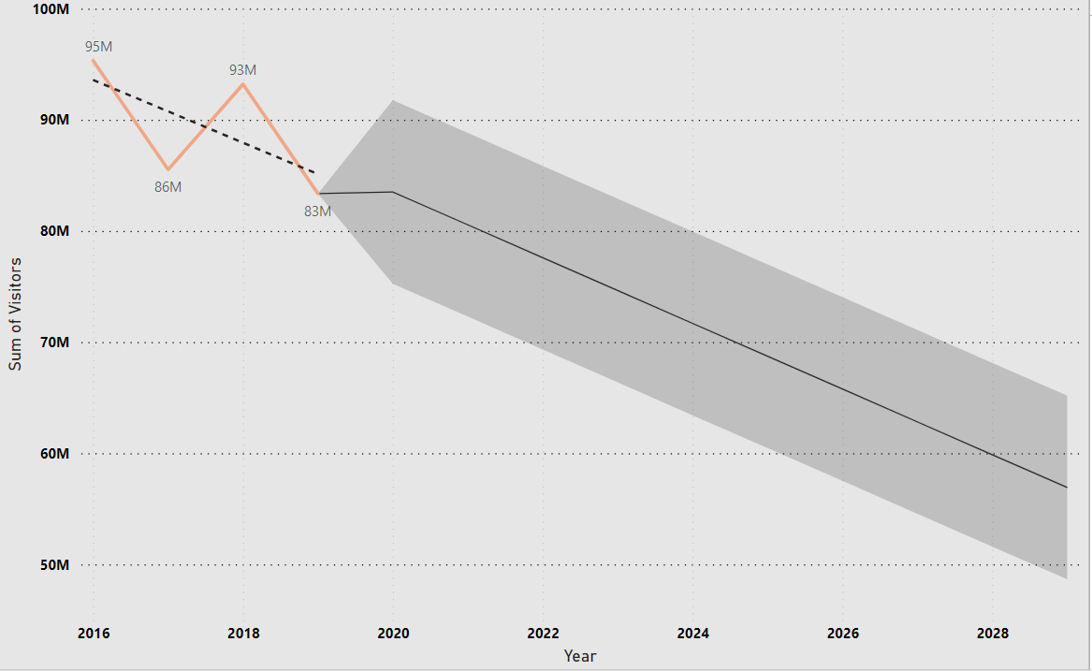
How many Number of visitors based on previous years?
Overall visitors are not increases based on previous years.

Slide 15
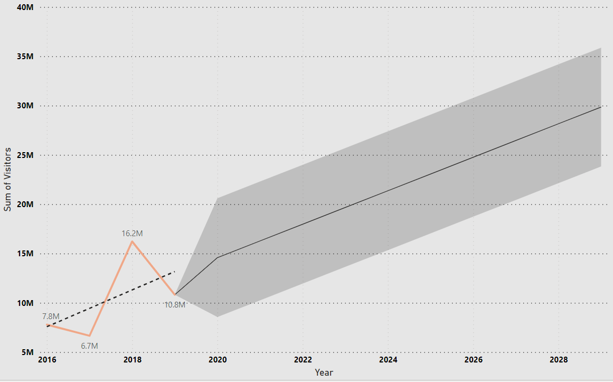
In January month number of visitors are increases based on previous years it is up to 23.6M from 2025.

Slide 16
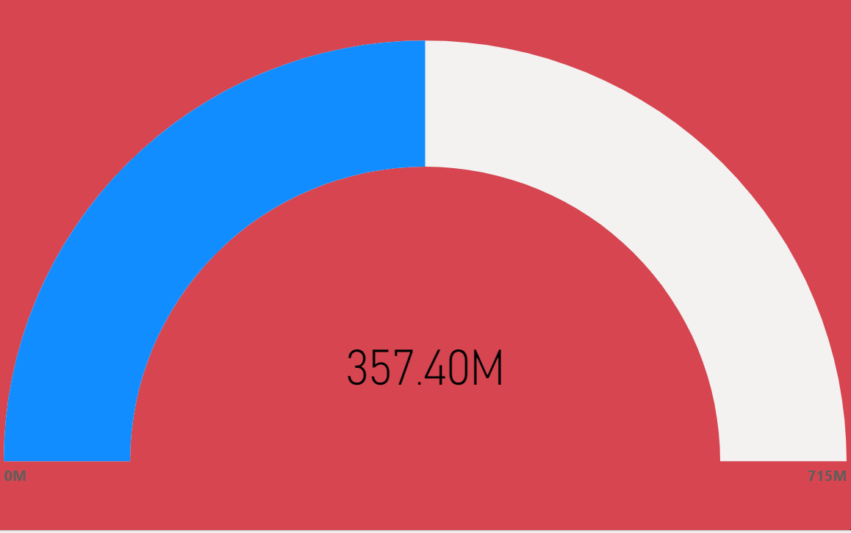
How Many visitors visits in Telangana?
From 2016 to 2019 there are 357.40M tourist visits in Telangana state. Maximum number of tourist are visits in 2016 that is 95.33M.

Slide 17
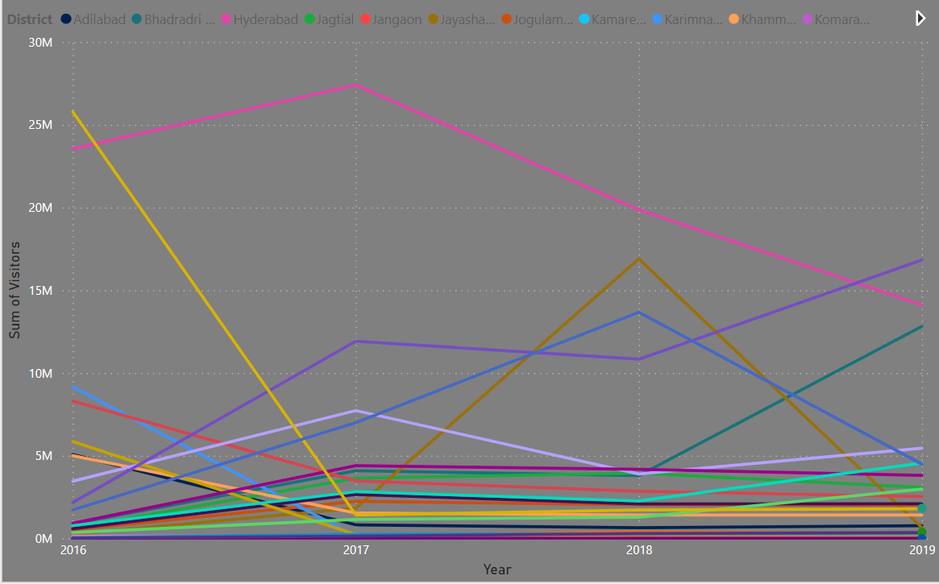
Which District has highest growth rate?
Hyderabad district has highest growth rate from April 2016 to October 2019.

Slide 18
Recommendation for growth rate
Hyderabad and Bhadrachalam has more rooms available compare to other cities.
Hyderabad has Highest growth rate, based on available data In Hyderabad city all types of
rooms are required.
Boost for tourism
We can organize maximum co-operative and cultural events in the low season months.
We can organize cultural events in the districts where tourists are less and we have to
arrange accommodation there.

