Slide 1
acme.ai
“Your go-to platform for budget-friendly trek recommendation system”

Slide 2
Members Name and their Responsibilities
Name |  | Responsibilities

Slide 3
Chapter 1: Introduction
Brief Overview of the case study
Lorem

Slide 4
Problem Identification
1
Inconsistent Services
2
Rising Costs
Visitors experience varied service quality, impacting their overall satisfaction.
Remote places with poor infrastructure raise prices and discourage visitors from visiting Nepal.
3
Health and Safety Concerns
4
Sustainable Growth
Trekking has distinct health and safety challenges, and maintaining visitor trust may be difficult due to inconsistent procedures.
Tourism growth affects resources, yet sustainable methods protect Nepal's natural and cultural history.

Slide 5
Purpose
Understanding Demographics of Travelers
1
3
Real-Time Analysis
Implement the solution to analyze content in real-time, providing immediate protection against emerging threats.
Develop a machine learning model capable of accurately identifying spam words and phishing links to improve cybersecurity defenses.
Reduce False Positives
2
4
Integrate with Existing Systems:
Optimize the model to minimize false alarms, ensuring that legitimate content is not mistakenly flagged as malicious.
Design the model to seamlessly integrate with existing email services, browsers, and security tools for widespread adoption and use.

Slide 6
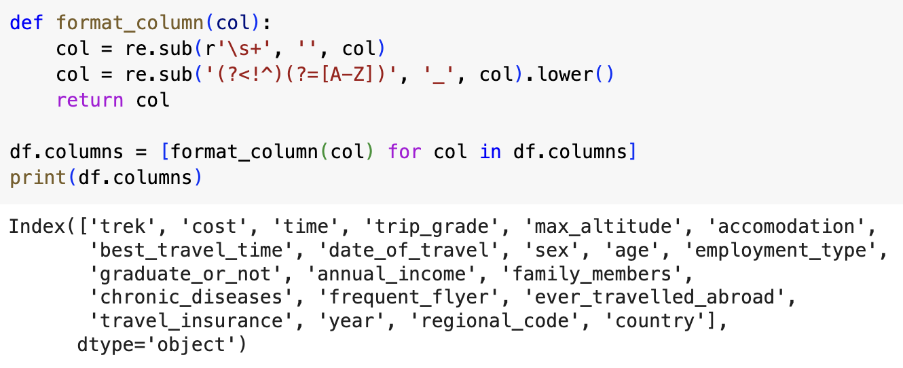
Data Preprocessing
The dataset must be cleared of several abnormalities, such as erroneous data types or missing values, before statistical analysis can be performed on it.

Slide 7
Data Cleaning
Each and every column and entries were analyzed and cleaned.
Trek
Cost
Best Travel Time
Removed currency, unit, and [\n; new line break] from values before converting to floating type.
Time
The unit “m” (meters) was removed
from “Max Altitude”.
Max Altitude
Cost
Date of Travel
Accommodation
Country
Countries and dependencies were renamed and spelled according to UN and ISO 3166-1 number designations.

Slide 8
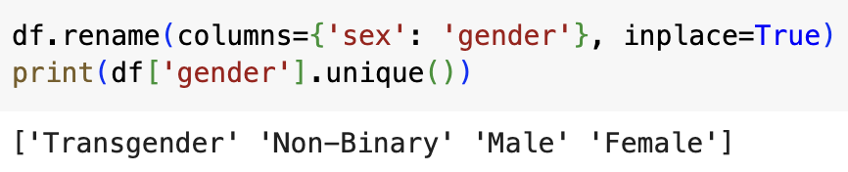
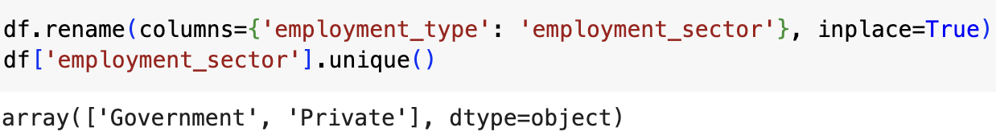
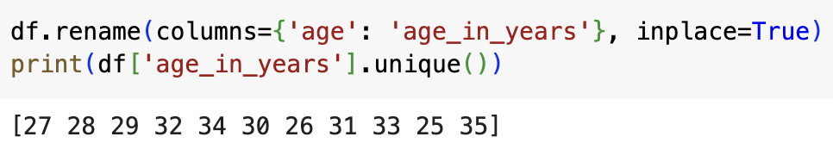
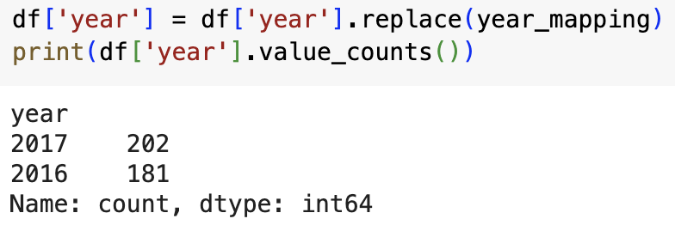
Data Validation
Replace is used/applied to these columns giving them appropriate name and representation for easy recognition and value count is used on each to see both unique options with count
Gender
Employment Type
Age
Year

Slide 9
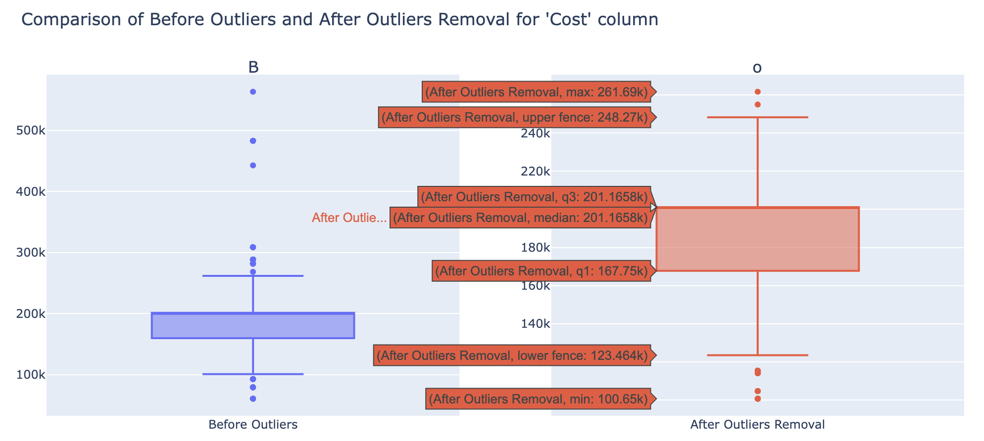
Removal of Outliers

Slide 10
Pre-processing Steps
Checking for Null Values
Identified and addressed missing values to ensure data completeness and accuracy.
Removing Duplicates
Removed duplicate entries to maintain data uniqueness and prevent model overfitting.

Slide 11
Encoding and Representation
One Hot Encoding
Spam: [1, 0, 0, 0, 0] - 0
Not Spam: [0, 1, 0, 0, 0] - 1
Phishing: [1, 0, 0, 0, 0] - 0
Not Phishing: [0, 1, 0, 0,0 ] - 1

Slide 12
AI Approach and
Model
Selection
1
Logistic Regression
A linear model predicting category probabilities using a logistic function, robust and versatile with regularization to prevent overfitting.
2
Decision Tree Classifier
A tree-based algorithm for classifying data by splitting it into decision nodes.
3
Support Vector Machine
A powerful classifier that finds the optimal hyperplane for maximum margin between classes, effective in high-dimensional spaces with various kernel functions.

Slide 13
Chapter 3: Experimental Setup and Results
Description of Experimental Setup
80%
Training Data
Used to train and adjust the model, typically comprising 80% of the dataset.
Corpus
20%
Testing Data
Used to evaluate the model's performance, typically comprising 20% of the dataset.

Slide 14
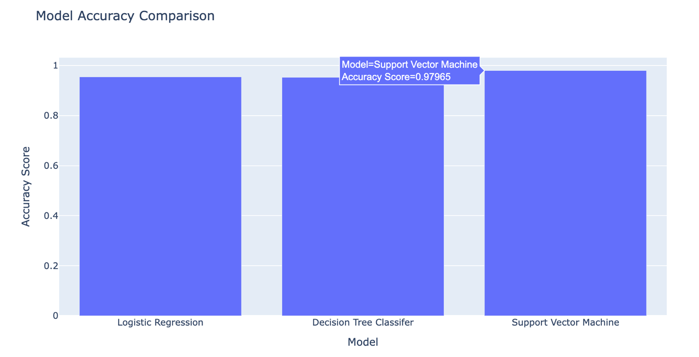
Key Results with Visualizations
Accuracy Score for Spam Detection
Model |  | Accuracy
 | Logistic Regression | 95.54 %
 | Decision Tree Classifier | 95.24 %
 | Support Vector Machine | 97.96 %

Slide 15
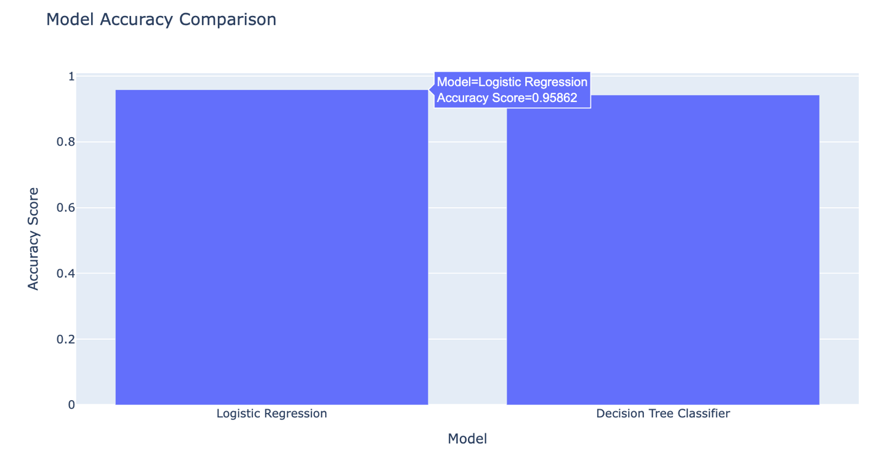
Key Results with Visualizations
Accuracy Score for Phishing Detection
Model |  | Accuracy
 | Logistic Regression | 95.86 %
 | Decision Tree Classifier | 94.28 %

Slide 16
Chapter 4: Discussion
Analysis of Final Result
Evaluation of Accuracy Scores:
Support Vector Machine: Highest accuracy of 97.96%, indicating it as the most effective model for Spam Detection .
Logistic Regression: Performed accuracy of 95.54% at Spam Detection and 95.86 at Phishing Link Detection.
Decision Tree Classifier: Also performed well with an accuracy of 95.54 % on Spam Detection and 94.28 on Phishing Link Detection.

Slide 17
Comparison with Baselines
Comparing Accuracy Scores

Slide 18
Implications and Limitations
1
Implications
2
Limitations
The potential positive effects or applications of the study's findings
The constraints or drawbacks that affect the study's outcomes or applicability.
Points
Pointa

Slide 19
Chapter 5: Future enhancements
Key Findings
1
Contextual Understanding: Incorporate advanced NLP techniques to better understand and analyze context, improving detection of sophisticated threats.
Adaptive Learning: Implement adaptive learning mechanisms to allow the model to continuously update and refine its detection capabilities based on new threat patterns.
2
3
Multi-Language Support: Expand the model to support multiple languages, increasing its effectiveness for a global user base.

Slide 20
Conclusion
In conclusion, this project has successfully developed a machine learning model that significantly enhances the detection of spam and phishing threats, offering high accuracy. Its potential for seamless integration into existing systems makes it a valuable tool for improving cybersecurity. Looking ahead, future enhancements such as contextual understanding, adaptive learning, and multi-language support will further refine the model, ensuring it remains effective against evolving threats and serves a broader audience.

Slide 21
Thank You.
For Your Time

