Slide 1

Team Details
Team name: Team Statiz
Team leader name: Rahul G

Slide 2

Brief about your solution
Statiz turns minimal product information (part number, brand, short description, manufacturer URL, reference PDFs) into rich, governed product intelligence.
Given sparse inputs, the pipeline scrapes manufacturer pages and reference documents, extracts spec tables from PDFs, auto-classifies each product into UNSPSC taxonomy with a confidence score, generates the six description types, up to 20 features and 50 attribute triplets (label/value/UOM), and writes the exact 252-column delivery format — with a human review console for governance.
Result on demo data: 145 products, 100% family classification accuracy, 116 cross-supplier cross-references, 8-second CPU runtime, $0 API cost.

Slide 3
1. How does your solution enrich minimal product information?
Briefly explain how your solution transforms limited inputs (e.g., Part Number, Brand, Short Description) into rich product intelligence.
2. How does your solution ensure accuracy and trust in the generated product data?
Describe your validation strategy. This may include:
(Confidence scoring, Multi-source verification, Human review, Rule-based validation, AI validation, Other approaches)
3. What makes your solution scalable for enterprise product catalogs?
Describe how your solution would handle: Large product catalogs, New manufacturers, Different document formats, Continuous product updates
1 · Enrichment from minimal inputs
Manufacturer page scraping (static + headless-browser fallback) extracts JSON-LD, meta tags and page text; reference PDFs (owner manuals, installation guides, spec sheets) are parsed into key/value tables. An LLM pass (structured JSON output) fuses all evidence into the delivery fields: 6 description variants, 20 features, 50 attribute triplets with UOMs, dimensions, certifications, images and document links. A heuristic JSON-LD path does the same offline.
2 · Accuracy and trust
- Confidence scoring on every classification (badge shown per product)
- Multi-source verification: LLM values never overwrite hard JSON-LD facts; attributes cross-checked between page and PDF
- Source grounding: every enriched attribute stores its source document + header
- Rule-based validation: unit/range checks, required-attribute flags per family
- Human review console: approve/correct before export — governed by construction
- Anti-hallucination prompt constraints: leave-blank rules; no invented certifications
3 · Enterprise scalability
- Fuzzy column detection (RapidFuzz): new manufacturers and unseen file layouts map automatically — no code changes, no hardcoding
- Embedding classification scales to full UNSPSC/eCl@ss (41k classes) by swapping taxonomy data — architecture unchanged
- Row-by-row streaming + disk-cached fetches handle large catalogs and cheap re-runs
- Continuous updates: re-run any row; review state persists

Slide 4
Opportunities
How different is it from any of the other existing ideas?
How will it be able to solve the problem statement given?
USP of the proposed solution
How different from existing ideas?
No mainstream PIM/search vendor natively auto-classifies to industrial taxonomies (UNSPSC/eCl@ss/ETIM); only one (inRiver) partially extracts datasheets; enrichment leaders enrich their own search index, not an exportable governed catalog. Partly proved cross-referencing data is worth $500M — but automotive-only. We combine all of it, self-serve.
How it solves the problem statement
Minimal product information (part no, brand, short desc) + manufacturer URLs is exactly our input; the 252-column delivery format is exactly our output — populated dynamically with unseen evaluation data handled by fuzzy schema detection.
USP
1. $0 cost, CPU-only, offline-capable (graceful LLM fallback) — vs $45–100K/yr tools
2. Every AI value carries evidence: confidence + source span
3. Cross-supplier substitute matching built in
4. 8-second end-to-end runtime on a laptop

Slide 5
List of features offered by the solution
- Fuzzy schema ingestion: any supplier's CSV/XLSX column names auto-mapped (in→mm, comma decimals)
- Manufacturer URL scraping with headless-browser fallback · PDF spec-sheet extraction
- UNSPSC auto-classification with confidence scores and top-5 candidate evidence
- LLM enrichment: 6 description types, 20 features, 50 attribute triplets (label/value/UOM)
- Cross-supplier part cross-referencing + substitute search API
- Human review console: approve/correct, confidence badges, source-tagged attributes
- Delivery export: all 252 static headers populated exactly (CSV + XLSX)
- Multi-provider free LLM layer (Cerebras/Groq/Gemini) with deterministic offline fallback

Slide 6
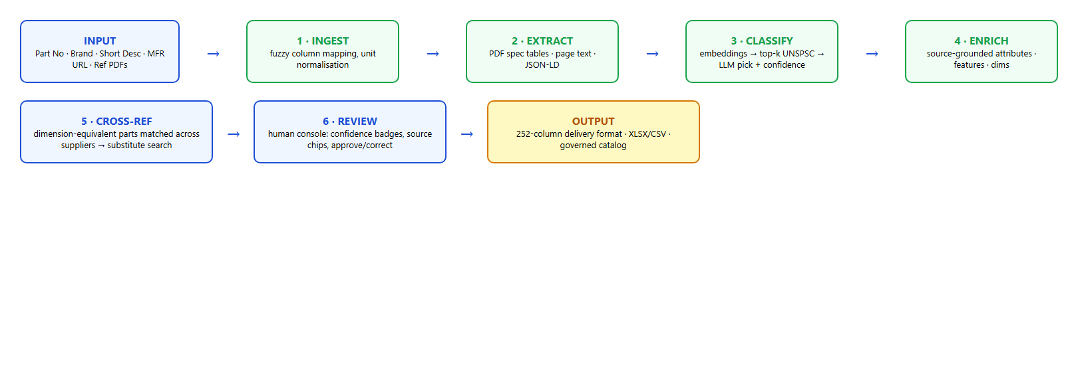
Process flow diagram or Use-case diagram

Slide 7
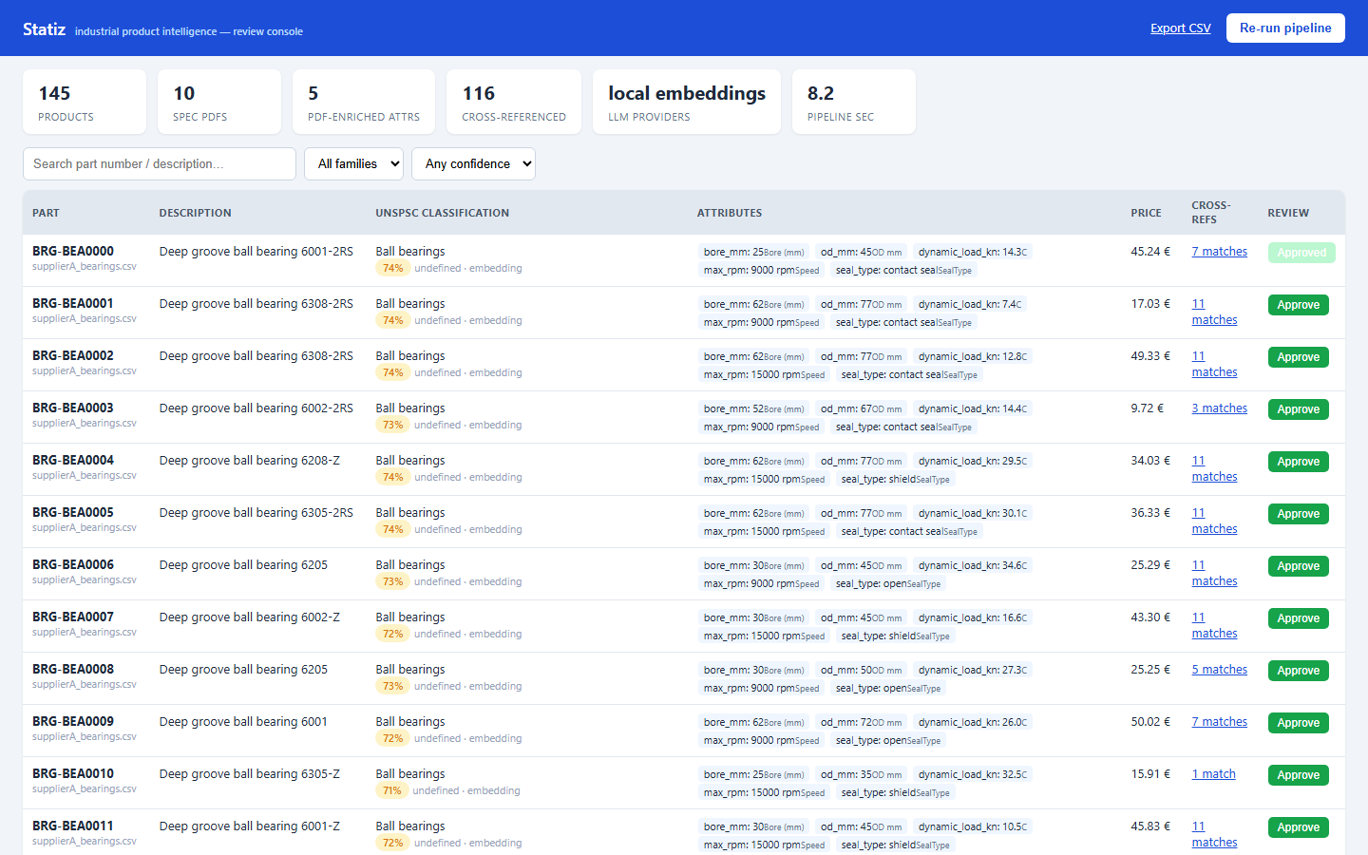
Wireframes/Mock diagrams of the proposed solution (optional)

Slide 8
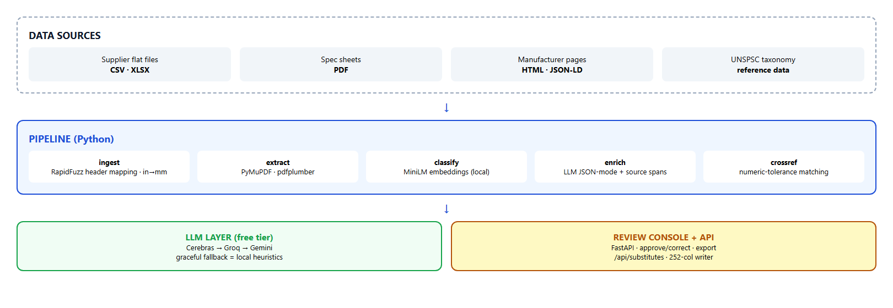
Architecture diagram of the proposed solution

Slide 9
Technologies used in the solution
Python 3.14 · FastAPI + Uvicorn (API & review console) · sentence-transformers MiniLM (local embeddings)
PyMuPDF + pdfplumber (PDF extraction) · RapidFuzz (fuzzy matching) · pandas/openpyxl (I/O)
Playwright/Chromium (JS-page scraping) · httpx (cached fetch layer)
LLM layer: Cerebras → Groq → Gemini free tiers, OpenAI-compatible JSON mode

Slide 10
Estimated implementation cost (optional)
Prototype: $0.
- LLMs: free tiers (Cerebras ~30K TPM / Groq / Gemini), offline heuristic fallback
- Embeddings: local on CPU — no API cost
- Hosting: Cloudflare quick tunnel (demo); Render free tier for a persistent MVP
At scale: paid LLM tier ≈ $0.001–0.005 per product; 100K products ≈ $100–500 one-time.

Slide 11
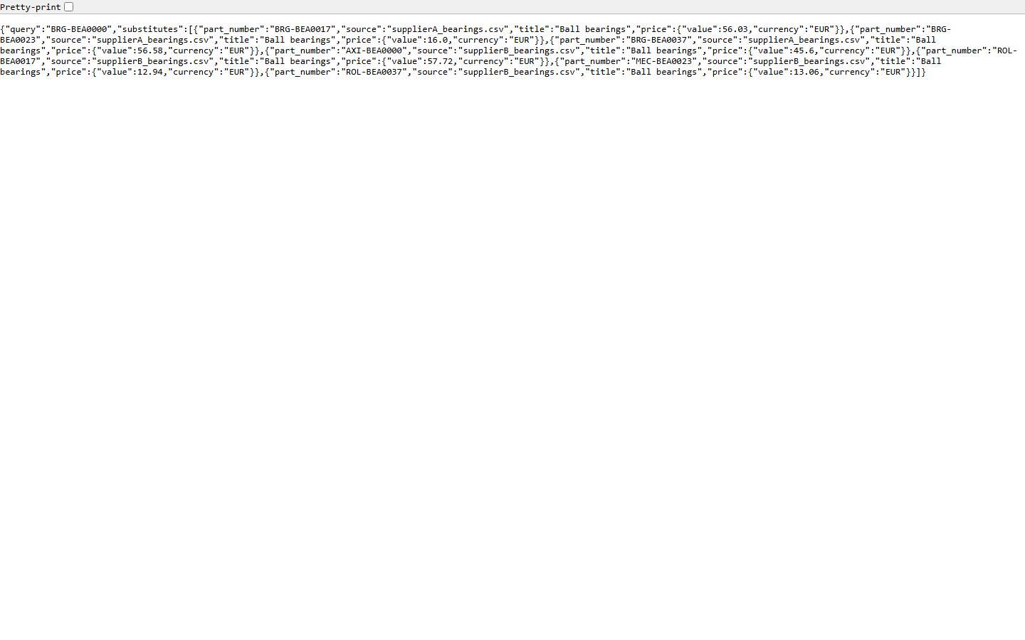
Snapshots of the MVP
Review console (left) · substitute search API (right)

Slide 12
Additional Details/Future Development (if any)
- Engineering-constraint substitution validation (fit/load margins, not just dimensions)
- OCR path for scanned datasheets
- Full eCl@ss/ETIM taxonomy trees + multi-language descriptions
- Image enrichment: product-photo attribute extraction
- Incremental catalog sync + enterprise SSO for review workflow

Slide 13
Provide links to your:
GitHub Public Repository
Demo Video Link (3 Minutes)
Working Prototype Link
GitHub Public Repository:
https://github.com/Rahulxoxo69/Statiz
Demo Video:
https://github.com/Rahulxoxo69/Statiz/blob/main/demo/demo_video.mp4
Working Prototype:
https://day-atm-become-bureau.trycloudflare.com
(live review console — search, filter, approve, export CSV; substitutes API at /api/substitutes/BRG-BEA0000)

Slide 14


