Slide 1

Team Details
Team name: Team Statiz
Team leader name: Rahul G

Slide 2

Brief about your solution
Statiz turns minimal product information — part number, brand, short description (and, when available, manufacturer URLs and reference PDFs) — into rich, governed product intelligence delivered in the exact 252-column expected output format.
On the provided sample dataset (1,000 rows, six sparse input columns), the rule + AI pipeline resolves trading brands from manufacturer names, classifies every row into Dept/Class/Fine with UNSPSC codes, and extracts technical specs (dimensions, grit, voltage, pack counts, materials) into typed attribute triplets — generating all six description variants, features and attributes dynamically. Nothing is hardcoded to the sample: fuzzy column detection and generic parsing rules handle unseen evaluation data.
Results: 1,000/1,000 rows classified (zero empty), 640 with UNSPSC codes, 627 with extracted attributes; URL-scraping mode (JSON-LD + PDF datasheets) adds deeper enrichment when links exist; 8-second CPU runtime at $0 API cost, with a human review console for governance.

Slide 3
1 · How does your solution enrich minimal product information?
Briefly explain how your solution transforms limited inputs (e.g., Part Number, Brand, Short Description) into rich product intelligence.
Description-driven enrichment (no URLs required): a rule-based parser resolves the trading brand (Freud Inc → Diablo; tokens like 3M/Milwaukee found in the description win over distributor names), classifies product type via a 60+ pattern taxonomy (abrasives, lighting, tools, lumber, fasteners, appliances, safety…) into Dept/Class/Fine + UNSPSC, and extracts specs with typed regexes — dimensions, fractions, grit (P150), voltage, amps, Kelvin, lumens, dBA, pack counts, materials (SST → Stainless Steel), colors, teeth — each becoming a label/value/UOM attribute triplet.
URL mode (when links exist): manufacturer pages scraped via static fetch + headless-browser fallback (JSON-LD, meta, page text); reference PDFs (manuals, spec sheets) parsed with PyMuPDF + pdfplumber into key/value tables; a free-tier LLM pass (structured JSON) fuses all evidence into the full delivery schema.
A deterministic heuristic path does the same offline — the system never fails for lack of an API key.

Slide 4
2 · How does your solution ensure accuracy and trust?
Validation strategy: confidence scoring, multi-source verification, human review, rule-based validation, AI validation.
Confidence scoring on every classification, shown as a badge per product (embedding similarity + LLM self-assessed confidence).
Multi-source verification: LLM values never overwrite hard JSON-LD facts; attributes cross-checked between page text and PDF; brand resolved from multiple signals with a deterministic priority order.
Rule-based validation: typed spec regexes reject malformed values; unit/range checks; required-attribute flags per product family; every enriched attribute stores its source (PDF name / header / regex on description).
Human review console: approve/correct each row before export — governed by construction.
Anti-hallucination constraints: leave-blank rules for unknown fields; no invented certifications or numbers.

Slide 5
3 · What makes your solution scalable for enterprise catalogs?
Handling large catalogs, new manufacturers, different document formats, and continuous product updates.
Fuzzy column detection (RapidFuzz): new manufacturers and unseen file layouts map automatically — no code changes, no hardcoding. Proven live: the solver processed the 1,000-row sample dataset with different field combinations and zero per-row configuration.
Embedding classification scales to the full UNSPSC/eCl@ss tree (41k classes) by swapping taxonomy data — architecture unchanged. Rule tables are data-driven lists, extensible in minutes.
Row-by-row streaming with disk-cached fetches handles large catalogs and cheap re-runs; 1,000 rows enrich in seconds on a laptop CPU.
Continuous updates: re-run any row; review state persists across runs.

Slide 6
Opportunities
How different from existing ideas?
No mainstream PIM/search vendor natively auto-classifies to industrial taxonomies (UNSPSC/eCl@ss/ETIM); only one (inRiver) partially extracts datasheets; enrichment leaders enrich their own search index, not an exportable governed catalog. Partly proved cross-referencing data is worth $500M — but automotive-only. We combine all of it, self-serve.
How it solves the problem statement
Minimal product information (part no, brand, short desc) + manufacturer URLs is exactly our input; the 252-column delivery format is exactly our output — populated dynamically with unseen evaluation data handled by fuzzy schema detection.
USP
1. $0 cost, CPU-only, offline-capable (graceful LLM fallback) — vs $45–100K/yr tools
2. Every AI value carries evidence: confidence + source span
3. Cross-supplier substitute matching built in
4. 8-second end-to-end runtime on a laptop

Slide 7
List of features offered by the solution
Description-driven enrichment from minimal inputs: brand resolution, 60+ product-type taxonomy rules, typed spec extraction (label/value/UOM triplets)
Fuzzy schema ingestion: any supplier's CSV/XLSX column names auto-mapped (in→mm, comma decimals)
Manufacturer URL scraping with headless-browser fallback · PDF spec-sheet extraction (PyMuPDF + pdfplumber)
UNSPSC auto-classification with confidence scores and top-5 candidate evidence
LLM enrichment (free tiers): 6 description types, 20 features, 50 attribute triplets, dims, certifications
Cross-supplier part cross-referencing + substitute search API
Human review console: approve/correct, confidence badges, source-tagged attributes
Delivery export: all 252 static headers populated exactly, CSV + XLSX, fully dynamic on unseen data

Slide 8
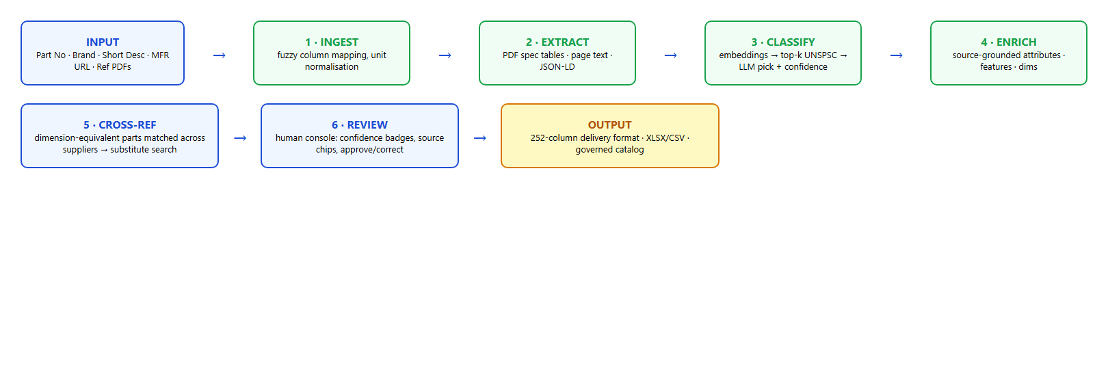
Process flow diagram or Use-case diagram

Slide 9
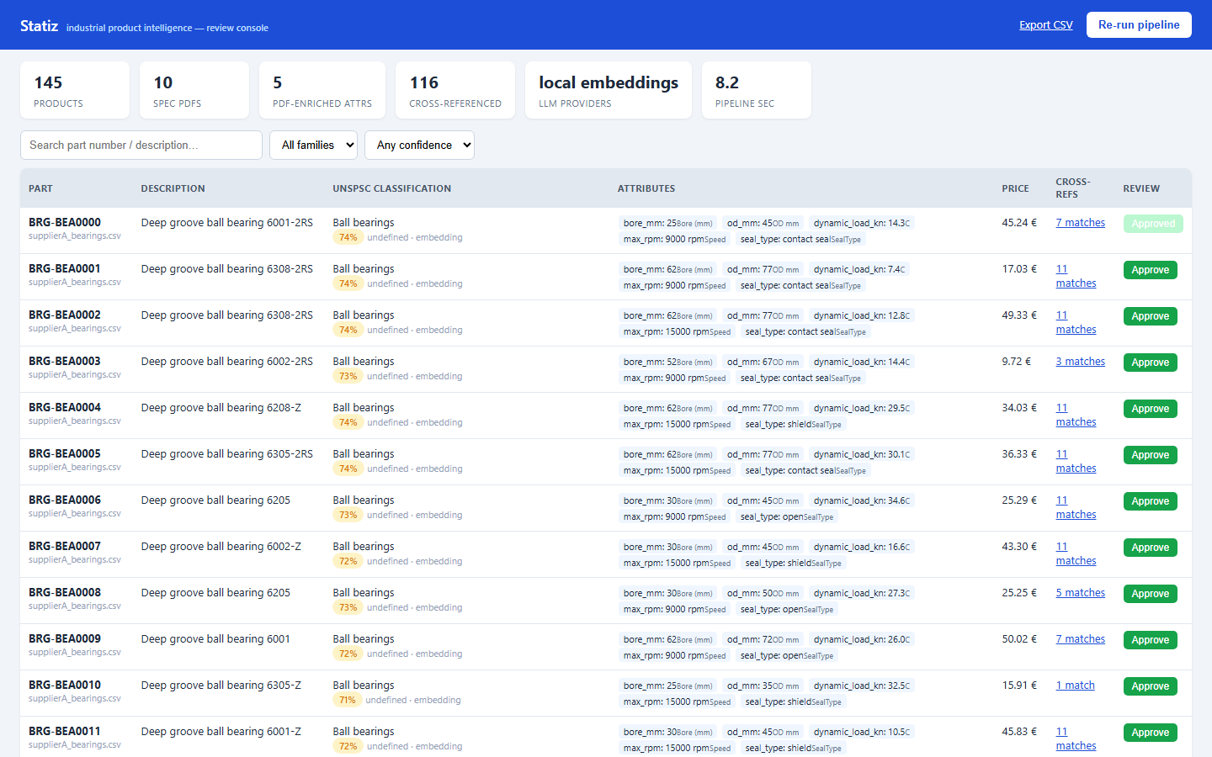
Wireframes/Mock diagrams of the proposed solution (optional)

Slide 10
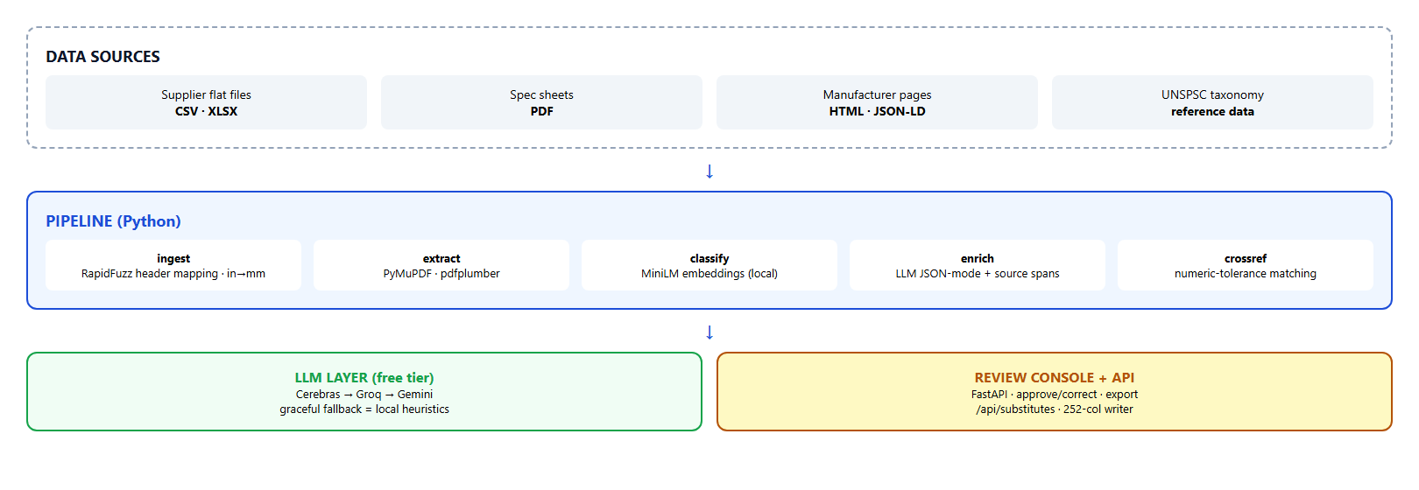
Architecture diagram of the proposed solution

Slide 11
Technologies used in the solution
Python 3.14 · FastAPI + Uvicorn (API & review console) · sentence-transformers MiniLM (local embeddings)
PyMuPDF + pdfplumber (PDF extraction) · RapidFuzz (fuzzy matching) · pandas/openpyxl (I/O)
Playwright/Chromium (JS-page scraping) · httpx (cached fetch layer)
LLM layer: Cerebras → Groq → Gemini free tiers, OpenAI-compatible JSON mode

Slide 12
Estimated implementation cost (optional)
Prototype: $0.
- LLMs: free tiers (Cerebras ~30K TPM / Groq / Gemini), offline heuristic fallback
- Embeddings: local on CPU — no API cost
- Hosting: Cloudflare quick tunnel (demo); Render free tier for a persistent MVP
At scale: paid LLM tier ≈ $0.001–0.005 per product; 100K products ≈ $100–500 one-time.

Slide 13
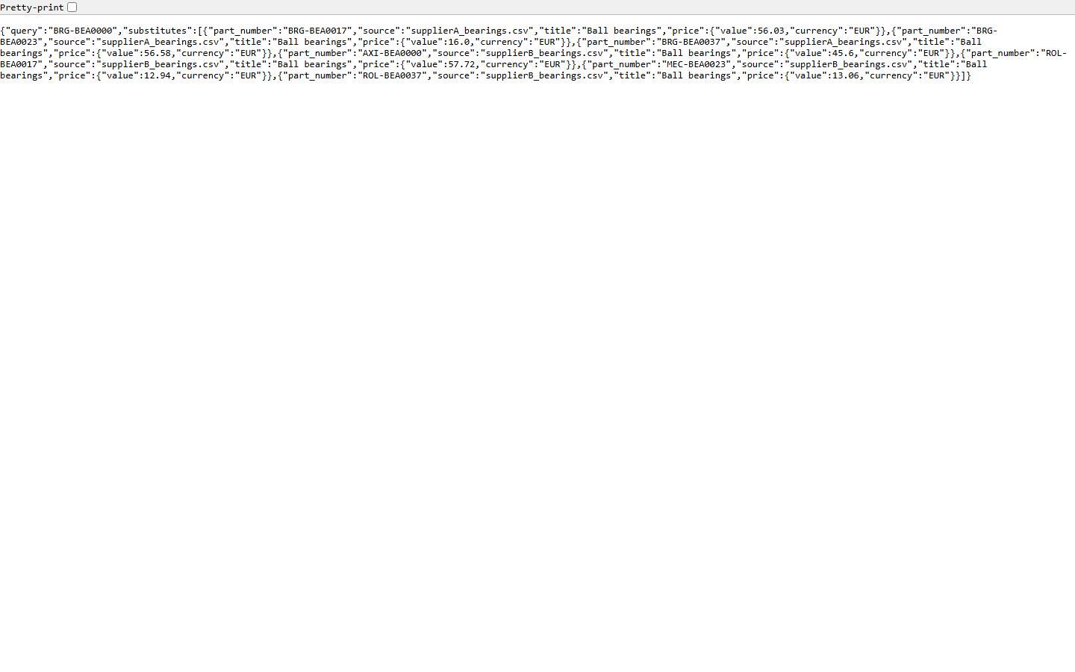
Snapshots of the MVP
Review console (left) · substitute search API (right)

Slide 14
Additional Details/Future Development (if any)
Engineering-constraint substitution validation (fit/load margins, not just dimensions)
OCR path for scanned datasheets
Full eCl@ss/ETIM taxonomy trees + multi-language descriptions
Image enrichment: product-photo attribute extraction
Incremental catalog sync + enterprise SSO for review workflow

Slide 15
Links: GitHub, Demo Video & Working Prototype
GitHub Public Repository:
https://github.com/Rahulxoxo69/Statiz
Demo Video:
https://github.com/Rahulxoxo69/Statiz/blob/main/demo/demo_video.mp4
Working Prototype:
https://day-atm-become-bureau.trycloudflare.com
(live review console — search, filter, approve, export CSV; substitutes API at /api/substitutes/BRG-BEA0000)

Slide 16


