Slide 1
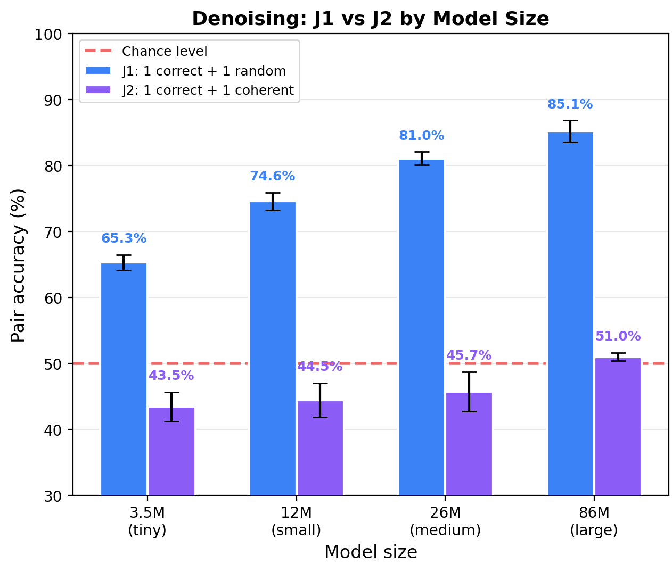
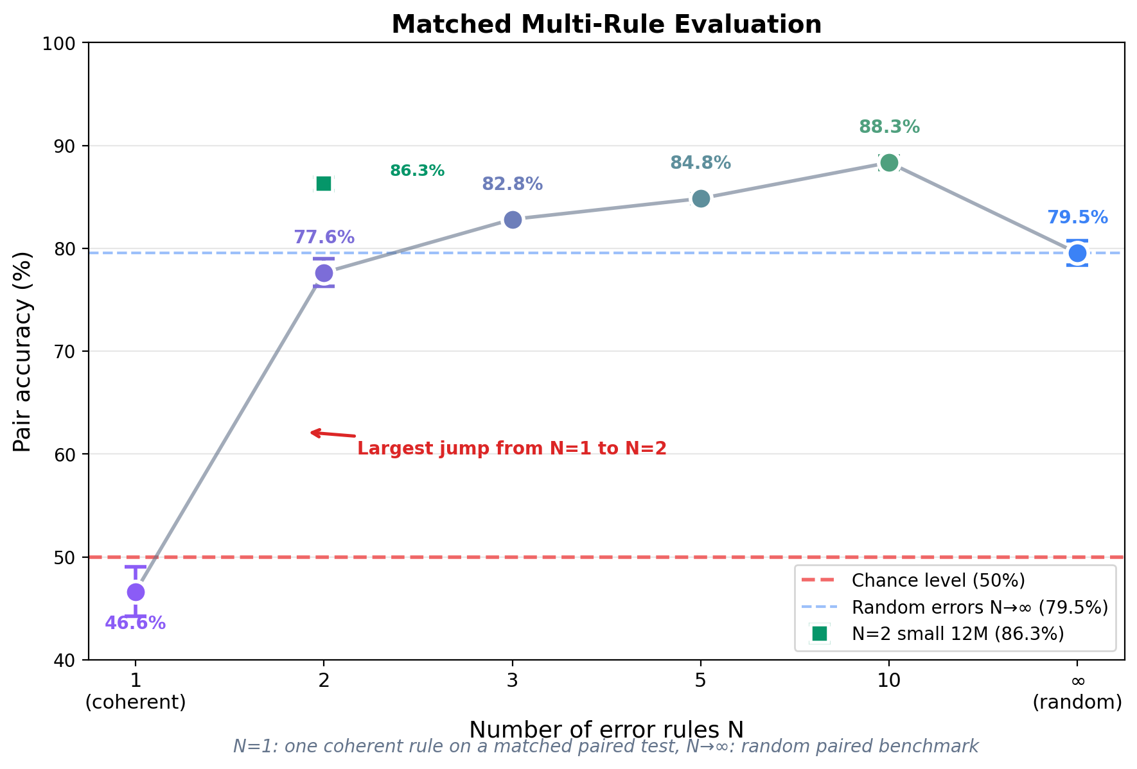
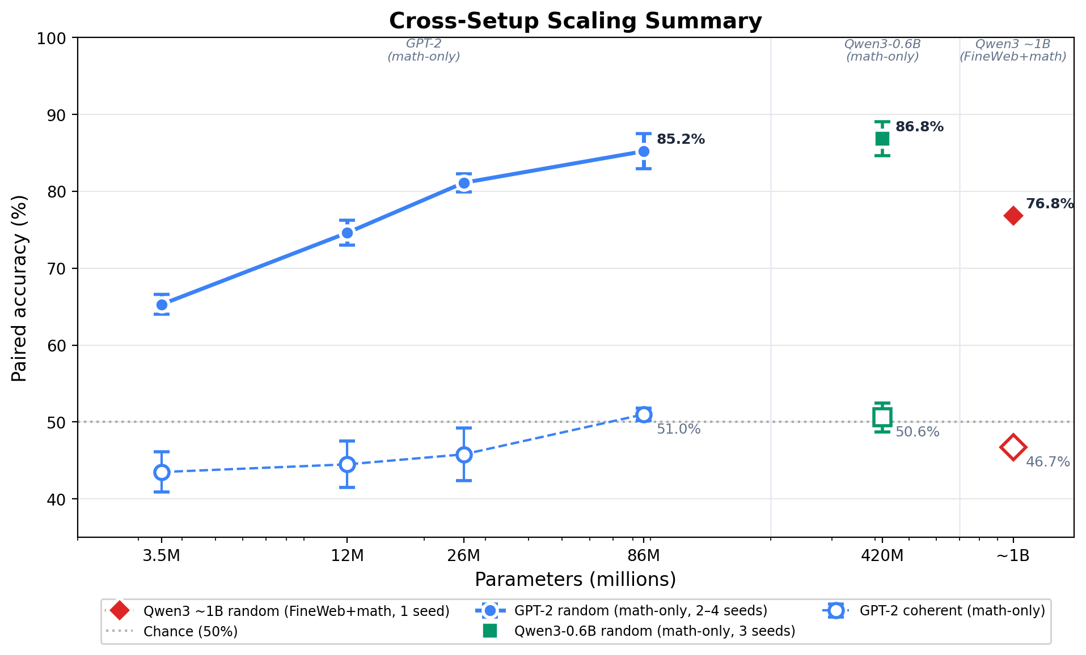
Truth as a Compression Artifact
in Language Model Training
Konstantin Krestnikov | Paper: arXiv:2603.11749 | [[НАЗВАНИЕ_МЕРОПРИЯТИЯ]]
1. The Question
2. Hypothesis: an MDL framing
3. Experimental design
Real-world corpora contain contradictions: the same problem appears with correct and incorrect solutions. Yet trained models often prefer the correct one — why?
Existing explanations (scaling, frequency, truth-correlated features) cannot explain why the training objective alone would favour one answer at equal frequency in the same format.
Cross-entropy training ≡ minimum code length.
An MDL learner minimizes L(M) + L(D | M).
▸ Random: K(T₂) ≫ K(T₁) → truth wins.
▸ Coherent: K(T₂) ≈ K(T₁) → no pref.
▸ N rules + selector: +O(n log N) bits.
GPT-2-like transformers trained from scratch. Only the structure of errors varies between conditions.
▸ Sizes: 3.5 M · 12 M · 26 M · 86 M · Qwen3-0.6B (420 M non-emb.) · ≈1 B.
▸ Seeds: core GPT-2 2–4 · Qwen3-0.6B 3 · ≈1 B single-seed sanity check.
▸ Metric: paired accuracy — does the model assign lower NLL to the correct completion? (forced-choice diagnostic, not generative accuracy.)
Key findings
Central contrast — random vs. coherent errors (paired accuracy, math)
1
Random → truth bias scales
2
Coherent → preference vanishes
Each problem appears with the correct answer and a freshly-sampled random wrong answer.
Paired accuracy rises monotonically with model size:
3.5 M → 12 M → 26 M → 86 M
65.3 % → 74.6 % → 81.1 % → 85.2 %
Larger models compress the true rule more efficiently than they could memorise a random false cluster — consistent with the MDL prediction.
▸ Truth bias is real, but it is a function of the description-length gap between correct and false generators — not of size alone.
Replace random wrongs with one systematic false rule, applied consistently — e.g. a·(b+c) = a·b + c instead of a·b + a·c.
3.5 M → 86 M: 43.5 % → 51.0 %
≈ chance at every scale.
K(T₂) ≈ K(T₁) → truth preference vanishes.
3
N rules + selector → bias returns
N=1: 46.6 % N=2: 77.6 % N=10: 88.3 %
Selector costs log N bits — consistent with the MDL prediction.
Standard 50/50 setup, tiny 3.5 M, 4 seeds.
Random (J1) vs. one coherent rule (J2). Same problem, same format, same frequency — only the error structure differs.
▸ Random: paired accuracy 65.3 % → 85.2 % across 3.5 – 86 M parameters.
▸ Coherent: 43.5 % → 51.0 % — at chance everywhere.
Transfer: Wikipedia entity substitution
The same contrast holds on natural text.
▸ Random entity substitution: ≈ 71 % across all sizes.
▸ Coherent global mapping ("France"→"Japan", "Paris"→"Tokyo"): 46 – 49 % (chance).
Gap is smaller on language than math (+22 pp vs. +34 pp): locally fluent errors compress better, dampening — but not eliminating — the effect.
Multi-rule crossover — the key control. With N=1 coherent rule the model is at chance; with N=2 it jumps to 77.6 % and at N=10 to 88.3 %, above pure-random (79.5 %). Selector costs log N bits per problem — consistent with the MDL prediction.
Lexical-diversity / token-corruption hypotheses do not predict the N=1 → N=2 jump.
Scaling to 1 B params · real text
Wikipedia entity substitution — paired accuracy
Size Random Coherent
tiny 3.5 M 69.6 % 48.7 %
small 12 M 70.7 % 46.6 %
medium 26 M 71.5 % 46.4 %
large 86 M 71.4 % 45.9 %
Qwen3 0.42 B math-only: rand 86.8 % · coh 50.6 %
Qwen3 ≈ 1 B (FineWeb+math): rand 76.8 % · coh 46.7 % (math = 8 % of training)
Takeaway. In controlled contradictory corpora, truth bias is not intrinsic to next-token prediction — it is a compression artifact: it appears when false answers are harder to compress than true ones.
▸ Coherent misinformation evades the filter at equal frequency.
▸ Verification scales inversely — bigger models absorb coherent patterns more readily.
▸ Diverse errors filter out, coordinated ones may not. Relevant for alignment, data curation, hallucinations.
Whether this extends to large-scale pretraining (multi-billion) remains an open question.

