Slide 1
Adversarial Attacks And Interpretability Covid Chestxray Dataset
Cognitive Computing and Artificial Intelligence - UniCT a.a 2019/2020
Raiti Mario O55000434
Nardo Gabriele Salvatore O55000430
Sortino Renato O55000405

Slide 2

Introduction
The project is available on github at following link : https://github.com/RaiMar96/AdversarialAttacksAndInterpretability-covid-chestxray-
The Dataset is available on github at following link : https://github.com/ieee8023/covid-chestxray-dataset
The project has been implemented in python on Jupyter environment, using Google Colab platform.

Slide 3
Informazioni Preliminari
In the following experiments a subset of the provided dataset has been utilized (images from perspective ‘PA’), made of 303 samples.
The following ratios have been applied: Train set 70% , Validation set 15%, Test set 15%

Slide 4
Outline
Dataset Creation
From Scratch CNN, train and evaluation
Model interpretabilty using Integrated Gradients
Adversarial attack FSGM
Adversarial Training, Fine tuning and evaluation of the model

Slide 5
Dataset Creation

Slide 6
Dataset Creation
Dataset creation has been realized with the image_dataset class, which takes as input parameters the file paths of CSV file containing the structure of the dataset, and the image fodler, the transformations to apply and the relative phase for the subset (Transformations are defined separately for train and test).

Slide 7
Dataset Creation
After creating the image dataset, the train, validation and test subset are generated using the class torch.Subset, and the relative dataloaders.

Slide 8
From Scratch CNN, train and evaluation

Slide 9
From Scratch CNN, train and evaluation
The from scratch model is made of 6 convolutional levels, each of which is followed by ReLU, BatchNormalization and MaxPooling.
Binary Cross Entropy is used as evaluation criterion for loss computation.
As optimizer, Adamo chiddu de scummissi is used.

Slide 10
From Scratch CNN, train and evaluation
For model evaluation two functions, testAccuracy and testCovid, are used.
testAccuracy computes test accuracy for the test subset.
testCovid computes accuracy of Covid/NOCovid classes.

Slide 11
Model interpretabilty using Integrated Gradients

Slide 12
Model interpretabilty using Integrated Gradients
Pytorch Captum module is used for model interpretability.
modelInterpretation function use integrated gradient criterion to define feature meaning after model computations.
Attributes are plotted trough ‘visualize_image_attr‘ called on ‘visualization’ element of captum.

Slide 13
Adversarial attack FGSM

Slide 14
Adversarial attack FGSM
The adversarial attack taked into consideration is Fast Gradient Sign Method.
Fgsm_attack function perform images perturbation that adds noise to the original images, multiplying an epsilon value to the gradient sign of the data. In our experiment, epsilon = 0.025 is used.
Test function verify model accuracy after image perturbation.

Slide 15
Adversarial Training, Fine tuning and evaluation of the model

Slide 16
Adversarial Training, Fine tuning and evaluation of the model
Same operations performed before, are repeated in adversarial mode.
A new adversarial image dataset is created; the new loaders are created through concatenation of the original dataset and the adversarial one; to do this, ConcatDataset class is used.
Model is trained with perturbed images, tuning parameters. Than, evaluation operations are repeated.

Slide 17
Results

Slide 18
Setup
For test, the following parameters are used:
Batch size = 8;
Learning rate = 10^-4
Num of epochs= 50

Slide 19
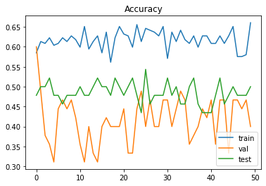
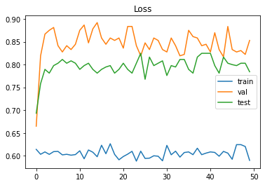
From Scratch Model Train Results
Accuracy
Loss

Slide 20
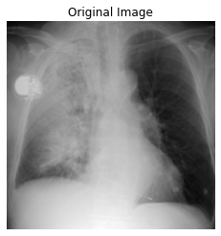
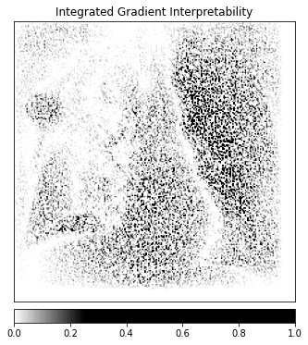
From Scratch Model Train Results
Image
Interpretation

Slide 21
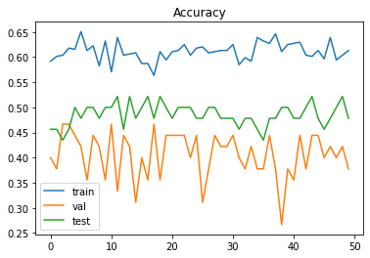
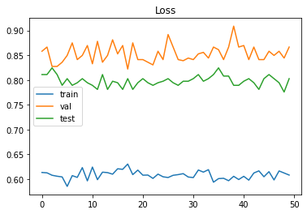
Adversarial Fine Tuned Model Train Results
Accuracy
Loss

Slide 22
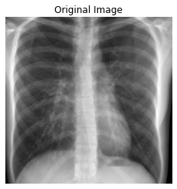
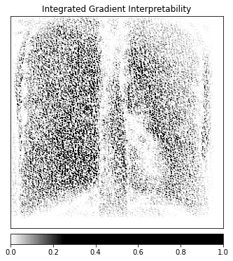
Adversarial Fine Tuned Model Interpretability Results
Image
Interpretation

