Slide 1
Adversarial Attacks And Interpretability Covid Chestxray Dataset
Cognitive Computing and Artificial Intelligence - UniCT a.a 2019/2020
Raiti Mario O55000434
Nardo Gabriele Salvatore O55000430
Sortino Renato O55000405

Slide 2
Problem Definition
The goal of this project is to define a convolutional model that classifies CoViD-19 cases starting from chest x-ray scans.
In order to make the model more robust to adversarial attacks, the idea is to fine-tune the model with perturbed images after a first phase of training on normal data.

Slide 3
Problem Definition
To create the adversarial samples, the Fast Gradient Sign Method method has been used
This method creates an image by adding a small amount to the original image.
Such quantity is computed multiplying an epsilon (e.g. 0,07) by the sign of the gradient.

Slide 4
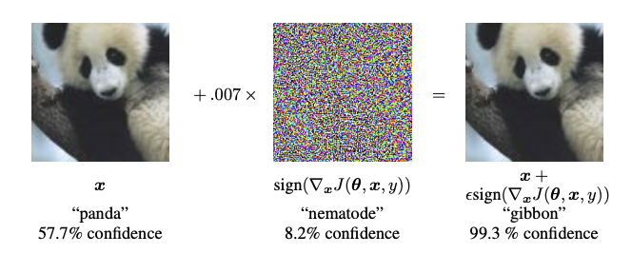
Fast Gradient Sign Method

Slide 5

Introduction
The project is available on github at following link : https://github.com/RaiMar96/AdversarialAttacksAndInterpretability-covid-chestxray-
The Dataset is available on github at following link : https://github.com/ieee8023/covid-chestxray-dataset
The project has been implemented in python on Jupyter environment, using Google Colab platform.

Slide 6
Dataset Creation

Slide 7
Dataset Creation
Dataset creation has been realized with the image_dataset class, which takes as input parameters the file paths of CSV file containing the structure of the dataset, and the image folder, the transformations to apply and the relative phase for the subset (Transformations are defined separately for train and test).

Slide 8
Data Transformations
Data Normalization with mean value 0,5 and variance 0,25
Resize to 128 pixels
ToTensor
Grayscale

Slide 9
Data Augmentation
Random Rotation of 30 degrees
RandomCrop of 112
RandomHorizontalFlip

Slide 10
Dataset Creation
In the following experiments a subset of the provided dataset has been utilized (images from perspective ‘PA’), made of 303 samples.
After creating the image dataset, the train, validation and test subset are generated using the class torch.Subset, and the relative dataloaders.

Slide 11
Class Distribution
COVID | NO-COVID
201 (66.34 %) | 102 (33.66 %)

Slide 12
From Scratch CNN, train and evaluation

Slide 13
From Scratch CNN
The from scratch model is made of 9 convolutional levels, each of which applies a 3x3 kernel and is followed by ReLU, BatchNormalization.
Three fully connected layers follow with 1024, 128 and 16 neurons respectively.
The first two convlutional layers have a stride value of 2. The last two layers are followed by a MaxPooling layer.

Slide 14
Train Details
Binary Cross Entropy is used as evaluation criterion for loss computation.
As optimizer, Adam is used.

Slide 15
Model interpretabilty using Integrated Gradients

Slide 16
Model interpretabilty using Integrated Gradients
Pytorch Captum module is used for model interpretability.
modelInterpretation function use integrated gradient criterion to define feature meaning after model computations.
Attributes are plotted trough ‘visualize_image_attr‘ called on ‘visualization’ element of captum.

Slide 17
Adversarial attack FGSM

Slide 18
Adversarial attack FGSM
The adversarial attack taked into consideration is Fast Gradient Sign Method.
Fgsm_attack function perform images perturbation that adds noise to the original images, multiplying an epsilon value to the gradient sign of the data. In our experiment, epsilon = 0.025 is used.

Slide 19
Adversarial Training, Fine tuning and evaluation of the model

Slide 20
Adversarial Training, Fine tuning and evaluation of the model
Same operations performed before, are repeated in adversarial mode.
A new adversarial image dataset is created; the new loaders are created through concatenation of the original dataset and the adversarial one; to do this, ConcatDataset class is used.
Model is trained with perturbed images, tuning parameters. Then, evaluation operations are repeated.

Slide 21
Results

Slide 22
Setup
For test, the following parameters are used:
Batch size = 8;
Learning rate = 10^-4
Num of epochs= 50

Slide 23
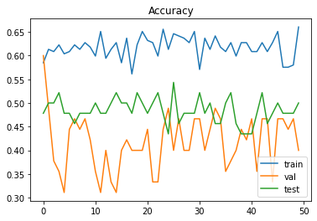
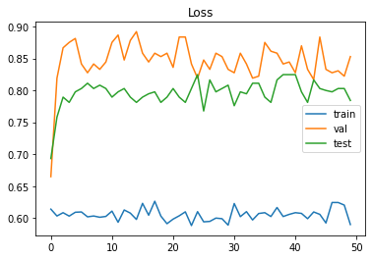
From Scratch Model Train Results
Accuracy
Loss

Slide 24
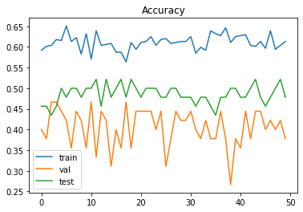
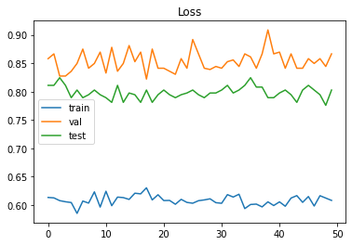
Adversarial Fine Tuned Model Train Results
Accuracy
Loss

Slide 25
Confusion Matrix
True values Predicted values | COVID | NO-COVID
COVID | 93 | 50
NO-COVID | 108 | 52
Precision = TP/ TP + FP = 93 / 143 = 65.03 %
Recall = TP / TP + FN = 93 / 201 = 46.26 %

Slide 26
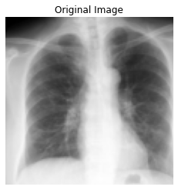
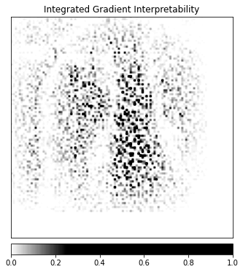
From Scratch Model Interpretability Results
Image
Interpretation

Slide 27
Adversarial Fine Tuned Model Interpretability Results
Image
Interpretation

Slide 28
Results Comparison
Interpretability results are evaluated based on the outcome of the interpretability function. It underlines the differences through the two model’s result: if the difference matrix shows values that are zeros (or close to zeros), it means that the evaluated features that have been used in the decision processes, were approximatelly the same.

