Slide 1

Soccer bet
GUI PREVIEW

Slide 2
Soccer BET GUI
Interfaccia grafica dell’applicazione

Slide 3
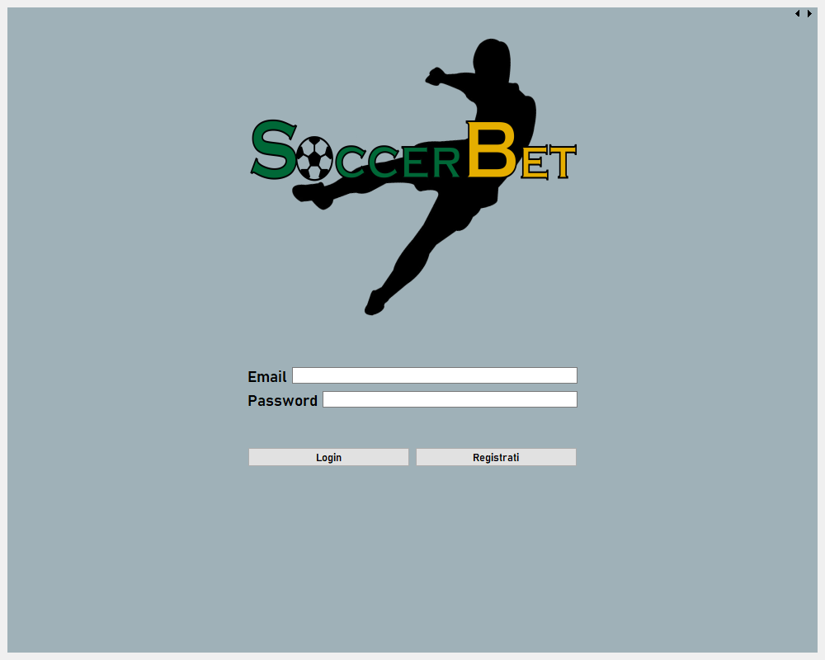
Login page

Slide 4
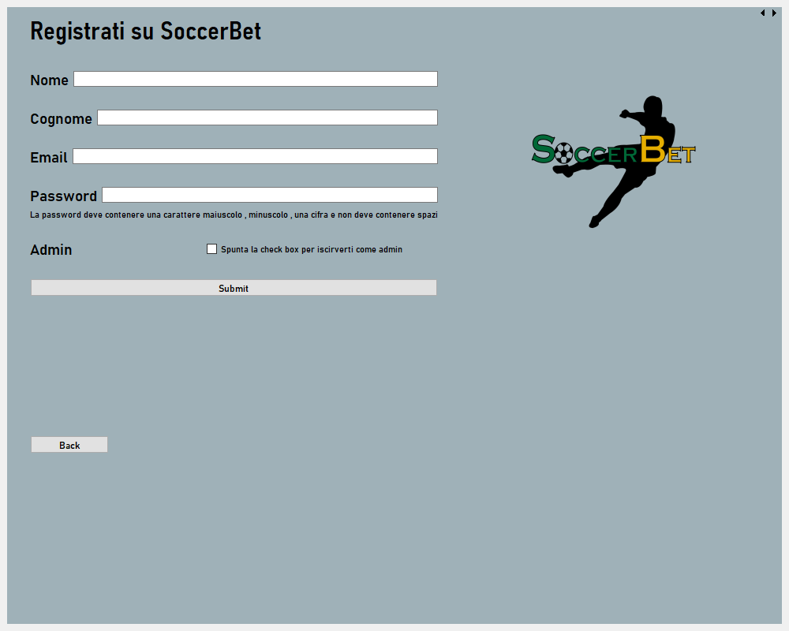
Registration page

Slide 5
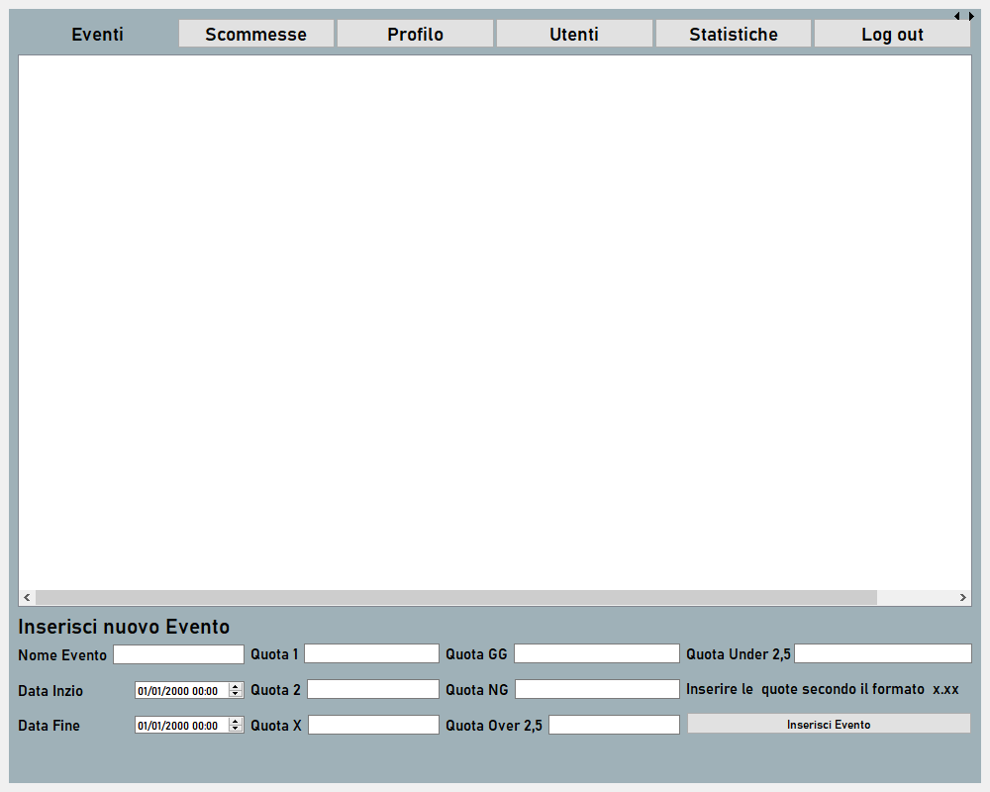
Admin home

Slide 6
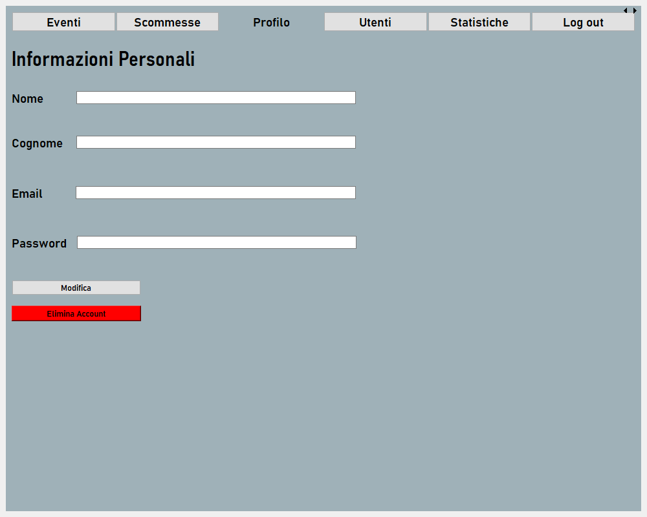
Admin profile

Slide 7
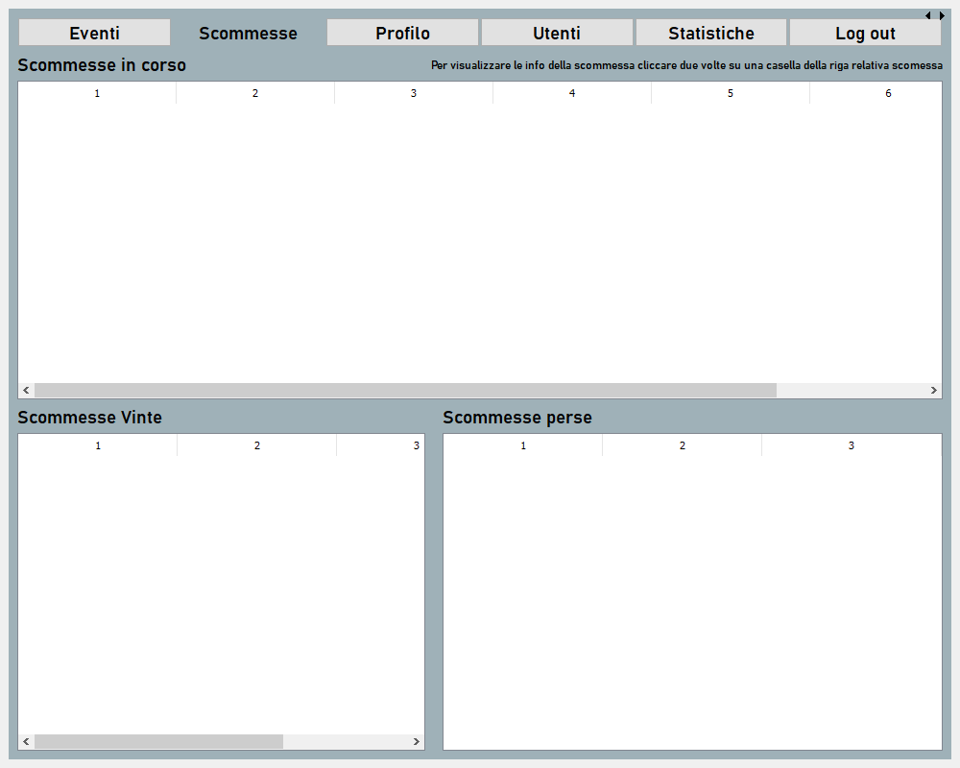
Admin bet

Slide 8
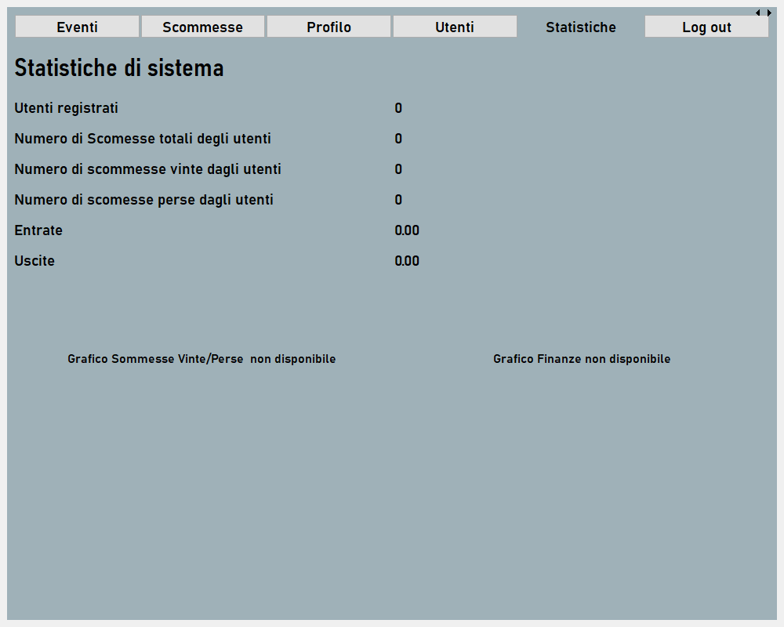
Admin stats

Slide 9
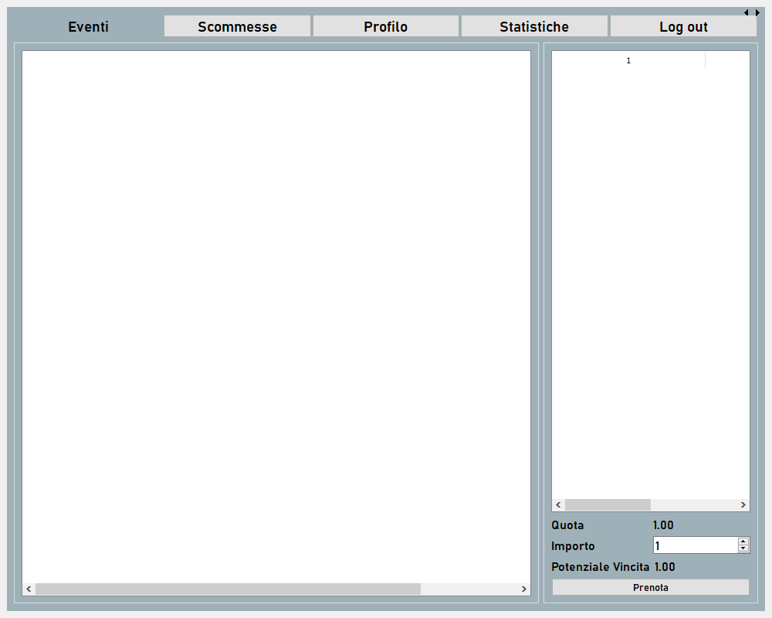
USer home

Slide 10
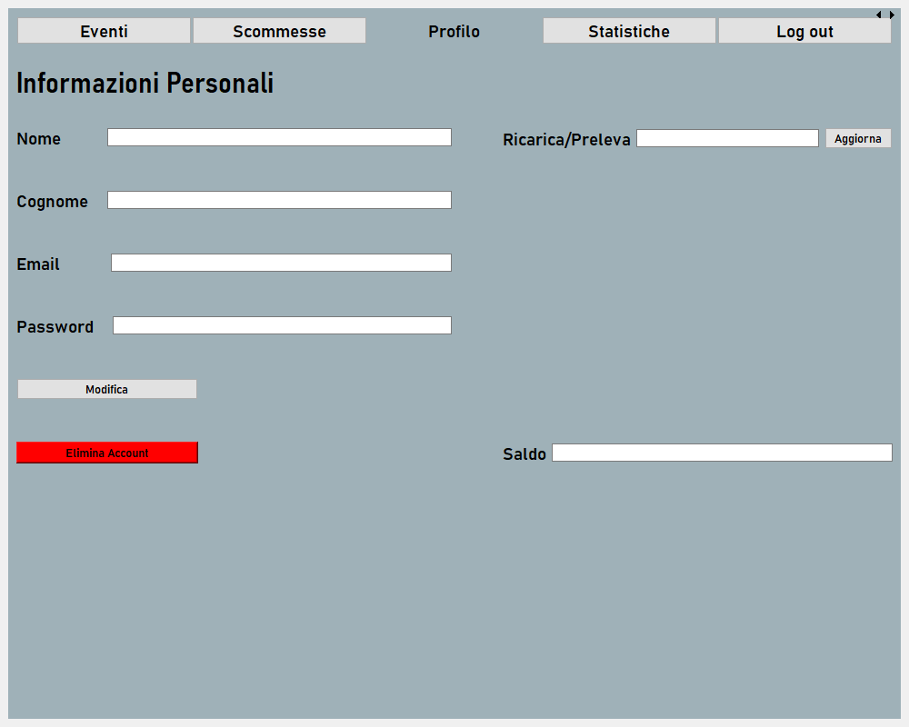
USER profile

Slide 11
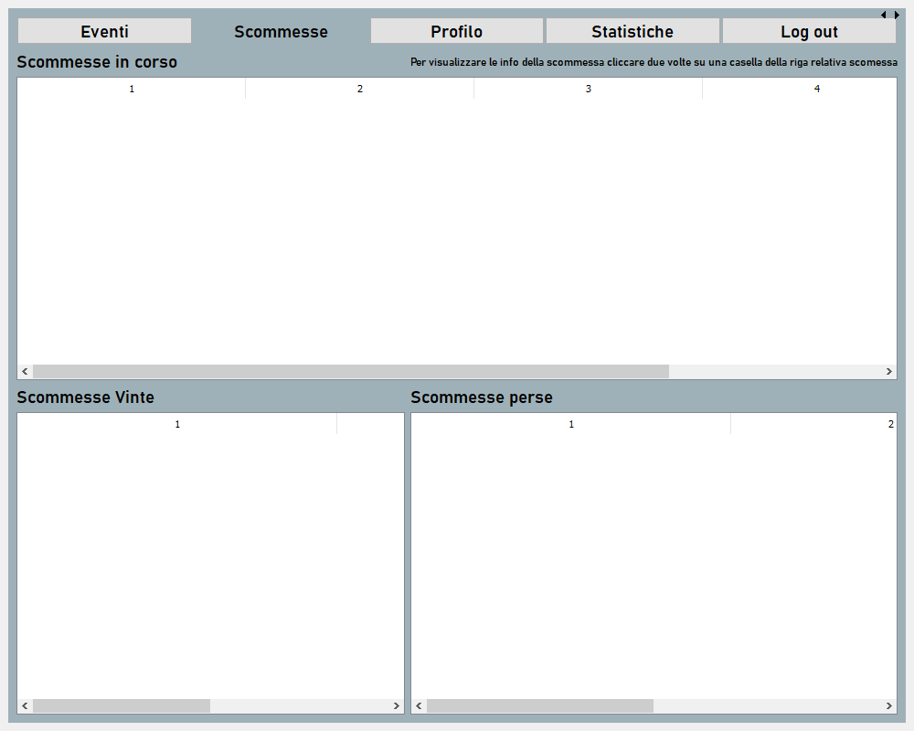
user bet

Slide 12
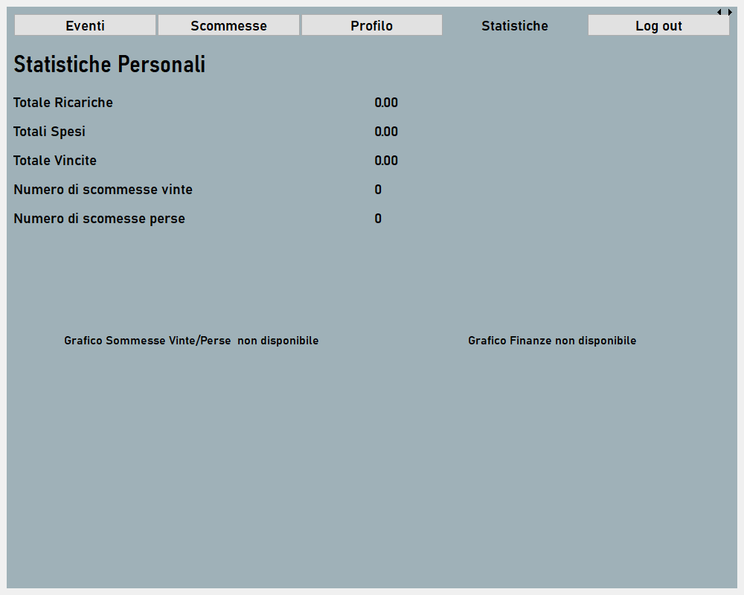
USer stats

Slide 13
Soccer BET GUI
Dialog esterne

Slide 14
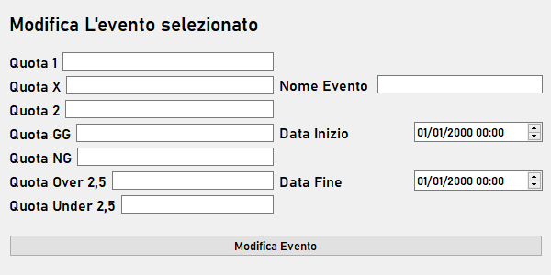
Editeventdialog.ui

Slide 15
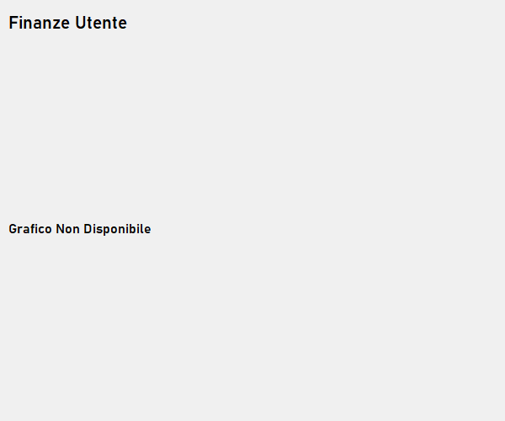
Userinfodialog.ui

Slide 16
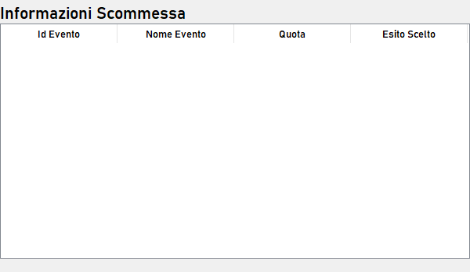
eventbetdialog.ui

