Slide 1
Project
Data-Driven Web Application
Utilizing Next.js, Firebase, Papa Parse, and Tailwind CSS
Presented By-Mrinal Rai

Slide 2
Contents
Introduction
Problem Statement
Objective
Approach
Features
Modules
Flowchart
Class Diagram
Technologies Used
10. Conclusion

Slide 3


Introduction
This project is a data-driven web application designed to efficiently parse and manage CSV data, offering seamless data manipulation and visualization.
Designed for data analysts, researchers, and businesses needing dynamic, real-time data management.
Utilizes Next.js, Firebase, Papa Parse, and Tailwind CSS

Slide 4

Problem Statement
Problems
Many web applications struggle with handling large CSV files efficiently, leading to slow performance and a poor user experience.
There is a need for a robust solution to parse and visualize CSV data dynamically in real-time.

Slide 5
Objective
The purpose of a data-driven web application project is:
1.To develop a web application that efficiently parses CSV files using Papa Parse.
2.To store and manage the parsed data with Firebase for real-time updates.
3.To design a responsive and user-friendly interface using Tailwind CSS.
4.To implement the application using Next.js for server-side rendering and improved performance.

Slide 6
Approach
1. Utilize Next.js for building the application, taking advantage of its SSR capabilities.
2. Incorporate Papa Parse to handle the parsing of large CSV files.
3. Use Firebase for backend services, including real-time database and authentication.
4. Design the front-end with Tailwind CSS for a responsive and modern UI.

Slide 7

Features
CSV File Upload and Parsing: Users can upload CSV files, which are parsed efficiently.
Data Visualization: Real-time charts and graphs generated from the parsed data.
User Authentication: Secure login and registration using Firebase Authentication.

Slide 8

Features (cont...)
Responsive Design: The application is fully responsive, offering a seamless experience across devices.
Real-Time Data Updates: Changes in data are reflected immediately due to Firebase's real-time capabilities.
Subscription Pricing Module: Calculator: Uses CSV data to calculate subscription pricing.
Display: Shows pricing based on credit score and credit lines

Slide 9
Features (cont...)
Subscription Pricing Formula:
CreditScore be the credit score obtained from the CSV data.
CreditLines be the number of credit lines mentioned in the CSV.
BasePrice be the base price for the subscription.
PricePerCreditLine be the additional price per credit line.
PricePerCreditScorePoint be the additional price per credit score point.

Slide 10

Application Modules
Upload Module: Handles file uploads and uses Papa Parse to process CSV data.
Authentication Module: Manages user registration and login using Firebase Authentication.
Data Management Module: Stores and retrieves data from Firebase, ensuring real-time updates.

Slide 11

APPLICATION Modules(cont...)
Visualization Module: Generates dynamic charts and graphs based on the processed data using libraries such as Chart.js.
UI Module: Implements the user interface with Tailwind CSS for a modern and responsive design.

Slide 12
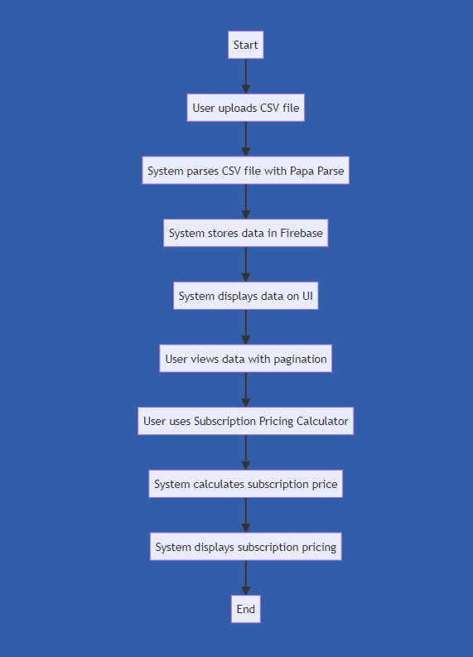
FLOWCHART

Slide 13
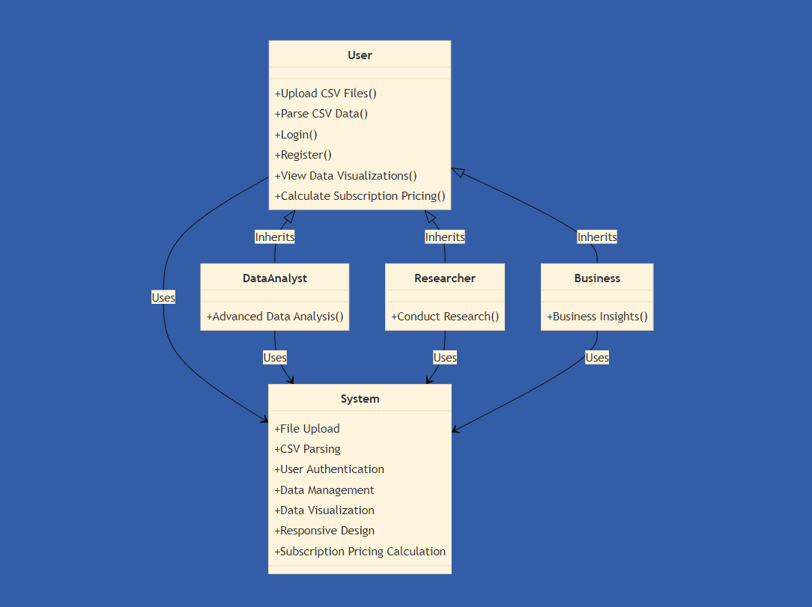
ClASS DIAGRAM

Slide 14
Technologies Used
Next.js: Framework for React applications that provides server-side rendering and static site generation.
Firebase: Platform for real-time databases, authentication, and hosting.
Papa Parse: Powerful library for parsing CSV files in JavaScript.
Tailwind CSS: Utility-first CSS framework for designing responsive and modern interfaces.

Slide 15
Conclusion
"The data-driven web application successfully addresses the challenge of parsing and managing large CSV files."
"Utilizing Next.js, Firebase, Papa Parse, and Tailwind CSS, the application offers a robust, responsive, and efficient solution."
"The subscription pricing calculator provides a practical application of the parsed data."
"Future improvements could include advanced data analysis features, enhanced visualization options, and broader integrations with other data sources."

Slide 16
Thank You

