Slide 1
Fuzzy Inference Example
CSE 4110 : Artificial Intelligence Laboratory

Slide 2
Mamdani-style Fuzzy Inference
Fuzzy inference can be defined as a process of mapping from a given input to an output, using the theory of fuzzy sets.
The Mamdani-style fuzzy inference process is performed in four steps:
Fuzzification of the input variables
Rule evaluation
Aggregation of the rule outputs
Defuzzification.

Slide 3
Mamdani-style Fuzzy Inference
As an example, we examine a problem where the business risk is calculated based a project_staffing and project_funding. It includes 3 rules:
If project_funding is adequate or project_staffing is small, then the risk is low.
If project_funding is marginal and project_staffing is large, then the risk is normal.
If project_funding is inadequate, then the risk is high.
Our Input is : project_funding= 35% and project_staffing=60%

Slide 4
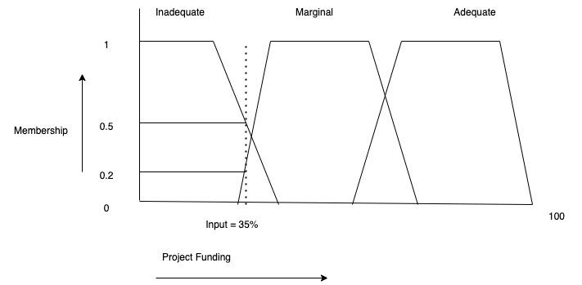
Mamdani-style Fuzzy Inference
Step1:
Fuzzification of the given crisp input into fuzzy input set:
Inadequate(35%)=0.5
Marginal(35%)=0.2
Adequate(35%)=0

Slide 5
Mamdani-style Fuzzy Inference

Slide 6
Mamdani-style Fuzzy Inference
1
0
A
X
B
C
D

Slide 7
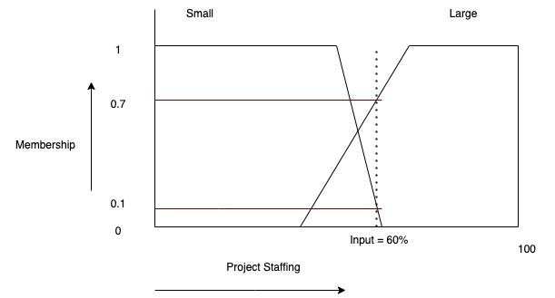
Mamdani-style Fuzzy Inference
Step1:
Fuzzification of the given crisp input into fuzzy input set:
Small(60%)=0.1
Large(60%)=0.7

Slide 8
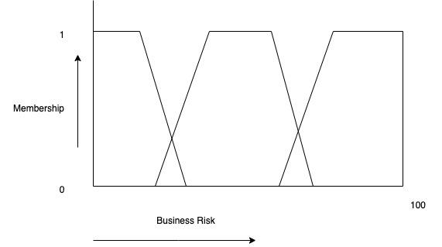
Mamdani-style Fuzzy Inference
Step1:
Fuzzificatiion of the given crisp input into fuzzy input set:

Slide 9
Mamdani-style Fuzzy Inference
Step2:
Now that we have the fuzzy values we can use the fuzzy rules to arrive at the
final fuzzy value. The rules are as follows:
If project_funding is adequate or project_staffing is small, then the risk is low.
If project_funding is marginal and project_staffing is large, then the risk is normal.
If project_funding is inadequate, then the risk is high.

Slide 10
Mamdani-style Fuzzy Inference
From Rule1 we get :
max( Project_Funding[Adequate],Project_Staffing[Small])
=max (0,0.1)
=0.1

Slide 11
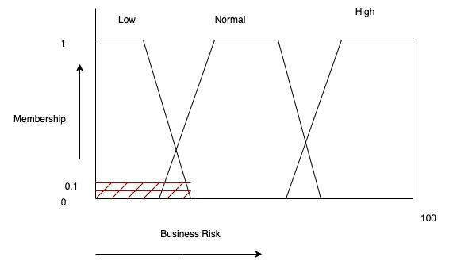
Mamdani-style Fuzzy Inference
From Rule1 we get :
max( Project_Funding[Adequate],Project_Staffing[Small])
=max (0,0.1)
=0.1

Slide 12
Mamdani-style Fuzzy Inference
From Rule2 we get :
min( Project_Funding[Marginal],Project_Staffing[Large])
=min (0.2,0.7)
=0.2

Slide 13
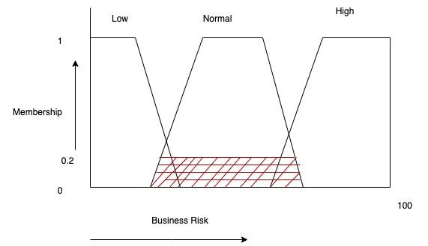
Mamdani-style Fuzzy Inference
From Rule2 we get :
min( Project_Funding[Marginal],Project_Staffing[Large])
=min (0.2,0.7)
=0.2

Slide 14
Mamdani-style Fuzzy Inference
From Rule3 we get :
Project_Funding[Inadequate]
=0.5

Slide 15
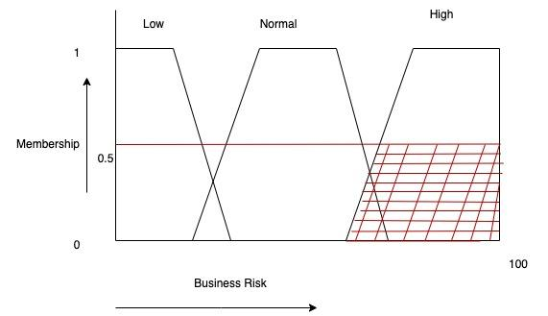
Mamdani-style Fuzzy Inference
From Rule3 we get :
Project_Funding[Inadequate]
=0.5

Slide 16
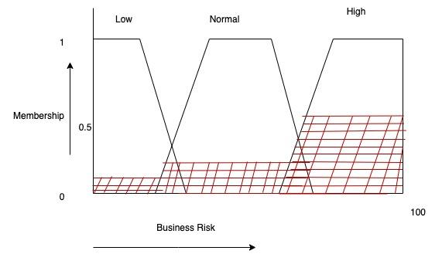
Mamdani-style Fuzzy Inference
Step3:
Aggregation of output all rules:

Slide 17
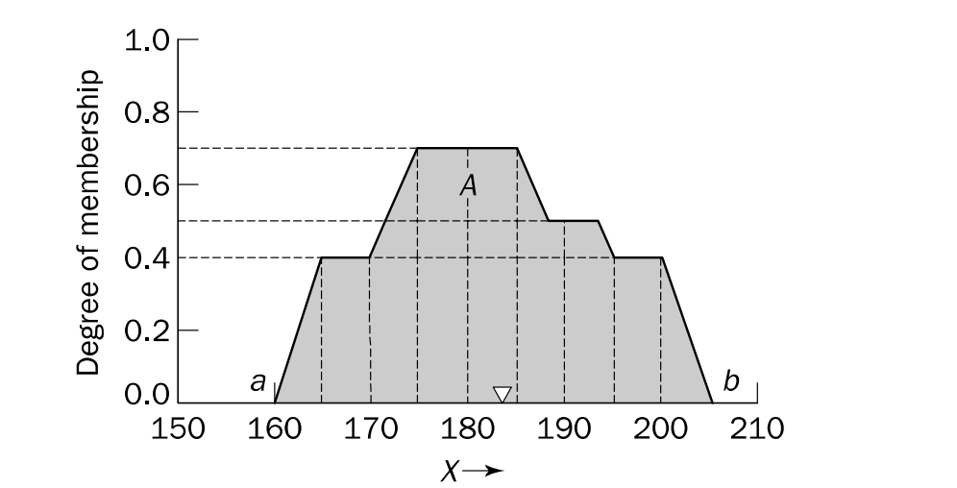
Mamdani-style Fuzzy Inference
Step4:
There are several defuzzification methods, here we have used centroid technique. It finds the point where a vertical line would slice the aggregate set into two equal masses.
a centroid defuzzification method finds a point representing the centre of gravity of the fuzzy set, A, on the interval, ab.

Slide 18
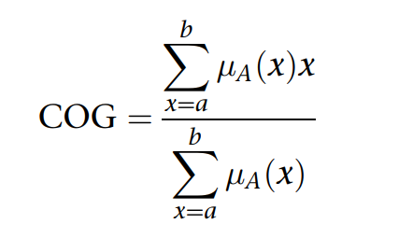
Mamdani-style Fuzzy Inference
A centroid defuzzification method finds a point representing the centre of gravity of the fuzzy set, A, on the interval, ab is given by the equation:

Slide 19
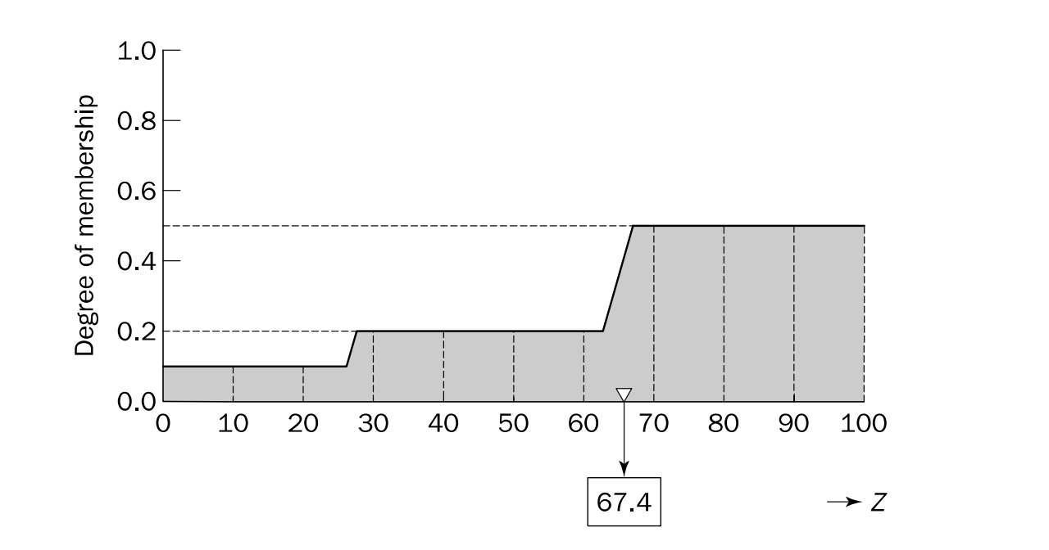
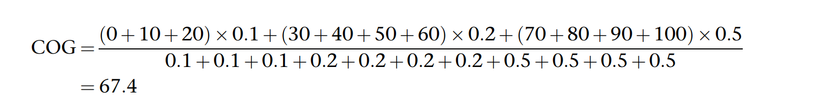
Mamdani-style Fuzzy Inference
Thus, the result of defuzzification, crisp output is 67.4. It means, for instance, that the risk involved in our ‘fuzzy’ project is 67.4%

