Slide 1
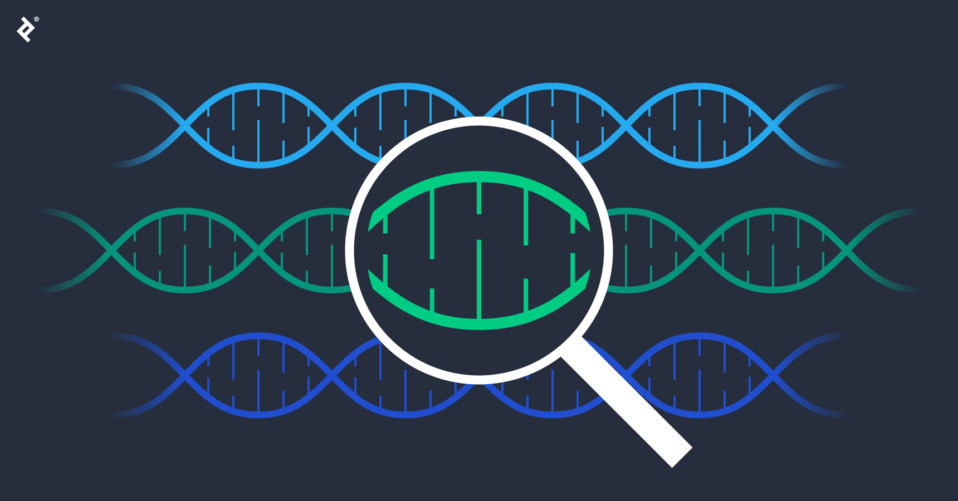
GENETIC ALGORITHM
CSE 4110 - Lab5

Slide 2

WHAT IS GA
Genetic algorithms are inspired by the process of natural selection and evolution.
They're used to find approximate solutions to optimization and search problems by mimicking the process of natural selection.
It finds the optimal solution by initiating the process with a random initial cost function and then searching for the one with the least cost in the space.
It comes in handy when you are discovering solutions for huge and complex datasets

Slide 3
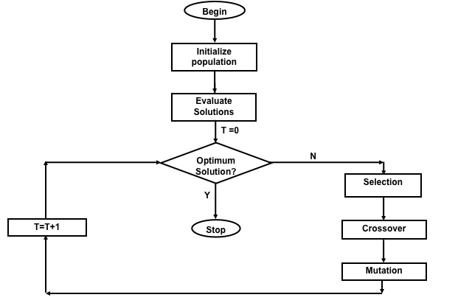
WORKING PRINCIPLE OF GA

Slide 4
GA STEPS
Initialization: Generation of an initial population of candidate solutions (individuals or chromosomes). The population is usually created randomly or using some heuristic method.
Evaluation: Evaluate each individual's fitness by applying a fitness function. The fitness function quantifies how good each solution is relative to other solutions.
Selection: Select individuals from the current population to serve as parents for the next generation. Selection is usually based on the fitness of individuals, with fitter individuals being more likely to be selected.
Crossover :Combine selected parents to create offspring for the next generation. Crossover operations involve exchanging genetic material between parents to produce new solutions

Slide 5
GA STEPS
Mutation: Occasionally, apply random changes to the offspring to introduce diversity into the population.
Replacement: Create a new generation by replacing the old population with the offspring. The replacement process may involve strategies such as elitism, where the best individuals from the current population are preserved in the next generation.
Termination: Determine when to stop the algorithm.

Slide 6
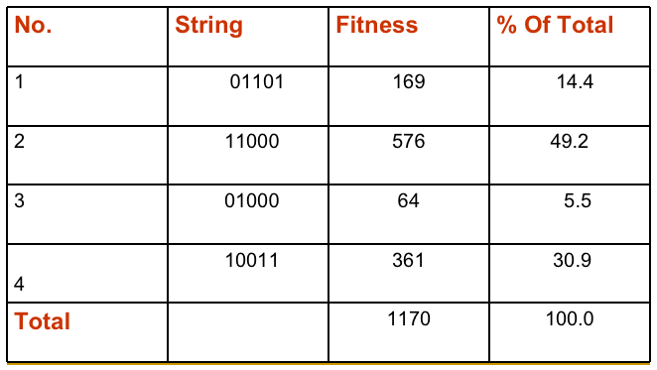
GA WORKING PROCESS
EXAMPLE OF ROULETTE WHEEL SELECTION

Slide 7
GA WORKING PROCESS
Simple problem: max x2 over {0,1,…,31}
GA approach:
Representation: binary code, e.g. 01101  13
Population size: 4
1-point xover, bitwise mutation
Roulette wheel selection
Random initialization

Slide 8
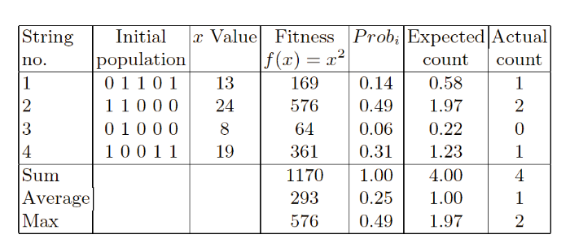
GA WORKING PROCESS
SELECTION

Slide 9
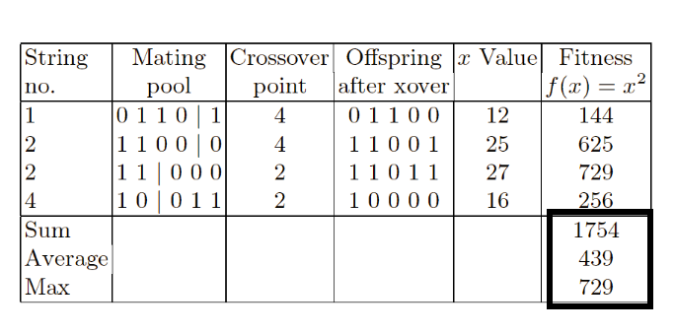
GA WORKING PROCESS
CROSSOVER

Slide 10
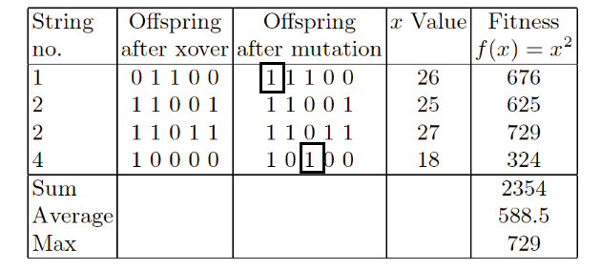
GA WORKING PROCESS
MUTATION

Slide 11
GA WORKING PROCESS
The process continues till we achieve maximum number of generations or maximum optimization.
GAs have been applied to a variety of function optimization problems, and have been shown to be highly effective in searching a large, poorly defined search space even in the presence of difficulties such as high-dimensionality, multi-modality, discontinuity and noise.

Slide 12
GA FOR GAME PLAYING
Each chromosome in the population represents a different strategy for playing the game. This could involve various tactics, heuristics, or decision-making rules that guide the behavior of the player.
Initial population is generated randomly
During the selection process each strategy is required to play a certain number of games against other strategies.
The strategies compete against each other in these games, and the outcomes (wins, losses, draws) are recorded.
The strategies with the most wins are selected for reproduction

Slide 13
GA FOR GAME PLAYING
The fitness of each strategy is determined based on its performance in the games played.
Strategies that win more games are considered more fit and have a higher chance of being selected for reproduction.
Strategies with the most wins are selected for reproduction, mimicking the concept of natural selection. This process is often referred to as "survival of the fittest."
The population increasingly consists of “good” strategies.
The process continues for a predefined number of generations or until a termination condition is met, such as finding a strategy that meets a certain performance threshold or reaching a computational limit.

