Slide 1
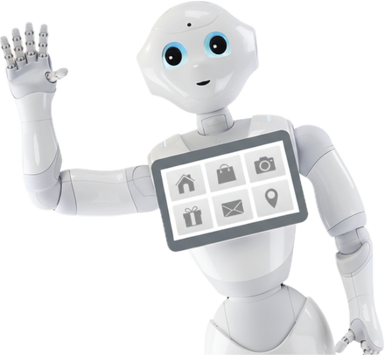
"I Loved How Pepper Talked About My Hoodie":
A Situated, MI-Grounded Multimodal Architecture for Empathy-Driven Conversational Engagement
Presented by PepperOnii
Raiyan Ashraf
Yanni Liu
Sruthi Ganji
12/12/2025

Slide 2
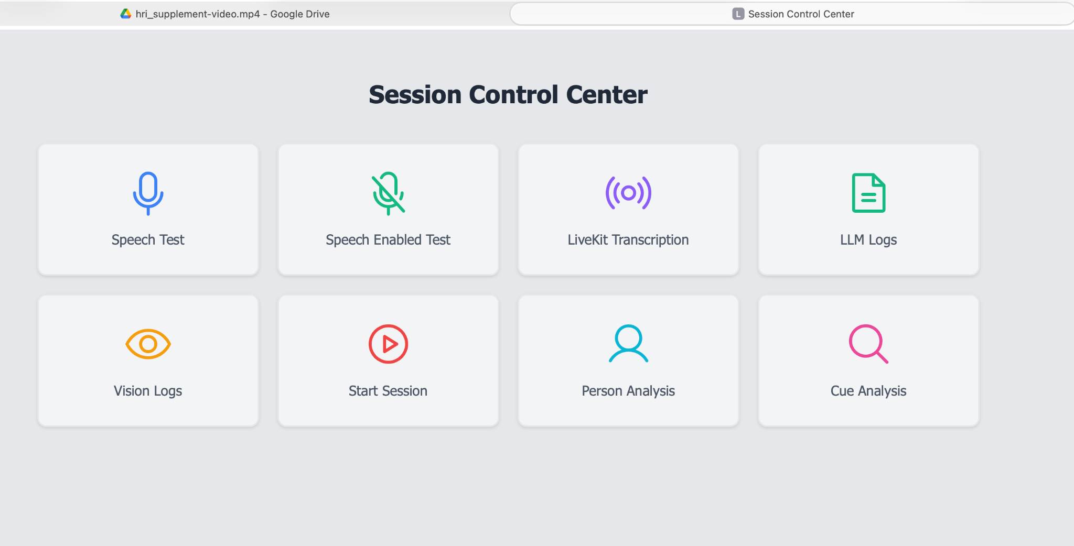
User Interface Pages

Slide 3
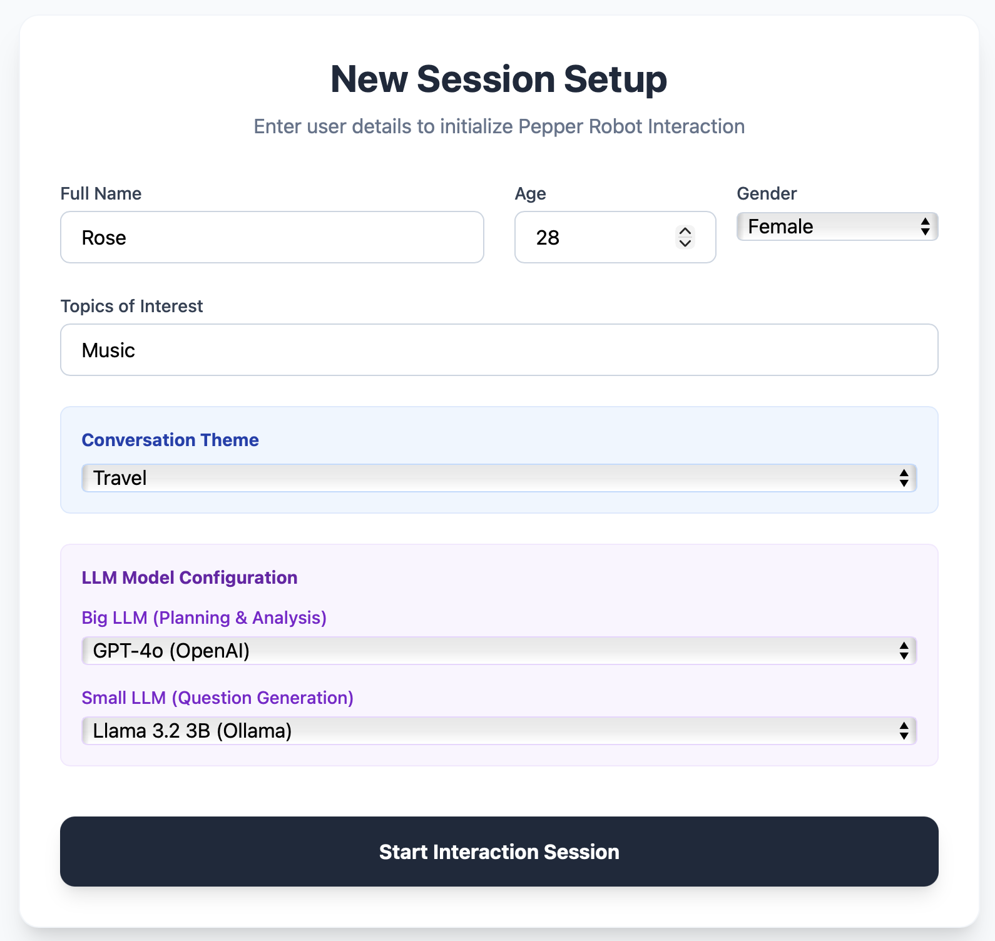
User Interface Pages

Slide 4
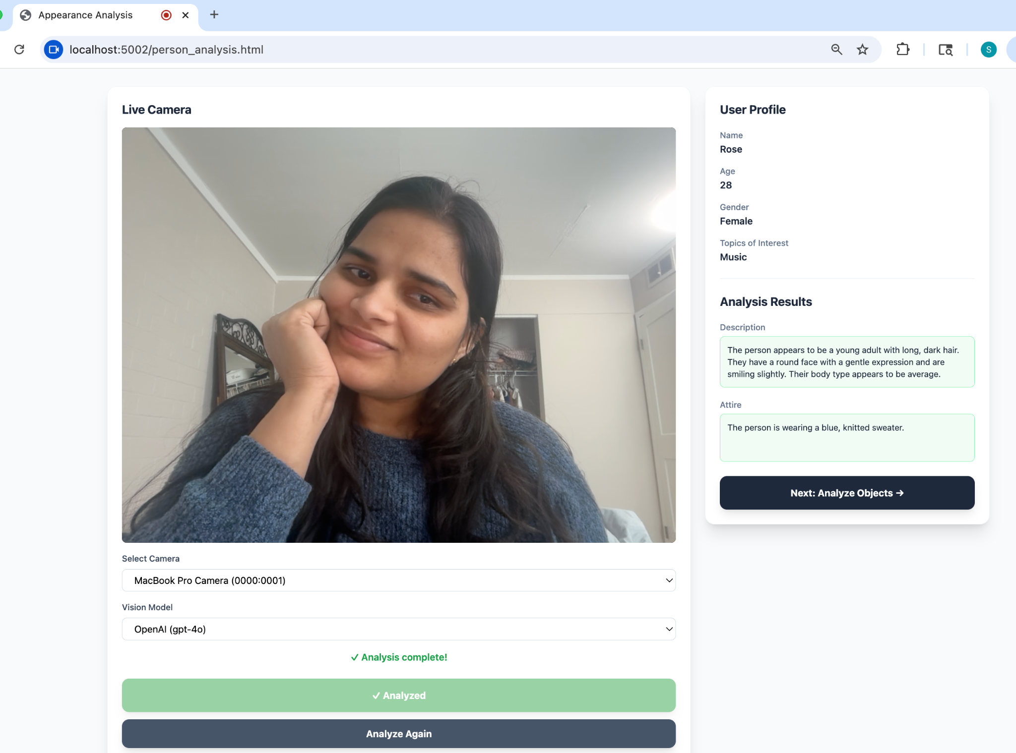
User Interface Pages

Slide 5
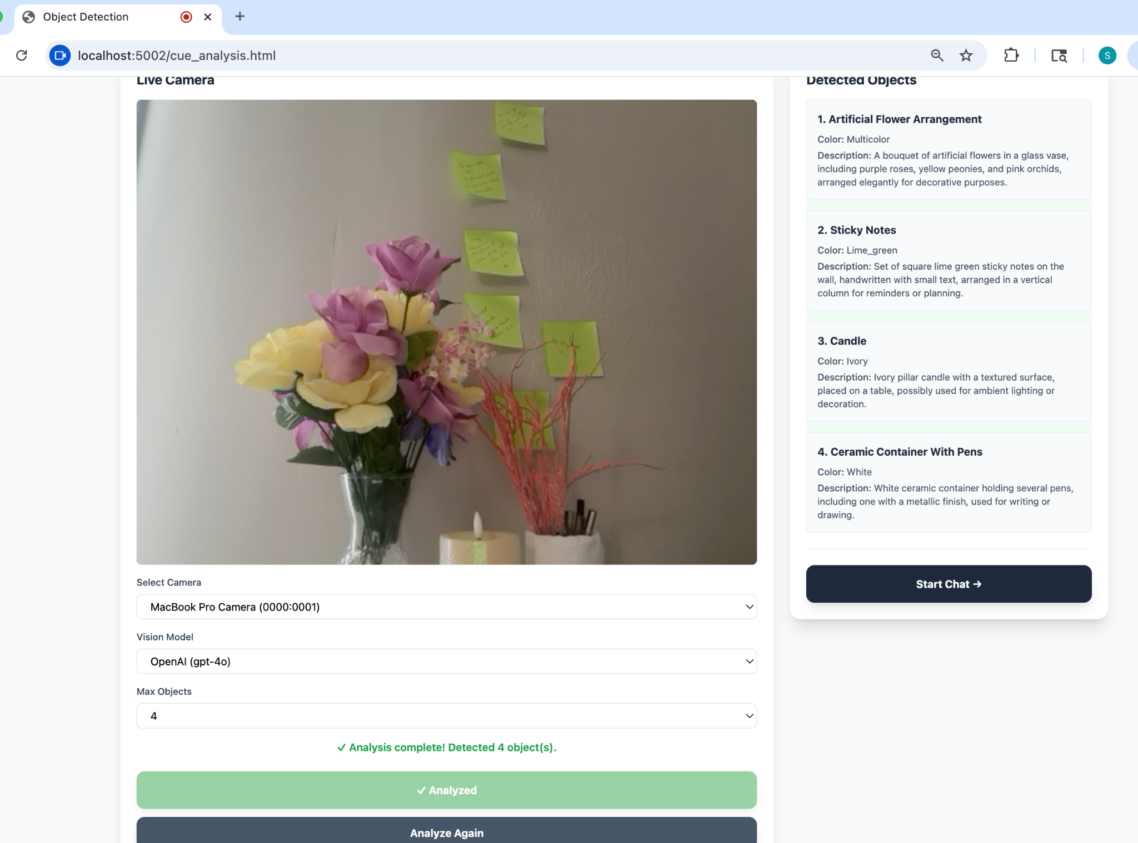
User Interface Pages

Slide 6
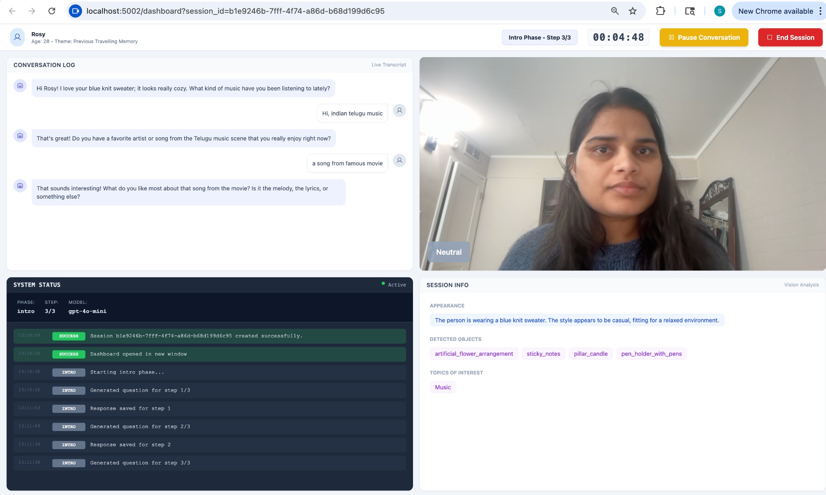
Main Dashboard and Conversation Page

Slide 7
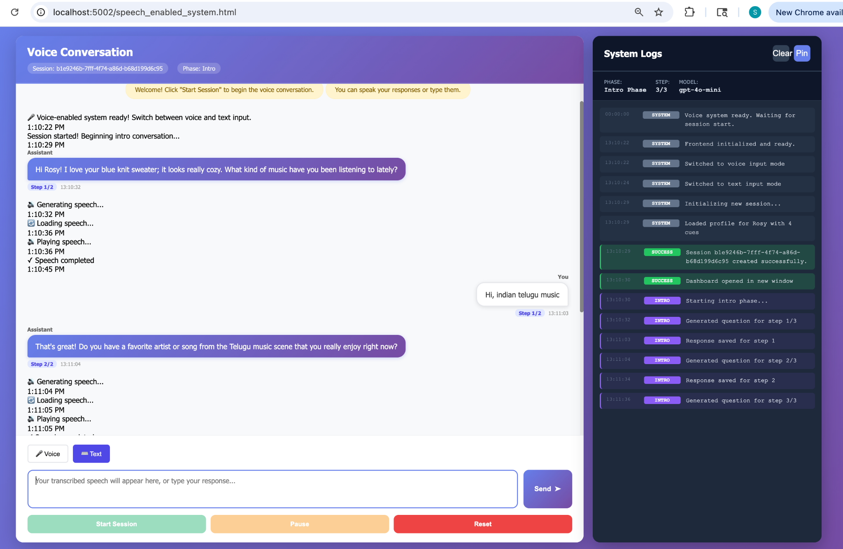
Main Dashboard and Conversation Page

Slide 8
Q&A？

