Slide 1
Automatic-Video Transcript Summarization with Pegasus: Extracting Insights From YouTube Content
Supervised By:
Dr. Sheikh Imran Hossain
Assistant Professor,
Department of Computer Science and Engineering
KUET
Presented By:
Raiyan Ashraf
1907023
Saugata Roy Arghya
1907116

Slide 2
CONTENTS
Introduction
Related Applications
Limitations
Significant Features
Tools
Gannt Chat
MVC Architecture
Use Case Diagram
UI Flow
Flow Diagram
Limitations and Future Works
References
Appendices
1/25

Slide 3
INTRODUCTION
A user friendly website that generates and stores summaries from the following sources:
YouTube Videos
Wikipedia Article
Large Text
2/25

Slide 4
RELATED APPLICATION
YouTubeTranscriptSummarizer[1]
VideoSum[2]
YouTube Video Summarizer[3]
Automatic-Youtube-Video-Summarizer[4]
Video-Summarizer-Front-End[5]
3/25

Slide 5
Why is our system different?
4/25

Slide 6
LIMITATIONS
Runs Models Locally
SOTA models (like T5, Pegasus) have word limit
UI is non-existent/not intuitive
Not free
Cannot save the summary in the database
5/25

Slide 7
Significant Features
Can Summarize Large Amount of Text, Long YouTube Video, Large Wikipedia Articles
Our site is secure with Authenticaiton
Database is used to save the link and summary of the content
Uses an API to summarize the content in the cloud
6/25

Slide 8
Significant Features
Can Summarize Large Amount of Text, Long YouTube Video, Large Wikipedia Articles
Our site is secure with Authenticaiton
Database is used to save the link and summary of the content
Uses an API to summarize the content in the cloud
6/25

Slide 9
Significant Features
Can Summarize Large Amount of Text, Long YouTube Video, Large Wikipedia Articles
Our site is secure with Authenticaiton
Database is used to save the link and summary of the content
Uses an API to summarize the content in the cloud
6/25

Slide 10
Significant Features
Can Summarize Large Amount of Text, Long YouTube Video, Large Wikipedia Articles
Our site is secure with Authenticaiton
Database is used to save the link and summary of the content
Uses an API to summarize the content in the cloud
6/25

Slide 11
TOOLS
Flask with MVC
Bootstrap
MySQL
Hugging Face Inference API
GitHub
7/25

Slide 12
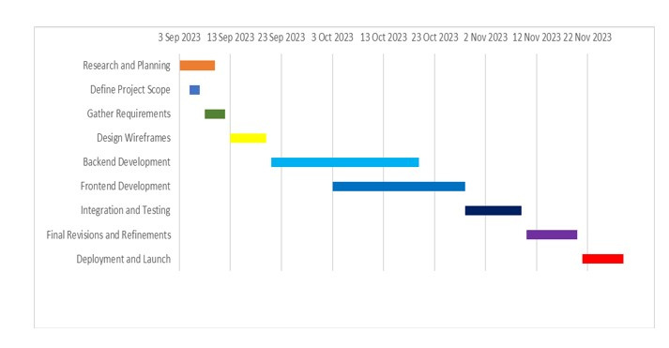
Gantt Chart
8/25

Slide 13
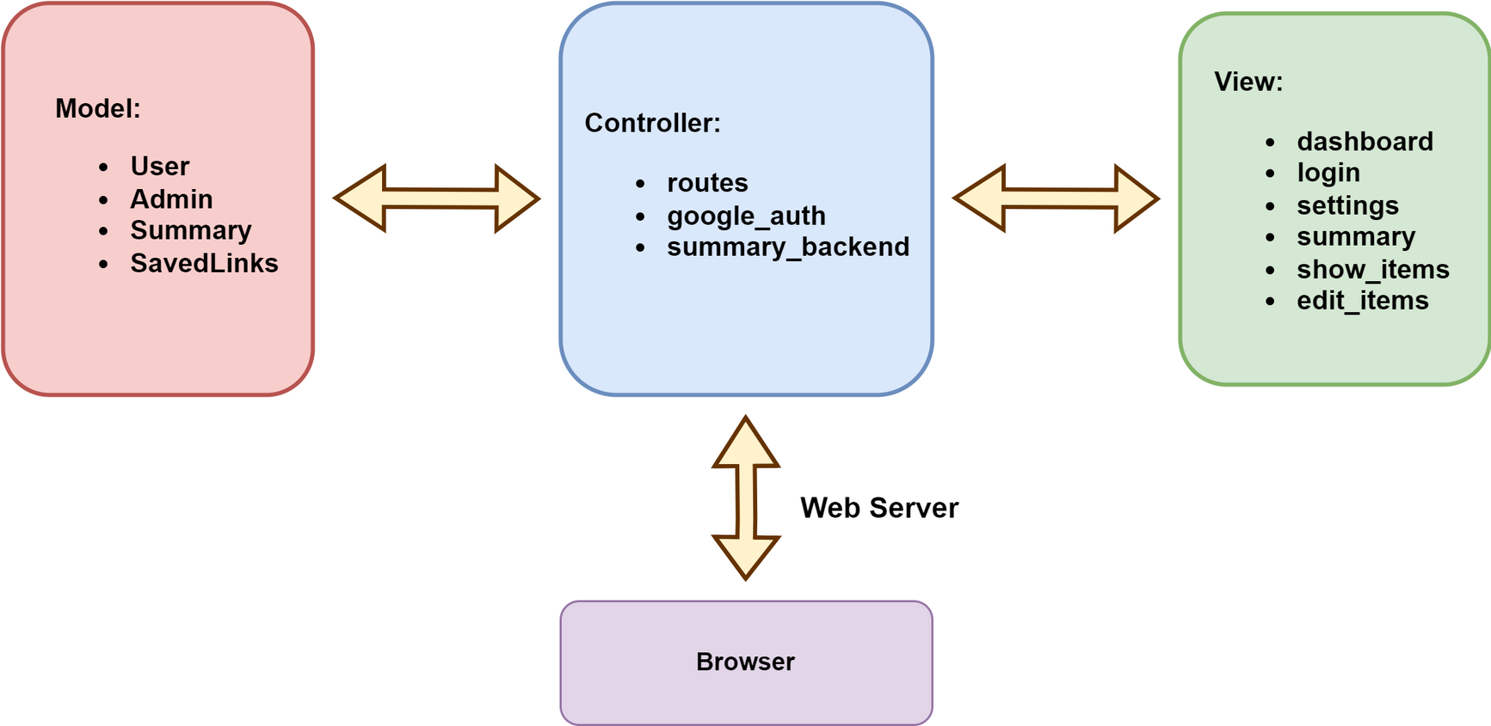
MVC ARCHITECTURE
9/25

Slide 14
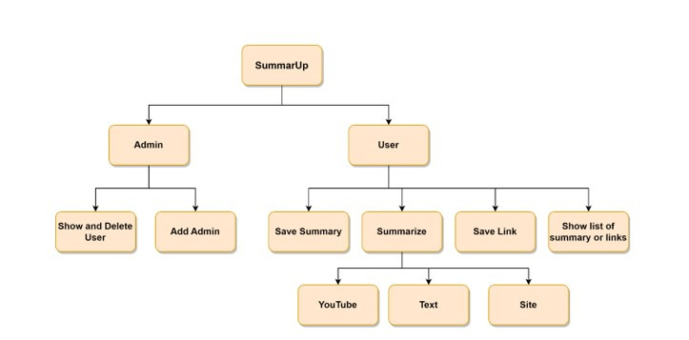
Use Case Diagram
10/25

Slide 15
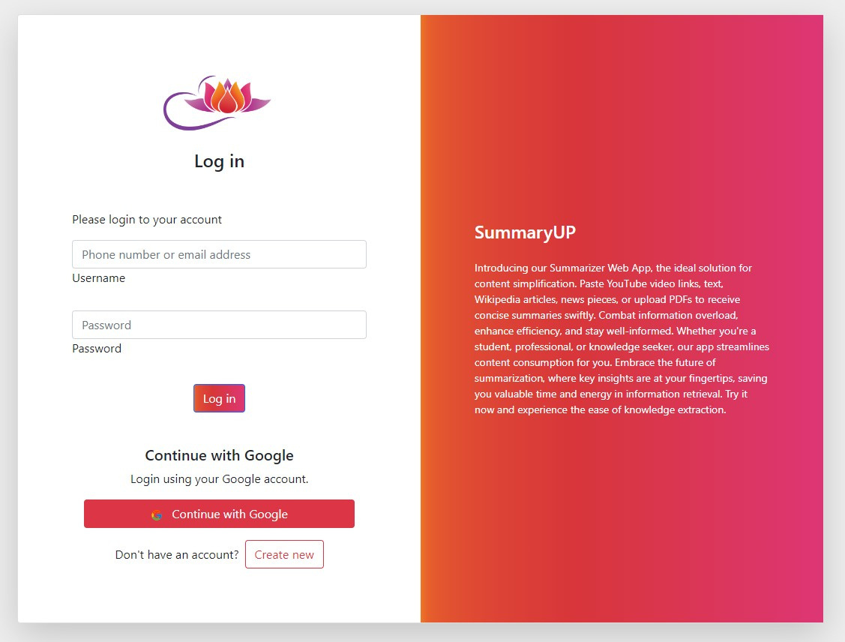
UI Flow
11/25

Slide 16

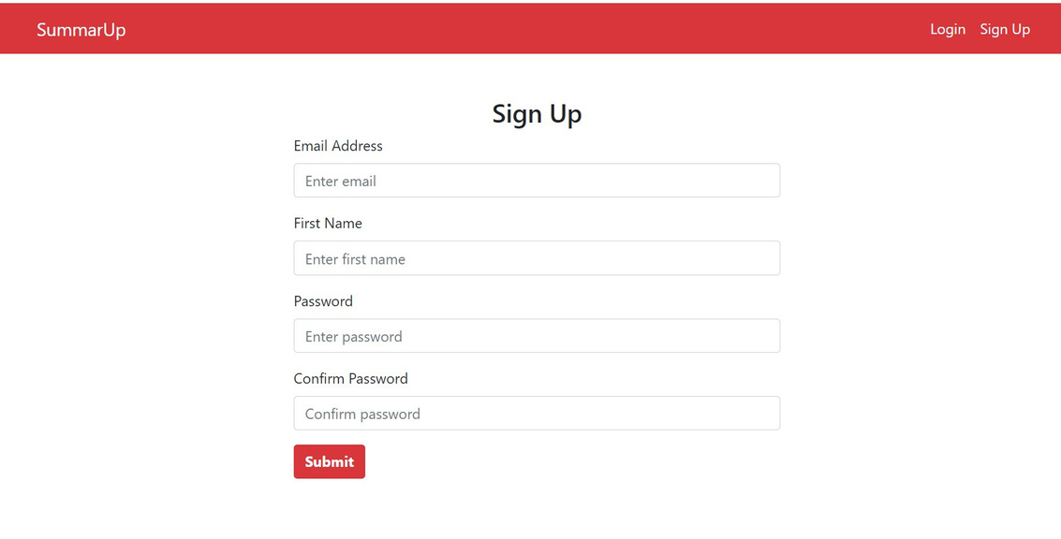
UI Flow(Cont’d)
12/25

Slide 17
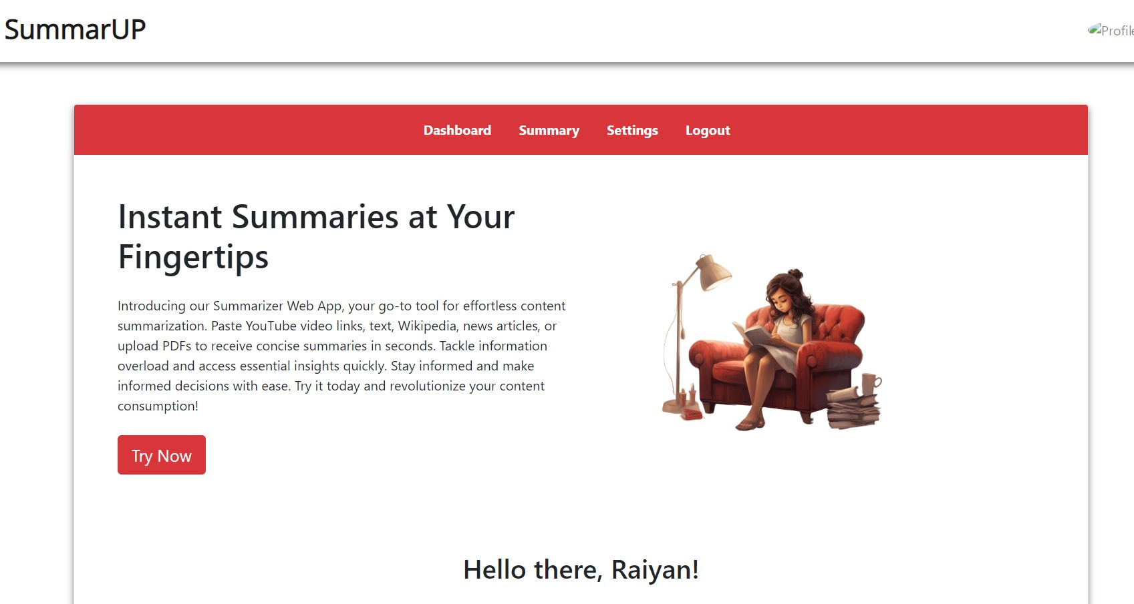
UI Flow(Cont’d)
13/25

Slide 18
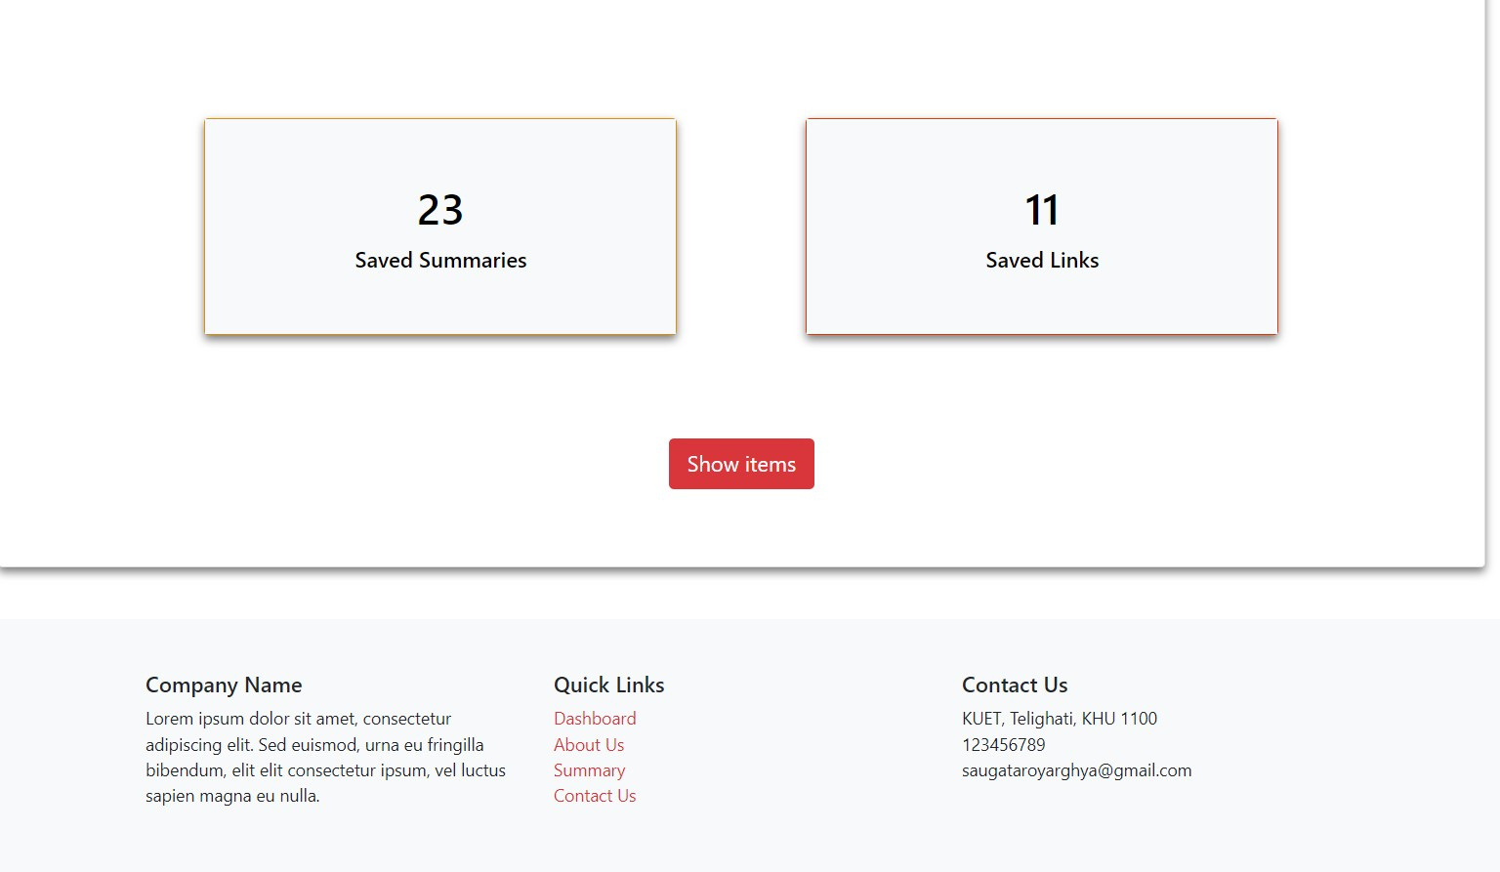
UI Flow(Cont’d)
14/25

Slide 19
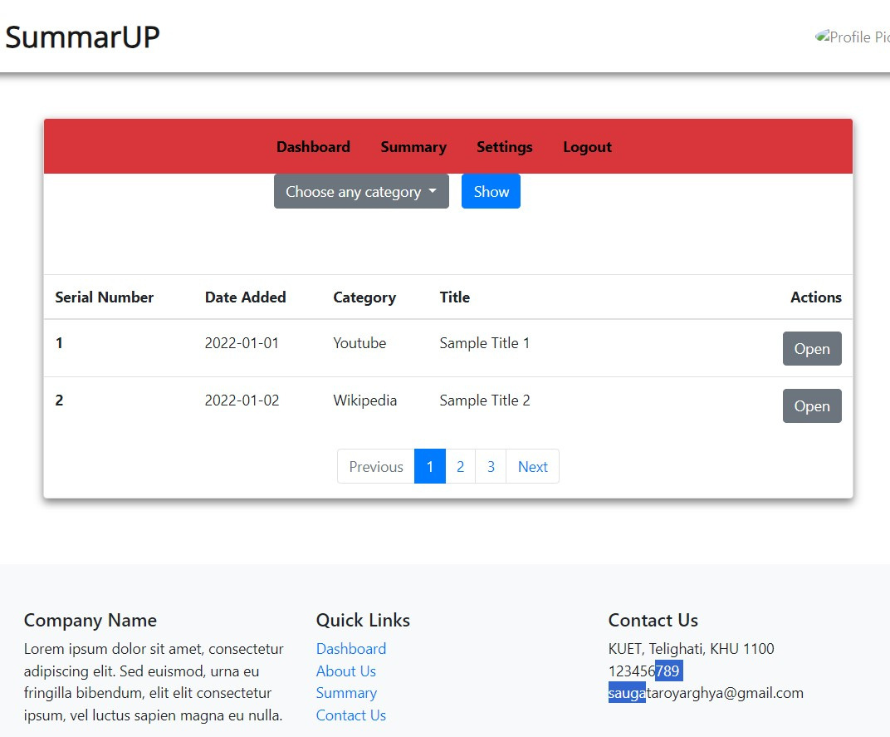
UI Flow(Cont’d)
15/25

Slide 20
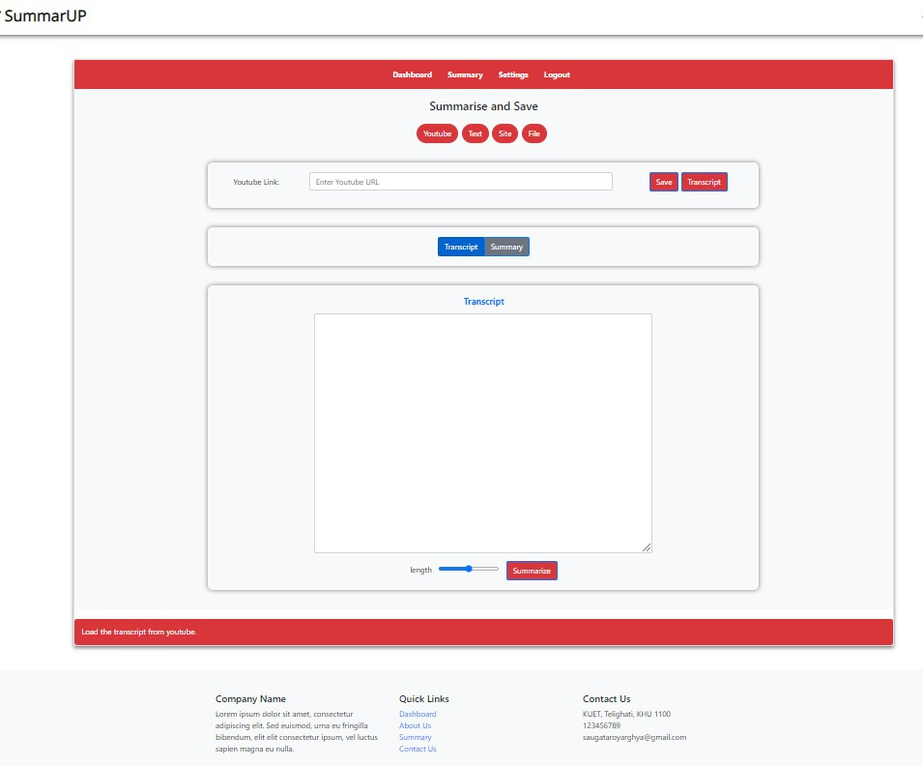
UI Flow(Cont’d)
16/25

Slide 21
UI Flow(Cont’d)
17/25

Slide 22
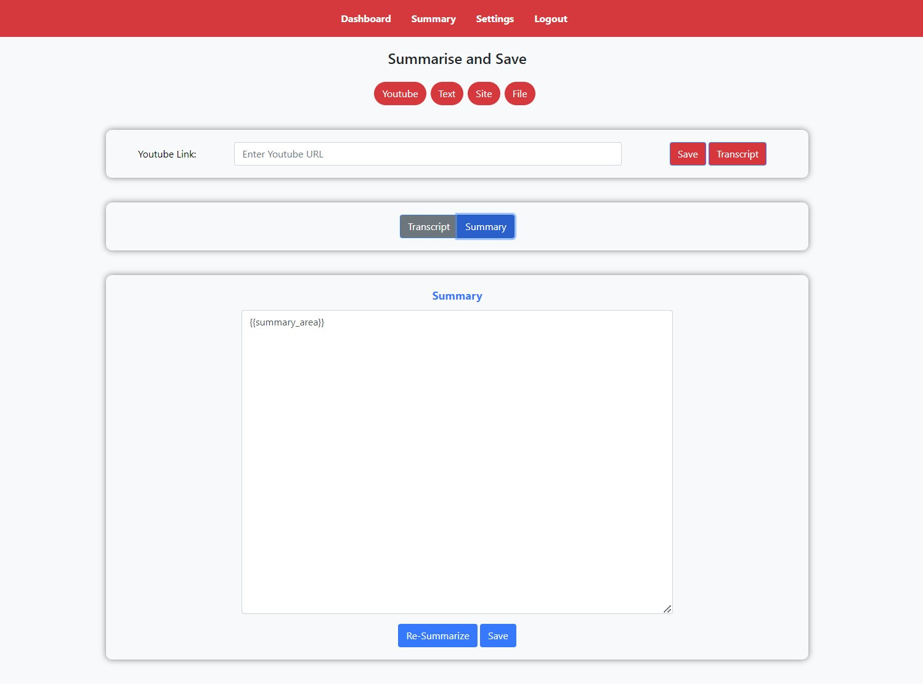
UI Flow(Cont’d)
18/25

Slide 23
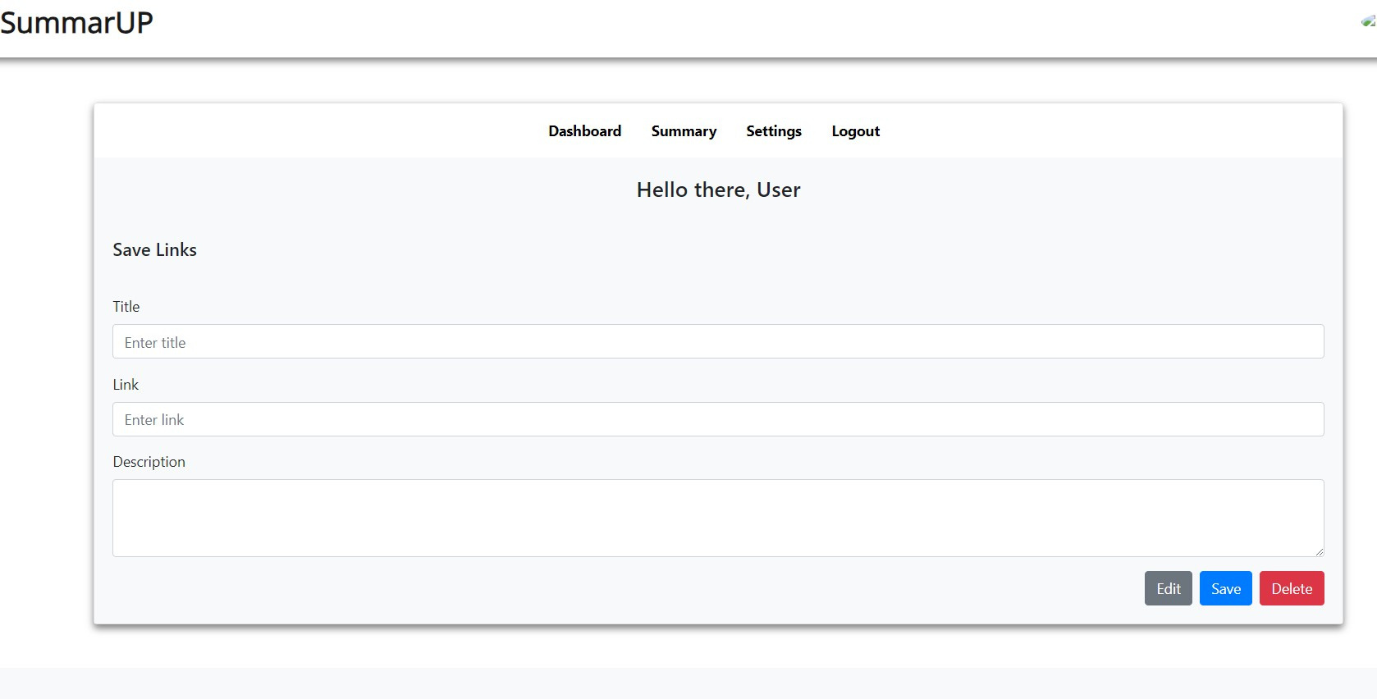
UI Flow(Cont’d)
19/25

Slide 24
UI Flow(Cont’d)
20/25

Slide 25
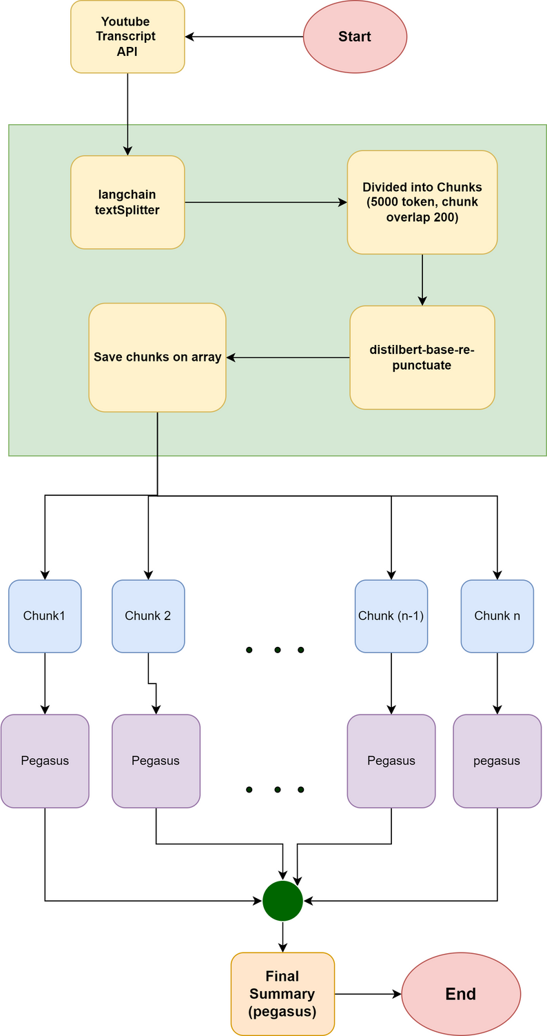
Flow Diagram
DATA RETRIEVAL
The backend retrieves text data from various sources such as YouTube videos,
documents, or user inputs.
PUNCTUATION AND CAPITALIZATION CORRECTION
The fetched data undergoes punctuation and capitalization correction using HuggingFace Inference API.
21/25

Slide 26
Flow Diagram(Cont’d
DATA RETRIEVAL
The backend retrieves text data from various sources such as YouTube videos,
documents, or user inputs.
PUNCTUATION AND CAPITALIZATION CORRECTION
The fetched data undergoes punctuation and capitalization correction using HuggingFace Inference API.
21/25

Slide 27
Flow Diagram(Cont’d)
CHUNKING WITH OVERLAPPING SENTENCES
The corrected text, considered large, undergoes chunking with overlapping sentences in each chunks.
HUGGING FACE INFERENCE API FOR PEGASUS
Utilizing the Hugging Face Inference API, the
sentence chunks are summarized with the help of PEGASUS model.
22/25

Slide 28
Flow Diagram(Cont’d)
CHUNKING WITH OVERLAPPING SENTENCES
The corrected text, considered large, undergoes chunking with overlapping sentences in each chunks.
HUGGING FACE INFERENCE API FOR PEGASUS
Utilizing the Hugging Face Inference API, the
sentence chunks are summarized with the help of PEGASUS model.
22/25

Slide 29
Flow Diagram
These individual summaries from overlapping chunks are combined and then, again, summaried using the PEGASUS model.
SUMMARIZATION WITH PEGASUS
SUMMARY OUTPUT
The result obtained from the last step is, then, presented as the final condensed summary.
23/25

Slide 30
Flow Diagram(Cont’d)
These individual summaries from overlapping chunks are combined and then, again, summaried using the PEGASUS model.
SUMMARIZATION WITH PEGASUS
SUMMARY OUTPUT
The result obtained from the last step is, then, presented as the final condensed summary.
23/25

Slide 31
Limitation and Future Work
Use Context-based Chunking
Create Browser Extension for easier access
Streamline the API I/O using Threading
Using the User Feedback to fine tune
24/25

Slide 32
References
https://github.com/neelam4/Youtube-Transcript-Summarizer. Accessed: November 28, 2023.
https://videosum.ai/. Accessed: November 28, 2023
https://github.com/adntgv/youtube-video-summarizer. Accessed: November 28, 2023
https://github.com/Soushi888/yt-videos-summarizer. Accessed: November 28, 2023
https://devpost.com/software/video-summarizer. Accessed: November 28, 2023
25/25

Slide 33
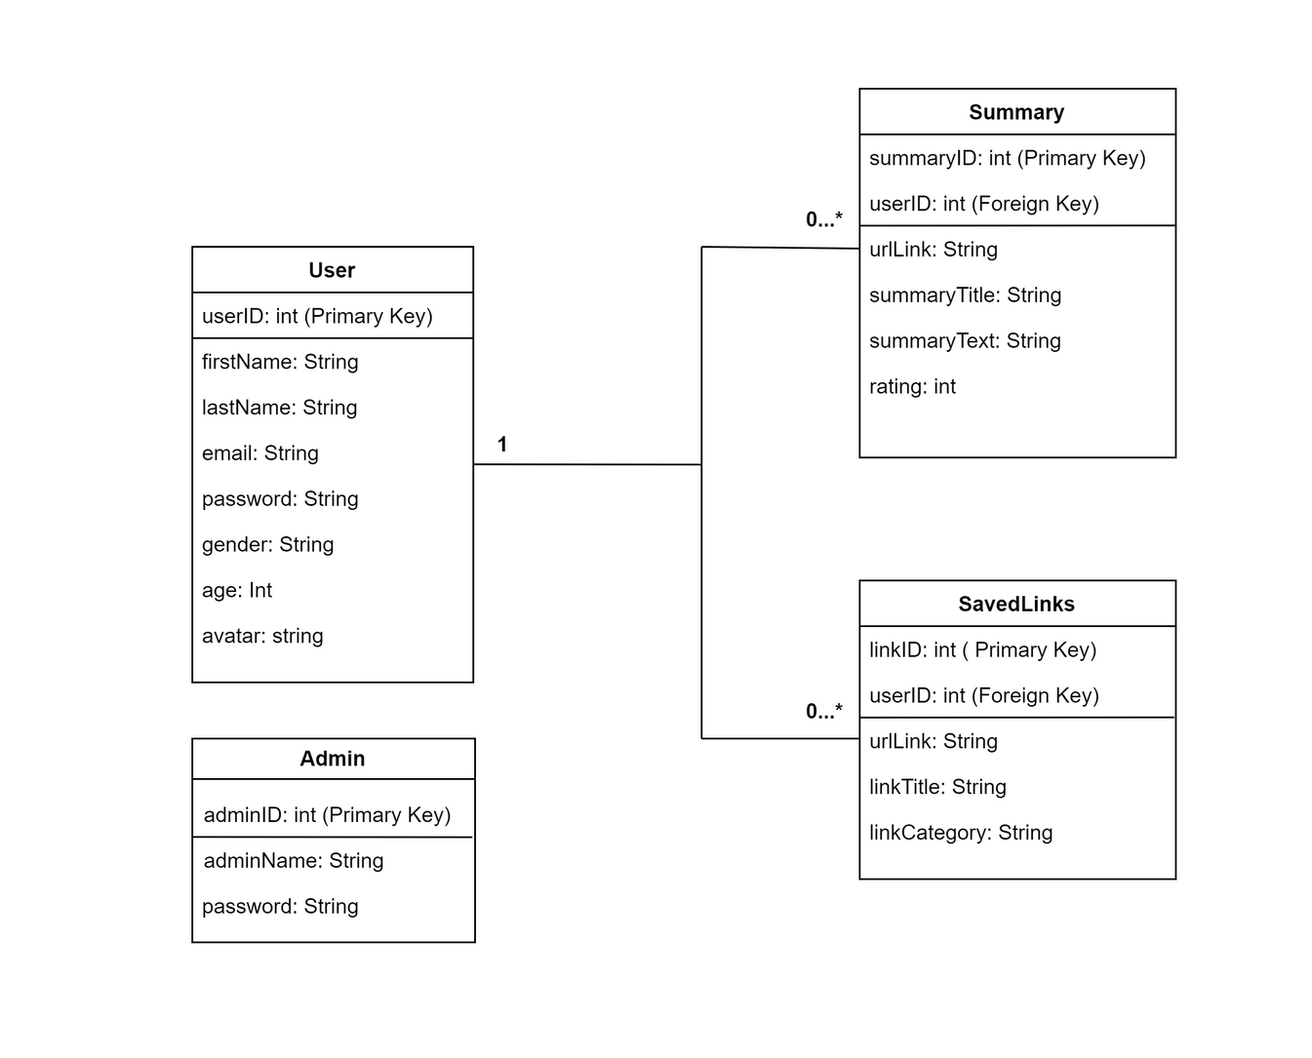
Appendices(Cont’d)
29

Slide 34
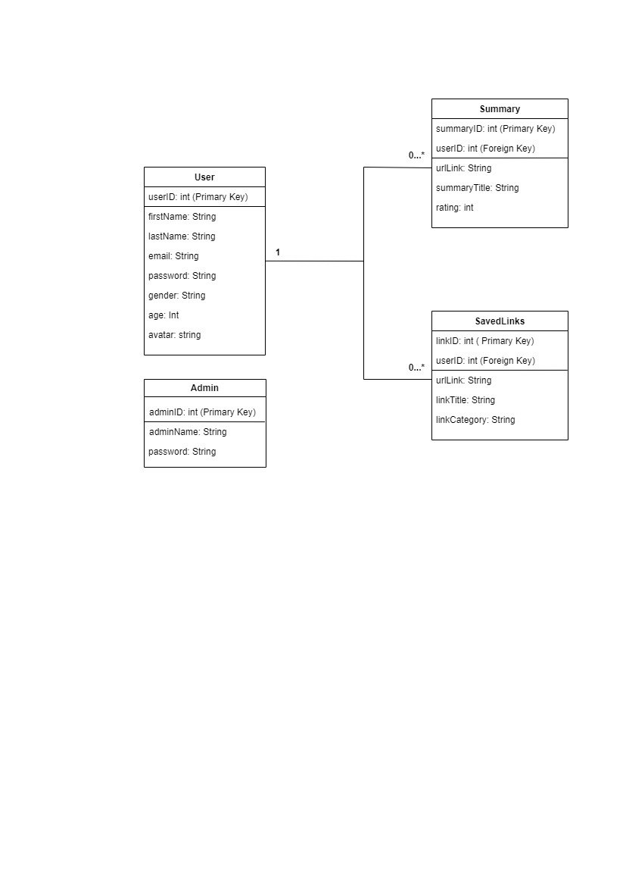
Appendices(Cont’d)
30

Slide 35
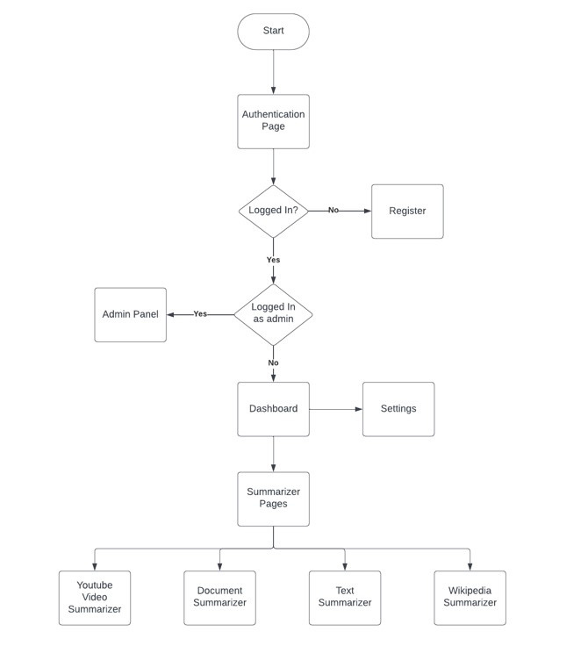
Appendices(Cont’d)
31

