Slide 1
CSE 4128 labtest
Instructors:
Dr. Sk. Md. Masudul Ahsan Professor,
Dept. of Computer Science and Engineering, KUET
Mr. Sunanda Das
Assistant Professor,
Dept. of Computer Science and Engineering, KUET

Slide 2
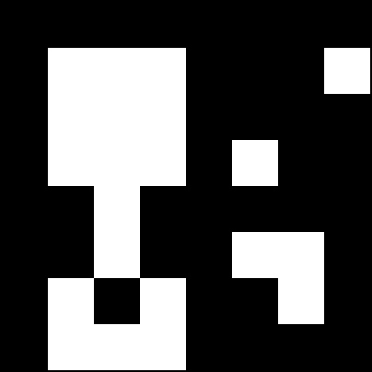
Problem 1
Use hit or miss transformation on the image and find object M.
Object M
Size: (50×50)
A B = (A Ɵ B₁ ) ∩ (A^{C} Ɵ B₂)
*

Slide 3
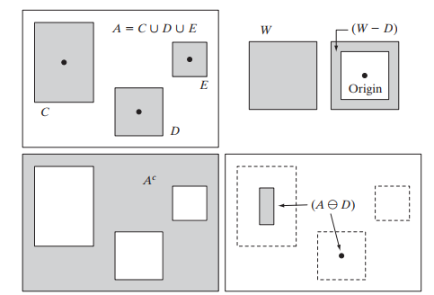
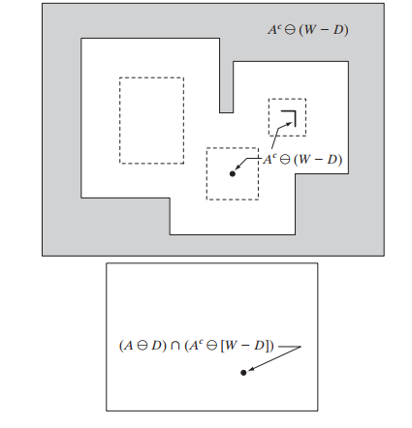


Supplementary material for problem 1
If B1 = D, B2 = (W - D) then

Slide 4
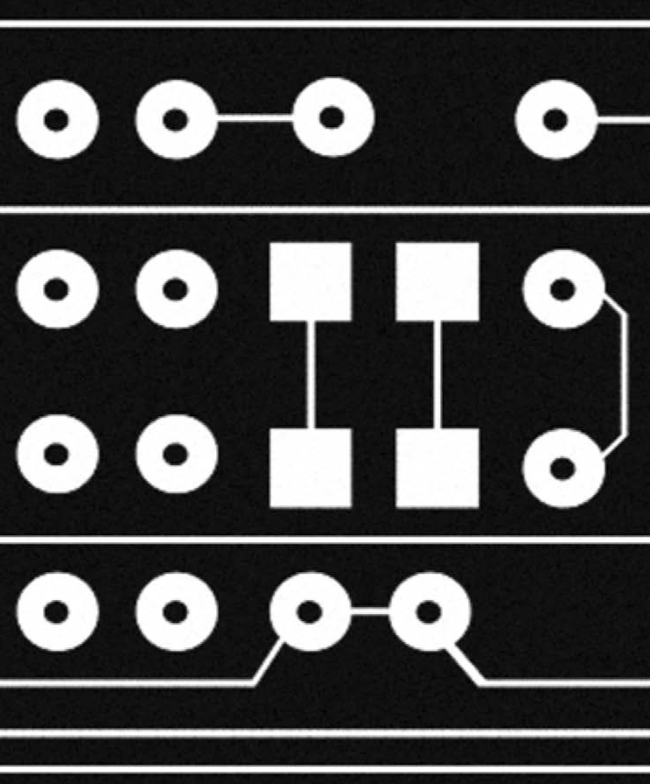

Problem 2
Fill up the hollow region using hole filling algorithm.

Slide 5
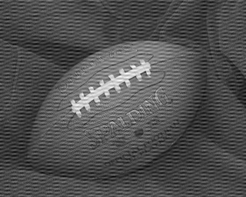
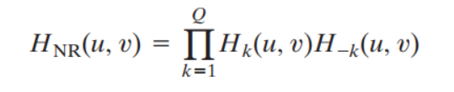
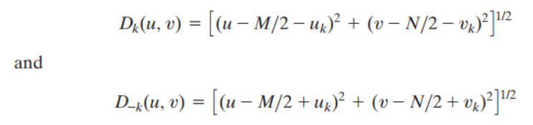
Problem 3
Remove the noise from the following image using ideal notch filter.
Supplementary material:

