Slide 1
Filtering in the Frequency Domain (Circulant Matrices and Convolution)
Digital Image Processing
Christophoros Nikou
cnikou@cs.uoi.gr

Slide 2
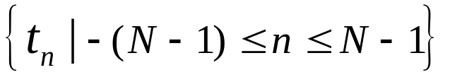
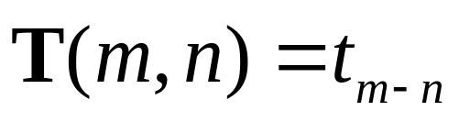
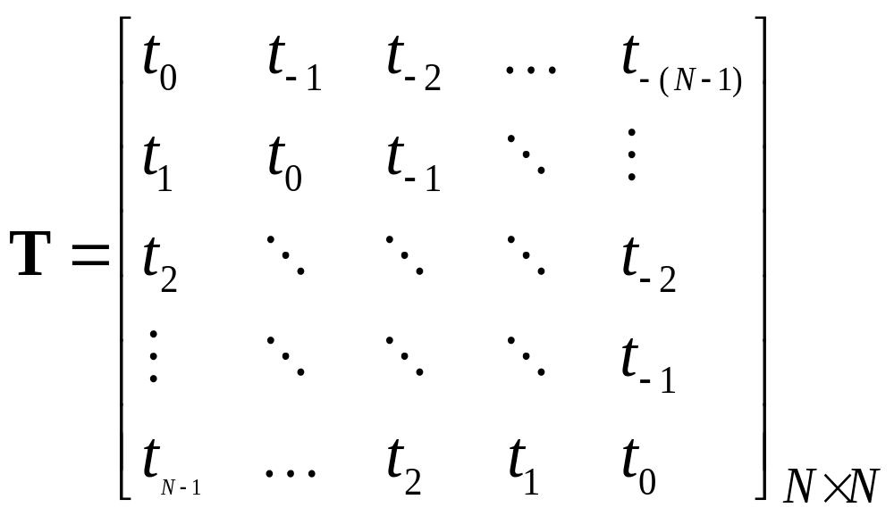
Toeplitz matrices
Elements with constant value along the main diagonal and sub-diagonals.
For a NxN matrix, its elements are determined by a (2N-1)-length sequence

Slide 3
Toeplitz matrices (cont.)
Each row (column) is generated by a shift of the previous row (column).
  The last element disappears.
  A new element appears.

Slide 4
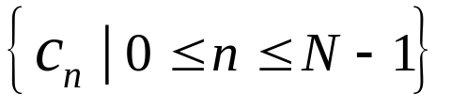
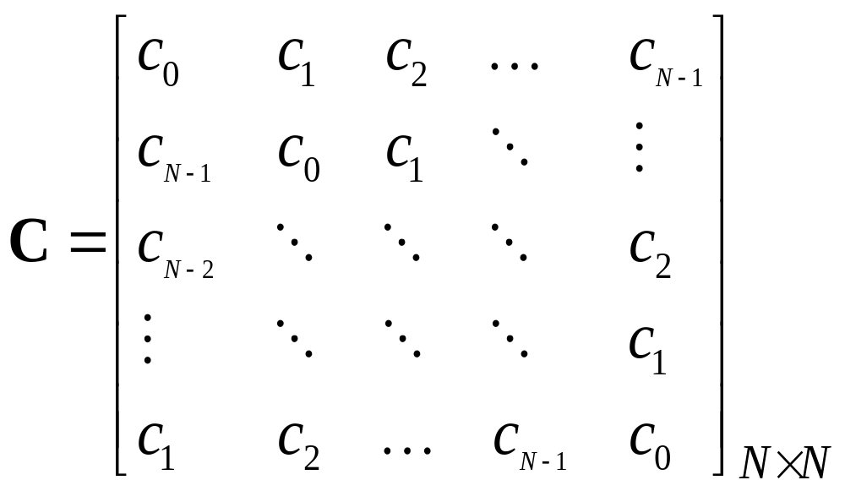
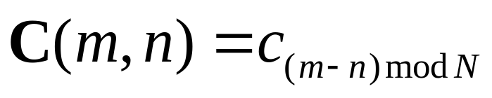
Circulant matrices
Elements with constant value along the main diagonal and sub-diagonals.
For a NxN matrix, its elements are determined by a N-length sequence

Slide 5
Circulant matrices (cont.)
Special case of a Toeplitz matrix.
Each row (column) is generated by a circular shift (modulo N) of the previous row (column).

Slide 6
Convolution by matrix-vector operations
1-D linear convolution between two discrete signals may be expressed as the product of a Toeplitz matrix constructed by the elements of one of the signals and a vector constructed by the elements of the other signal.
1-D circular convolution between two discrete signals may be expressed as the product of a circulant matrix constructed by the elements of one of the signals and a vector constructed by the elements of the other signal.
Extension to 2D signals.

Slide 7
1D linear convolution using Toeplitz matrices
The linear convolution g[n]=f [n]*h [n] will be of length N=N₁+N₂-1=3+2-1=4.
We create a Toeplitz matrix H from the elements of h [n] (zero-padded if needed) with
  N=4 lines (the length of the result).
  N₁=3 columns (the length of f [n]).
  The two signals may be interchanged.

Slide 8
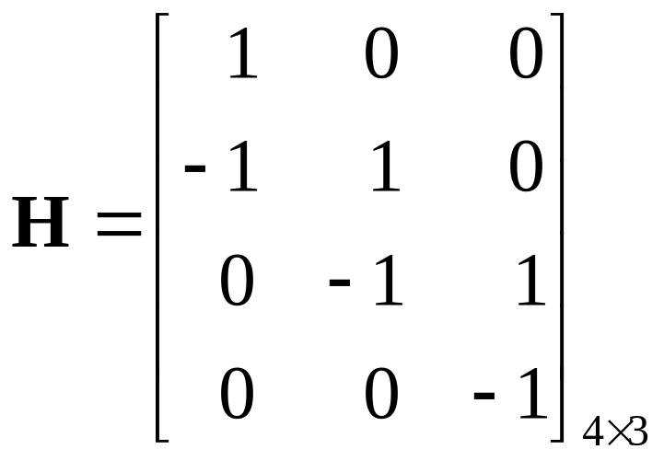
1D linear convolution using Toeplitz matrices (cont.)
Length of the result =4
Notice that H is not circulant (e.g. a -1 appears in the second line which is not present in the first line.
Length of f [n] = 3
Zero-padded h[n] in the first column

Slide 9
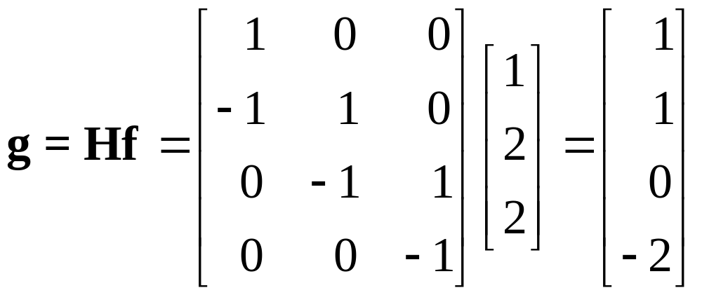
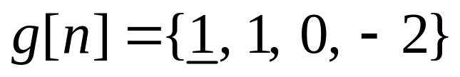
1D linear convolution using Toeplitz matrices (cont.)

Slide 10
1D circular convolution using circulant matrices
The circular convolution g[n]=f [n]h [n] will be of length N=max{N₁, N₂}=3.
We create a circulant matrix H from the elements of h [n] (zero-padded if needed) of size NxN.
  The two signals may be interchanged.

Slide 11
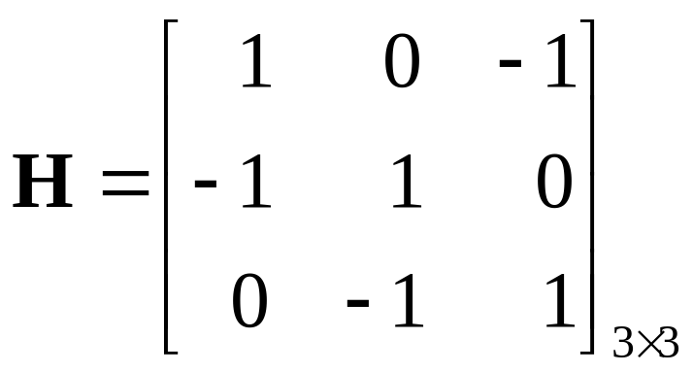
1D circular convolution using circulant matrices (cont.)
Zero-padded h[n] in the first column

Slide 12
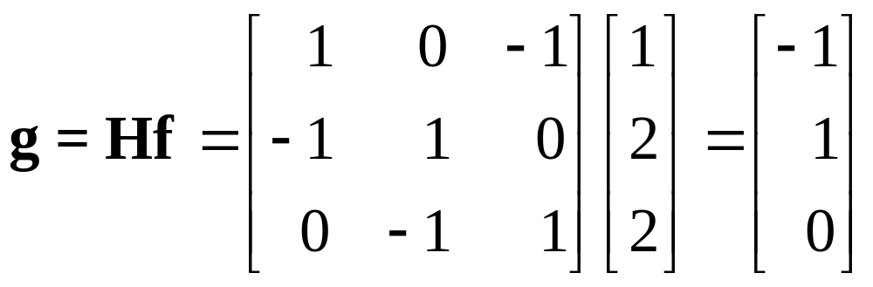
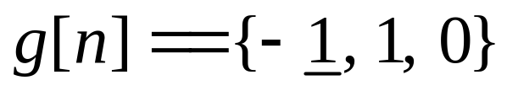
1D circular convolution using circulant matrices (cont.)

Slide 13
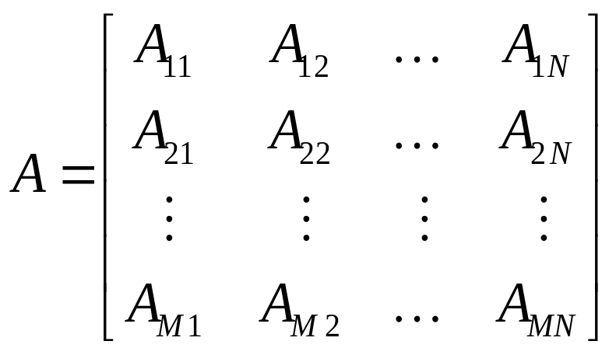
Block matrices
A_{ij} are matrices.
If the structure of A, with respect to its sub-matrices, is Toeplitz (circulant) then matrix A is called block-Toeplitz (block-circulant).
If each individual A_{ij} is also a Toeplitz (circulant) matrix then A is called doubly block-Toeplitz (doubly block-circulant).

Slide 14
2D linear convolution using doubly block Toeplitz matrices
m
m
1
4
1
1
1
2
5
3
1
-1
n
n
f [m,n]
h [m,n]
M₁=2, N₁=3
M₂=2, N₂=2
The result will be of size (M₁+M₂-1) x (N₁+N₂-1) = 3 x 4

Slide 15
2D linear convolution using doubly block Toeplitz matrices (cont.)
m
m
1
4
1
1
1
2
5
3
1
-1
n
n
f [m,n]
h [m,n]
At first, h[m,n] is zero-padded to 3 x 4 (the size of the result).
Then, for each row of h[m,n], a Toeplitz matrix with 3 columns (the number of columns of f [m,n]) is constructed.
m
0
0
0
0
1
1
0
0
1
-1
0
0
n
h[m,n]

Slide 16
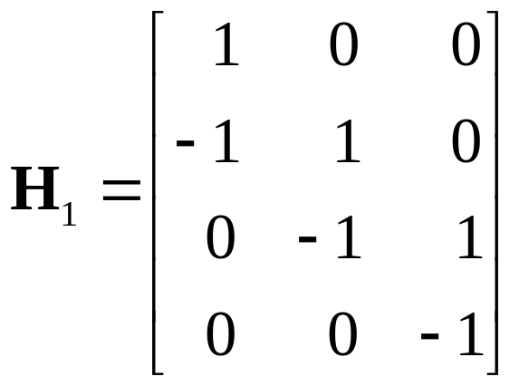
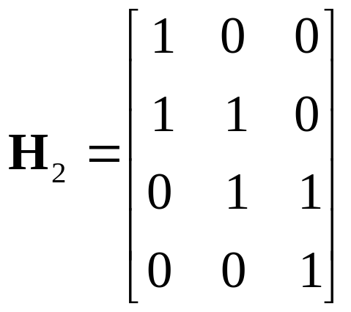
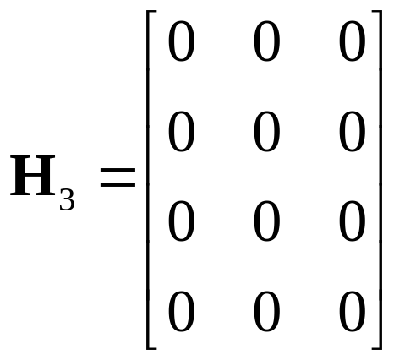
2D linear convolution using doubly block Toeplitz matrices (cont.)
m
For each row of h[m,n], a Toeplitz matrix with 3 columns (the number of columns of f [m,n]) is constructed.
0
0
0
0
1
1
0
0
1
-1
0
0
n
h[m,n]

Slide 17
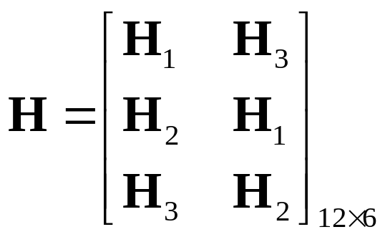
2D linear convolution using doubly block Toeplitz matrices (cont.)
m
m
1
4
1
1
1
2
5
3
1
-1
n
n
f [m,n]
h [m,n]
Using matrices H₁, H₂ and H₃ as elements, a doubly block Toeplitz matrix H is then constructed with 2 columns (the number of rows of f [m,n]).

Slide 18
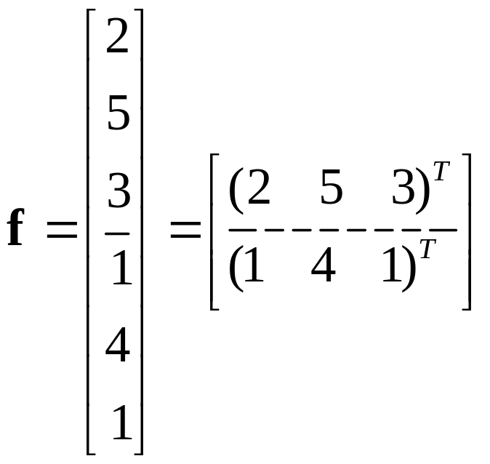
2D linear convolution using doubly block Toeplitz matrices (cont.)
m
m
1
4
1
1
1
2
5
3
1
-1
n
n
f [m,n]
h [m,n]
We now construct a vector from the elements of f [m,n].

Slide 19
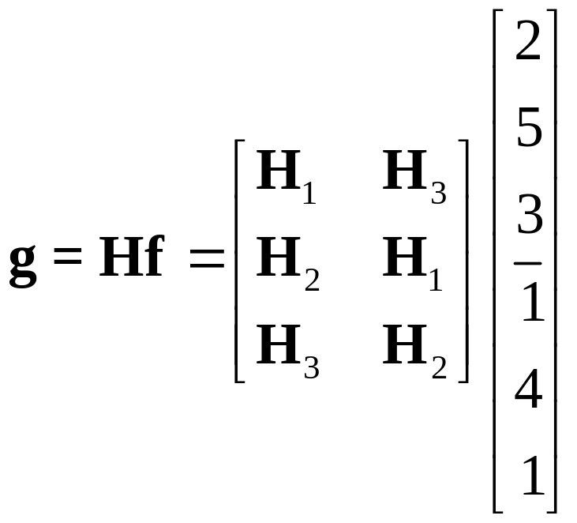
2D linear convolution using doubly block Toeplitz matrices (cont.)
m
m
1
4
1
1
1
2
5
3
1
-1
n
n
f [m,n]
h [m,n]

Slide 20
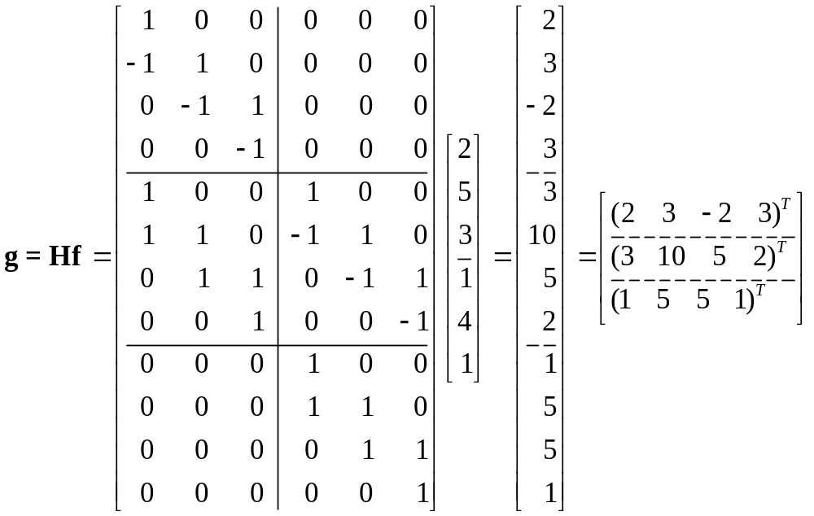
2D linear convolution using doubly block Toeplitz matrices (cont.)

Slide 21
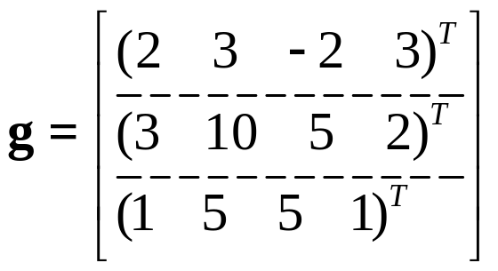
2D linear convolution using doubly block Toeplitz matrices (cont.)
m
m
1
4
1
*
1
1
2
5
3
1
-1
n
n
f [m,n]
h [m,n]
m
1
5
5
1
=
3
10
5
2
2
3
-2
3
n
g [m,n]

Slide 22
2D linear convolution using doubly block Toeplitz matrices (cont.)
Another example
m
m
3
4
1
2
1
-1
n
n
f [m,n]
h [m,n]
M₁=2, N₁=2
M₂=1, N₂=2
The result will be of size (M₁+M₂-1) x (N₁+N₂-1) = 2 x 3

Slide 23
2D linear convolution using doubly block Toeplitz matrices (cont.)
m
m
3
4
1
2
1
-1
n
n
f [m,n]
h [m,n]
At first, h[m,n] is zero-padded to 2 x 3 (the size of the result).
Then, for each line of h[m,n], a Toeplitz matrix with 2 columns (the number of columns of f [m,n]) is constructed.
m
0
0
0
1
-1
0
n
h[m,n]

Slide 24
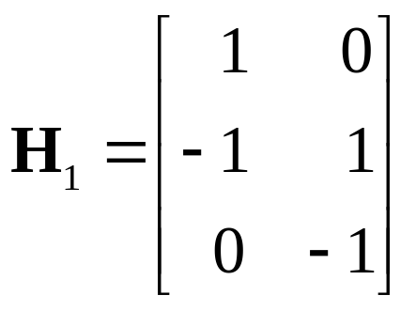
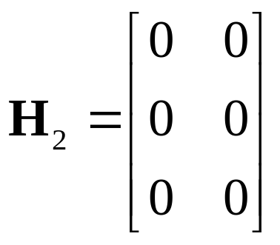
2D linear convolution using doubly block Toeplitz matrices (cont.)
For each row of h[m,n], a Toeplitz matrix with 2 columns (the number of columns of f [m,n]) is constructed.
m
0
0
0
1
-1
0
n
h[m,n]

Slide 25
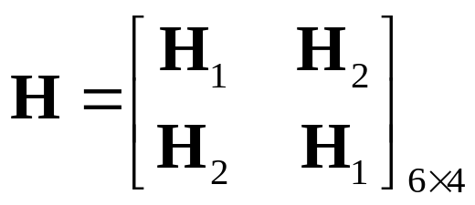
2D linear convolution using doubly block Toeplitz matrices (cont.)
m
m
3
4
1
2
1
-1
n
n
f [m,n]
h [m,n]
Using matrices H₁ and H₂ as elements, a doubly block Toeplitz matrix H is then constructed with 2 columns (the number of rows of f [m,n]).

Slide 26
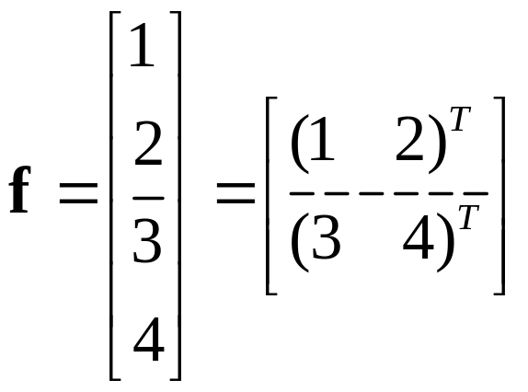
2D linear convolution using doubly block Toeplitz matrices (cont.)
m
m
3
4
1
2
1
-1
n
n
f [m,n]
h [m,n]
We now construct a vector from the elements of f [m,n].

Slide 27
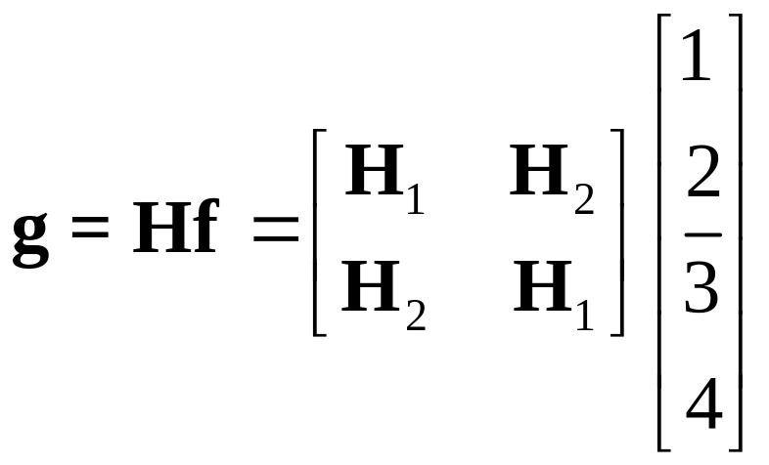
2D linear convolution using doubly block Toeplitz matrices (cont.)
m
m
3
4
1
2
1
-1
n
n
f [m,n]
h [m,n]

Slide 28
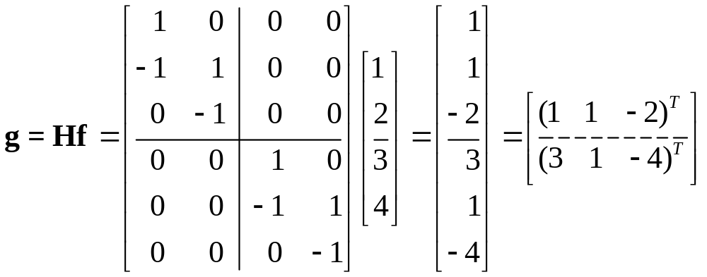
2D linear convolution using doubly block Toeplitz matrices (cont.)

Slide 29
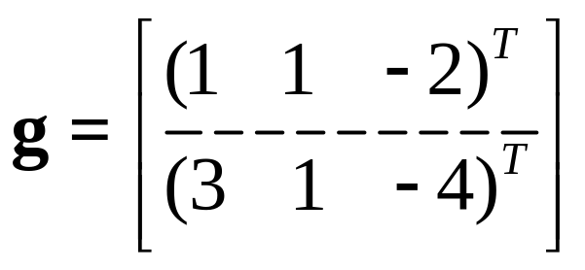
2D linear convolution using doubly block Toeplitz matrices (cont.)
m
m
3
4
*
1
2
1
-1
n
n
f [m,n]
h [m,n]
m
=
3
1
4
1
1
-2
n
g [m,n]

Slide 30
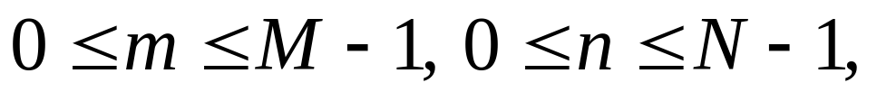
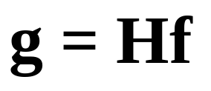
2D circular convolution using doubly block circulant matrices
The circular convolution g[m,n]=f [m,n]h [m,n]
with
may be expressed in matrix-vector form as:
where H is a doubly block circulant matrix generated by h [m,n] and f is a vectorized form of f [m,n].

Slide 31
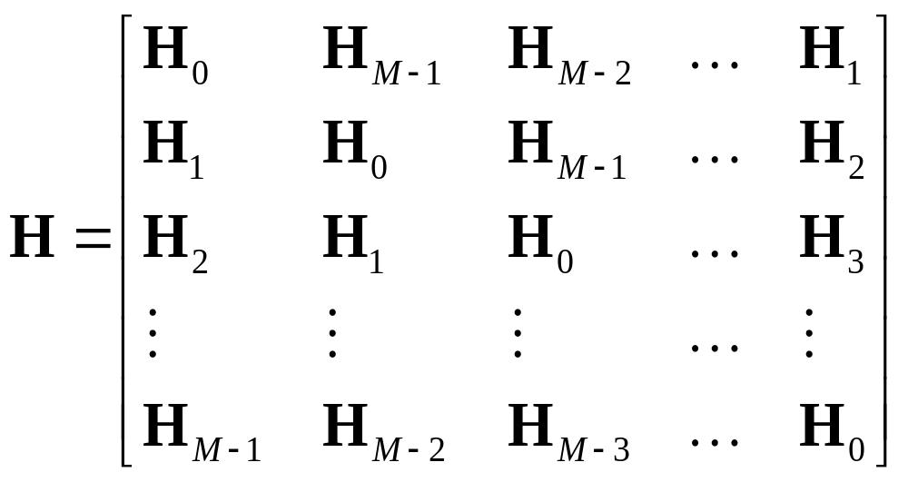
2D circular convolution using doubly block circulant matrices (cont.)
Each H_{j}, for j=1,..M, is a circulant matrix with N columns (the number of columns of f [m,n]) generated from the elements of the j-th row of h [m,n].

Slide 32
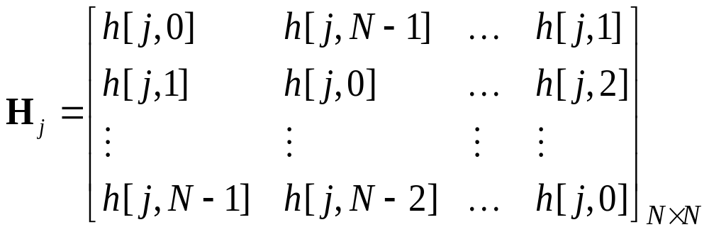
2D circular convolution using doubly block circulant matrices (cont.)
Each H_{j}, for j=1,..M, is a NxN circulant matrix generated from the elements of the j-th row of h [m,n].

Slide 33
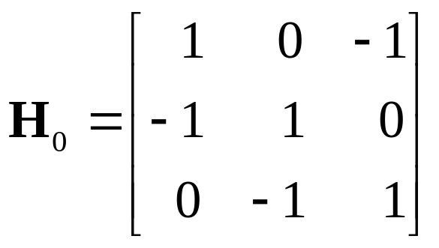
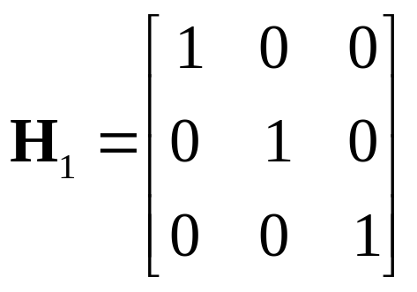
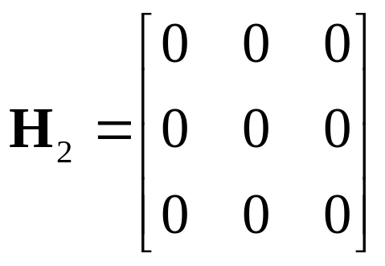
2D circular convolution using doubly block circulant matrices (cont.)
m
m
0
1
0
0
0
0
1
3
-1
✪
1
0
0
1
2
1
1
-1
0
n
n
f [m,n]
h [m,n]

Slide 34
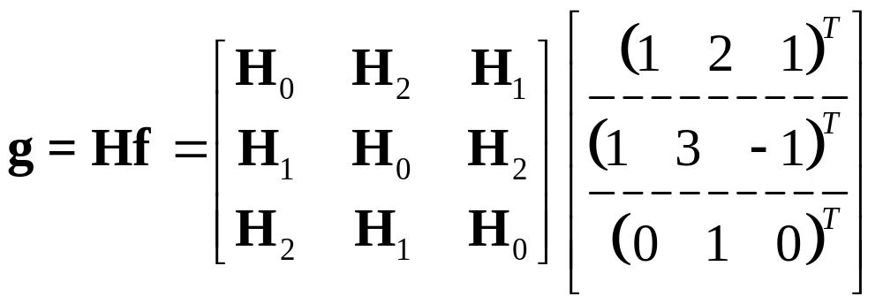
2D circular convolution using doubly block circulant matrices (cont.)
m
m
0
1
0
0
0
0
1
3
-1
✪
1
0
0
1
2
1
1
-1
0
n
n
f [m,n]
h [m,n]

Slide 35
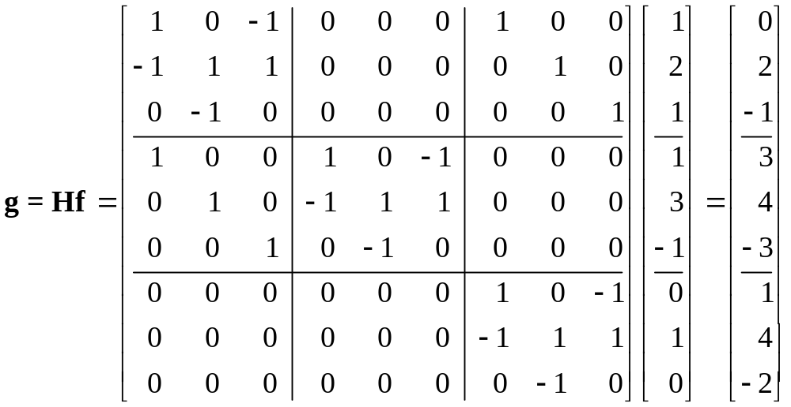
2D circular convolution using doubly block circulant matrices (cont.)

Slide 36
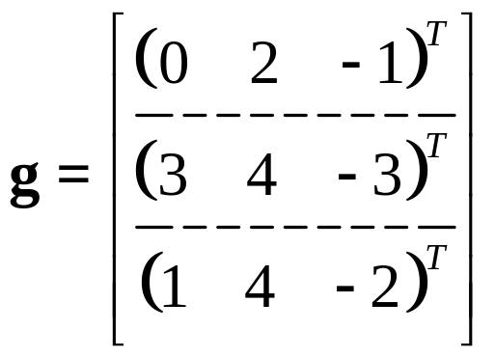
2D circular convolution using doubly block circulant matrices (cont.)
m
m
0
0
0
0
1
0
✪
1
0
0
1
3
-1
1
-1
0
1
2
1
n
n
h [m,n]
f [m,n]
m
=
1
4
-2
3
4
-3
0
2
-1
n
g [m,n]

Slide 37
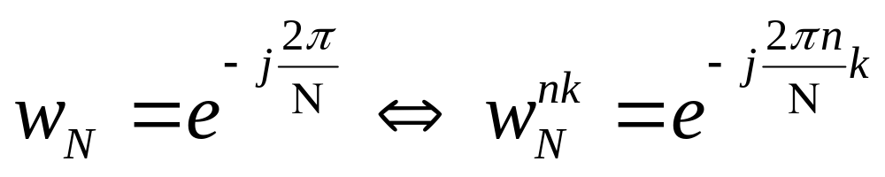
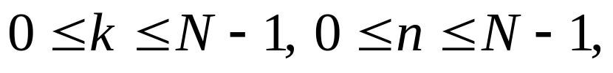
Diagonalization of circulant matrices
Theorem: The columns of the inverse DFT matrix are eigenvectors of any circulant matrix. The corresponding eigenvalues are the DFT values of the signal generating the circulant matrix.
Proof: Let
be the DFT basis elements of length N with:

Slide 38

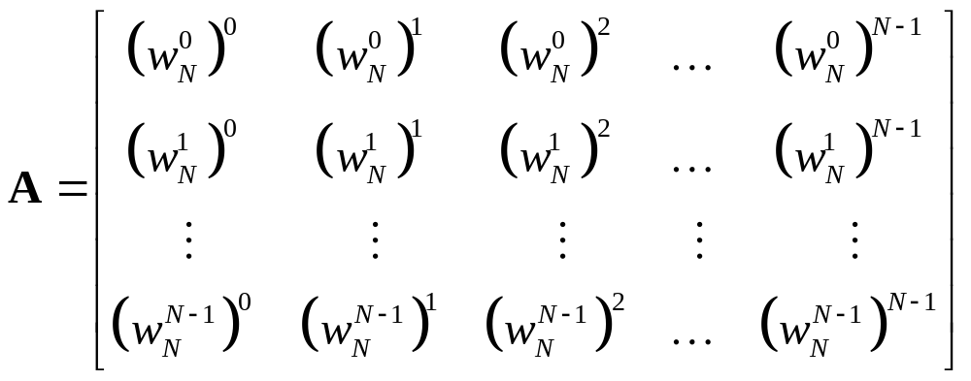
Diagonalization of circulant matrices (cont.)
We know that the DFT F [k] of a 1D signal f [n]
may be expressed in matrix-vector form:
where

Slide 39

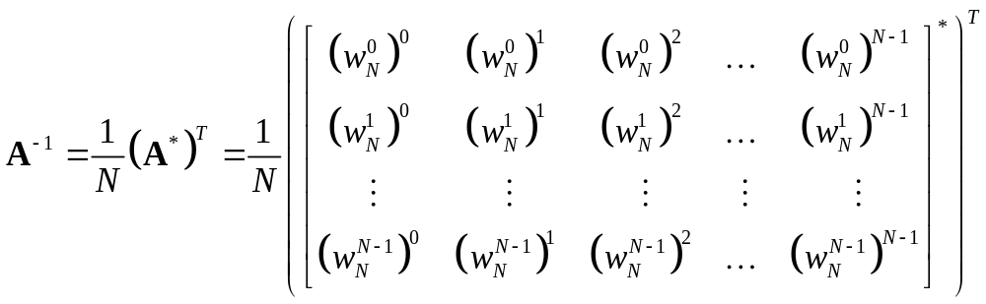
Diagonalization of circulant matrices (cont.)
The inverse DFT is then expressed by:
where
The theorem implies that any circulant matrix has eigenvectors the columns of A⁻¹.

Slide 40
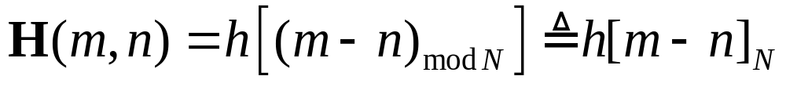
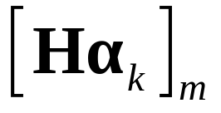
Diagonalization of circulant matrices (cont.)
Let H be a NxN circulant matrix generated by the 1D N-length signal h[n], that is:
Let also α_{k} be the k-th column of the inverse DFT matrix A⁻¹.
We will prove that α_{k}, for any k, is an eigenvector of H.
The m-th element of the vector Hα_{k}, denoted by
is the result of the circular convolution of the signal h[n] with α_{k}.

Slide 41
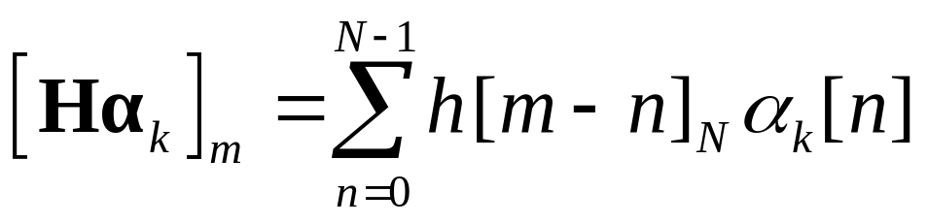
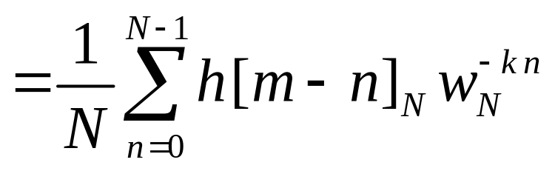
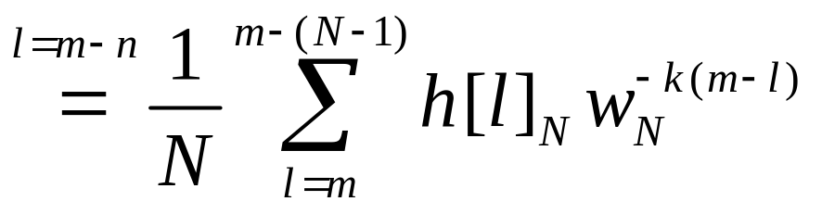
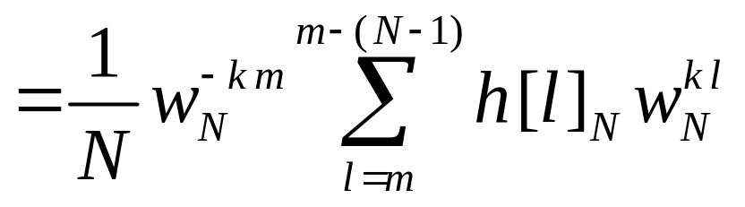
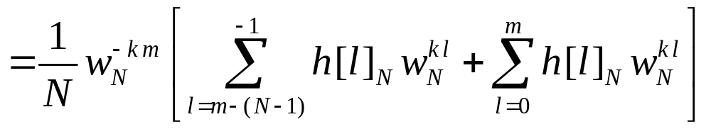
Diagonalization of circulant matrices (cont.)
We will break it into two parts

Slide 42
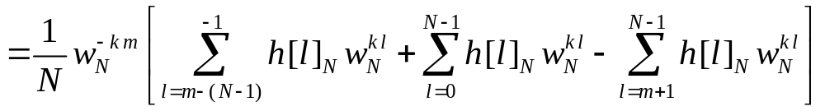



Diagonalization of circulant matrices (cont.)
Periodic with respect to N.

Slide 43



Diagonalization of circulant matrices (cont.)
DFT of h[n] at k.
This holds for any value of m. Therefore:
which means that α_{k}, for any k, is an eigenvector of H with corresponding eigenvalue the k-th element of H[k], the DFT of the signal generating H .

Slide 44



Diagonalization of circulant matrices (cont.)
The above expression may be written in terms of the inverse DFT matrix:
or equivalently:
Based on this diagonalization, we can prove the property between circular convolution and DFT.

Slide 45





Diagonalization of circulant matrices (cont.)
DFT of g[n]
DFT of h [n]
DFT of f [n]

Slide 46


Diagonalization of doubly block circulant matrices
These properties may be generalized in 2D.
We need to define the Kronecker product:

Slide 47


Diagonalization of doubly block circulant matrices (cont.)
The 2D signal f [m,n],
may be vectorized in lexicographic ordering (stacking one column after the other) to a vector:
The DFT of f [m,n], may be obtained in matrix-vector form:

Slide 48


Diagonalization of doubly block circulant matrices (cont.)
Theorem: The columns of the inverse 2D DFT matrix
are eigenvectors of any doubly block circulant matrix. The corresponding eigenvalues are the 2D DFT values of the 2D signal generating the doubly block circulant matrix:
Diagonal, containing the 2D DFT of h[m,n] generating H
Doubly block circulant

