Slide 1


Thesis Defense 14 Oct
DEPARTMENT OF COMPUTER SCIENCE & ENGINEERING · UTTARA UNIVERSITY
UNCERTAINTY ESTIMATION AND CONFIDENCE CALIBRATION IN UNIMOD FOR MULTIMODAL MEDICAL DIAGNOSIS
An empirical investigation of post processing confidence calibration and uncertainty reliability for multimodal clinical diagnostic systems.
PRESENTED BY
PRESENTED BY
PRESENTED BY
SUPERVISED BY
Raian Mahadi
Mehrab Hasan Badhon
Mamun Shake
Mohsin Hossain
ID: 2233081266
ID: 2233081271
ID: 2233081255
Lecturer, Dept. of CSE
[Program, e.g. B.Sc. in CSE]
[Program, e.g. B.Sc. in CSE]
[Program, e.g. B.Sc. in CSE]
Notes:
Welcome the committee, introduce yourself and the thesis title.

Slide 2
PRESENTATION OUTLINE
What We'll Cover
01
Introduction & Motivation
02
Problem Statement
03
Research Objectives
04
Literature Review
05
Methodology
06
System Design
07
Implementation
08
Results & Analysis
09
Comparison & Discussion
10
Conclusion & Future Work
Department of CSE · Uttara University
02 / 15
Notes:
Walk through the outline in one breath, don't linger.

Slide 3
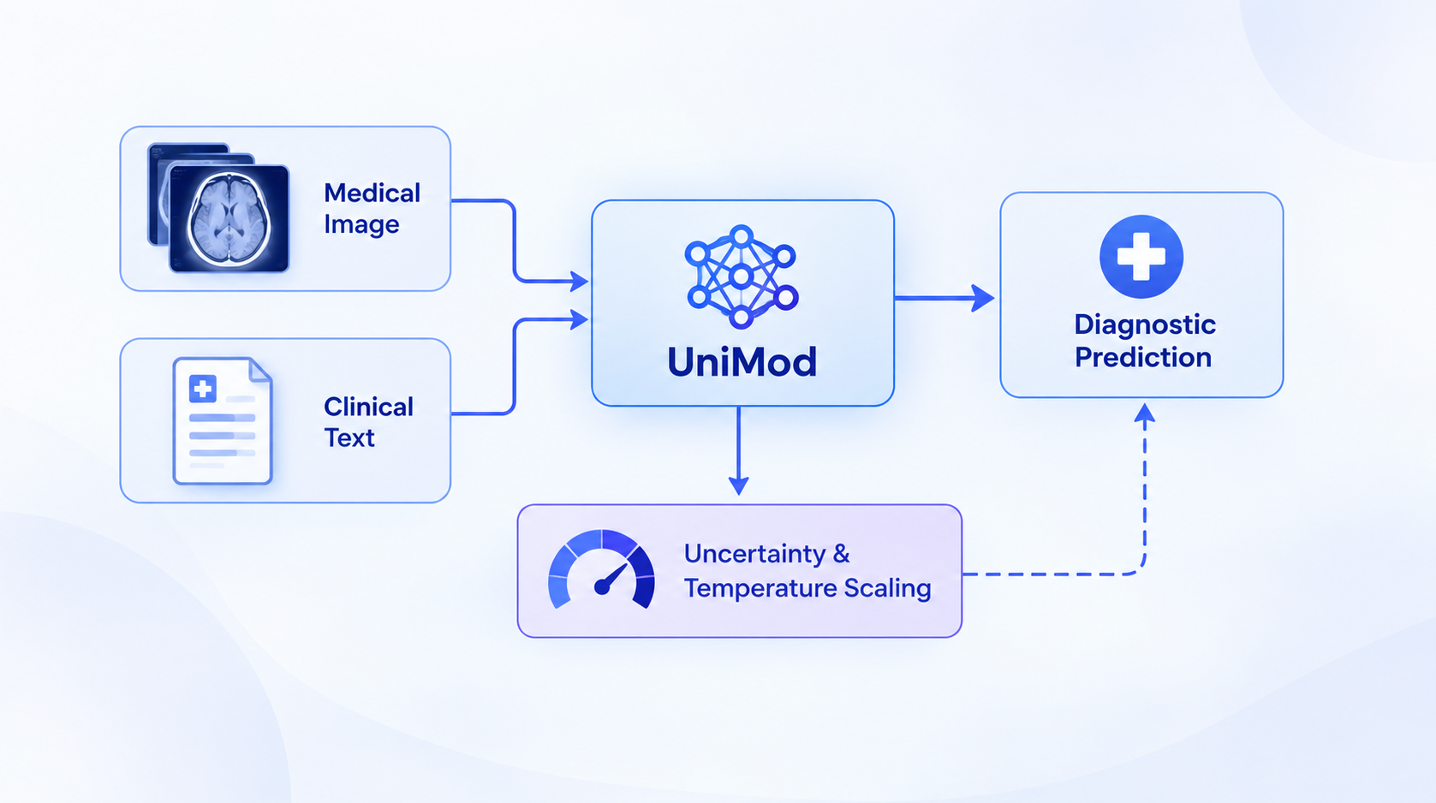
01 — INTRODUCTION
Introduction & Background
Operating within modern healthcare AI, this research focuses on multimodal learning frameworks like UniMod that integrate hetero-geneous medical images and clinical text to support diagnostic decision-making.
Addressing the critical clinical risk where deep learning models produce overconfident misclassifications that fail to reflect their true likelihood of correctness, thereby threatening patient safety.
Investigating uncertainty estimation and post-processing temperature scaling within UniMod to align predicted confidence scores with observed accuracy without altering underlying model weights.
Department of CSE · Uttara University
03 / 15
Notes:
Set the context — why this domain matters before narrowing to the problem.

Slide 4
02 — PROBLEM STATEMENT
The Problem We Address
Modern multimodal medical diagnostic frameworks (such as UniMod) often produce uncalibrated confidence scores that fail to reflect their actual diagnostic accuracy, creating severe clinical risks where overconfident misclassifications can dangerously mislead healthcare decision-making.
WHO IS AFFECTED
CURRENT LIMITATION
WHY NOW
Clinicians and Healthcare Professionals
Patients
Medical AI Researchers and Developers
Focus on Accuracy Over Calibration
Inherent Overconfidence in Deep Learning
Lack of Multimodal-Specific Calibration Evidence:
Rapid Growth of Multimodal Medical AI
Critical Safety Demand for Trustworthy AI
Timely Opportunity for Post-Processing Solutions
Department of CSE · Uttara University
04 / 15
Notes:
State the gap in one sentence, then the supporting points.

Slide 5
03 — OBJECTIVES
Research Objectives
01
02
Evaluate the baseline diagnostic performance and confidence score distributions of the UniMod framework using suitable medical image-text data.
Measure confidence calibration quantitatively using the Expected Calibration Error (ECE) and the Brier Score across confidence intervals.
03
04
Investigate whether post-processing temperature scaling can effectively improve confidence calibration and minimize the calibration error of UniMod.
Compare overall model performance, probability reliability, and prediction coverage before and after calibration to assess the practical viability of the approach.
Department of CSE · Uttara University
05 / 15
Notes:
Each objective should map to a result you'll show later.

Slide 6
04 — LITERATURE REVIEW
Related Work
AUTHOR / YEAR
APPROACH
LIMITATION
Guo et al. (2017)
Temperature scaling for calibration
Not specific to UniMod
Nixon et al. (2019)
Calibration metrics (ECE, ACE)
Metrics have limitations
Kurz et al. (2022)
Reviews medical AI uncertainty methods
Not focused on UniMod calibration
Lambert et al. (2024)
Reviews uncertainty in clinical AI
UniMod specific calibration remains to be evaluated
Department of CSE · Uttara University
06 / 15
Notes:
Only show the 4-5 most relevant works; group by approach.

Slide 7
05 — METHODOLOGY
Research Methodology
1
2
3
4
Review UniMod
→
Select and Prepare Data
→
Evaluate Baseline
→
Fit Temperature Scaling
Confirm the model architecture, available codebase, and supported diagnostic tasks.
Inspect modalities, labels, permissions and data splits
Save logits or probabilities, predicted classes and labels.
Optimize the temperature using validation data.
→
6
5
Compare Results
→
Evaluate Calibrated Model
Analyze metric changes and discuss limitations
Calculate accuracy, ECE and Brier Score on test data.
Department of CSE · Uttara University
07 / 15
Notes:
Walk left to right through the pipeline.

Slide 8
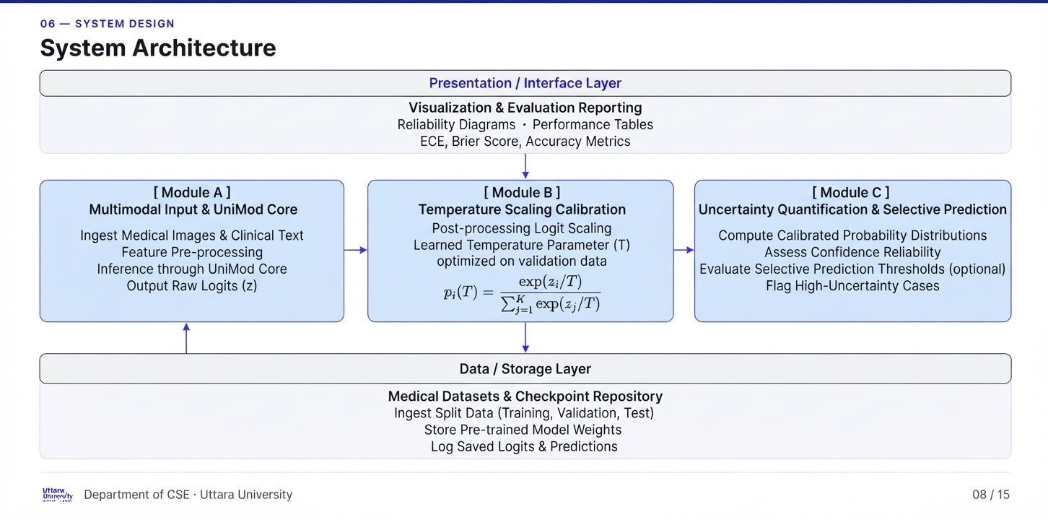
06 — SYSTEM DESIGN
System Architecture
Presentation / Interface Layer
Visualization & Evaluation Reporting
Reliability Diagrams - Performance Tables
ECE, Brier Score, Accuracy Metrics
↓
[ Module A ]
Multimodal Input & UniMod Core
Ingests medical images and clinical text,
pre-processes features, and runs inference to output raw logits (z)
[ Module B ]
[ Module C ]
↓
Data / Storage Layer
Department of CSE · Uttara University
08 / 15
Notes:
Point to each layer/module as you name it.

Slide 9
07 — IMPLEMENTATION
Implementation Details
# Key Temperature Scaling Pseudocode (Guo et al.)
import torch
import torch.nn as nn
import torch.optim as optim
def calibrate_logits(logits, temperature):
"""
Applies temperature scaling to raw model logits.
Equation: p_i(T) = exp(z_i / T) / sum_j exp(z_j / T)
"""
return logits / temperature
def fit_temperature(val_logits, val_labels):
# Initialize temperature parameter T > 0
temperature = nn.Parameter(torch.ones(1) * 1.5)
criterion = nn.CrossEntropyLoss()
optimizer = optim.LBFGS([temperature], lr=0.01, max_iter=50)
def eval_loss():
optimizer.zero_grad()
scaled_logits = calibrate_logits(val_logits, temperature)
loss = criterion(scaled_logits, val_labels)
loss.backward()
return loss
optimizer.step(eval_loss)
return temperature.item()
TOOLS & TECHNOLOGIES
Python 3.x
PyTorch
NumPy / pandas
CSV / JSON Logs
Matplotlib / CUDA
Separation of Validation and Test Data: The temperature parameter T is optimized exclusively using validation data via negative log likelihood minimization, ensuring that held out test set logits remain completely unexposed during calibration.
Department of CSE · Uttara University
09 / 15
Notes:
Mention only tools/decisions the committee will ask about.

Slide 10
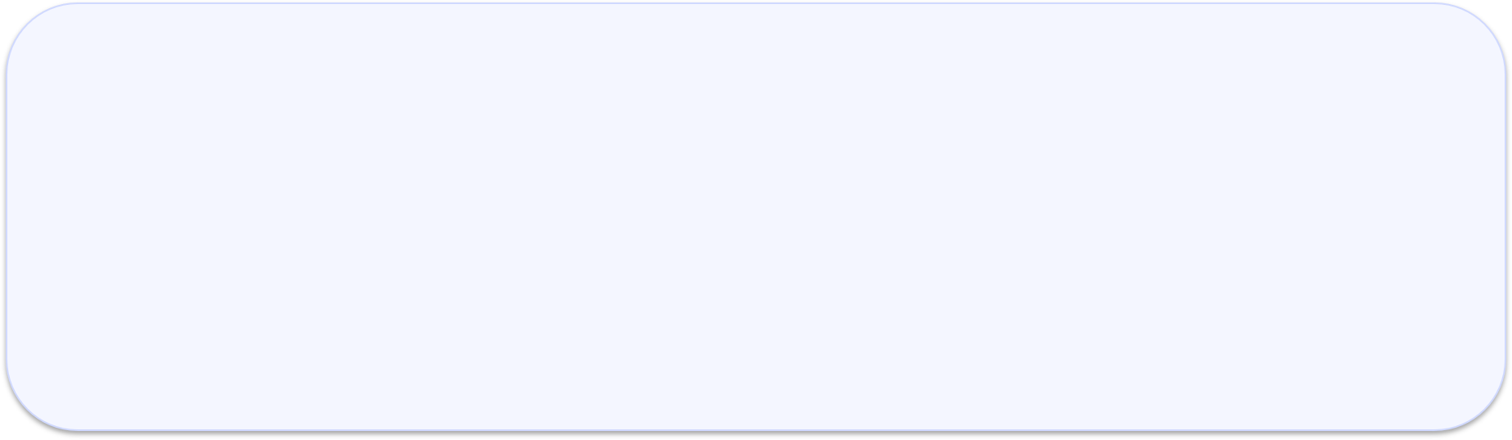





08 — RESULTS & ANALYSIS
Results & Analysis
ECE
Brier Score
Accuracy
Expected Calibration Error
Multiclass probabilistic prediction error
Diagnostic classification performance
10 / 15
Department of CSE · Uttara University
Notes:
Lead with the headline number, then the chart.

Slide 11
09 — COMPARISON & DISCUSSION
How It Compares
METHOD
ECE
BS
ACCURACY
Baseline UniMod
Measure
Measure
Measure
Temperature Scaling
Measure
Measure
Measure
Calibrated UniMod
Measure
Measure
Measure
ECE = Expected Calibration Error
BS = Brier Score
Measure indicates experimental values that still need to be calculated.
Department of CSE · Uttara University
11 / 15
Notes:
Highlight the row/column where your approach wins.

Slide 12
10 — CONCLUSION & FUTURE WORK
Conclusion & Future Work
CONCLUSION
FUTURE WORK
Investigated uncertainty estimation and confidence calibration in the UniMod framework for multimodal medical diagnosis, evaluating performance via accuracy, Expected Calibration Error (ECE), and the Brier Score.
Extending validation beyond single-dataset constraints to evaluate external generalizability across diverse hospital settings, patient populations, and device configurations.
Evaluated whether post-processing temperature scaling can effectively align uncalibrated model probability scores with true diagnostic accuracy without compromising classification performance.
Exploring alternative or combined uncertainty quantification methods (such as deep ensembles or data-driven variance estimation) beyond basic temperature scaling.
Emphasized the critical necessity of assessing confidence reliability separately from raw prediction accuracy to support safer, more trustworthy clinical AI systems.
Investigating automated selective prediction (abstention frameworks) to dynamically defer ambiguous, high-uncertainty diagnostic instances for expert human review.
Department of CSE · Uttara University
12 / 15
Notes:
Close the loop back to the objectives on slide 5.

Slide 13
11 — REFERENCES
References
[1] C. Guo, G. Pleiss, Y. Sun, and K. Q. Weinberger, “On calibration of modern neural networks,” in Proceedings of the 34th International Conference on Machine Learning, ser. Proceedings of Machine Learning Research, D. Precup and Y. W. Teh, Eds., vol. 70. PMLR, 06–11 Aug 2017, pp. 1321–1330. [Online]. Available: https://proceedings.mlr.press/v70/guo17a.html
[2] J. Nixon, M. Dusenberry, G. Jerfel, T. Nguyen, J. Liu, L. Zhang, and D. Tran, “Measuring calibration in deep learning,” 2020. [Online]. Available: https://arxiv.org/abs/1904.01685
[3] A. Kurz, K. Hauser, H. A. Mehrtens, E. Krieghoff-Henning, A. Hekler, J. N. Kather, S. Fr¨ohling, C. von Kalle, and T. J. Brinker, “Uncertainty estimation in medical image classification: Systematic review,” JMIR Med Inform, vol. 10, no. 8, p. e36427, Aug 2022. [Online]. Available: https://medinform.jmir.org/2022/8/e36427
[4] K. Zou, Z. Chen, X. Yuan, X. Shen, M. Wang, and H. Fu, “A review of uncertainty estimation and its application in medical imaging,” Meta Radiology, vol. 1, no. 1, p. 100003, 2023. [Online]. Available: https: //www.sciencedirect.com/science/article/pii/S2950162823000036
[5] B. Lambert, F. Forbes, S. Doyle, H. Dehaene, and M. Dojat, “Trustworthy clinical ai solutions: A unified review of uncertainty quantification in deep learning models for medical image analysis,” Artificial Intelligence in Medicine, vol. 150, p. 102830, 2024. [Online]. Available: https://www.sciencedirect.com/science/article/ pii/S0933365724000721
Department of CSE · Uttara University
13 / 15
Notes:
No need to read these aloud — keep for committee reference.

Slide 14

12 — ACKNOWLEDGEMENT
Acknowledgement
We express our sincere gratitude to our supervisor Mr. Mohsin Hossain for his valuable guidance and support. We also thank the Department of CSE, Uttara University and our families and peers for their encouragement throughout this research.
Department of CSE · Uttara University
14 / 15
Notes:
Keep this brief and sincere.

Slide 15
Thank You
Questions & Discussion
Raian Mahadi · [raian.mahadi@uttarauniversity.edu.bd]
Mehrab Hasan Badhon· [meherub.hb@uttarauniversity.edu.bd]
Mamun Shake· [mamun.shake@uttarauniversity.edu.bd]
Notes:
Invite questions from the committee.

