Slide 1

Pathways viewer for Saccharomyces cerevisiae
A quick guide to browsing budding-yeast signaling and regulatory pathways on a map
raico-lab.github.io/pathways_viewer_sc
Runs in your web browser · no installation · free and open source (GPLv3)
The first launch takes about a minute while the data load.

Slide 2
Explore how yeast genes connect
6,613
Map around a gene
Draw the upstream and downstream neighbours of any gene
1
genes
Trace connections
List the paths that link two or more genes
62,083
2
relations: phosphorylation, transcription, binding …
Filter by condition
Keep paths reported under stress, nutrients, cell-cycle phase …
3
6,387
Overlay measurements
Colour the map by deletion-strain or condition data
4
relations checked against papers

Slide 3
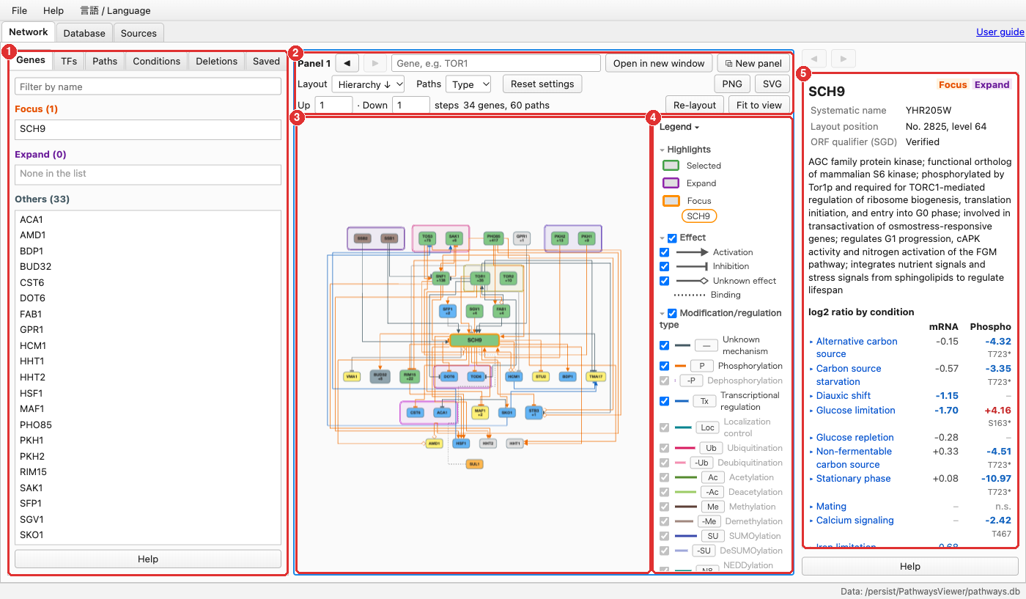
The screen at a glance
1
Left tabs
Genes, TFs, Paths, Conditions, Deletions, Saved
2
Search and settings
Find a gene; layout, line colours, number of steps
3
Map
Genes (boxes) and the relations between them
4
Legend
Meaning of colours and symbols; untick to hide a type
5
Details
Description, evidence and papers for what you click

Slide 4
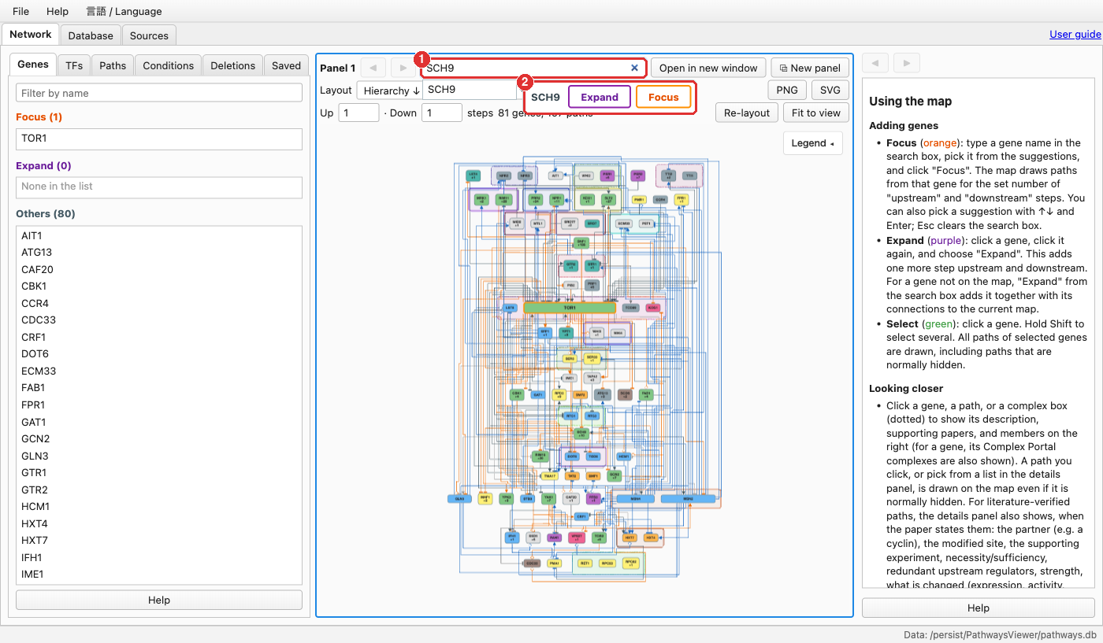
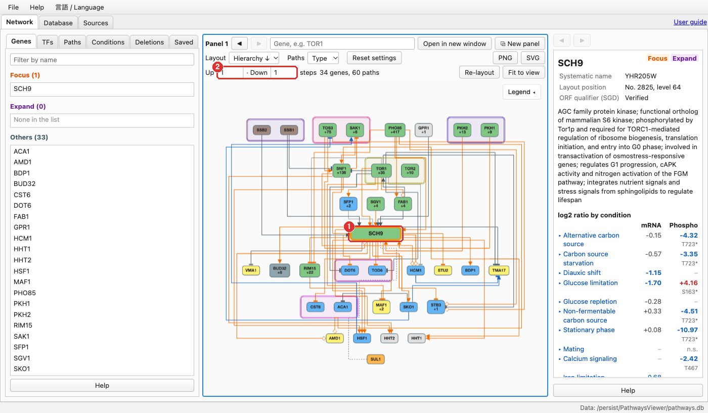
Step 1 — Put a gene on the map
Type a gene name and choose Focus
The map is redrawn around that gene
Type a gene name in the search box ① — standard or systematic (SCH9 / YHR205W)
Click Focus ② — the gene is shown with a thick orange frame
Up / Down ② set how many steps to follow; start with 1–2

Slide 5
Step 2 — Read the map
Line ending = effect
Line colour = type
Boxes and frames
Activation
P
Phosphorylation
SCH9
Focused gene (orange frame)
Inhibition
-P
Dephosphorylation
SNF1
+138
+N: downstream genes not yet drawn
Tx
Transcriptional regulation
Dotted frame: protein complex
Unknown effect (could be either)
—
Unknown mechanism
Double frame: paralog pair
Binding (no direction)
Set “Paths” to Effect to colour lines red (activation) / blue (inhibition)
Upstream genes are placed higher; box colour shows the gene’s role

Slide 6
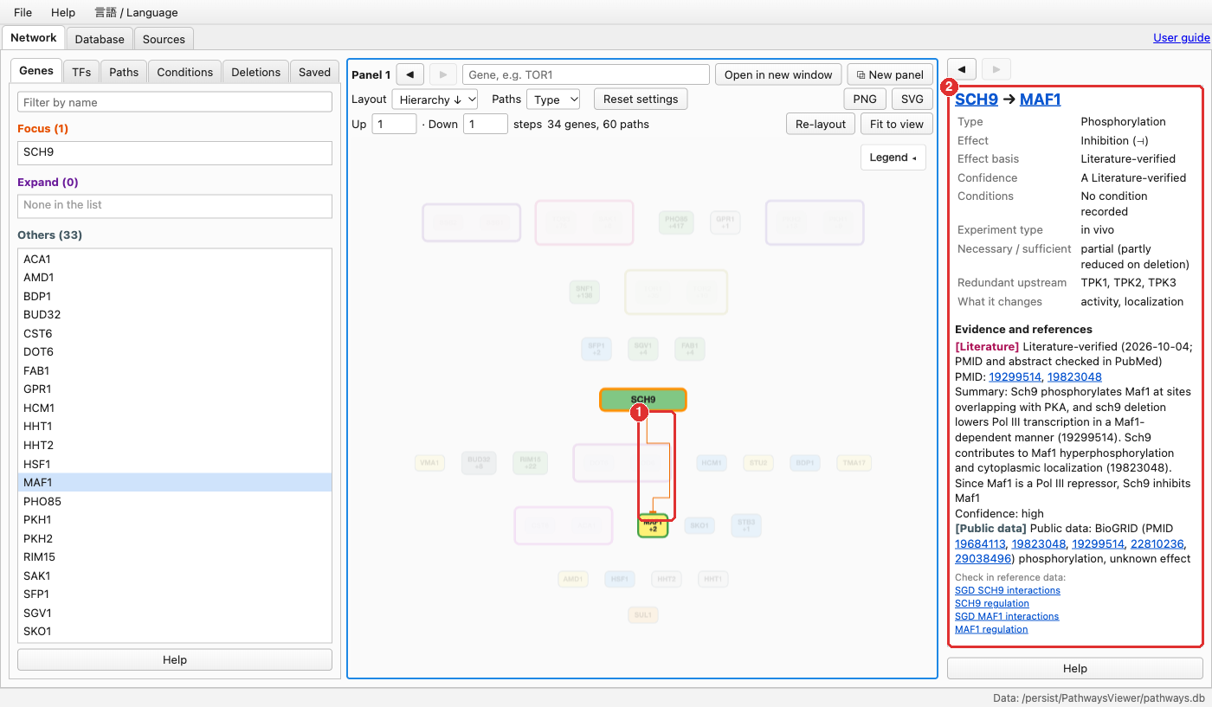
Step 3 — Click for details and evidence
1
Click a gene or a line
Click a selected gene again to Expand (add its neighbours) or Focus
2
Read the evidence
Type, effect, confidence (A literature-verified … D inferred), conditions, PubMed links, and links to SGD / YEASTRACT+

Slide 7
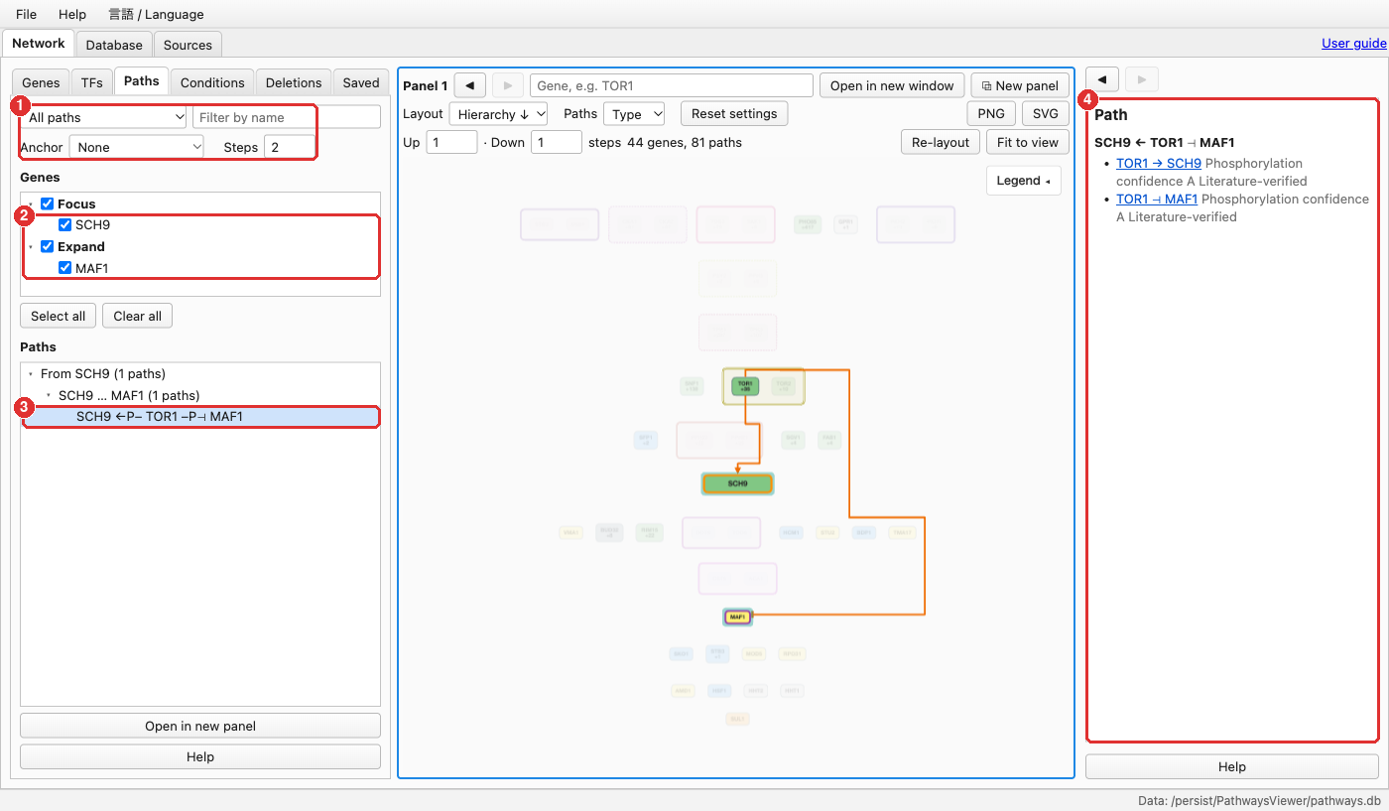
Paths tab — how do two genes connect?
1
Choose what to list
e.g. All paths, with the number of steps
2
Tick the genes
Focused and expanded genes are listed here
3
Pick a path
It is drawn and highlighted on the map
4
See each step
Every relation in the path, with its confidence

Slide 8
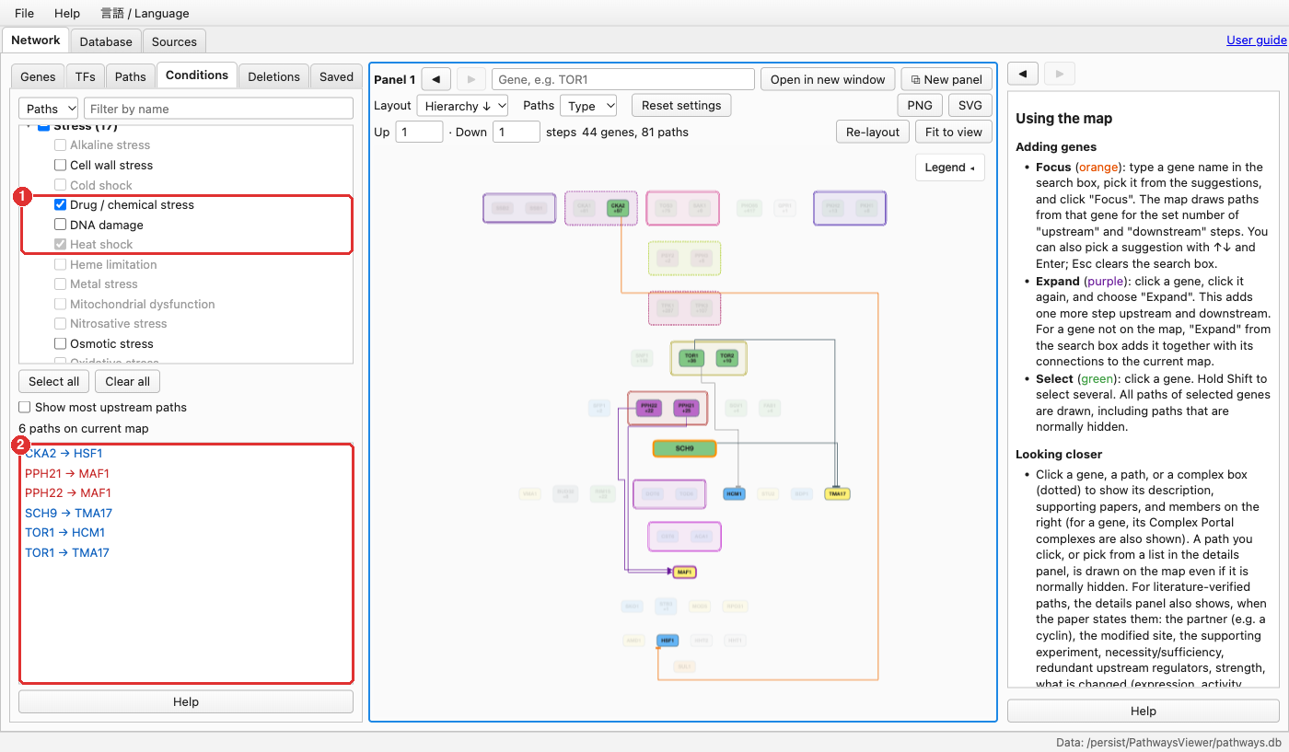
Conditions tab — paths under specific conditions
1
Tick conditions
“Clear all”, then tick e.g. Heat shock and Drug / chemical stress
2
Matching paths
Only those paths stay on the map; click one for its evidence
Switch to “Genes” to highlight genes whose mRNA or phosphorylation changes ≥ 2-fold under the chosen conditions.

Slide 9
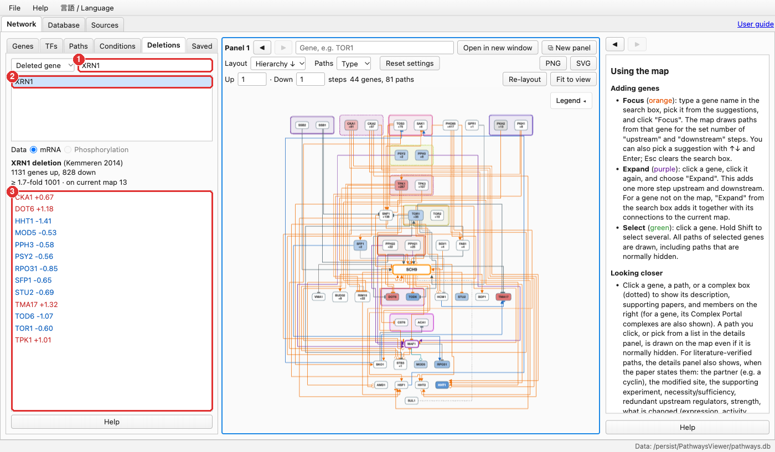
Deletions tab — what changes when a gene is deleted?
1
Find the strain
Choose “Deleted gene” and type its name (e.g. XRN1)
2
Click the strain
Map colours: red = up, blue = down
3
Changed genes
Genes on the current map that changed in that strain
mRNA: Deleteome (Kemmeren 2014, 1,481 strains). Phosphorylation: Bodenmiller 2010 (113 kinase / phosphatase strains).

Slide 10
More you can do
⧉
★
↓
Several panels
Open up to 4 maps side by side with “New panel”
Saved views
Name and recall a map in the Saved tab (kept in your browser)
PNG / SVG
Save the whole map as an image
‹ ›
?
A
Back / forward
Return to the previous map or details
Help everywhere
Every panel has a Help button; full User guide at top right
日本語 / English
Switch the language from the 言語 / Language menu

Slide 11
Where the data come from
Public databases
SGD · BioGRID · YEASTRACT+ · GO-CAM · UniProt · Complex Portal · Alliance (retrieved Sep–Oct 2026, refreshed regularly)
Please note
“Unknown effect” means the relation could be activating or inhibiting.
Bundled data stay under each source’s terms; please cite the original sources (listed in the Sources tab).
The map is a guide to the literature, not a substitute for checking the original papers.
Literature curation
Key relations checked against 4,718 papers; each relation shows its PMIDs
Measurements
Expression (SGD SPELL), phosphorylation (Leutert 2023), deletion strains

Slide 12
Try it now
Open the link in a desktop browser (Chrome, Edge, Safari, Firefox).
https://raico-lab.github.io/pathways_viewer_sc/
Source code: github.com/Raico-lab/pathways_viewer_sc

