Slide 1

Pathways viewer for Saccharomyces cerevisiae
https://raico-lab.github.io/pathways_viewer_sc/
Runs in a web browser without installation. Open source under GPLv3.
A desktop browser such as Chrome, Edge, Safari or Firefox is recommended.
Source code: github.com/Raico-lab/pathways_viewer_sc

Slide 2
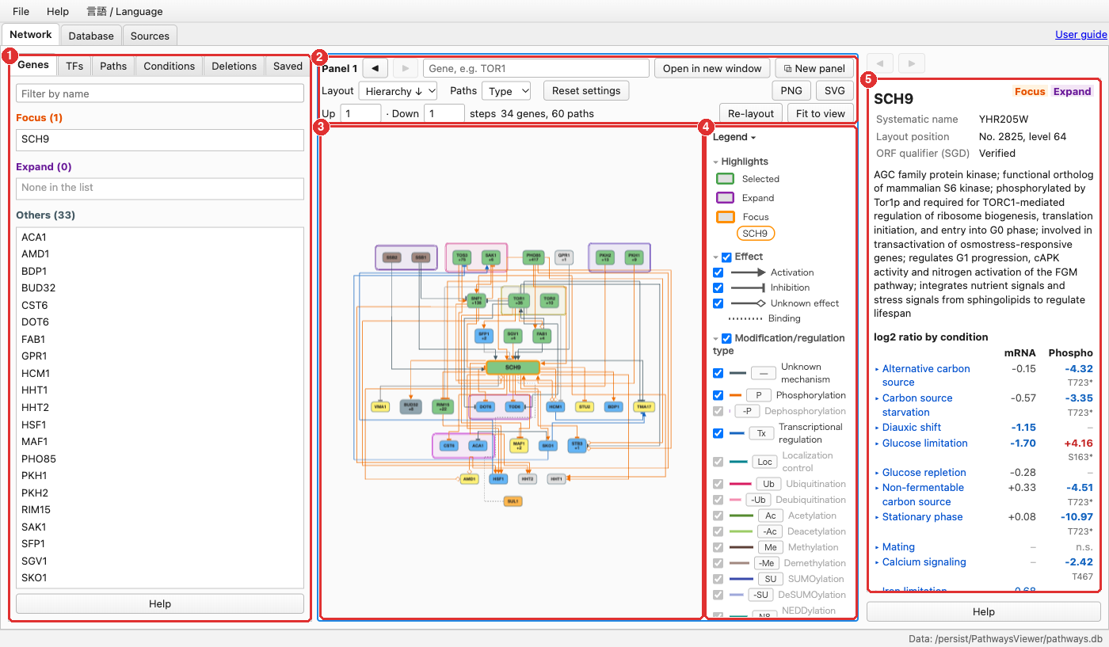
Interface
1
Left-hand tabs
Genes, transcription factors, paths, conditions, deletion strains and saved views
2
Search and settings
Gene search, layout, edge colouring and search depth
3
Map
Genes as nodes and relations as edges
4
Legend
Symbol definitions; unticking an item hides that category
5
Details
Annotation, evidence and references for the selected item

Slide 3
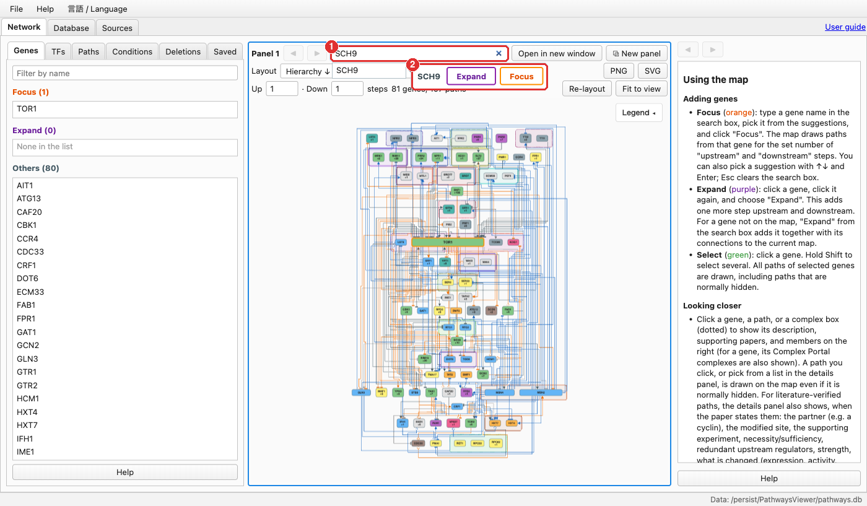
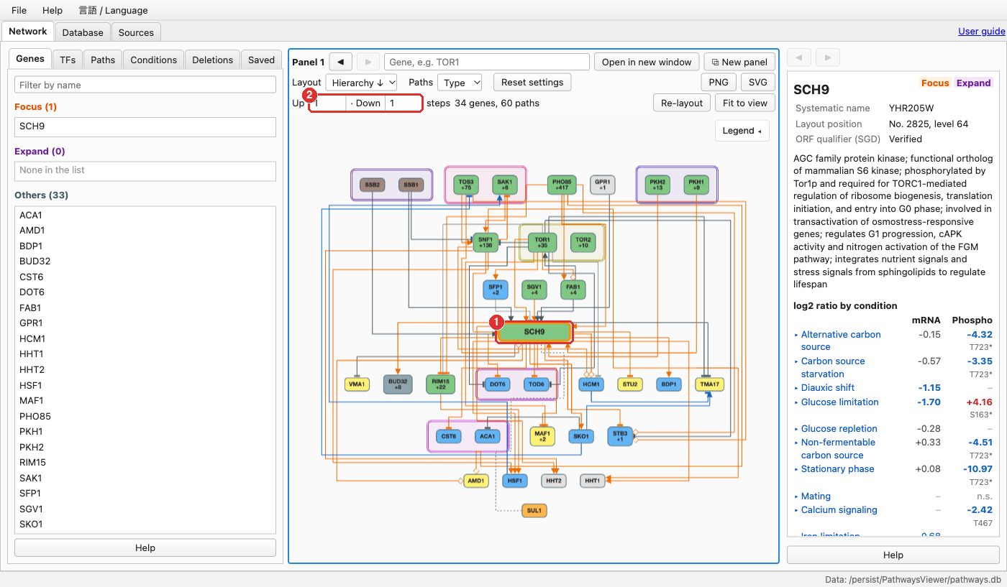
Displaying a gene
Gene search
Map centred on SCH9
Enter a standard or systematic gene name in the search box ①, e.g. SCH9 or YHR205W.
Select Focus ②. The query gene is outlined in orange.
Set the upstream and downstream depth ②. A greater depth adds many genes and makes the map slower.

Slide 4
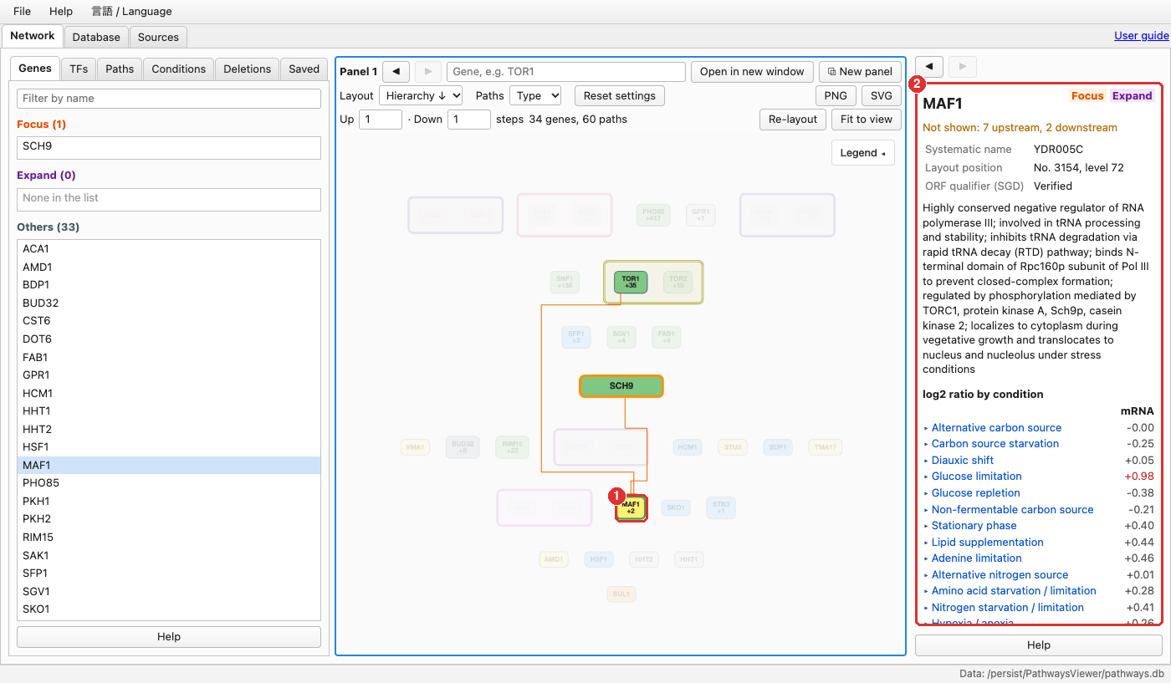
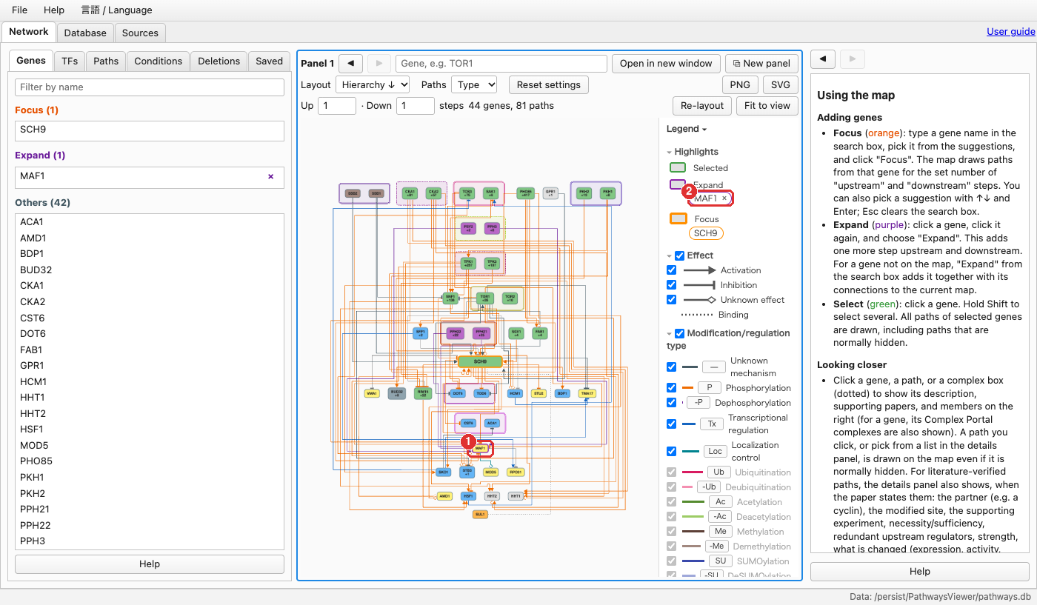
Selection and expansion
MAF1 selected
Map after expanding MAF1
Clicking a gene selects it ①. Only its relations remain highlighted, and its annotation appears in the details panel ②. Shift-click selects several genes; clicking the background clears the selection.
Clicking a selected gene again offers Expand and Focus. Expand keeps the current map and adds one step upstream and downstream of that gene.
Expanded genes are outlined in purple ① and can be removed with × in the legend ②. Focus redraws the map around the gene.

Slide 5
Map notation
Edge terminus: effect
Edge colour: mechanism
Nodes and frames
Activation
P
Phosphorylation
SCH9
Focused gene
Inhibition
-P
Dephosphorylation
SNF1
+138
+N: undisplayed downstream genes
Tx
Transcriptional regulation
Dashed frame: protein complex
Unknown effect
—
Unknown mechanism
Double frame: paralog pair
Undirected binding
Edges can instead be coloured by effect: red for activation, blue for inhibition.
Upstream genes are placed higher. Node colour indicates functional class.

Slide 6
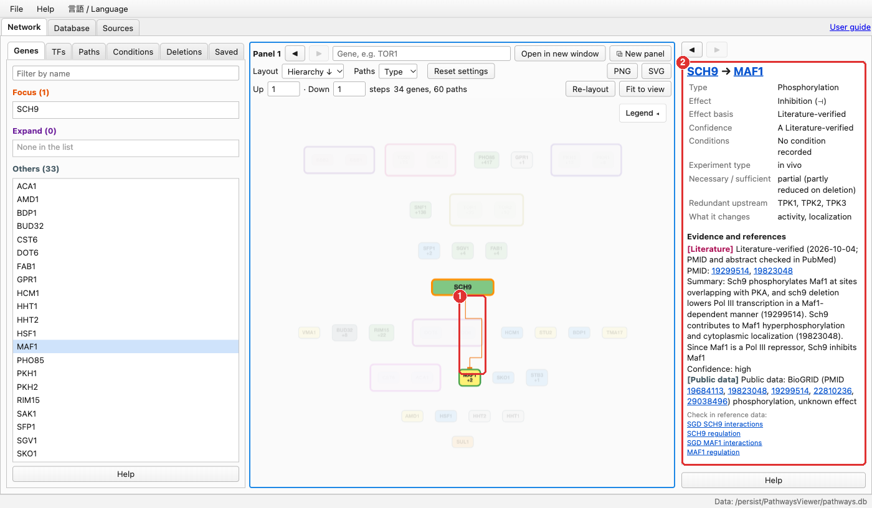
Evidence for each relation
1
Selecting a relation
Clicking an edge shows the relation in the details panel.
2
Evidence panel
Mechanism, effect, confidence grade A–D, conditions, PubMed identifiers and links to SGD and YEASTRACT+.

Slide 7
Left-hand tabs
Genes
TFs
Paths
Lists genes on the current map, grouped as focused, expanded and others. Selecting a gene highlights it and shows its annotation.
Lists transcription factors regulating the focused and expanded genes, grouped by effect. Ticked factors are added to the top row of the map.
Searches for paths between ticked genes with a specified number of steps and highlights the selected path.
Conditions
Deletions
Saved
Filters relations by the conditions under which they were reported. Genes mode highlights genes whose expression or phosphorylation changes.
Colours the map by mRNA or phosphorylation changes measured in deletion strains, and lists strains that affect a given gene.
Stores the current map state under a name for later recall. Saved views are kept in the browser.

Slide 8
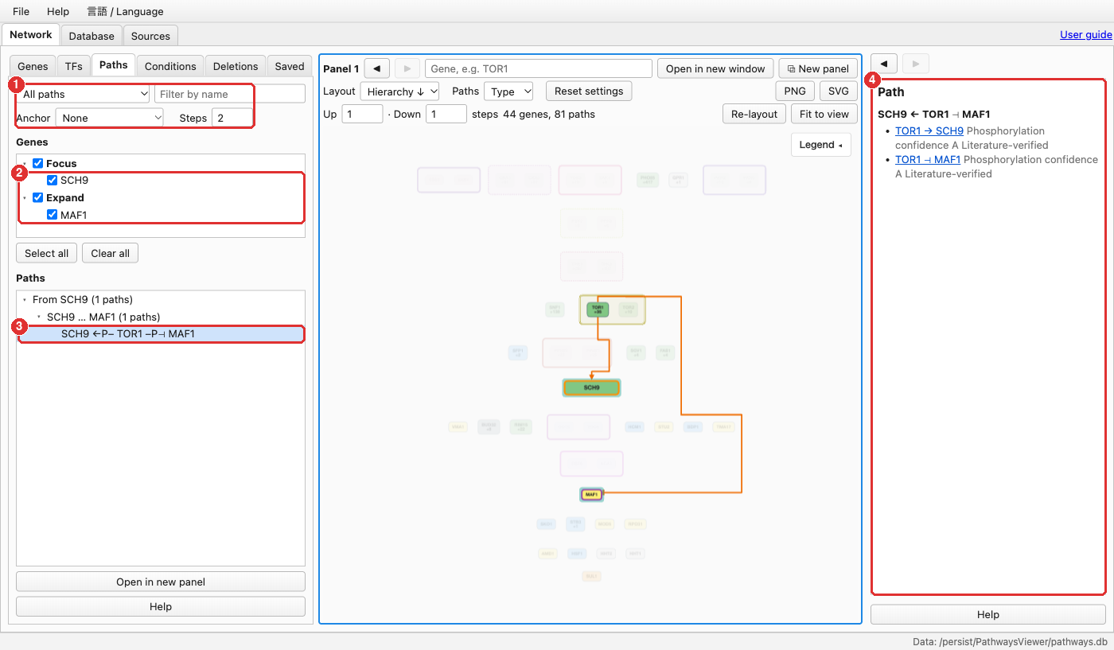
Paths: connections between genes
1
Search mode
Select the path type and the number of steps.
2
Genes
Tick the focused or expanded genes to be connected.
3
Results
Selecting a path highlights it on the map.
4
Path details
Each step is listed with its confidence grade.

Slide 9
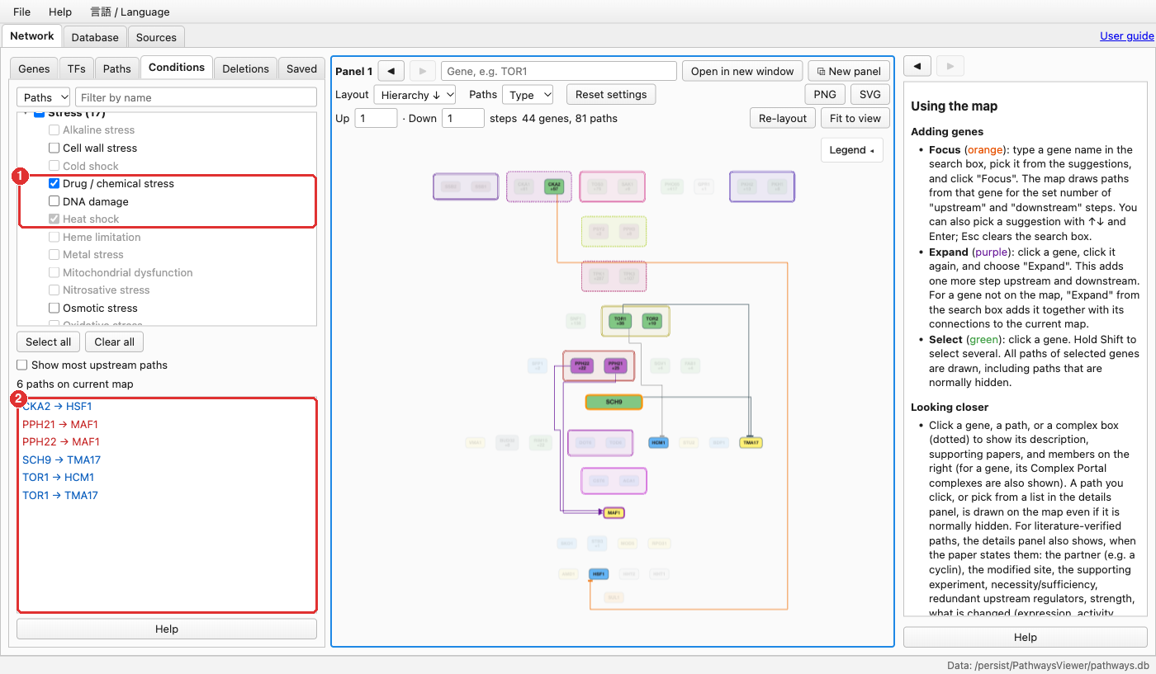
Conditions: condition-specific relations
1
Conditions
Choose Paths or Genes at the top left. Clear all, then tick the conditions of interest, such as heat shock or drug stress.
2
Matching relations
Only relations reported under these conditions remain on the map.
Paths
Relations reported under the selected conditions remain on the map.
Genes
Genes whose mRNA or phosphorylation changes at least twofold under the selected conditions are highlighted.

Slide 10
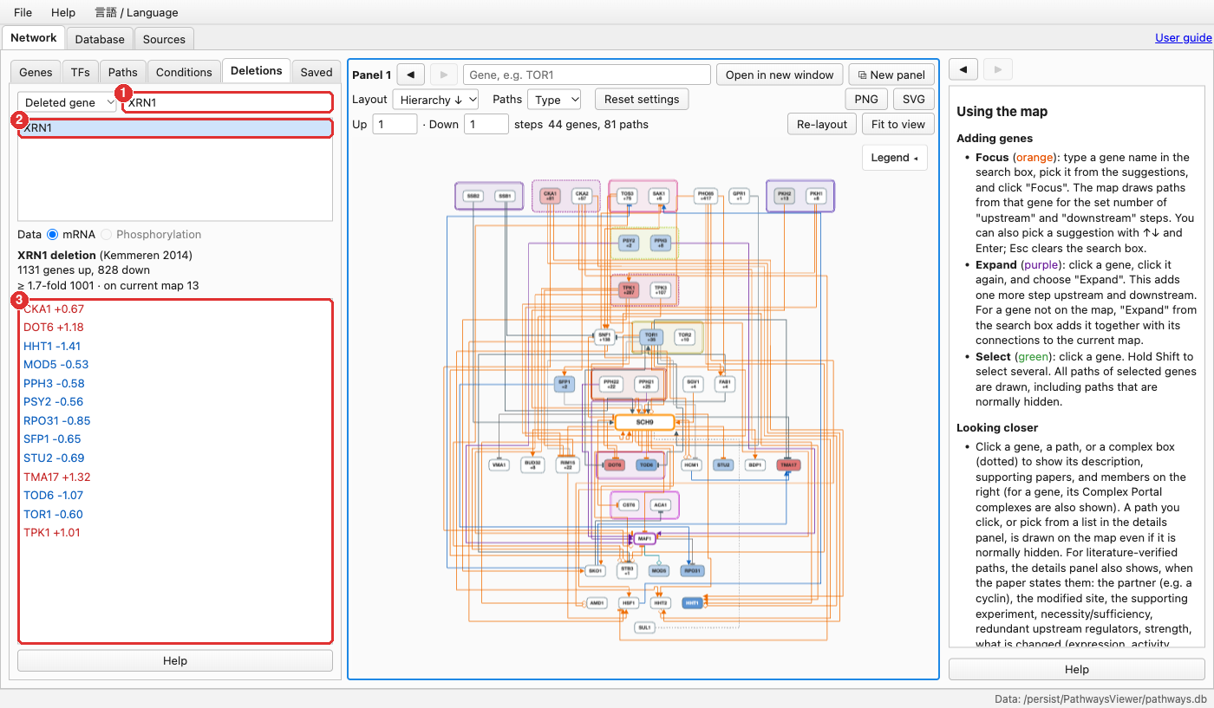
Deletions: measurements in deletion strains
1
Strain search
Choose Deleted gene or Changed gene at the top left, then enter a gene name, e.g. XRN1.
2
Strain selection
Nodes are coloured by measured change: red, increased; blue, decreased.
3
Changed genes
Genes on the current map that changed in the strain.
mRNA: Kemmeren et al. 2014, 1,481 strains. Phosphorylation: Bodenmiller et al. 2010, 113 kinase and phosphatase strains.
Deleted gene
Select a deletion strain; the map is coloured by the changes measured in that strain.
Changed gene
Select a gene on the map; the strains in which it changed are listed.

Slide 11
Additional functions
⧉
≡
↓
Multiple panels
Up to four maps can be compared side by side.
Database tab
Genes, relations and categories in tabular form, with filtering.
Export
Maps can be saved as PNG or SVG.
‹ ›
?
A
History
Previous maps and details can be revisited.
Help
Each panel has a Help button; the full user guide is linked at the top right.
Language
Japanese and English are available from the Language menu.

