Slide 1
Secure Data HIDING in images Using steganography
Presented By: Raid Abdul Razzak Dandekar
Student Name : Raid Abdul Razzak Dandekar
College Name & Department : Finolex Academy of Management and Technology & ENTC

Slide 2
OUTLINE
Problem Statement
Technology used
Wow factor
End users
Result
Conclusion
Git-hub Link
Future scope

Slide 3
Problem Statement
Secure communication is a challenge in digital communications.
Traditional encryption methods attract attention, whereas steganography hides messages in images.
This project enables hiding and retrieving messages using OpenCV.

Slide 4
Technology used
Programming Language: Python
Libraries: OpenCV, NumPy
Platform: Windows

Slide 5
Wow factors
Uses image pixels to store secret messages.
Simple yet effective encryption and decryption.
Requires a password for decryption, adding an extra security layer.

Slide 6
End users
Cybersecurity professionals
Individuals requiring covert communication
Digital forensics teams

Slide 7
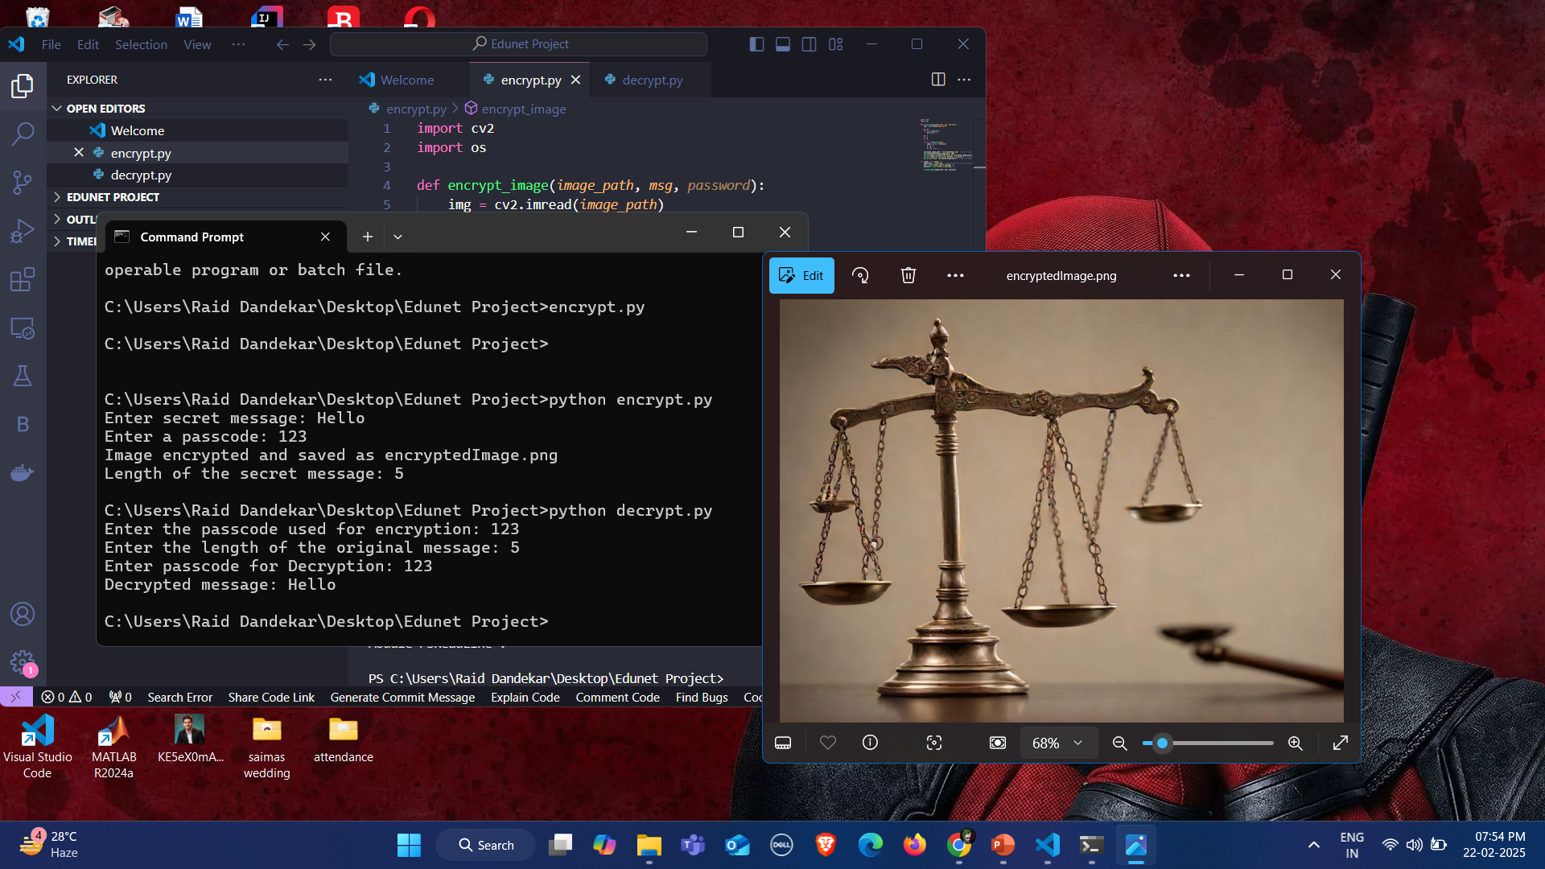
Results

Slide 8
Conclusion
This project demonstrates how steganography can securely transmit messages using images.

Slide 9
GitHub Link
https://github.com/RaidDandekar2002/Edunet-Project.git

Slide 10
Future scope
Improving security by adding AES encryption before steganography.
Supporting different file formats beyond images.

Slide 11
THANK YOU

