Slide 1


Estimating Loss Given Default (LGD)
with a Two-Stage Model
TEAM: Xudong Chen, Abhilash Kalapatapu, Zitao Song, Zhong Tian
MENTORS: Raiden Han, Catherine Tang

Slide 2
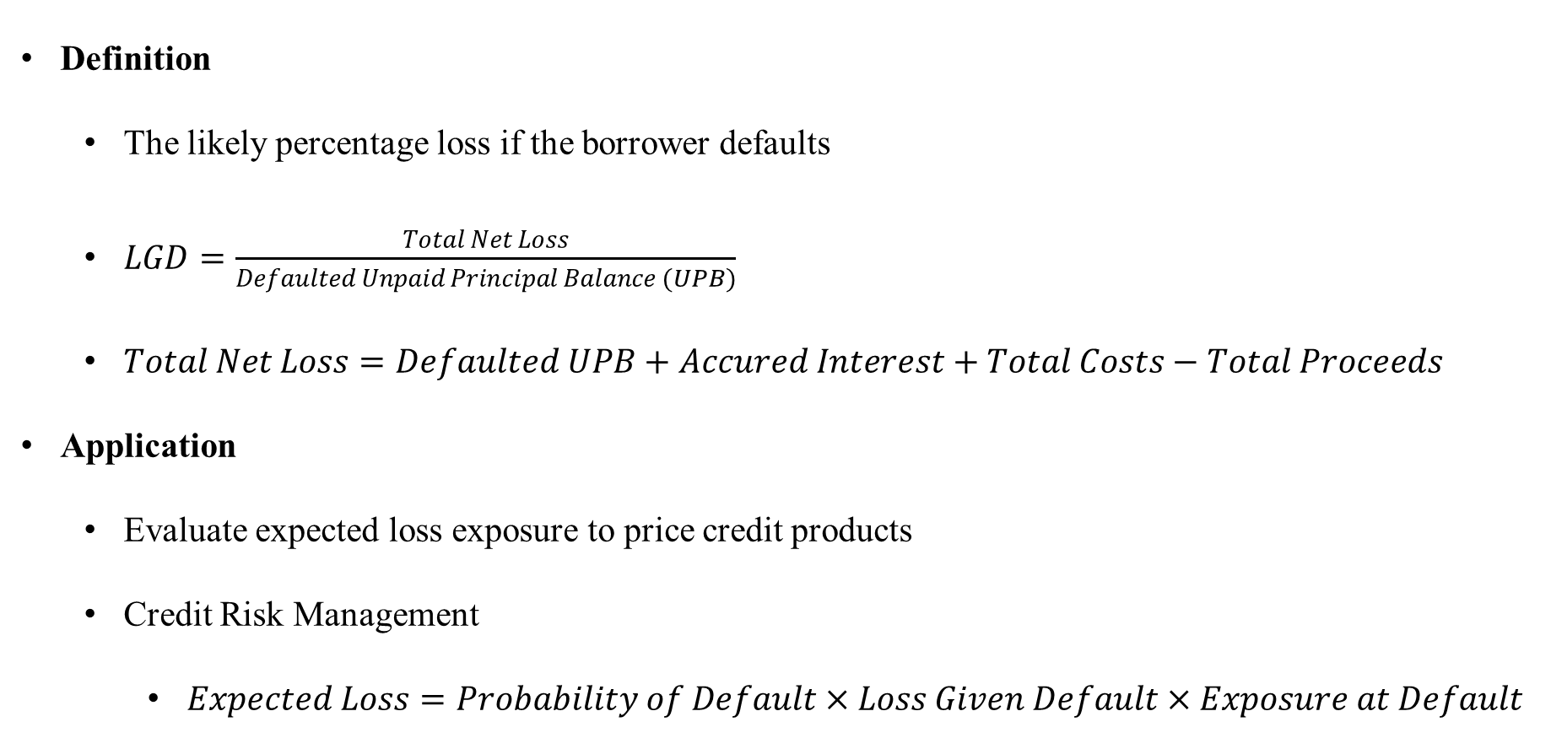
Introduction & Structure
Definition
The likely percentage loss if the borrower defaults
$LGD=\frac{Total Net Loss}{Defaulted Unpaid Principal Balance (UPB)}$
$Total Net Loss=Defaulted UPB+Accured Interest+Total Costs−Total Proceeds$
Application
Evaluate expected loss exposure to price credit products
Credit Risk Management
$Expected Loss=Probability of Default×Loss Given Default×Exposure at Default$

Slide 3





Introduction & Structure
Data Preprocessing
Is $LGD=1$?
True
False
Feature Selection
$$LGD=1$$
Is $LGD=0$?
True
False
Exploratory Data Analysis
$$LGD=0$$
Regression
Model Building
$$0<LGD<1$$
Result Analysis

Slide 4
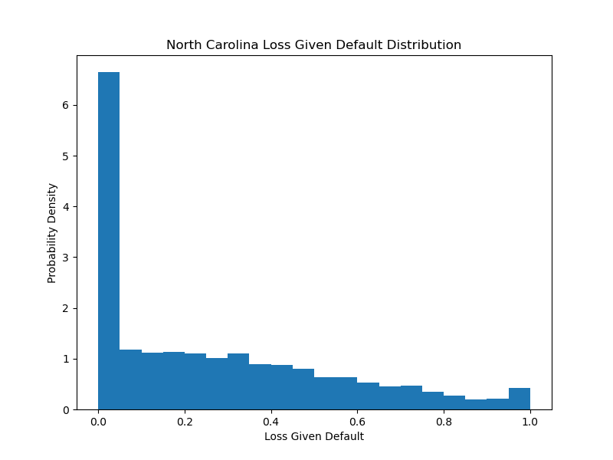
Introduction & Structure
Why use a two-stage model?
A large number of boundary cases at 0 and 1
There could be special conditions that would make a lender either pay back the full amount or pay back nothing
Transformers do not apply to boundary cases

Slide 5
Data Preprocessing
Data Source
Fannie Mae Data Dynamics Single-Family Historical Loan Performance Data
Federal Reserve Economic Data
Data Preprocessing
Time Frame: January 2000 – June 2022
Property State: North Carolina
Disposition Date: Before December 1, 2021
Calculate LGD based on defaulted loan data

Slide 6
Feature Selection
Macroeconomic Variables
Federal Funds Effective Rate
Unemployment Rate in North Carolina
Home Price Index (HPI) in North Carolina
30-Year Fixed Rate Mortgage Average
Borrower-Related Variables
Debt-to-Income (DTI)
Borrower Credit Score at Origination
Property-Related Variables
Original UPB
Original Loan-to-Value Ratio (LTV)
Loan Purpose
Property Type
Number of Units
Occupancy Status
UPB at the Time of Removal

Slide 7
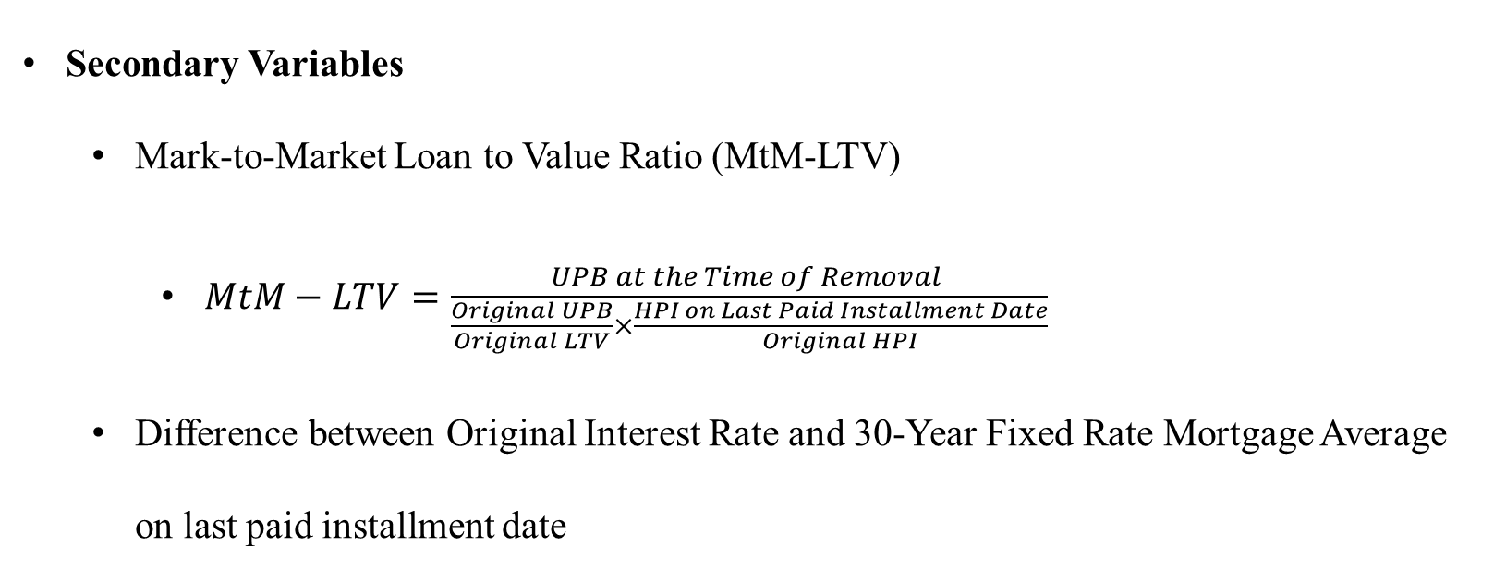
Feature Selection
Secondary Variables
Mark-to-Market Loan to Value Ratio (MtM-LTV)
$MtM−LTV=\frac{UPB at the Time of Removal }{\frac{Original UPB}{Original LTV}×\frac{HPI on Last Paid Installment Date}{Original HPI}}$
Difference between Original Interest Rate and 30-Year Fixed Rate Mortgage Average on last paid installment date

Slide 8
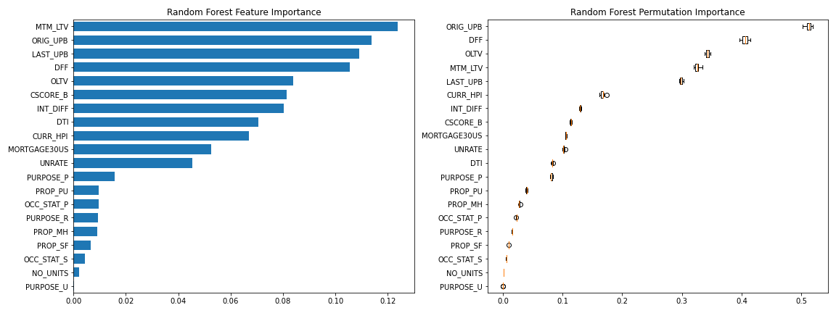
Feature Selection
Random-Forest-Based Feature Importance Analysis

Slide 9
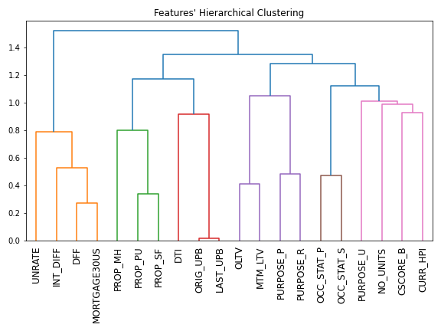
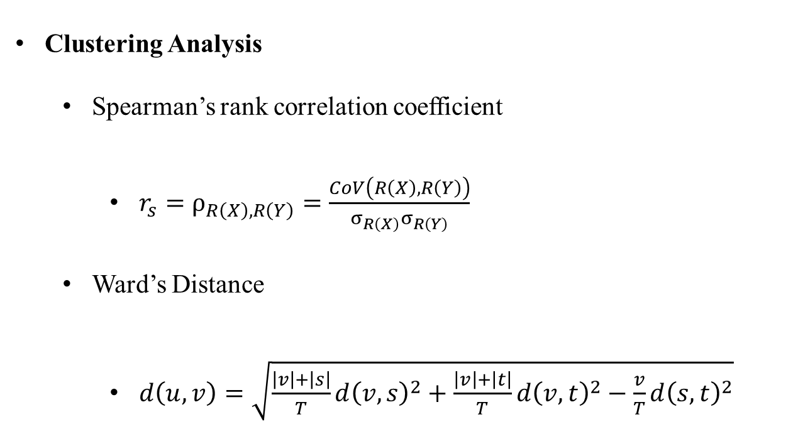
Feature Selection
Clustering Analysis
Spearman’s rank correlation coefficient
$r_{s}=ρ_{R\left(X\right),R\left(Y\right)}=\frac{CoV\left(R\left(X\right),R\left(Y\right)\right)}{σ_{R\left(X\right)}σ_{R\left(Y\right)}}$
Ward’s Distance
$d\left(u,v\right)=\sqrt{\frac{\left|v\right|+\left|s\right|}{T}d{\left(v,s\right)}^{2}+\frac{\left|v\right|+\left|t\right|}{T}d{\left(v,t\right)}^{2}−\frac{v}{T}d{\left(s,t\right)}^{2}}$

Slide 10
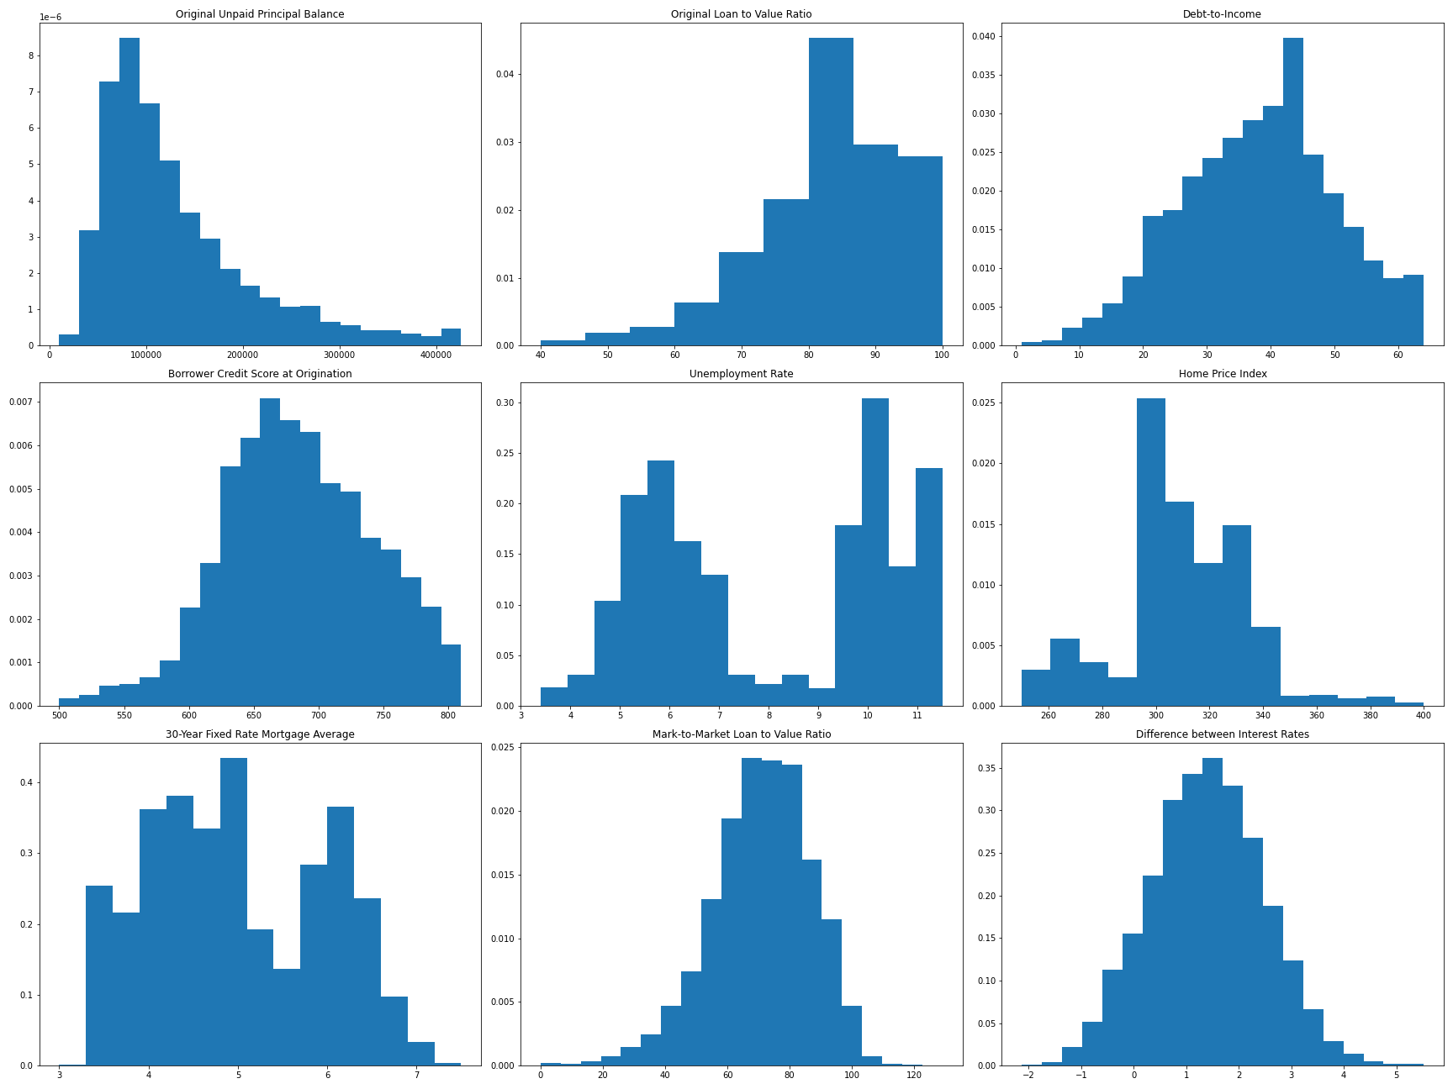
Exploratory Data Analysis
Features’ Distributions
Most of the features are symmetrically distributed
Take the logarithm of the Original Unpaid Principal Balance to increase the spread (Figure in Row 1, Col 1)

Slide 11
Model Building
Data Splitting
Test Set: 20% of the total 14,624 defaulted loans
Training Set: 5-Fold Cross-Validation (CV)
Metrics
Classification
Hyperparameter Tuning: Area under the ROC Curve (AUC)
Model Selection across Different Types: Accuracy
Regression: Mean Absolute Error (MAE)

Slide 12
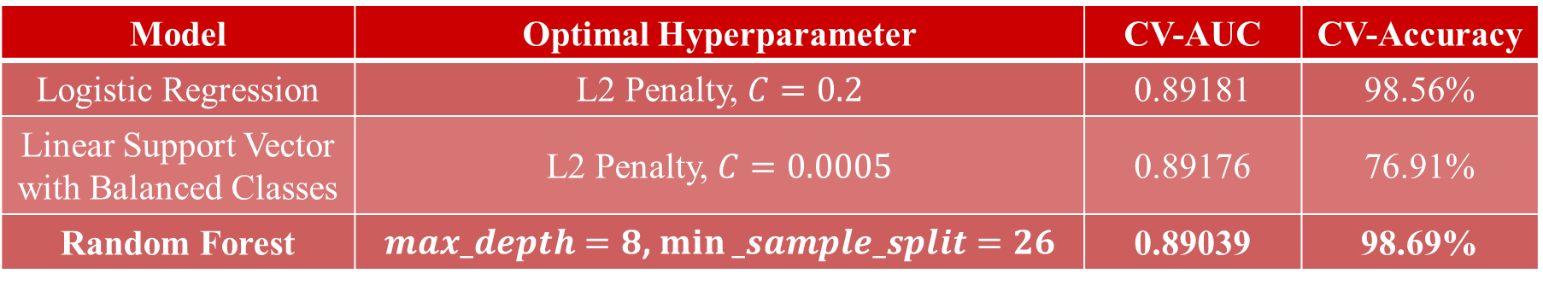
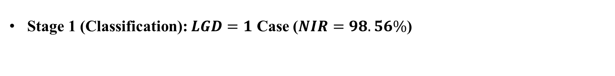
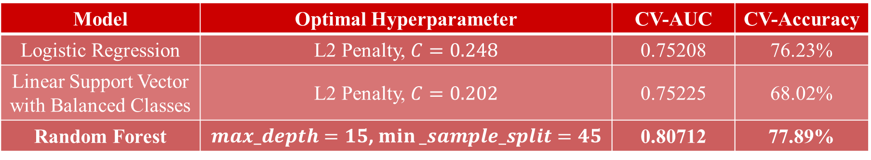
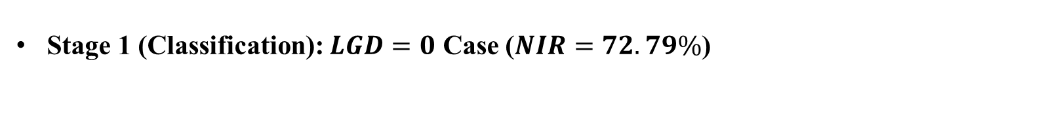
Model Building
Stage 1 (Classification): $LGD=1$ Case ($NIR=98.56\%$)
Model | Optimal Hyperparameter | CV-AUC | CV-Accuracy
Logistic Regression | L2 Penalty, $C=0.2$ | 0.89181 | 98.56%
Linear Support Vector with Balanced Classes | L2 Penalty, $C=0.0005$ | 0.89176 | 76.91%
Random Forest | $max_depth=8$, $min⁡_sample_split=26$ | 0.89039 | 98.69%
Stage 1 (Classification): $LGD=0$ Case ($NIR=72.79\%$)
Model | Optimal Hyperparameter | CV-AUC | CV-Accuracy
Logistic Regression | L2 Penalty, $C=0.248$ | 0.75208 | 76.23%
Linear Support Vector with Balanced Classes | L2 Penalty, $C=0.202$ | 0.75225 | 68.02%
Random Forest | $max_depth=15$, $min⁡_sample_split=45$ | 0.80712 | 77.89%

Slide 13

Model Building
Stage 2 (Regression)
Transformer $T:\left(0,1\right)→ℝ$
Fractional Logit Transformer: $T_{f}=\log\left(LGD\right)−\log\left(1−LGD\right)$
Beta Transformer: $T_{b}=Φ^{−1}\left(Beta\left(LGD,α,β,0,1\right)\right)$
Probit Transformer: $T_{p}=Φ^{−1}\left(eCDF\left(LGD\right)\right)$

Slide 14
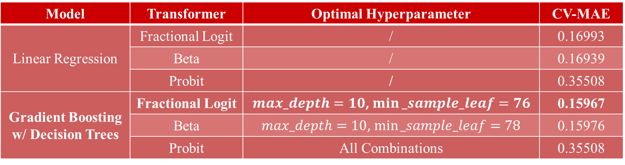
Model Building
Stage 2 (Regression)
Model | Transformer | Optimal Hyperparameter | CV-MAE
Linear Regression | Fractional Logit | / | 0.16993
Linear Support Vector with Balanced Class | Beta | / | 0.16939
Random Forest | Probit | / | 0.35508
Gradient Boosting w/ Decision Trees | Fractional Logit | $max_depth=10$, $min⁡_sample_leaf=76$ | 0.15967
 | Beta | $max_depth=10$, $min⁡_sample_leaf=78$ | 0.15976
 | Probit | All Combinations | 0.35508

Slide 15
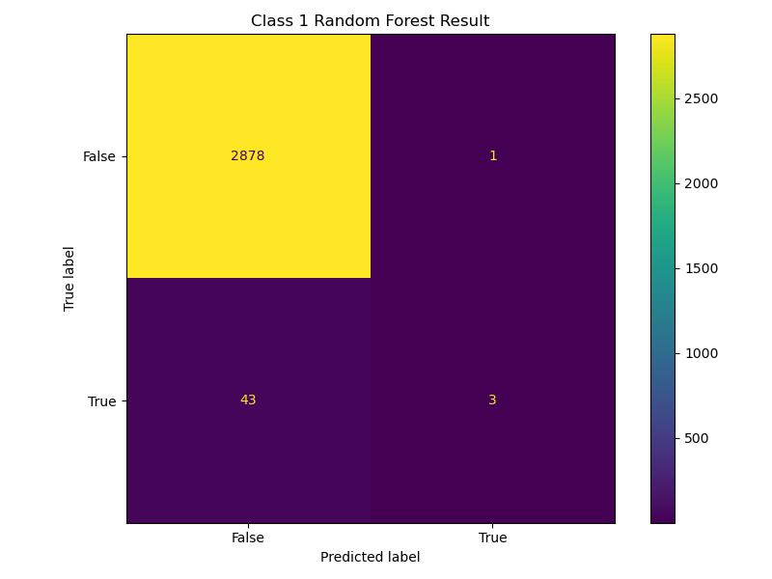
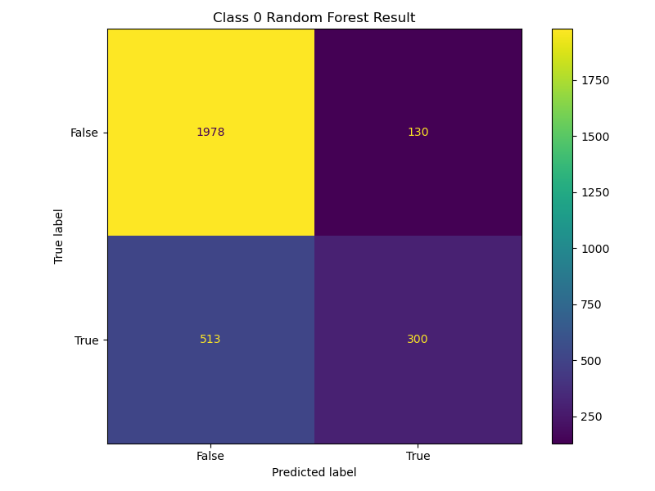
Result Analysis
Test Set Performance
Regression MAE: 0.1828, Overall MAE: 0.1644

Slide 16

Result Analysis
Feature Coefficients and Importance
Stage 1 (Classification): $LGD=1$ Case
Stage 1 (Classification): $LGD=0$ Case
Feature | MTM_LTV | LOG_OUPB | CSCORE_B | INT_DIFF | OLTV | CURR_HPI
Importance | 0.341⁻ | 0.283⁻ | 0.074⁻ | 0.062⁺ | 0.055⁻ | 0.052⁺
Feature | MTM_LTV | CURR_HPI | LOG_OUPB | UNRATE | OLTV | MORTGAGE
Importance | 0.154⁻ | 0.146⁻ | 0.123⁺ | 0.113⁻ | 0.111⁺ | 0.099⁺

Slide 17
Result Analysis
Feature Coefficients and Importance
Stage 2 (Regression)
Feature | OLTV | DTI | CSCORE_B | UNRATE | CURR_HPI | MORTGAGE
Coefficient | 0.079 | 0.001 | 0.000 | -0.004 | -0.003 | -0.001
p-value | 0.000 | 0.362 | 0.403 | 0.000 | 0.000 | 0.099
Feature | MTM_LTV | INT_DIFF | LOG_OUPB | PURPOSE_P | PURPOSE_R
Coefficient | -0.000 | -0.006 | 0.031 | 0.017 | 0.006
p-value | 0.000 | 0.000 | 0.000 | 0.000 | 0.000
Feature | PURPOSE_U | PROP_CP | PROP_MH | PROP_PU | PROP_SF
Coefficient | -0.008 | -0.000 | -0.019 | 0.006 | -0.008
p-value | 0.626 | 0.001 | 0.000 | 0.012 | 0.000

Slide 18
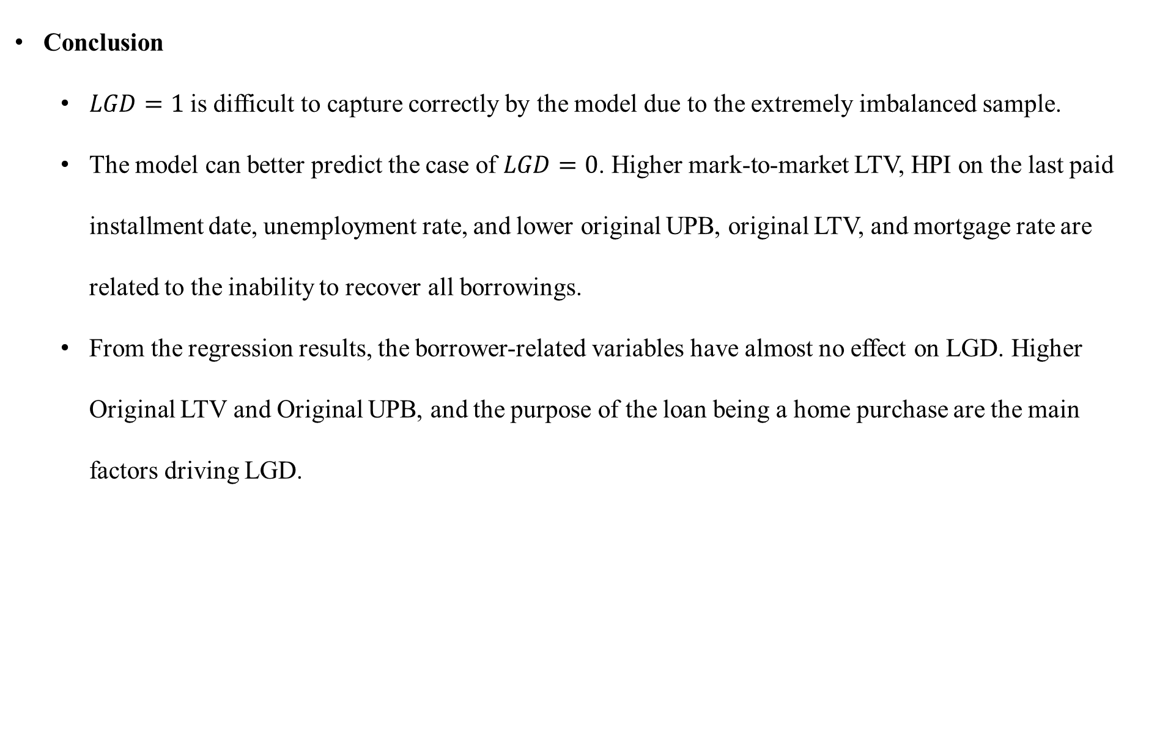
Result Analysis
Conclusion
$LGD=1$is difficult to capture correctly by the model due to the extremely imbalanced sample.
The model can better predict the case of $LGD=0$. Higher mark-to-market LTV, HPI on the last paid installment date, unemployment rate, and lower original UPB, original LTV, and mortgage rate are related to the inability to recover all borrowings.
From the regression results, the borrower-related variables have almost no effect on LGD. Higher Original LTV and Original UPB, and the purpose of the loan being a home purchase are the main factors driving LGD.

Slide 19
Result Analysis
Further Development
Develop a baseline model as a control to quantify the advantage that the two-stage model brings to estimating LGD.
Increase the sample size and add the corresponding macro variables in an attempt to address the imbalance issue.
Expand the types of regression models to understand the non-linear relationship between features and LGD.

Slide 20
THANKS

