Slide 1

Phaethon
5th Semester AP degree project for Means SIA
Presented by: Ralfs Zangis Andrei –Eugen Birta Adam Blazsek

Slide 2
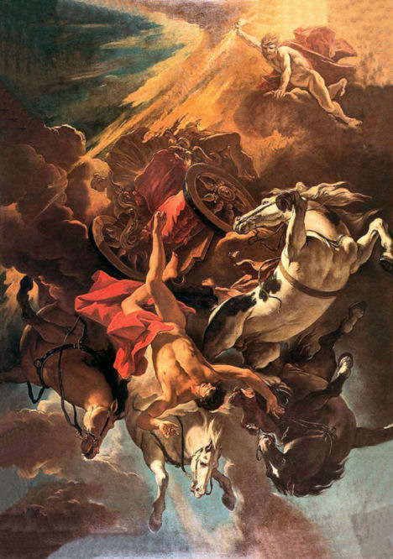
Origin of the projects name
Phaethon, after receiving conformation from his mother that he is a son of the sun god, asked his father for some proof that would demonstrate his relationship with the sun. When the god promised to grant him whatever he wanted, he insisted on being allowed to drive the sun chariot for a day. Helios tried to dissuade Phaethon, telling him that even Zeus was not strong enough to steer these horses. Placed in charge of the chariot, Phaethon was unable to control the horses, at first flying too high in the air, freezing the Earth (leaving north and south poles), later falling, scorching the Earth (leaving Sahara desert), witnessing the unfolding disaster Zeus decided to prevent disaster by striking Phaethon down with a thunderbolt, killing him in the process

Slide 3

Means SIA
Company
1
Inital problem
2
Proposed solution
3
Notes:
The company for whom we decided to make our project is called “Means” and since 2001 it is in business of computer retail and mending of software and hardware issues. Currently it has only 3 employees and a manager, but it still is the market leader in city called Tukums, providing services also for high standing customers, like government institutions.
Means contacted us explaining their need for a software solution, which would allow for more efficient management of incoming and outgoing invoices. This was done since currently dealing with invoices was almost exclusively performed through pen and paper approach, meaning that there was a great chance of human error, process was slow and existing information was hard to manage.
After hearing, what company was interested in we offered them to not only make management of invoices easier, but also create a specialized product, which in future could perform all of the companies needs in one place, as right now the business was dependent on various solutions to perform day to day tasks. To atcheive this we decided for Business logic to be located on a dedicated server and clients interacting with it.

Slide 4

Functionality represents all the system-wide functional requirements that one would expect to be described.
Functionality list
Manage invoices
Manage items
Manage Jobs
Users
Multiple languages
Notes:
For Means this meant having the previously mentioned points related to organizational difficulties and help speed up the overall workflow for the company

Slide 5

Usability
Simple UI
Languages
Bootstrap
Notes:
Usability refers to the product’s ease of use, in terms of UI elements and user interaction. Our take on it, was try and make it as intuitive as possible, although we did not nail it the first time, after a round of refactoring the UI, followed by the companies feedback, we believe we’ve achieved a decent stand on it. As none of us can do the job of a web designer, we’ve decided to use bootstrap, a library that offers predefined styles for almost every type of UI element, a web site can have. We’ve also decided to make the website, a multi-lingual one, just to make sure that language, will not be one of the reasons, Means’ employees are going to have trouble with, during the use of our solution.

Slide 6

Reliability includes aspects such as availability, accuracy and recoverability
LAN
Amount of users
Logs
Architecture
TDD
Coding standards
Notes:
Thanks to Test Driven Development, we don’t really have issues with reliability
The application is running on a LAN connection so any downtime is a fault outside the application
Logs are kept of the users activities so all steps are retracable
Low amount of users will never provide a problem for the system, logs or the database

Slide 7
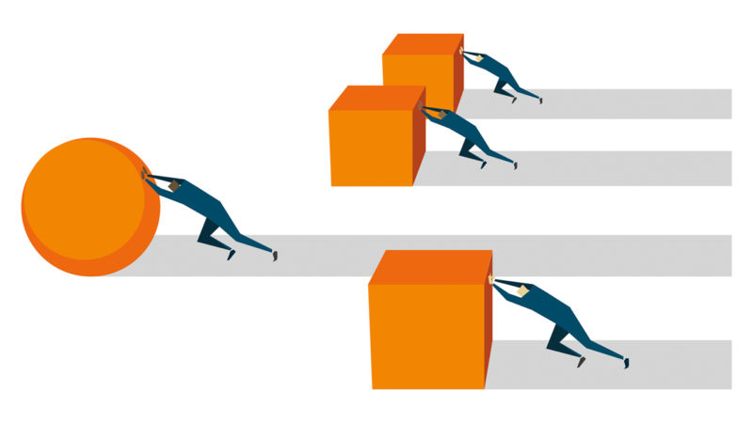

Performance
Light weight construction
Not demanding communication protocols
Clients hardware
Notes:
Performance of the created solution was important to us, as we wanted it to not only achieve the required uses cases, but also be well like by its users. While testing the product we have noticed, that daily activities can be performed really fast, only time when performing the tasks was noticeably slower was only when starting the application, but that was to be expected, due to application being built.
To achieve highly performing application we decided to make everything as simple as possible, limiting the waste of processing time while doing something unnecessary. Another thing we determined would be useful was, to use Web API, as it is light weight architectural style, meaning, that unlike SOAP which is protocol, we had to exchange only the necessary information, to perform task. In our opinion the thing that will effect the end users application performance the most could be the hardware they choose for hosting this service, as although the created solution is not hardware intensive use of weak server could ruin performance for all of the users.

Slide 8

Supportability
Swagger
1
Logging
2
Notes:
The supportability in our project is ensured in 2 different ways: The extensive documentation of the web api, allowing future dev teams to easily see what the api’s functionality is and how they can best use it, to create a new type of client. And through the logging system we have set up. System which allows the support team, to reproduce any errors that the users may encounter, thus easing the struggle in finding a way to fix the issue. And the way this system works, is: every time a request is made to the api, the request is intercepted by the logger, before reaching the endpoint, it’s url, headers and body are recorded, then forwarded to the required endpoint. Once the endpoint is ready to return a response, the response is intercepted by the logger, recorded and then forwarded back to the client. Later on, when a user requests some assistance, the support team, can easily go into the database, see exactly the specified entry and try to aid the user.

Slide 9
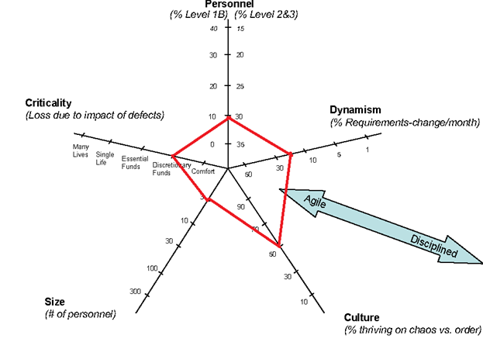
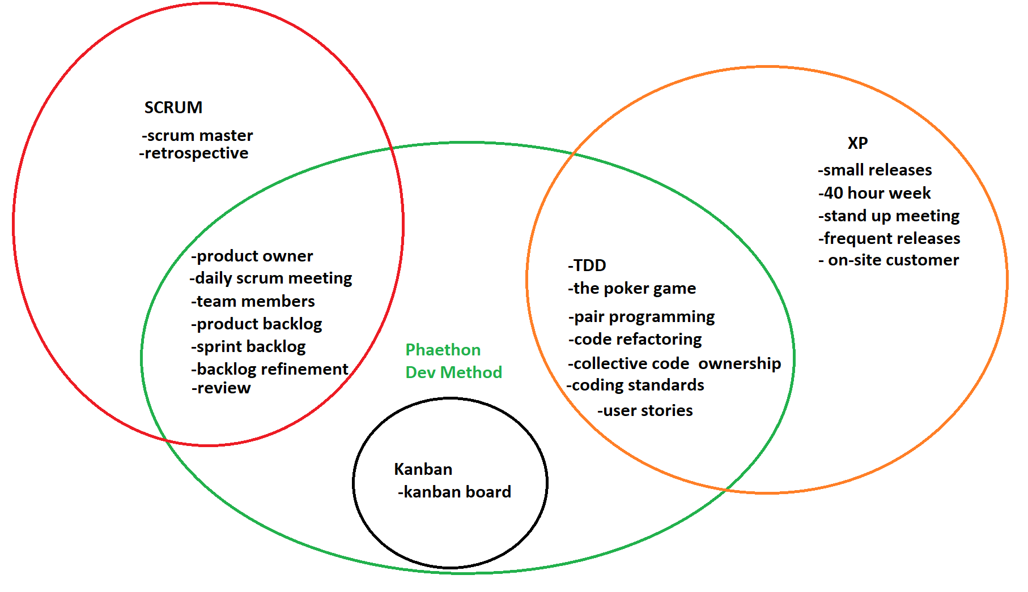

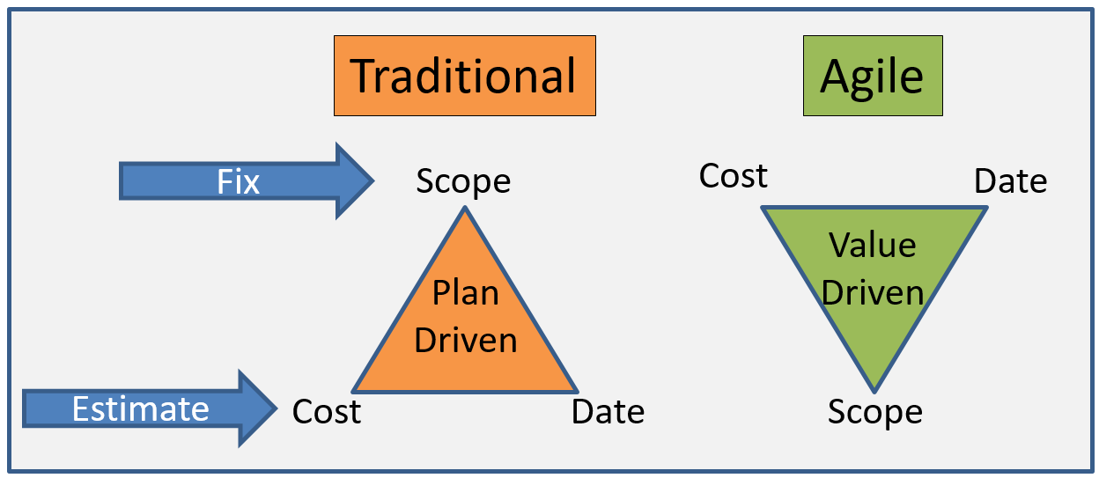
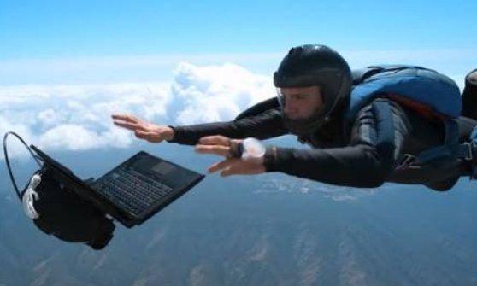
Developement methods
Notes:
Adam: Plan vs Agile
Andrei: Why we chose what we did
Ralfs: Describe the picture

Slide 10








Sprints
Analysis
Product development
Quality assurance
Notes:
Andrei: the initials Ralfs: the middle Adam: end it ()your own life you piece of shit

Slide 11

The application

