Slide 1
W.A.S.P.
By Ralfs Zangis
& Birta Andrei

Slide 2
Presentation Plan
Who we are
What we did
How we did
Final thoughts
QNA

Slide 3
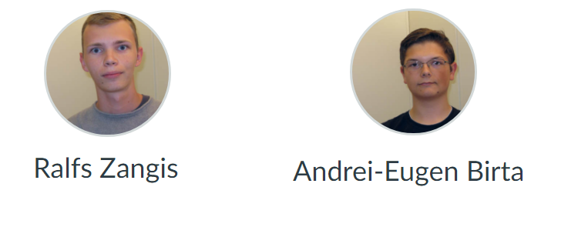
Who are we?

Slide 4
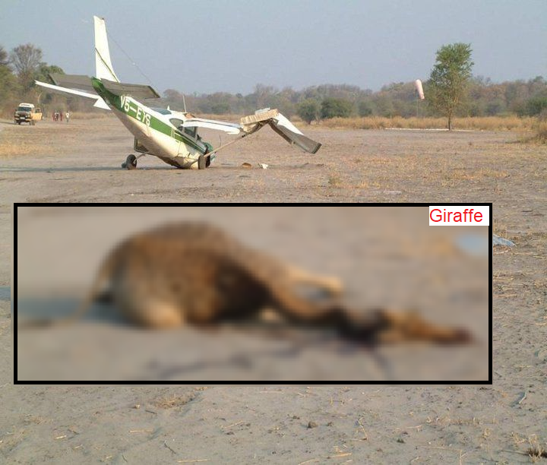
What did we do?
Wildlife
Aircraft
Strike
Project

Slide 5
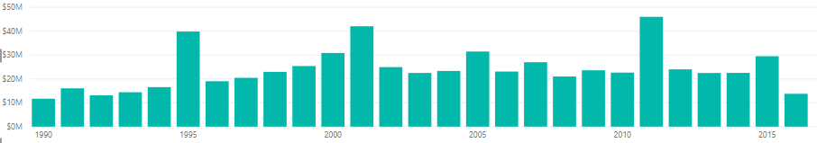
Why this subject and not something else?
142.921.417 total flights 2009-2017 in the USA
86.877 strikes 2009-2017 in the USA
0.06% collision rate in the USA
532 million US$ (457 million euros)

Slide 6
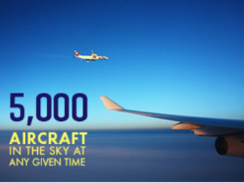
Why this subject and not something else?
87.000 average flights per day

Slide 7
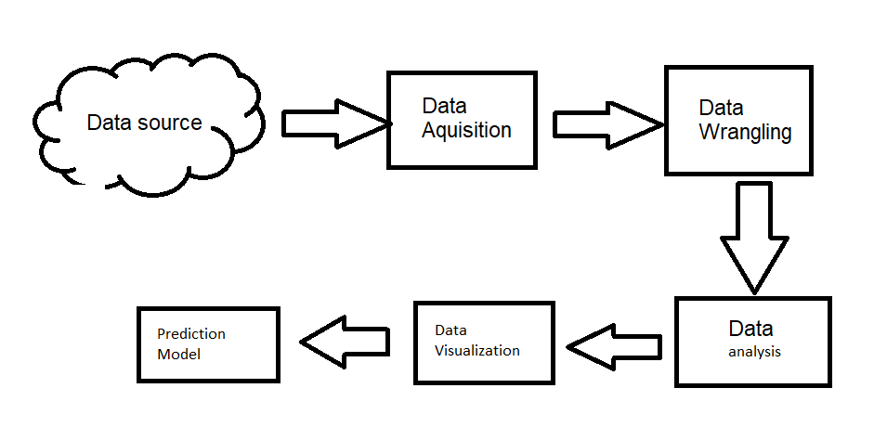
How are we reducing the number of collisions?

Slide 8
How is all that stuff, reducing the collision rate?
Educating
Predicting
Prescribing

Slide 9
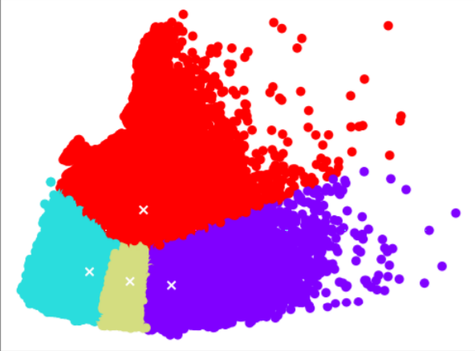
What about that Prediction Model, how does it work?
Unsupervised (K-means)
Supervised (decision tree)
Notes:
combination
k means, data refining(click)
how: clusters (elbow analysis)
why: clusters how could it help, 1 cluster is more likely

Slide 10
How does the model make a decision?
Supervised learning (decision tree)
Accuracy:
99.55% (combined)
99.53% (tree only)
Notes:
decision tree
accuracity
file

Slide 11
How did we manage to achieve this?
Development framework: Kanban
Total working time: ~500 hours (combined)
Notes:
what we used
how much time
most in reserch
followed by data cleaning

Slide 12
Data Wrangling
Identifying Missing Values
Handle N/A
Data Formatting
Data Normalization
Notes:
pyhton
started by reviewing data
determined nan values
mode mean median or removing
correct format (datetime instead of string)
normalized values (airport name in place of id)
15 ways of saying dove

Slide 13
The End?

