Slide 1
W.A.S.P.
By Ralfs Zangis
& Birta Andrei

Slide 2
Presentation Plan
Who we are
What we did
How we did
Final thoughts
QNA

Slide 3
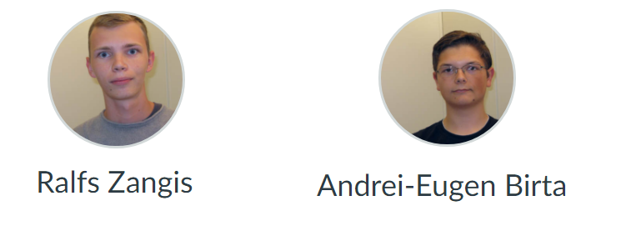
Who are we?

Slide 4
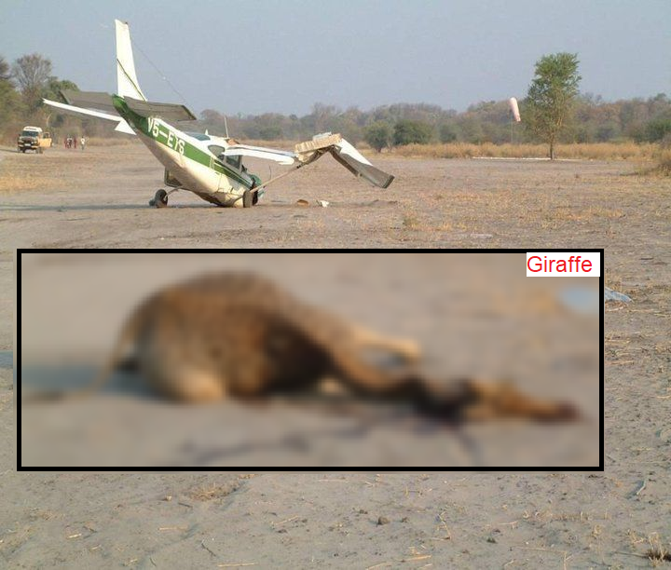
What did we do?
Wildlife
Aircraft
Strike
Project

Slide 5
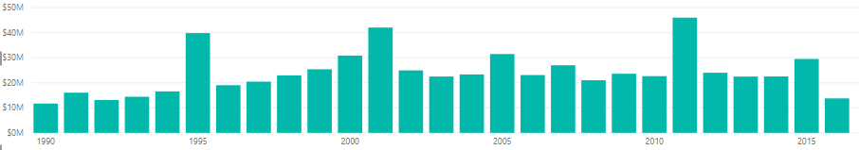
Why this subject and not something else?
142.921.417 total flights 2009-2017 in the USA
86.877 strikes 2009-2017 in the USA
0.06% collision rate in the USA
532 million US$ (457 million euros)

Slide 6
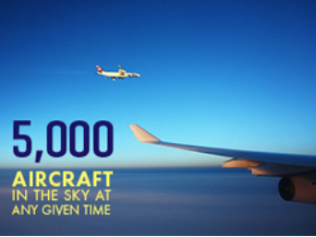
Why this subject and not something else?
87.000 average flights per day

Slide 7
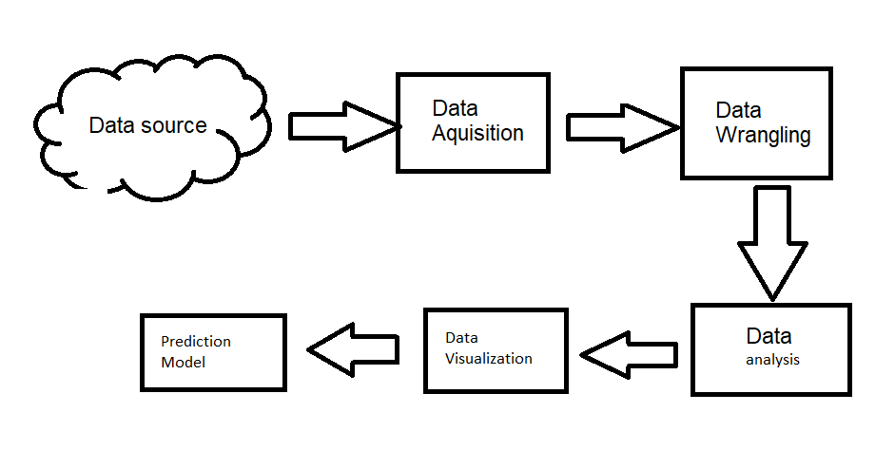
How are we reducing the number of collisions?

Slide 8
How is all that stuff, reducing the collision rate?
Educating
Predicting
Prescribing

Slide 9
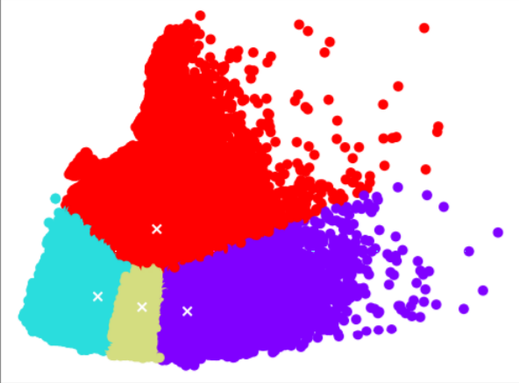
What about that Prediction Model, how does it work?
Unsupervised (K-means)
Supervised (decision tree)

Slide 10
How does the model make a decision?
Supervised learning (decision tree)
Accuracy:
99.55% (combined)
99.53% (tree only)

Slide 11
How did we manage to achieve this?
Development framework: Kanban
Total working time: ~500 hours (combined)

Slide 12
Data Wrangling
Identifying Missing Values
Handle N/A
Data Formatting
Data Normalization

Slide 13
The End?

