Slide 1
Automatic Mail Delivery Notification
IoT-Group Final Pitch
Raid Dokhan and Anas Homsi
16.07.2025

Slide 2
Idea:
Annoying to always check mailbox and have it be empty
Waiting on an important letter and having to check multiple times a day

Slide 3
Objective:
See status of your mailbox (empty/full) on user dashboard (custom website)
Get notification when mail is delivered to you (push-notifications)
Log the times at which mailbox was filled/emptied

Slide 4
Hardware:
Arduino Nano ESP32
Ultrasonic Sensor
Powerbank

Slide 5
Software:
Backend:
MCU in deep-sleep until woken up (based on periodic timer)
Detect letter using ultrasonic sensor (measurement)
Send information to Webhosting-Service (www.lima-city.de)
Webhosting-Service → push-notifications via App (Ntfy)
Frontend:
Webapp to view mailbox status
Mobile App (Ntfy) to receive push-notifications

Slide 6
Final Sensor:

Slide 7
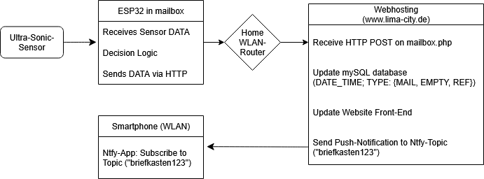
Dataflow:

Slide 8
Script logic on MCU

Slide 9
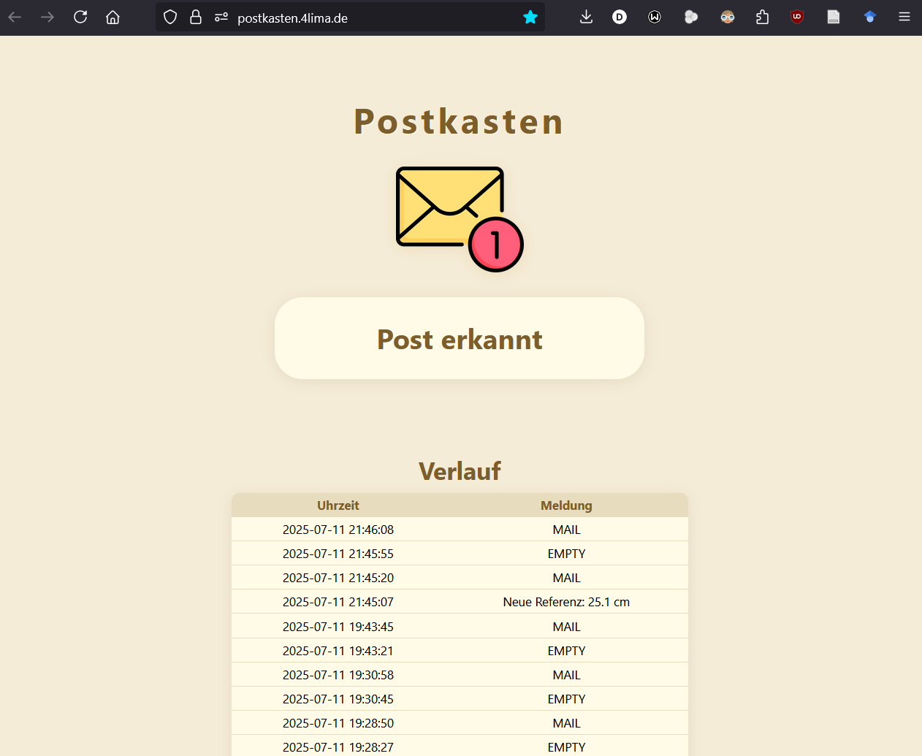
Website (www.lima-city.de) URL : www.postkasten.4lima.de

