Slide 1
Airbus Ship Detection
Traditional machine learning and CNN comparison
Machine Learning Mini Project
Image-level classification: Ship vs No Ship
Kaggle Airbus Ship Detection Challenge
1

Slide 2
Problem and dataset
192,556 labelled images in the attached dataset
42,556 ship images and 150,000 no-ship images
Run-length annotations converted into one label per image
Images resized to 128 x 128 for the experiment
The dataset is imbalanced, so accuracy is not enough
2

Slide 3
Data preparation
Read the annotation CSV and group rows by ImageId
Mark an image as Ship when at least one annotation is present
Locate images from either train_v2/ or train_v2.zip
Use stratified samples so both classes appear in each split
Keep the complete workflow inside one Kaggle notebook
3

Slide 4
Models and features
Traditional models: Random Forest, Linear SVM, KNN, Gaussian Naive Bayes, and LDA
Features: normalized HSV colour histogram plus HOG texture/shape features
CNN: convolution and pooling blocks, global average pooling, dropout, and dense layers
CNN images are streamed in batches to control memory use
Class weights are used during CNN training
4

Slide 5
Experimental setup
Traditional ML: 3,000 images, 80/20 stratified train-test split
CNN: 5,000-image stratified sample with training, validation, and test sets
Metrics: accuracy, precision, recall, and F1-score
Outputs: JSON metrics, CSV comparison, trained models, and plots
Execution environment: Kaggle Notebook with Tesla T4 GPU
5

Slide 6
Model comparison
Values from the completed Kaggle run
Model | Accuracy | Precision | Recall | F1-score
Random Forest | 0.857 | 0.851 | 0.429 | 0.570
Naive Bayes | 0.477 | 0.286 | 0.910 | 0.435
Svm | 0.713 | 0.367 | 0.406 | 0.386
Lda | 0.730 | 0.347 | 0.248 | 0.289
Cnn | 0.787 | 0.562 | 0.163 | 0.253
Knn | 0.790 | 0.889 | 0.060 | 0.113
6

Slide 7
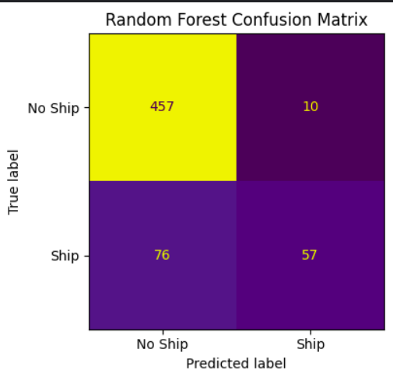
Random Forest result
Best overall balance in this experiment
Accuracy: 0.857
Precision: 0.851
Recall: 0.429
F1-score: 0.570
7

Slide 8
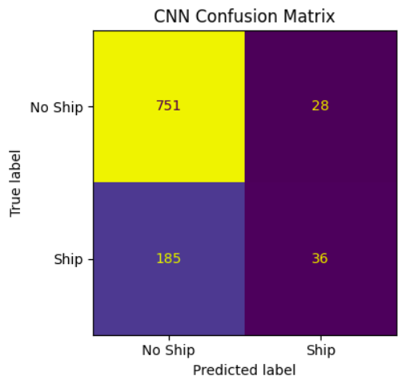
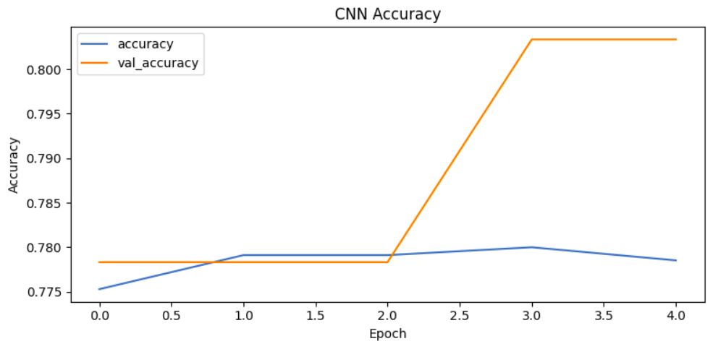
CNN result
Higher accuracy, but many ship images are still missed
Accuracy: 0.787
Precision: 0.563
Recall: 0.163
F1-score: 0.253
8

Slide 9
Conclusion and next steps
Random Forest is the strongest baseline according to F1-score
The CNN needs better ship recall before it can be preferred for this task
Accuracy should be read together with precision, recall, and F1-score
Next steps: transfer learning, augmentation, threshold tuning, and ship localization
The notebook and all generated outputs are included in the repository
9

