Slide 1
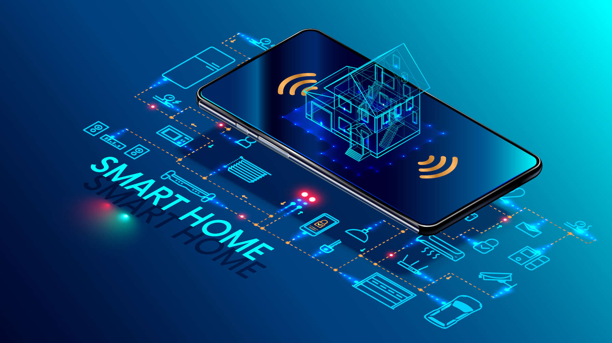




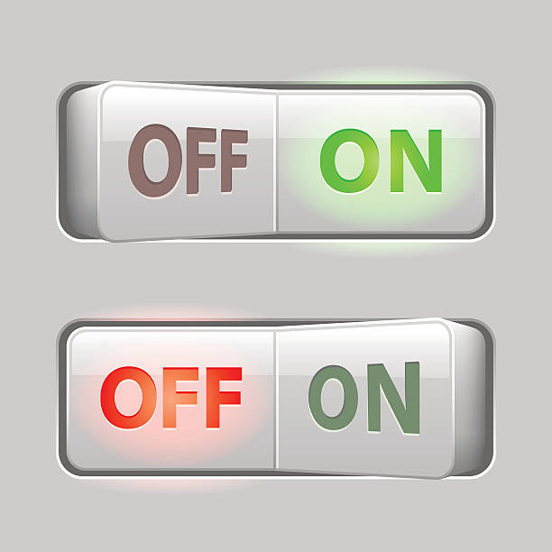

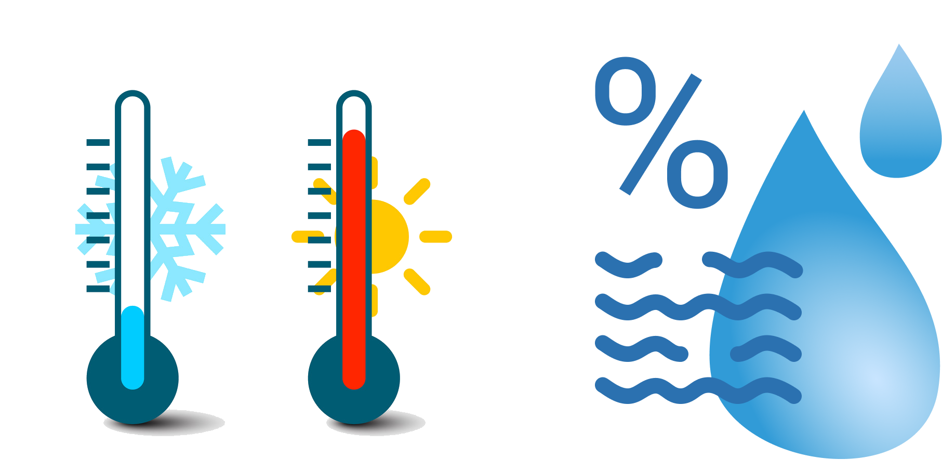

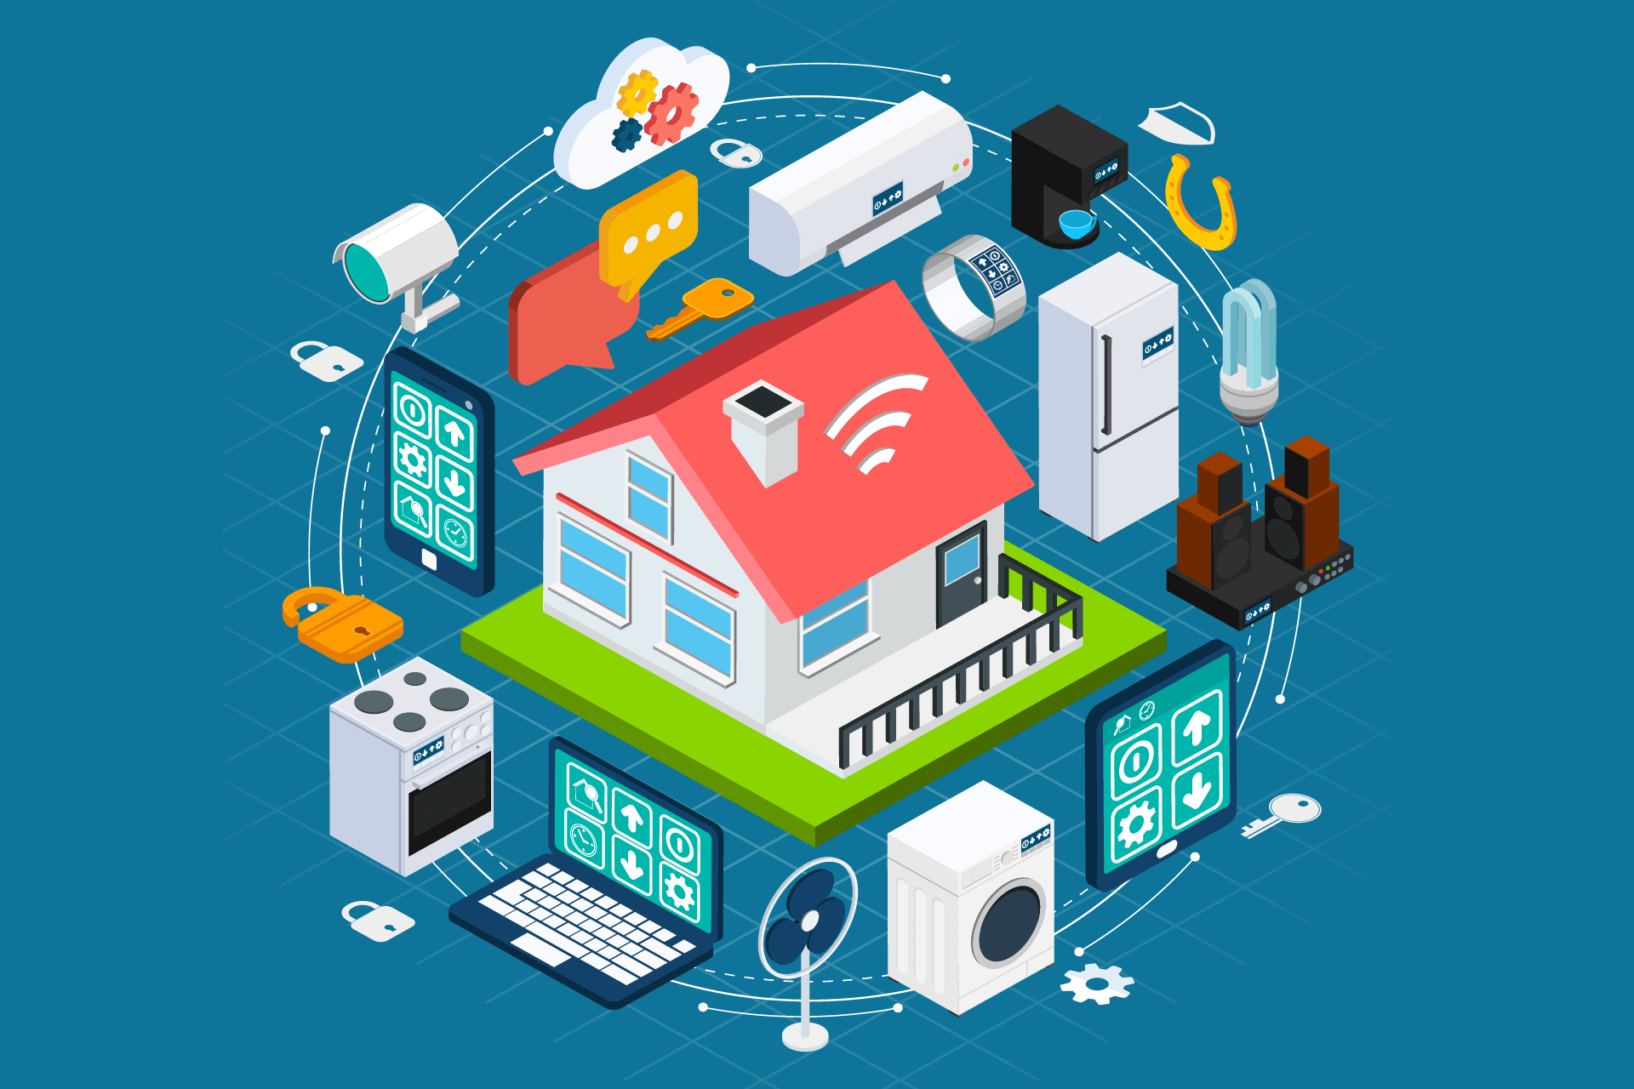
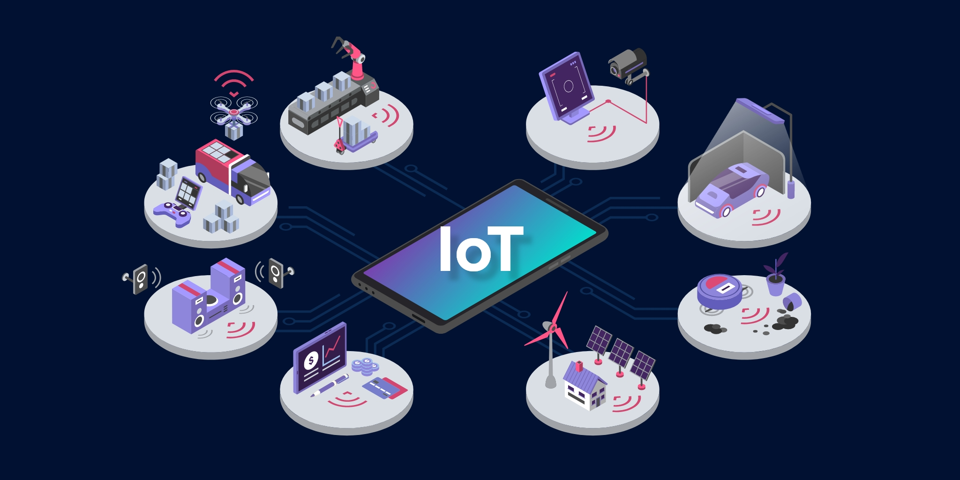
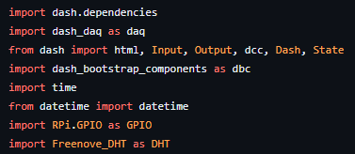
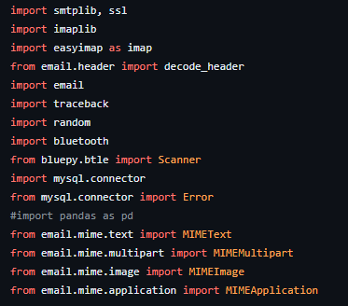
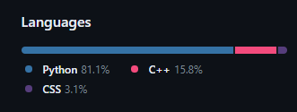


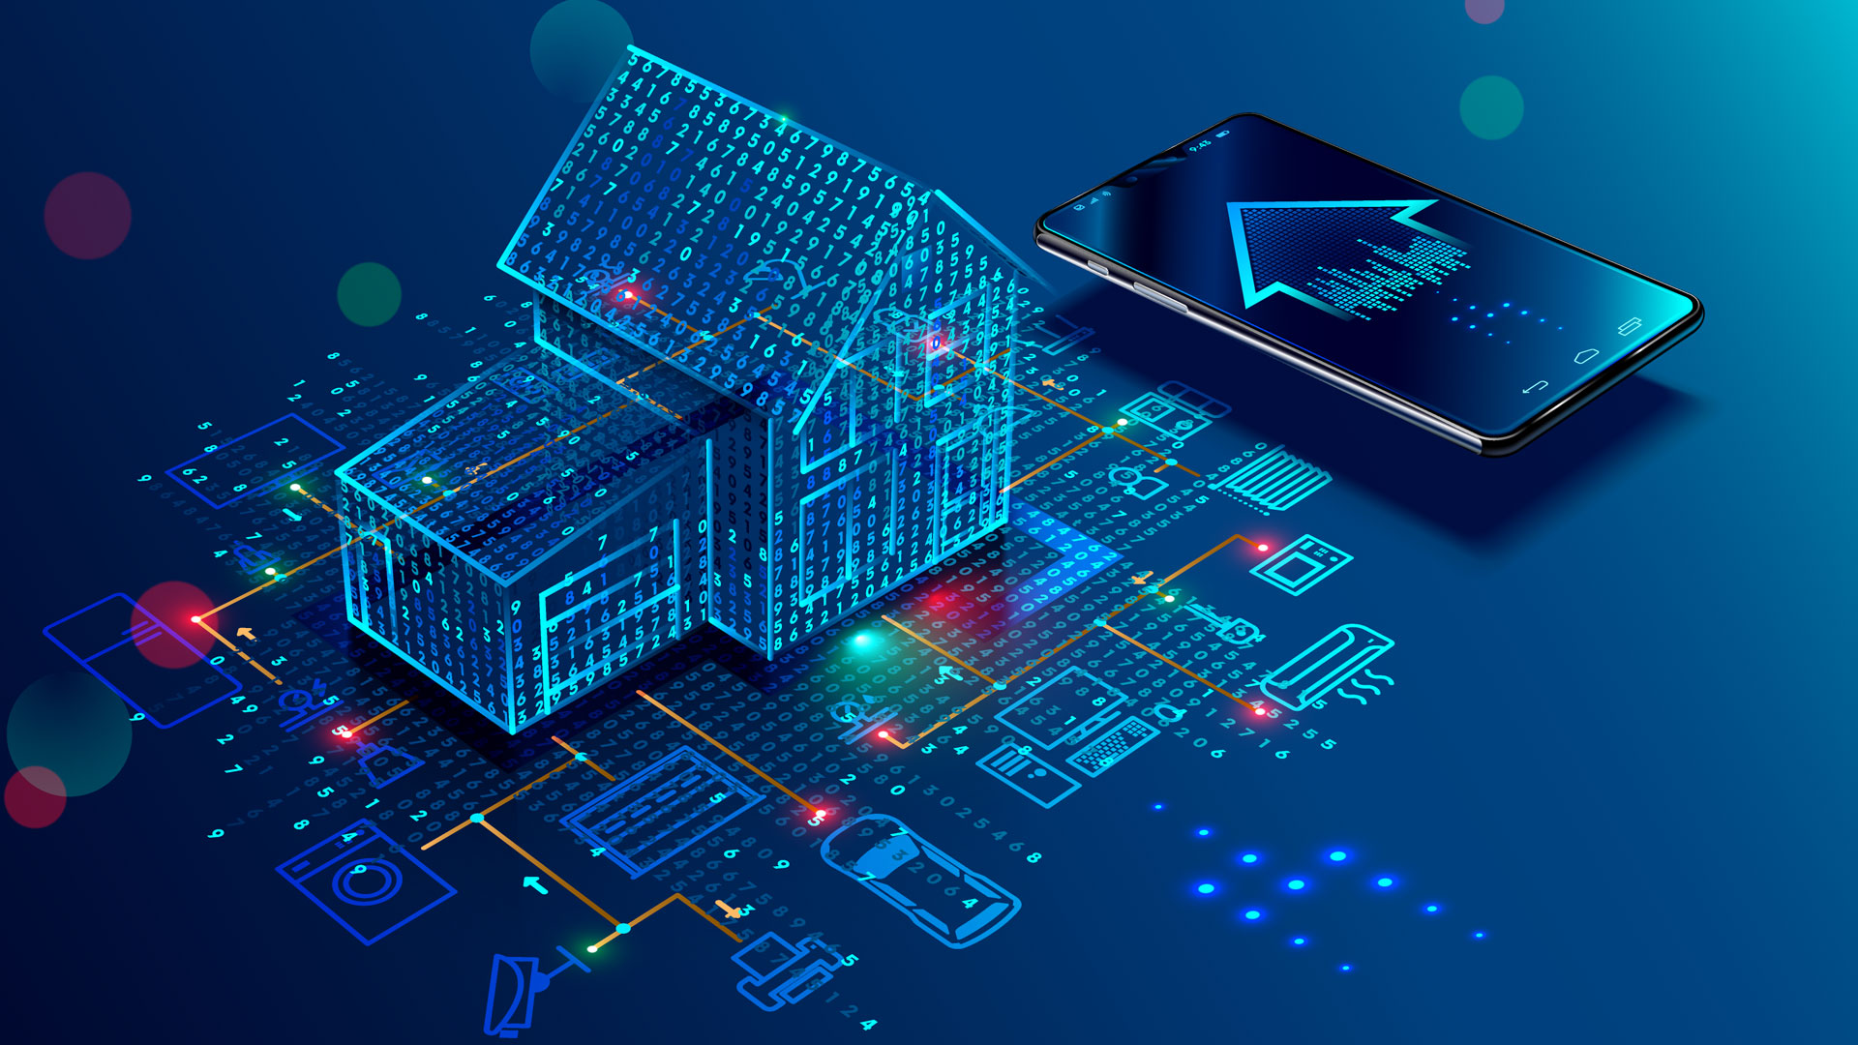

Smart Home
by Tiqwa
Developing hope for a better future together
أمل
תקווה
Your comfort is our priority!
Awad, Ibrahim
Patel, Deven
Raigorodskyi, Igor
Agenda
- Project scopes and objectives
- Deliverables 1-2-3-4
- Requirements and Materials
- Work Breakdown Structure
- Method and solution
1
Your comfort is our objective!
- Smart Lighting System
- Smart Climatization
- Smart Tracking System
- Client Authentication
2
Deliverable 1
Turning on the LED
Data Capture
Switch button on Dashboard
ON/OFF modes on the switch
Data Communication
Capturing Switch State transferred to RPi
Data Presentation
Turning on or off the LED depending on the Switch status
Icon of the button should change according to the Switch status
3
Deliverable 2
Temperature and Humidity Capture
Data Capture
DHT-11 sensor captures current temperature and humidity
Data Communication
Transferring captured data to RPi
Data Presentation
Dashboard should display the captured data using a gauge
The dashboard must contain a Fan icon
If the temperature is greater than 24°C, an email should be sent asking to turn on the Fan
If the response is “Yes”, the Fan icon should be switched to ON, otherwise – it stays the same
The RPi should, as well, turn on the fan (motor), if the response to the email was “Yes”
4
Deliverable 3
Smart Lightening System
Data Capture
Photoresistor, connected to ESP8266, captures the light intensity
Data Communication
Captured Data via a Wi-Fi connection transfers data to the MQTT-broker
The RPi receives the data through the subscription to the broker
If the light intensity is below 400, the RPi will turn on the LED and send
an email that LED was turned on at the moment
Data Presentation
The dashboard must contain a bar displaying current light intensity, as well as
an LED icon that would change depending on the status of the LED
“Email Sent” message will be displayed on the dashboard when email is sent
5
Deliverable 4
Smart Home - Final
Data Capture
All the previously mentioned devices connected
RFID reader connected to the ESP8266 captures RFID tags
Data Communication
All data communication previously mentioned connected
functioning together
ESP8266, when reads an RFID tag, sends it to the MQTT broker.
The RPi sends an email saying, that this person entered the
room at the moment
The settings (Temperature, Humidity, Light Intensity thresholds)
change to user’s preferences
Data Presentation
Full dashboard displaying all functions and settings of the previous 2 deliverables
Preferred user’s settings and their name are displayed on the dashboard
The dashboard displays the number of Bluetooth devices around the RPi
6
Requirements and Materials
Software
Arduino
Mosquitto, MQTT broker
Thonny IDE
Programming Languages
Python
C++/Arduino
CSS/HTML
JavaScript (only in the beginning)
7
Requirements and Materials
Hardware
Wires
DHT-11
LED
Photoresistor
ESP8266
RFID reader
RFID tags
Motor
Resistors
Breadboard
RaspberryPi
8
Work Breakdown Structure
Deven
Motor connection
Sending/Receiving email script
Turning on the motor/fan
Help with connecting other parts of the hardware and help with frontend
Ibrahim
Most of frontend development
Connection of captured data to the Dashboard
Assuring accurate data display
Help with connecting some parts of hardware
Igor
Most of the hardware connection
Assuring data communication
Calling functions, receiving broker messages, updating information, etc.
Help with frontend development
9
Method and Solution
Objective - Building a Smart Home
Data capture
DHT reader, Photoresistor, Wires, Resistors, RFID-reader
Breadboard
RaspberryPi
Data communication
Python, Arduino/C++, MQTT-broker, Wi-Fi, ESP8266
Data Presentation
HTML/CSS, Images
Python, Wi-Fi, MQTT-broker
10
Q&A

Slide 2
Smart Home
by Tiqwa
Developing hope for a better future together
أمل
תקווה
Your comfort is our priority!
Awad, Ibrahim
Patel, Deven
Raigorodskyi, Igor
Agenda
- Project scopes and objectives
- Deliverables 1-2-3-4
- Requirements and Materials
- Work Breakdown Structure
- Method and solution
1
Your comfort is our objective!
- Smart Lighting System
- Smart Climatization
- Smart Tracking System
- Client Authentication
2
Deliverable 1
Turning on the LED
Data Capture
Switch button on Dashboard
ON/OFF modes on the switch
Data Communication
Capturing Switch State transferred to RPi
Data Presentation
Turning on or off the LED depending on the Switch status
Icon of the button should change according to the Switch status
3
Deliverable 2
Temperature and Humidity Capture
Data Capture
DHT-11 sensor captures current temperature and humidity
Data Communication
Transferring captured data to RPi
Data Presentation
Dashboard should display the captured data using a gauge
The dashboard must contain a Fan icon
If the temperature is greater than 24°C, an email should be sent asking to turn on the Fan
If the response is “Yes”, the Fan icon should be switched to ON, otherwise – it stays the same
The RPi should, as well, turn on the fan (motor), if the response to the email was “Yes”
4
Deliverable 3
Smart Lightening System
Data Capture
Photoresistor, connected to ESP8266, captures the light intensity
Data Communication
Captured Data via a Wi-Fi connection transfers data to the MQTT-broker
The RPi receives the data through the subscription to the broker
If the light intensity is below 400, the RPi will turn on the LED and send
an email that LED was turned on at the moment
Data Presentation
The dashboard must contain a bar displaying current light intensity, as well as
an LED icon that would change depending on the status of the LED
“Email Sent” message will be displayed on the dashboard when email is sent
5
Deliverable 4
Smart Home - Final
Data Capture
All the previously mentioned devices connected
RFID reader connected to the ESP8266 captures RFID tags
Data Communication
All data communication previously mentioned connected
functioning together
ESP8266, when reads an RFID tag, sends it to the MQTT broker.
The RPi sends an email saying, that this person entered the
room at the moment
The settings (Temperature, Humidity, Light Intensity thresholds)
change to user’s preferences
Data Presentation
Full dashboard displaying all functions and settings of the previous 2 deliverables
Preferred user’s settings and their name are displayed on the dashboard
The dashboard displays the number of Bluetooth devices around the RPi
6
Requirements and Materials
Software
Arduino
Mosquitto, MQTT broker
Thonny IDE
Programming Languages
Python
C++/Arduino
CSS/HTML
JavaScript (only in the beginning)
7
Requirements and Materials
Hardware
Wires
DHT-11
LED
Photoresistor
ESP8266
RFID reader
RFID tags
Motor
Resistors
Breadboard
RaspberryPi
8
Work Breakdown Structure
Deven
Motor connection
Sending/Receiving email script
Turning on the motor/fan
Help with connecting other parts of the hardware and help with frontend
Ibrahim
Most of frontend development
Connection of captured data to the Dashboard
Assuring accurate data display
Help with connecting some parts of hardware
Igor
Most of the hardware connection
Assuring data communication
Calling functions, receiving broker messages, updating information, etc.
Help with frontend development
9
Method and Solution
Objective - Building a Smart Home
Data capture
DHT reader, Photoresistor, Wires, Resistors, RFID-reader
Breadboard
RaspberryPi
Data communication
Python, Arduino/C++, MQTT-broker, Wi-Fi, ESP8266
Data Presentation
HTML/CSS, Images
Python, Wi-Fi, MQTT-broker
10
Q&A

Slide 3
Smart Home
by Tiqwa
Developing hope for a better future together
أمل
תקווה
Your comfort is our priority!
Awad, Ibrahim
Patel, Deven
Raigorodskyi, Igor
Agenda
- Project scopes and objectives
- Deliverables 1-2-3-4
- Requirements and Materials
- Work Breakdown Structure
- Method and solution
1
Your comfort is our objective!
- Smart Lighting System
- Smart Climatization
- Smart Tracking System
- Client Authentication
2
Deliverable 1
Turning on the LED
Data Capture
Switch button on Dashboard
ON/OFF modes on the switch
Data Communication
Capturing Switch State transferred to RPi
Data Presentation
Turning on or off the LED depending on the Switch status
Icon of the button should change according to the Switch status
3
Deliverable 2
Temperature and Humidity Capture
Data Capture
DHT-11 sensor captures current temperature and humidity
Data Communication
Transferring captured data to RPi
Data Presentation
Dashboard should display the captured data using a gauge
The dashboard must contain a Fan icon
If the temperature is greater than 24°C, an email should be sent asking to turn on the Fan
If the response is “Yes”, the Fan icon should be switched to ON, otherwise – it stays the same
The RPi should, as well, turn on the fan (motor), if the response to the email was “Yes”
4
Deliverable 3
Smart Lightening System
Data Capture
Photoresistor, connected to ESP8266, captures the light intensity
Data Communication
Captured Data via a Wi-Fi connection transfers data to the MQTT-broker
The RPi receives the data through the subscription to the broker
If the light intensity is below 400, the RPi will turn on the LED and send
an email that LED was turned on at the moment
Data Presentation
The dashboard must contain a bar displaying current light intensity, as well as
an LED icon that would change depending on the status of the LED
“Email Sent” message will be displayed on the dashboard when email is sent
5
Deliverable 4
Smart Home - Final
Data Capture
All the previously mentioned devices connected
RFID reader connected to the ESP8266 captures RFID tags
Data Communication
All data communication previously mentioned connected
functioning together
ESP8266, when reads an RFID tag, sends it to the MQTT broker.
The RPi sends an email saying, that this person entered the
room at the moment
The settings (Temperature, Humidity, Light Intensity thresholds)
change to user’s preferences
Data Presentation
Full dashboard displaying all functions and settings of the previous 2 deliverables
Preferred user’s settings and their name are displayed on the dashboard
The dashboard displays the number of Bluetooth devices around the RPi
6
Requirements and Materials
Software
Arduino
Mosquitto, MQTT broker
Thonny IDE
Programming Languages
Python
C++/Arduino
CSS/HTML
JavaScript (only in the beginning)
7
Requirements and Materials
Hardware
Wires
DHT-11
LED
Photoresistor
ESP8266
RFID reader
RFID tags
Motor
Resistors
Breadboard
RaspberryPi
8
Work Breakdown Structure
Deven
Motor connection
Sending/Receiving email script
Turning on the motor/fan
Help with connecting other parts of the hardware and help with frontend
Ibrahim
Most of frontend development
Connection of captured data to the Dashboard
Assuring accurate data display
Help with connecting some parts of hardware
Igor
Most of the hardware connection
Assuring data communication
Calling functions, receiving broker messages, updating information, etc.
Help with frontend development
9
Method and Solution
Objective - Building a Smart Home
Data capture
DHT reader, Photoresistor, Wires, Resistors, RFID-reader
Breadboard
RaspberryPi
Data communication
Python, Arduino/C++, MQTT-broker, Wi-Fi, ESP8266
Data Presentation
HTML/CSS, Images
Python, Wi-Fi, MQTT-broker
10
Q&A

Slide 4
Smart Home
by Tiqwa
Developing hope for a better future together
أمل
תקווה
Your comfort is our priority!
Awad, Ibrahim
Patel, Deven
Raigorodskyi, Igor
Agenda
- Project scopes and objectives
- Deliverables 1-2-3-4
- Requirements and Materials
- Work Breakdown Structure
- Method and solution
1
Your comfort is our objective!
- Smart Lighting System
- Smart Climatization
- Smart Tracking System
- Client Authentication
2
Deliverable 1
Turning on the LED
Data Capture
Switch button on Dashboard
ON/OFF modes on the switch
Data Communication
Capturing Switch State transferred to RPi
Data Presentation
Turning on or off the LED depending on the Switch status
Icon of the button should change according to the Switch status
3
Deliverable 2
Temperature and Humidity Capture
Data Capture
DHT-11 sensor captures current temperature and humidity
Data Communication
Transferring captured data to RPi
Data Presentation
Dashboard should display the captured data using a gauge
The dashboard must contain a Fan icon
If the temperature is greater than 24°C, an email should be sent asking to turn on the Fan
If the response is “Yes”, the Fan icon should be switched to ON, otherwise – it stays the same
The RPi should, as well, turn on the fan (motor), if the response to the email was “Yes”
4
Deliverable 3
Smart Lightening System
Data Capture
Photoresistor, connected to ESP8266, captures the light intensity
Data Communication
Captured Data via a Wi-Fi connection transfers data to the MQTT-broker
The RPi receives the data through the subscription to the broker
If the light intensity is below 400, the RPi will turn on the LED and send
an email that LED was turned on at the moment
Data Presentation
The dashboard must contain a bar displaying current light intensity, as well as
an LED icon that would change depending on the status of the LED
“Email Sent” message will be displayed on the dashboard when email is sent
5
Deliverable 4
Smart Home - Final
Data Capture
All the previously mentioned devices connected
RFID reader connected to the ESP8266 captures RFID tags
Data Communication
All data communication previously mentioned connected
functioning together
ESP8266, when reads an RFID tag, sends it to the MQTT broker.
The RPi sends an email saying, that this person entered the
room at the moment
The settings (Temperature, Humidity, Light Intensity thresholds)
change to user’s preferences
Data Presentation
Full dashboard displaying all functions and settings of the previous 2 deliverables
Preferred user’s settings and their name are displayed on the dashboard
The dashboard displays the number of Bluetooth devices around the RPi
6
Requirements and Materials
Software
Arduino
Mosquitto, MQTT broker
Thonny IDE
Programming Languages
Python
C++/Arduino
CSS/HTML
JavaScript (only in the beginning)
7
Requirements and Materials
Hardware
Wires
DHT-11
LED
Photoresistor
ESP8266
RFID reader
RFID tags
Motor
Resistors
Breadboard
RaspberryPi
8
Work Breakdown Structure
Deven
Motor connection
Sending/Receiving email script
Turning on the motor/fan
Help with connecting other parts of the hardware and help with frontend
Ibrahim
Most of frontend development
Connection of captured data to the Dashboard
Assuring accurate data display
Help with connecting some parts of hardware
Igor
Most of the hardware connection
Assuring data communication
Calling functions, receiving broker messages, updating information, etc.
Help with frontend development
9
Method and Solution
Objective - Building a Smart Home
Data capture
DHT reader, Photoresistor, Wires, Resistors, RFID-reader
Breadboard
RaspberryPi
Data communication
Python, Arduino/C++, MQTT-broker, Wi-Fi, ESP8266
Data Presentation
HTML/CSS, Images
Python, Wi-Fi, MQTT-broker
10
Q&A

Slide 5
Smart Home
by Tiqwa
Developing hope for a better future together
أمل
תקווה
Your comfort is our priority!
Awad, Ibrahim
Patel, Deven
Raigorodskyi, Igor
Agenda
- Project scopes and objectives
- Deliverables 1-2-3-4
- Requirements and Materials
- Work Breakdown Structure
- Method and solution
1
Your comfort is our objective!
- Smart Lighting System
- Smart Climatization
- Smart Tracking System
- Client Authentication
2
Deliverable 1
Turning on the LED
Data Capture
Switch button on Dashboard
ON/OFF modes on the switch
Data Communication
Capturing Switch State transferred to RPi
Data Presentation
Turning on or off the LED depending on the Switch status
Icon of the button should change according to the Switch status
3
Deliverable 2
Temperature and Humidity Capture
Data Capture
DHT-11 sensor captures current temperature and humidity
Email response
Data Communication
Transferring captured data to RPi
Data Presentation
Dashboard should display the captured data using a gauge
The dashboard must contain a Fan icon
If the temperature is greater than 24°C, an email should be sent asking to turn on the Fan
If the response is “Yes”, the Fan icon should be switched to ON, otherwise – it stays the same
The RPi should, as well, turn on the fan (motor), if the response to the email was “Yes”
4
Deliverable 3
Smart Lightening System
Data Capture
Photoresistor, connected to ESP8266, captures the light intensity
Data Communication
Captured Data via a Wi-Fi connection transfers data to the MQTT-broker
The RPi receives the data through the subscription to the broker
If the light intensity is below 400, the RPi will turn on the LED and send
an email that LED was turned on at the moment
Data Presentation
The dashboard must contain a bar displaying current light intensity, as well as
an LED icon that would change depending on the status of the LED
“Email Sent” message will be displayed on the dashboard when email is sent
5
Deliverable 4
Smart Home - Final
Data Capture
All the previously mentioned devices connected
RFID reader connected to the ESP8266 captures RFID tags
Data Communication
All data communication previously mentioned connected
functioning together
ESP8266, when reads an RFID tag, sends it to the MQTT broker.
The RPi sends an email saying, that this person entered the
room at the moment
The settings (Temperature, Humidity, Light Intensity thresholds)
change to user’s preferences
Data Presentation
Full dashboard displaying all functions and settings of the previous 2 deliverables
Preferred user’s settings and their name are displayed on the dashboard
The dashboard displays the number of Bluetooth devices around the RPi
6
Requirements and Materials
Software
Arduino
Mosquitto, MQTT broker
Thonny IDE
Programming Languages
Python
C++/Arduino
CSS/HTML
JavaScript (only in the beginning)
7
Requirements and Materials
Hardware
Wires
DHT-11
LED
Photoresistor
ESP8266
RFID reader
RFID tags
Motor
Resistors
Breadboard
RaspberryPi
8
Work Breakdown Structure
Deven
Motor connection
Sending/Receiving email script
Turning on the motor/fan
Help with connecting other parts of the hardware and help with frontend
Ibrahim
Most of frontend development
Connection of captured data to the Dashboard
Assuring accurate data display
Help with connecting some parts of hardware
Igor
Most of the hardware connection
Assuring data communication
Calling functions, receiving broker messages, updating information, etc.
Help with frontend development
9
Method and Solution
Objective - Building a Smart Home
Data capture
DHT reader, Photoresistor, Wires, Resistors, RFID-reader
Breadboard
RaspberryPi
Data communication
Python, Arduino/C++, MQTT-broker, Wi-Fi, ESP8266
Data Presentation
HTML/CSS, Images
Python, Wi-Fi, MQTT-broker
10
Q&A

Slide 6
Smart Home
by Tiqwa
Developing hope for a better future together
أمل
תקווה
Your comfort is our priority!
Awad, Ibrahim
Patel, Deven
Raigorodskyi, Igor
Agenda
- Project scopes and objectives
- Deliverables 1-2-3-4
- Requirements and Materials
- Work Breakdown Structure
- Method and solution
1
Your comfort is our objective!
- Smart Lighting System
- Smart Climatization
- Smart Tracking System
- Client Authentication
2
Deliverable 1
Turning on the LED
Data Capture
Switch button on Dashboard
ON/OFF modes on the switch
Data Communication
Capturing Switch State transferred to RPi
Data Presentation
Turning on or off the LED depending on the Switch status
Icon of the button should change according to the Switch status
3
Deliverable 2
Temperature and Humidity Capture
Data Capture
DHT-11 sensor captures current temperature and humidity
Data Communication
Transferring captured data to RPi
Data Presentation
Dashboard should display the captured data using a gauge
The dashboard must contain a Fan icon
If the temperature is greater than 24°C, an email should be sent asking to turn on the Fan
If the response is “Yes”, the Fan icon should be switched to ON, otherwise – it stays the same
The RPi should, as well, turn on the fan (motor), if the response to the email was “Yes”
4
Deliverable 3
Smart Lighting System
Data Capture
Photoresistor, connected to ESP8266, captures the light intensity
Data Communication
Captured Data via a Wi-Fi connection transfers data to the MQTT-broker
via Arduino
The RPi receives the data through the subscription to the broker
If the light intensity is below 400, the RPi will turn on the LED and send
an email that LED was turned on at the moment
Data Presentation
The dashboard must contain a bar displaying current light intensity, as well as
an LED icon that would change depending on the status of the LED
“Email Sent” message will be displayed on the dashboard when email is sent
5
Deliverable 4
Smart Home - Final
Data Capture
All the previously mentioned devices connected
RFID reader connected to the ESP8266 captures RFID tags
Data Communication
All data communication previously mentioned connected
functioning together
ESP8266, when reads an RFID tag, sends it to the MQTT broker.
The RPi sends an email saying, that this person entered the
room at the moment
The settings (Temperature, Humidity, Light Intensity thresholds)
change to user’s preferences
Data Presentation
Full dashboard displaying all functions and settings of the previous 2 deliverables
Preferred user’s settings and their name are displayed on the dashboard
The dashboard displays the number of Bluetooth devices around the RPi
6
Requirements and Materials
Software
Arduino
Mosquitto, MQTT broker
Thonny IDE
Programming Languages
Python
C++/Arduino
CSS/HTML
JavaScript (only in the beginning)
7
Requirements and Materials
Hardware
Wires
DHT-11
LED
Photoresistor
ESP8266
RFID reader
RFID tags
Motor
Resistors
Breadboard
RaspberryPi
8
Work Breakdown Structure
Deven
Motor connection
Sending/Receiving email script
Turning on the motor/fan
Help with connecting other parts of the hardware and help with frontend
Ibrahim
Most of frontend development
Connection of captured data to the Dashboard
Assuring accurate data display
Help with connecting some parts of hardware
Igor
Most of the hardware connection
Assuring data communication
Calling functions, receiving broker messages, updating information, etc.
Help with frontend development
9
Method and Solution
Objective - Building a Smart Home
Data capture
DHT reader, Photoresistor, Wires, Resistors, RFID-reader
Breadboard
RaspberryPi
Data communication
Python, Arduino/C++, MQTT-broker, Wi-Fi, ESP8266
Data Presentation
HTML/CSS, Images
Python, Wi-Fi, MQTT-broker
10
Q&A

Slide 7
Smart Home
by Tiqwa
Developing hope for a better future together
أمل
תקווה
Your comfort is our priority!
Awad, Ibrahim
Patel, Deven
Raigorodskyi, Igor
Agenda
- Project scopes and objectives
- Deliverables 1-2-3-4
- Requirements and Materials
- Work Breakdown Structure
- Method and solution
1
Your comfort is our objective!
- Smart Lighting System
- Smart Climatization
- Smart Tracking System
- Client Authentication
2
Deliverable 1
Turning on the LED
Data Capture
Switch button on Dashboard
ON/OFF modes on the switch
Data Communication
Capturing Switch State transferred to RPi
Data Presentation
Turning on or off the LED depending on the Switch status
Icon of the button should change according to the Switch status
3
Deliverable 2
Temperature and Humidity Capture
Data Capture
DHT-11 sensor captures current temperature and humidity
Data Communication
Transferring captured data to RPi
Data Presentation
Dashboard should display the captured data using a gauge
The dashboard must contain a Fan icon
If the temperature is greater than 24°C, an email should be sent asking to turn on the Fan
If the response is “Yes”, the Fan icon should be switched to ON, otherwise – it stays the same
The RPi should, as well, turn on the fan (motor), if the response to the email was “Yes”
4
Deliverable 3
Smart Lightening System
Data Capture
Photoresistor, connected to ESP8266, captures the light intensity
Data Communication
Captured Data via a Wi-Fi connection transfers data to the MQTT-broker
The RPi receives the data through the subscription to the broker
If the light intensity is below 400, the RPi will turn on the LED and send
an email that LED was turned on at the moment
Data Presentation
The dashboard must contain a bar displaying current light intensity, as well as
an LED icon that would change depending on the status of the LED
“Email Sent” message will be displayed on the dashboard when email is sent
5
Deliverable 4
Smart Home - Final
Data Capture
All the previously mentioned devices connected
RFID reader connected to the ESP8266 captures RFID tags
Data Communication
All data communication previously mentioned connected
functioning together
ESP8266, when reads an RFID tag, sends it to the MQTT broker.
The RPi sends an email saying, that this person entered the
room at the moment
The settings (Temperature, Humidity, Light Intensity thresholds)
change to user’s preferences
Data Presentation
Full dashboard displaying all functions and settings of the previous 2 deliverables
Preferred user’s settings and their name are displayed on the dashboard
6
Requirements and Materials
Software
Arduino
Mosquitto, MQTT broker
Thonny IDE
Programming Languages
Python
C++/Arduino
CSS/HTML
JavaScript (only in the beginning)
7
Requirements and Materials
Hardware
Wires
DHT-11
LED
Photoresistor
ESP8266
RFID reader
RFID tags
Motor
Resistors
Breadboard
RaspberryPi
8
Work Breakdown Structure
Deven
Motor connection
Sending/Receiving email script
Turning on the motor/fan
Help with connecting other parts of the hardware and help with frontend
Ibrahim
Most of frontend development
Connection of captured data to the Dashboard
Assuring accurate data display
Help with connecting some parts of hardware
Igor
Most of the hardware connection
Assuring data communication
Calling functions, receiving broker messages, updating information, etc.
Help with frontend development
9
Method and Solution
Objective - Building a Smart Home
Data capture
DHT reader, Photoresistor, Wires, Resistors, RFID-reader
Breadboard
RaspberryPi
Data communication
Python, Arduino/C++, MQTT-broker, Wi-Fi, ESP8266
Data Presentation
HTML/CSS, Images
Python, Wi-Fi, MQTT-broker
10
Q&A

Slide 8
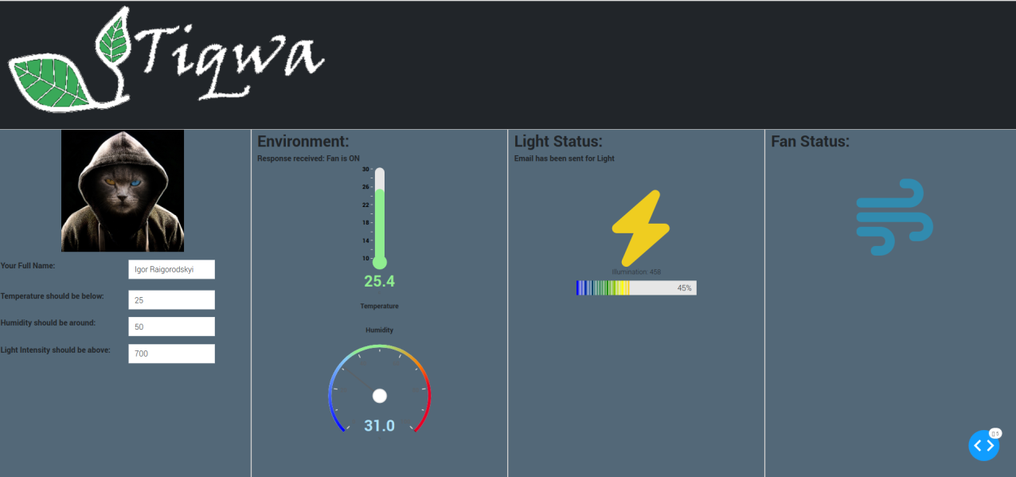
Smart Home
by Tiqwa
Developing hope for a better future together
أمل
תקווה
Your comfort is our priority!
Awad, Ibrahim
Patel, Deven
Raigorodskyi, Igor
Agenda
- Project scopes and objectives
- Deliverables 1-2-3-4
- Requirements and Materials
- Work Breakdown Structure
- Method and solution
1
Your comfort is our objective!
- Smart Lighting System
- Smart Climatization
- Smart Tracking System
- Client Authentication
2
Deliverable 1
Turning on the LED
Data Capture
Switch button on Dashboard
ON/OFF modes on the switch
Data Communication
Capturing Switch State transferred to RPi
Data Presentation
Turning on or off the LED depending on the Switch status
Icon of the button should change according to the Switch status
3
Deliverable 2
Temperature and Humidity Capture
Data Capture
DHT-11 sensor captures current temperature and humidity
Data Communication
Transferring captured data to RPi
Data Presentation
Dashboard should display the captured data using a gauge
The dashboard must contain a Fan icon
If the temperature is greater than 24°C, an email should be sent asking to turn on the Fan
If the response is “Yes”, the Fan icon should be switched to ON, otherwise – it stays the same
The RPi should, as well, turn on the fan (motor), if the response to the email was “Yes”
4
Deliverable 4
Smart Home - Final
Deliverable 3
Data Capture
All the previously mentioned devices connected
RFID reader connected to the ESP8266 captures RFID tags
Data Communication
All data communication previously mentioned connected
functioning together
ESP8266, when reads an RFID tag, sends it to the MQTT broker.
The RPi sends an email saying, that this person entered the
room at the moment
The settings (Temperature, Humidity, Light Intensity thresholds)
change to user’s preferences
Data Presentation
Full dashboard displaying all functions and settings of the previous 2 deliverables
Preferred user’s settings and their name are displayed on the dashboard
The dashboard displays the number of Bluetooth devices around the RPi
Smart Lightening System
Data Capture
Photoresistor, connected to ESP8266, captures the light intensity
Data Communication
Captured Data via a Wi-Fi connection transfers data to the MQTT-broker
The RPi receives the data through the subscription to the broker
If the light intensity is below 400, the RPi will turn on the LED and send
an email that LED was turned on at the moment
Data Presentation
The dashboard must contain a bar displaying current light intensity, as well as
an LED icon that would change depending on the status of the LED
“Email Sent” message will be displayed on the dashboard when email is sent
5
6
7
Requirements and Materials
Software
Arduino
Mosquitto, MQTT broker
Thonny IDE
Programming Languages
Python
C++/Arduino
CSS/HTML
JavaScript (only in the beginning)
7
Requirements and Materials
Hardware
Wires
DHT-11
LED
Photoresistor
ESP8266
RFID reader
RFID tags
Motor
Resistors
Breadboard
RaspberryPi
8
Work Breakdown Structure
Deven
Motor connection
Sending/Receiving email script
Turning on the motor/fan
Help with connecting other parts of the hardware and help with frontend
Ibrahim
Most of frontend development
Connection of captured data to the Dashboard
Assuring accurate data display
Help with connecting some parts of hardware
Igor
Most of the hardware connection
Assuring data communication
Calling functions, receiving broker messages, updating information, etc.
Help with frontend development
9
Method and Solution
Objective - Building a Smart Home
Data capture
DHT reader, Photoresistor, Wires, Resistors, RFID-reader
Breadboard
RaspberryPi
Data communication
Python, Arduino/C++, MQTT-broker, Wi-Fi, ESP8266
Data Presentation
HTML/CSS, Images
Python, Wi-Fi, MQTT-broker
10
Q&A

Slide 9
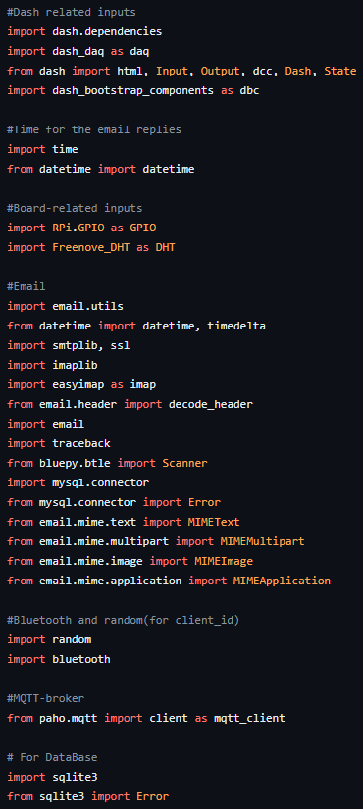
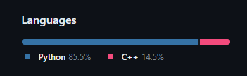
Smart Home
by Tiqwa
Developing hope for a better future together
أمل
תקווה
Your comfort is our priority!
Awad, Ibrahim
Patel, Deven
Raigorodskyi, Igor
Agenda
- Project scopes and objectives
- Deliverables 1-2-3-4
- Requirements and Materials
- Work Breakdown Structure
- Method and solution
1
Your comfort is our objective!
- Smart Lighting System
- Smart Climatization
- Smart Tracking System
- Client Authentication
2
Deliverable 1
Turning on the LED
Data Capture
Switch button on Dashboard
ON/OFF modes on the switch
Data Communication
Capturing Switch State transferred to RPi
Data Presentation
Turning on or off the LED depending on the Switch status
Icon of the button should change according to the Switch status
3
Deliverable 2
Temperature and Humidity Capture
Data Capture
DHT-11 sensor captures current temperature and humidity
Data Communication
Transferring captured data to RPi
Data Presentation
Dashboard should display the captured data using a gauge
The dashboard must contain a Fan icon
If the temperature is greater than 24°C, an email should be sent asking to turn on the Fan
If the response is “Yes”, the Fan icon should be switched to ON, otherwise – it stays the same
The RPi should, as well, turn on the fan (motor), if the response to the email was “Yes”
4
Deliverable 3
Smart Lightening System
Data Capture
Photoresistor, connected to ESP8266, captures the light intensity
Data Communication
Captured Data via a Wi-Fi connection transfers data to the MQTT-broker
The RPi receives the data through the subscription to the broker
If the light intensity is below 400, the RPi will turn on the LED and send
an email that LED was turned on at the moment
Data Presentation
The dashboard must contain a bar displaying current light intensity, as well as
an LED icon that would change depending on the status of the LED
“Email Sent” message will be displayed on the dashboard when email is sent
5
Deliverable 4
Smart Home - Final
Data Capture
All the previously mentioned devices connected
RFID reader connected to the ESP8266 captures RFID tags
Data Communication
All data communication previously mentioned connected
functioning together
ESP8266, when reads an RFID tag, sends it to the MQTT broker.
The RPi sends an email saying, that this person entered the
room at the moment
The settings (Temperature, Humidity, Light Intensity thresholds)
change to user’s preferences
Data Presentation
Full dashboard displaying all functions and settings of the previous 2 deliverables
Preferred user’s settings and their name are displayed on the dashboard
The dashboard displays the number of Bluetooth devices around the RPi
6
Requirements and Materials
Software
Arduino
Mosquitto, MQTT broker
Thonny IDE
Programming Languages
Python
C++/Arduino
CSS/HTML
JavaScript (only in the beginning)
8
Requirements and Materials
Hardware
Wires
DHT-11
LED
Photoresistor
ESP8266
RFID reader
RFID tags
Motor
Resistors
Breadboard
RaspberryPi
8
Work Breakdown Structure
Deven
Motor connection
Sending/Receiving email script
Turning on the motor/fan
Help with connecting other parts of the hardware and help with frontend
Ibrahim
Most of frontend development
Connection of captured data to the Dashboard
Assuring accurate data display
Help with connecting some parts of hardware
Igor
Most of the hardware connection
Assuring data communication
Calling functions, receiving broker messages, updating information, etc.
Help with frontend development
9
Method and Solution
Objective - Building a Smart Home
Data capture
DHT reader, Photoresistor, Wires, Resistors, RFID-reader
Breadboard
RaspberryPi
Data communication
Python, Arduino/C++, MQTT-broker, Wi-Fi, ESP8266
Data Presentation
HTML/CSS, Images
Python, Wi-Fi, MQTT-broker
10
Q&A

Slide 10
Smart Home
by Tiqwa
Developing hope for a better future together
أمل
תקווה
Your comfort is our priority!
Awad, Ibrahim
Patel, Deven
Raigorodskyi, Igor
Agenda
- Project scopes and objectives
- Deliverables 1-2-3-4
- Requirements and Materials
- Work Breakdown Structure
- Method and solution
1
Your comfort is our objective!
- Smart Lighting System
- Smart Climatization
- Smart Tracking System
- Client Authentication
2
Deliverable 1
Turning on the LED
Data Capture
Switch button on Dashboard
ON/OFF modes on the switch
Data Communication
Capturing Switch State transferred to RPi
Data Presentation
Turning on or off the LED depending on the Switch status
Icon of the button should change according to the Switch status
3
Deliverable 2
Temperature and Humidity Capture
Data Capture
DHT-11 sensor captures current temperature and humidity
Data Communication
Transferring captured data to RPi
Data Presentation
Dashboard should display the captured data using a gauge
The dashboard must contain a Fan icon
If the temperature is greater than 24°C, an email should be sent asking to turn on the Fan
If the response is “Yes”, the Fan icon should be switched to ON, otherwise – it stays the same
The RPi should, as well, turn on the fan (motor), if the response to the email was “Yes”
4
Deliverable 3
Smart Lightening System
Data Capture
Photoresistor, connected to ESP8266, captures the light intensity
Data Communication
Captured Data via a Wi-Fi connection transfers data to the MQTT-broker
The RPi receives the data through the subscription to the broker
If the light intensity is below 400, the RPi will turn on the LED and send
an email that LED was turned on at the moment
Data Presentation
The dashboard must contain a bar displaying current light intensity, as well as
an LED icon that would change depending on the status of the LED
“Email Sent” message will be displayed on the dashboard when email is sent
5
Deliverable 4
Smart Home - Final
Data Capture
All the previously mentioned devices connected
RFID reader connected to the ESP8266 captures RFID tags
Data Communication
All data communication previously mentioned connected
functioning together
ESP8266, when reads an RFID tag, sends it to the MQTT broker.
The RPi sends an email saying, that this person entered the
room at the moment
The settings (Temperature, Humidity, Light Intensity thresholds)
change to user’s preferences
Data Presentation
Full dashboard displaying all functions and settings of the previous 2 deliverables
Preferred user’s settings and their name are displayed on the dashboard
The dashboard displays the number of Bluetooth devices around the RPi
6
Requirements and Materials
Software
Arduino
Mosquitto, MQTT broker
Thonny IDE
Programming Languages
Python
C++/Arduino
CSS/HTML
JavaScript (only in the beginning)
7
Requirements and Materials
Hardware
Wires
DHT-11
LED
Photoresistor
ESP8266
RFID reader
RFID tags
Motor
Resistors
Breadboard
RaspberryPi
9
Work Breakdown Structure
Deven
Motor connection
Sending/Receiving email script
Turning on the motor/fan
Help with connecting other parts of the hardware and help with frontend
Ibrahim
Most of frontend development
Connection of captured data to the Dashboard
Assuring accurate data display
Help with connecting some parts of hardware
Igor
Most of the hardware connection
Assuring data communication
Calling functions, receiving broker messages, updating information, etc.
Help with frontend development
9
Method and Solution
Objective - Building a Smart Home
Data capture
DHT reader, Photoresistor, Wires, Resistors, RFID-reader
Breadboard
RaspberryPi
Data communication
Python, Arduino/C++, MQTT-broker, Wi-Fi, ESP8266
Data Presentation
HTML/CSS, Images
Python, Wi-Fi, MQTT-broker
10
Q&A

Slide 11
Smart Home
by Tiqwa
Developing hope for a better future together
أمل
תקווה
Your comfort is our priority!
Awad, Ibrahim
Patel, Deven
Raigorodskyi, Igor
Agenda
- Project scopes and objectives
- Deliverables 1-2-3-4
- Requirements and Materials
- Work Breakdown Structure
- Method and solution
1
Your comfort is our objective!
- Smart Lighting System
- Smart Climatization
- Smart Tracking System
- Client Authentication
2
Deliverable 1
Turning on the LED
Data Capture
Switch button on Dashboard
ON/OFF modes on the switch
Data Communication
Capturing Switch State transferred to RPi
Data Presentation
Turning on or off the LED depending on the Switch status
Icon of the button should change according to the Switch status
3
Deliverable 2
Temperature and Humidity Capture
Data Capture
DHT-11 sensor captures current temperature and humidity
Data Communication
Transferring captured data to RPi
Data Presentation
Dashboard should display the captured data using a gauge
The dashboard must contain a Fan icon
If the temperature is greater than 24°C, an email should be sent asking to turn on the Fan
If the response is “Yes”, the Fan icon should be switched to ON, otherwise – it stays the same
The RPi should, as well, turn on the fan (motor), if the response to the email was “Yes”
4
Deliverable 3
Smart Lightening System
Data Capture
Photoresistor, connected to ESP8266, captures the light intensity
Data Communication
Captured Data via a Wi-Fi connection transfers data to the MQTT-broker
The RPi receives the data through the subscription to the broker
If the light intensity is below 400, the RPi will turn on the LED and send
an email that LED was turned on at the moment
Data Presentation
The dashboard must contain a bar displaying current light intensity, as well as
an LED icon that would change depending on the status of the LED
“Email Sent” message will be displayed on the dashboard when email is sent
5
Deliverable 4
Smart Home - Final
Data Capture
All the previously mentioned devices connected
RFID reader connected to the ESP8266 captures RFID tags
Data Communication
All data communication previously mentioned connected
functioning together
ESP8266, when reads an RFID tag, sends it to the MQTT broker.
The RPi sends an email saying, that this person entered the
room at the moment
The settings (Temperature, Humidity, Light Intensity thresholds)
change to user’s preferences
Data Presentation
Full dashboard displaying all functions and settings of the previous 2 deliverables
Preferred user’s settings and their name are displayed on the dashboard
The dashboard displays the number of Bluetooth devices around the RPi
6
Requirements and Materials
Software
Arduino
Mosquitto, MQTT broker
Thonny IDE
Programming Languages
Python
C++/Arduino
CSS/HTML
JavaScript (only in the beginning)
7
Requirements and Materials
Hardware
Wires
DHT-11
LED
Photoresistor
ESP8266
RFID reader
RFID tags
Motor
Resistors
Breadboard
RaspberryPi
8
Work Breakdown Structure
Deven
Motor connection
Sending/Receiving email script
Turning on the motor/fan
Help with connecting other parts of the hardware and help with frontend (Pictures, some sized)
Ibrahim
Connection of captured data to the Dashboard
Assuring accurate data display
Help with connecting some parts of hardware
Part in frontend development (icons, fonts)
Igor
Most of the hardware connection
Assuring data communication
Calling functions, receiving broker messages, updating information, etc.
Help with frontend development (Fonts, sizes, display)
10
Method and Solution
Objective - Building a Smart Home
Data capture
DHT reader, Photoresistor, Wires, Resistors, RFID-reader
Breadboard
RaspberryPi
Data communication
Python, Arduino/C++, MQTT-broker, Wi-Fi, ESP8266
Data Presentation
HTML/CSS, Images
Python, Wi-Fi, MQTT-broker
10
Q&A

Slide 12
Smart Home
by Tiqwa
Developing hope for a better future together
أمل
תקווה
Your comfort is our priority!
Awad, Ibrahim
Patel, Deven
Raigorodskyi, Igor
Agenda
- Project scopes and objectives
- Deliverables 1-2-3-4
- Requirements and Materials
- Work Breakdown Structure
- Method and solution
1
Your comfort is our objective!
- Smart Lighting System
- Smart Climatization
- Smart Tracking System
- Client Authentication
2
Deliverable 1
Turning on the LED
Data Capture
Switch button on Dashboard
ON/OFF modes on the switch
Data Communication
Capturing Switch State transferred to RPi
Data Presentation
Turning on or off the LED depending on the Switch status
Icon of the button should change according to the Switch status
3
Deliverable 2
Temperature and Humidity Capture
Data Capture
DHT-11 sensor captures current temperature and humidity
Data Communication
Transferring captured data to RPi
Data Presentation
Dashboard should display the captured data using a gauge
The dashboard must contain a Fan icon
If the temperature is greater than 24°C, an email should be sent asking to turn on the Fan
If the response is “Yes”, the Fan icon should be switched to ON, otherwise – it stays the same
The RPi should, as well, turn on the fan (motor), if the response to the email was “Yes”
4
Deliverable 3
Smart Lightening System
Data Capture
Photoresistor, connected to ESP8266, captures the light intensity
Data Communication
Captured Data via a Wi-Fi connection transfers data to the MQTT-broker
The RPi receives the data through the subscription to the broker
If the light intensity is below 400, the RPi will turn on the LED and send
an email that LED was turned on at the moment
Data Presentation
The dashboard must contain a bar displaying current light intensity, as well as
an LED icon that would change depending on the status of the LED
“Email Sent” message will be displayed on the dashboard when email is sent
5
Deliverable 4
Smart Home - Final
Data Capture
All the previously mentioned devices connected
RFID reader connected to the ESP8266 captures RFID tags
Data Communication
All data communication previously mentioned connected
functioning together
ESP8266, when reads an RFID tag, sends it to the MQTT broker.
The RPi sends an email saying, that this person entered the
room at the moment
The settings (Temperature, Humidity, Light Intensity thresholds)
change to user’s preferences
Data Presentation
Full dashboard displaying all functions and settings of the previous 2 deliverables
Preferred user’s settings and their name are displayed on the dashboard
The dashboard displays the number of Bluetooth devices around the RPi
6
Requirements and Materials
Software
Arduino
Mosquitto, MQTT broker
Thonny IDE
Programming Languages
Python
C++/Arduino
CSS/HTML
JavaScript (only in the beginning)
7
Requirements and Materials
Hardware
Wires
DHT-11
LED
Photoresistor
ESP8266
RFID reader
RFID tags
Motor
Resistors
Breadboard
RaspberryPi
8
Work Breakdown Structure
Deven
Motor connection
Sending/Receiving email script
Turning on the motor/fan
Help with connecting other parts of the hardware and help with frontend
Ibrahim
Most of frontend development
Connection of captured data to the Dashboard
Assuring accurate data display
Help with connecting some parts of hardware
Igor
Most of the hardware connection
Assuring data communication
Calling functions, receiving broker messages, updating information, etc.
Help with frontend development
9
Method and Solution
Objective - Building a Smart Home
Data capture
DHT reader, Photoresistor, Wires, Resistors, RFID-reader
Breadboard
RaspberryPi
Data communication
Python, Arduino/C++, MQTT-broker, Wi-Fi, ESP8266
Data Presentation
HTML/CSS, Images
Python, Wi-Fi, MQTT-broker
11
Q&A

Slide 13
Smart Home
by Tiqwa
Developing hope for a better future together
أمل
תקווה
Your comfort is our priority!
Awad, Ibrahim
Patel, Deven
Raigorodskyi, Igor
Agenda
- Project scopes and objectives
- Deliverables 1-2-3-4
- Requirements and Materials
- Work Breakdown Structure
- Method and solution
1
Your comfort is our objective!
- Smart Lighting System
- Smart Climatization
- Smart Tracking System
- Client Authentication
2
Deliverable 1
Turning on the LED
Data Capture
Switch button on Dashboard
ON/OFF modes on the switch
Data Communication
Capturing Switch State transferred to RPi
Data Presentation
Turning on or off the LED depending on the Switch status
Icon of the button should change according to the Switch status
3
Deliverable 2
Temperature and Humidity Capture
Data Capture
DHT-11 sensor captures current temperature and humidity
Data Communication
Transferring captured data to RPi
Data Presentation
Dashboard should display the captured data using a gauge
The dashboard must contain a Fan icon
If the temperature is greater than 24°C, an email should be sent asking to turn on the Fan
If the response is “Yes”, the Fan icon should be switched to ON, otherwise – it stays the same
The RPi should, as well, turn on the fan (motor), if the response to the email was “Yes”
4
Deliverable 3
Smart Lightening System
Data Capture
Photoresistor, connected to ESP8266, captures the light intensity
Data Communication
Captured Data via a Wi-Fi connection transfers data to the MQTT-broker
The RPi receives the data through the subscription to the broker
If the light intensity is below 400, the RPi will turn on the LED and send
an email that LED was turned on at the moment
Data Presentation
The dashboard must contain a bar displaying current light intensity, as well as
an LED icon that would change depending on the status of the LED
“Email Sent” message will be displayed on the dashboard when email is sent
5
Deliverable 4
Smart Home - Final
Data Capture
All the previously mentioned devices connected
RFID reader connected to the ESP8266 captures RFID tags
Data Communication
All data communication previously mentioned connected
functioning together
ESP8266, when reads an RFID tag, sends it to the MQTT broker.
The RPi sends an email saying, that this person entered the
room at the moment
The settings (Temperature, Humidity, Light Intensity thresholds)
change to user’s preferences
Data Presentation
Full dashboard displaying all functions and settings of the previous 2 deliverables
Preferred user’s settings and their name are displayed on the dashboard
The dashboard displays the number of Bluetooth devices around the RPi
6
Requirements and Materials
Software
Arduino
Mosquitto, MQTT broker
Thonny IDE
Programming Languages
Python
C++/Arduino
CSS/HTML
JavaScript (only in the beginning)
7
Requirements and Materials
Hardware
Wires
DHT-11
LED
Photoresistor
ESP8266
RFID reader
RFID tags
Motor
Resistors
Breadboard
RaspberryPi
8
Work Breakdown Structure
Deven
Motor connection
Sending/Receiving email script
Turning on the motor/fan
Help with connecting other parts of the hardware and help with frontend
Ibrahim
Most of frontend development
Connection of captured data to the Dashboard
Assuring accurate data display
Help with connecting some parts of hardware
Igor
Most of the hardware connection
Assuring data communication
Calling functions, receiving broker messages, updating information, etc.
Help with frontend development
9
Method and Solution
Objective - Building a Smart Home
Data capture
DHT reader, Photoresistor, Wires, Resistors, RFID-reader
Breadboard
RaspberryPi
Data communication
Python, Arduino/C++, MQTT-broker, Wi-Fi, ESP8266
Data Presentation
HTML/CSS, Images
Python, Wi-Fi, MQTT-broker
10
Q&A

