Slide 1
Baseline 1: Frozen V-JEPA 2.1 on Clean Egocentric Video
EgoRecover-JEPA: reliability-aware latent recovery for egocentric action anticipation
CSE 499A.3 Project progress update | 25th Oct 2026
Raihan Mahmud
ID 2222642642
Saleh Sazzad
ID 2021735642
Shamsuddin Hussain
ID 2322217642
Afra Saiyara Sikder
ID 2112083642
Notes:
This update covers what we built and measured for baseline 1 of the EgoRecover-JEPA proposal: a frozen V-JEPA 2.1 encoder on clean EPIC-KITCHENS-100 video.

Slide 2
Where baseline 1 fits in the project
The question
Can a V-JEPA latent predictor recover action-relevant meaning when the most recent egocentric frames are blurred or occluded?
The plan
Frozen V-JEPA 2.1 encoder, a reliability estimator, latent recovery with the V-JEPA predictor, and a reliability-gated fusion before predicting the next verb-noun action.
Why baseline 1 first
Every later result is a drop or recovery measured against clean-video performance.
1 Frozen V-JEPA 2.1, clean video (done this period)
2 Frozen V-JEPA 2.1, corrupted video
3 Corruption augmentation
4 Mask / remove unreliable tokens
5 Reconstruction-based baseline
6 Latent recovery, no gating
7 Full EgoRecover-JEPA
8 Oracle corruption mask
Notes:
The project asks whether a latent predictor can recover meaning when the last frames before an action are blurred or occluded. Baseline 1 is the clean-video reference for all later comparisons.

Slide 3
Methodology: frozen encoder, small trained probe
4 s window
ends 1 s before the action
16 frames
sampled at 4 fps
384 px
resize + centre crop
V-JEPA 2.1
ViT-L, frozen
288 tokens
8 time x 36 spatial
Probe
verb / noun / action
>
>
>
>
>
Probe: 2 self-attention blocks plus 3 learned queries, with heads for verb (97), noun (300) and action (3,568 pairs)
Training: 30 epochs, AdamW, lr 1e-3, weight decay 0.05, batch 64, 3 seeds
Metrics: Recall@5 and mean-class Recall@5; unseen action pairs count as misses
Comparisons: chance, frequency prior (top-5 train classes), linear probe on mean-pooled tokens
Ablation: only the last 0.5 / 1 / 2 s of the window visible
Checks: top-k curves, per-class and per-video recall, 95% bootstrap intervals
Notes:
Only the probe is trained. Frames are decoded once per video, windows are sliced at the anticipation point, and encoder features are cached so later experiments reuse them.

Slide 4
METHODOLOGY
Frozen representation; two lightweight probes
V-JEPA 2.1 provides the representation; only downstream prediction heads are trained.
16 RGB frames
V-JEPA 2.1
288 tokens
Trainable prediction heads
4 s · 384 × 384
ViT-L · weights frozen
8 temporal × 36 spatial
97 verbs / 300 nouns / 3,568 actions
NO BACKBONE UPDATES
Linear Probe (Mean-Pooled V-JEPA Features)
B · Custom attentive probe
Average token embeddings → linear classifiers
Two self-attention blocks + three learned queries
Training: AdamW · LR 1×10⁻³ · weight decay 0.05 · batch 64 · 30 epochs · seeds 0, 1, 2
EgoRecover-JEPA / CSE 499A / Baseline 1
05 / 10
Notes:
Use the phrase custom attentive probe: the experiment is not a verified one-to-one reproduction of Meta’s published official probe protocol. Frozen encoder produces pooled features from the same clips. The classifier heads receive identical precomputed representations. The notebook trains a mean-pooled linear probe and a two-block attention model with learned queries, predicting future verb, noun, action labels.

Slide 5
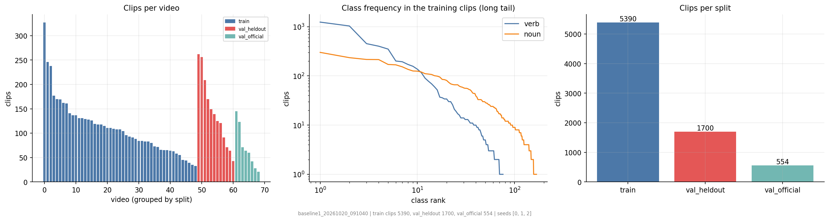
Data: from one video to 69, with a faster pipeline
69
7,644
4.5 GB
3
videos
4-second clips
cached features
splits (below)
Train: 49 videos, 5,390 clips
Held-out: 12 whole videos, 1,700 clips (video-level split)
Official validation: 8 videos, 554 clips
Fetched in parallel from a faster mirror plus a resumable downloader for the official server
Decoded once per video; features and raw videos backed up to Google Drive
Open provided Google Drive folder
Open separately shared Drive item (type unverified)
Notes:
The first pilot used one video. The official downloader uses one connection with no resume. We switched to a faster mirror for most videos, a resumable multi-connection downloader for the rest, and cache features once per video.

Slide 6
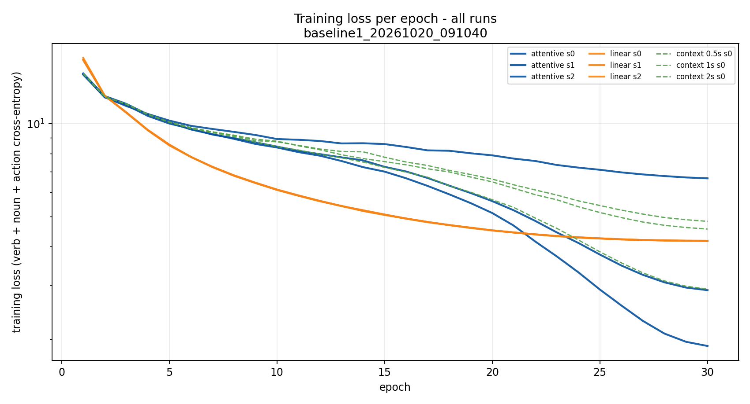
Training: three seeds, 30 epochs, every run logged
Epoch 1 loss about 14.5 for the attentive probe
Final loss by seed: 1.9, 2.9 and 6.7, so optimization varies a lot between seeds
Linear probe converges smoothly to 4.2 and is almost identical across seeds
About 18 s per epoch on a T4 GPU, features cached in memory
Lower training loss did not mean better held-out accuracy (next slides).
Notes:
Loss is the sum of three cross-entropies on the training clips. Seeds differ strongly in how far the attentive probe drives the loss down, but held-out accuracy is similar.

Slide 7
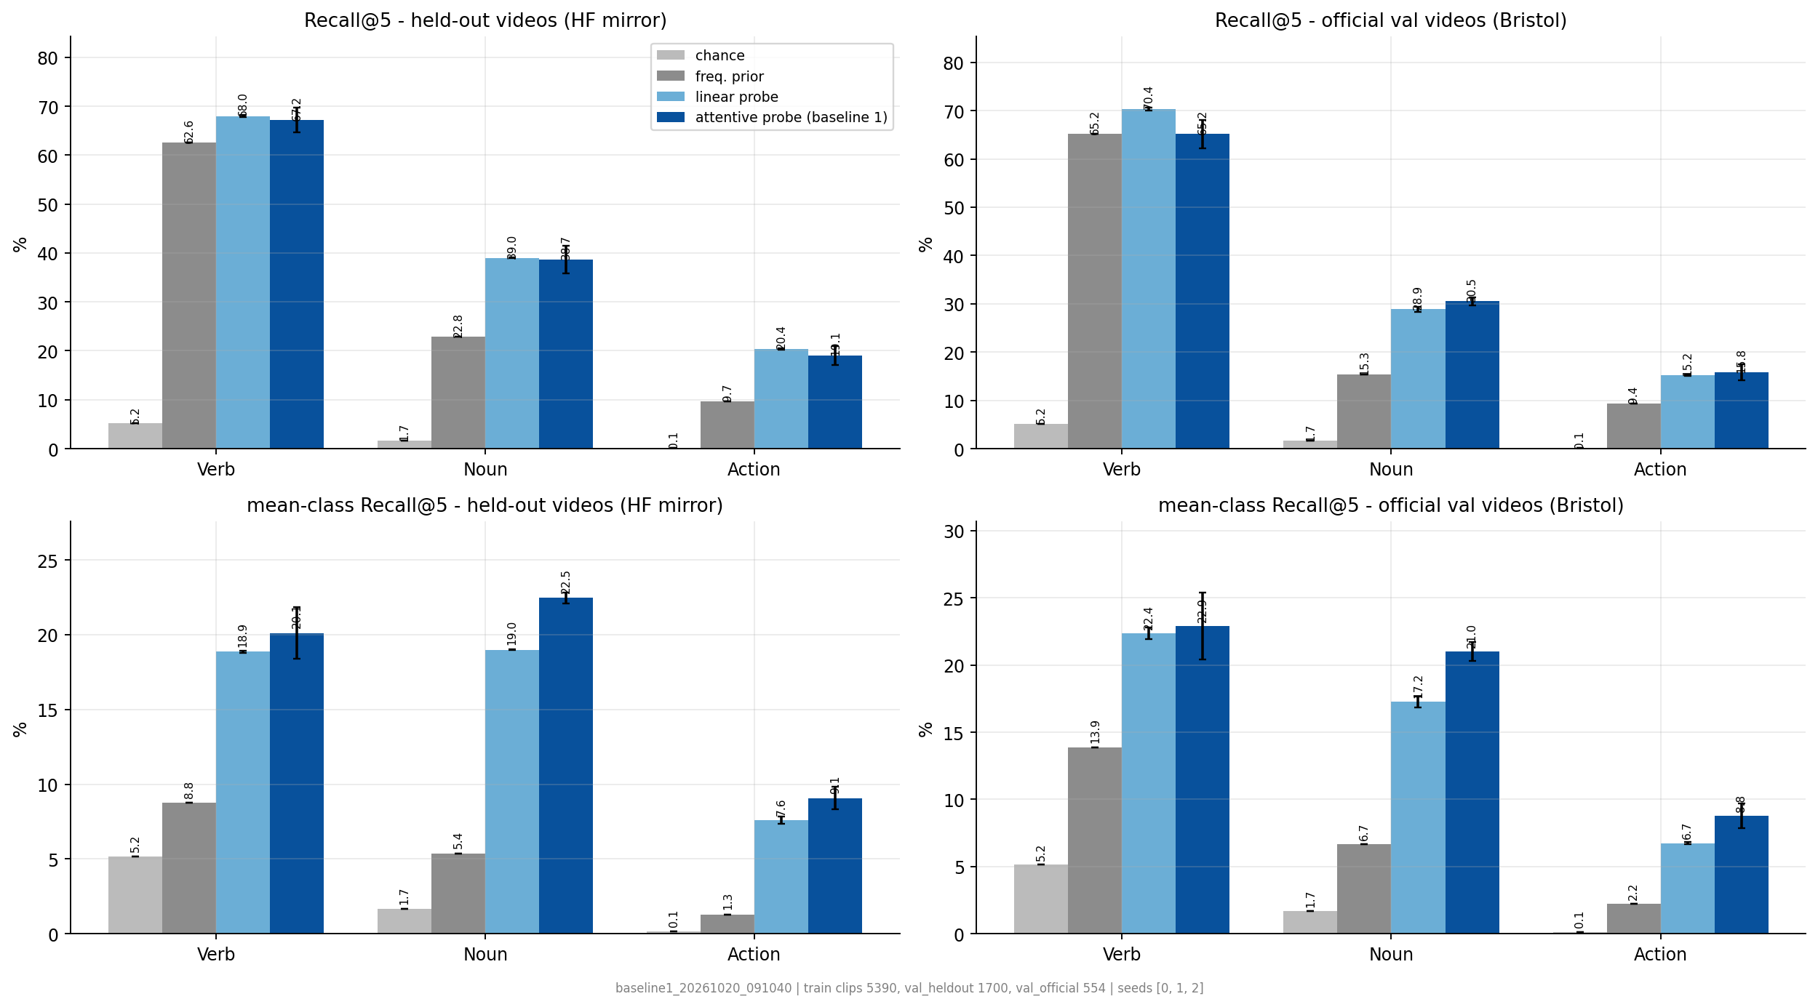
Attentive Probing Improves Mean-Class Recall, with Mixed Overall Recall@5 Results
Held-out videos, Recall@5 (mean over 3 seeds)
Attentive probe: verb 67.2, noun 38.7, action 19.1
Mean-class Recall@5
Attentive 20.1 / 22.5 / 9.1 vs linear 18.9 / 19.0 / 7.6
Official validation videos
Attentive 65.2 / 30.5 / 15.8; lower on nouns and actions than held-out
Key findings
Outperforms the frequency prior on held-out videos.
Achieves higher mean-class action Recall@5 than linear pooling (9.1% vs 7.6%).
Achieves slightly lower overall held-out action Recall@5 (19.1% vs 20.4%).
On the official validation subset, attentive action Recall@5 is 15.8%, compared with 19.1% on held-out recordings.
Notes:
Plain Recall@5 is dominated by frequent classes; the frequency prior already scores 62.6 on verbs. The attentive probe is better on mean-class Recall@5, which is the more honest metric.

Slide 8
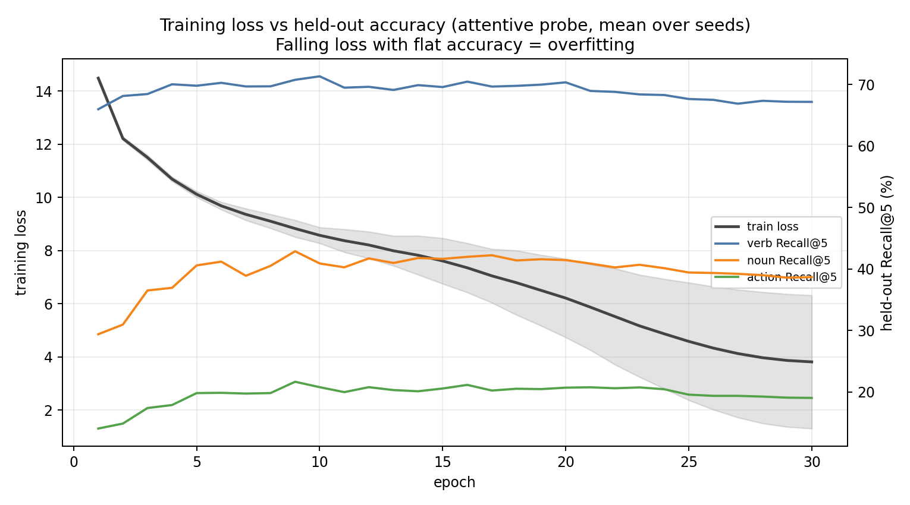
Finding: the attentive probe overfits after about 10 epochs
Held-out Recall@5, peak vs final
Verb: 71.4 (epoch 10) to 67.2
Noun: 42.9 (epoch 9) to 38.7
Action: 21.7 (epoch 9) to 19.1
Next fix
Early stopping near 10 epochs, more regularization, smaller probe, chosen on a dev set of training videos.
Notes:
Mean over three seeds on held-out videos. Training loss keeps falling while recall peaks around epoch 9 to 10 and then declines. The simple linear probe matches it on plain Recall@5.

Slide 9
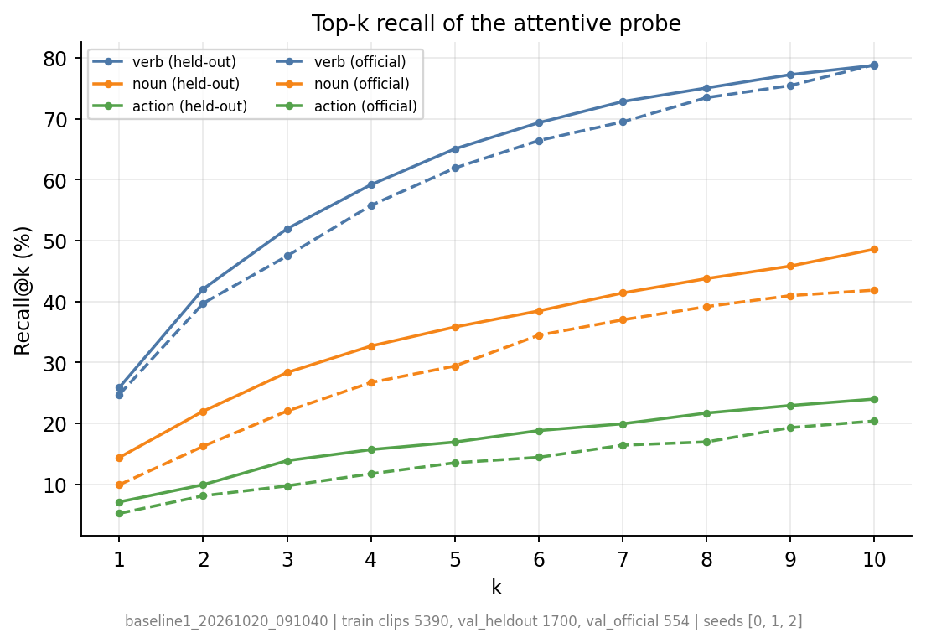
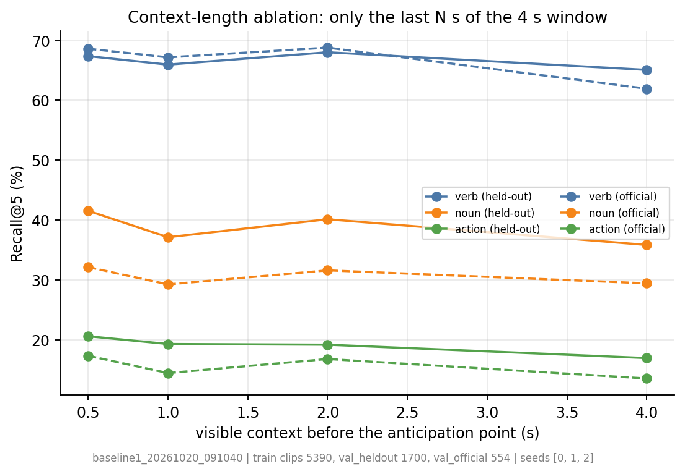
Recent frames carry much of the signal
Top-k: verb Recall@10 is about 79% on held-out clips. Context: with only 0.5 s visible, held-out noun 41.5 and action 20.6, versus 38.7 and 19.1 for the full window (different seed counts). Consistent with the project premise that the last moments matter most.
Notes:
Probes that see only the last 0.5 to 2 seconds are competitive with or better than the full 4 second window (for example 0.5 s: noun 41.5, action 20.6 against 38.7 and 19.1 for the full window, which is a 3-seed mean). One seed per setting, and fewer tokens also reduces overfitting, so this is suggestive rather than conclusive.

Slide 10
Why our recall is below the paper's 40.8
40.8
19.1
9.1
Different data and setup, so the numbers are not directly comparable.
paper: action Recall@5
ours, held-out (official val: 15.8)
ours, mean-class (official: 8.8)
Difference we know about | What we know / status
Training data: 49 training videos, 5,390 clips (of 495 official training videos) | Only a small part of the official training split; effect not yet measured (data-scaling run planned)
Probe training: learning rate 1e-3, 30 epochs, chosen by us, not taken from the paper; no tuning | Probe overfits after about 10 epochs (final loss 1.9 to 6.7, held-out recall flat): not trained well yet
Preprocessing: 16 frames at 4 fps, 384 px centre crop, spatial tokens pooled to 288 | Our own choices for speed and storage; effect unmeasured; paper settings not yet checked
Evaluation: held-out clips plus 8 official val videos (554 clips); plain and mean-class Recall@5 | Not the full official validation set; unclear which of our numbers matches the paper's metric
Encoder weights: community Hugging Face port | Not verified against the official checkpoint's outputs
Bottom line: we cannot say which factor explains the gap, because none was isolated. Next: tune the probe on a dev set, run a data-scaling curve, ablate pooling, and read the paper's evaluation settings.
Notes:
The paper's 40.8 Recall@5 is for EPIC-KITCHENS-100 action anticipation, as cited in our proposal. We have not read its exact probe, learning-rate or preprocessing settings, and we did not run any experiment that isolates one cause. So the table lists known differences and their status, not a ranking of causes.

Slide 11
Questions: where we stand and what we learned
Research question (proposal) | Status | What baseline 1 gives us
1. How much do blur and hand-occlusion hurt anticipation, especially right before the action? | Next: baseline 2 | The clean-video reference to measure the drop against
2. Are V-JEPA latents more tolerant than reconstruction-based representations? | Not tested yet | Needs a reconstruction baseline (baseline 5)
3. Can reliability-aware latent prediction recover meaning from context? | Not tested yet | Needs reliability head and a predictor; availability still to check
4. Does latent recovery beat augmentation, masking or pixel restoration? | Not tested yet | Needs baselines 3, 4, 6 and 7
What we learned from baseline 1
Frozen features beat chance and a frequency prior, especially on mean-class Recall@5
The linear probe equals or beats the attentive probe on plain Recall@5; the attentive probe is better on mean-class Recall@5 (held-out action 9.1 vs 7.6)
The attentive probe overfits after about 10 epochs
Probes seeing only the last 0.5 to 2 s are competitive with or better than the full 4 s window (one seed per setting)
Nouns and actions score lower on official validation videos (30.5 and 15.8) than held-out (38.7 and 19.1)
Comparison order on held-out clips: chance < frequency prior < linear probe about equal to attentive probe.
Notes:
None of the four proposal research questions is answered yet; they all need corrupted-video experiments. Baseline 1 supplies the clean reference and the first findings about the probe, the data and the recent-frames premise.

Slide 12
Problems found, planned fixes and baseline 2
Problem found in our work | Planned fix (not done yet)
Attentive probe overfits: loss keeps falling, held-out recall peaks near epoch 9-10 | Early stopping, more regularization, smaller probe; choose settings on a dev set of training videos
Small data: 5,390 training clips; not comparable with the paper's 40.8 action Recall@5 | Encode more of the available clips; report mean-class Recall@5 and paired comparisons
Noisy validation: official set is 8 videos (554 clips); seeds differ a lot in final loss (1.9 to 6.7) | Report intervals, add seeds, compare clean vs corrupted on the same clips
Not yet checked whether V-JEPA predictor weights are available in the encoder port we use | Check first; if missing, train a small token predictor on the cached features
Next works for baseline 2 (planned)
Build motion-blur and hand-occlusion generators for the last frames before the action
Vary severity, duration and distance from the anticipation point, as in the proposal
Inspect clean vs corrupted frames visually before any run
Small pilot first: clean-trained probe on corrupted held-out clips; measure the drop in Recall@5
Then the reliability head, latent recovery and gated fusion (baselines 6 and 7), plus the oracle-mask test
Future work from the proposal: gaze as an additional, possibly missing input.
Notes:
Fixes and baseline 2 steps are planned work, not completed work. The problems are what we actually observed in the baseline 1 runs.

