Slide 1
CSE 471: MACHINE LEARNING
Probabilistic Reasoning Over Time

Slide 2
Outline
Markov process
Inference
Hidden Markov Model
Notes:
Chapter 14

Slide 3
Notations
X_{t} – State of variables at time t
E_{t} – Set of observable evidence variables
e_{t} – Observation at time t

Slide 4
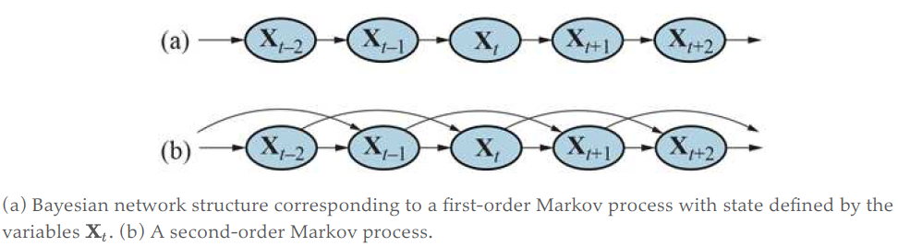
Markov process
Markov assumption - The current state depends on only a finite fixed number of previous states
First order Markov process:
P(Xt|X_{0:t}) = P(X_{t}|X_{t-1})
Time-homogeneous process – Conditional probabilities do not change over time

Slide 5
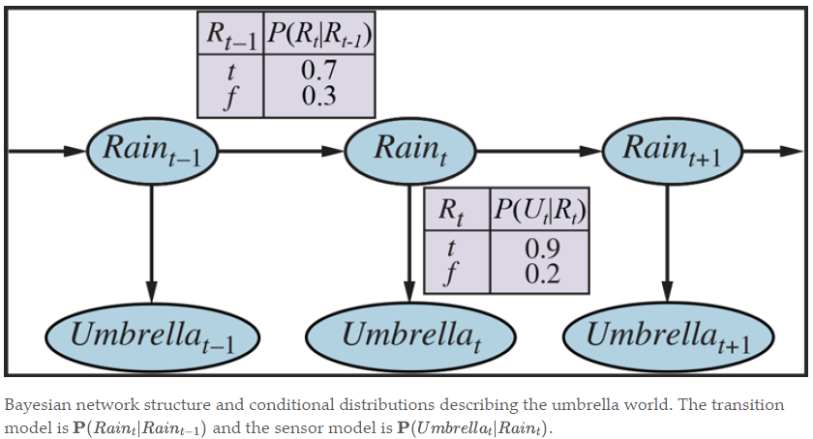

P(E_{t}|X_{0:t}, E_{1:t-1}) = P(E_{t}|X_{t})

Slide 6

Inference
Filtering
  Compute the belief state P(X_{t}|e_{1:t})
Prediction
  Compute posterior distribution over future state, P(X_{t+k}|e_{1:t})
Smoothing
  Compute posterior distribution over past state, P(X_{k}|e1:t) [ 0 ≤ k < t]
Most likely explanation
  Most likely sequence of states

Slide 7
Learning
Learn from observations
  Transition model
  Sensor model

Slide 8

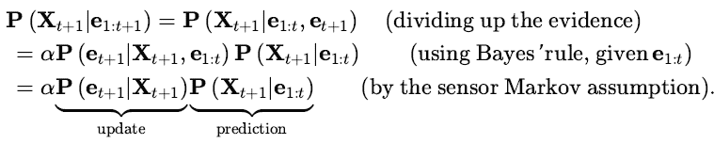
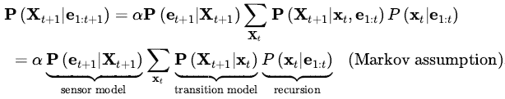
Filtering
Recursive Estimation
Notes:
Example – See page 875 of ref. book.

Slide 9

Prediction

Slide 10
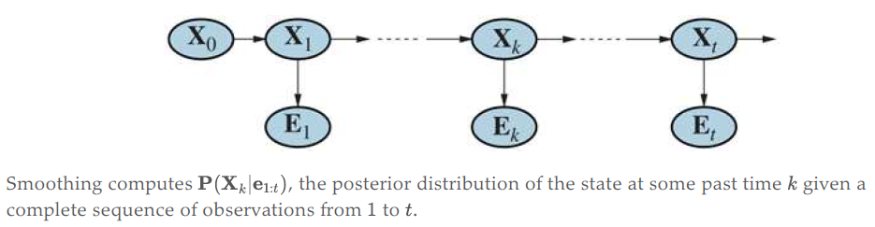
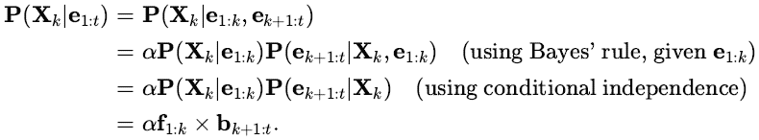
Smoothing

Slide 11
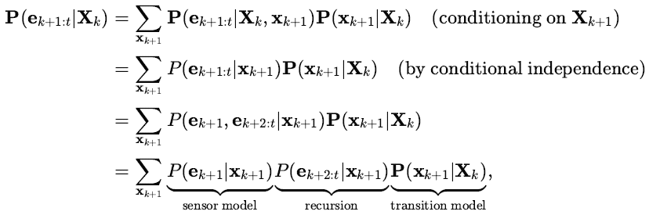

Smoothing

Slide 12
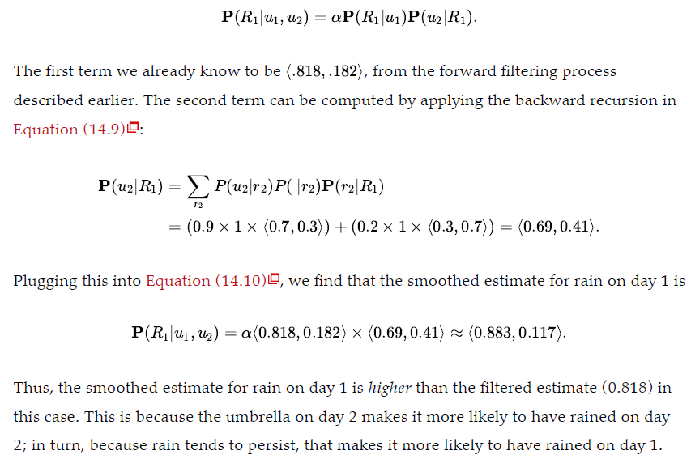
Smoothed estimate of rain probability at time 1
given umbrella objervation on both days

Slide 13
The Decoding Problem
Given the observation
  Identify the most likely sequence of states
Viterbi graph / Viterbi Algorithm
  Nodes are possible states at each timestamp
  An edge represents state transition
  The edges move to the right

Slide 14
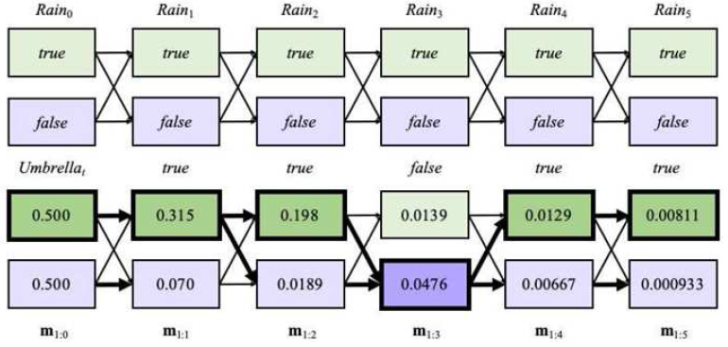
The Decoding Problem
Notes:
(TOP) Possible state sequences for can be viewed as paths through a graph of the possible states at each time step.
(BOTTOM) Operation of the Viterbi algorithm for the umbrella observation sequence, where the evidence starts at time 1. For each t, we have shown the values of the message m_{1:t}, which gives the probability of the best sequence reaching each state at time t. Also, for each state, the bold arrow leading into it indicates its best predecessor as measured by the product of the preceding sequence probability and the transition probability. Following the bold arrows back from the most likely state in gives the most likely sequence, shown by the bold outlines and darker shading.

Slide 15


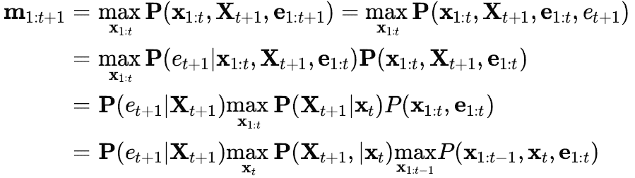

The Decoding Problem
The above is equivalent to maximizing:
Notes:
Numerical underflow is a significant issue for the Viterbi algorithm. One possible solution is simply to normalize m at each step; this rescaling
does not affect correctness.
2. A second solution is to use log probabilities everywhere and replace multiplication by addition.

Slide 16
Stationary distribution
π = πP
  π – Probability distribution of states
  P – Transition matrix
Mixing time
  Time taken to reach stationary distribution

Slide 17
HMM Parameter Estimation
So far, we have assumed that the transition and emission probabilities are known.
However, in most HMM applications, the probabilities are not known. It’s very hard to estimate the probabilities.
Notes:
From here to the rest of the slide, the content is taken from pages 217 – 226 of Bioinformatics Algorithms: An Active Learning Approach 2nd Edition, Vol. II (Phillip Compeau & Pavel Pevzner)

Slide 18
HMM Parameter Estimation Problem
Given
HMM with states and alphabet (emission characters)
Independent training sequences x¹, … x^{m}
Find HMM parameters Θ (that is, a_{kl}, e_{k}(b)) that maximize
P(x¹, …, x^{m} | Θ)
the joint probability of the training sequences.

Slide 19
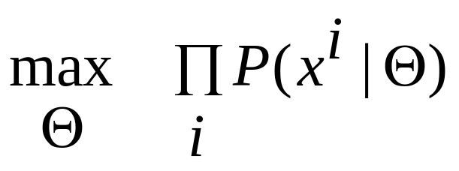
Maximize the likelihood
P(x¹, …, x^{m} | Θ) as a function of Θ is called the likelihood of the model.
The training sequences are assumed independent, therefore
P(x¹, …, x^{m} | Θ) = Π_{i} P(x^{i} | Θ)
The parameter estimation problem seeks Θ that realizes
In practice the log likelihood is computed to avoid underflow errors

Slide 20

Two situations
Known paths for training sequences
One evening the casino dealer allows us to see when he changes dice
Unknown paths
Do not see when the casino dealer changes dice

Slide 21
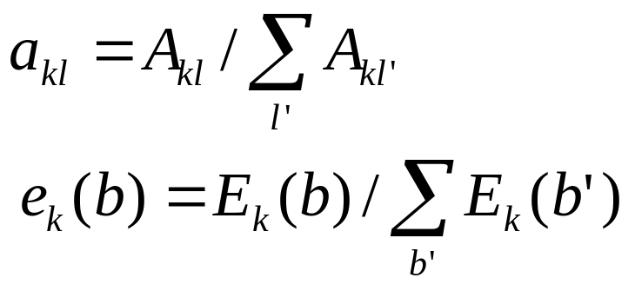
Known paths
A_{kl} = # of times each k → l is taken in the training sequences
E_{k}(b) = # of times b is emitted from state k in the training sequences
Compute a_{kl} and e_{k}(b) as maximum likelihood estimators:

Slide 22
Pseudocounts
Some state k may not appear in any of the training sequences. This means A_{kl} = 0 for every state l and a_{kl} cannot be computed with the given equation.
To avoid this overfitting use predetermined pseudocounts r_{kl} and r_{k}(b).
A_{kl} = # of transitions k→l + r_{kl}
E_{k}(b) = # of emissions of b from k + r_{k}(b)
The pseudocounts reflect our prior biases about the probability values.

Slide 23

Unknown paths: Viterbi training
Idea: use Viterbi decoding to compute the most probable path for training sequence x
Start with some guess for initial parameters and compute π* the most probable path for x using initial parameters.
Iterate until no change in π* :
Determine A_{kl} and E_{k}(b) as before
Compute new parameters a_{kl} and e_{k}(b) using the same formulas as before
Compute new π* for x and the current parameters

Slide 24
Baum-Welch Learning
We begin with random initialization of the parameters
E-Step: (observations, ?, Parameters) → Soft decoding (Responsibility profile)
M-Step: (observations, Responsibility profile, ?) → Parameters

Slide 25
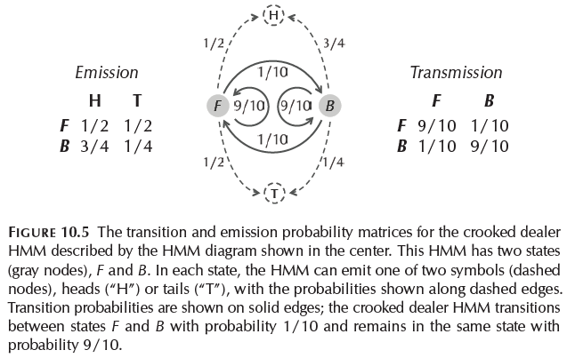

Slide 26
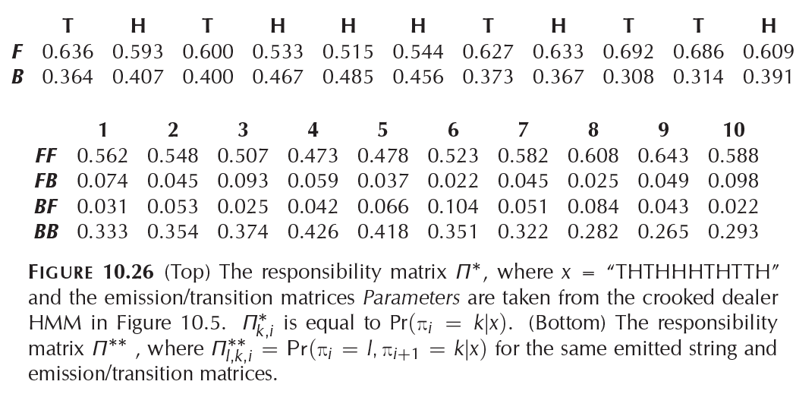

Slide 27
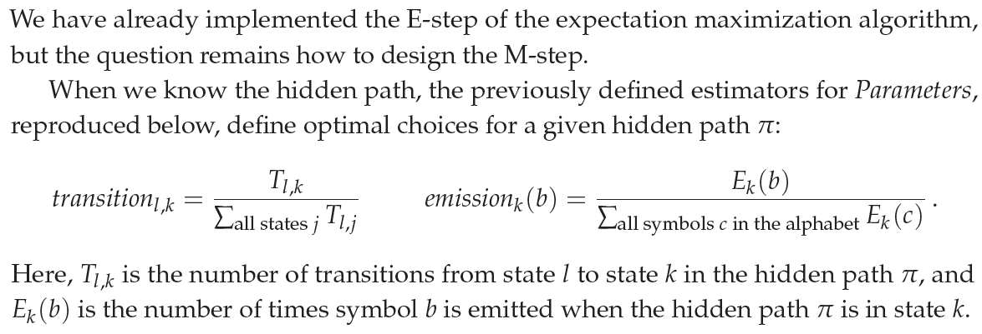
Baum-Welch Learning

Slide 28
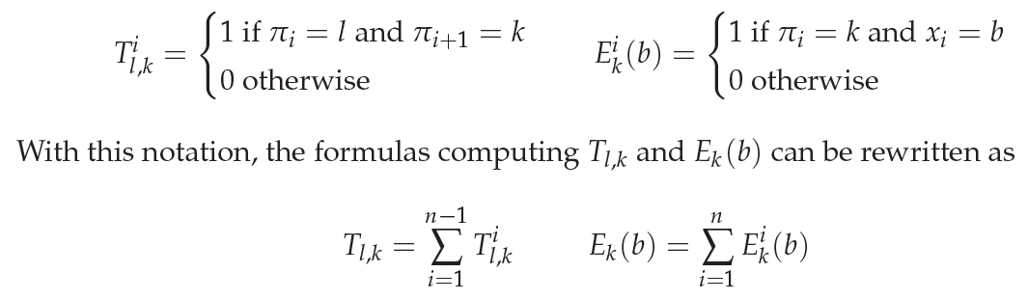
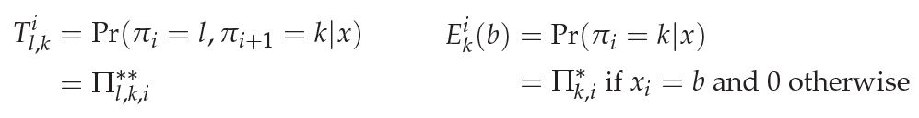
Baum-Welch Learning
When the hidden path is known
When the hidden path is unknown

Slide 29
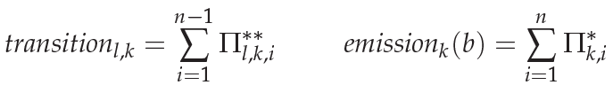
Baum-Welch Learning
When the hidden path is unknown

