Slide 1
CSE 471: MACHINE LEARNING
Learning Probabilistic Models

Slide 2
Outline
Bayesian Learning
MAP hypothesis
Maximum likelihood hypothesis
Naïve Bayes model
Generative vs. Discriminative model
Bayesian parameter learning
EM Algorithm

Slide 3
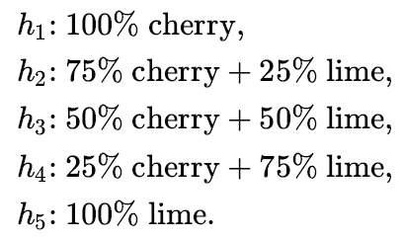



Bayesian Learning
Hypothesis prior
Likelihood
Prediction

Slide 4
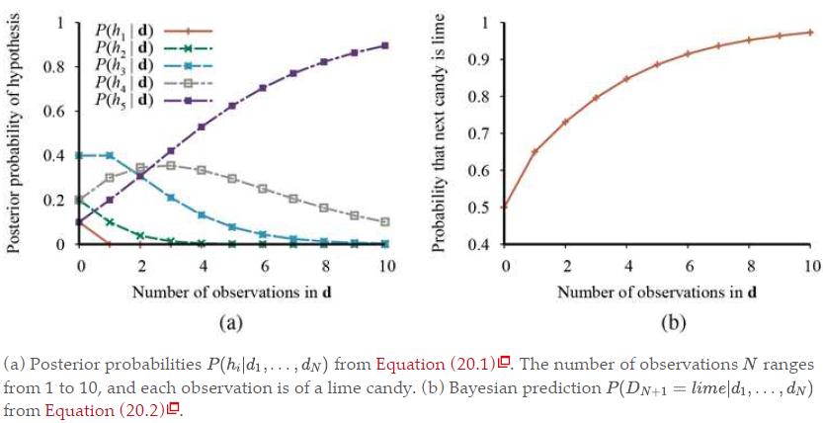
Bayesian Learning
Notes:
For any fixed prior that does not rule out the true hypothesis, the posterior probability of any false hypothesis will, under certain technical conditions, eventually vanish. This happens simply because the probability of generating “uncharacteristic” data indefinitely is vanishingly small.
The optimality of Bayesian learning comes at a price, of course. For real learning problems, the hypothesis space is usually very large or infinite. In some cases, the summation (or integration, in the continuous case) can be carried out tractably, but in most cases we must resort to approximate or simplified methods.

Slide 5
Maximum a posteriori hypothesis
Single most probable hypothesis
An h_{i} that maximizes P(h_{i}|d)
Optimization problem, rather than summation
  Often times, it is much easier to solve
Notes:
In our candy example, after three lime candies in a row, so the MAP learner then predicts that the fourth candy is lime with probability 1.0—a much more dangerous prediction than the Bayesian prediction of 0.8.

Slide 6
Maximum-Likelihood hypothesis
Uniform prior assumed over the hypothesis space
Find the h_{i} that maximizes P(d|h_{i})
Notes:
When the data set is large, the prior distribution over hypotheses is less important—the evidence from the data is strong enough to swamp the prior distribution over hypotheses.
That means maximum likelihood learning is a good approximation to Bayesian and MAP learning with large data sets, but it has problems with small data sets.

Slide 7



ML parameter learning

Slide 8
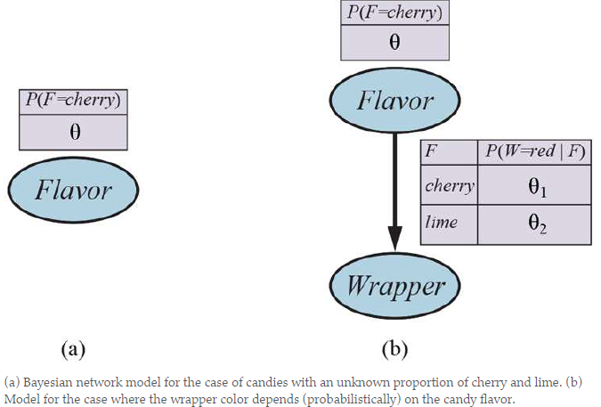
ML parameter learning

Slide 9

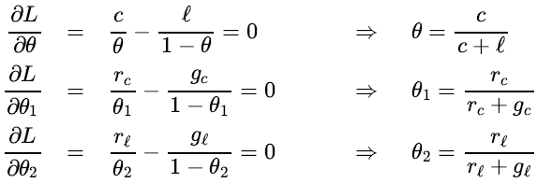
ML parameter learning
Notes:
With complete data, the maximum-likelihood parameter learning problem for a Bayesian network decomposes into separate learning problems, one for each parameter

Slide 10

Naive Bayes models
Attributes are assumed to be conditionally independent, given the class.

Slide 11
Generative and discriminative models
A generative model models the probability distribution of each class
A discriminative model directly learns the decision boundary between classes

Slide 12
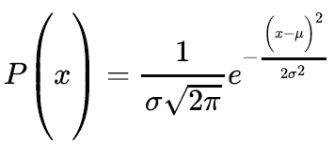
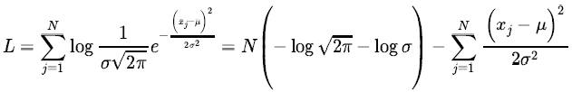
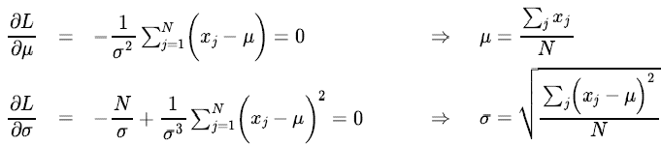
ML parameter learning (Continuous model)

Slide 13
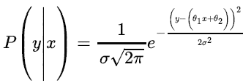

Conditional distribution P(Y|X)
Y has a Gaussian distribution
  Fixed standard deviation
  Mean is linearly dependent on X
Maximizing the log likelihood with respect to these parameters is the same as minimizing:
Notes:
The final quantity is the L₂ loss function.
Now we can understand why: minimizing the sum of squared errors gives the maximum-likelihood straight-line model, provided that the data are generated with Gaussian noise of fixed variance.

Slide 14

Bayesian parameter learning
θ - Probability that a randomly selected piece of candy is cherry-flavored
Θ - A random variable that defines the hypothesis space
  θ is the (unknown) value
Hypothesis prior is the prior distribution over P(Θ)
  Beta distribution can be used.
Notes:
a and b are two hyperparameters of the Beta distribution.
They are called hyperparameters because they parameterize a distribution over θ, which is itself a parameter.

Slide 15
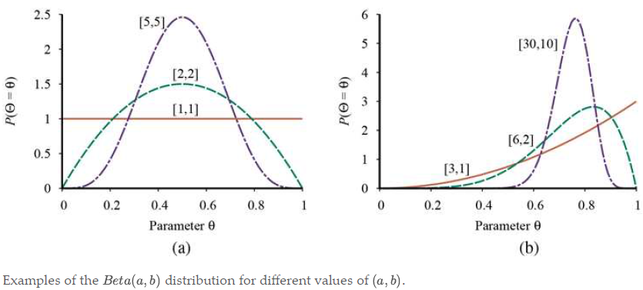
Beta distribution
Mean = a/(a+b)

Slide 16
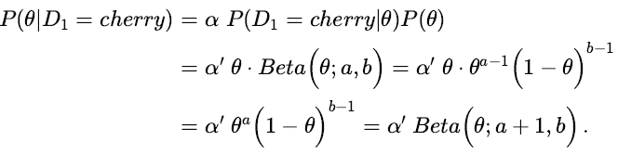
Beta distribution
If Θ has a prior β(a, b) then after a data point is observed, the posterior distribution of Θ is also a β distribution
  Closed under update.
The beta family is called the conjugate prior for the family of distributions for a Boolean variable.
Notes:
a and b are called virtual counts.

Slide 17
The EM Algorithm

Slide 18
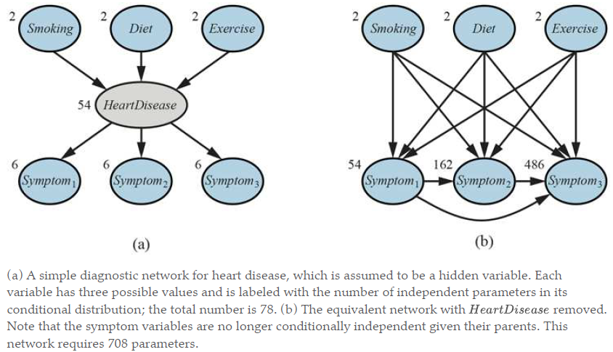
Why hidden variables?

Slide 19
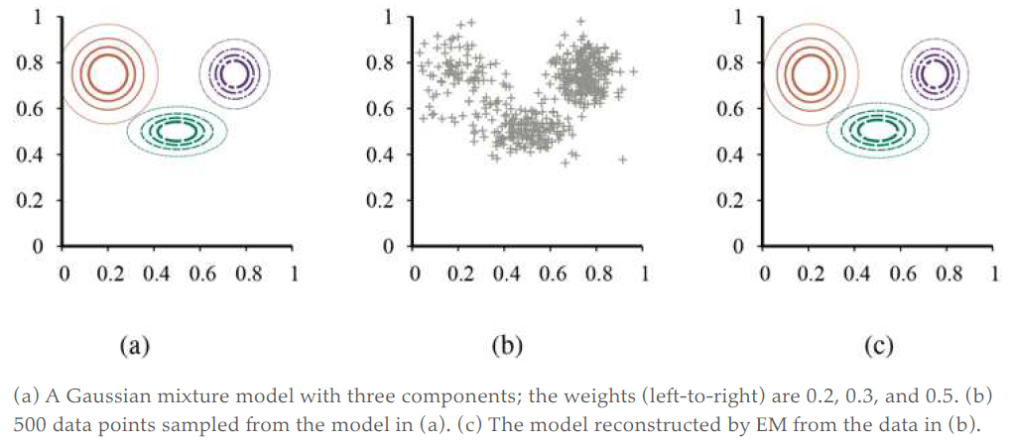
Gaussian mixture model

Slide 20

Mixture distribution
k components
Each component is a distribution itself
C is the random variable denoting the component

Slide 21
Mixture of Gaussians
Each component is a multivariate Gaussian
Parameters
  The weight of each component, w_{i} = P(C = i)
  The mean of each component, (mu)
  The covariance of each component ∑_{i}

Slide 22
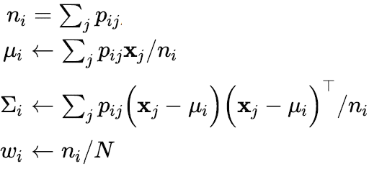
Solving by EM Algorithm
Initialize the parameters arbitrarily
E-Step
  p_{ij} = P(C = i|x_{j}) Probability that the datum x_{j} was generated by component I
  = αP(x_{j}|C=i)P(C = i)
M-Step
Notes:
The E-step, or expectation step, can be viewed as computing the expected values p_{ij} of the hidden indicator variables Z_{ij} , where Z_{ij} is 1 if datum was generated by the i^{th} component and 0 otherwise.
The M-step, or maximization step, finds the new values of the parameters that maximize the log likelihood of the data, given the expected values of the hidden indicator variables.

Slide 23
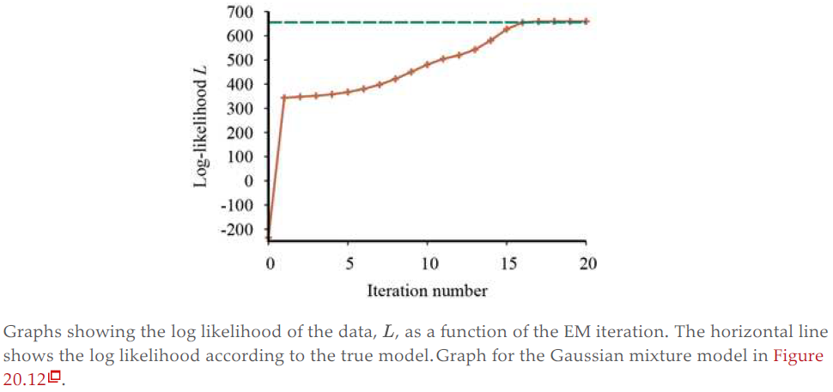
Log likelihood increasing
Notes:
EM increases the log likelihood of the data at every iteration. This fact can be proved in general.

Slide 24
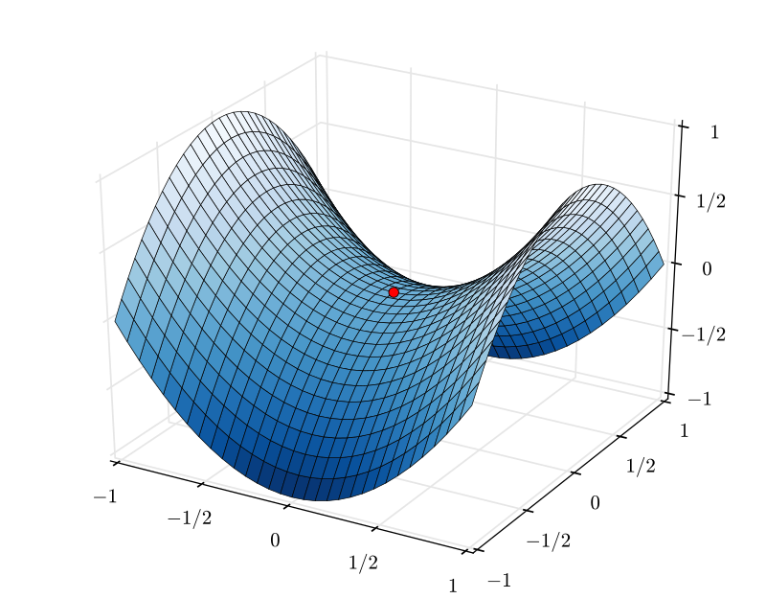
Saddle Point
Notes:
Under certain conditions (that hold in most cases), EM can be proven to reach a local maximum in likelihood.
In rare cases, it could reach a saddle point or even a local minimum.

Slide 25
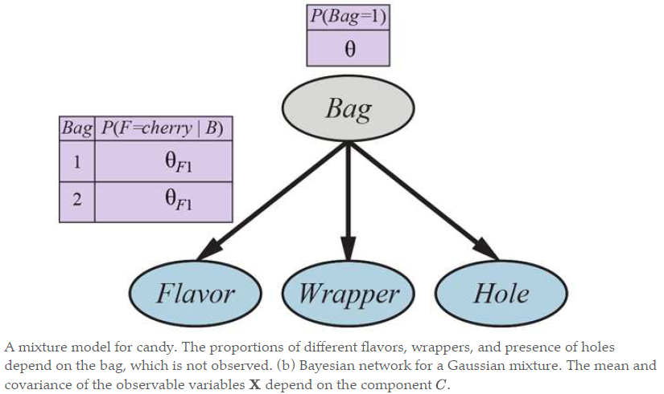
Learning Bayes Net parameters

Slide 26
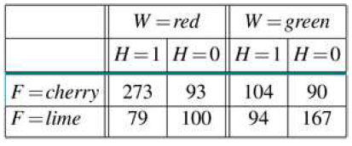

Learning Bayes Net parameters

Slide 27
Learning Bayes Net parameters
The expected count of cherry candies from bag 1 is given by

Slide 28
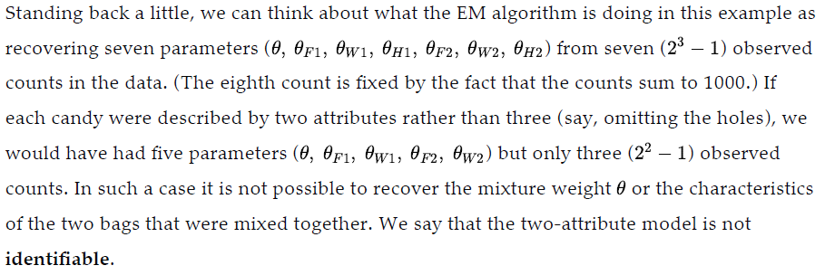
Identifiability

Slide 29
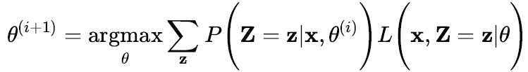

General form of EM Algorithm
Posterior over the hidden variables, given the data
The M-step is the maximization of this expected log likelihood with respect to the parameters.
Notes:
Let x be all the observed values in all the examples, let denote all the hidden variables for all the examples, and let be all the parameters for the probability model. Then the EM algorithm is

