Slide 1

GDevelop - Game Creation
editor.gdevelop.io

Slide 2
Notes:
Complete 3 levels per lesson
Your teacher will demo each level for you to complete.
We will all move at the same pace
Listen carefully to your teacher.
By the end of this course you will know how to make your own basic platformer game

Slide 3
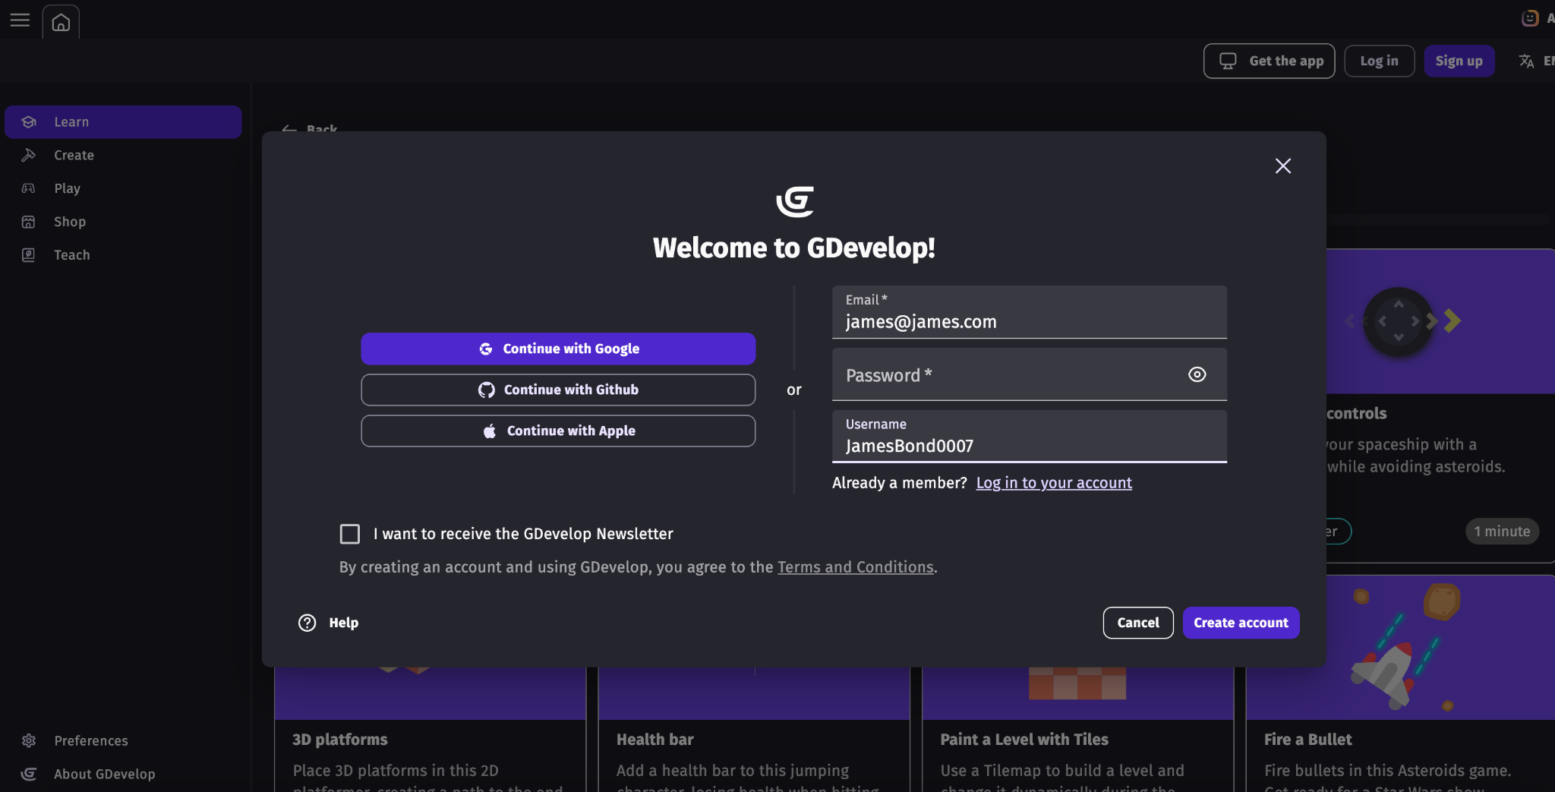
Click on Sign up and use a fake email and fake username

Slide 4
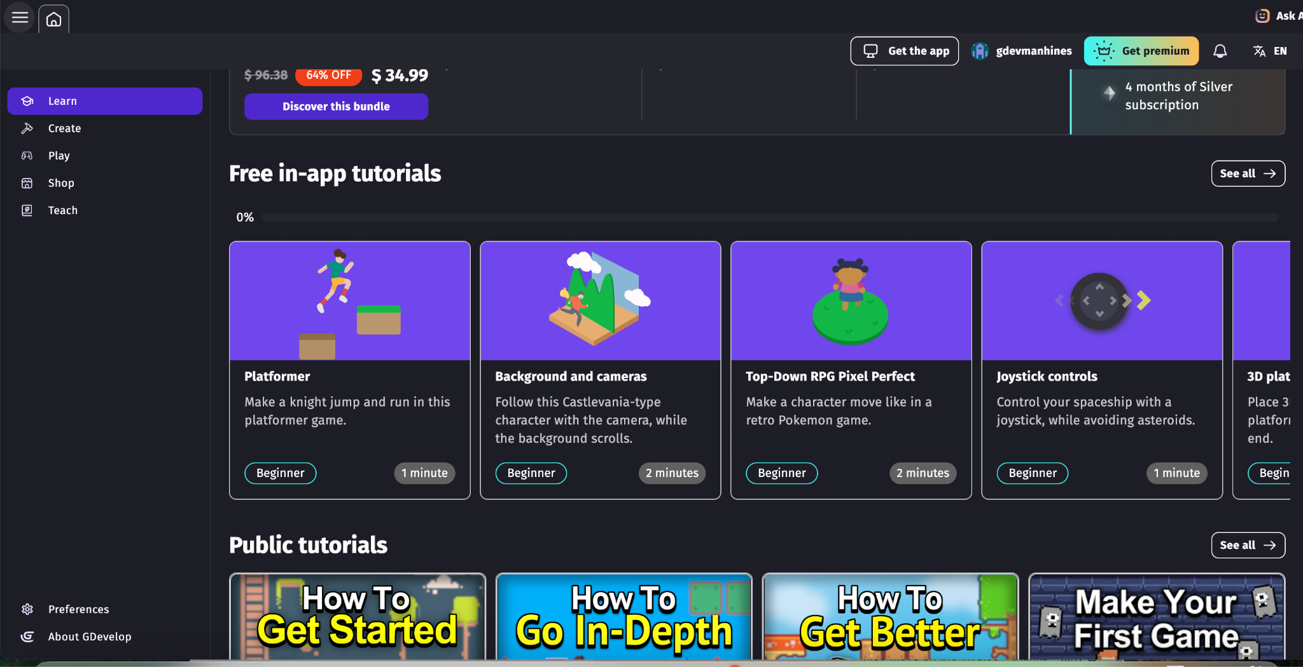
Scroll Down to “Free in-app tutorials” and click on “See All”
Notes:
Video Source: https://www.youtube.com/watch?v=e1St8LB4VJA&feature=emb_logo

Slide 5
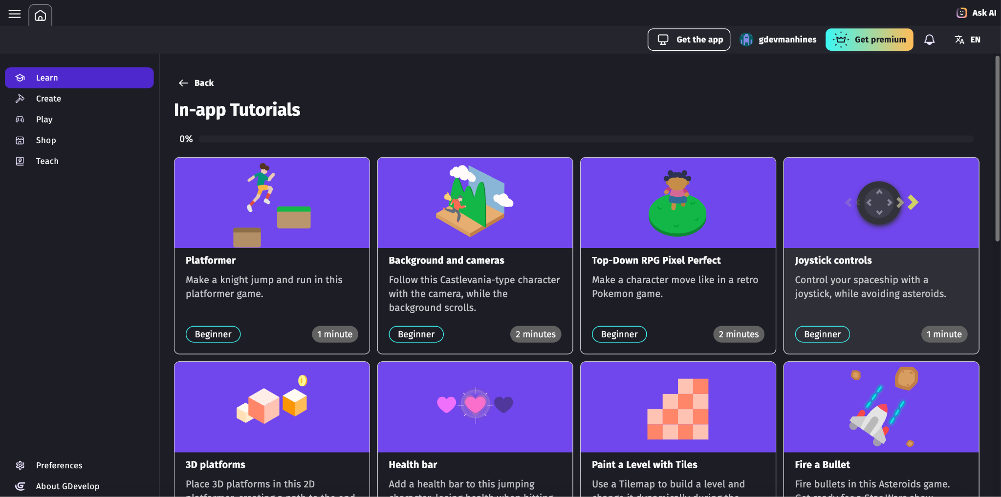
Click on “Platformer” and begin to follow instructions
Notes:
Video Source: https://www.youtube.com/watch?v=e1St8LB4VJA&feature=emb_logo

