Slide 1
Pilot FTV-Based pCR Prediction in I-SPY2 Breast MRI
Tumor-source validation with a future temporal graph learning framework

Slide 2
Research problem
Breast MRI can monitor response during neoadjuvant therapy.
Machine learning depends on reliable tumor features.
Raw DICOM SEG masks were not reliable tumor-only masks in this pipeline.
Official MRI/FTV support features became the stronger modeling path.

Slide 3
Dataset and pipeline
Dataset size on Cradle: 1.6T
Patients in inventory: 719
Series: 32411
DICOM files counted: 5586493
Workflow: inventory, SEG diagnosis, support-data FTV modeling, graph-ready dataset.

Slide 4
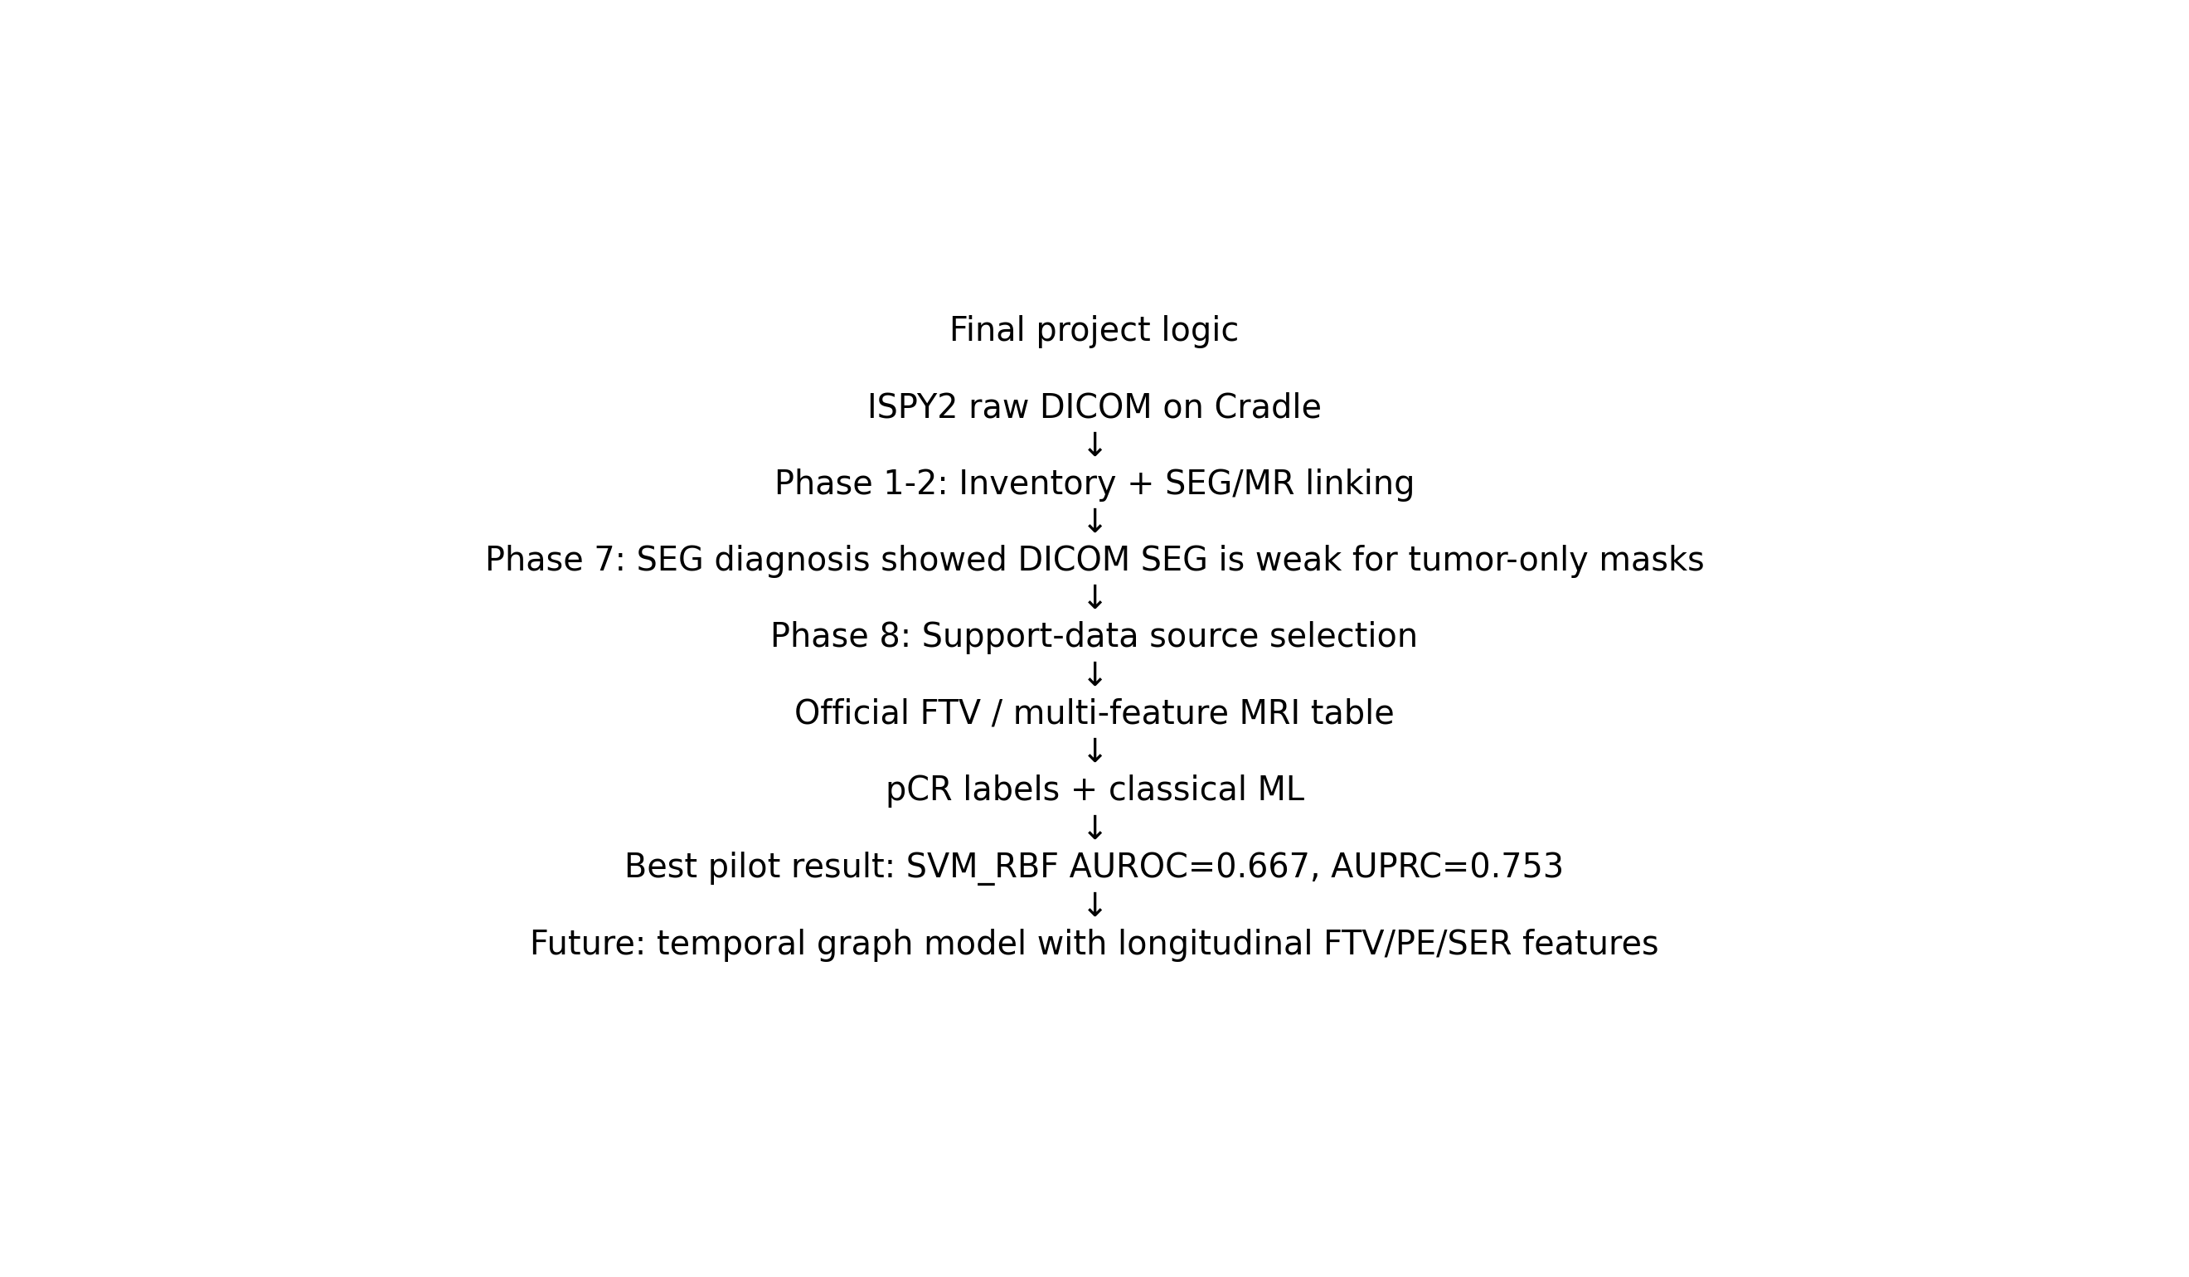
Project pipeline
Overall project workflow.

Slide 5
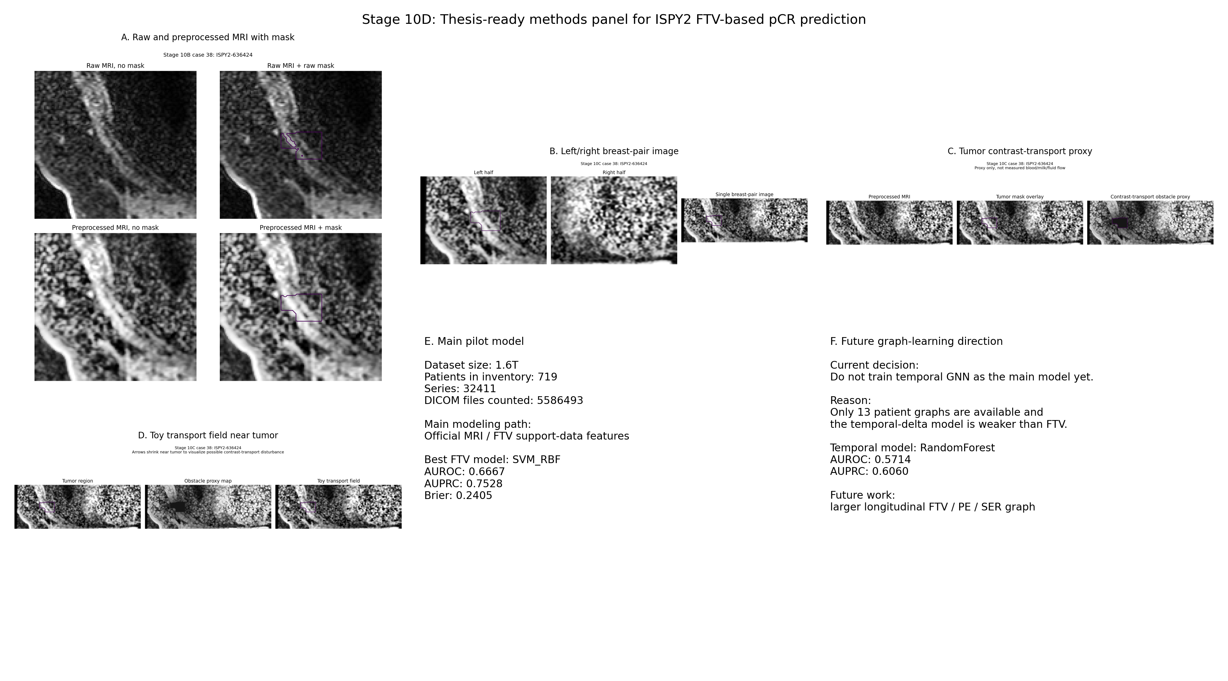
Visual preprocessing and breast-pair methods
Stage 10D master methods panel.

Slide 6
Main pilot result
Best current model: SVM_RBF
FTV AUROC: 0.6667
FTV AUPRC: 0.7528
FTV Brier score: 0.2405
Earlier baseline AUROC: 0.5462

Slide 7
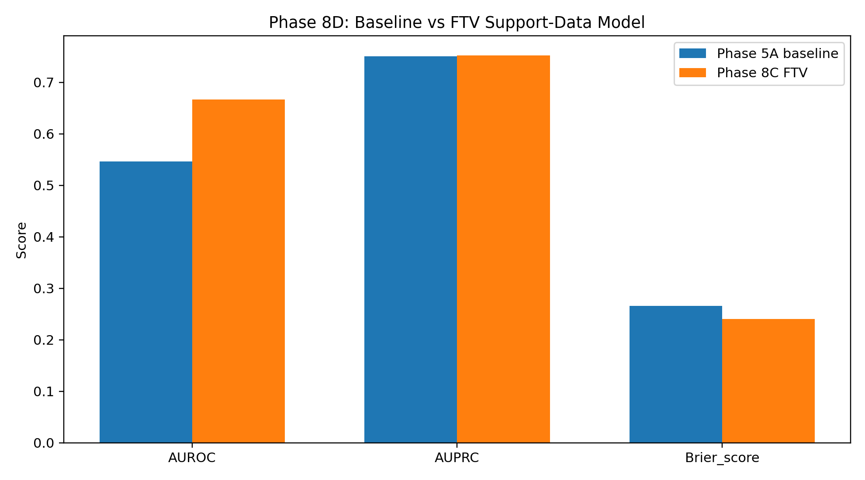
FTV model vs baseline
FTV support-data model gave the strongest pilot signal.

Slide 8
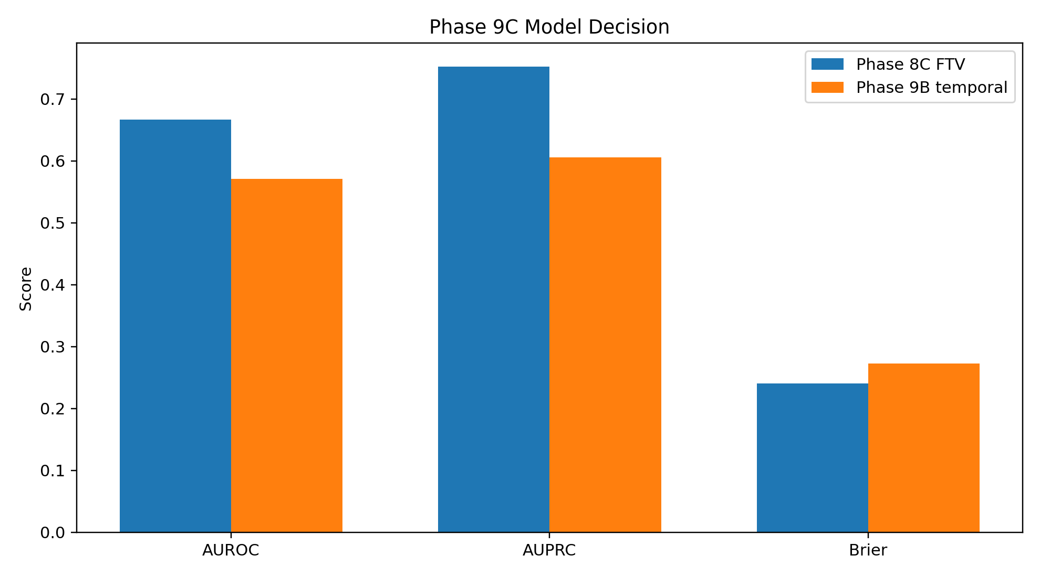
Temporal graph decision
Temporal graph learning is future work, not the main current model.

Slide 9
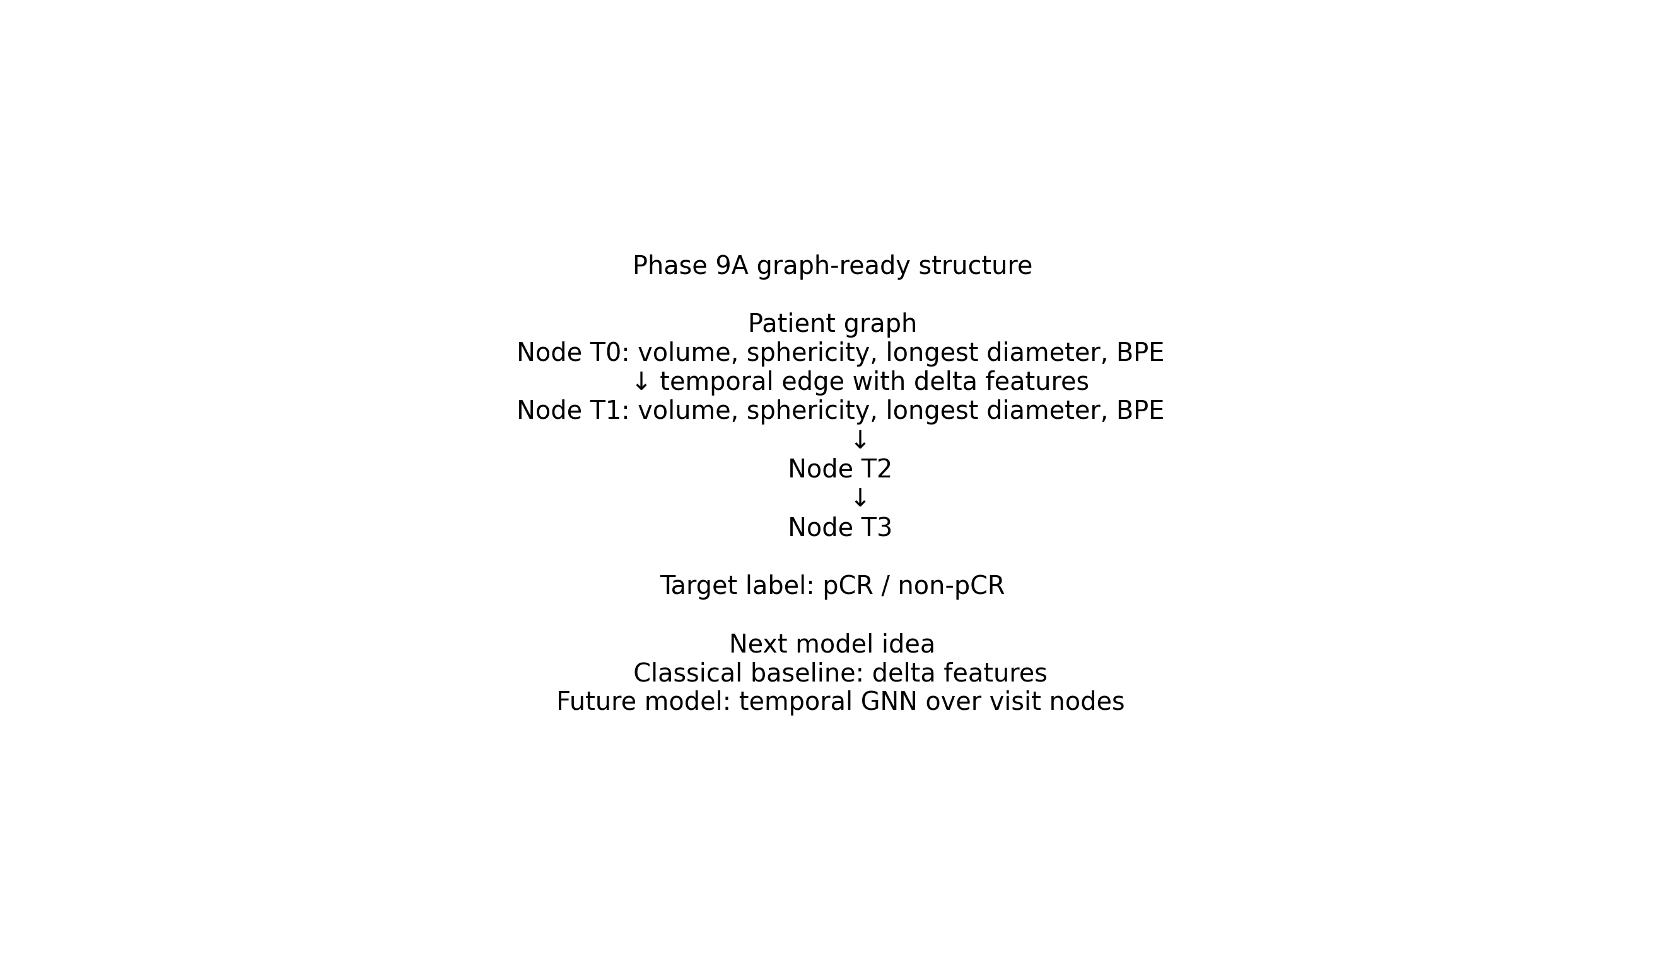
Future temporal graph framework
Patient visits become graph nodes; temporal edges track treatment change.

Slide 10
Limitations
Pilot cohort is small.
The best FTV model used 13 labeled patients.
This is not clinical validation.
DICOM SEG masks were diagnostic, not the final tumor-source path.
Temporal GNN needs more patients and stable longitudinal node identity.

Slide 11
Conclusion
The project built a reproducible ISPY2 Cradle-to-GitHub pipeline.
Tumor-source validation changed the research direction.
Official MRI/FTV support features gave the strongest pilot pCR signal.
Temporal graph learning remains the next research phase.

