Slide 1

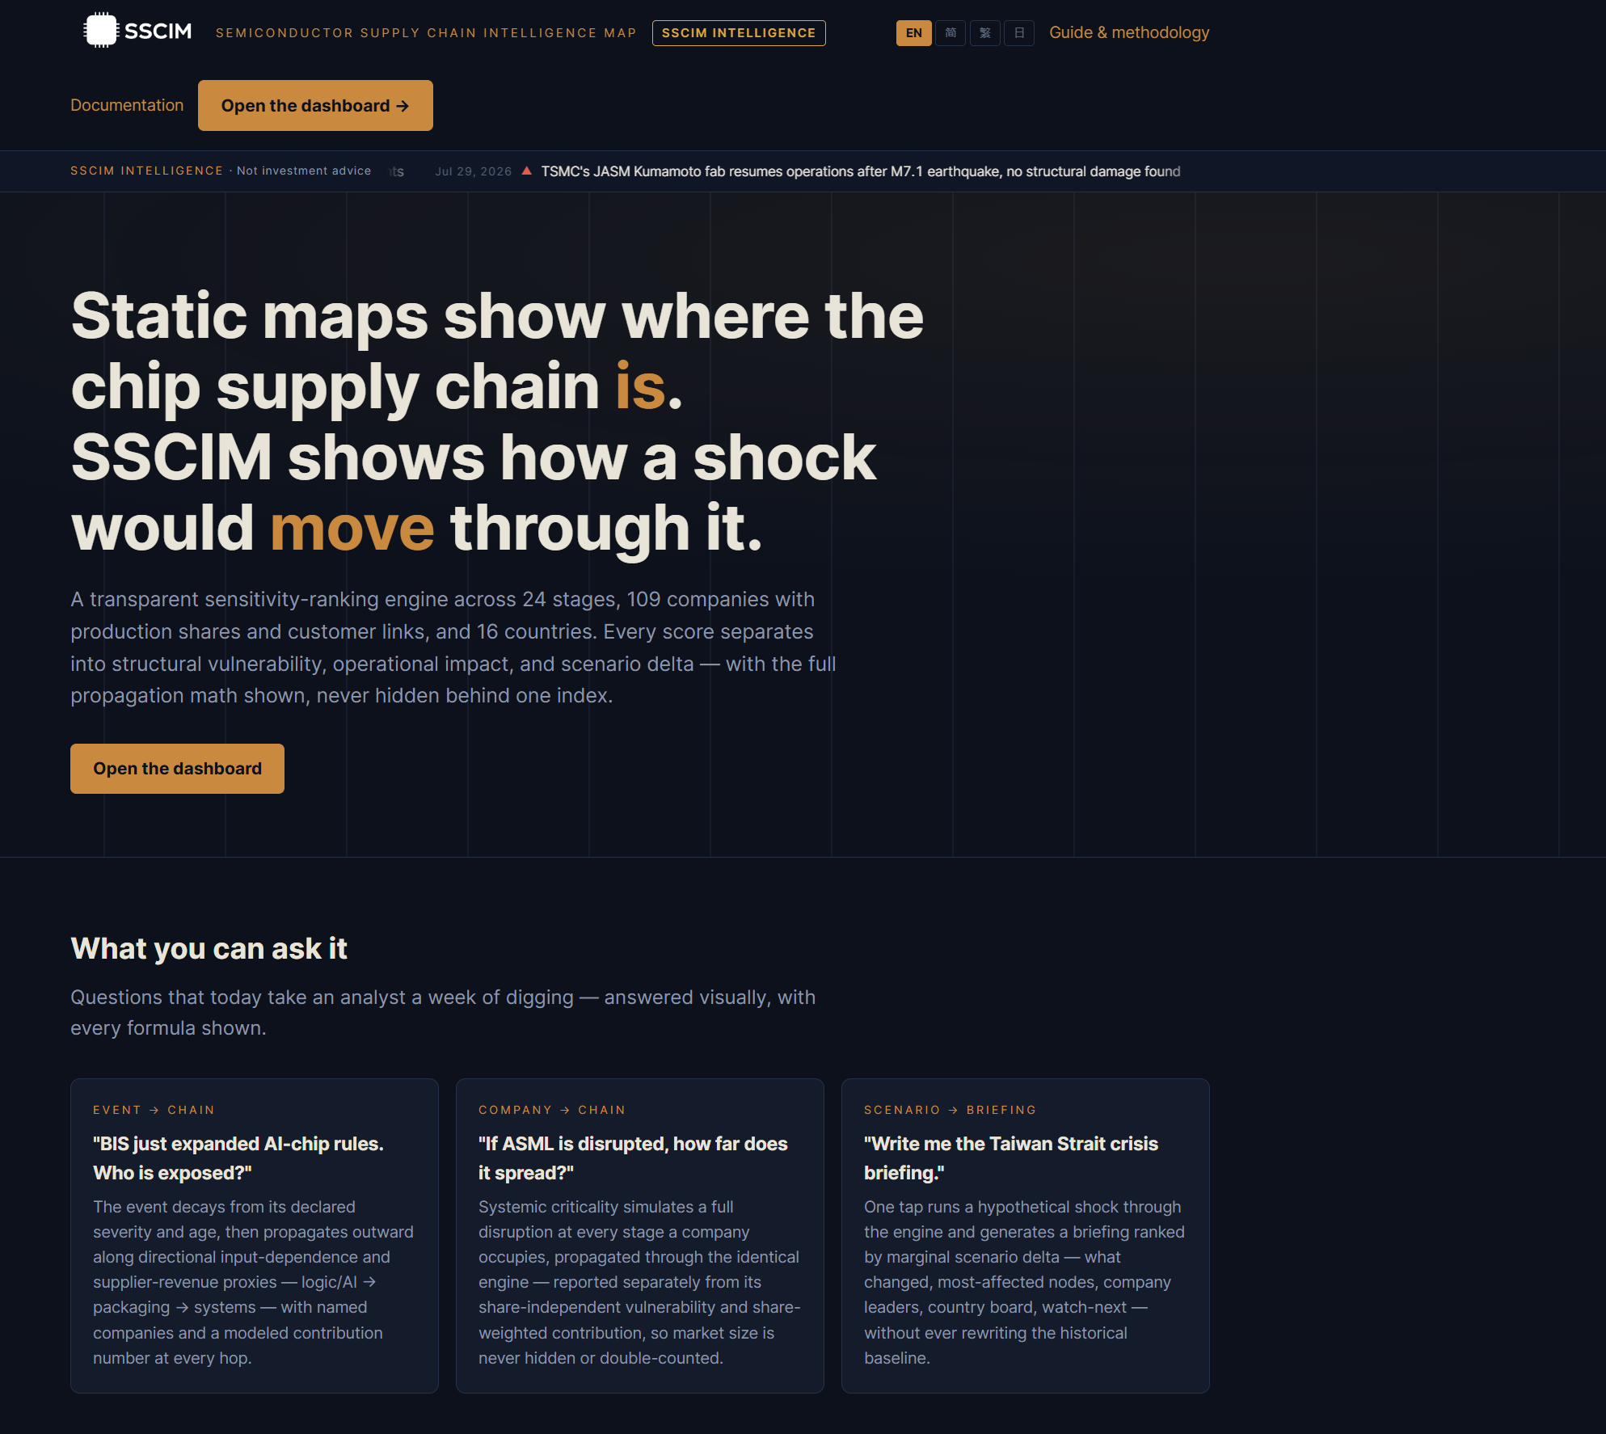
LIVE PROJECT SCREENSHOT
SEMICONDUCTOR SUPPLY CHAIN INTELLIGENCE MAP
See how a disruption moves - without hiding the assumptions.
An explainable, deterministic research platform for mapping structure, tracing shocks, comparing scenarios, and reviewing evidence.
Project overview - snapshot 2026-07-29

Slide 2
SSCIM
Static maps show where. SSCIM explores what changes.
Semiconductor production is globally distributed yet concentrated at critical stages. A single rule, outage, earthquake, or capacity decision can propagate far beyond its origin.
What SSCIM refuses to claim
No probability of disruption
No realized financial loss
The question
No measured trade volume
Given this event and these stated assumptions, which modeled stages, companies, and countries become more exposed?
No investment signal
No hidden confidence weighting
SSCIM - explainable semiconductor supply-chain intelligence
2

Slide 3
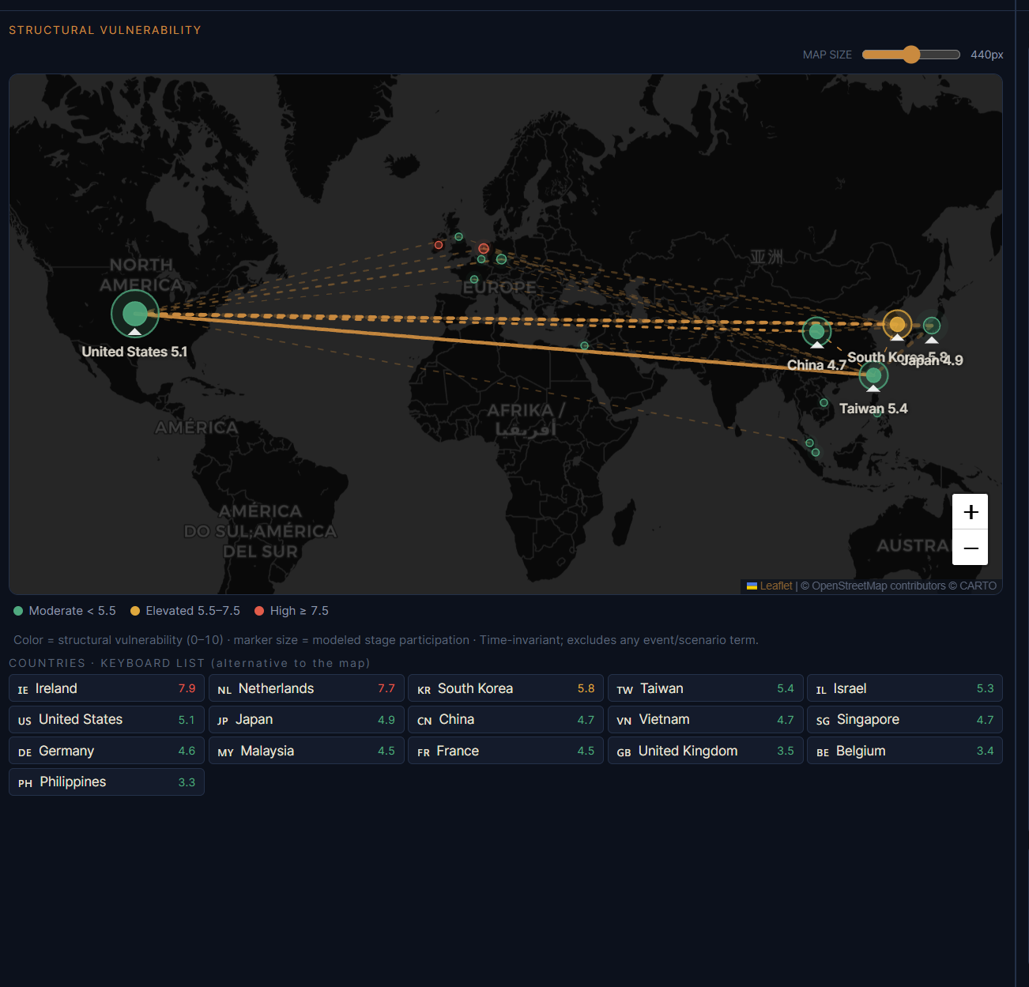
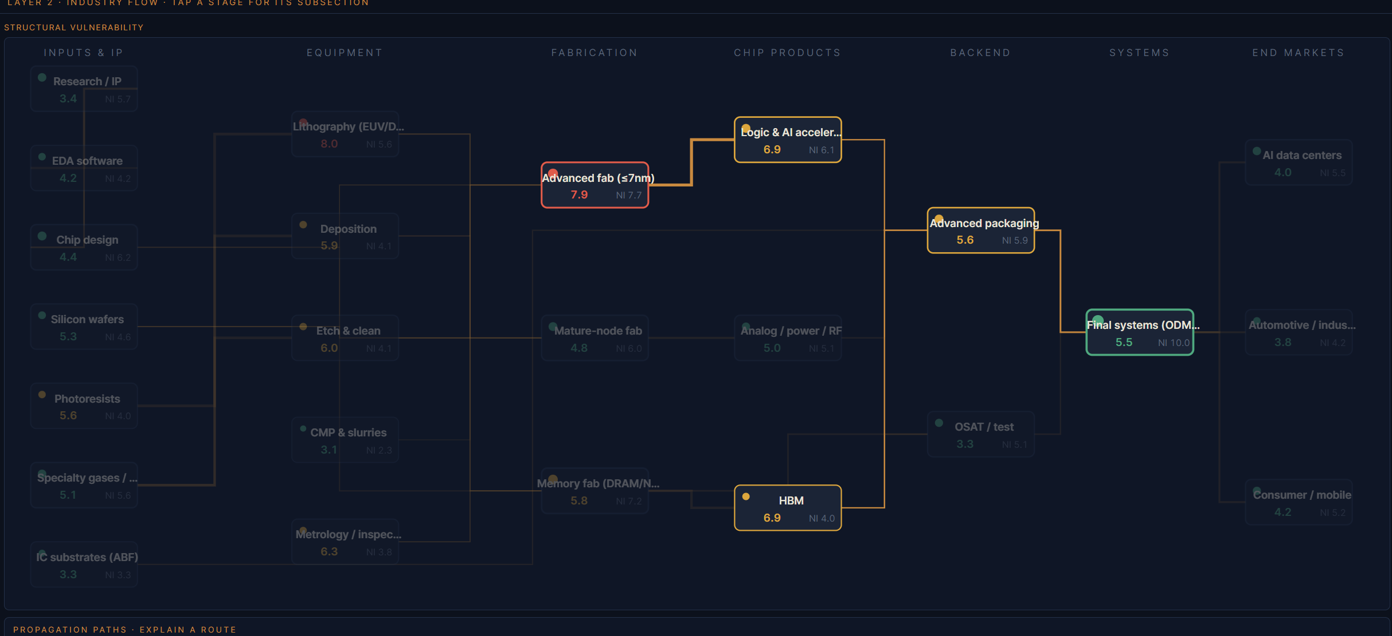
SSCIM
A single product surface connects structure, events, and evidence.
LIVE PROJECT SCREENSHOT
24
34
production stages
directed dependencies
109
56
modeled companies
reviewed live events
Also represented: 16 countries, 243 supplier/customer relationships, 75 ownership records, and 7 policy instruments.
SSCIM - explainable semiconductor supply-chain intelligence
3

Slide 4
SSCIM
A reader moves from evidence to explanation in five steps.
1
Select
2
Inspect
3
Trace
4
Compare
5
Brief
Choose a sourced event or build a hypothetical scenario.
Read the date, source, confidence, affected stages, and exclusions.
Follow the same selection across the map, flow graph, and topology.
Switch lenses, remove links, compare routes, or test sensitivity.
Generate a current or archived briefing without rewriting history.
Interpretation rule
A high score is a question to investigate, not an answer. Use the source and assumptions to decide whether the modeled pathway is credible.
SSCIM - explainable semiconductor supply-chain intelligence
4

Slide 5
SSCIM
One selection, three synchronized views.
LIVE PROJECT SCREENSHOT
LIVE PROJECT SCREENSHOT
LIVE PROJECT SCREENSHOT
World map - production geography
Industry flow - stage dependencies
Topology - country x stage centres
Capture required: dashboard-map.png
Capture required: dashboard-flow.png
Capture required: topology.png
MAP
INDUSTRY FLOW
TOPOLOGY
Country exposure aggregated from where production occurs - not headquarters.
Stage structure and declared input-dependence priors reveal why a shock spreads.
Derived functional centres and modeled routes support path and resilience analysis.
SSCIM - explainable semiconductor supply-chain intelligence
5

Slide 6
SSCIM
The model keeps structure and current impact deliberately separate.
STRUCTURAL VULNERABILITY
OPERATIONAL IMPACT
What is fragile here even before today?
What do selected events do now?
Graph/data: - network influence - geographic concentration - policy exposure Analyst judgment: - substitutability - market sensitivity
Signed shock field - 5 is neutral - above 5 is adverse pressure - below 5 is mitigating - ages against the frozen snapshot date - scenarios are comparisons, never history
Keeping these numbers separate prevents one score from moving for two incompatible reasons.
SSCIM - explainable semiconductor supply-chain intelligence
6

Slide 7
SSCIM
Every operational score follows the same declared computation.
1
2
3
4
5
Seed
Age
Propagate
Combine
Display
severity / 10
2^(-age / 12)
down 0.55 / up 0.30
bounded noisy-OR
5 + signed field
sign from reviewed classification
true 12-day half-life
all reachable directed paths
overlap can add, never explode
clamped to a 0-10 index
Confidence is evidence metadata. It is never multiplied into the magnitude.
SSCIM - explainable semiconductor supply-chain intelligence
7

Slide 8
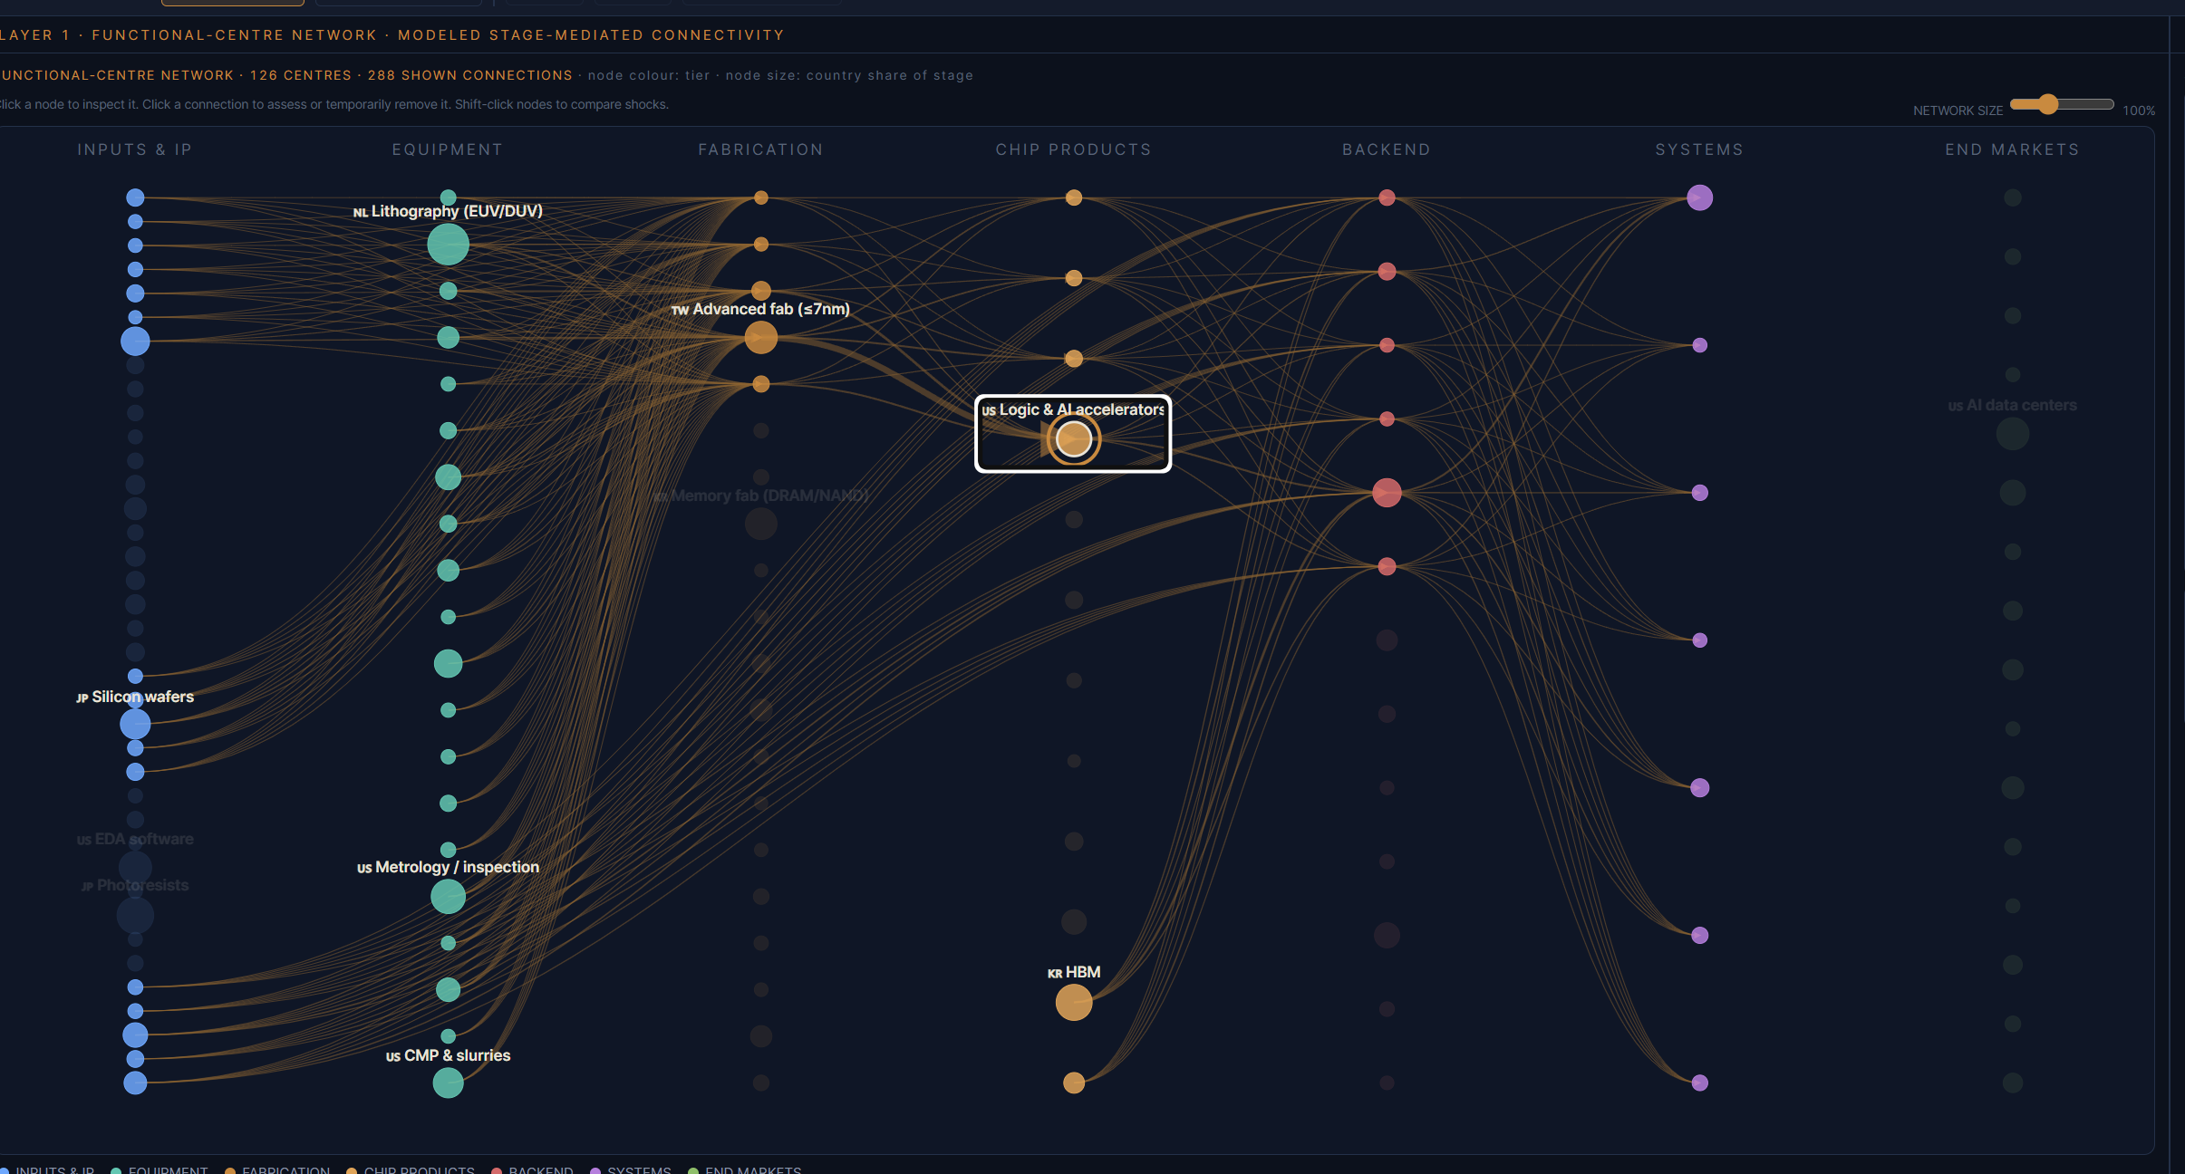
SSCIM
Topology turns the stage graph into an interactive resilience laboratory.
Functional centres
LIVE PROJECT SCREENSHOT
Country x production-stage nodes derived from the same vault.
Routes
Click origin and destination to expose modeled dependency paths.
Stress tests
Remove links, compare alternatives, and inspect scenario deltas.
Honest boundary
Connections are not trade flows, shipping lanes, or direct contracts.
SSCIM - explainable semiconductor supply-chain intelligence
8

Slide 9
SSCIM
Publication is a controlled evidence pipeline, not an AI autopilot.
SOURCE
DEDUPE
AI DRAFT
HUMAN GATE
REBUILD
VERIFY
PUBLISH
USGS, rules, news
exact + near-match
classification proposal
approve, edit, reject
vault + snapshot
audit + 185 tests
commit + Pages
Authority boundary
AI may draft a proposal. Only a human decision can admit an event to the vault, and only a passing audit/test gate can publish it.
SSCIM - explainable semiconductor supply-chain intelligence
9

Slide 10
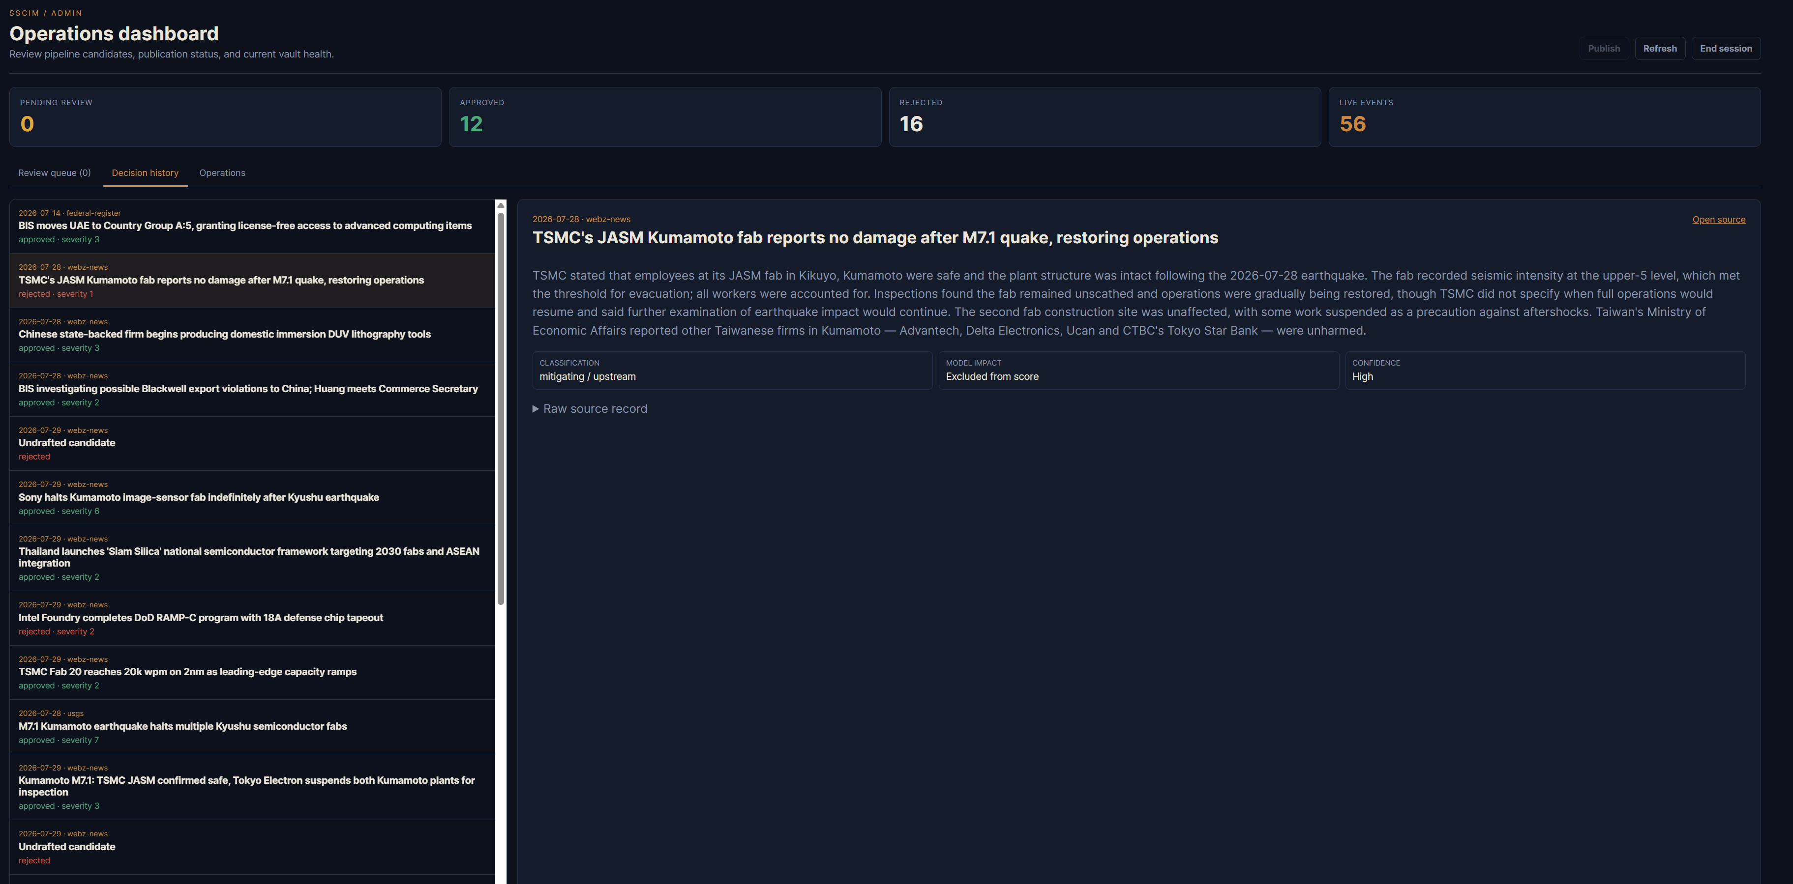
SSCIM
The review dashboard preserves both accepted and rejected evidence.
LIVE PROJECT SCREENSHOT
12
16
approved candidates
rejected candidates
0
0
pending review
unpublished decisions
Each record retains the original URL, raw source payload, AI proposal, reviewer decision, timestamp, and duplicate flags.
Capture required: admin-history.png
SSCIM - explainable semiconductor supply-chain intelligence
10

Slide 11
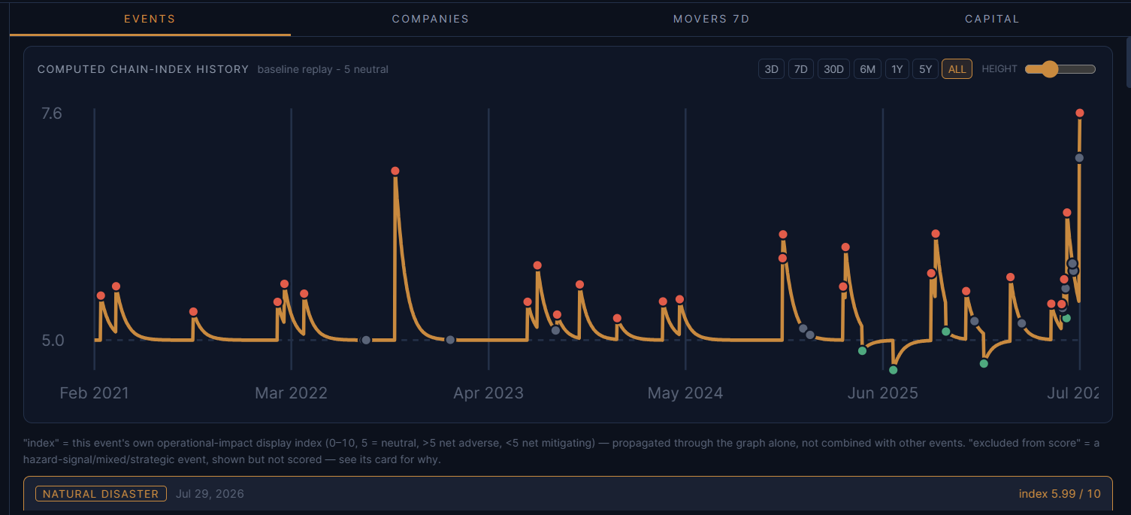
SSCIM
History stays useful even when the local API is offline.
COMPUTED CHAIN-INDEX HISTORY
LIVE PROJECT SCREENSHOT
3 days | 7 days | 30 days | 6 months | 1 year | 5 years | all time
7.56
archived baseline chain index on 2026-07-29
Resilient publication
GitHub Pages keeps serving the last audited snapshot when the PC, tunnel, or API is unavailable.
SSCIM - explainable semiconductor supply-chain intelligence
11

Slide 12
SSCIM
A hybrid architecture separates public availability from private write authority.
READ PATH
WRITE PATH
PUBLIC BROWSER
GITHUB PAGES
CLOUDFLARE
LOCAL API
VAULT
React / Vite UI
versioned static snapshot
HTTPS tunnel
Express on :8787
SQLite + review queue
Scheduled writer
The daily local pipeline fetches, deduplicates, drafts, ages events, refreshes quotes, exports, archives, verifies, commits, and pushes. No public browser can write directly to GitHub.
SSCIM - explainable semiconductor supply-chain intelligence
12

Slide 13
SSCIM
Transparency is the trust model.
A / B / C
peer-reviewed, institutional, and official primary evidence
Reproduce a result with:
1. repository commit 2. snapshot date 3. event or scenario id 4. topology removals 5. low / base / high sensitivity case
D
declared analyst judgment, labeled rather than hidden
GRAPH
deterministic output computed from the versioned snapshot
Declared priors are inspectable - and explicitly uncalibrated.
CONFIDENCE
evidence quality shown beside magnitude, never folded into it
SSCIM - explainable semiconductor supply-chain intelligence
13

Slide 14
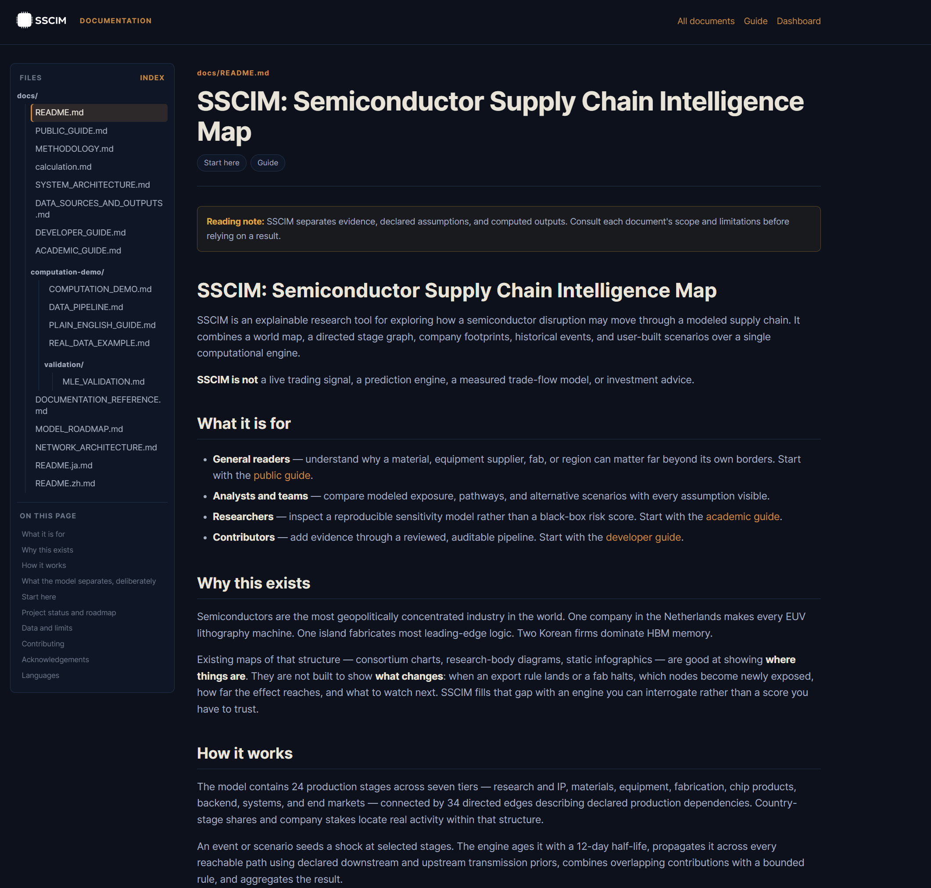
SSCIM
Documentation gives every audience a different doorway into the same system.
GENERAL PUBLIC
LIVE PROJECT SCREENSHOT
plain-language guide and interpretation limits
ANALYSTS
methodology, events, sources, and scenario workflow
ACADEMICS
reproducibility, evidence tiers, validation boundary
DEVELOPERS
architecture, data contracts, tests, and publication
SSCIM - explainable semiconductor supply-chain intelligence
14

Slide 15
SSCIM
The roadmap is a data program before it is a modeling program.
Facility layer
Buffer layer
Dependence layer
Qualification layer
Calibration layer
actual production sites, capacity, utilization, and geography
inventory days, time-to-recover, and time-to-switch
bill of materials, buyer input share, supplier revenue share
alternate suppliers and switching feasibility
historical disruption outcomes and goodness-of-fit
Until those layers exist, SSCIM remains a transparent sensitivity model - not a forecast or loss estimator.
SSCIM - explainable semiconductor supply-chain intelligence
15

Slide 16
EXPLAINABLE BY CONSTRUCTION
Explore the chain. Challenge the assumptions. Improve the evidence.
SSCIM makes the method visible, keeps human review authoritative, and preserves a usable public snapshot even when the live backend is offline.
sscim.railgunbreaker.icu
Documentation | Dashboard | Reviewed vault

