Slide 1
HS300 Multi-factor Study — Summary
Reproducible factors, IC, robustness, and liquidity-aware backtest

Slide 2
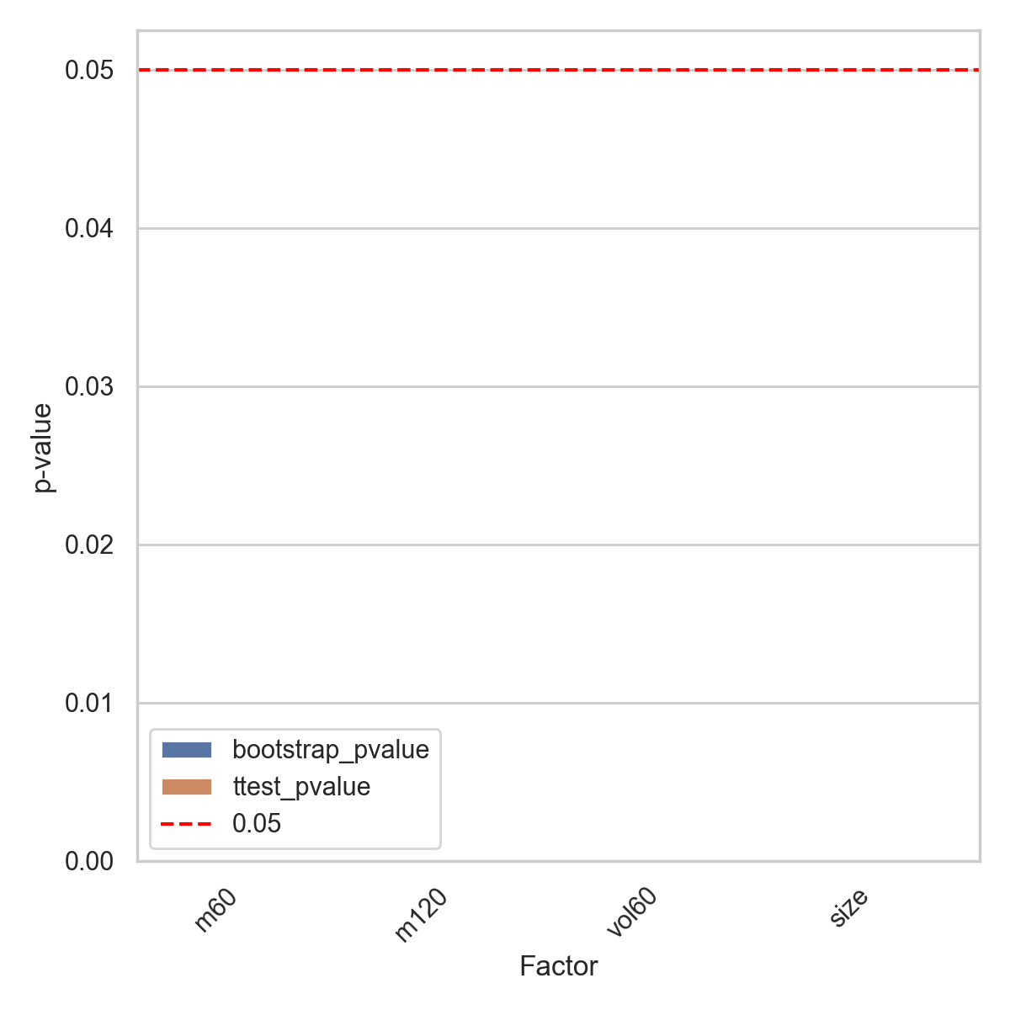
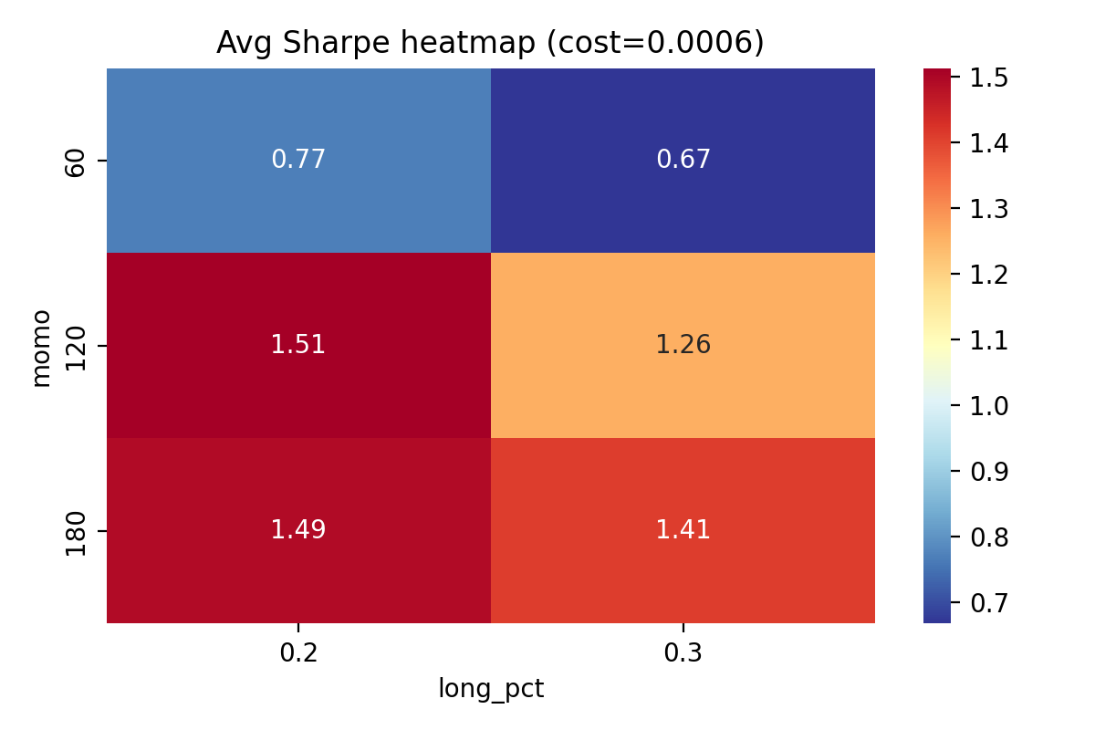
IC significance & Robustness

Slide 3
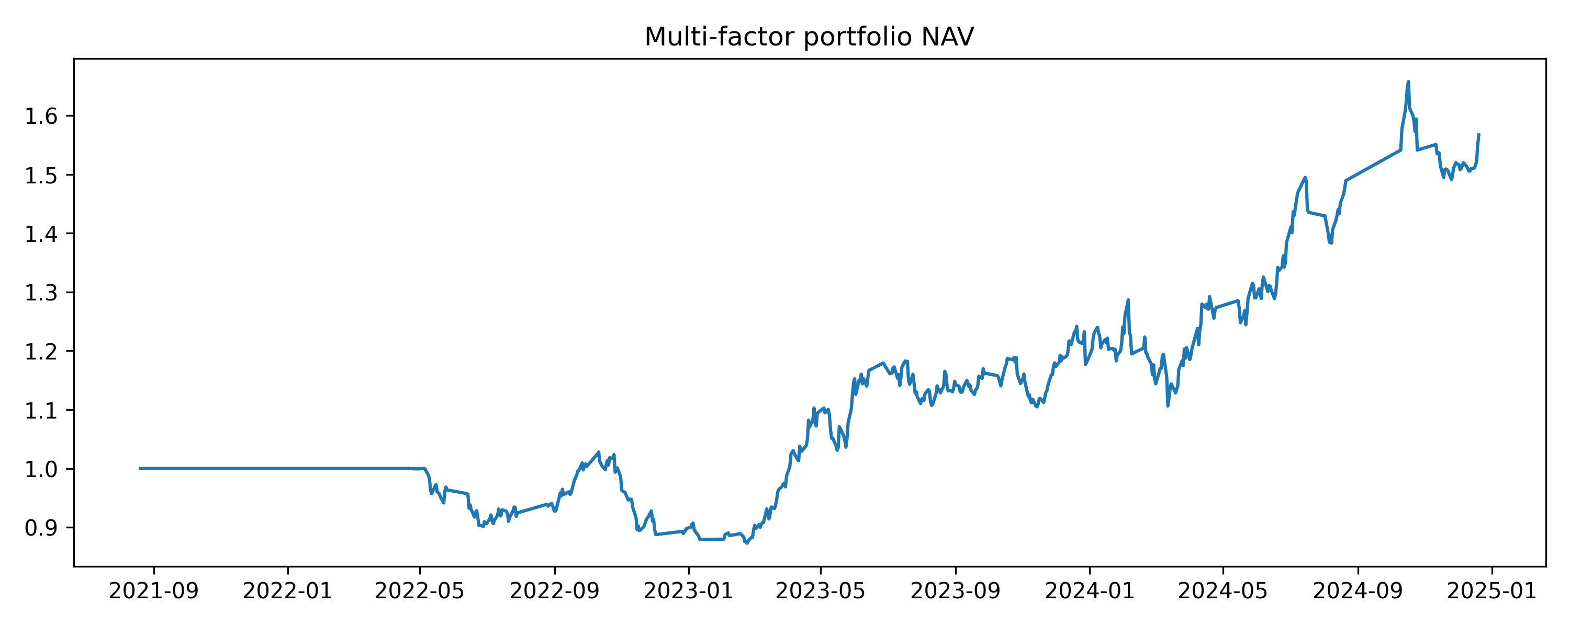
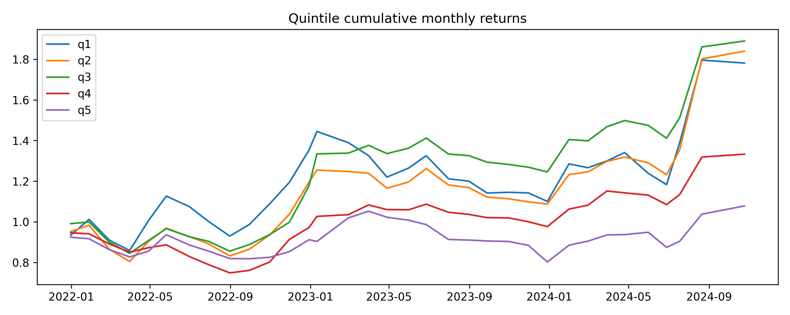
Portfolio NAV & Quintile Returns

Slide 4
Methodology & Liquidity Assumptions
Factors: m120 (momentum), m60, vol60, size. Cross-sectional z-score; industry-neutral; monthly rebalance.
Liquidity: ADV 20-day average; max 20% ADV per rebalance; linear impact cost applied.
Robustness: rolling-window tests and parameter grid; results saved in outputs/robustness_param_summary.csv.

