Slide 1

Data
8 classes
< 8k images
Each class < 1k images

Slide 2
EDA
Scrape data

Slide 3

Data Aug
ImgAmg

Slide 4
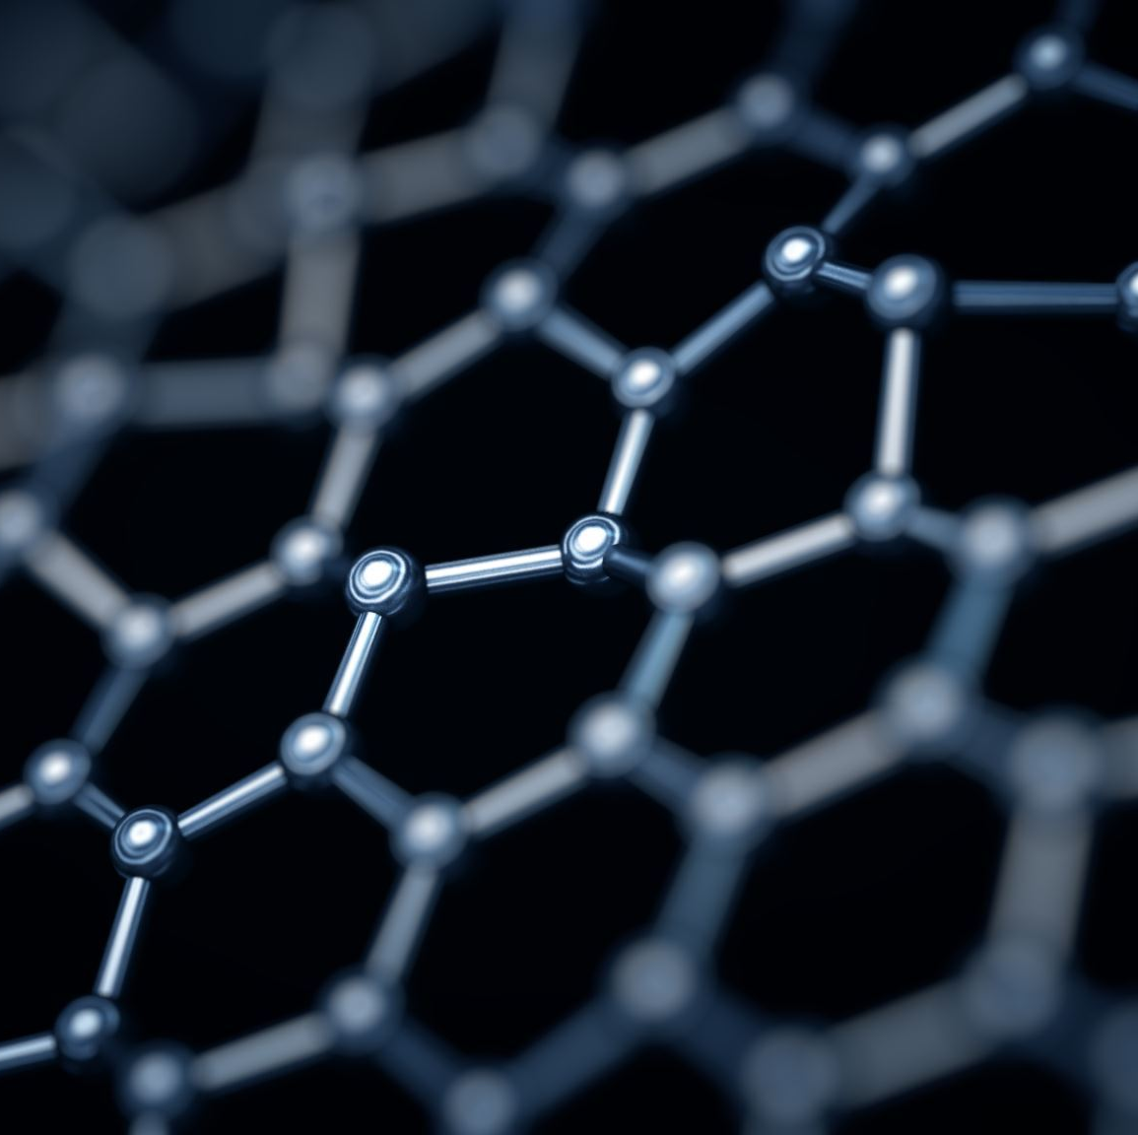
Frameworks
Sklearn
TF
Torch

Slide 5

Basic
Logistic
KNN
SVM
Ensemble (DT, RF, XGB)

Slide 6

Model - CNN
VGG
Resnet
Dense Net
Mobile Net
Dark Net
Efficient Net

Slide 7

Miscellaneous
Transformer
GNN

