Slide 1
What is Rails?
A short introduction

Slide 2

Ruby on Rails

Slide 3
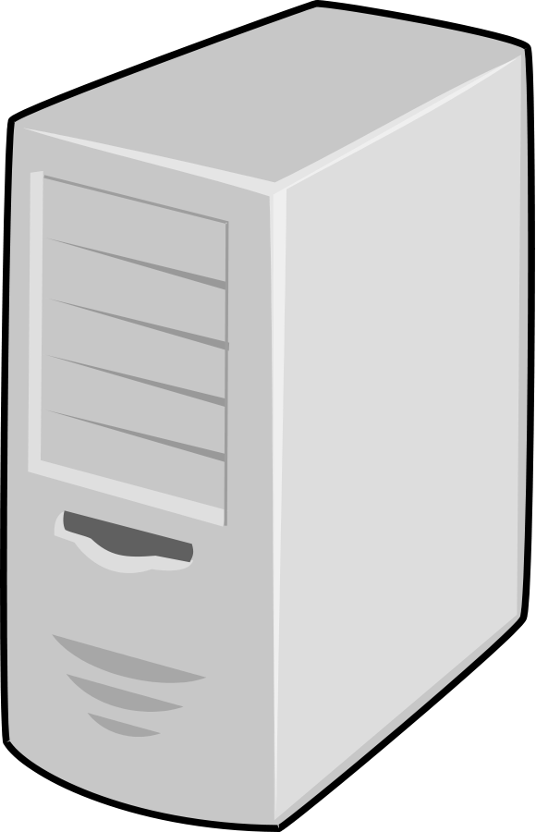
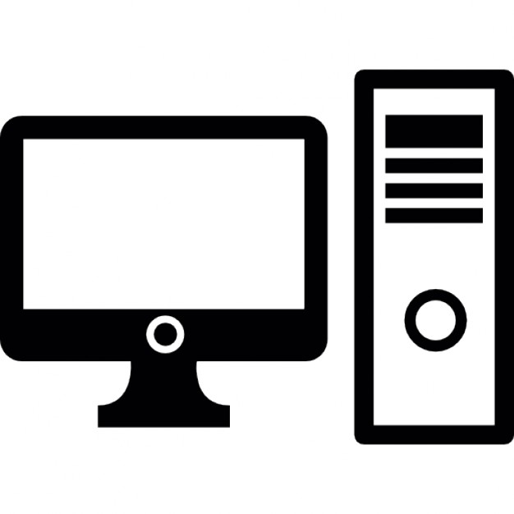


Slide 4
Ruby on Rails, or just ‘Rails’, is a Framework

Slide 5
Controller
View
Ruby on Rails
Model

Slide 6
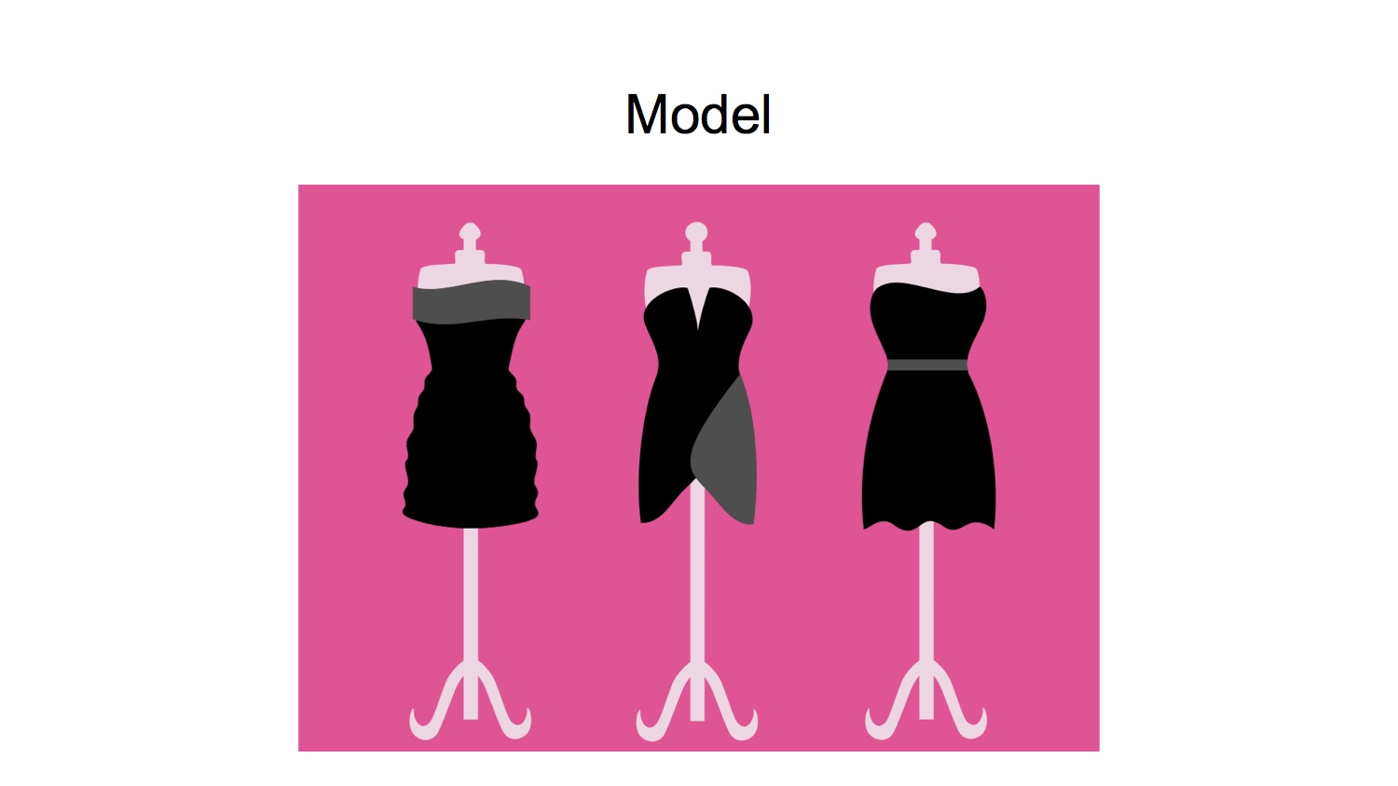

Slide 7
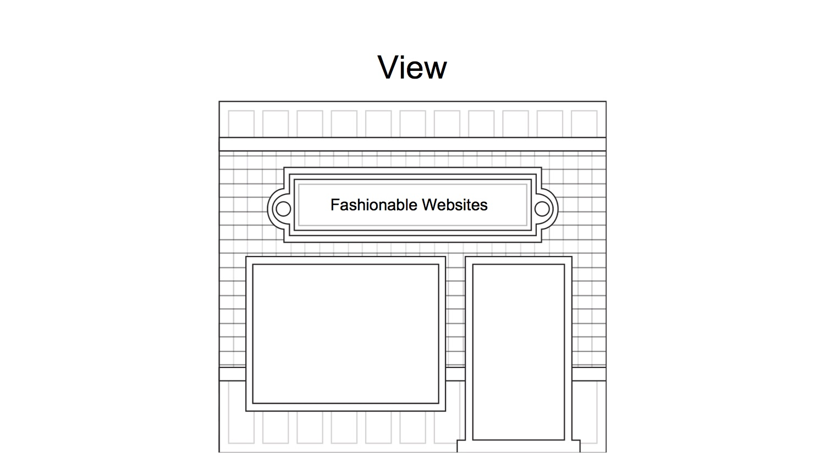

Slide 8
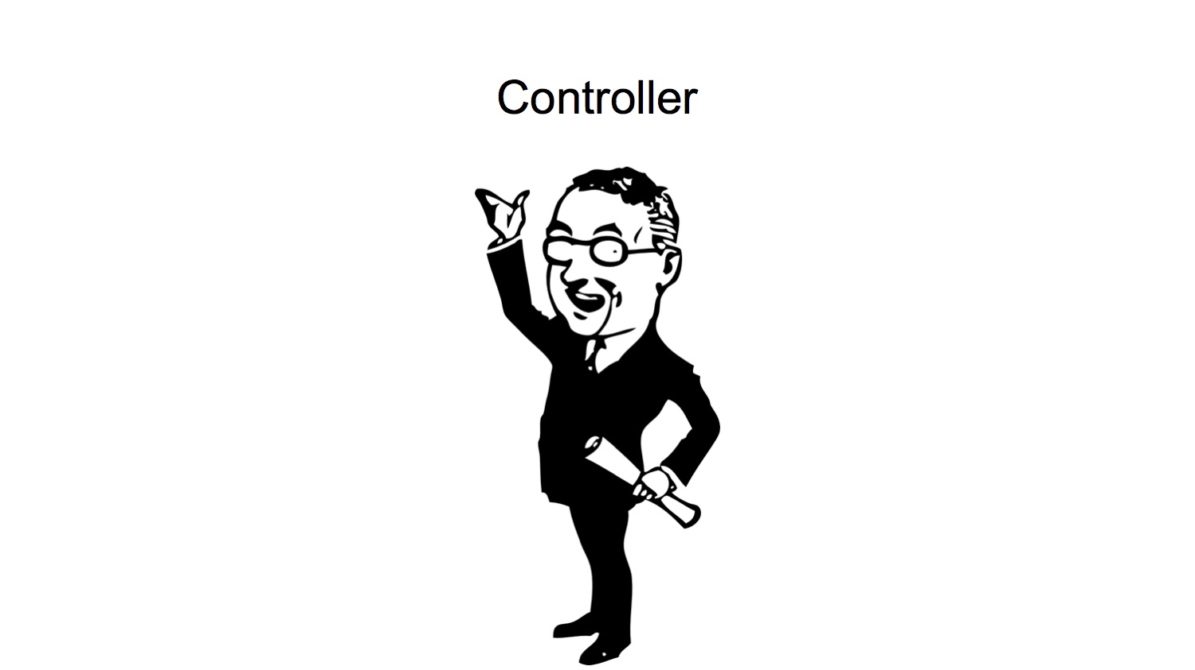

Slide 9
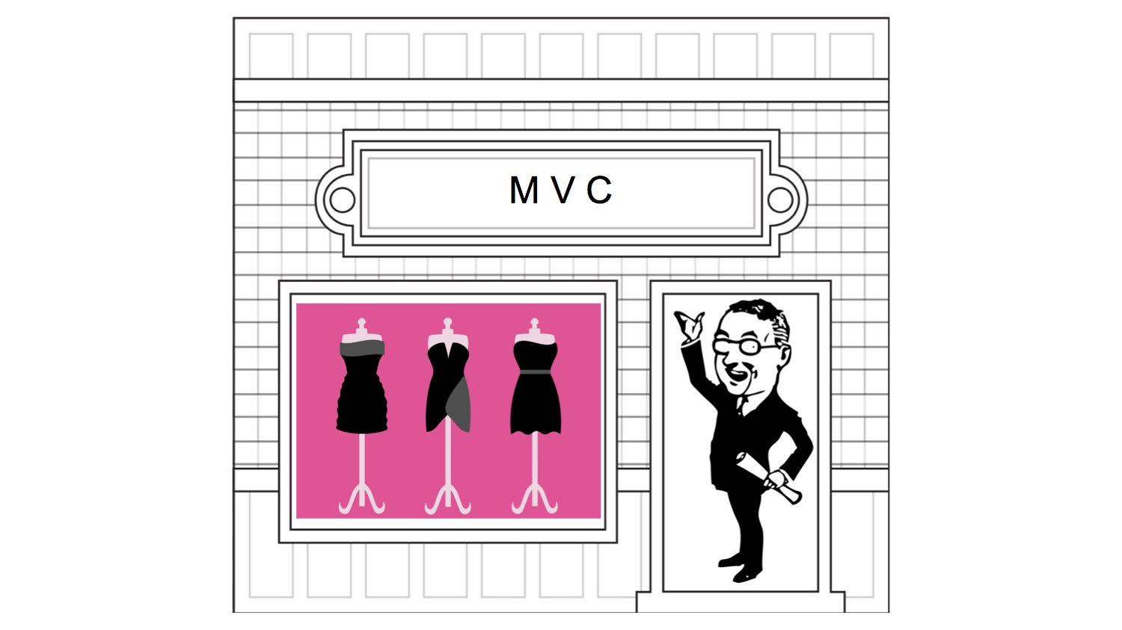

Slide 10
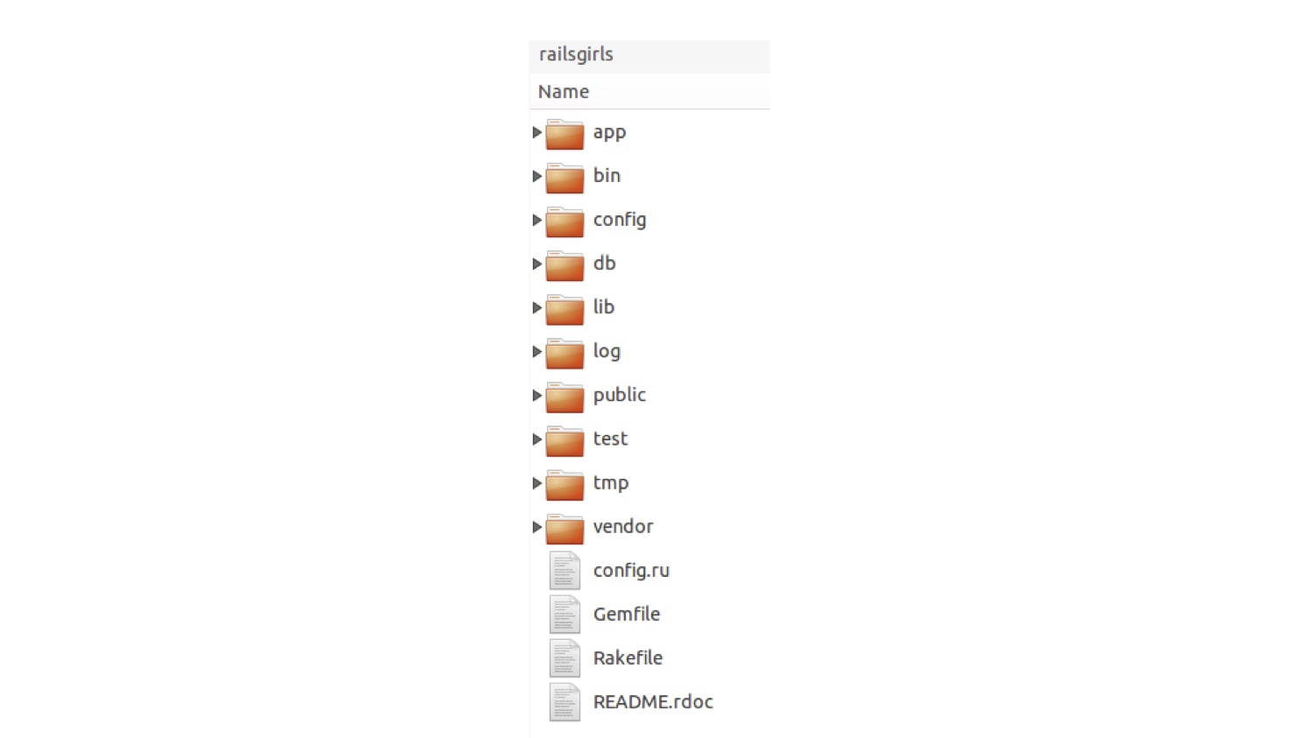

Slide 11
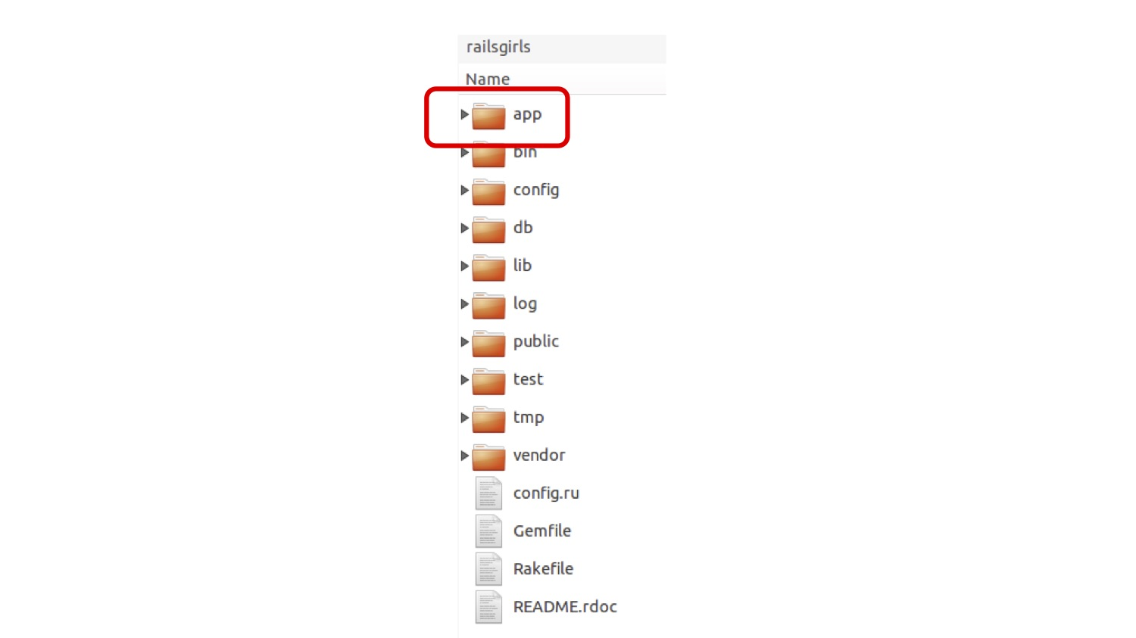

Slide 12
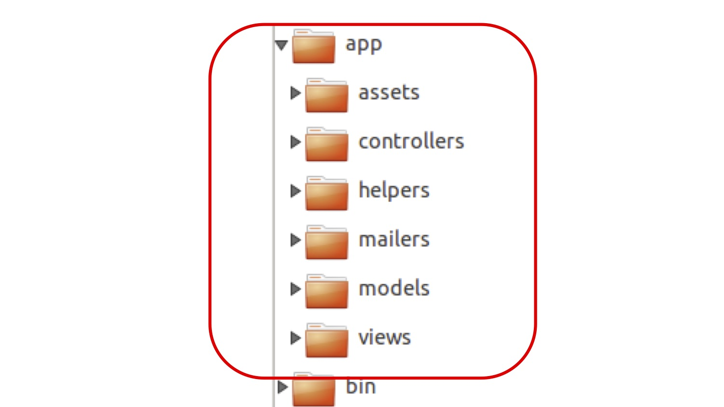

Slide 13
