Slide 1







Hello Programming
Stefania Farrugia
RailsGirls
Galway 2014
Notes:
About me

Slide 2
The Plan
What are Web Applications?
What are Programming Languages?
What is Ruby on Rails?
Getting Started with Ruby on Rails

Slide 3
What are Web Applications?

Slide 4
Web Applications
Receive a request from a user
Do something
Return a result back to the user
Request
Client
(browser)
INTERNET
Web Application
Response
Notes:
Request what?
Do what?
Response what?

Slide 5
Static Websites
Fixed Content
Same info to all users
Needs to be updated manually

Slide 6
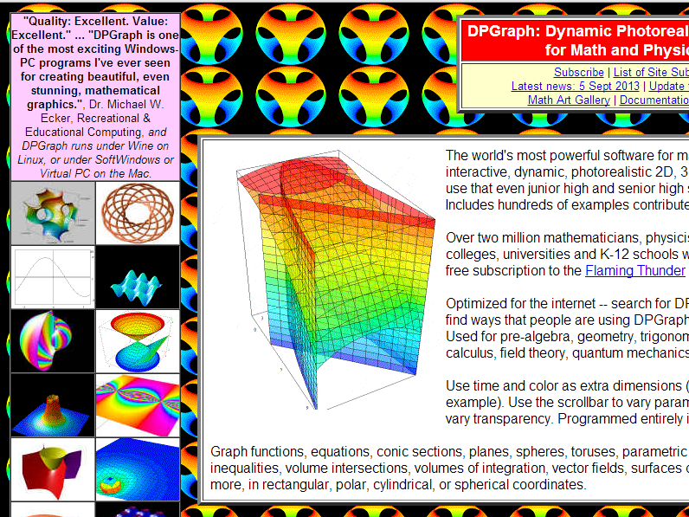

Slide 7








Dynamic Websites
Content is not fixed
Customised experience for the user
Frequently updated

Slide 8
What are Programming Languages?
Notes:
climax

Slide 9
Let’s cook…
Notes:
Imagine we’re about to start cooking

Slide 10
Cooking vs Web Apps
COOKING | WEB APPLICATION
RECIPE | SPECIFICATION
COOKING SET | FRAMEWORK
COOKING UTENSILS | LIBRARY
RAW INGREDIENTS | PROGRAMMING LANGUAGE

Slide 11
Specification (The Recipe)
What shall we do?
How shall we do it?
Notes:
e.g. Rails4Girls app

Slide 12
Framework (The Cooking Set)
Baking Set (baking)
Sushi Set (making Sushi)
Cheese Set (presenting cheese)

Slide 13
Framework (The Cooking Set)
Rails Framework (web applications)
Android Framework (android applications)
AngularJS Framework (web applications)

Slide 14
Library (The Cooking Utensils)
Knife (cutting)
Rolling Pin (rolling dough)
Oven (baking)

Slide 15

Library (The Cooking Utensils)
Sqlite3 (sql database)
Carrier Wave (file uploading)
Devise (authentication framework)
Notes:
WE BUILD LIBRARIES USING RUBY
IN RUBY, LIBRARIES ARE CALLED GEMS

Slide 16
Programming Language (The Raw Ingredients)
Bread, ham, cheese (sandwich)
Mushrooms, onions, stock (soup)
Eggs, milk, butter (omelette)

Slide 17
Programming Language (The Raw Ingredients)
Ruby Language (web applications)
Java Language (enterprise applications)
Objective-C Language (mobile applications)

Slide 18
What is Ruby on Rails?
Notes:
climax

Slide 19
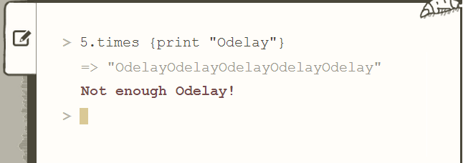
What is Ruby?
The programming language

Slide 20

What is Rails?
The underlying framework
Used for web programming
Notes:
This was installed yesterday evening on your pc

Slide 21

What is Ruby on Rails?
Open-source
A web application framework
Lets you write beautiful code
Optimised for
programmer happiness ☺
Notes:
Define open-source – universal access to everyone free distribution, source code available
therefore

Slide 22
Let’s Code
Notes:
climax

Slide 23
Tools
Text Editor (Sublime Text, Komodo Edit, Vim, Emacs, Gedit…)
Terminal / Command Prompt
Web browser (Firefox, Safari, Chrome…)
Notes:
Recap of what you need

Slide 24
Getting Started
Start off at:
http://guides.railsgirls.com/install/
To view the app:
http://localhost:3000
Notes:
Define open-source
therefore

Slide 25
tryruby.org
Notes:
Web-based ruby shell
Gets you started in 15 mins

Slide 26
Other Resources
Rails for Zombies:
http://railsforzombies.org
Rails Guides:
http://guides.rubyonrails.org/
Code Quizzes:
http://www.codequizzes.com/
Rails Screencasts:
http://railscasts.com/
Codecademy: http://www.codecademy.com/tracks/ruby
Notes:
The point is that there are a lot of resources out there. Use them. It can be fun.

Slide 27
?
Questions?

Slide 28
Thank You… Happy Coding!
Notes:
Have fun

