Slide 1
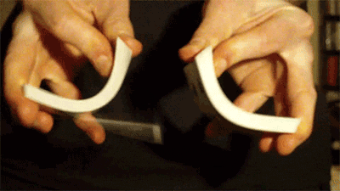
Do the List Shuffle or
Optimizing an Erlang Functional Algorithm
The path to Erlang’s new rand:shuffle(List) in OTP 29.0.
What makes an algorithm fast/slow?
Raimo Niskanen
Erlang/OTP
2026-05-13

Slide 2
Inception
A thread on ErlangForums
How about implementing lists:random_sort/1?
Would lists:sort(fun rbool/1, L) work?
No – the sort algorithm leaks through!
There are apparently pitfalls here...

Slide 3
How to Shuffle
Mutable is certainly the norm
Wikipedia: “Fisher-Yates shuffle”
Random Pick (Fisher-Yates/Knuth shuffle) | Shuffles a mutable array in place
Randomize and Sort | Attach random tag, sort by tag, untag
ErlangForums
Pointer to Haskell list archive | Fisher-Yates with a tree (?)
Recursive Random Split (sketched) ”Basically a randomized quicksort” | Random split, recursion over parts

Slide 4
Requirements
Random permutation: every list element shall have the same probability for every output position, “Perfect Shuffle”
Underlying PRNG presumed “perfect”.
Implement in rand – plugin PRNG:s and other useful stuff
Test data
Simulations
Games – any gambling site

Slide 5
About Erlang
Terms and Heap space
List: [X, Y, …] is single linked and occupy one cons cell
per element, 2 words
Tuple: {X, Y, …} occupies N + 1 words
Map: #{K => V, …} (≥ 32 elements) is a HAMT
(Hash Array Mapped Trie) that branches in trie nodes,
16..2-tuples
array: is a complete tree of 16-tuples,
where the integer index digits is the tree path

Slide 6
About Erlang
Garbage must be collected
Chopping off the head of a list renders
one cons cell (2 words) as garbage
A tuple update will copy from the old tuple,
which becomes garbage
A map() update (as array, or any tree) render
all nodes up to the root as garbage
The PRNG updates its state and returns values wrapped in tuples → garbage

Slide 7
This Benchmark
Shuffles a list of N immediate integers Cnt times
in a newly spawned process and traces the process.
Measures produced garbage, heap size, data structure size, PRNG use, and execution time
Plot: N = 2^{[3 .. 20]}-1 [7 .. ≈10⁶]
x axis: N, logarithmic.
y axis: words, calls or µs / N

Slide 8
How to Shuffle
Random Pick
Fisher-Yates / Knuth / Durstenfeld Shuffle
Randomize and Sort
Recursive Random Split

Slide 9
Random Pick
Fisher-Yates / Knuth / Durstenfeld Shuffle
Fisher & Yates (1938):
pencil, paper and random number tables.
Durstenfeld (1964) / Knuth (1969):
shuffle an array in place.
Randomly pick the next output element
among the remaining

Slide 10
Random Pick
Fisher-Yates / Knuth / Durstenfeld Shuffle
a,
{
b,
d,
b,
c,
e,
}
[
]

Slide 11
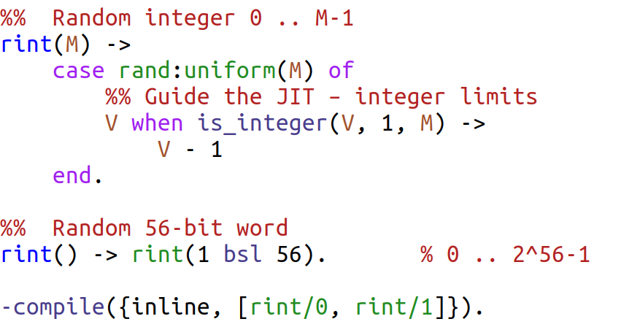
Pseudo Random Integers
See rand:uniform/1
Optimizes JIT code

Slide 12
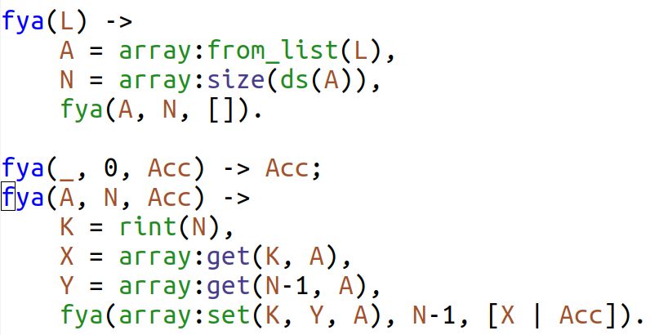
Fisher-Yates with array
Create array
Random index
Element at index
Last element
Save last element at index
Output element
Avoids array:resize(N-1, A)

Slide 13
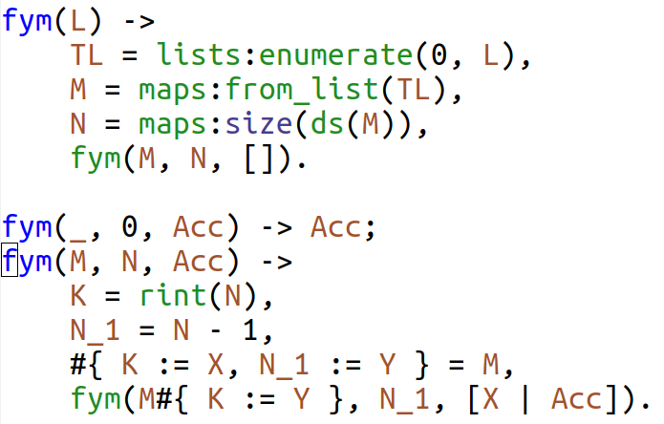
Fisher-Yates with map()
Create {Index,Element} list
Then create map
Map syntax; map functions perform the same
Avoids maps:remove(N_1, M)

Slide 14
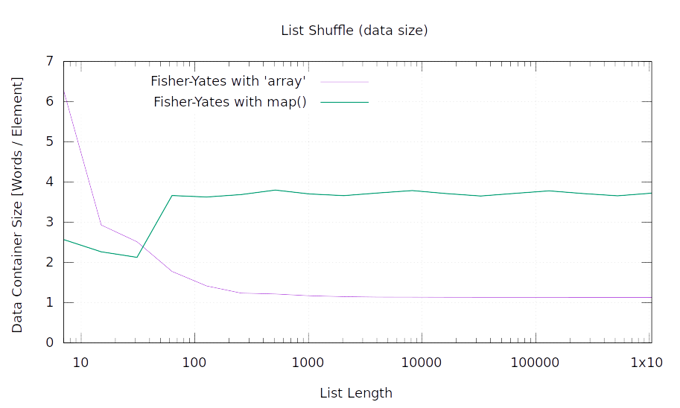
1 .. 16 element array uses 27 words.
map() has to store the “array index”,
+ 1 leaf tuple element

Slide 15
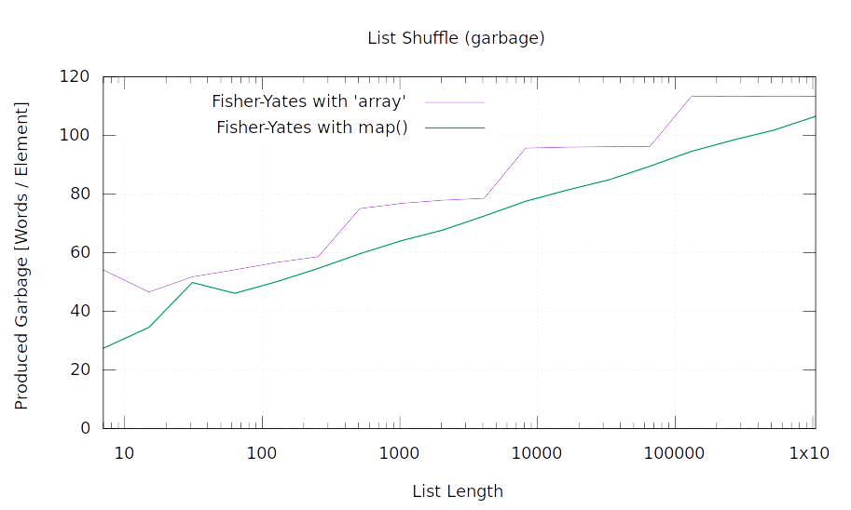

Slide 16
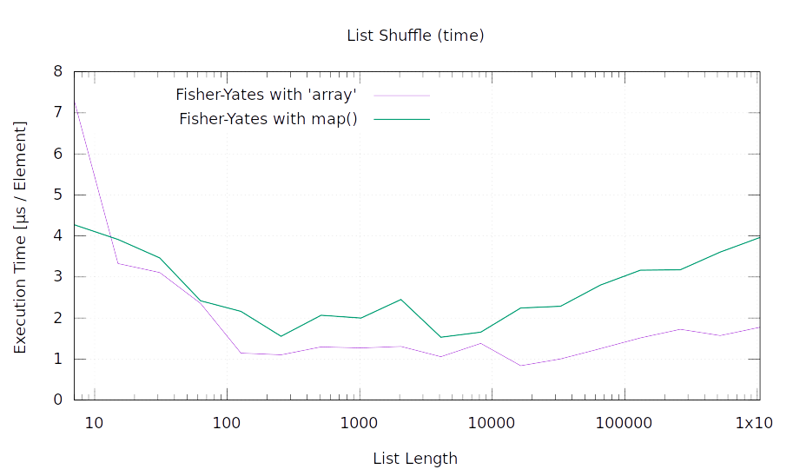
The Haskell mailing list archive solution
Fisher-Yates with complete binary tree
– essentially the same as array!
array:from_list/1 is very fast

Slide 17
How to Shuffle
Random Pick
Fisher-Yates / Knuth / Durstenfeld Shuffle
Randomize and Sort
Recursive Random Split

Slide 18
Randomize and Sort
Tag with random integers
Sort by tags
Untag

Slide 19
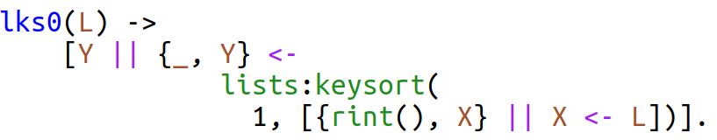
“One-liner” with lists:keysort/1
Untag
Sort
Tag
It is a one-liner if you have 70 columns
Does not handle rint() duplicates
Shuffle duplicates (recursively) while untagging
Preserves the order of the lists, for no good reason
Use functions for tagging and untagging

Slide 20
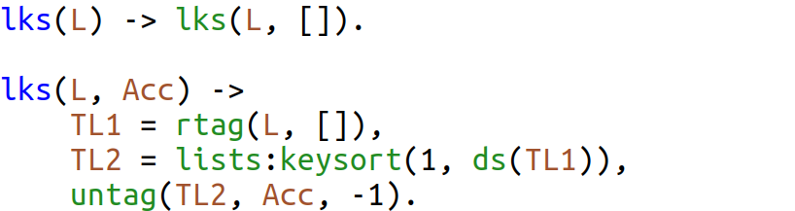
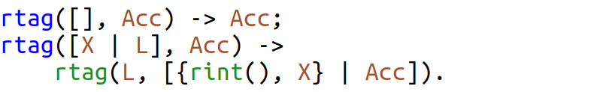
Randomize and Sort: lists:keysort/1
Tag
Sort
Untag

Slide 21
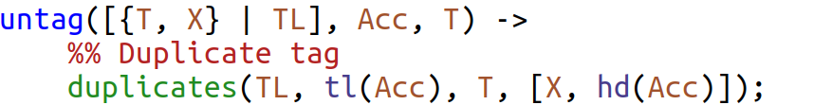
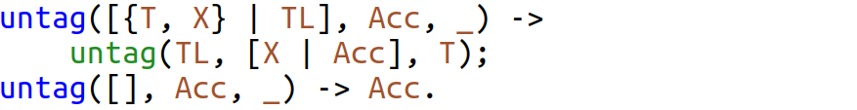
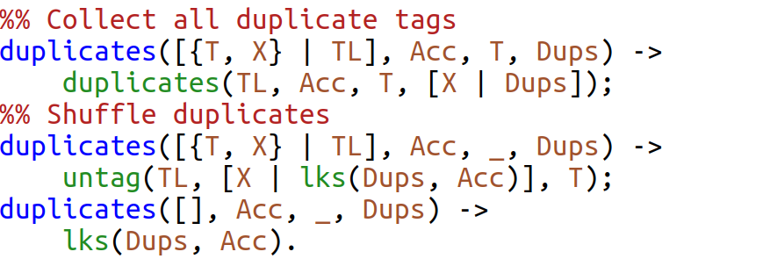
Randomize and Sort: lists:keysort/1 (cont)
Check for duplicate
Collect duplicates
This does not
happen unless
we reduce
the PRNG width..
Shuffle duplicates

Slide 22
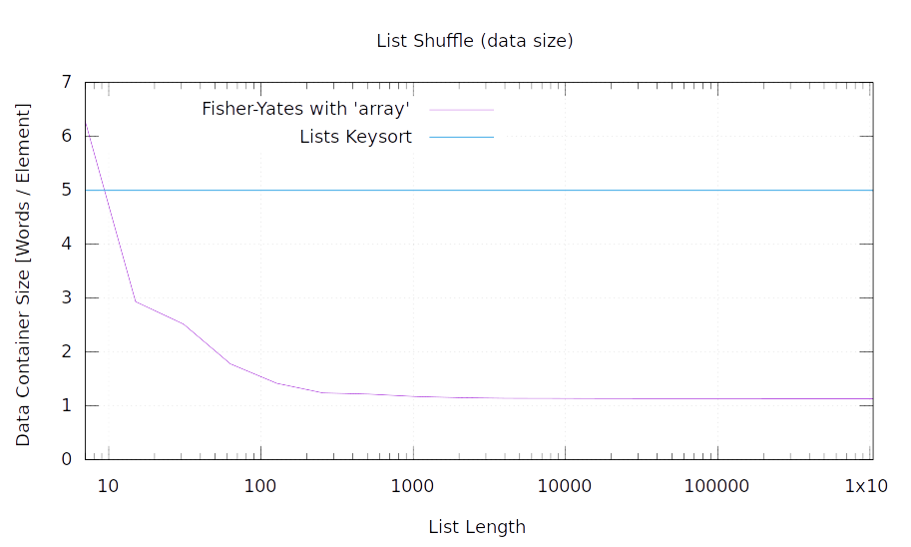
List of 2-tuples → 2+3 words per element

Slide 23
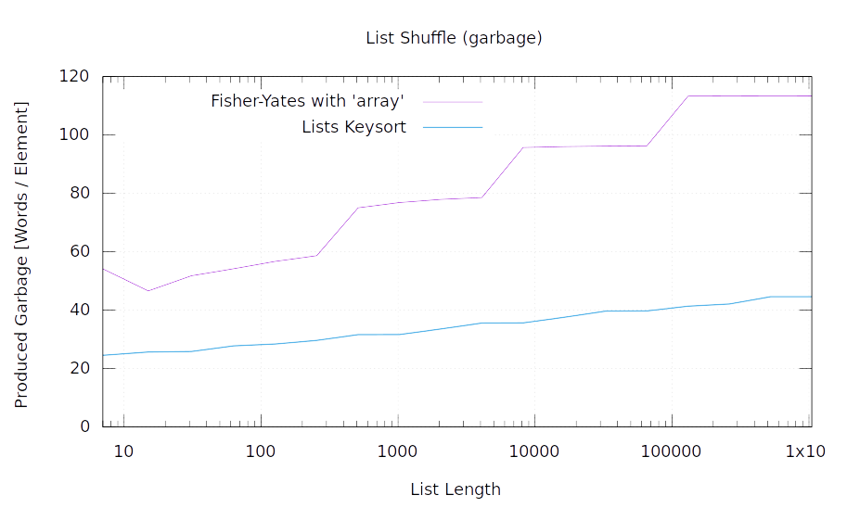
The 2-tuples become
garbage once at the end

Slide 24
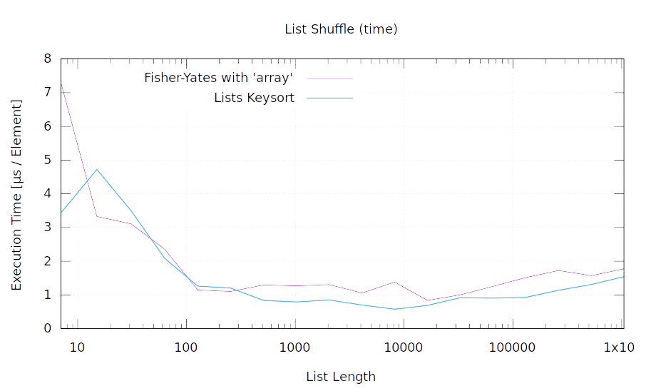
The 2-tuples goes to the old heap
and dodges garbage collection

Slide 25
Randomize and Sort (again)
Tag with random integers
Sort by tags
Untag
Simply insert elements in a map() with random keys.
Avoid duplicates
Use map() key order
That key order is too undetermined
Slower than using lists:keysort/1

Slide 26
How to Shuffle
Random Pick
Fisher-Yates / Knuth / Durstenfeld Shuffle
Randomize and Sort
Recursive Random Split

Slide 27
Recursive Random Split
”Basically a randomized quicksort”
Randomly split the list in parts
Shuffle the parts recursively

Slide 28
Recursive Random Split
a
b
c
d
e
[ , , , , ]
[ , ]
[ , , ]
[ ]
[ ]
[ , ]
[ ]
[ ]
[ ]
[ , , , , ]

Slide 29
Recursive Random Split
How to split?
Knuth’s selection algorithm – P( = N div 2) out of N
Needs one rint(N) per element per recursion level,
which kills the performance
I did not know about that one…
Split by “coin flip” (bit), cache a word of “coin” bits

Slide 30
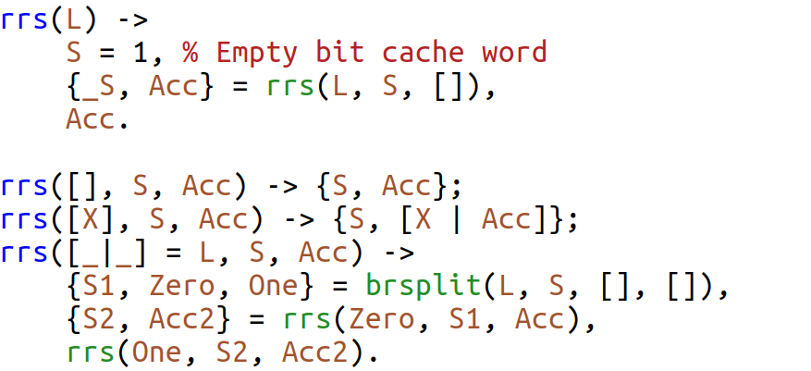
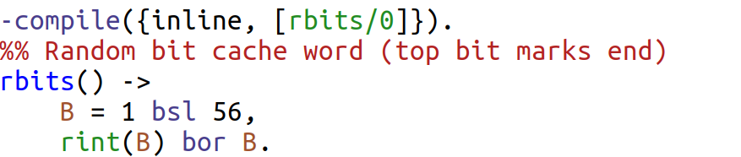
Recursive Random Split
(Coin Flip)
A singleton list
is output
Split the list
Bit cache S is
treaded through
all functions
Shuffle the parts
Generate bit cache
(JIT optimized)

Slide 31
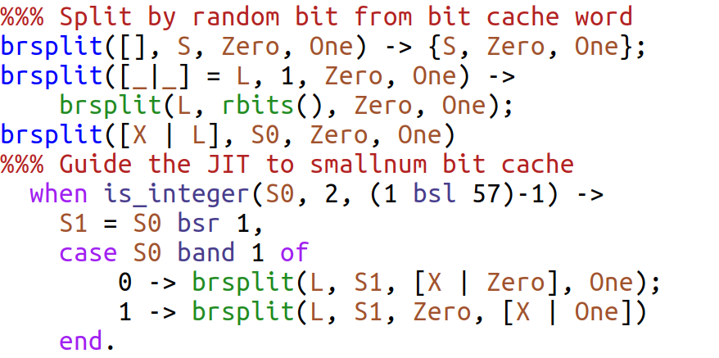
Recursive Random Split (Coin Flip), cont
Generate new
bit cache
Shift down for
next iteration
Low bit selects
List Zero
List One

Slide 32
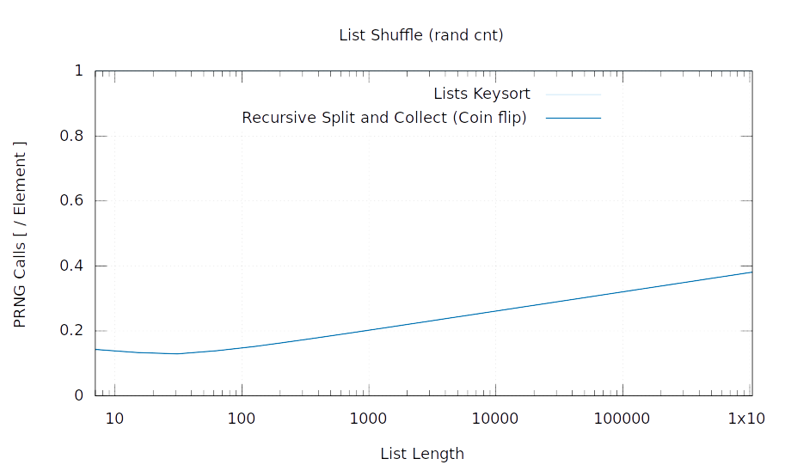
Lists Keysort = 1
One random bit
per element
per recursion level

Slide 33
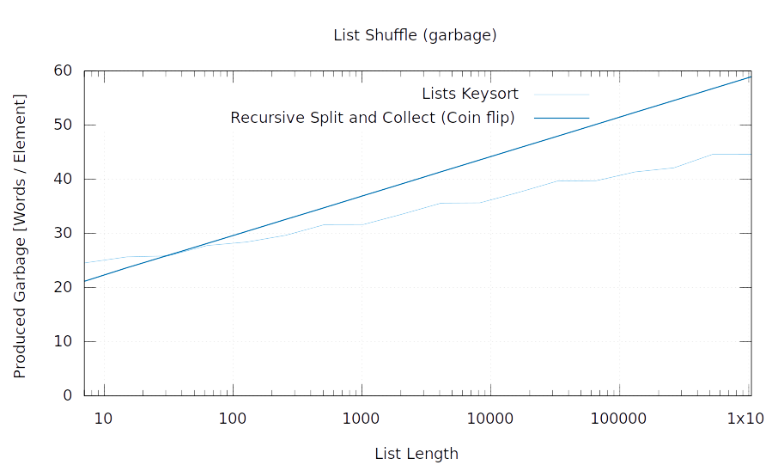

Slide 34
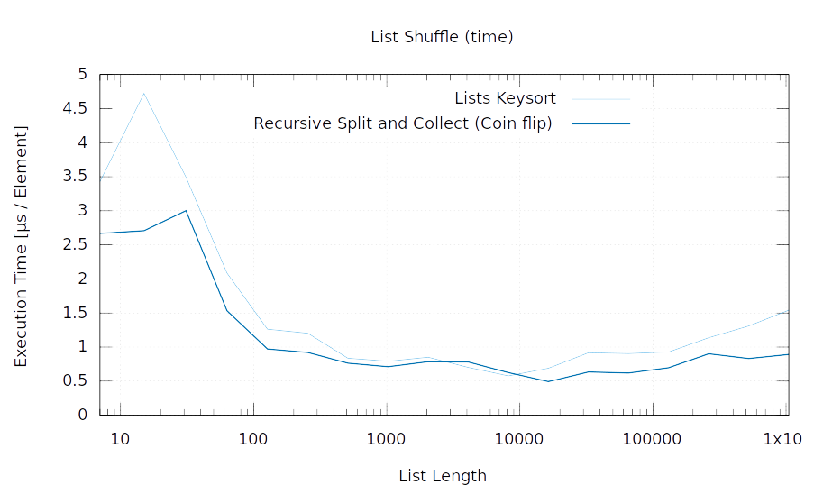
Further optimizations in rand:shuffle/1
4 way split by 2 bits
Immediate permutation of 2 and 3 elements
Direct access to PRNG internals

Slide 35
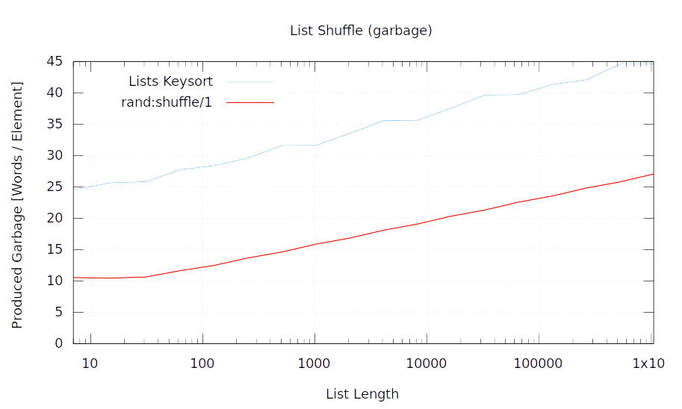

Slide 36
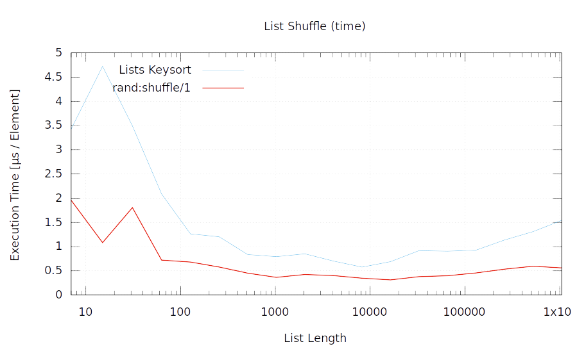
We have a winner!

Slide 37
Similarities
With equal probability
for all elements
Split into subsets
Recursively shuffle them in order
All these algorithms
are actually variants of:
Fisher-Yates: use a size 1 subset
Knuth subset: split in half
Coin Flip: split with equal probability
Tag and Sort uses very very many small subsets
1-bit tags and handling duplicates is equivalent to Coin Flip

Slide 38
Epilogue (since OTP 29.0)
Tried to beat array with tailored complete trees
of pairs (cons cells), 4-, 8-, and 16-tuples
Tied for second place with tag-and-sort
Asked an AI (apparently mandatory bullet point)
It had read Wikipedia, F-Y, array, L-C:s, maps, … nothing new
Rao-Sandelius Shuffle with bits (1961, 1963)
Insert Shuffle (randomized insert sort)
With tailored tree performs between F-Y with maps and array
End of story?

Slide 39
Generic Shuffling Pitfall (for any algorithm)
There are N ! permutations of a list.
A deck of cards has 52! ≈ 2²²⁶ permutations
rand defaults to 116 bits state and ≈ 20 bits
initial seed entropy
It cannot produce all permutations for a deck of cards
There are better generators in rand and crypto
Are all permutations required, or many?

Slide 40
Takeaways
Algorithms and data structures are inseparable
Immutability is a blessing and a curse
Keep an eye on the math
A constant factor can sometimes beat the Ordo
Lists are often efficient
Reduce garbage, live data, and recursion depth
Integer guards can optimize JIT:ed code
Measure! But is the benchmark relevant?

Slide 41
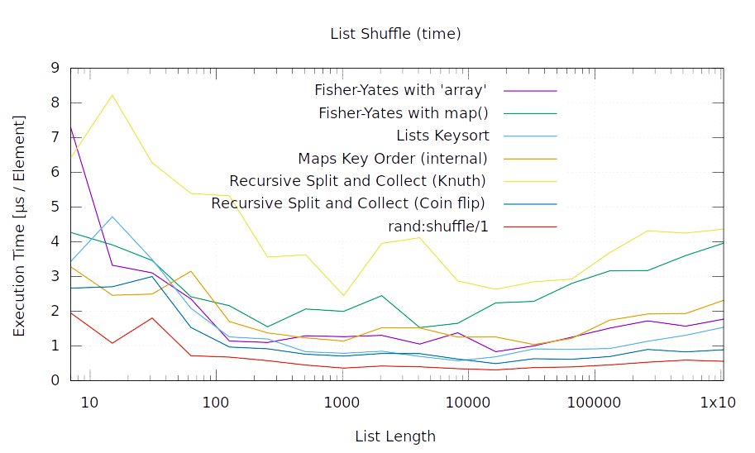

Slide 42
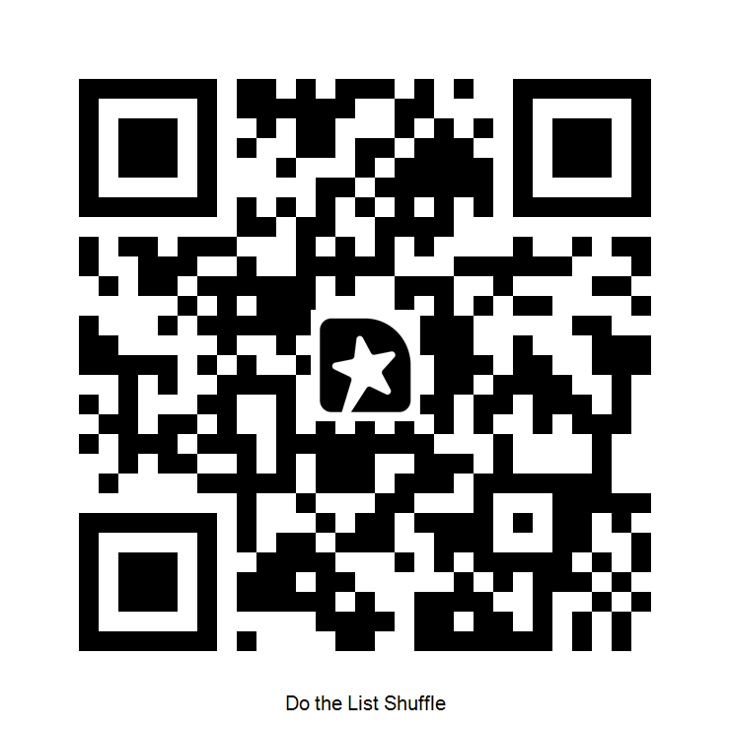
Feedback
Feedback
https://gist.github.com/RaimoNiskanen/fb5e9dd44106bd9d2f085fd46807aecd
shuffle.erl

Slide 43
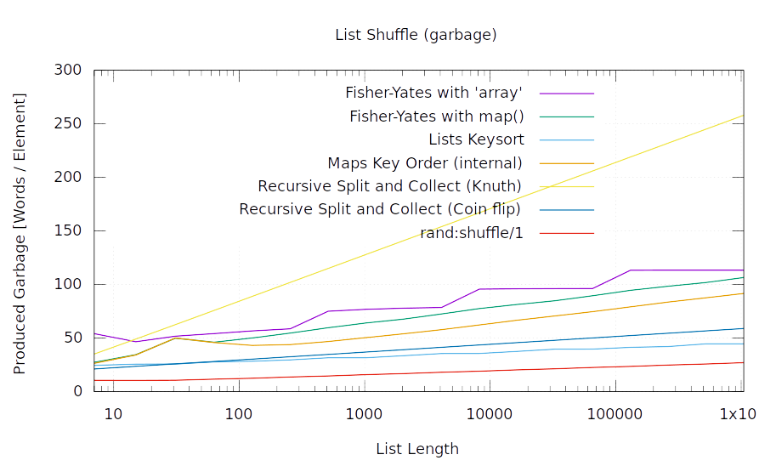

Slide 44
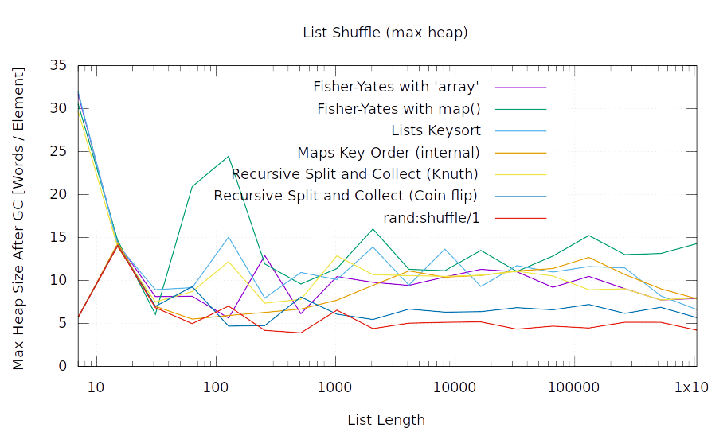

Slide 45
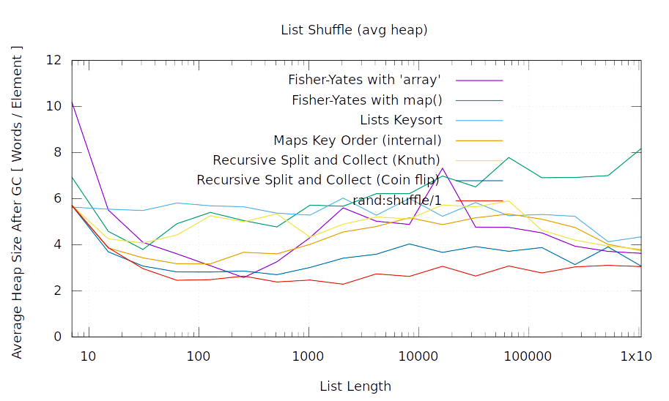

Slide 46
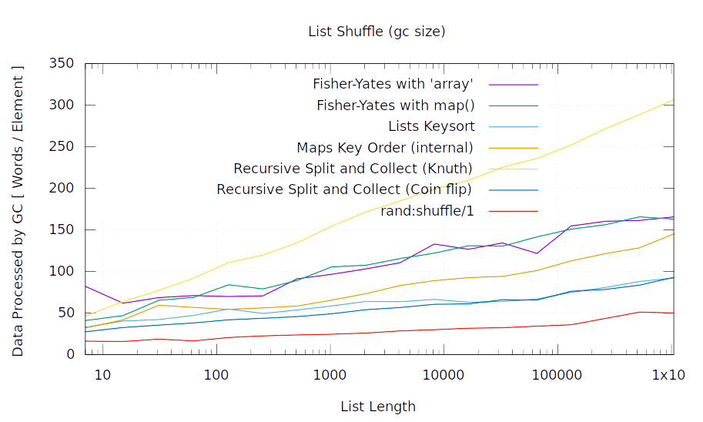

Slide 47
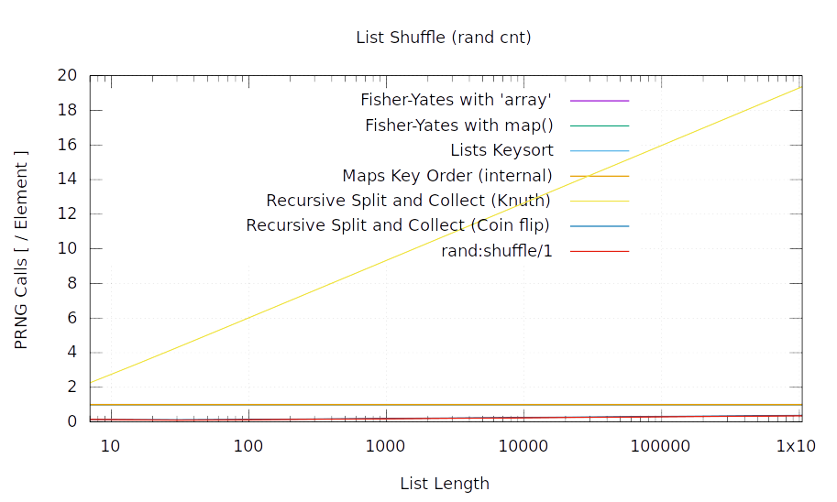

Slide 48
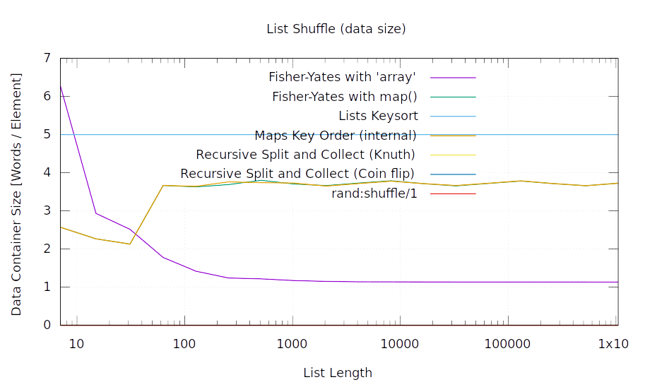

Slide 49
That’s all, folks!

