Slide 1
To Do List Web Application(TDL)
By: Raimonds Mezals

Slide 2
Introduction
The project:
Documentation
A To Do List Web Application that would be able to crate a to do lists with CRUD functionality and have an ability to add or remove items from specific lists.
Junit and integration testing to test the back-end of the system
Selenium testing to test the front end of the system

Slide 3






Consultant Journey
Learned skills Week 5:
Java
Eclipse
Git and GitHub
MySQL and H2
Agile scrum
Junit
Maven
SonarQube
Learned skills Week 8:
Spring
Visual Studio Code
Postman
Integration Testing
Mockito
Selenium
HTML
CSS
JavaScript

Slide 4
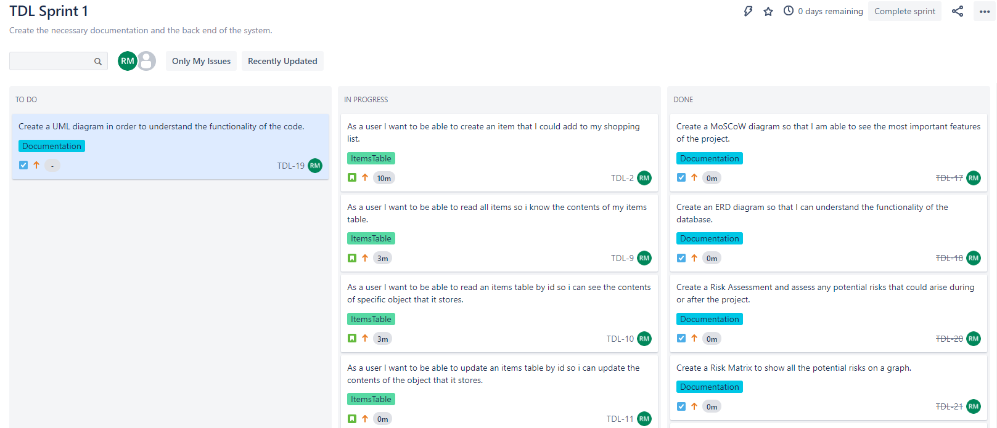
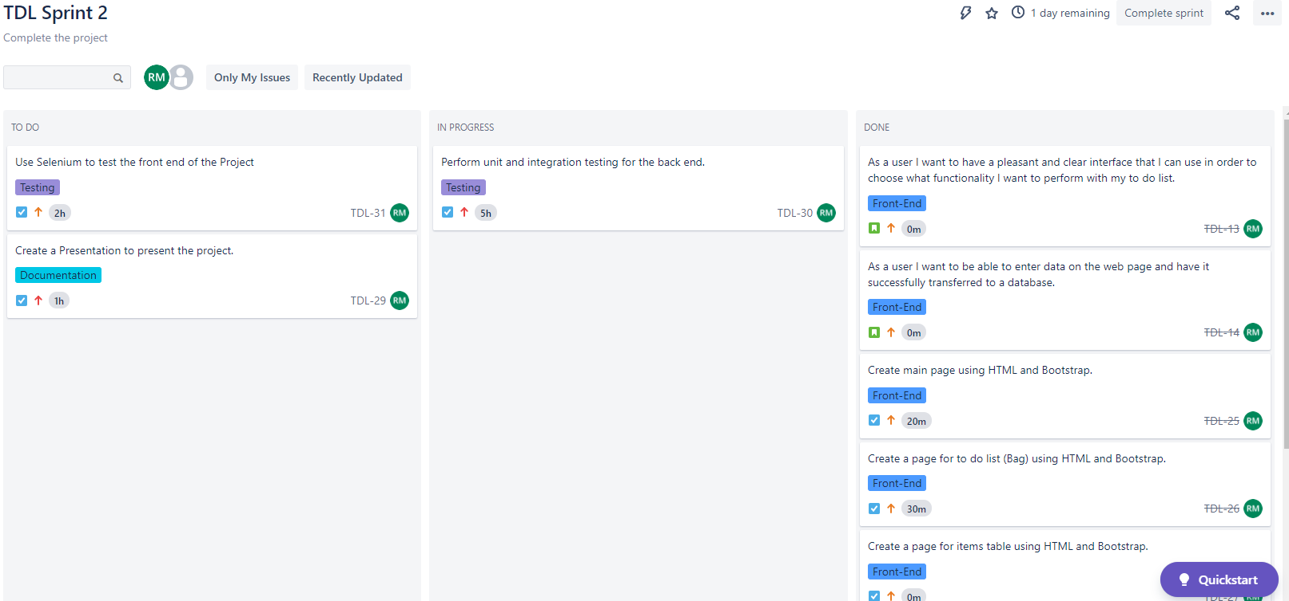
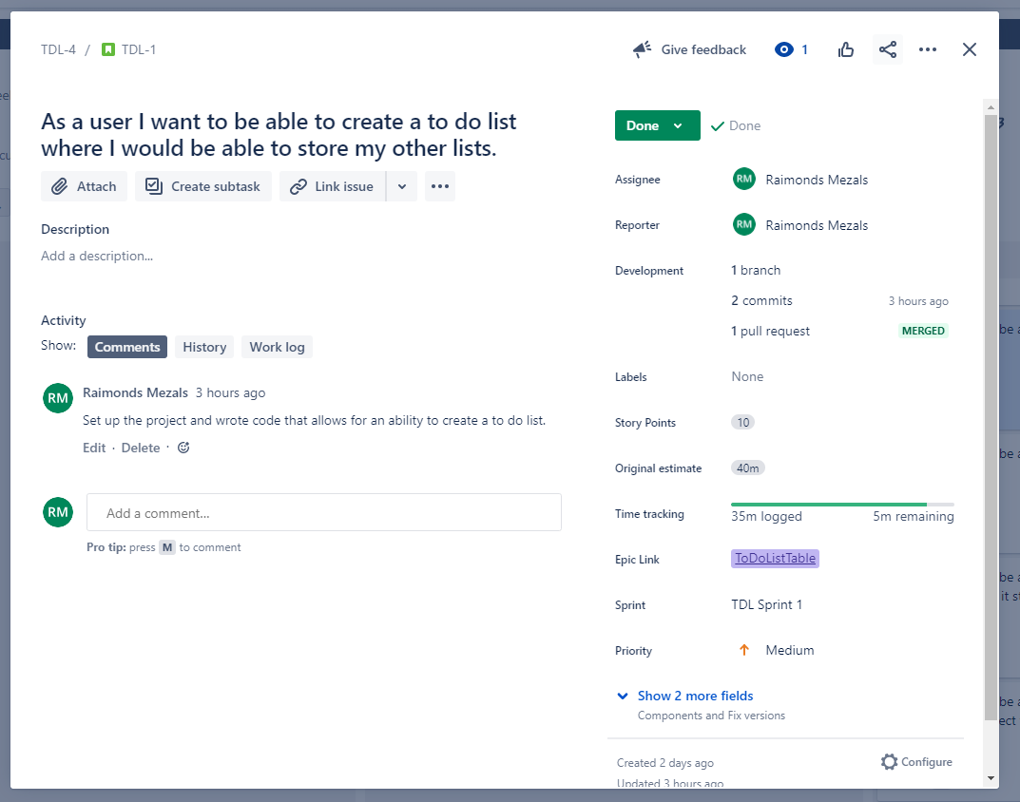
Continuous Integration Version Control: Jira

Slide 5
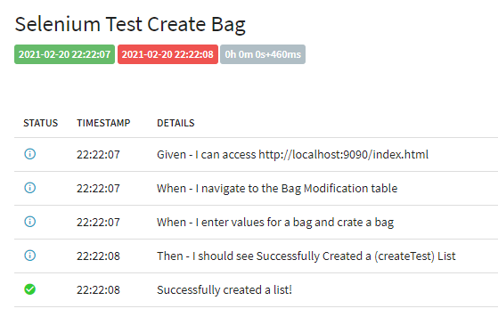
Testing
Junit and integration testing
BagController
BagService
Selenium testing
Front-end

Slide 6
Demonstration

Slide 7
Sprint Review
Minimum Viable Product
User Stories
Specific Tasks
Bugs

Slide 8
Sprint Retrospect
What Went Well
Product meets a minimum viable product
Junit and Integration tests covered over 80% of the project code.
What Could Be Improved
More time was needed in order to refactor the code, time management could be improved.
Selenium testing could be improved given more time.
More time could be spent to improve the design and general aesthetics of the front-end of the application.

Slide 9
Conclusion
The overall project and its functionality was a success.
Junit and integration tests covered over 80% of the main code for the back-end
Relevant documentation was created on time

Slide 10
Questions?

