Slide 1
Inventory Management System (IMS)
By: Raimonds Mezals

Slide 2
Introduction
The project:
Simulate an industry level workflow:
Documentation
An IMS system that would manage and store items, customers and orders using a database.
Junit testing to test the code.

Slide 3
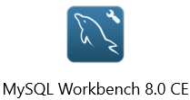


Consultant Journey
Learned technical skills:
Java
Eclipse
Git and GitHub
MySQL and H2
Agile scrum
Junit.
Notes:
Over the course of my training period for the QA Consultant in software testing I have learned a great deal of techniques and technologies. Before the academy I did not have any experience using these technologies however over these 5 weeks I have learned a great deal. The first technology that I have learned within this academy which was a large part of this project was the use of Git and GitHub. These technologies were used to keep track of my project and create relevant backups in case of any unexpected mistakes. For example, if I break my code and I am not sure how to fix It I could simply revert to one of my previous commits when the code was working. Soon after git we focused on databases; this is where I was thought the functionality of MySQL which I have used to store data for this project. The biggest part of this project was the use of Java to write the program itself. Over the course of the academy we have heavily focused on learning Java, different methodologies on how to utilise each of its functions and best practices to make sure that my code is readable and makes sense. During the recent 2 weeks of the academy I have also learned the functionality of Junit which allowed me to have the knowledge on unit testing for my project. The whole process of the project used Agile Scrum methodology to implement the most important features first and then work on the additional features. This knowledge was thought to me within the first weeks of the academy.

Slide 4
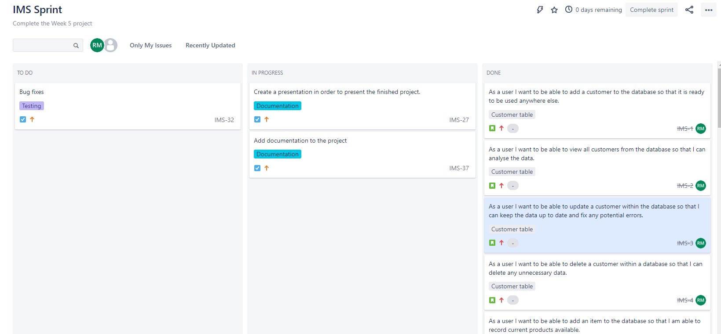
Continuous Integration Version Control: Jira
Jira Link: https://qademo.atlassian.net/secure/RapidBoard.jspa?projectKey=IMS&useStoredSettings=true&rapidView=2&atlOrigin=eyJpIjoiNTRhNTgwMGRmZmZhNDQ4YmJjMTFlY2NmYTk1ZDRlMjgiLCJwIjoiaiJ9
Notes:
Continuous Integration. The version control system that I have used for this project was Jira. Jira allowed me to create a board of many user stories and tasks which gave me an opportunity to plan and track each aspect of my project. This was very useful as it gave me an idea on exactly how much work I need to do to reach a Minimum Viable Product. Jira even allowed me to link my GitHub commits with specific user stories and tasks within my Jira board which provides a greater visibility on the work done.

Slide 5
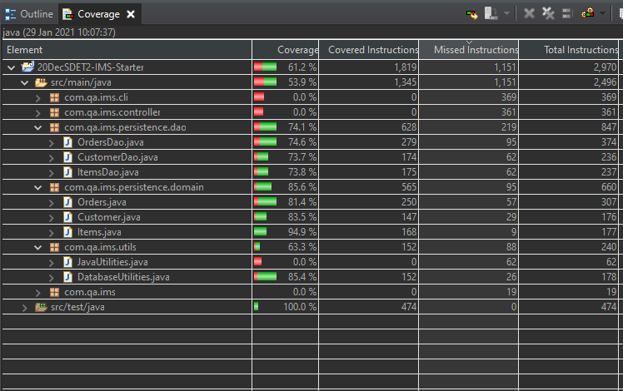
Testing
Junit testing
Orders
Items
Customer
OrdersDao
ItemsDao
CustomerDao

Slide 6
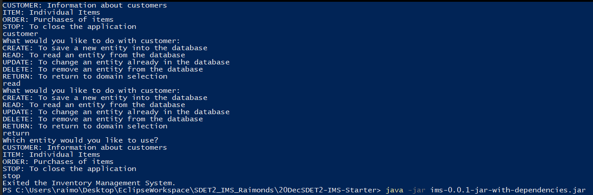
Demonstration

Slide 7
Sprint Review
Minimum Viable Product
User Stories
Specific Tasks
Bugs

Slide 8
Sprint Retrospect
What Wend Well
Product meets a minimum viable product
Junit was used to successfully test methods within DAO classes.
What Could Be Improved
Final ERD diagram is simpler than the original
More time could be allocated for refactoring
Mockito could be used to test the controllers
Methods could be tested for exceptions

Slide 9
Conclusion
The project was a success
Minimum Viable Product has been met
Relevant documentation created
Tests created covered all of the methods within the DAO classes
Great learning experience

Slide 10
Questions?

