Slide 1
nasm基本语法

Slide 2
注意事项
Nasm的不同架构的寄存器和编译方式
乘法和除法算术指令会影响多个寄存器
编程时注意代码规范，要有注释，函数封装
检查作业前要熟悉自己的代码逻辑

Slide 3
本PPT旨在介绍一个基本的语法，一些不是必须要用到的语法可能不在讲解之列。课后自行阅读nasm.pdf，参考：https://www.nasm.us/docs.php

Slide 4
一个单文件的汇编示例

Slide 5
;Section to store uninitialized variables section .data string: db 'Hello World', 0Ah length: equ 13
section .bss var: resb 1
section .text global _start: _start: mov eax, 4 mov ebx, 1 mov ecx, string mov edx, length int 80h
;System Call to exit mov eax, 1 mov ebx, 0 int 80h

Slide 6
Sections in NASM
Section .text: This is the part of a NASM Program which contains the executable code. It is the place from where the execution starts in NASM program, analogous to the main( ) function in CProgramming.
section .bss : This is the part of program used to declare variables without initialization
section .data : This is the part of program used to declare and initialize the variables in the program.
Notes:
text：代码区
bss：未初始化的变量的声明区，什么意思呢，就是如果你只是想预留一部分空间留着用，但是也不在乎这里的值是多少，那你就可以在这里搞
data：初始化的变量的声明区，如果你想初始化一个变量，譬如a=1,那就在这里弄

Slide 7
example
section .data var1: db 10 str1: db “Hello World!..” section .bss var3: resb 1 var4: resq 1
RESx directive is used to reserve just space in memory for a variable without giving any initial values.
Dx directive is used for declaring space in the memory for any variable and also providing the initial values at that moment

Slide 8
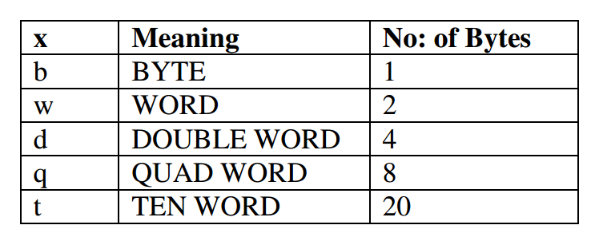

Slide 9
声明变量
可能会想每次Dx或者RESx命令只能声明一个变量吗？那不是很麻烦？如果要声明一个字符串呢？每次一个字符？
可以这样：
var: db 10,5,8,9
string: db “Hello” string2: db “H”, “e”, “l”, “l”, “o”
上面两种是等价的
Notes:
Reserves 4 bytes in memory for var and stores the values 10, 5, 8, 9 respectively in that

Slide 10
访问变量-解引用
MOV dword[ebx], 1 INC BYTE[label] ADD eax, dword[label]
[]之前可以有的：
BYTE, WORD, DWORD, QWORD, TWORD
Notes:
mov eax, [label];Value stored in the address location will be copied to eax mov ebx, label; The address location will be copied to ebx reg.

Slide 11
可能用到的一些系统调用和小技巧

Slide 12
系统调用
EXIT SYSTEM CALL
mov eax, 1 ;System Call Number mov ebx, 0 ;Parameter int 80h ;Triggering OS Interrupt
注意将系统调用号放在eax寄存器里，参数放在其他通用寄存器里，然后使用int指令。
Notes:
应当知道，读写是操作系统提供给应用程序的操作，Linux提供了read、write两个调用。所以这次作业要读取输入输出，就必须要进行系统调用，如何在汇编层面进行系统调用？

Slide 13
Read System Call
mov eax, 3 mov ebx, 0 mov ecx, var mov edx, dword[size] int 80h
Notes:
mov eax, 3 ;Sys_call number for read mov ebx, 0 ;Source Keyboard mov ecx, var ;Pointer to memory location mov edx, dword[size] ;Size of the string int 80h ; Triggering OS Interrupt

Slide 14
Write System Call
mov eax, 4 mov ebx, 1 mov ecx, msg1 mov edx, size1 int 80h
Notes:
mov eax, 4 ;Sys_call number mov ebx, 1 ;Standard Output device mov ecx, msg1 ;Pointer to output string mov edx, size1 ;Number of characters int 80h ;Triggering interrupt.

Slide 15
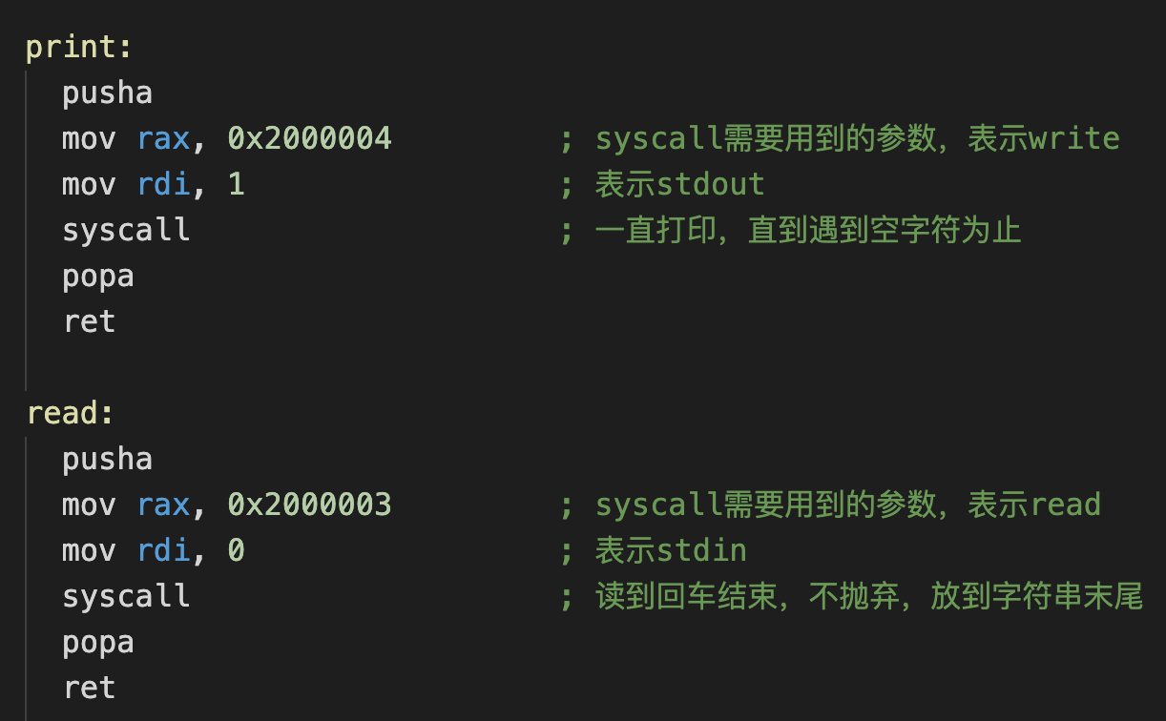
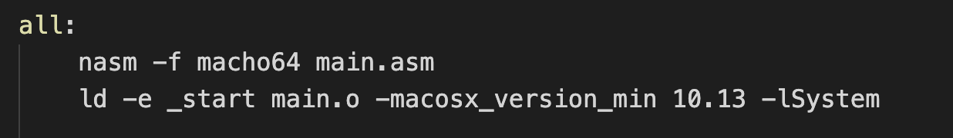
注意平台差异
32位和64位
Linux和macOS
Notes:
mov eax, 4 ;Sys_call number mov ebx, 1 ;Standard Output device mov ecx, msg1 ;Pointer to output string mov edx, size1 ;Number of characters int 80h ;Triggering interrupt.

Slide 16
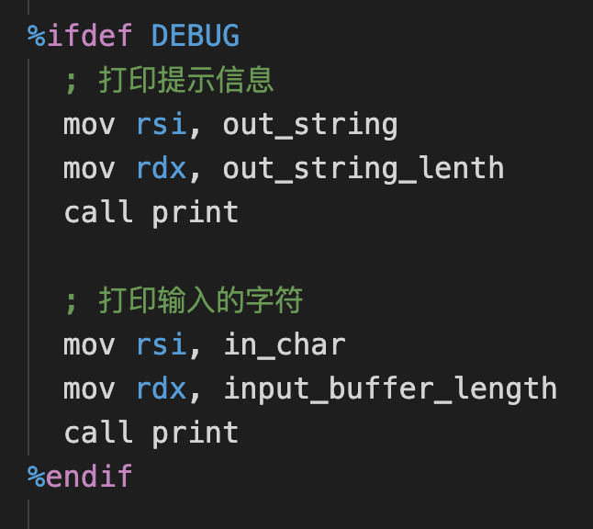
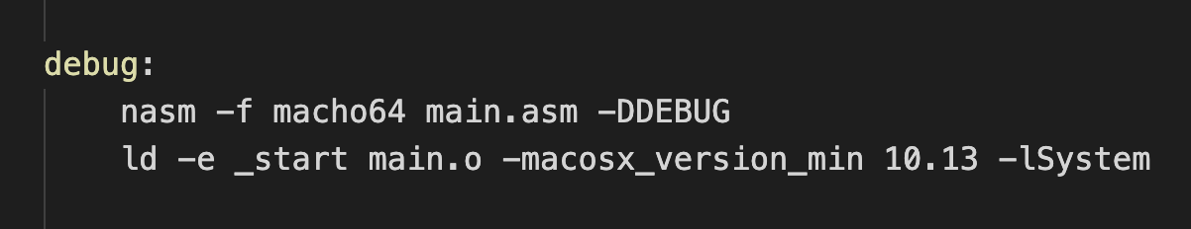
预处理指令
%define SIZE 100
%ifdef DEBUG
可以用来输出一些调试信息
配合Makefile可以生成不同版本

Slide 17
函数
CALL与RET
Notes:
mov eax, 4 ;Sys_call number mov ebx, 1 ;Standard Output device mov ecx, msg1 ;Pointer to output string mov edx, size1 ;Number of characters int 80h ;Triggering interrupt.

Slide 18
SECTION .data
msg db 'Hello, brave new world!', 0Ah
SECTION .text
global _start
_start:
mov eax, msg
call strlen
mov edx, eax
mov ecx, msg
mov ebx, 1
mov eax, 4
int 80h
mov ebx, 0
mov eax, 1
int 80h
Notes:
主函数里面：
msg移到eax里面，利用寄存器传参
然后调用strlen函数 call命令会自动保存函数的返回地址，RET会自动恢复返回地址。

Slide 19
strlen:
push ebx
mov ebx, eax
nextchar:
cmp byte [eax], 0
jz finished
inc eax
jmp nextchar
finished:
sub eax, ebx
pop ebx
ret
Notes:
为什么保存ebx，因为你函数内部要使用ebx，所以原则是你会使用哪个寄存器，就会覆盖该寄存器的值，所以要保存这个寄存器的值。
函数内部将eax设计为一个指针，指向每一个字符，直到它指到\0
ebx现在持有字符串首地址，eax最终指向字符串后面的第一个\0, eax-ebx就得到字符串的长度

Slide 20
多文件
%include "./help.asm"
Notes:
mov eax, 4 ;Sys_call number mov ebx, 1 ;Standard Output device mov ecx, msg1 ;Pointer to output string mov edx, size1 ;Number of characters int 80h ;Triggering interrupt.

Slide 21
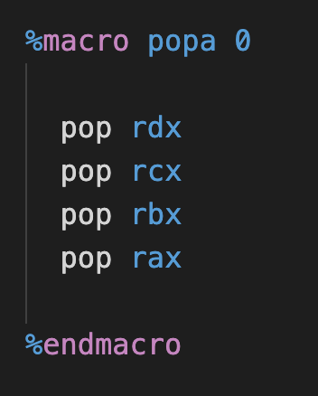
宏
有些环境可能不支持popa指令
可以用宏来自定义一个简单版
Notes:
mov eax, 4 ;Sys_call number mov ebx, 1 ;Standard Output device mov ecx, msg1 ;Pointer to output string mov edx, size1 ;Number of characters int 80h ;Triggering interrupt.

Slide 22
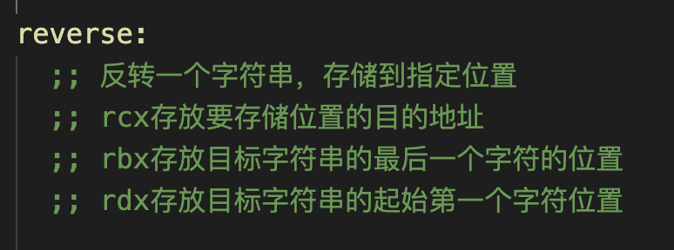
注释
可读性
可以将一些约定写成注释，减轻记忆负担
Notes:
mov eax, 4 ;Sys_call number mov ebx, 1 ;Standard Output device mov ecx, msg1 ;Pointer to output string mov edx, size1 ;Number of characters int 80h ;Triggering interrupt.

Slide 23
常用基本指令集简介

Slide 24
算术逻辑指令
比较类指令
跳转指令
移位类指令

Slide 25
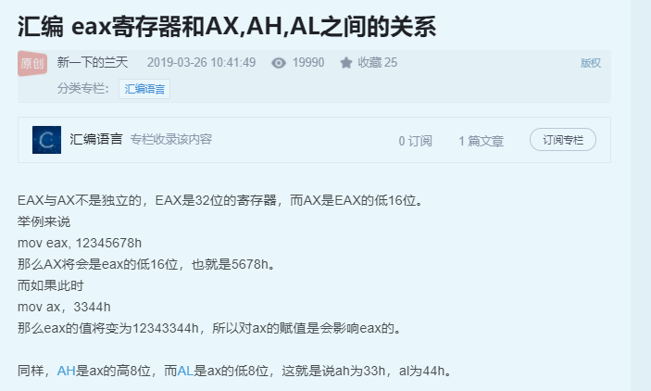
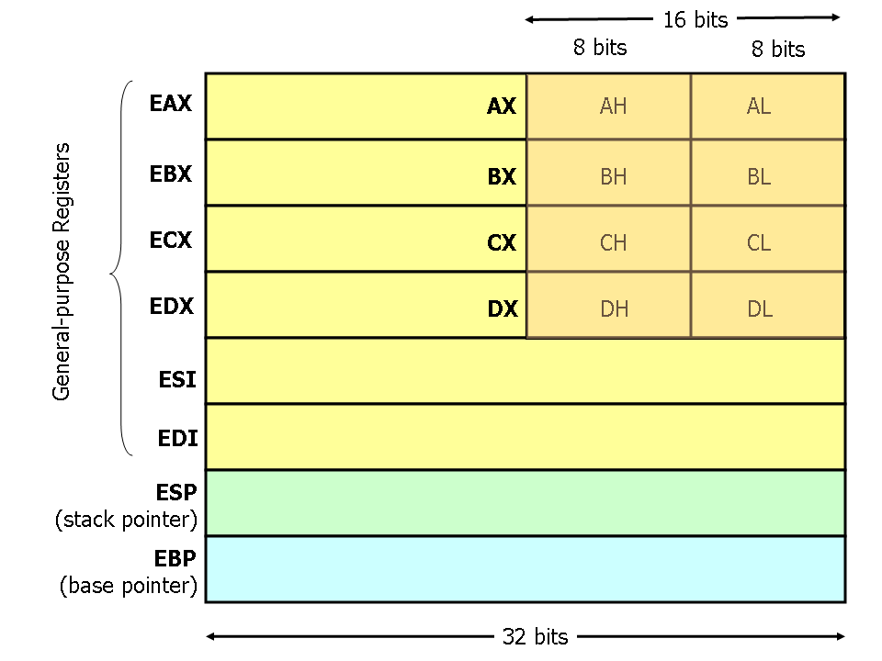
寄存器长度问题
eax d
ax w
al b
ah b

Slide 26
MOV
mov eax, ebx
mov ecx, 109
mov al, bl
mov byte[var1], al
mov word[var2], 200
mov eax, dword[var3]
Notes:
mov eax, ebx ;Copy the content of ebx to eax mov ecx, 109 ; Changes the value of ecx to 109 mov al, bl mov byte[var1], al;Copy the content of al reg to the variable var in memory mov word[var2], 200 mov eax, dword[var3]

Slide 27
MOVZX(无符号扩展)
movzx eax, ah movzx cx, al
Notes:
movzx eax, ah movzx cx, al

Slide 28
ADD
add eax, ecx ; eax = eax + ecx add al, ah ; al = al + ah add ax, 5 add edx, 31h
Notes:
add eax, ecx ; eax = eax + ecx add al, ah ; al = al + ah add ax, 5 add edx, 31h

Slide 29
SUB
sub eax, ecx ; eax = eax - ecx sub al, ah ; al = al - ah sub ax, 5 sub edx, 31h

Slide 30
MUL
mul src
要知道相同位数的两个数字相乘之后位数翻倍
If src is 1 byte then AX = AL * src
If src is 1 word (2 bytes) then DX:AX = AX * src (ie. Upper 16 bits of the result will go to DX and the lower 16 bits will go to AX)
If src is 2 words long(32 bit) then EDX:EAX = EAX * src (ie. Upper 32 bits of the result will go to EDX and the lower 32 bits will go to EAX)
Notes:
If src is 1 byte then AX = AL * src • If src is 1 word (2 bytes) then DX:AX = AX * src (ie. Upper 16 bits of the result will go to DX and the lower 16 bits will go to AX) • If src is 2 words long(32 bit) then EDX:EAX = EAX * src (ie. Upper 32 bits of the result will go to EDX and the lower 32 bits will go to EAX)

Slide 31
DIV
div src
跟乘法有一点反过来的意思
If src is 1 byte then AX will be divide by src, remainder will go to AH and quotient will go to AL
If src is 1 word (2 bytes) then DX:AX will be divide by src, remainder will go to DX and quotient will go to AX
If src is 2 words long(32 bit) then EDX:EAX will be divide by src, remainder will go to EDX and quotient will go to EAX

Slide 32
条件分支指令
JMP
CMP
…

Slide 33
JMP
label: ------------- ------------- JMP label ------------- ------------- JMP exit ------------ ------------ exit:

Slide 34
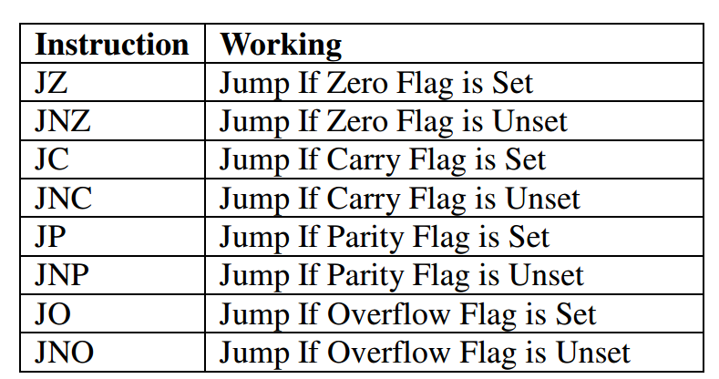
CMP
CMP op1, op2
it will affect the CPU FLAGS
Notes:
For example if op1 == op2 then the Zero Flag(ZF) will be set to 1.

Slide 35
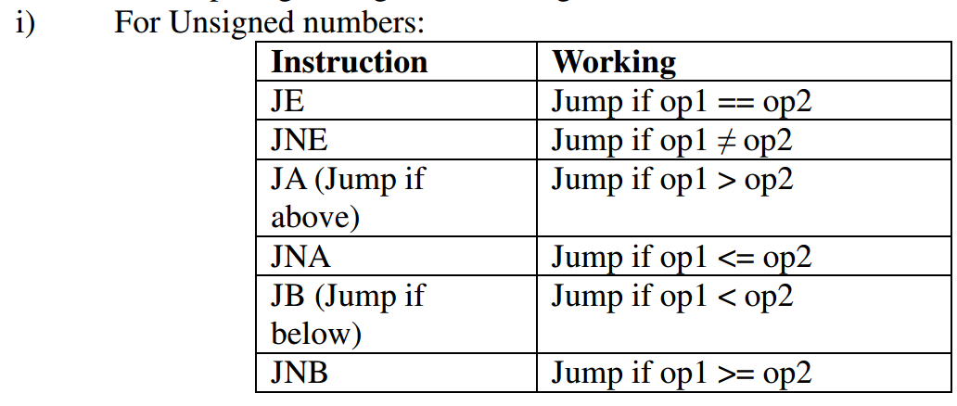

Slide 36
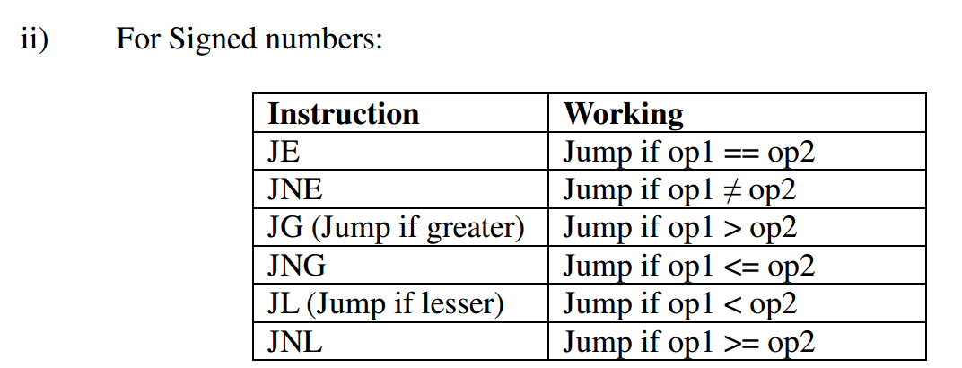

Slide 37
条件分支实例
cmp eax, ebx JE if ------ JMP L1 if: INC eax L1: -----------

Slide 38
循环
循环也没有额外的语法，有了JMP和条件跳转就能组合形成循环。

Slide 39
位运算
AND
OR
XOR
NOT
TEST
SHL
SHR
ROL
ROR
RCL
RCR

Slide 40
AND
AND op1, op1 op1=op1 and op2
or, xor, 类似

Slide 41
NOT
NOT op1
op1=~op1

Slide 42
TEST
TEST op1, op2
It performs the bitwise logical AND of op1 and op2 but it won’t save the result to any registers. Instead the result of the operation will affect CPU FLAGs.

Slide 43
SHL与SHR
SHL – Shift Left
sy: SHL op1, op2 op1 = op1 << op2
example
shl eax, 5
op1 should be a reg / memory variable but op2 must be an immediate(constant) value
SHR类似，左边用0补充

Slide 44
ROL与ROR
循环左移与循环右移
ROL op1, op2

Slide 45
栈操作
PUSH
POP
PUSHA
POPA
PUSHA和POPA用于将所有通用寄存器压栈出栈，当你在函数调用时需要保存现场的时候用会比较方便

Slide 46
PUSH
PUSH decreases the value of ESP and copies the value of a reg / constant into the system stack
PUSH ax ;ESP减2 PUSH eax ;ESP减4 PUSH ebx PUSH dword 5 PUSH word 258

Slide 47
POP
POP bx ; ESP= ESP + 2 POP ebx ; ESP= ESP + 4
increases the value of ESP

Slide 48
谢谢！
Notes:
mov eax, 4 ;Sys_call number mov ebx, 1 ;Standard Output device mov ecx, msg1 ;Pointer to output string mov edx, size1 ;Number of characters int 80h ;Triggering interrupt.

