Slide 1
CSC343 PROJECT PRESENTATION
Vanessa Yu and Yuanze Bao

Slide 2
Domain
The domain of our project will be about different countries’ situation regarding the Coronavirus disease. Our dataset includes total population, daily cases and death, vaccination of Covid-19 from the first vaccine date, public health social measure.

Slide 3
Investigative Questions
What is the given country's population that has been reported as a confirmed case of Covid-19 since 1/3/2020 for each quarter? What’s the quarterly change of this measurement? What percentage of a given country’s population has been fully vaccinated?
How are the vaccination process and daily cases related? Does higher vaccination rate imply fewer daily cases? How’s the vaccination rate different across different WHO regions?
How are public health measures and daily cases related? Does stricter public health measurement imply fewer daily cases? Which measurement might contribute the most in preventing the spread of Covid-19?

Slide 4
Results

Slide 5
Q2：
How are the vaccination process and daily cases related? Does higher vaccination rate imply fewer daily cases? How’s the vaccination rate different across different WHO regions?
For most of the countries, the total number of cases is more than before the date of getting first vaccine. We don’t see an obvious relationship between the vaccination rate and daily cases. We found the WPRO has the highest vaccination rate and AFRO has the lowest vaccination rate.

Slide 6
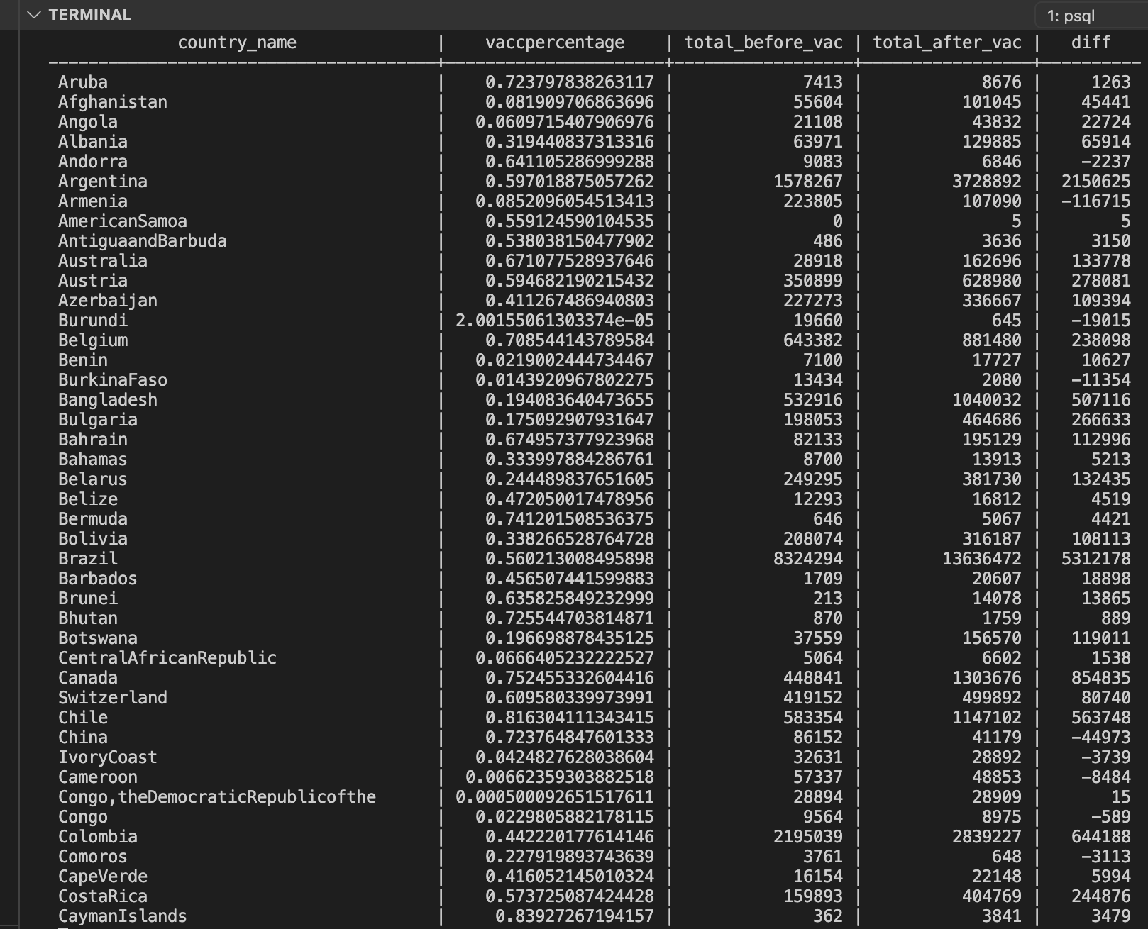
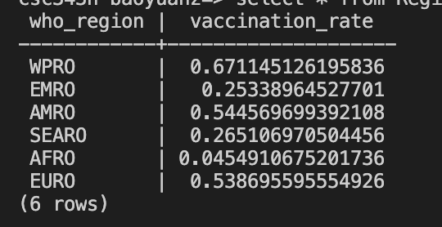


Dataset for Q2:

Slide 7
Q3:
How are public health measures and daily cases related?

Slide 9
Challenges
Inserting data without violating the foreign key constraints
Collapse multiple rows with the same information into one row

Slide 10
Lessons
learn to approach question in a step-by-step manner.
Visualization is important during every step.

Slide 11
Questions ?

