Slide 1
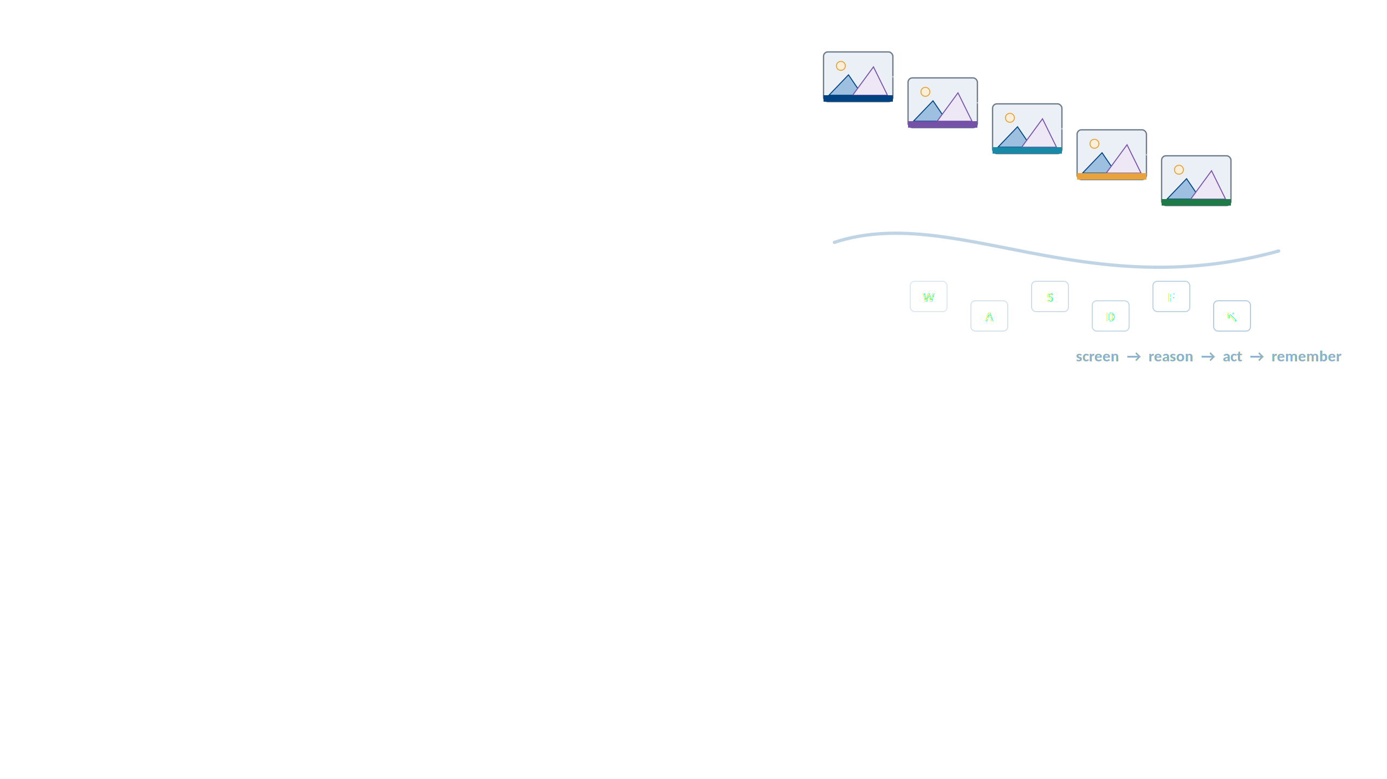
Hades
A Generalist Vision-Language-Action Model for Long-Horizon Real-Time GUI Game Agents
miHoYo Lumi · full author list in the paper's Contributions section
Industrial-scale generalist agent research
Manuscript dated 26 August 2026

Slide 2
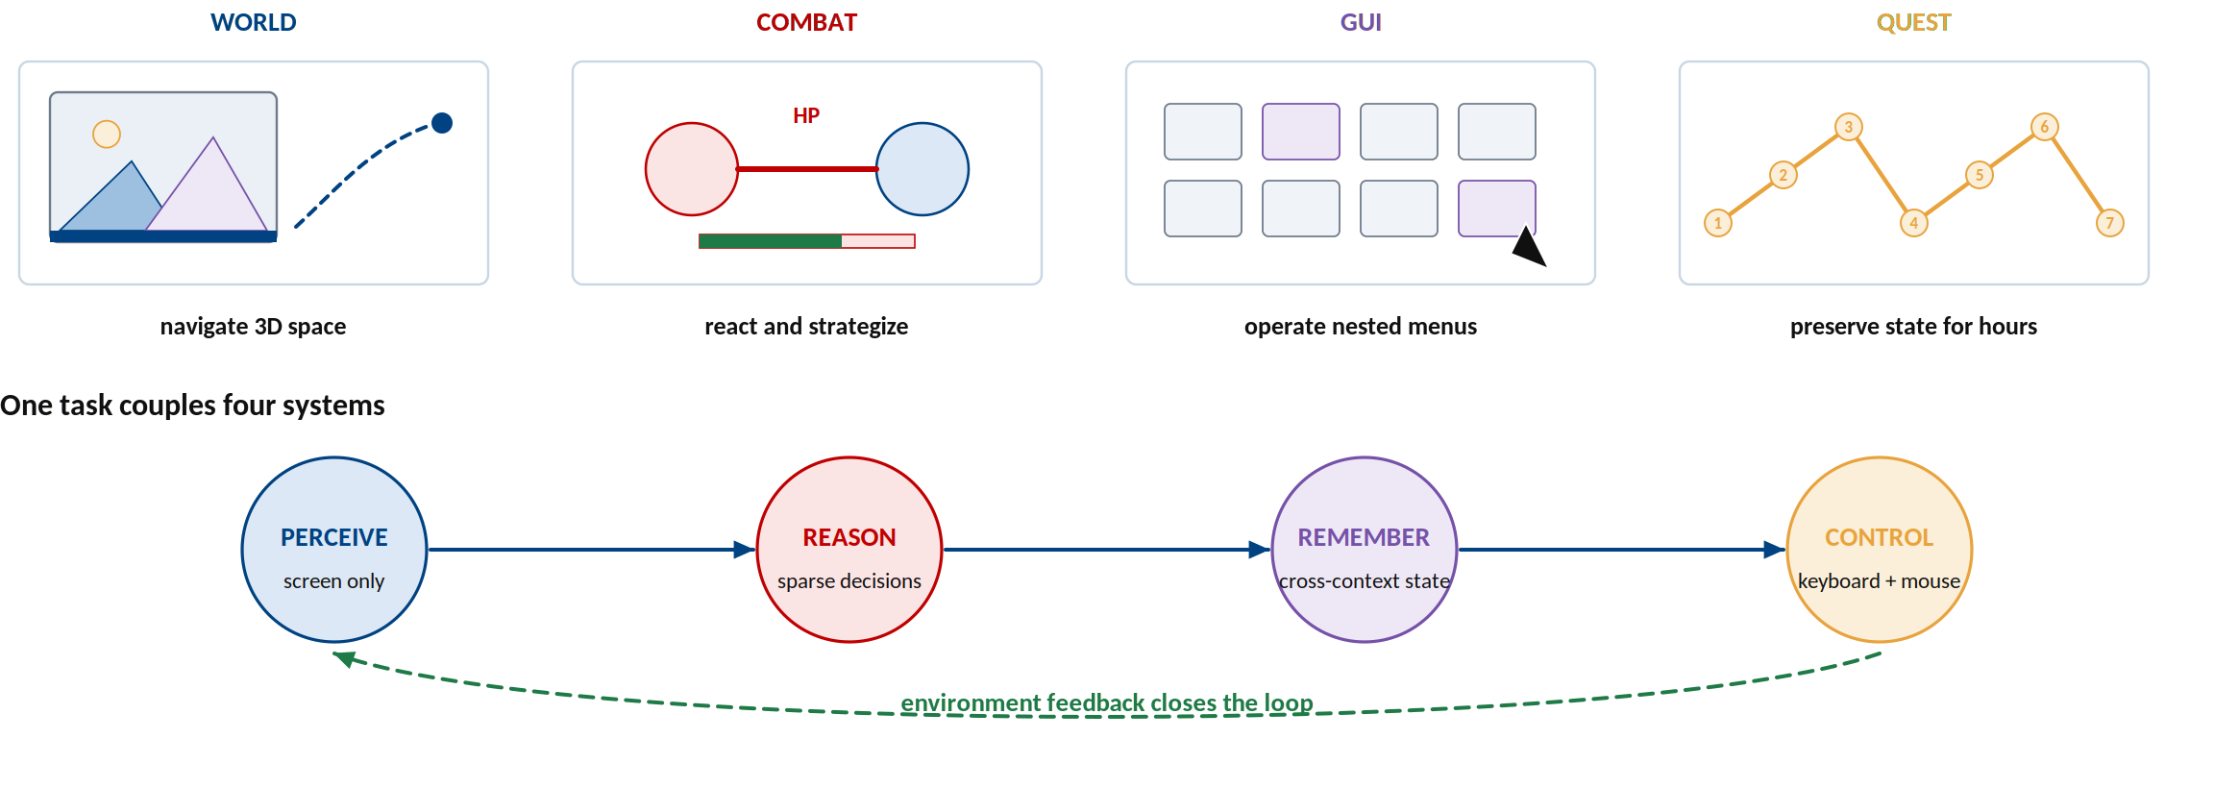
Commercial games expose the full agent problem
Pixels in, keyboard and mouse out — with hours of state in between.
Introduction of the paper.

Slide 3
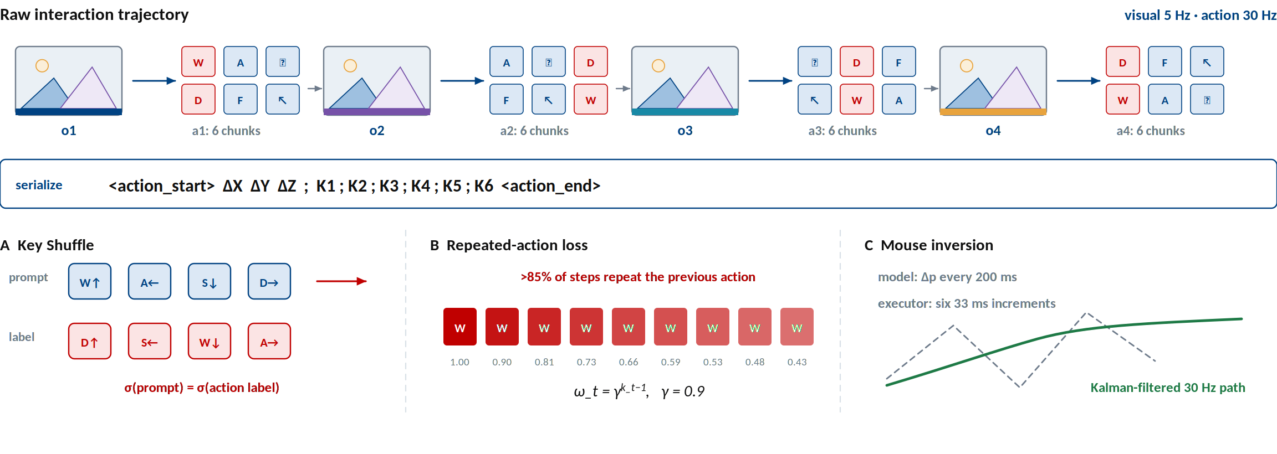
Stage 1 — learn a universal device-level action language
Compress 30 Hz control into tokens, then debias what the model learns from repetition.
Sections 2.1–2.5 and Figure 1.

Slide 4
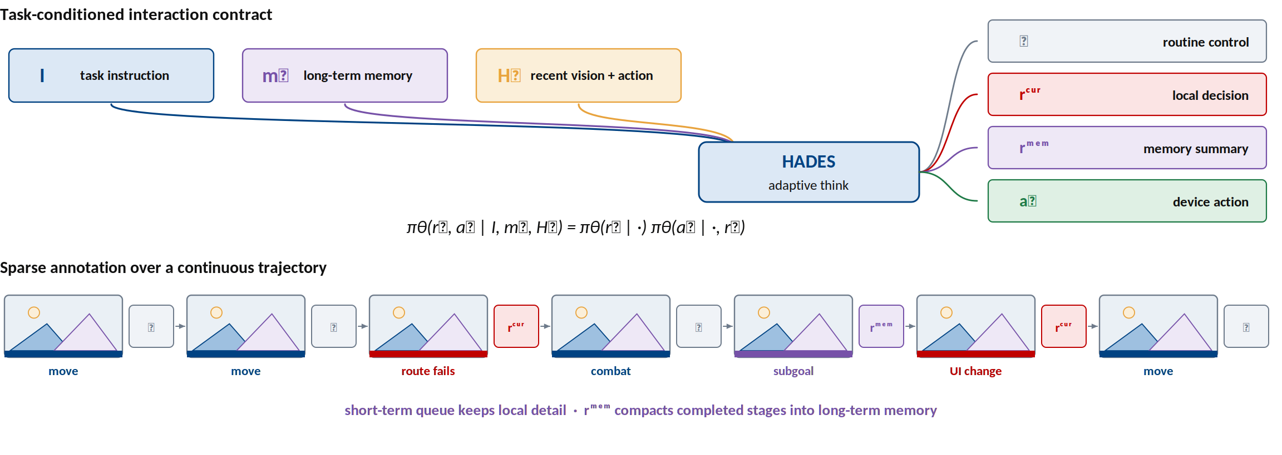
Stage 2 — think sparsely and remember across context windows
Routine control stays fast; decisions and memory appear only at critical moments.
Sections 3.1–3.6 and Figure 1.

Slide 5
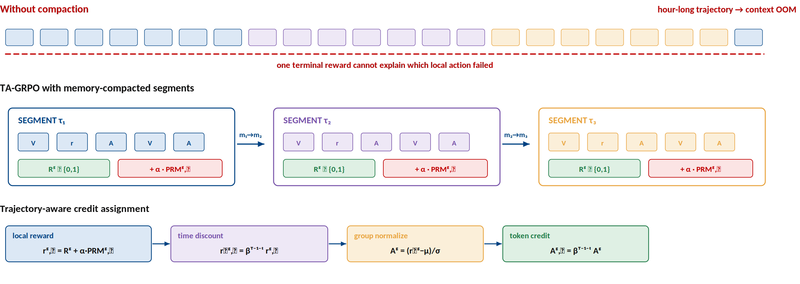
Stage 3 — TA-GRPO turns an hour-long rollout into learnable segments
Compact memory across segments and assign credit near the state changes that matter.
Sections 4.1–4.5 and Figure 2.

Slide 6
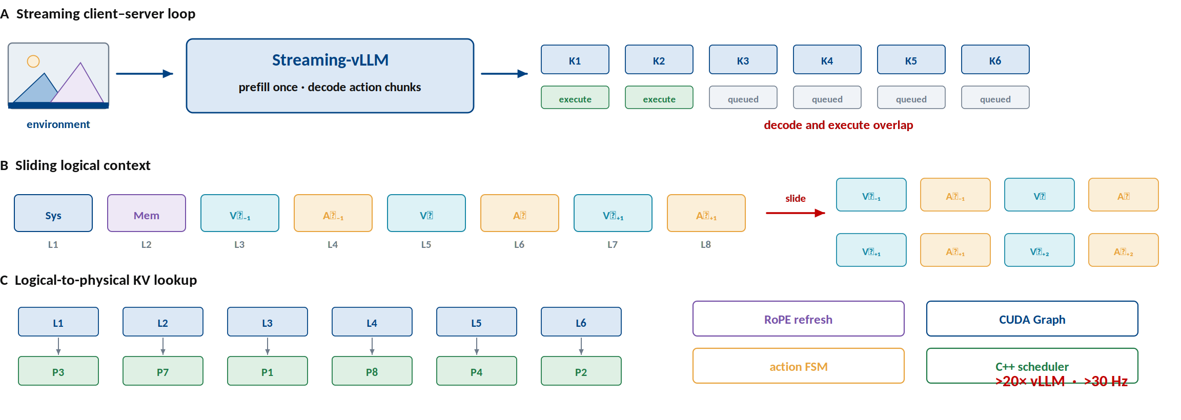
Deployment — stream actions while the model is still decoding
Streaming-vLLM overlaps generation with execution and reuses the moving context.
Sections 5.1–5.7 and Figure 3.

Slide 7
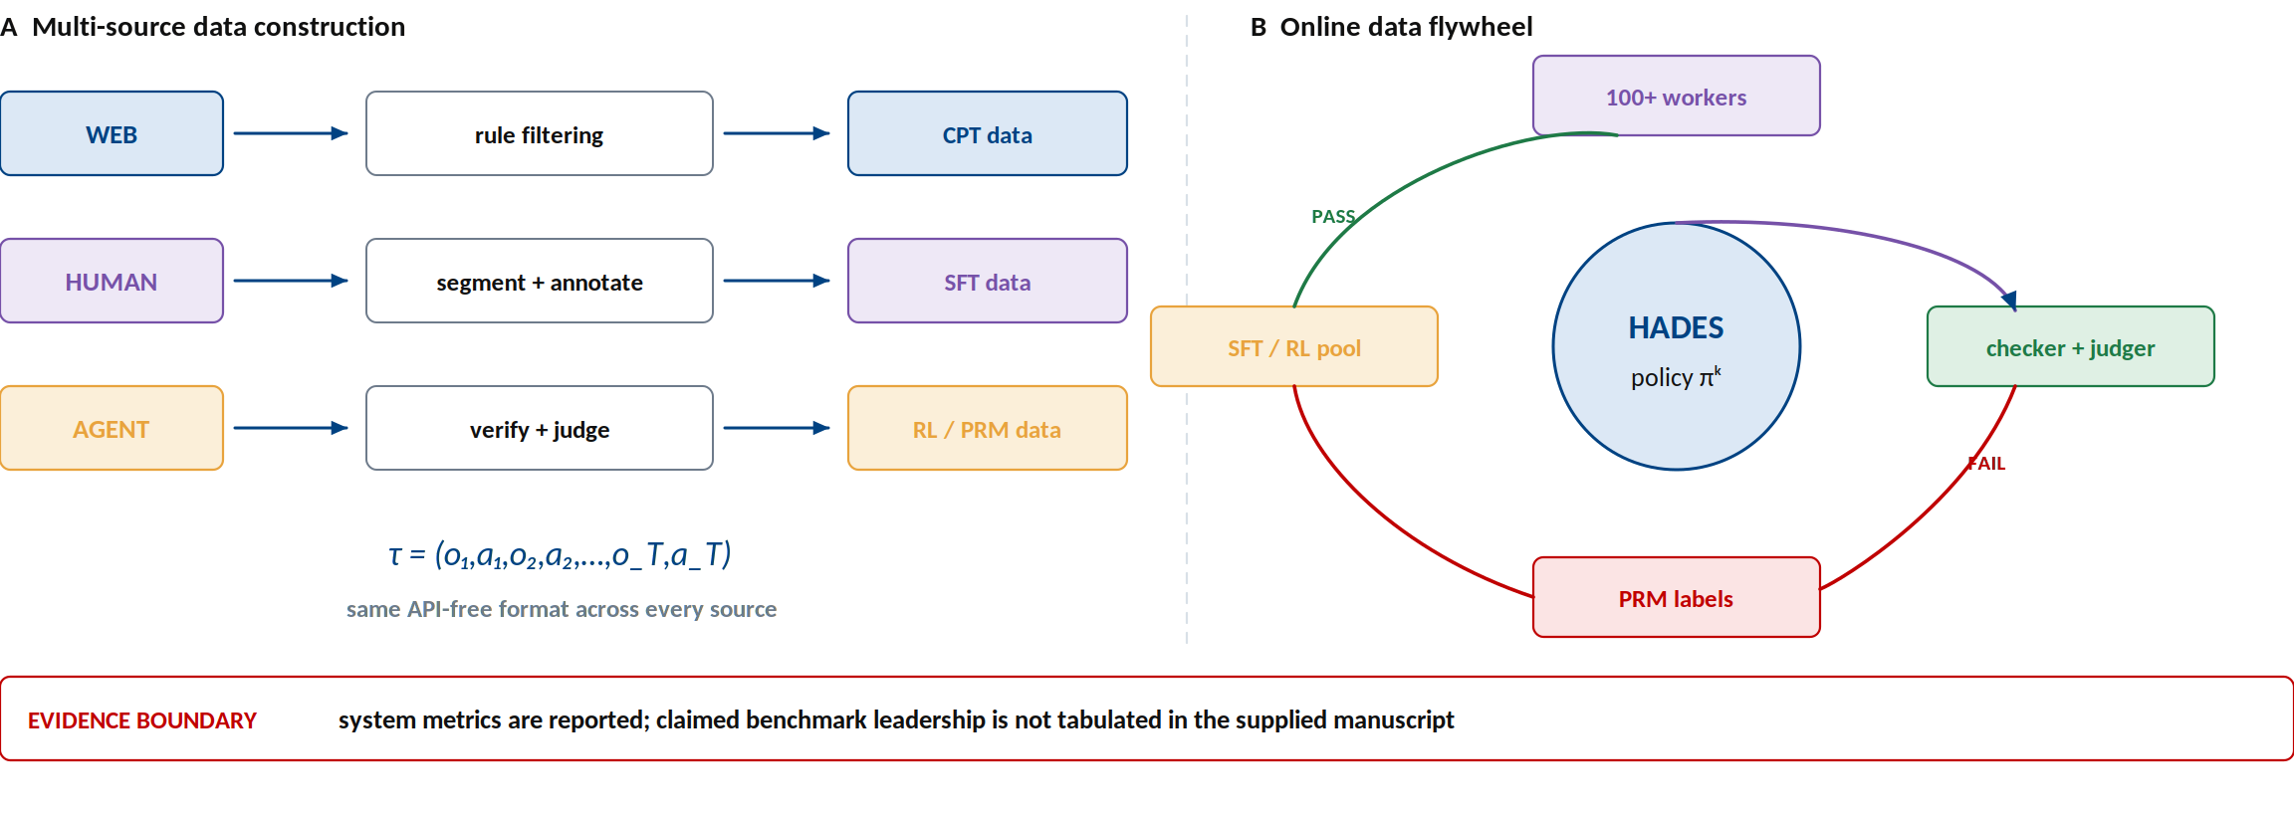
System view — data, policy, verifier, and infrastructure form one loop
The contribution is an industrial agent stack, not only a policy model.
miHoYo Lumi. Hades: A Generalist Vision-Language Action Foundation Model for Long-Horizon Real-Time GUI Game Agent. Manuscript, 2026.

