Slide 1
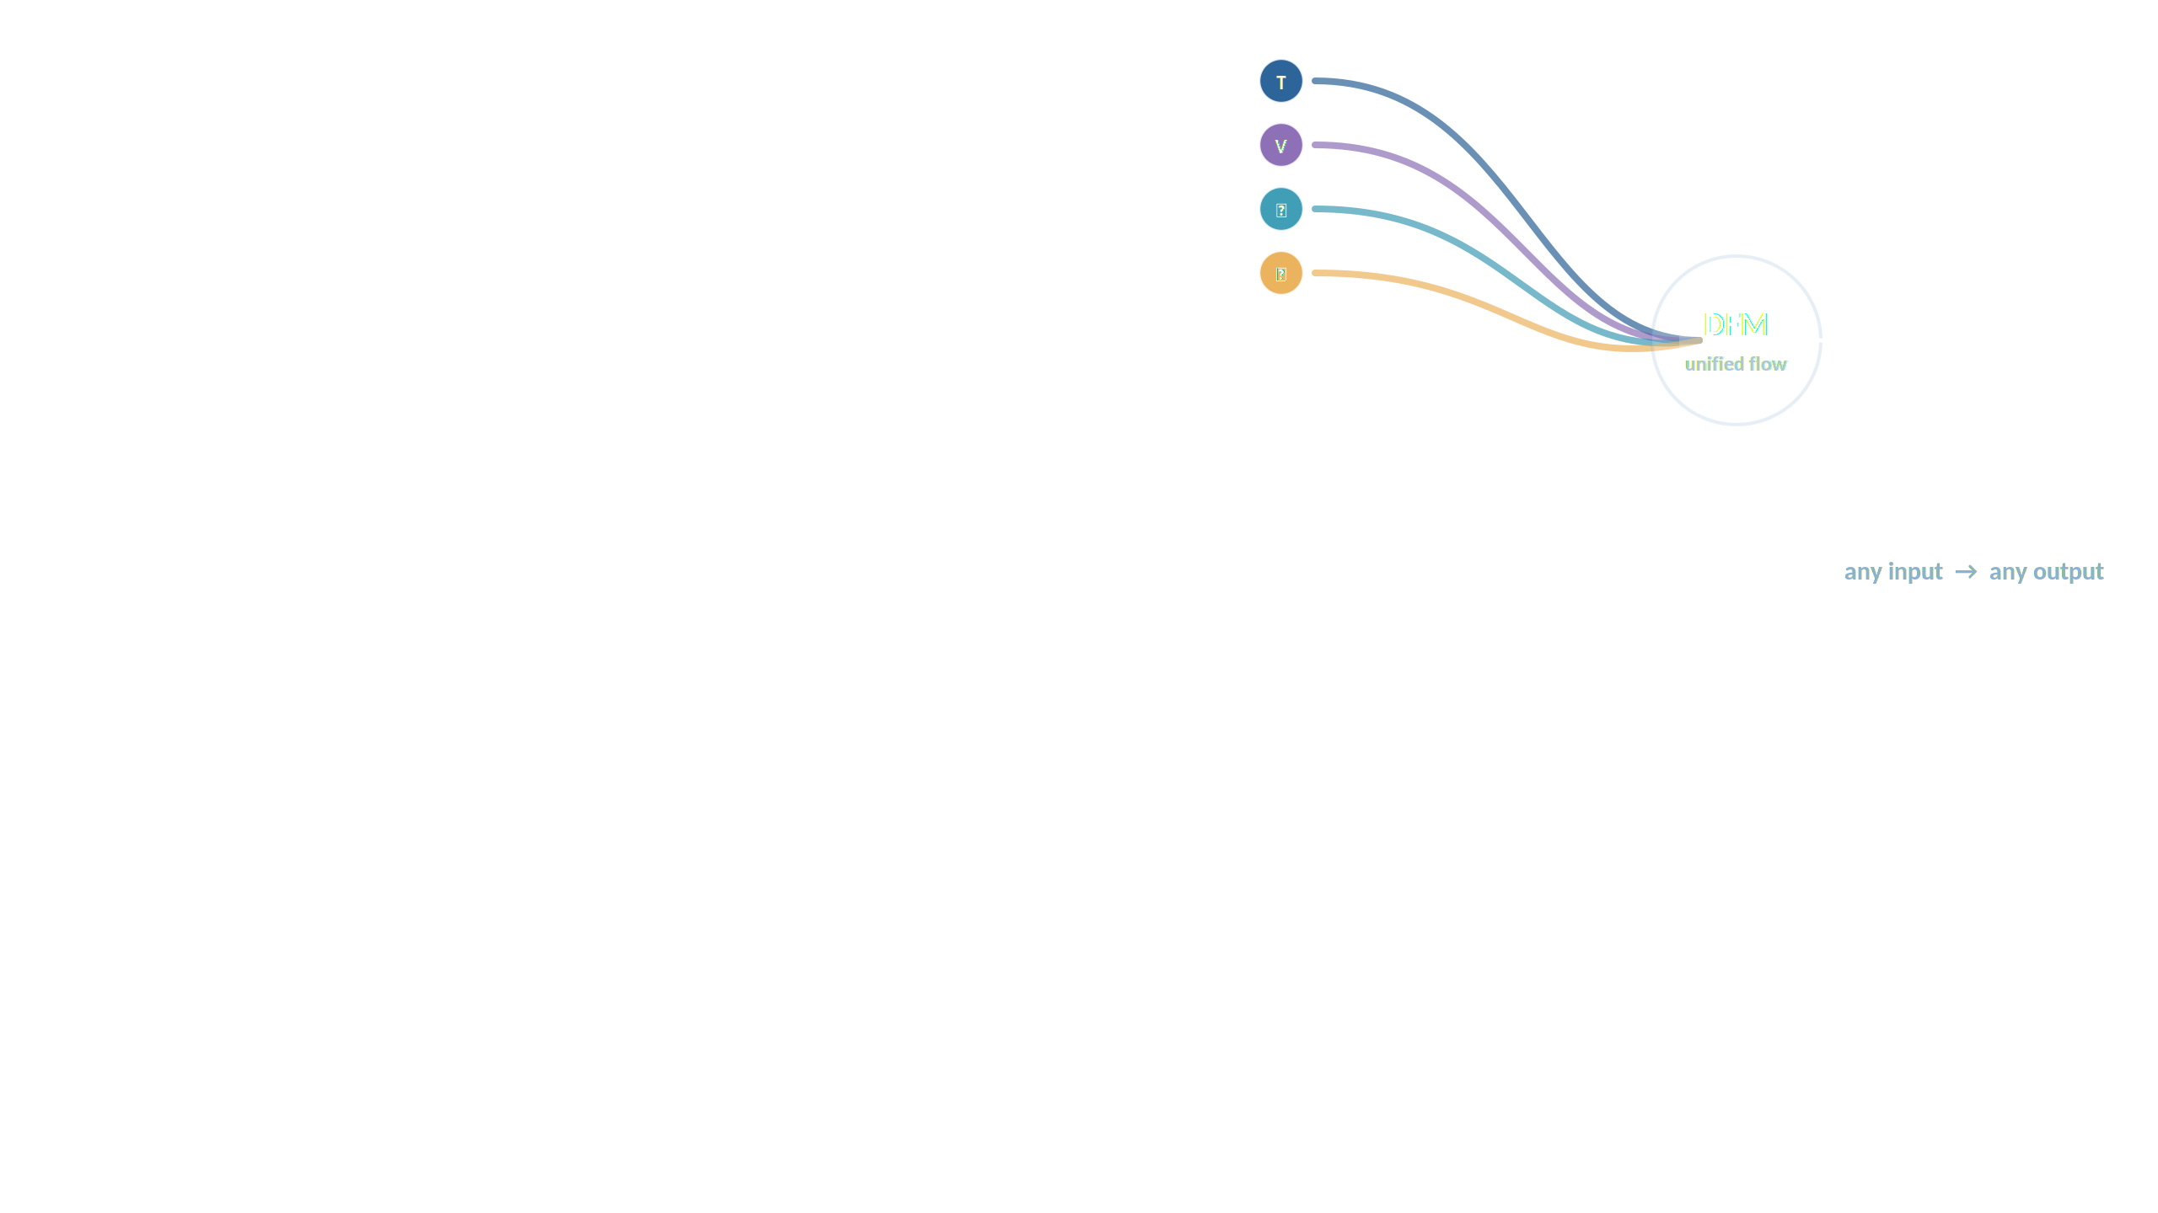
NExT-OMNI
Any-to-Any Omnimodal Foundation Models with Discrete Flow Matching
Run Luo · Xiaobo Xia · Lu Wang · Longze Chen · Renke Shan · Jing Luo · Min Yang · Tat-Seng Chua
SIAT, Chinese Academy of Sciences · UCAS · NExT++ Research Center · NUS
arXiv:2510.13721v2 [cs.CL]

Slide 2
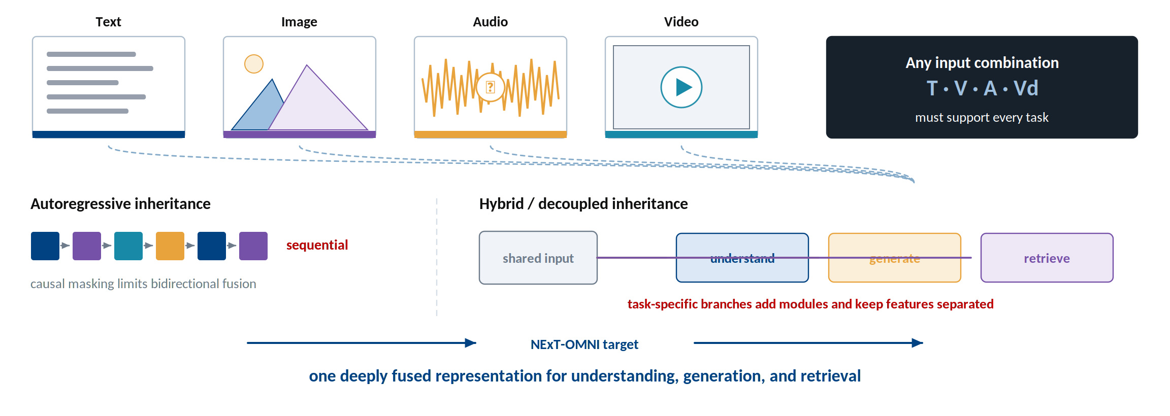
The conflict — one model, three jobs, four modalities
Autoregression is sequential; hybrid systems unify tasks by splitting the model.
Introduction and Figure 1 of the paper.

Slide 3
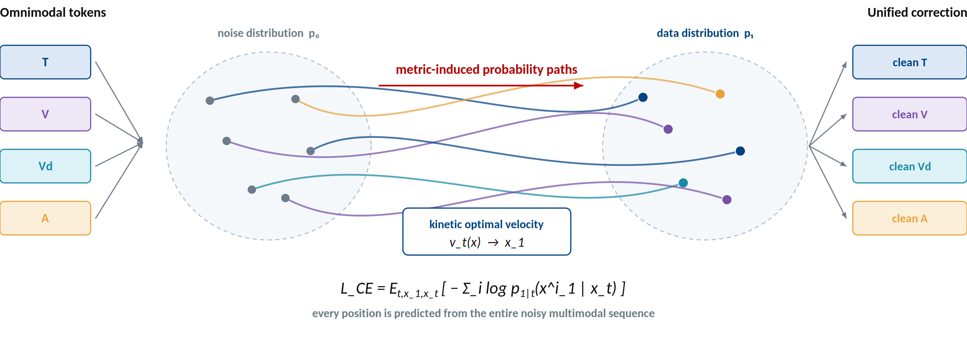
The alternative — discrete flow learns to correct in parallel
Corrupt globally, predict globally, refine iteratively — with bidirectional context.
Sections 2.3–2.4 and Appendix A of the paper.

Slide 4
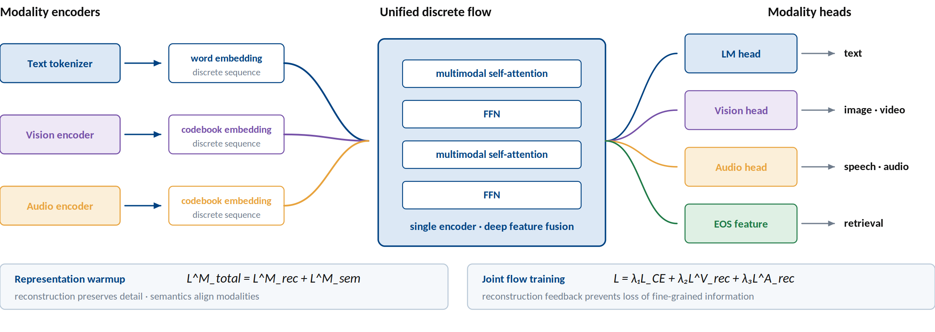
NExT-OMNI — a single deeply fused representation
One backbone serves understanding, generation, and retrieval — no task router required.
Sections 2.1–2.3 and Figure 2 of the paper.

Slide 5
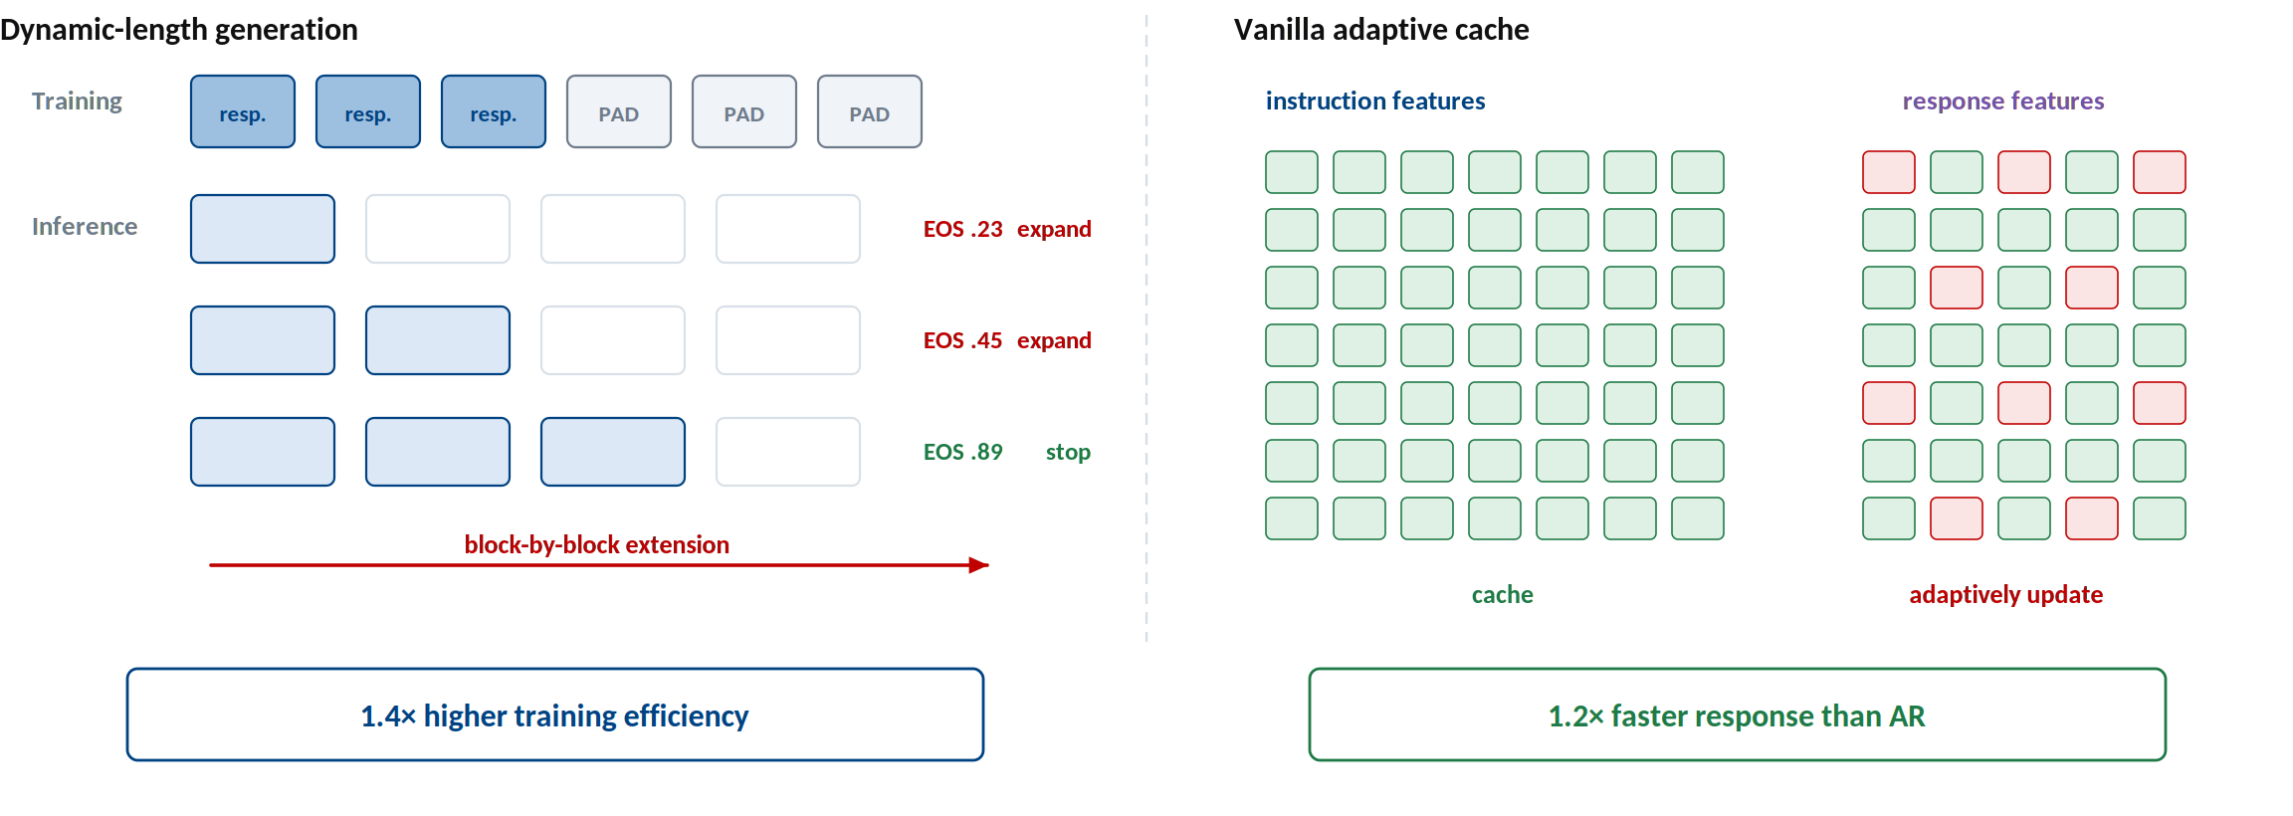
Training and inference — make iterative decoding practical
Interleave modalities, grow responses by blocks, and cache features that barely change.
Section 2.4 and Figure 3 of the paper.

Slide 6
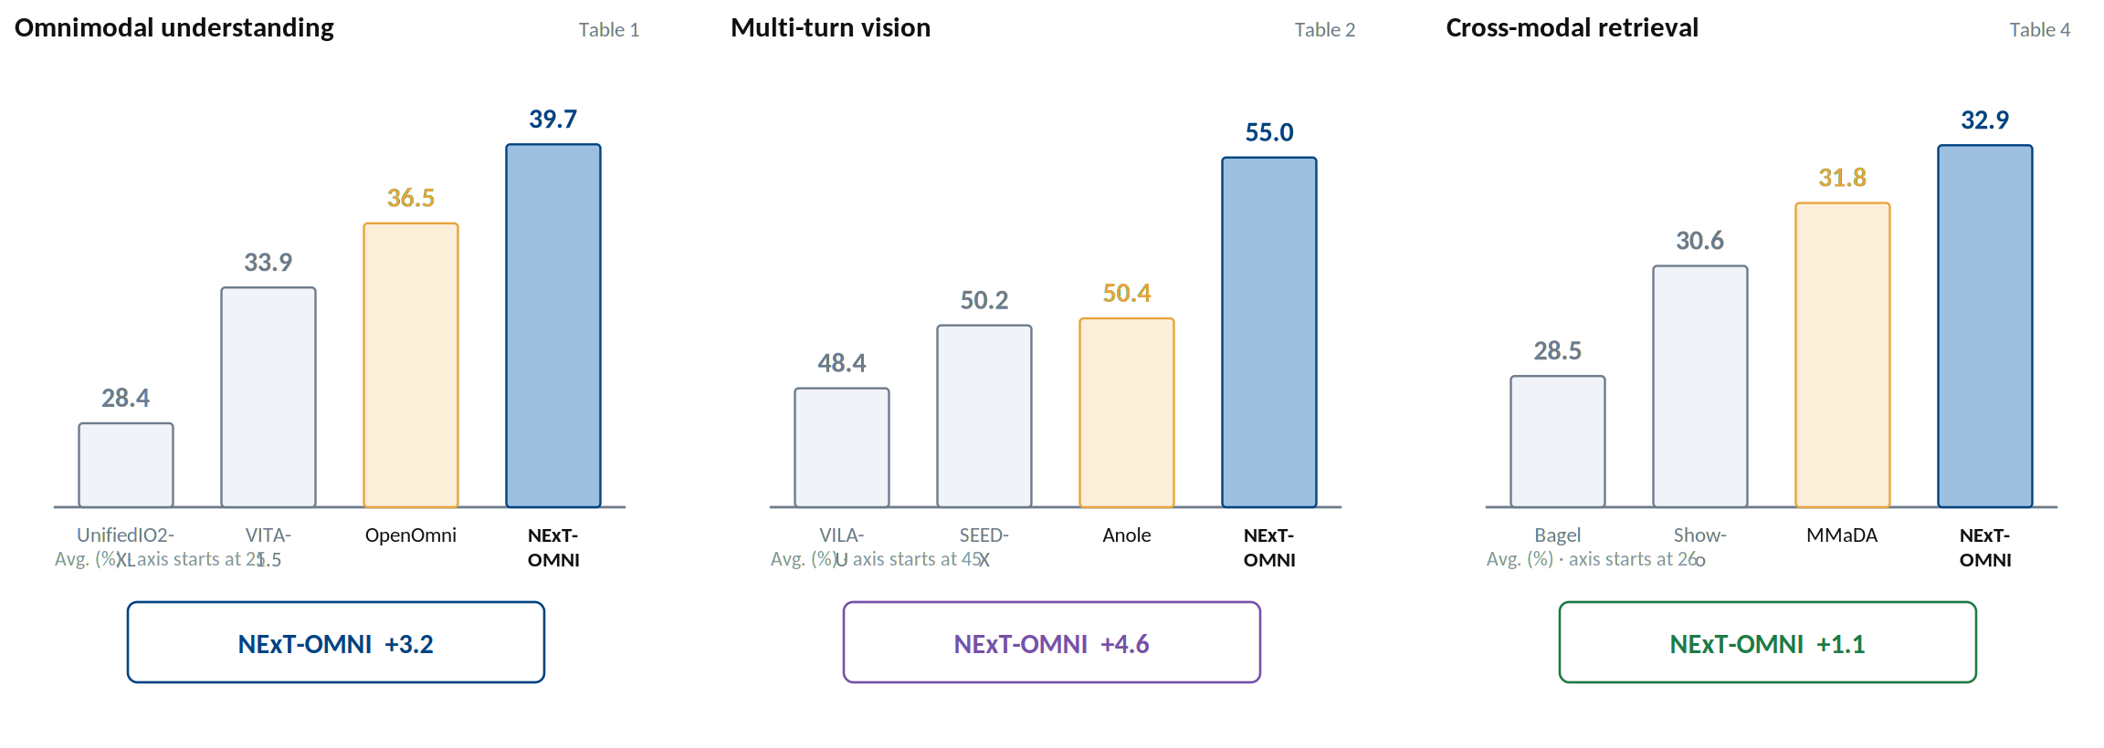
Evidence — the unified flow transfers across task families
NExT-OMNI leads on understanding, multi-turn vision, and cross-modal retrieval.
Main-paper Tables 1, 2, and 4.

Slide 7
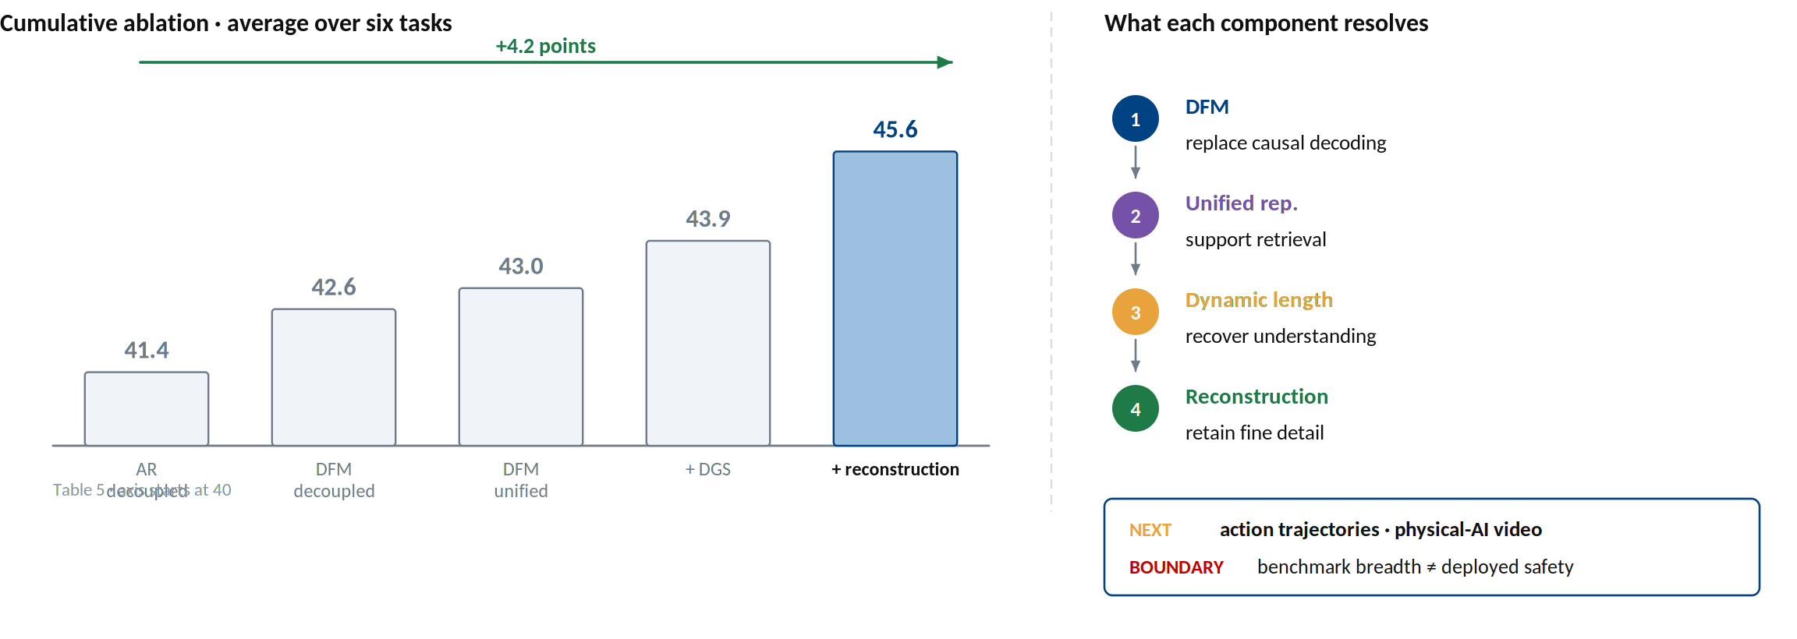
What the ablation says — unification needs the full recipe
DFM opens the door; dynamic length and reconstruction make the unified model work.
Run Luo, Xiaobo Xia, Lu Wang, Longze Chen, Renke Shan, Jing Luo, Min Yang, and Tat-Seng Chua. NExT-OMNI: Towards Any-to-Any Omnimodal Foundation Models with Discrete Flow Matching. arXiv:2510.13721v2, 2025.

