Slide 1

VCM: Vision Concept Modeling
Adaptive Vision Token Compression via Instruction Fine-Tuning
Run Luo · Renke Shan · Longze Chen · Ziqiang Liu · Lu Wang · Min Yang · Xiaobo Xia
SIAT, Chinese Academy of Sciences · UCAS · National University of Singapore · USTC
arXiv:2504.19627v2 [cs.CL]

Slide 2
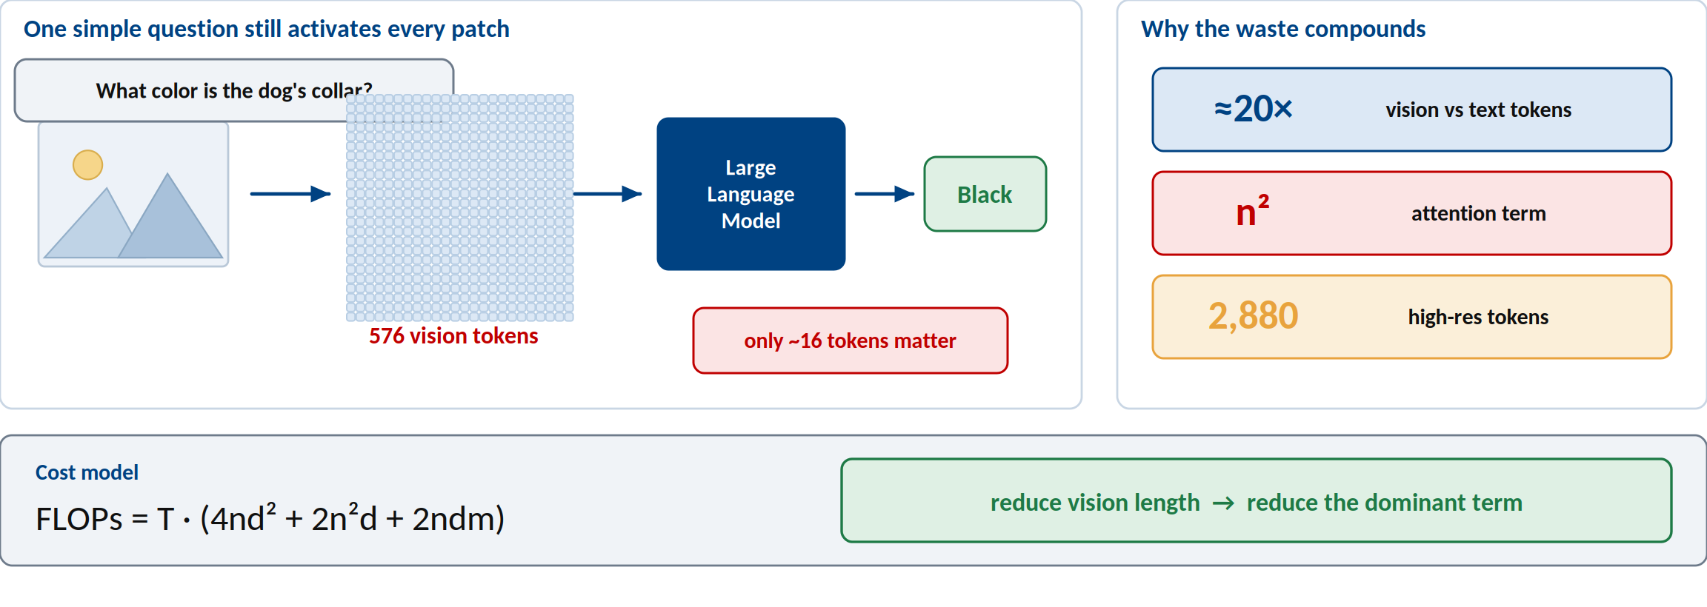
The bottleneck — LVLMs still read every image token
The answer needs a concept; the model pays for the whole image.
Figure 1 and Appendix D of the paper.

Slide 3
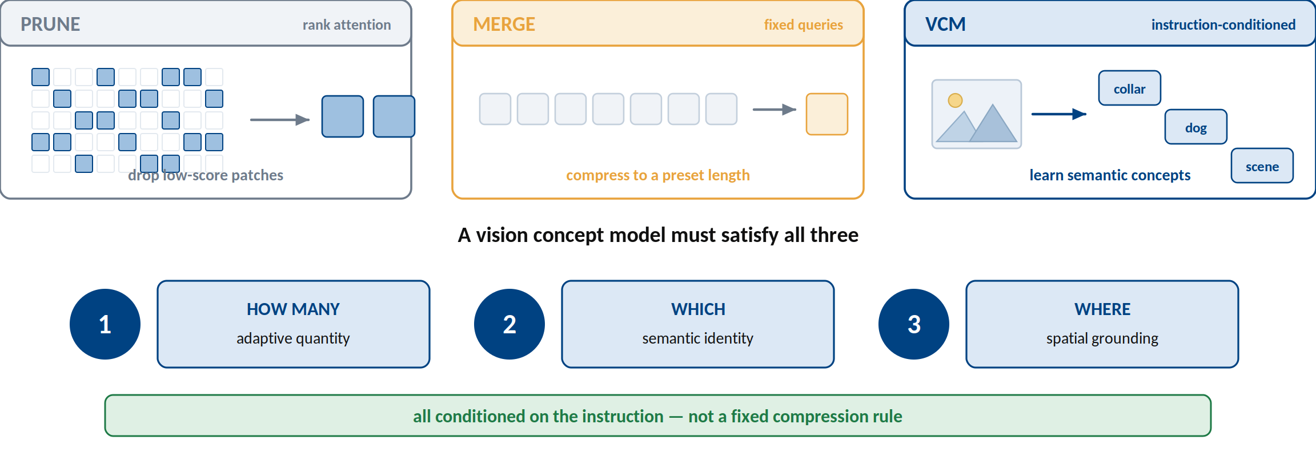
Compression is not yet concept modeling
A vision concept model must decide how many, which, and where — from the instruction.
Sections 1, 2, and 5.1 of the paper.

Slide 4
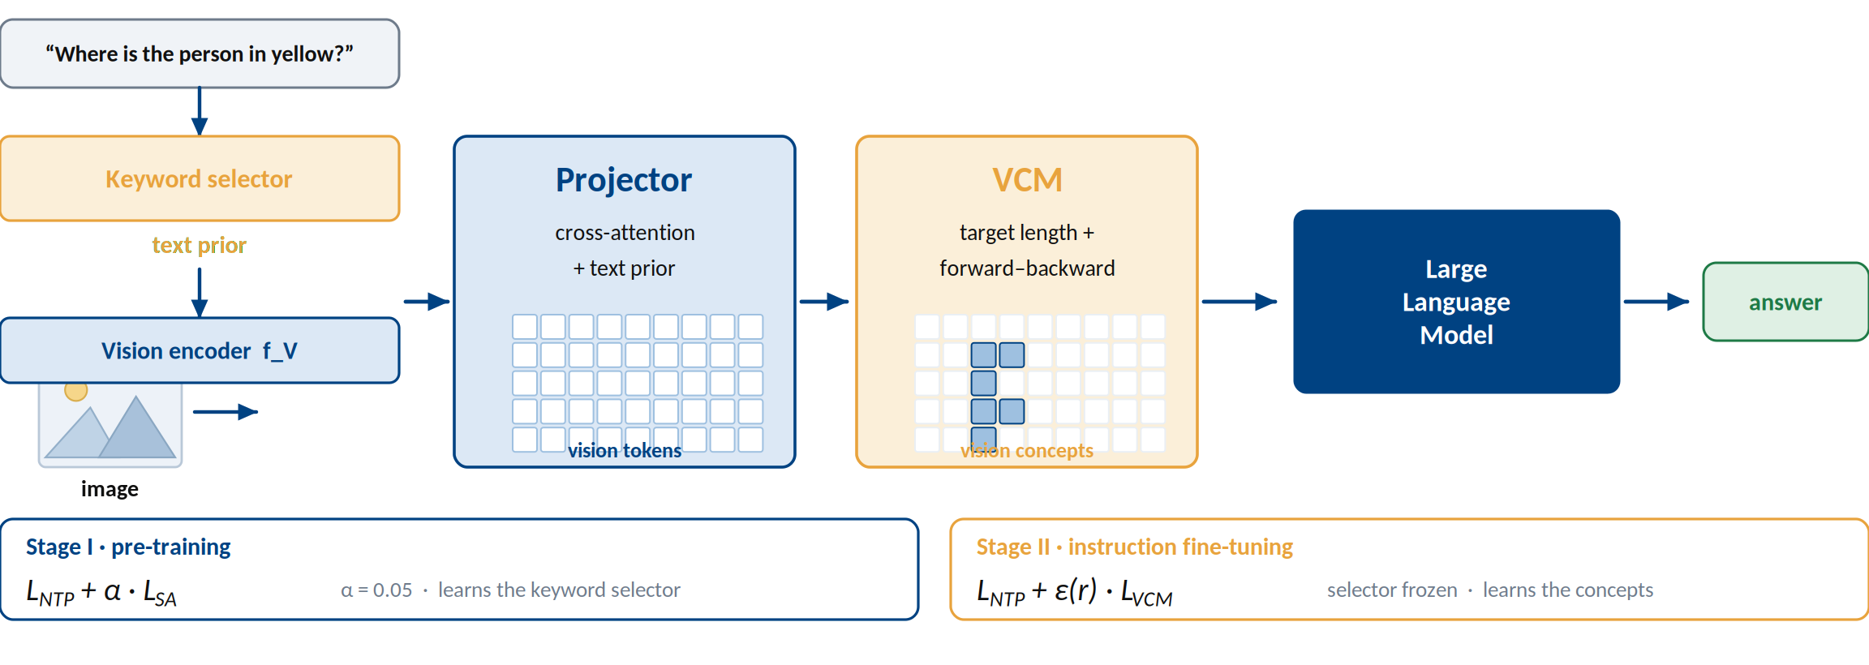
VCM — one model, two training stages
Use the text prior to set a budget, then align tokens into concepts.
Section 3 and Figure 3(a) of the paper.

Slide 5
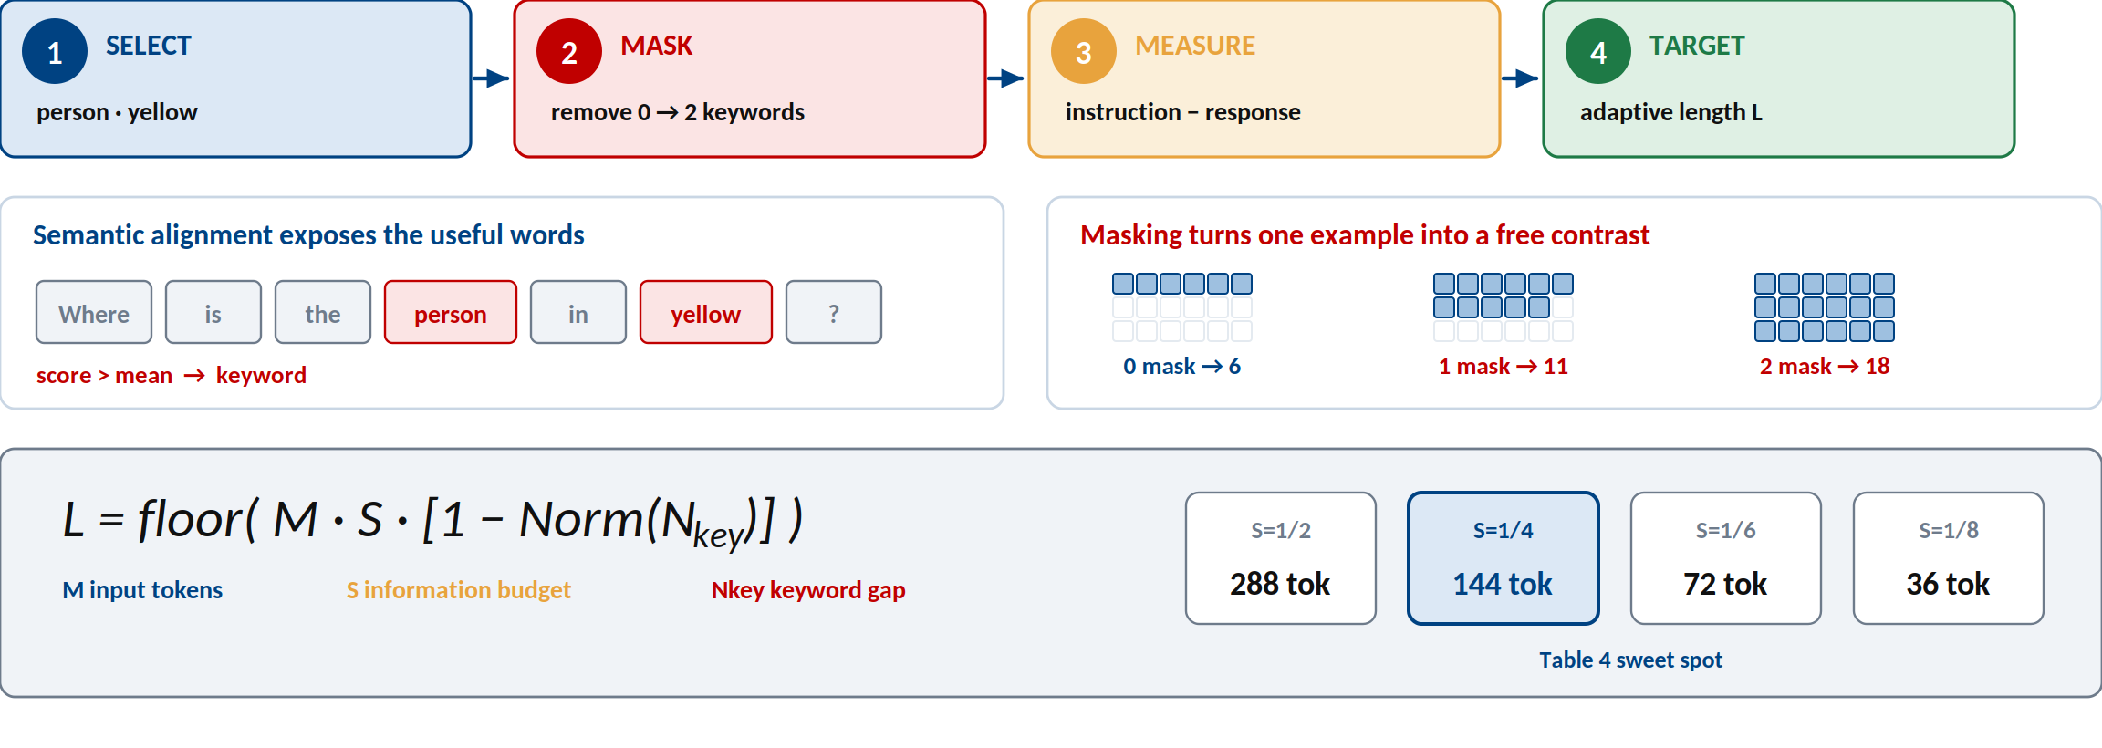
Self-supervision — the instruction tells us what vision is needed
Keywords provide the signal; masking creates the contrast; no concept labels are required.
Sections 3.1–3.3 and Figures 2–4 of the paper.

Slide 6
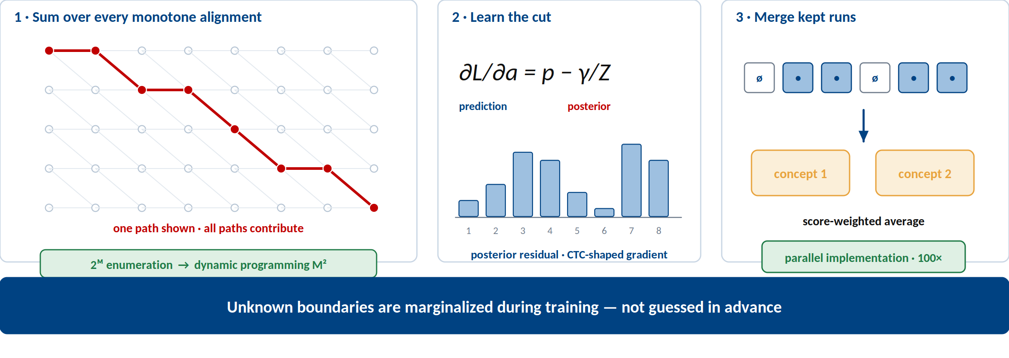
Optimization — learn variable-length concepts without choosing a cut
Forward–backward sums every alignment, then adjacent kept tokens merge into concepts.
Sections 3.3–3.4, Appendix C, Table 6, and Algorithm 2.

Slide 7
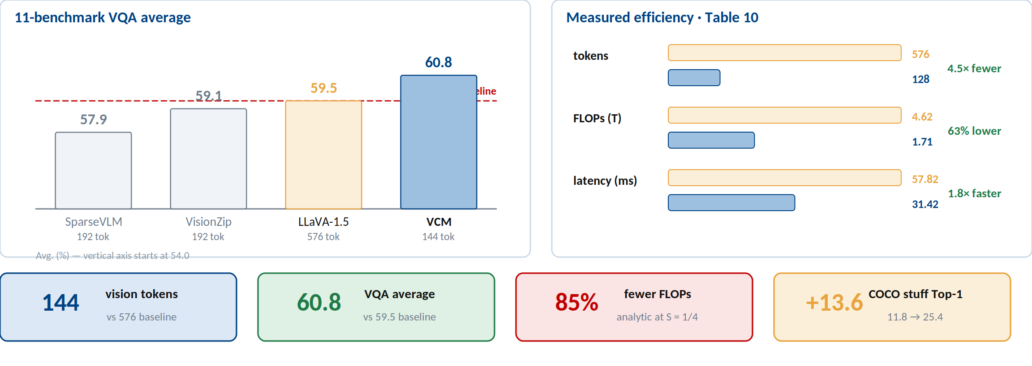
Core evidence — less computation, no performance trade-off
At 144 tokens VCM beats the 576-token baseline; at S = 1/4 it uses 85% fewer FLOPs.
Tables 1 and 10; Appendix D.

Slide 8
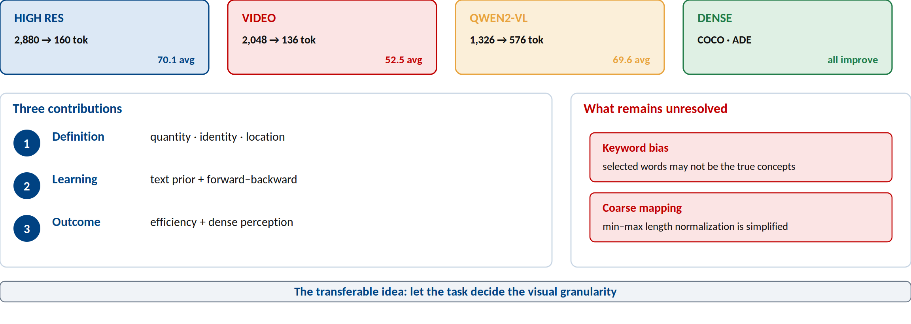
What VCM changes — efficiency, representation, and scope
Model the concepts the instruction needs — not every token the image has.
Run Luo, Renke Shan, Longze Chen, Ziqiang Liu, Lu Wang, Min Yang, Xiaobo Xia. VCM: Vision Concept Modeling with Adaptive Vision Token Compression via Instruction Fine-Tuning. arXiv:2504.19627v2, 2025.

