Slide 1

VCM: Vision Concept Modeling
Adaptive Vision Token Compression via Instruction Fine-Tuning
Run Luo · Renke Shan · Longze Chen · Ziqiang Liu · Lu Wang · Min Yang · Xiaobo Xia
SIAT, Chinese Academy of Sciences · UCAS · National University of Singapore · USTC
arXiv:2504.19627v2 [cs.CL]

Slide 2
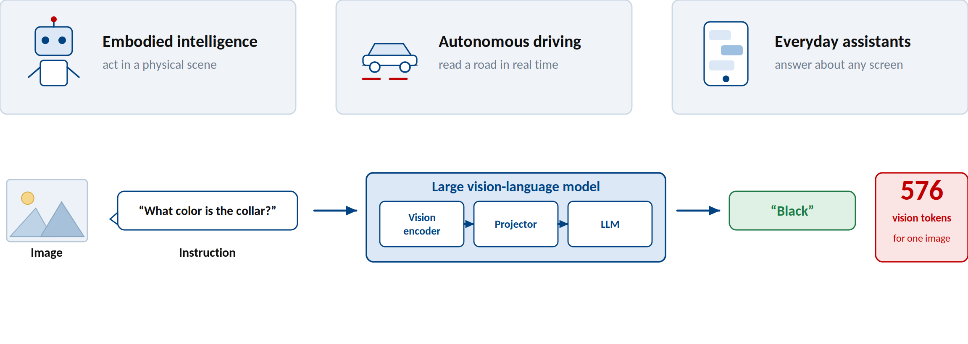
LVLMs are the interface to the real world
Powerful, general, deployed — and still reading every image token by token.
Liu et al. Visual Instruction Tuning. NeurIPS 2024. · Bai et al. Qwen-VL. arXiv:2308.12966, 2023.

Slide 3
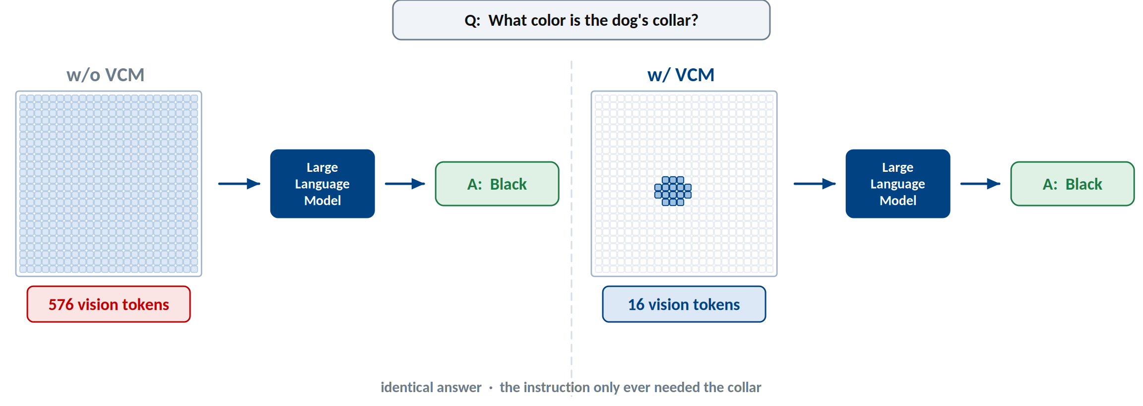
Humans answer with concepts, LVLMs pay for tokens
The question needs a few concepts; the model still pays for all 576 tokens.
Figure 1 of the paper.

Slide 4
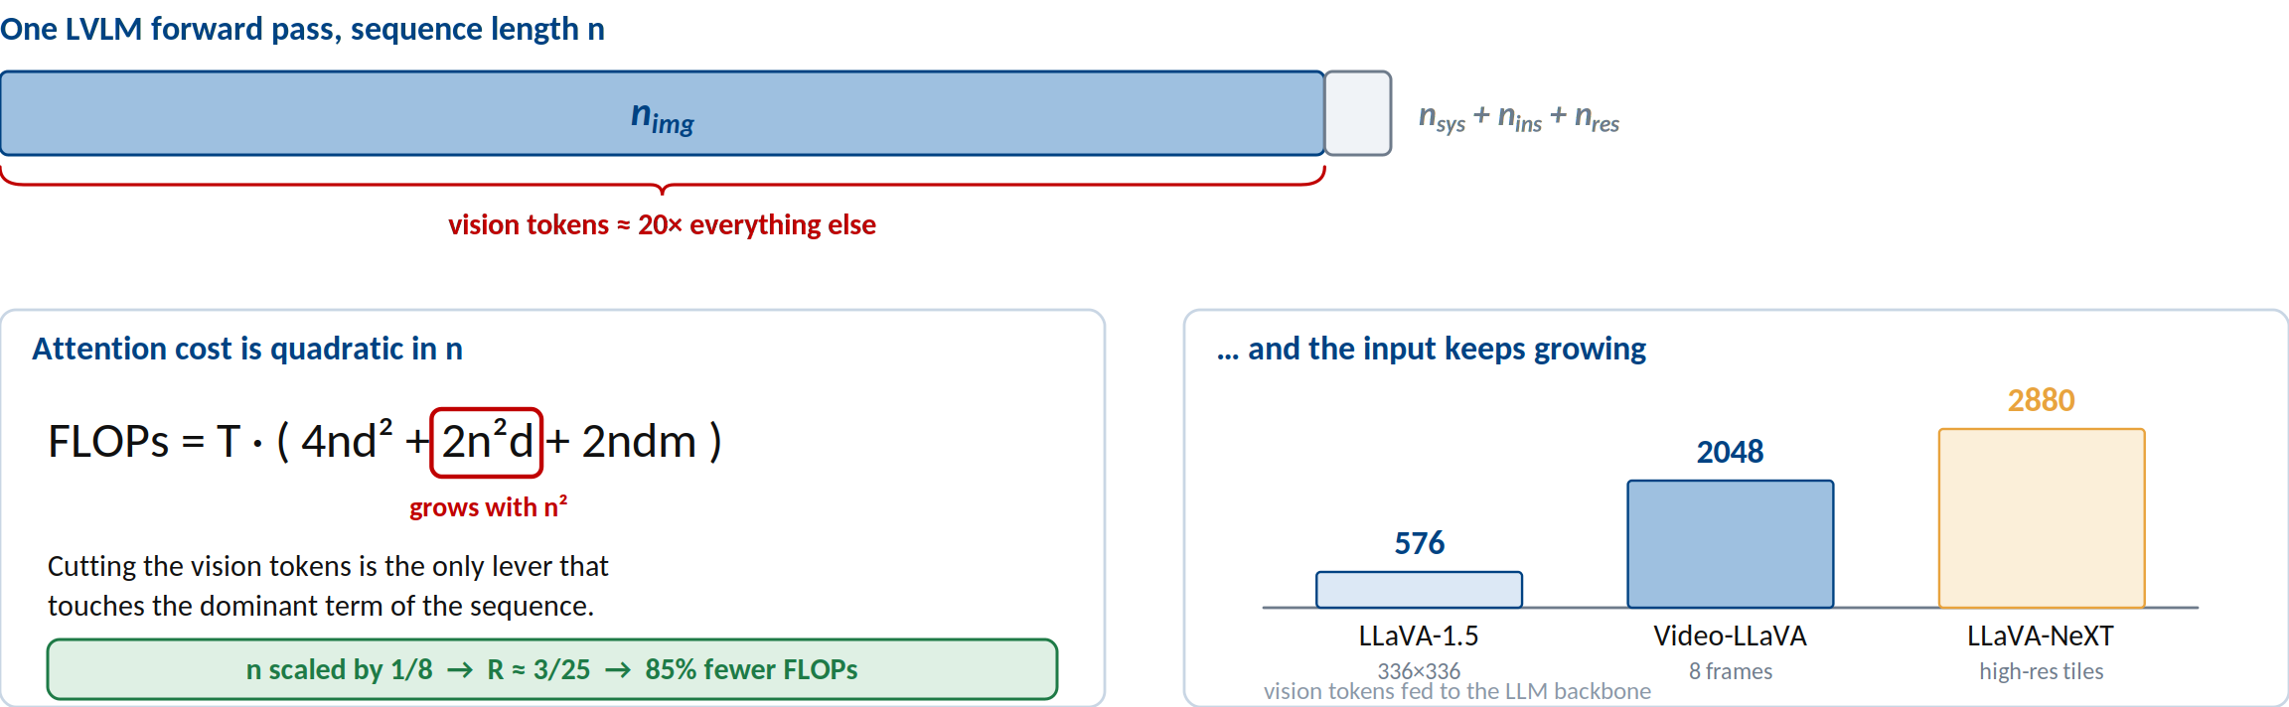
Why that redundancy is expensive
Vision tokens dominate the sequence, and attention is quadratic in its length.
Higher resolution and longer video make the dominant term grow fastest.
Appendix D of the paper. FLOPs = T·(4nd² + 2n²d + 2ndm).

Slide 5
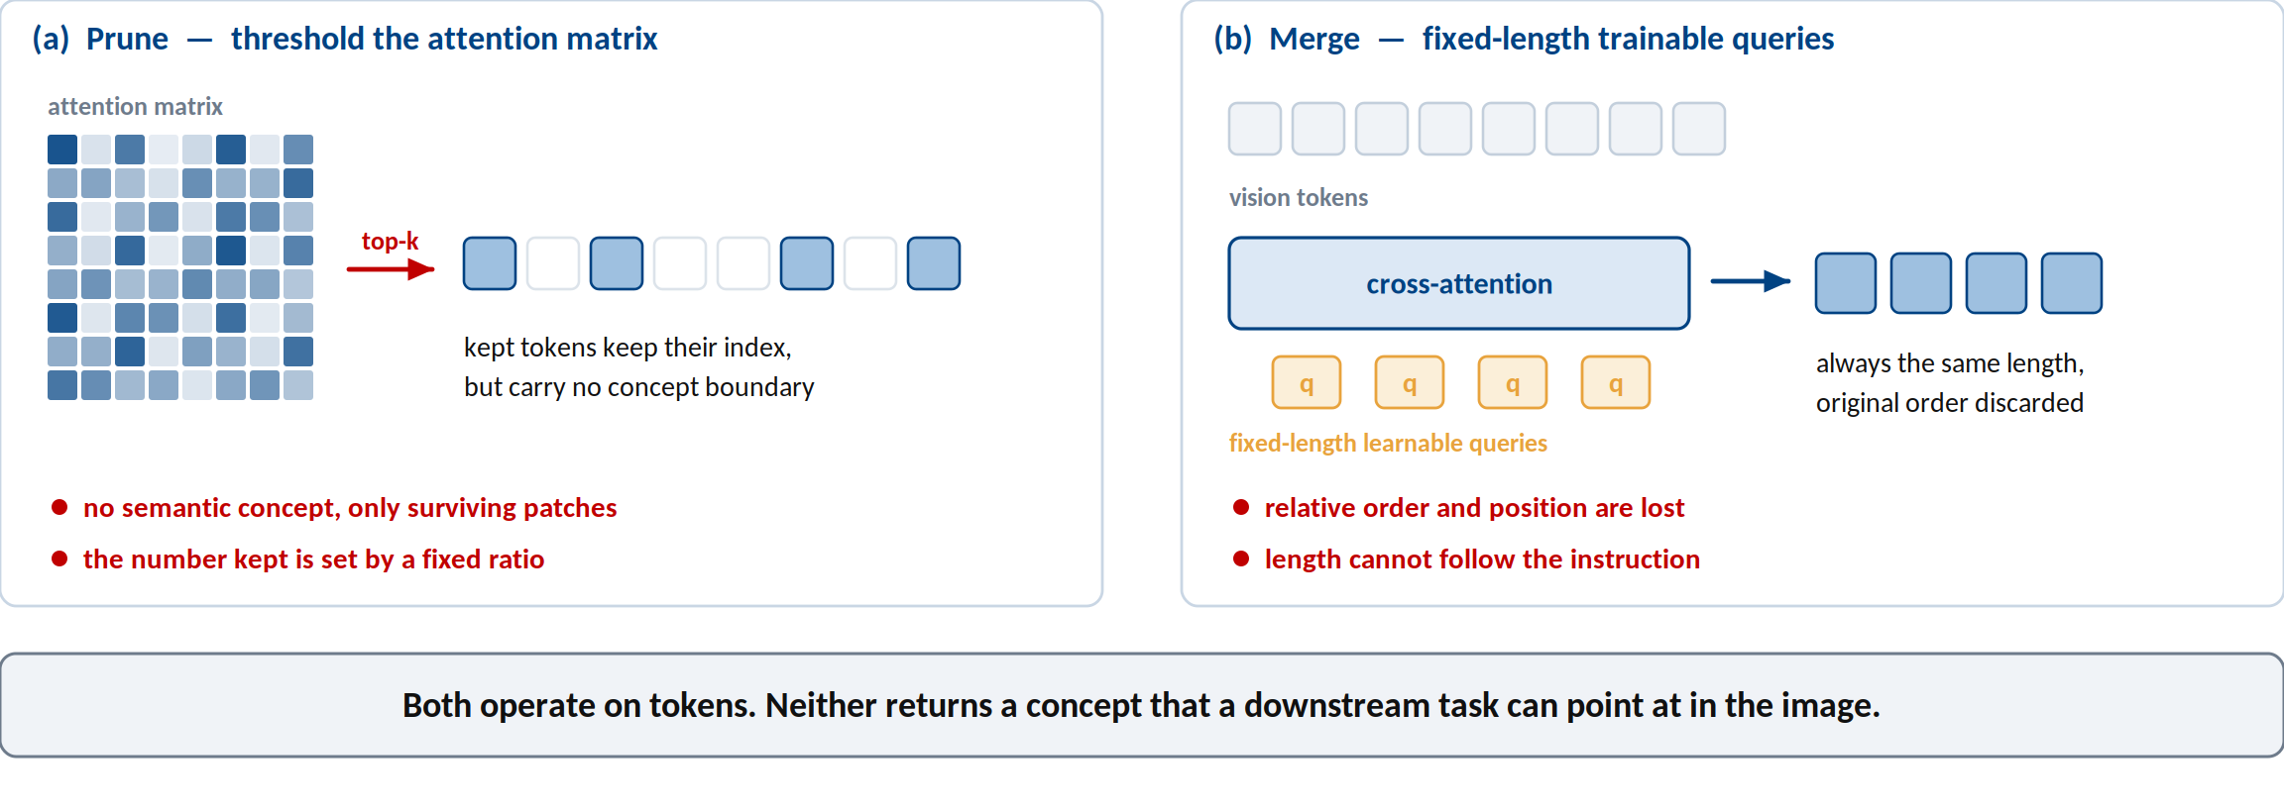
The existing recipe: prune, or merge
Both make the sequence shorter; neither makes it conceptual.
FastV (ECCV 2025) · SparseVLM · PyramidDrop · VisionZip · MQT-LLaVA · ToMe.

Slide 6
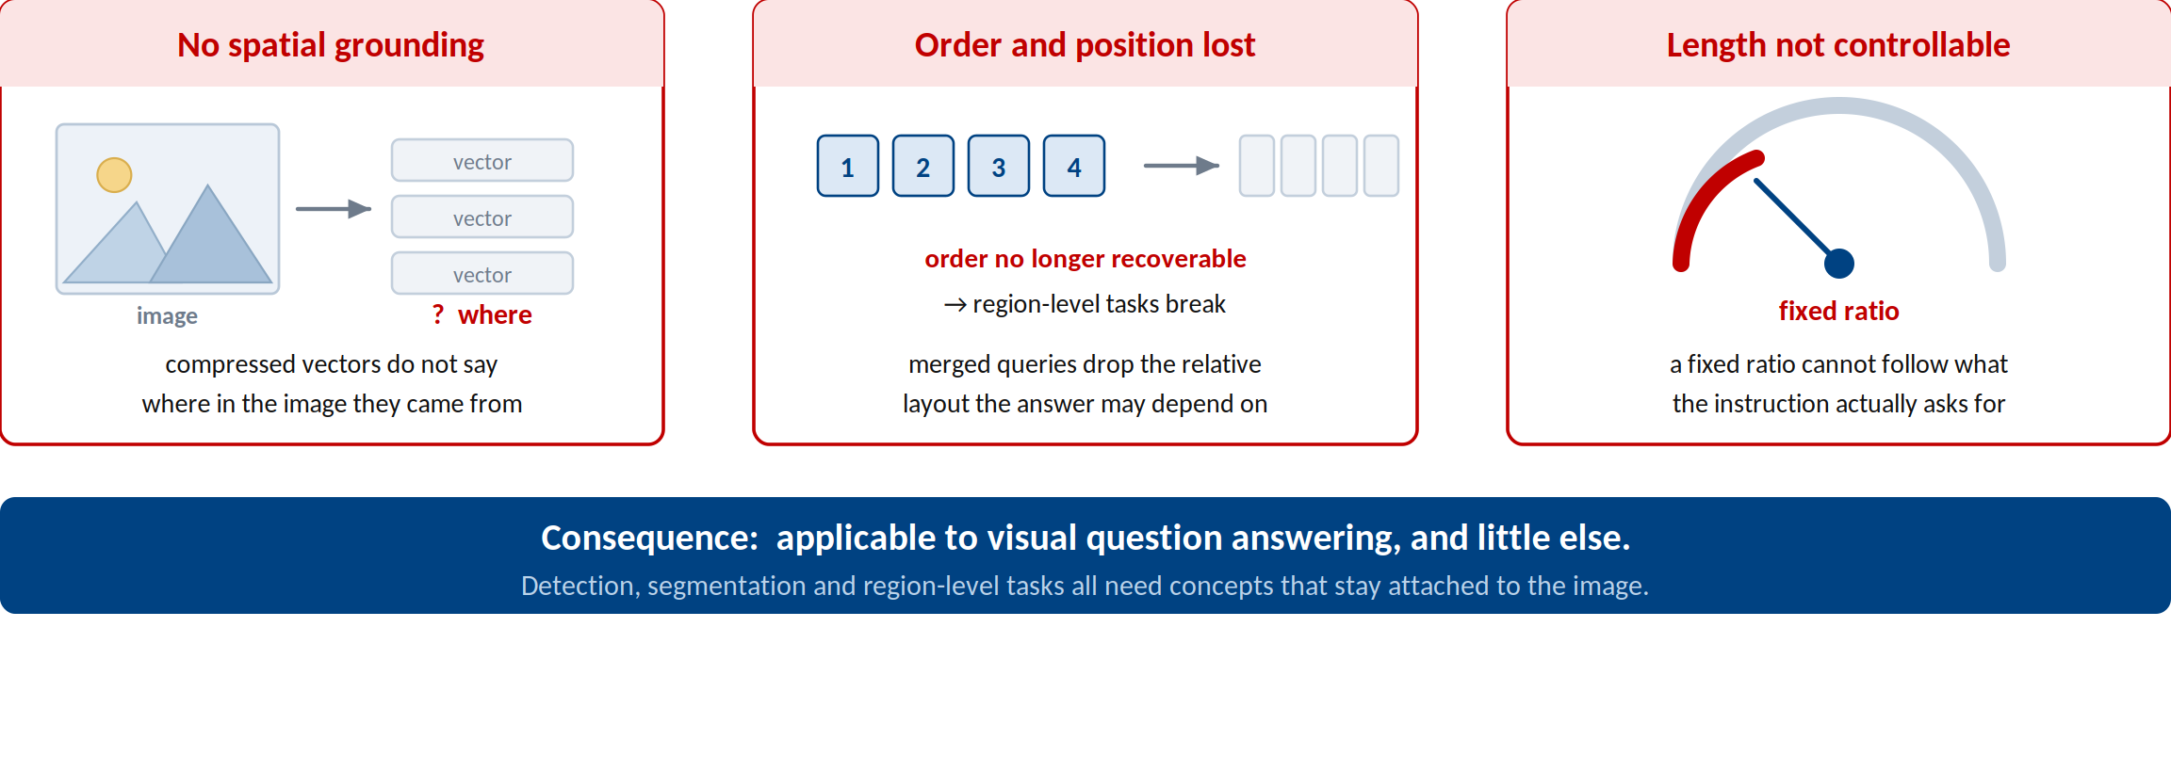
What is still missing
Shorter is not the same as conceptual — so none of them is a vision concept model.
Section 1 and Section 5.1 of the paper.

Slide 7
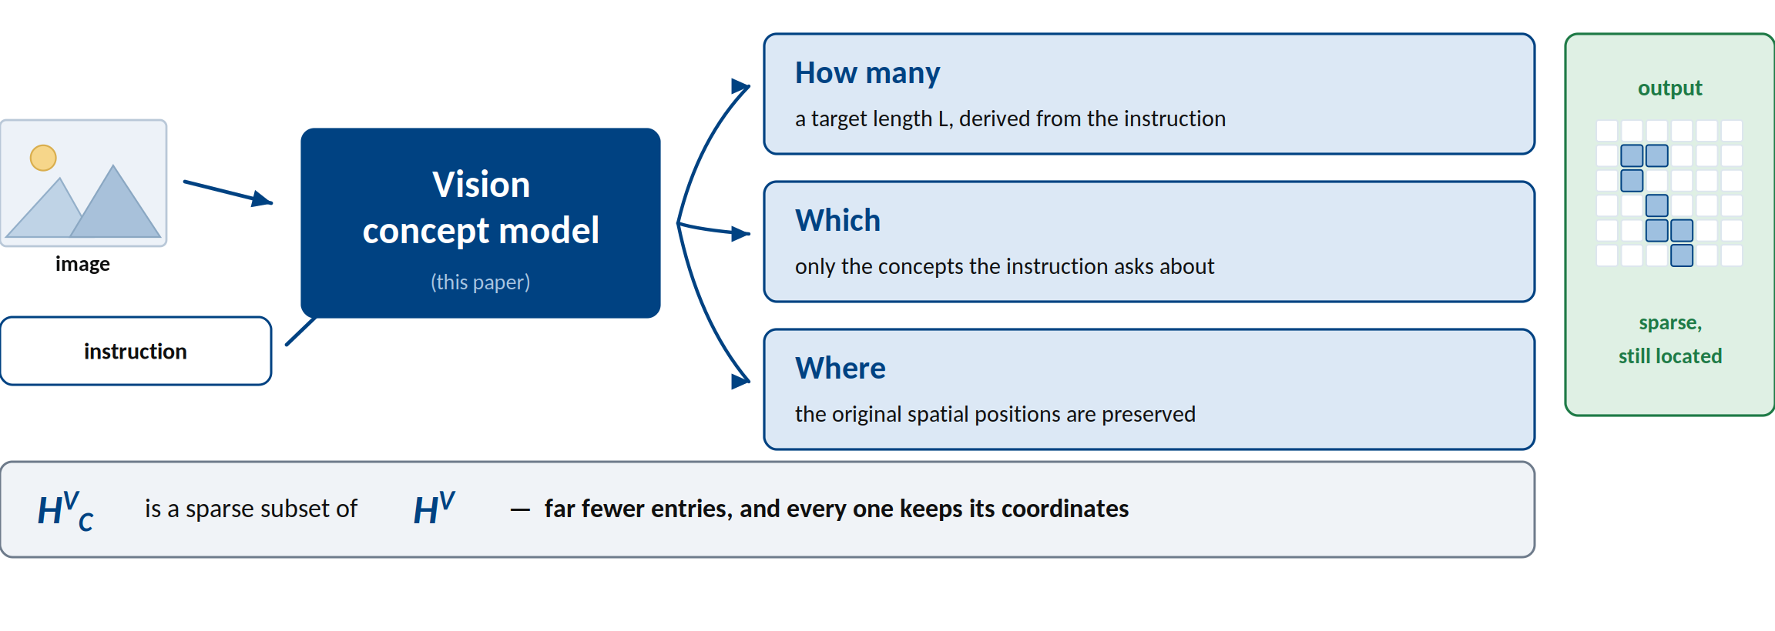
Definition: the vision concept model
A model that decides how many concepts, which ones, and where — from the instruction.
Contribution (1) of the paper.

Slide 8
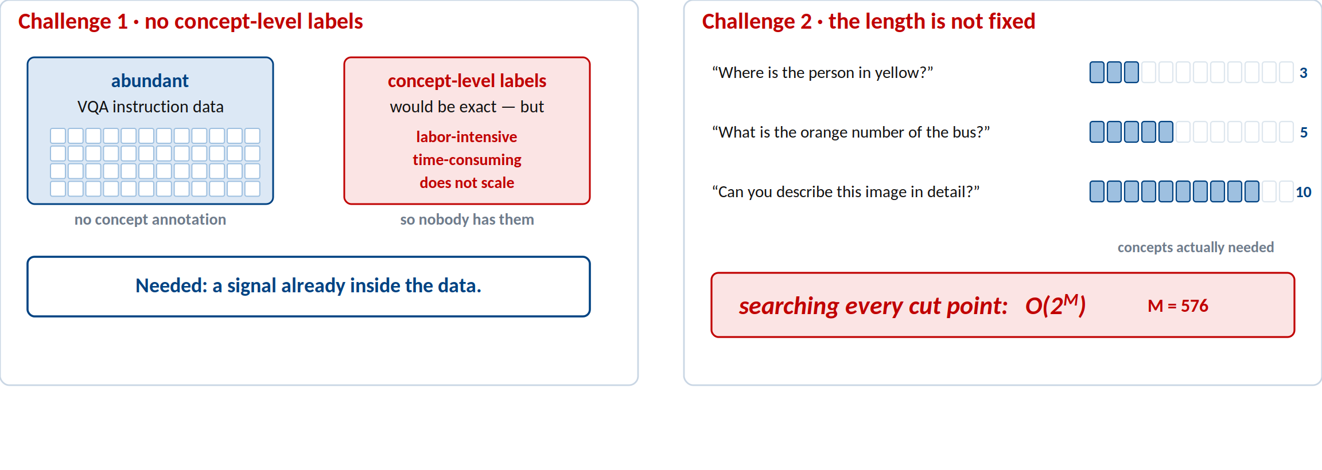
Two challenges stand in the way
We need supervision without labels, and optimization without a fixed length.
Section 2, Goal and challenges.

Slide 9
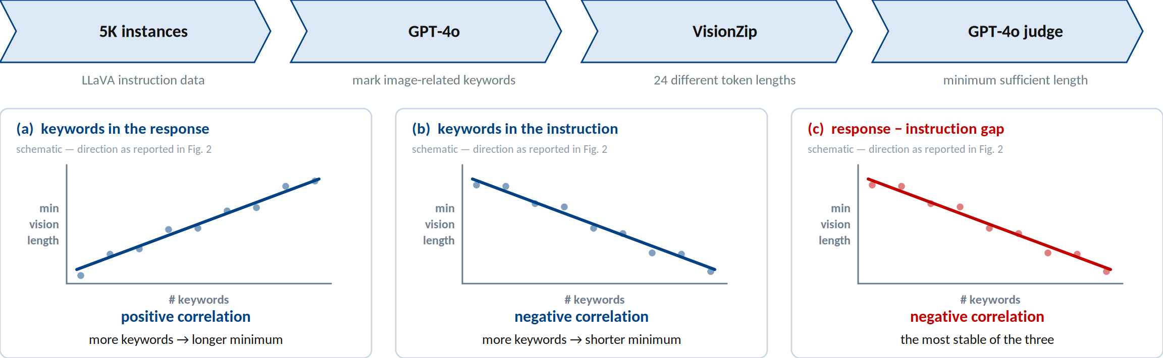
The text prior already knows the answer
Probe: 5K LLaVA instances · GPT-4o extracts image-related keywords · VisionZip at 24 lengths · GPT-4o judges the minimum sufficient length.
The instruction–response keyword gap is a supervision signal that costs nothing.
Section 3.1 and Figure 2 of the paper.

Slide 10
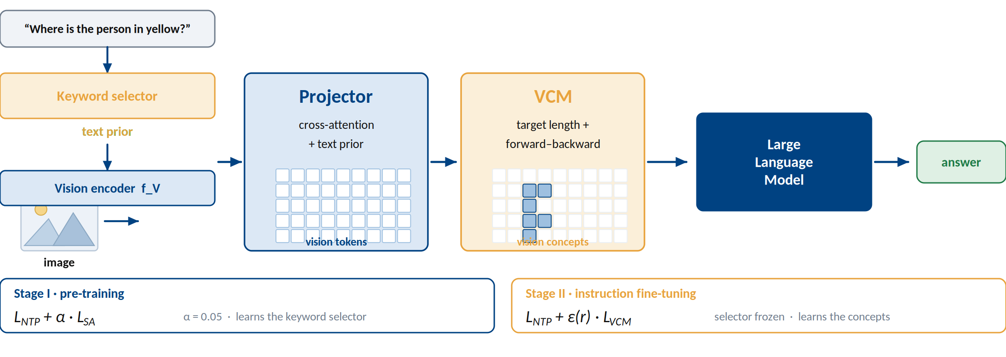
VCM at a glance
Select keywords, estimate a length, then align by dynamic programming.
Figure 3(a) of the paper.

Slide 11
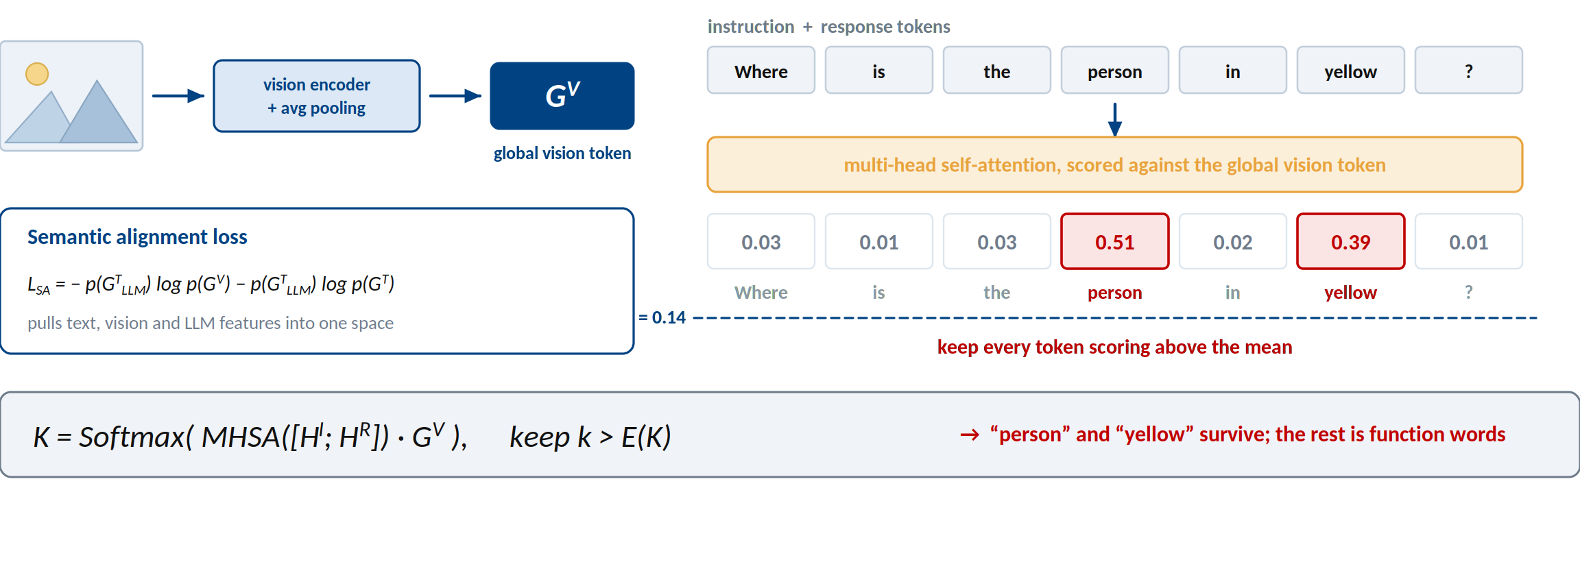
Step 1 — keywords from semantic alignment
Keywords fall out of vision–language alignment, not out of human annotation.
Section 3.2 and Figure 3(b) of the paper.

Slide 12
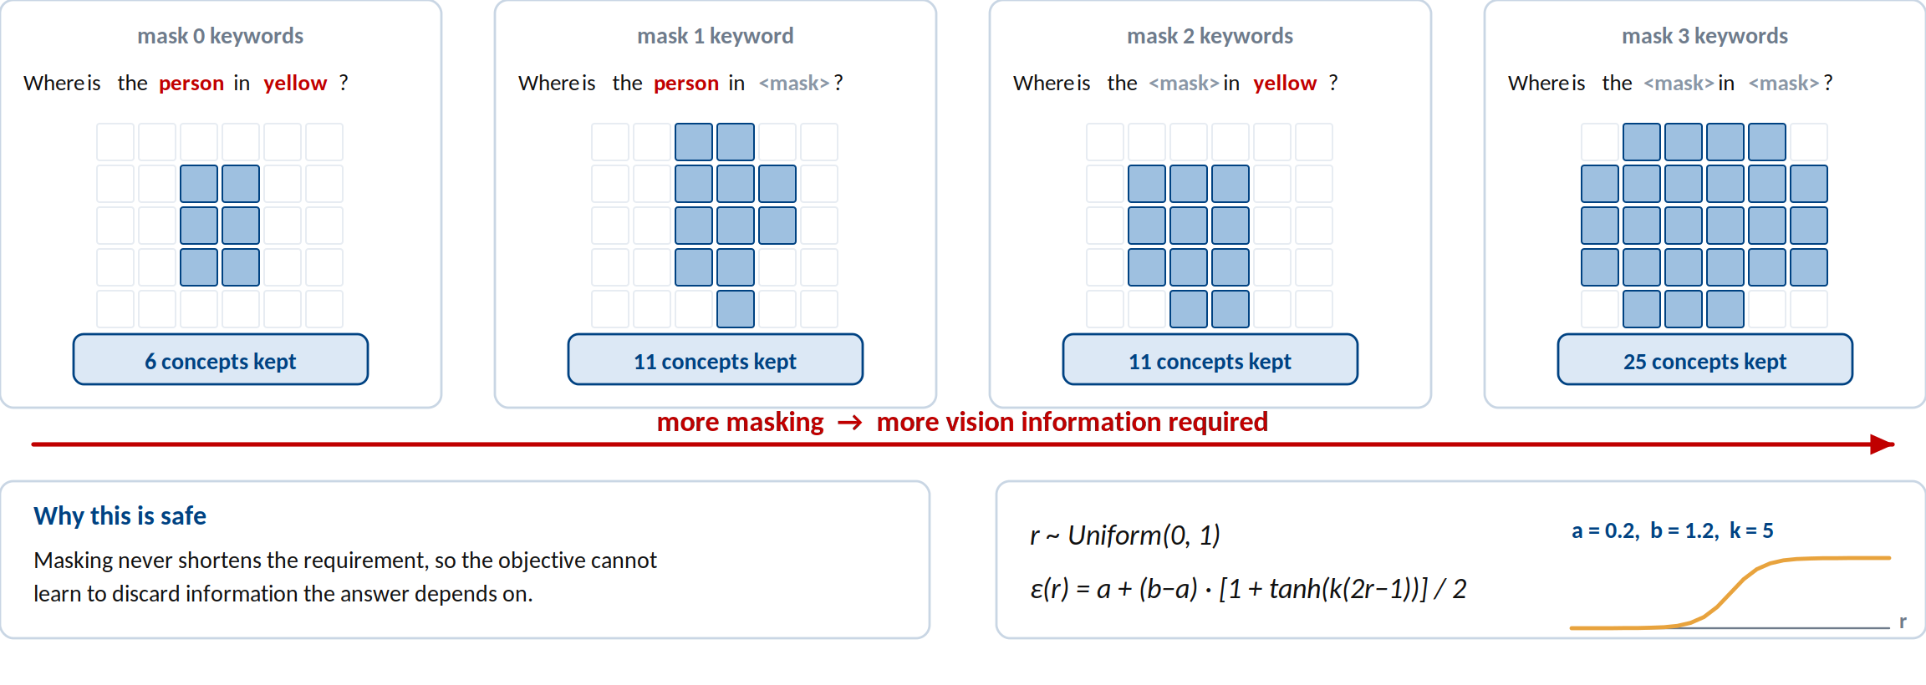
Step 2 — implicit contrastive sampling
Masking keywords lengthens what is needed — a free contrast, and a knob at inference.
Section 3.3 and Figure 4 (top) of the paper.

Slide 13
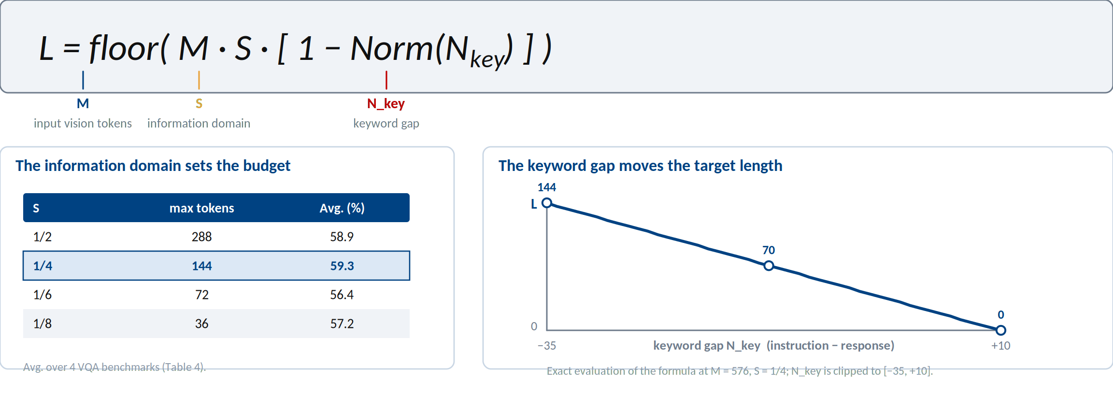
Step 3 — turn the prior into a target length
The text prior becomes an explicit target length — still no concept labels.
Section 3.3 of the paper.

Slide 14
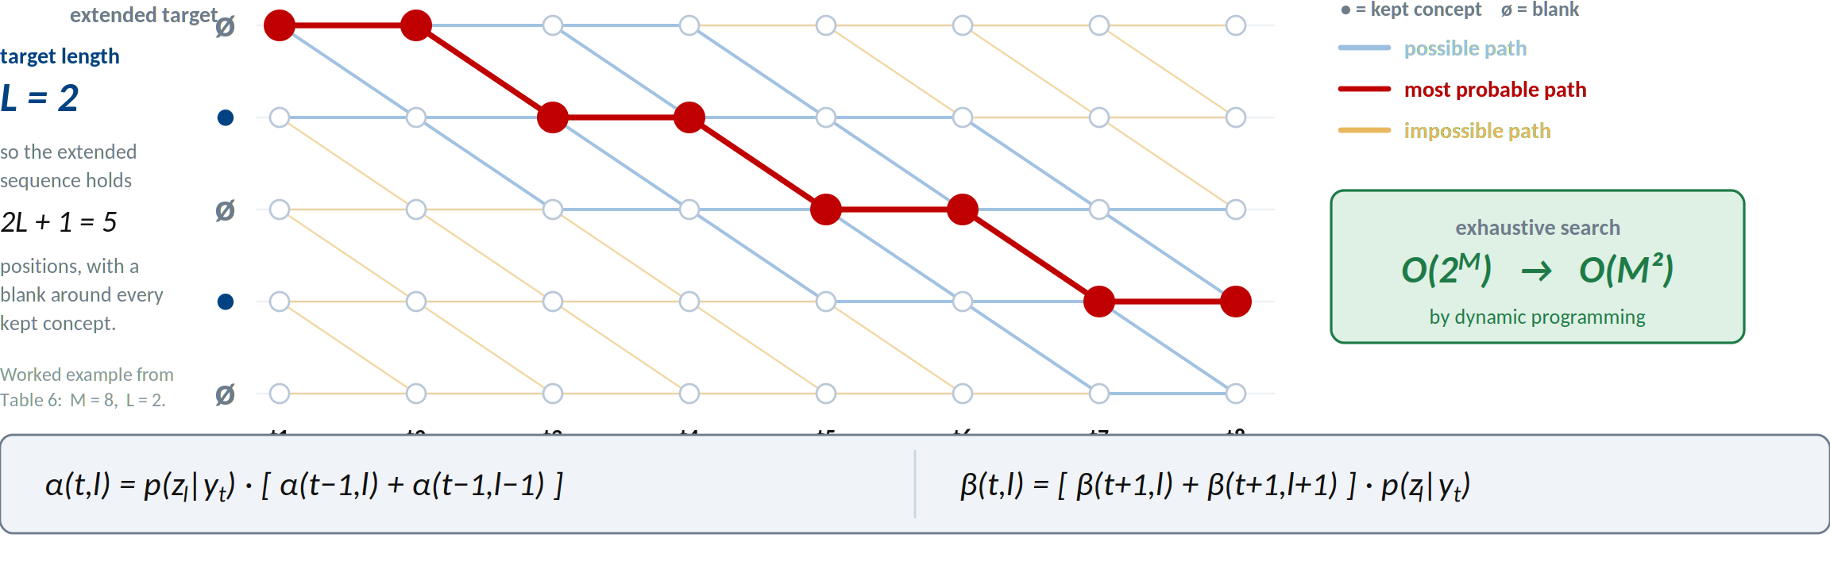
Step 4 — forward–backward over all alignments
Every monotone path through the lattice is one way to cut the sequence into L concepts; the forward and backward recursions score all of them at once.
Where to cut is unknown, so we sum over every alignment: 2ᴹ → M².
Section 3.3 of the paper. Dynamic programming: Bellman, Science 1966.

Slide 15
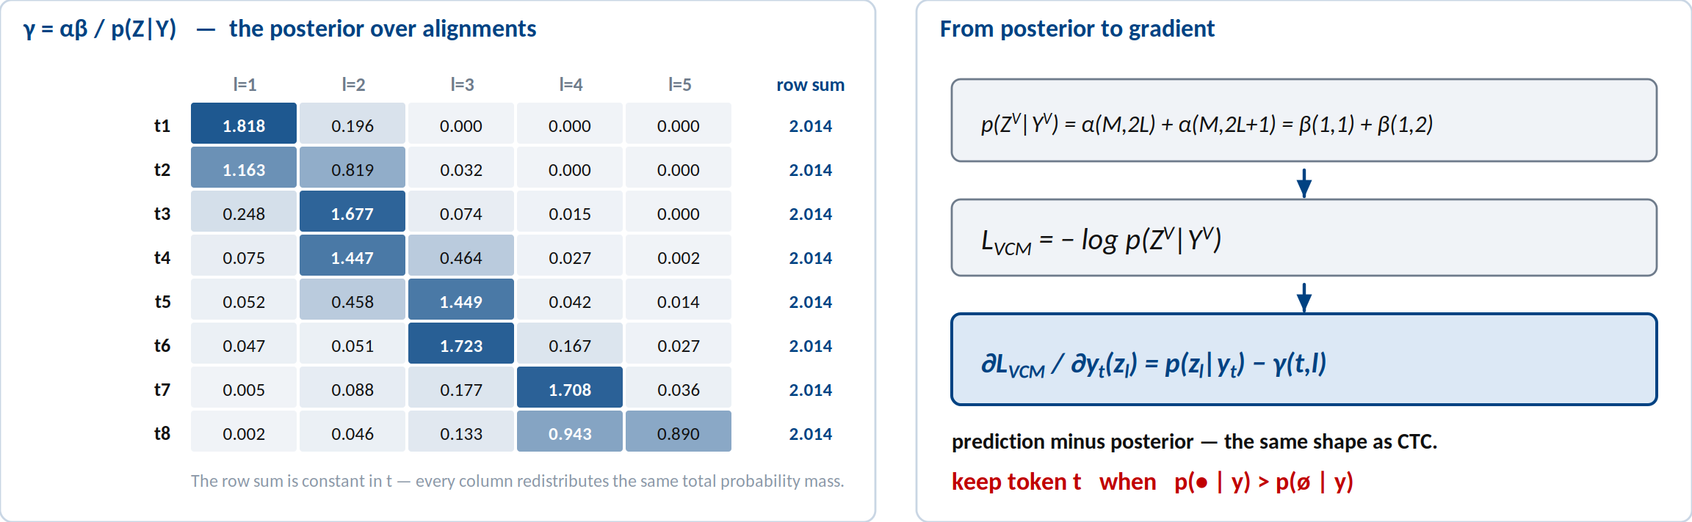
The gradient is a posterior residual
Worked example from Table 6: M = 8 input tokens, target length L = 2. Row sums of γ stay constant across t.
One clean rule — prediction minus posterior, exactly CTC's gradient shape.
Section 3.4, Appendix C, and Table 6 of the paper.

Slide 16
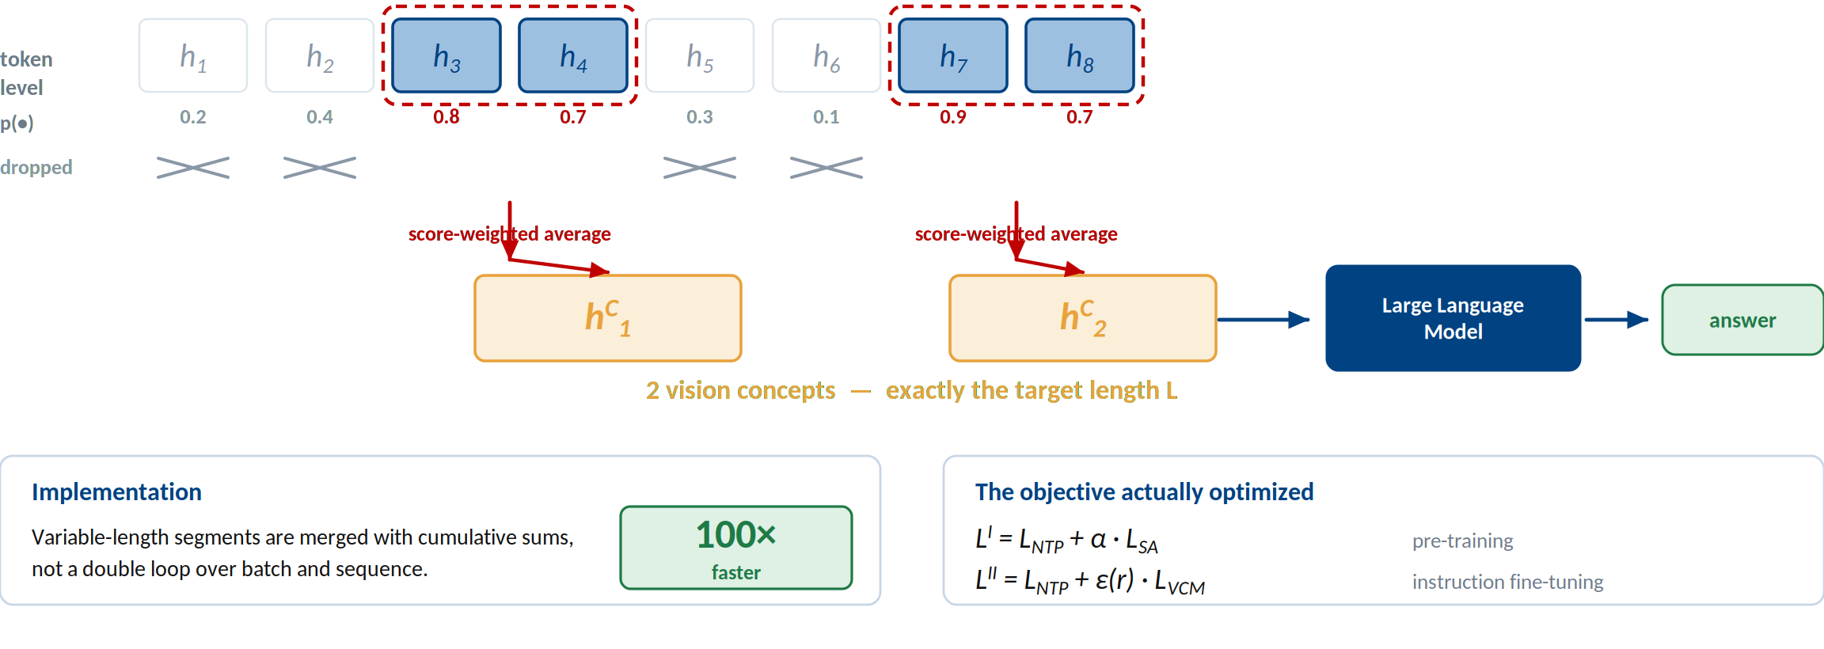
Step 5 — merge the kept runs into concepts
Adjacent kept tokens merge by score-weighted average — and the op is 100× faster than a double loop.
Section 3.4 and Algorithm 2 of the paper.

Slide 17
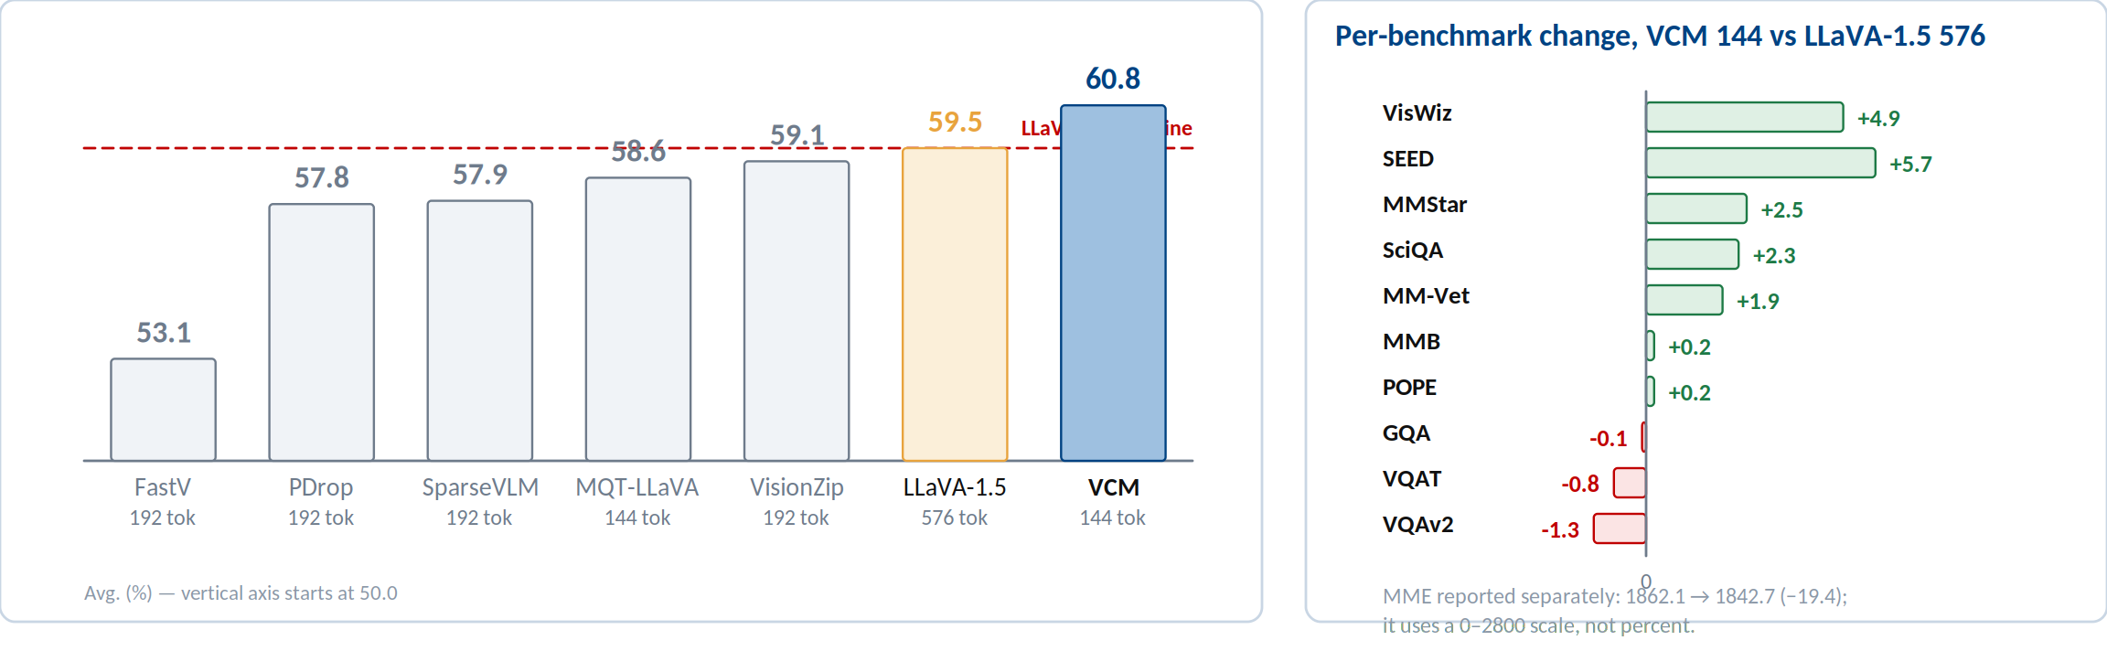
Evidence — better than the model it compresses
Average over 11 image-based VQA benchmarks (Table 1).
144 tokens instead of 576, and a higher average than LLaVA-1.5 itself.
Table 1 of the paper. #Vision Tokens = tokens fed to the LLM backbone.

Slide 18
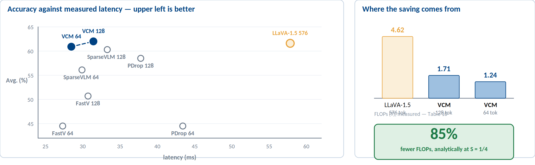
Evidence — the cost actually drops
Average over the 8 benchmarks reported in Table 10; FLOPs and latency measured in the same setting.
85% fewer FLOPs in theory, 1.8× lower latency in practice, no average loss.
Table 10 and Appendix D of the paper. Analytic ratio R ≈ 3/25 at S = 1/4.

Slide 19
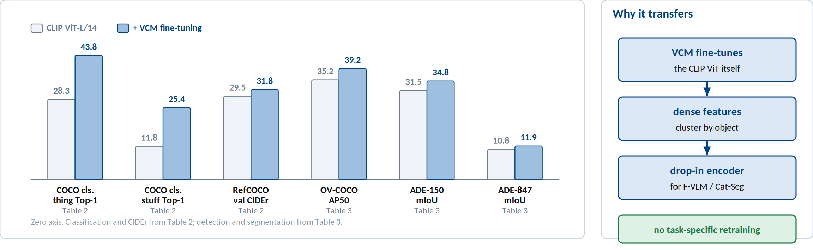
Evidence — the vision encoder itself improves
CLIP ViT-L/14 with and without VCM fine-tuning, dropped into F-VLM (detection) and Cat-Seg (segmentation).
Not only compression — concept modeling improves dense perception.
Tables 2 and 3 of the paper.

Slide 20
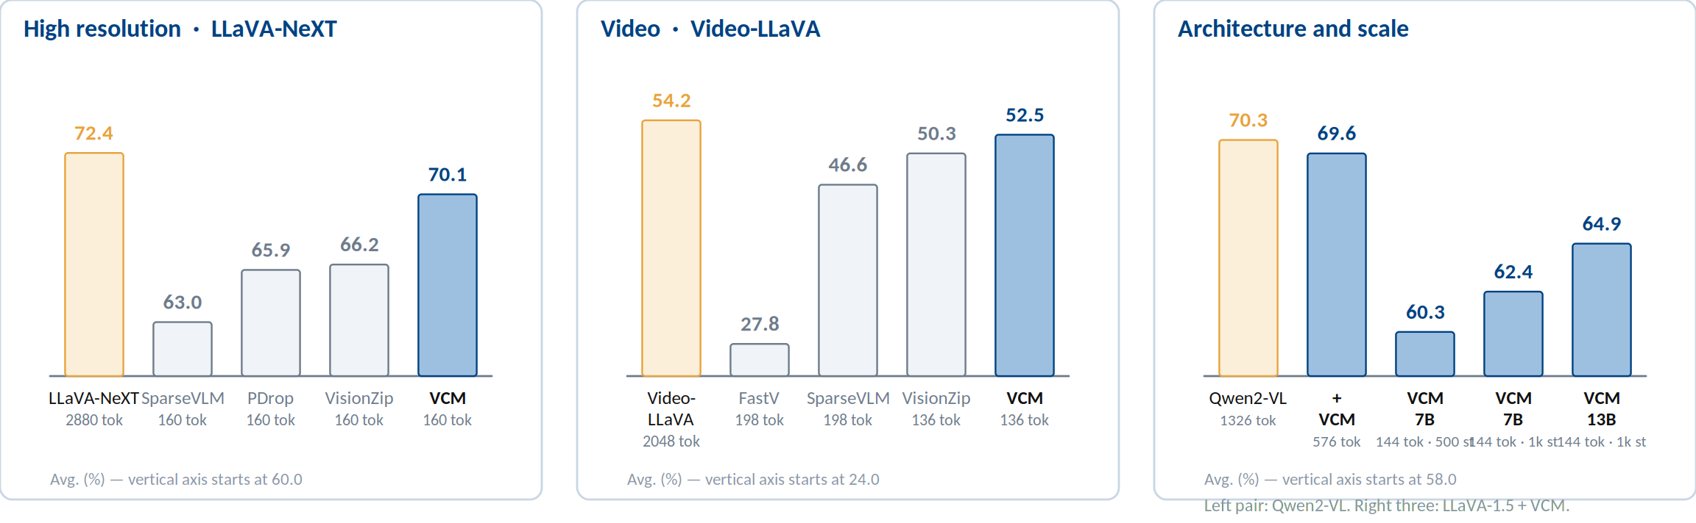
Evidence — the recipe transfers
High resolution (Table 7) · video (Table 8) · other architectures and larger LLMs (Table 9).
Resolution, modality, architecture, scale — the same recipe holds.
Tables 7, 8, and 9 of the paper.

Slide 21
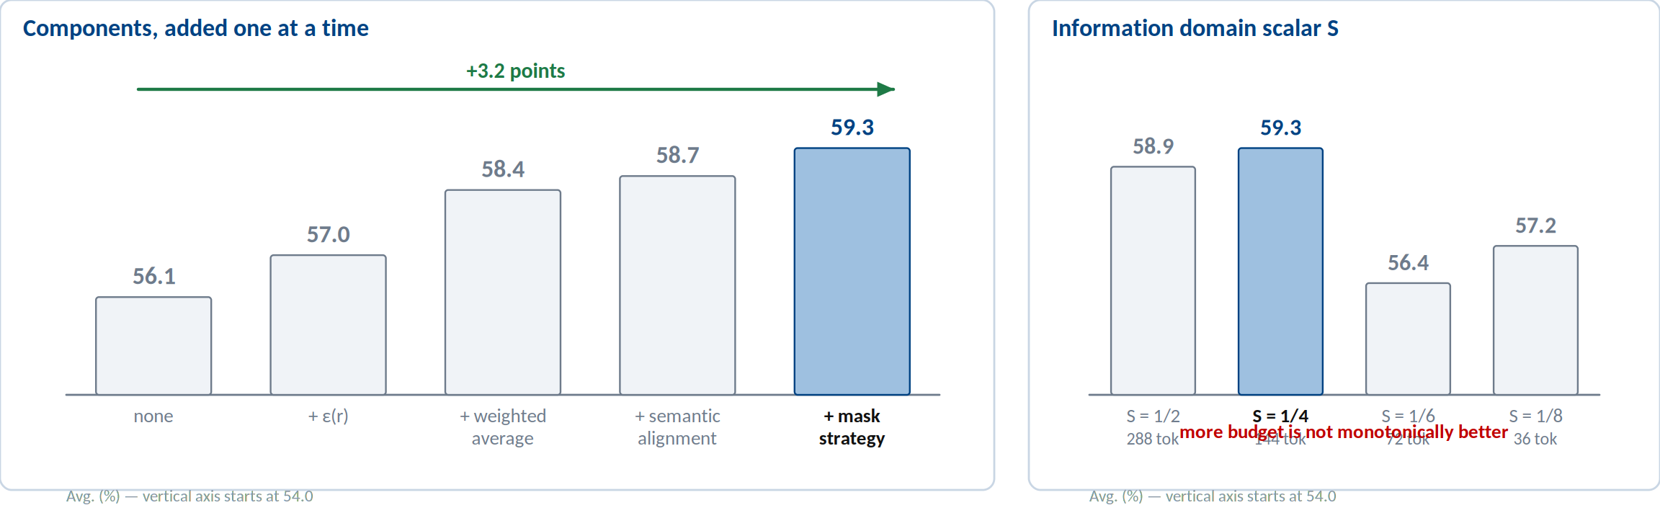
Ablation — what each piece buys
Average over 4 image-based VQA benchmarks, batch size 128, 500 training steps (Table 4).
Every component contributes, and S = 1/4 is the accuracy–cost sweet spot.
Table 4 of the paper.

Slide 22
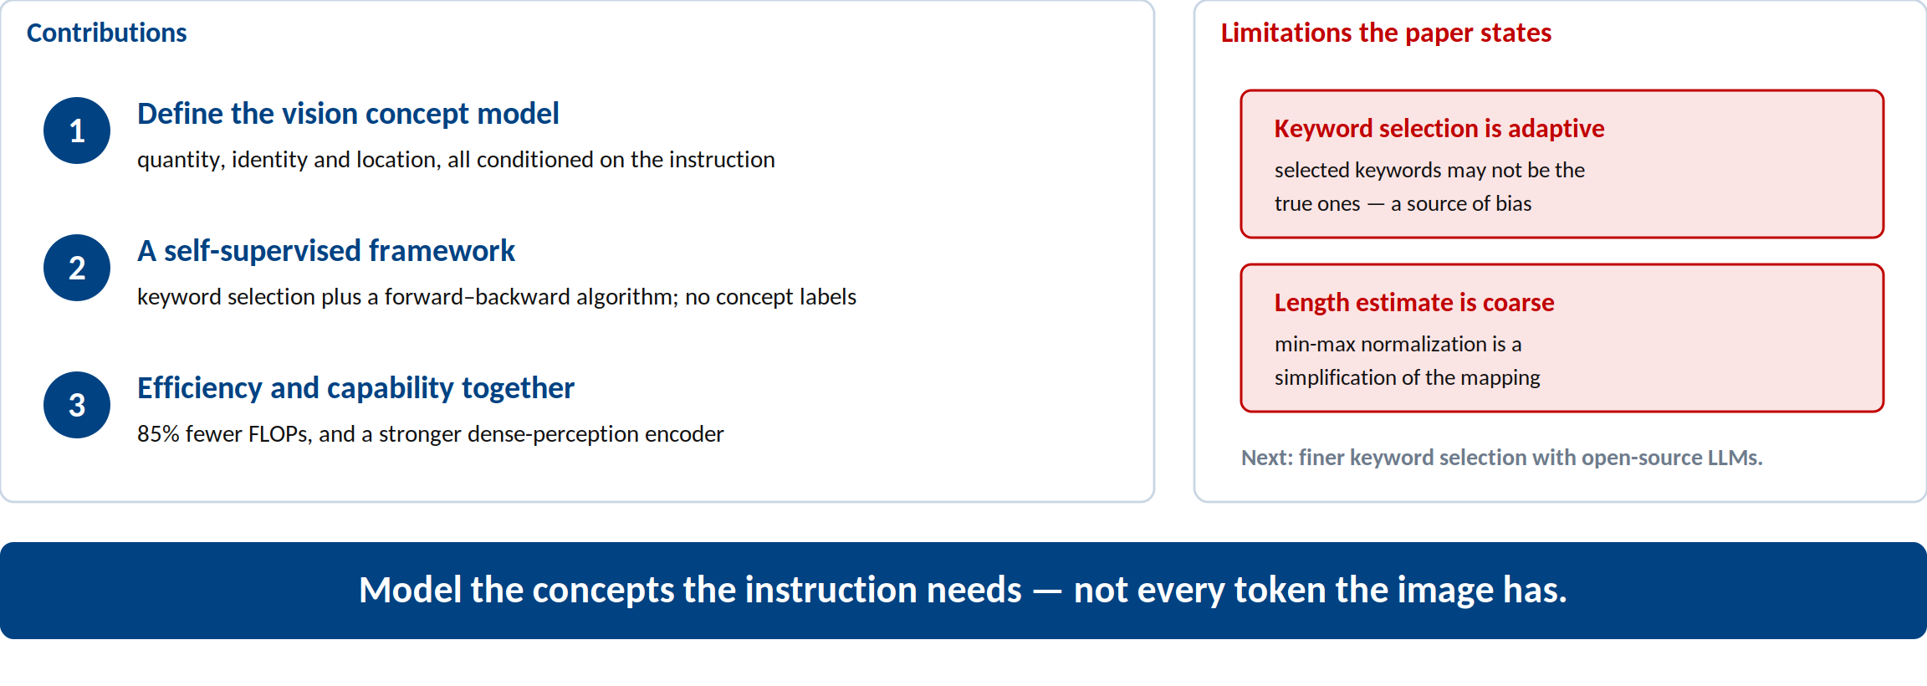
Conclusion
Model the concepts the instruction needs — not every token the image has.
Run Luo, Renke Shan, Longze Chen, Ziqiang Liu, Lu Wang, Min Yang, Xiaobo Xia. VCM: Vision Concept Modeling with Adaptive Vision Token Compression via Instruction Fine-Tuning. arXiv:2504.19627v2, 2025.

