Slide 1
Andersen DevOps course exam
Marchenko Ivan

Slide 2
Presentation plan:
Applications
CI/CD
Chosen Workflows
Workflows implementation
Infrastructure implementation
Terraform template
Ideal CI/CD pipeline
Demonstration

Slide 3
Applications
Python app:
Flask framework.
Gunicorn WSGI server.
Image size: 8.88 MB.
GET & POST requests.
8080 port exposed.
Workflow used: Git flow
Message: Hello World 1
Golang app:
Gin framework.
-
Image size: 9.06 MB.
GET & POST requests.
8080 port exposed.
Workflow used: Github flow
Message: Hello World 2

Slide 4
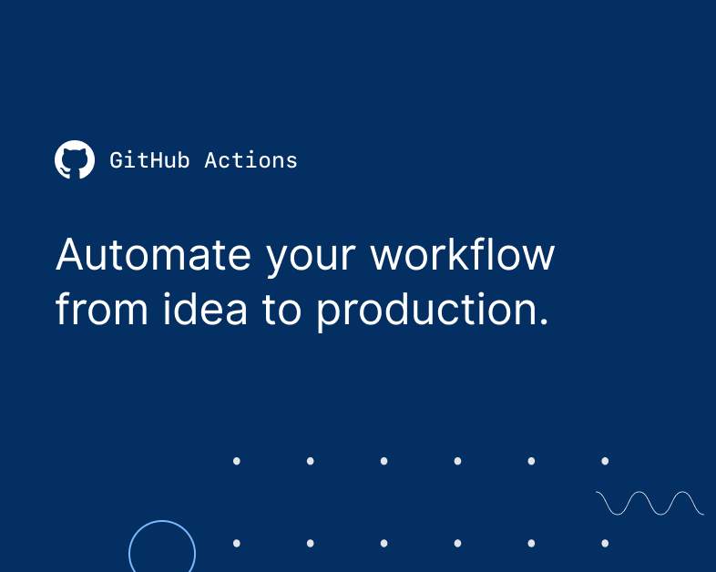
CI/CD
For my exam task I’ve chosen the Github Actions CI/CD platform because of these benefits:
Integration with the Github and big amount of triggers for Github events.
There is no need to use third-party CI/CD platforms when everything can be done in Github.
Plenty amount of Actions: from simple Telegram notifications to Terraform integration.
Easy-to-use YALM format code.
There is no need to run a dedicated server for CI/CD platform.

Slide 5
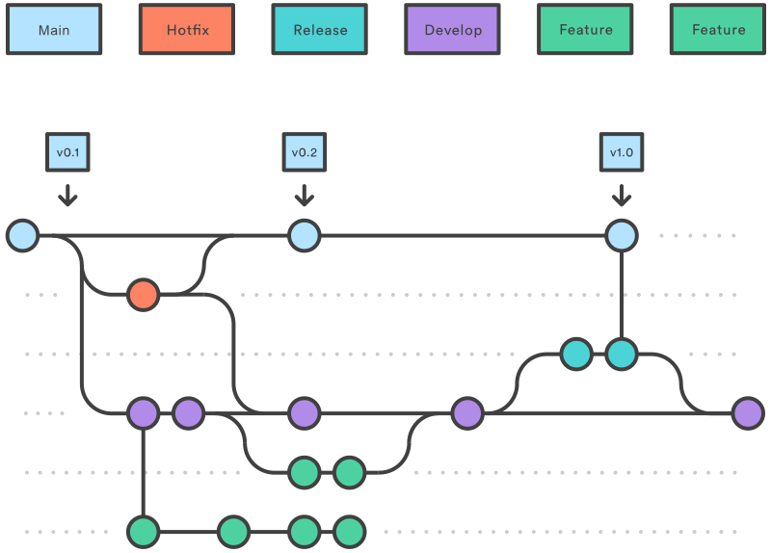
Chosen workflows | Gitflow
Gitflow workflow uses several primary branches instead of one main branch.
Every developer is working in his feature branches until feature is done. Developers can’t interact with the main branch.
Project history is stored in several branches which includes Hotfix, Release, Develop and Main branch itself.
There is a high risk of merge conflicts and Gitflow has fallen in popularity in favor of trunk-based workflows.

Slide 6
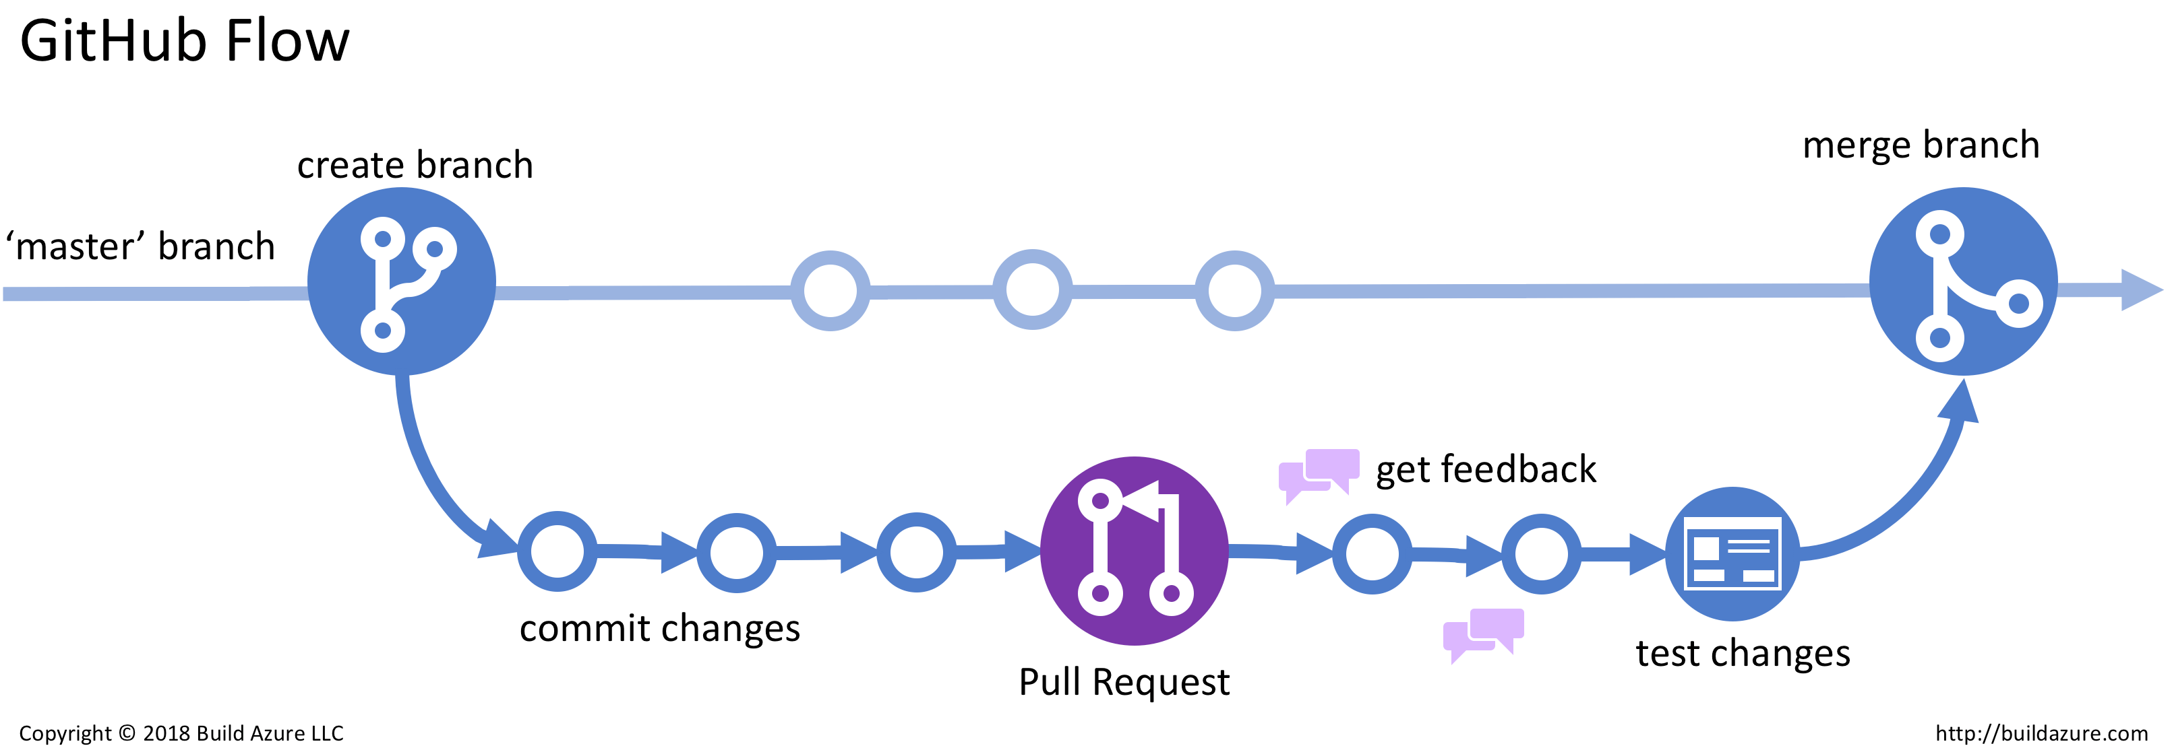
Chosen workflows | Github flow
Github flow is a simple workflow with only one main branch.
Every developer is working in his feature branch and able to create a pull request to the main branch.
After changes are merged to the main code is going for tests, staging and production.
Today the Github flow is a most popular workflow because of microservices popularity that require for high commit rate.

Slide 7
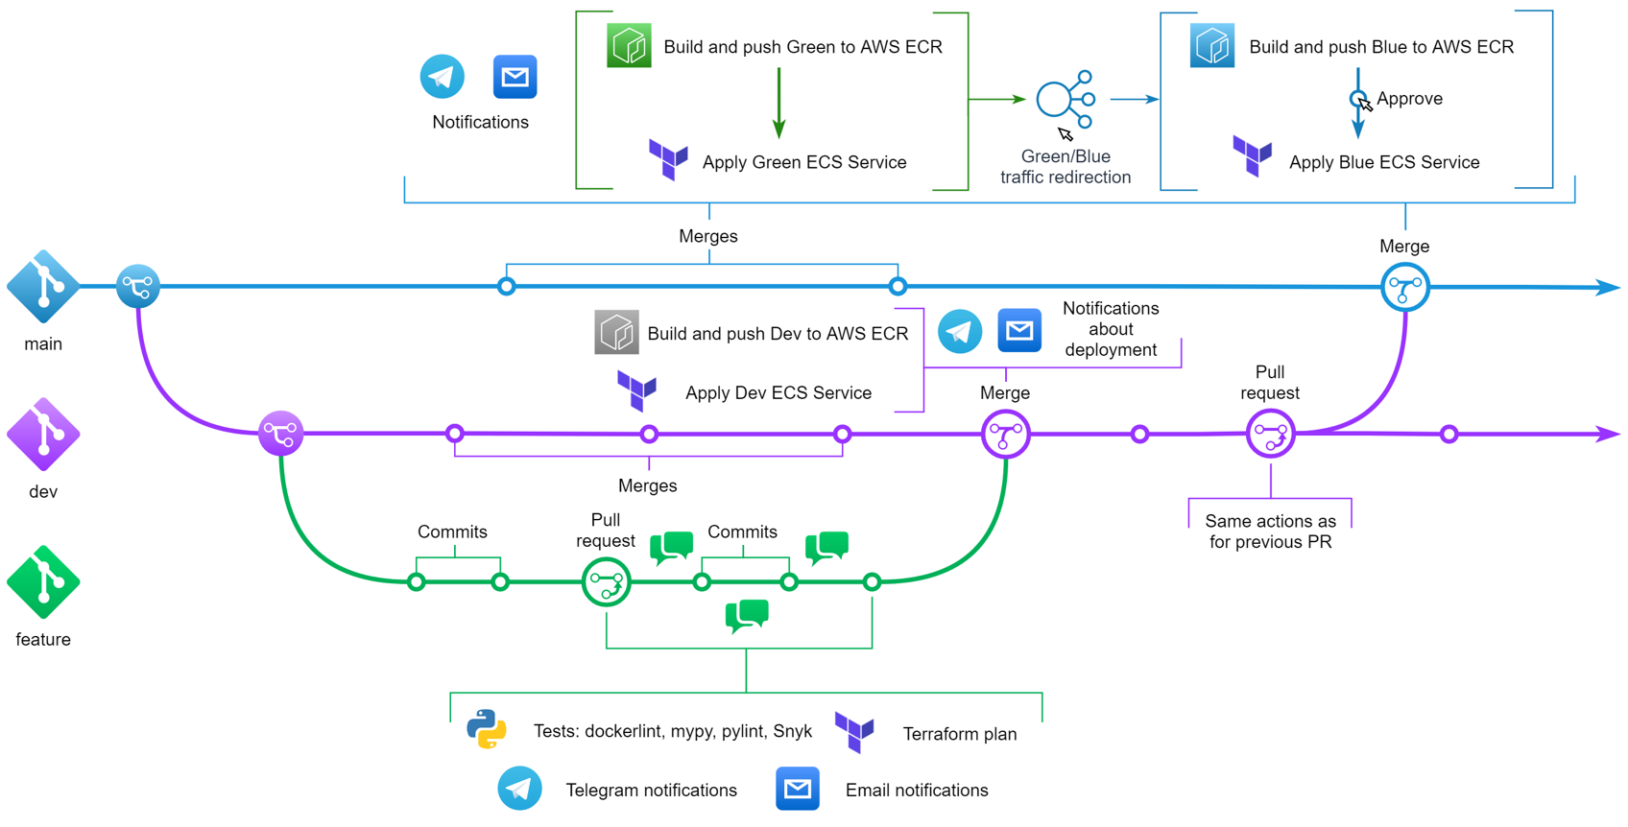
Workflows implementation | Gitflow

Slide 8
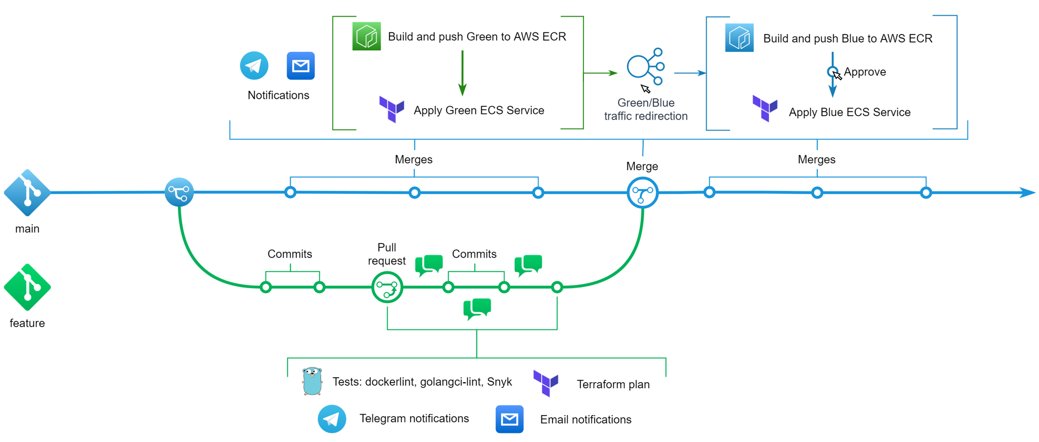
Workflows implementation | Github flow

Slide 9
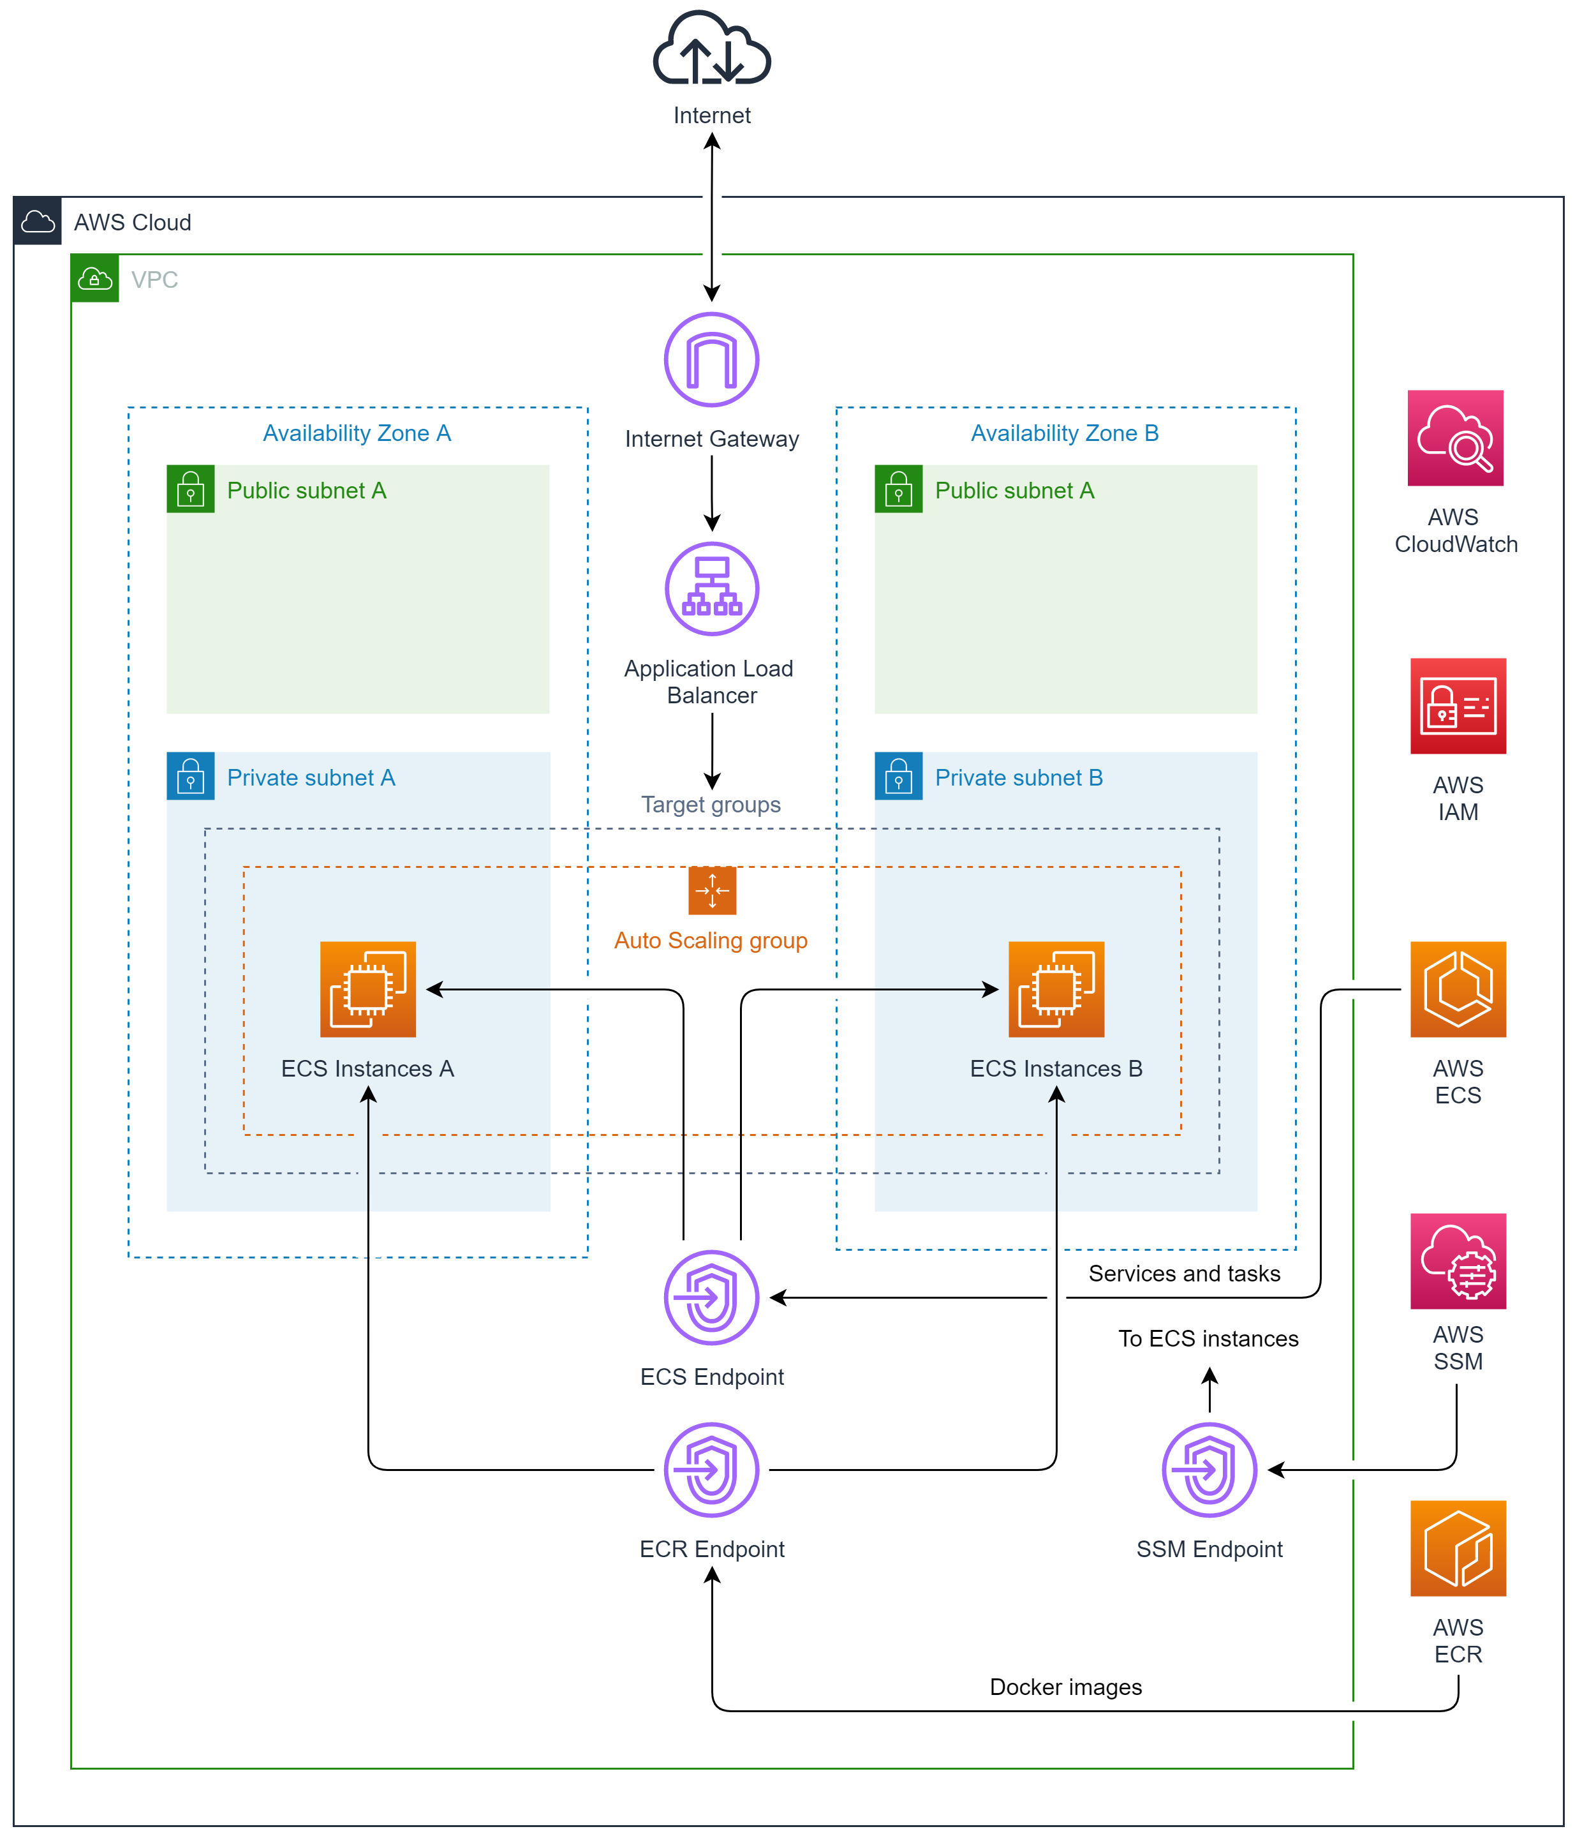
Infrastructure implementation
AWS ECS Cluster based on AWS EC2 Auto Scaling group.
Application Load Balancer that is balancing load between Services Tasks.
Ability to change traffic between Green and Blue services.
AWS Services Endpoints for ECS Instances in private subnets. Endpoints allows to control ECS Tasks & Services and upload images from ECR Repositories
ECS Instances are in private subnets and there is no bastion host. How to connect to them? Simple: via SSM from AWS Console or AWS CLI.

Slide 10
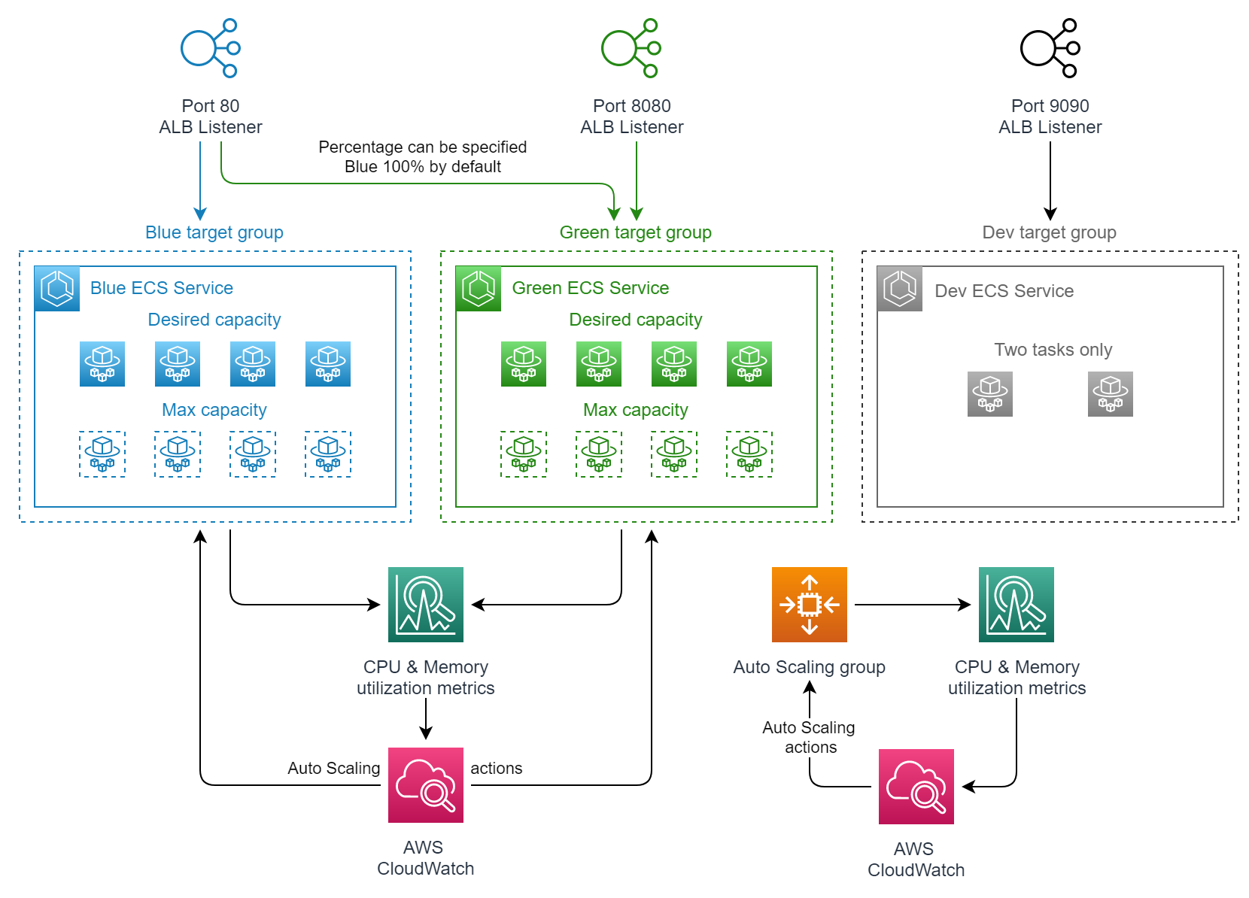
Infrastructure implementation
Traffic between Blue and Green services can be specified by one of the five presets: blue, blue-80, split, green-80 and green.
There is the Github Actions workflow called “Redirect Traffic” which allows to do it without interactions with CLI.
Every ECS Service have different listeners. If you want to test Green or Dev, then connect to the ALB via 8080 or 9090 port.
AWS CloudWatch alarms allows to monitor CPU & memory usage of the services and take Auto Scaling actions if one of the metrics is >80% usage.

Slide 11
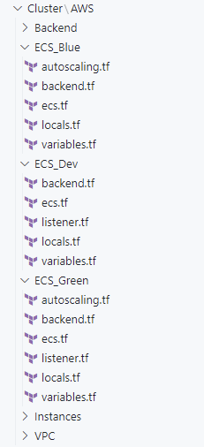
Terraform template
Terraform template consists of several directories created for every resource. It allows to create, change or destroy resources separately.
Each created resource have its own remote state in the S3 Bucket with DynamoDB locking.
In implemented workflows each resource is created automatically in Github Actions workflows.
Creation or destruction of the resources can be triggered automatically by PRs & pushes or manually with workflow dispatch.

Slide 12
Ideal CI/CD pipeline
There are some features I would like to add to my CI/CD pipelines and infrastructure so they will be closer to the ideal:
CI pipeline:
Unit tests.
Integration tests.
More integration with Github: comments, labels, tags, etc.
And for CD pipeline too:
QA.
Logging.
Auto tests.
Monitoring.
And of course there is no ideal CI/CD universal pipelines.
Everything is depends on situation, tasks and type of project and service.
For now there are some things missed in the AWS Infrastructure:
SSL/TLS secure connection.
Domain name.
Metrics for ECS Development service.
Secrets management.
Variables for resources in Terraform template are messed up and need to be reworked.

Slide 13
Demonstration

